Slide 1
Exercise 9
Discussion

Slide 2
Q1
You genetically designed bacteria to produce a miracle drug that reverses balding of men and now you grow these
bacteria at an industrial scale. There is an ideal time point at which you should collect your bacteria,
for which you have determined the optical absorption of your bacteria culture.
You also know the extinction coefficient of the bacteria culture solution.
Your measurement cuvette has a length d and the initial light intensity is I₀.
Derive the relationship between I, the intensity you measure after light has passed the cuvette, and I₀.

Slide 3
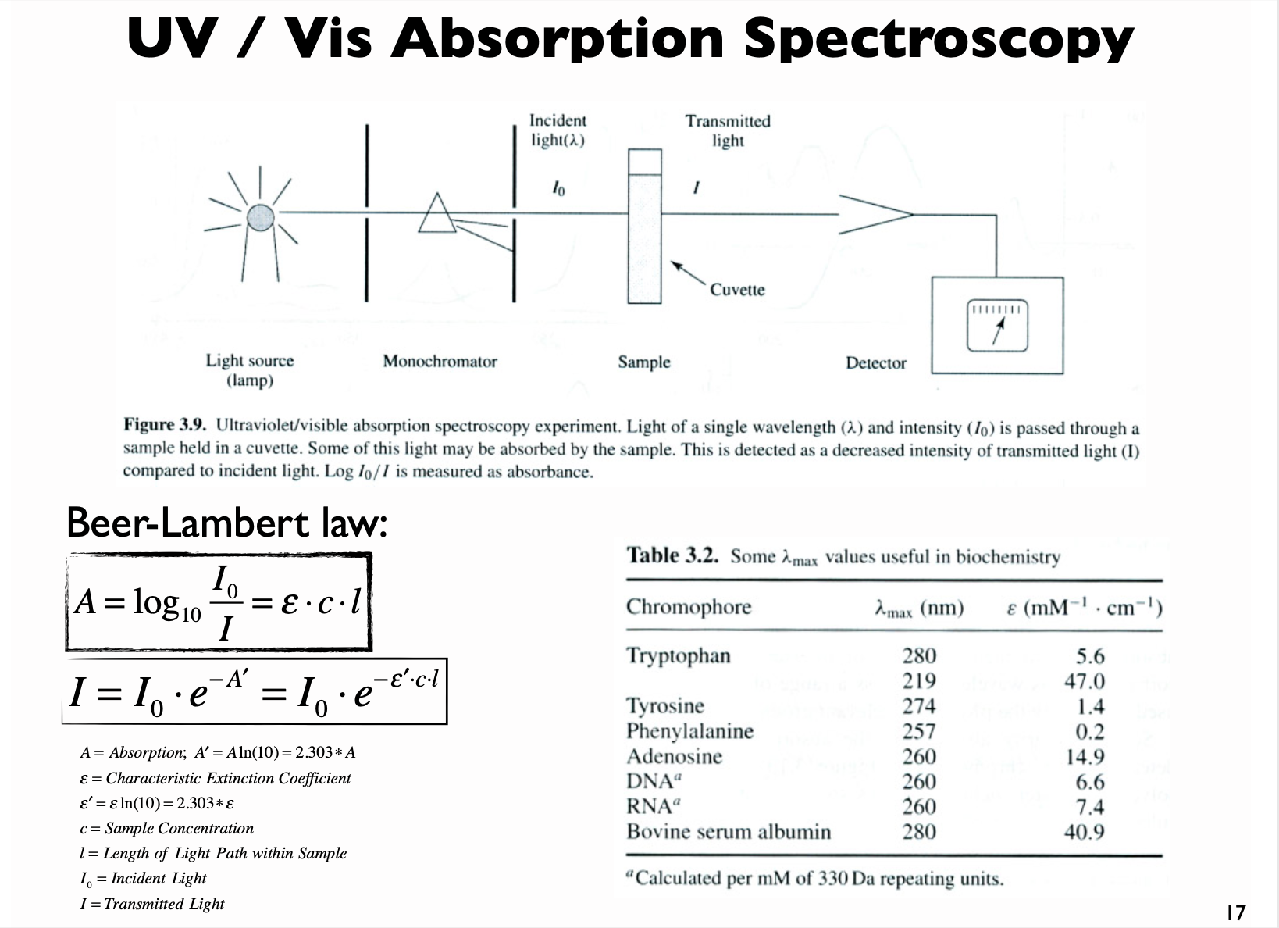
Q1
You genetically designed bacteria to produce a miracle drug that reverses balding of men and now you grow these
bacteria at an industrial scale. There is an ideal time point at which you should collect your bacteria,
for which you have determined the optical absorption of your bacteria culture.
You also know the extinction coefficient of the bacteria culture solution.
Your measurement cuvette has a length d and the initial light intensity is I₀.
Derive the relationship between I, the intensity you measure after light has passed the cuvette, and I₀.

Slide 4
Q2
The antibody “IgG” is a protein that has an extinction coefficient of 210’000 M⁻¹cm⁻¹ at 280 nm
and a molecular mass of 150 kDa.
Determine the concentration (molarity) for a measured absorption in a 1cm thick cuvette of 0.65.
What would you do if the extinction coefficient were unknown?

Slide 5
Q2
The antibody “IgG” is a protein that has an extinction coefficient of 210’000 M⁻¹cm⁻¹ at 280 nm
and a molecular mass of 150 kDa.
Determine the concentration (molarity) for a measured absorption in a 1cm thick cuvette of 0.65.
What would you do if the extinction coefficient were unknown?
Notes:
If epsilon unknown: measure absorbance at different (known) concentrations. The slope is epsilon*l

Slide 6
Q3
What information can you get from CD experiments?
What are the advantages of this method?
Can you determine the melting temperature “Tm" of a protein using this method?

Slide 7
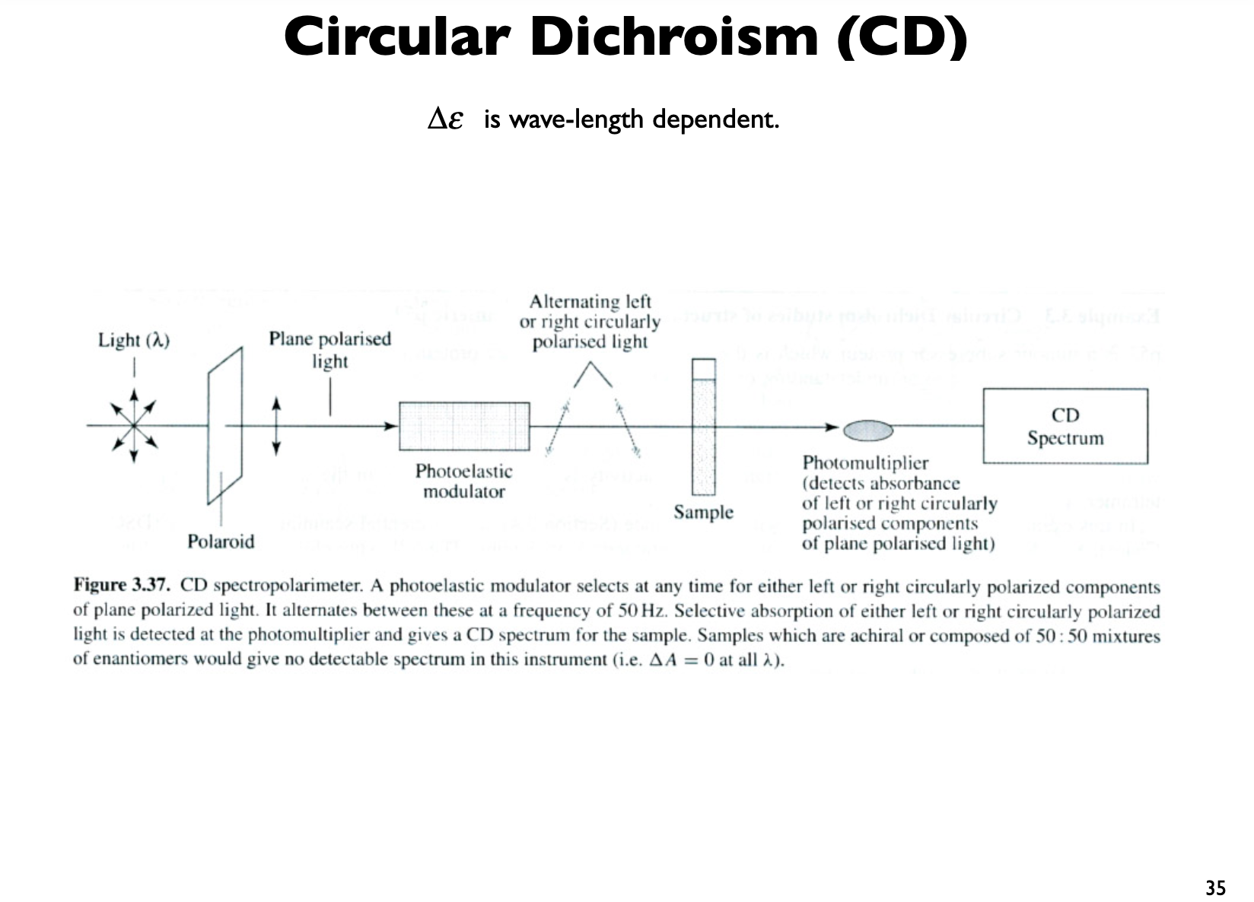
Q3
What information can you get from CD experiments?
What are the advantages of this method?
Can you determine the melting temperature “Tm" of a protein using this method?

Slide 8
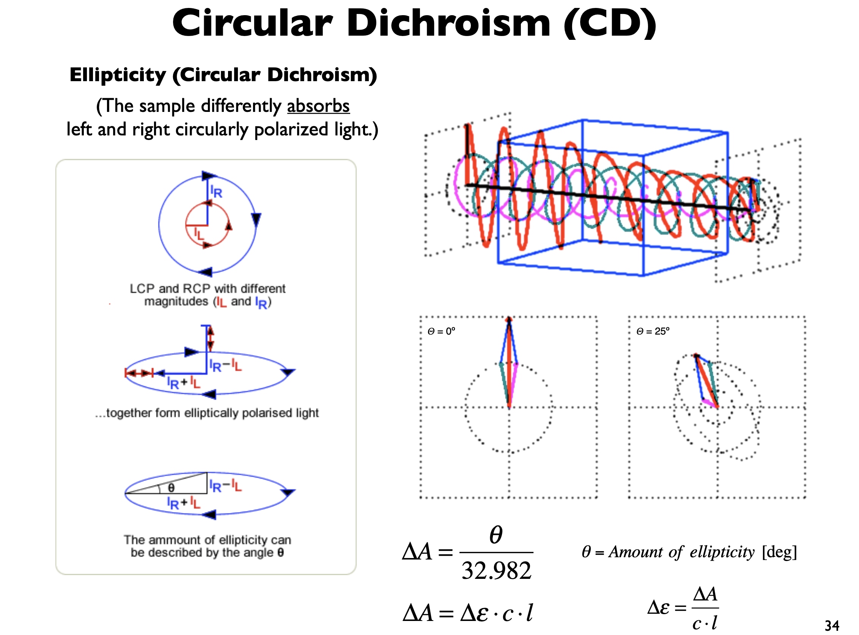
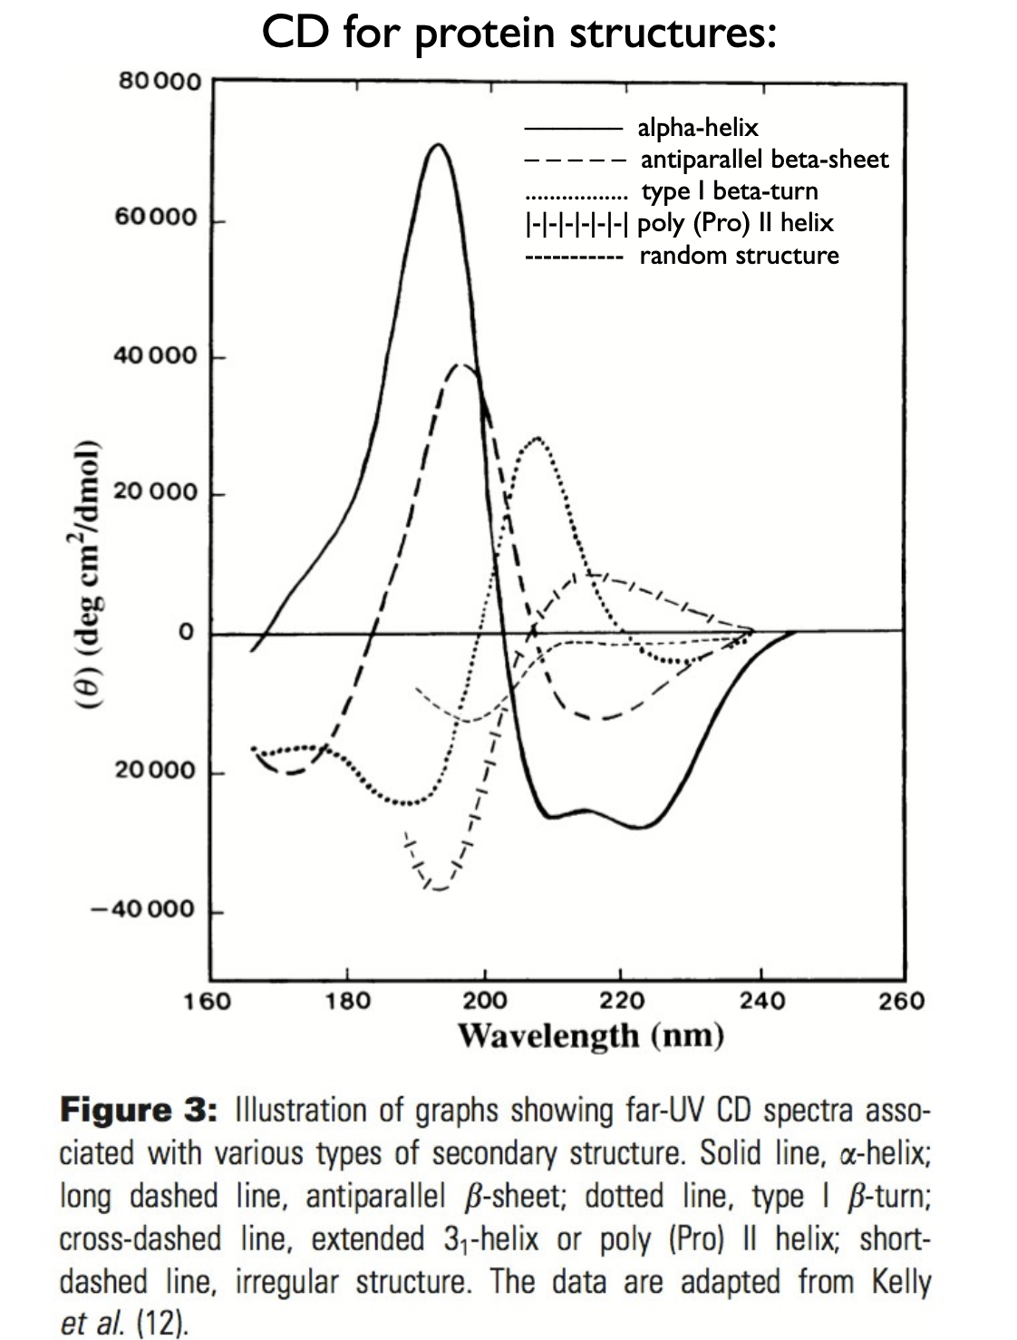
Q3
What information can you get from CD experiments?
What are the advantages of this method?
Can you determine the melting temperature “Tm" of a protein using this method?

Slide 9
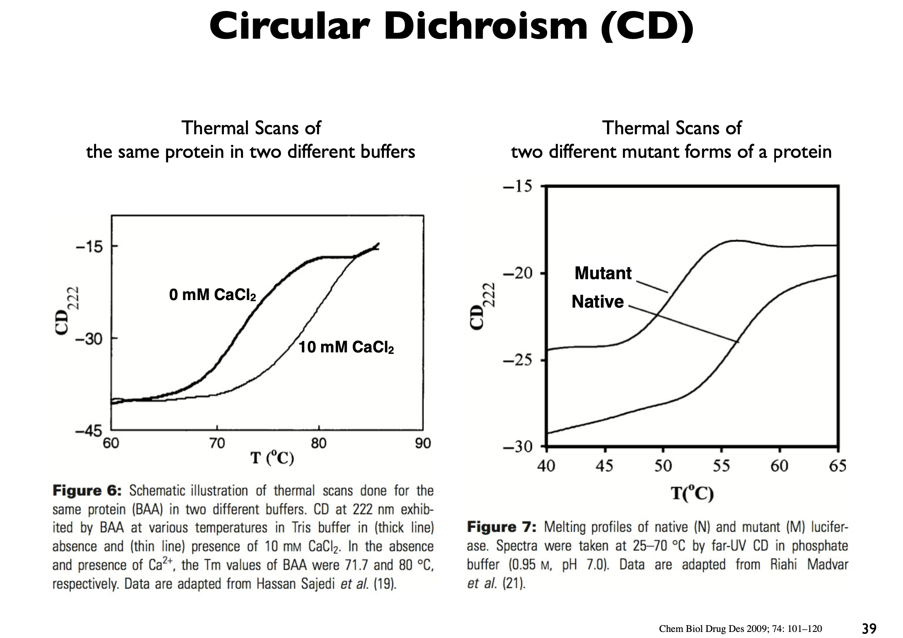
Q3
What information can you get from CD experiments?
What are the advantages of this method?
Can you determine the melting temperature “Tm" of a protein using this method?

Slide 10
Q4
What’s the difference between fluorescence and Raman scattering?

Slide 11
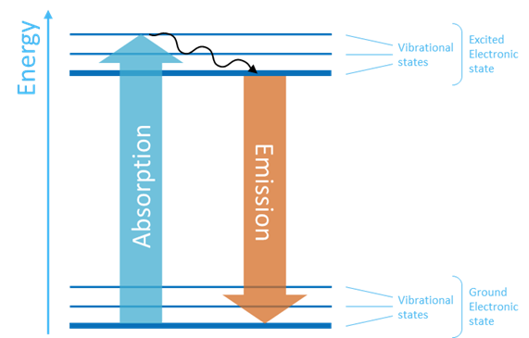
Q4
What’s the difference between fluorescence and Raman scattering?
Fluorescence

Slide 12
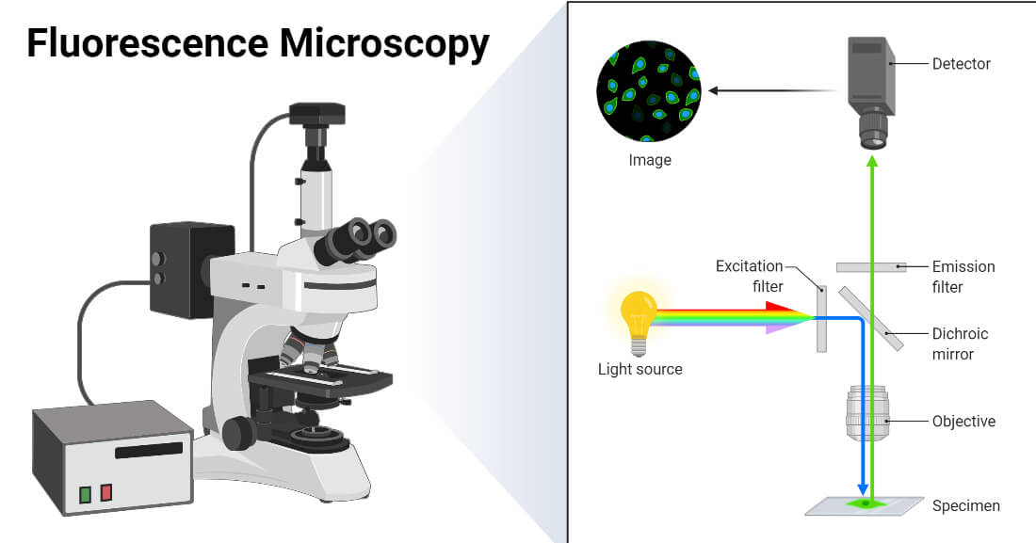
Q4
What’s the difference between fluorescence and Raman scattering?

Slide 13
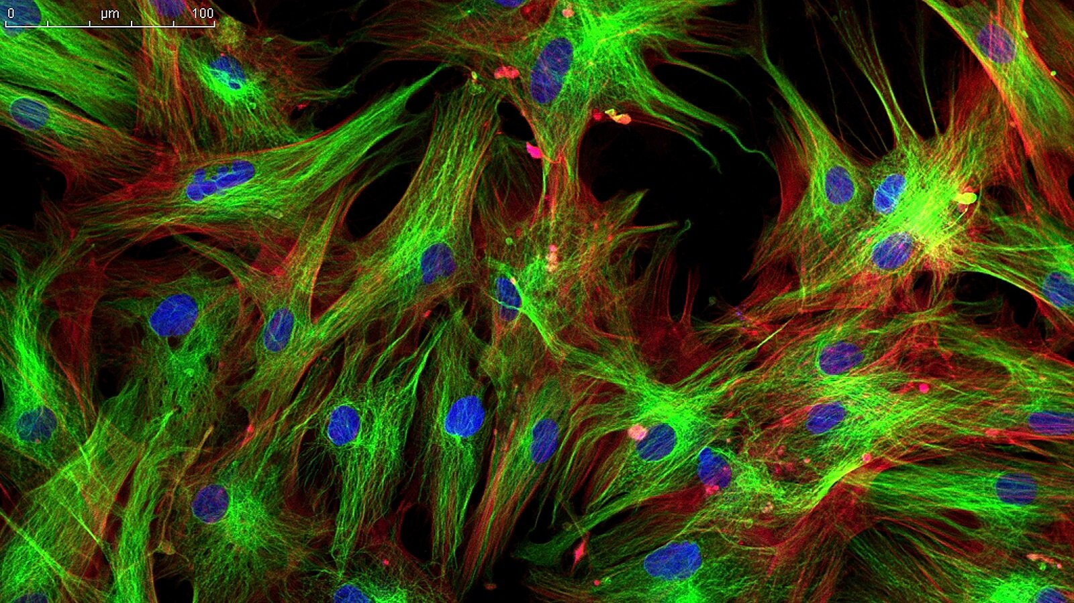
Q4
What’s the difference between fluorescence and Raman scattering?

Slide 14
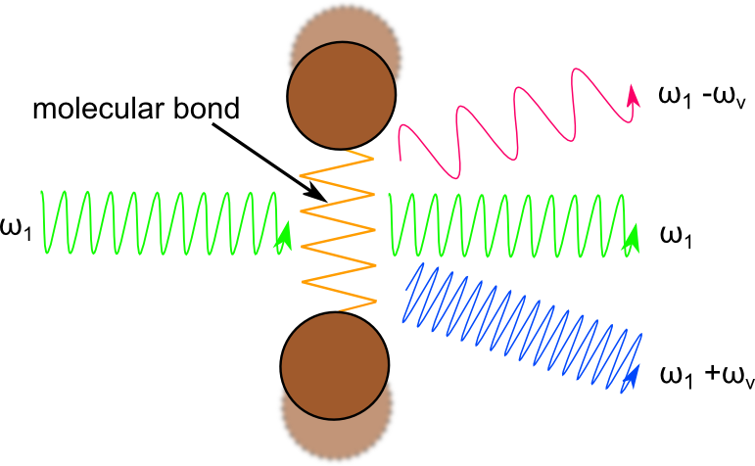
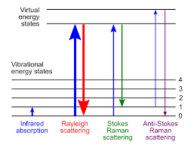
Q4
What’s the difference between fluorescence and Raman scattering?
Raman scattering

