Slide 1
Exercise 5
Discussion

Slide 2
Q2
Make a rough sketch of the F-type ATPase

Slide 3
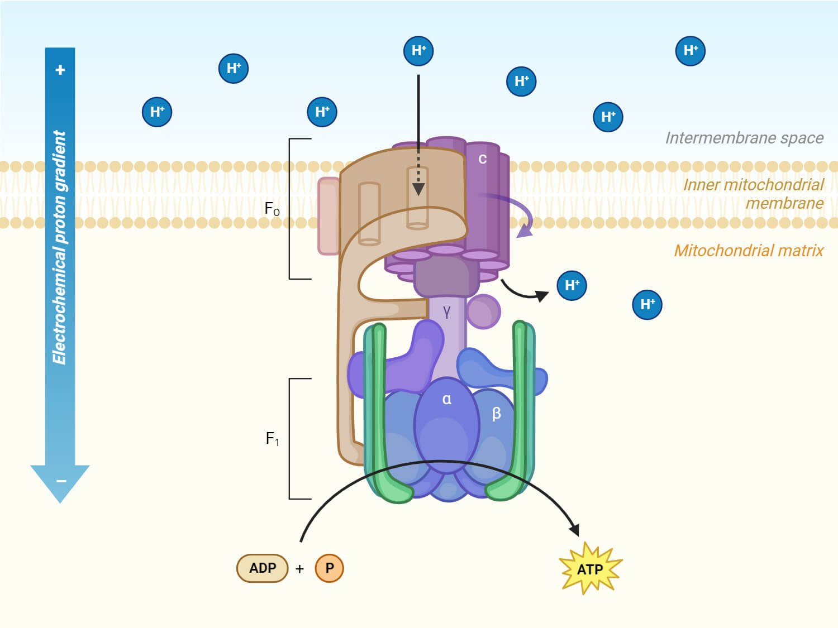
Q2
Make a rough sketch of the F-type ATPase
Aryal S., 2023. ATP Synthase: Structure, Mechanisms, Significances. Microbe Notes.

Slide 4
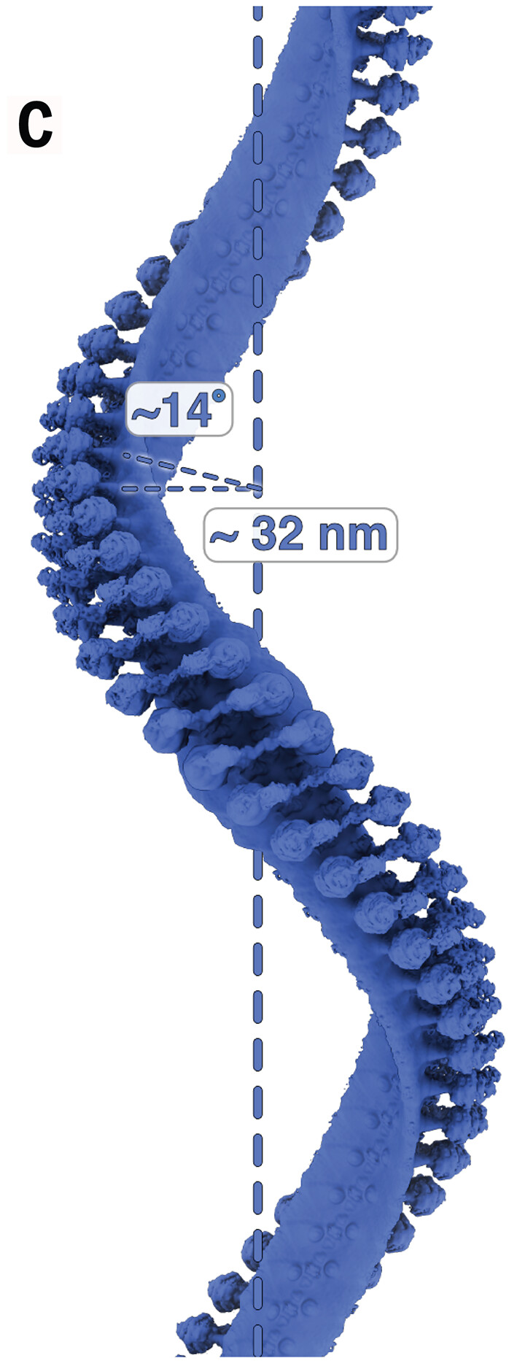
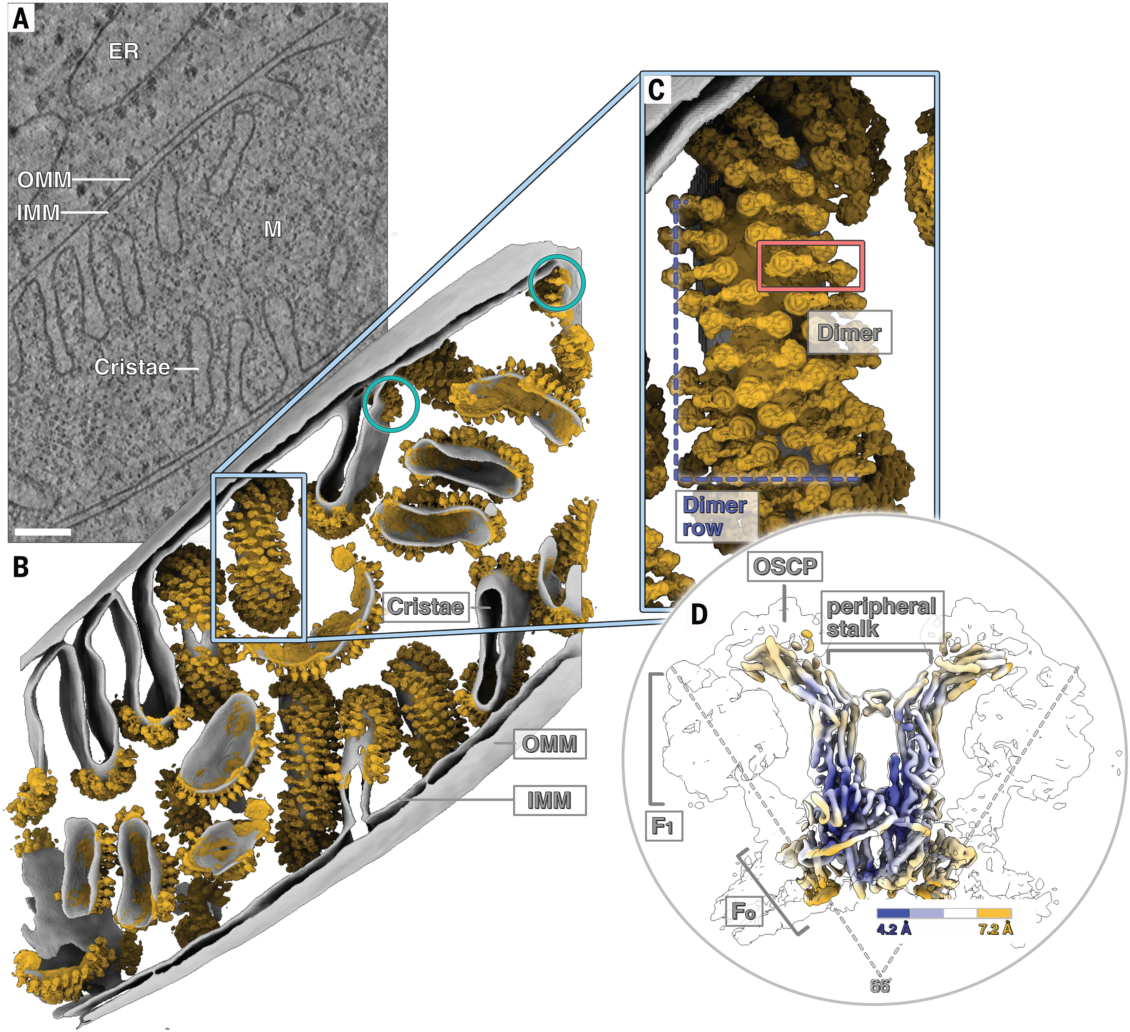
Q1
Make a rough sketch of the F-type ATPase
Dietrich, L. et al. 2024. In situ structure and rotary states of mitochondrial ATP synthase in whole Polytomella cells. Science

Slide 5
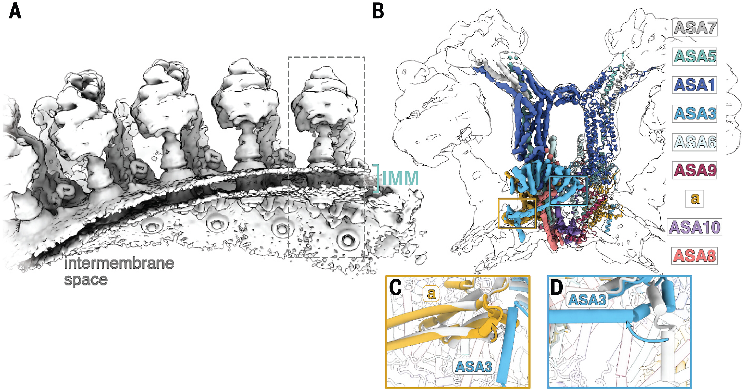
Q1
Make a rough sketch of the F-type ATPase
Dietrich, L. et al. 2024. In situ structure and rotary states of mitochondrial ATP synthase in whole Polytomella cells. Science

Slide 6
Q2
For the F-type ATPase, the number of c subunits seems to be adapted to the environmental conditions of the
respective ATPases in the membrane systems they operate in. Explain the advantages that some ATPases
have when they have more c subunits, and why other ATPases need to have less c subunits.

Slide 7
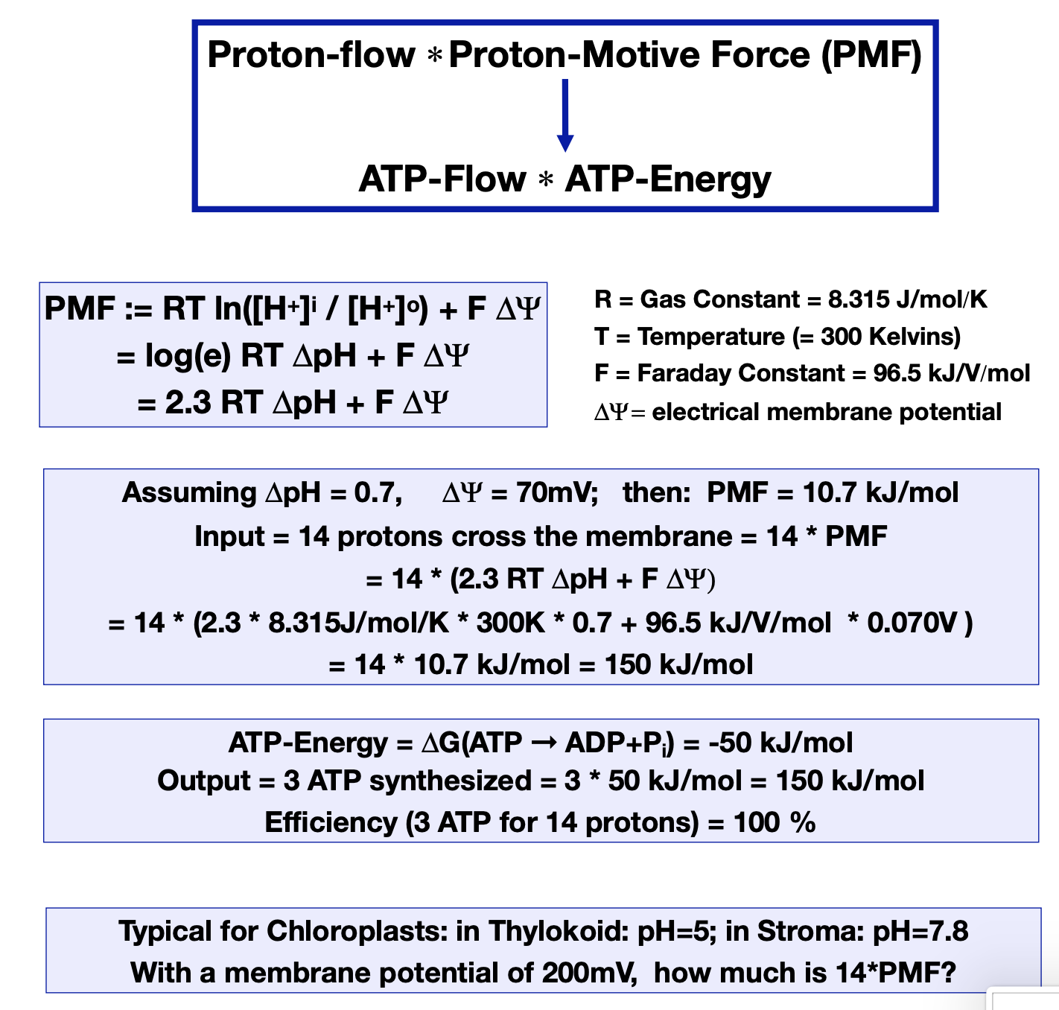
Q2
For the F-type ATPase, the number of c subunits seems to be adapted to the environmental conditions of the
respective ATPases in the membrane systems they operate in. Explain the advantages that some ATPases
have when they have more c subunits, and why other ATPases need to have less c subunits.

Slide 8
Q3
Sort the types of bonds in biomolecules by their strength.
Indicate the energy in eV for each bond type

Slide 9
Q3
Sort the types of bonds in biomolecules by their strength.
Indicate the energy in eV for each bond type
Bond Type | Approx. Energy (eV) | Comments / Example
Covalent bonds | ~3.0 – 5.0 eV | Backbone of biomolecules (e.g. C–C, C–H)
– C–C single bond | ~3.6 eV | Found in fatty acids, sugars
– C=O double bond | ~7.7 eV | Stronger, found in proteins, DNA
– O–H bond | ~4.8 eV | Found in water, alcohols
– N–H bond | ~4.0 eV | Found in amines, proteins
Ionic interactions | ~0.5 – 3.0 eV | Salt bridges between charged residues
– Na⁺ – Cl⁻ (in vacuum) | ~3.0 eV | Stronger in vacuum, weaker in water
– In aqueous environment | ~0.1 – 0.5 eV | Shielded by water → much weaker
Hydrogen bonds | ~0.1 – 0.4 eV | In DNA base pairs, protein folding
– N–H···O | ~0.2 – 0.3 eV | Found in alpha-helices, beta-sheets
– O–H···O | ~0.2 – 0.4 eV | Stronger H-bonds (e.g., in water)
van der Waals (dispersion) | ~0.01 – 0.05 eV | Weak, but numerous (lipid packing, etc.)
– Between nonpolar molecules | ~0.02 eV | Hydrophobic interactions
π–π stacking | ~0.05 – 0.1 eV | Aromatic bases in DNA
Hydrophobic effect | Not a bond; entropy-driven | Comes from exclusion of water; ~0.02–0.05 eV per interaction

Slide 10
Q4
Explain in your own words the van’t Hoff relationship. How can van’t Hoff’s plot be used to distinguish
between an endothermic and exothermic reaction?

Slide 11
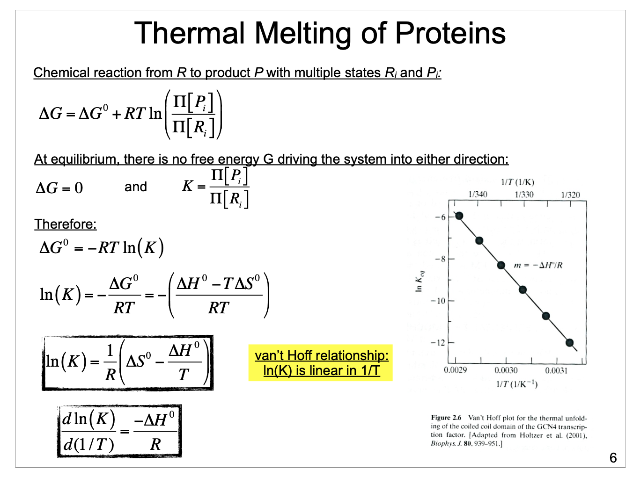
Q4
Explain in your own words the van’t Hoff relationship. How can van’t Hoff’s plot be used to distinguish
between an endothermic and exothermic reaction?
$$R_{i}→P_{i}$$

Slide 12
Q5
Is the thermal unfolding of a protein an endo- or exothermic reaction? Why?

Slide 13
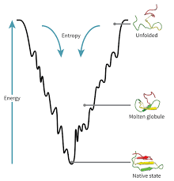

Q5
Is the thermal unfolding of a protein an endo- or exothermic reaction? Why?
$$ΔG=ΔH−TΔS$$
$$H$$

Slide 14
Q6
How can a Thermofluor Melting Curve be used to find conditions
(e.g., pH, salt concentrations), where the protein is more stable?

Slide 15
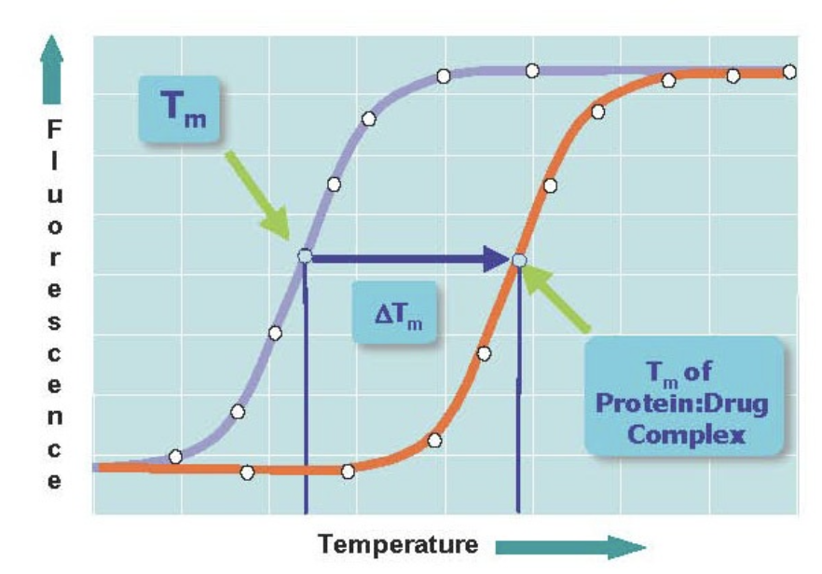
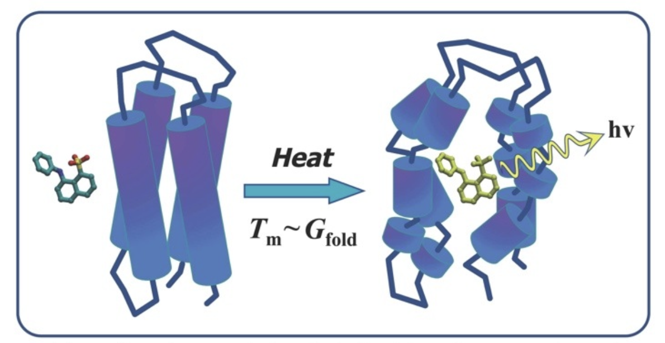
Q6
How can a Thermofluor Melting Curve be used to find conditions
(e.g., pH, salt concentrations), where the protein is more stable?

