Slide 1
Exercise 4
Discussion

Slide 2
Q1
How does mass spectrometry work
and what are the important components of a mass spectrometer?

Slide 3
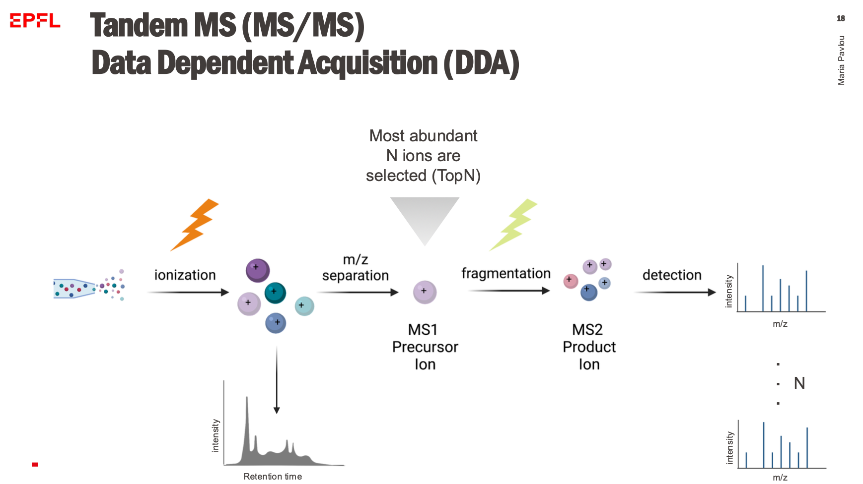
Q1
How does mass spectrometry work
and what are the important components of a mass spectrometer?

Slide 4
Q2
Why does the mass spectrometry operate under vacuum?

Slide 5
Q2
Why does the mass spectrometry operate under vacuum?
All mass spectrometers operate at very low pressure (high vacuum). This reduces the chance of ions colliding with other molecules in the mass analyzer. Any collision can cause the ions to react, neutralize, scatter, or fragment. All these processes will interfere with the mass spectrum. In addition, the vacuum assists the entry of the ions in the mass spectrometer.

Slide 6
Q3
Why wouldn’t one use trypsin for analysis of proteomic sample?

Slide 7
Q3
Why wouldn’t one use trypsin for analysis of proteomic sample?
While trypsin is widely used in bottom-up mass spectrometry experiments due to its reliability and efficiency, there are situations where alternative enzymes or digestion methods may be more suitable based on the characteristics of the protein of interest and the experimental conditions.
Trypsin specifically cleaves peptide bonds at the carboxyl side of lysine and arginine residues. If the protein of interest lacks these amino acids or has too many of them (ex. histones) trypsin digestion may produce peptides that are too long or too short for optimal mass spectrometry analysis. In such a case, in silico digestion with other proteases would assist identifying the optimal one. Furthermore, post-translational modifications affecting K side chain (ex. acetylation, methylation) can interfere with trypsin digestion by blocking or altering cleavage sites. Finally, trypsin is active at slightly basic pH (pH 8) and in case the experimental procedure necessitates a different pH, alternative proteases could be used.

Slide 8
Q4
Electron ionization is one technique necessary to cause an analyte to accelerate in the vacuum of the machine.
What causes the ionization?

Slide 9
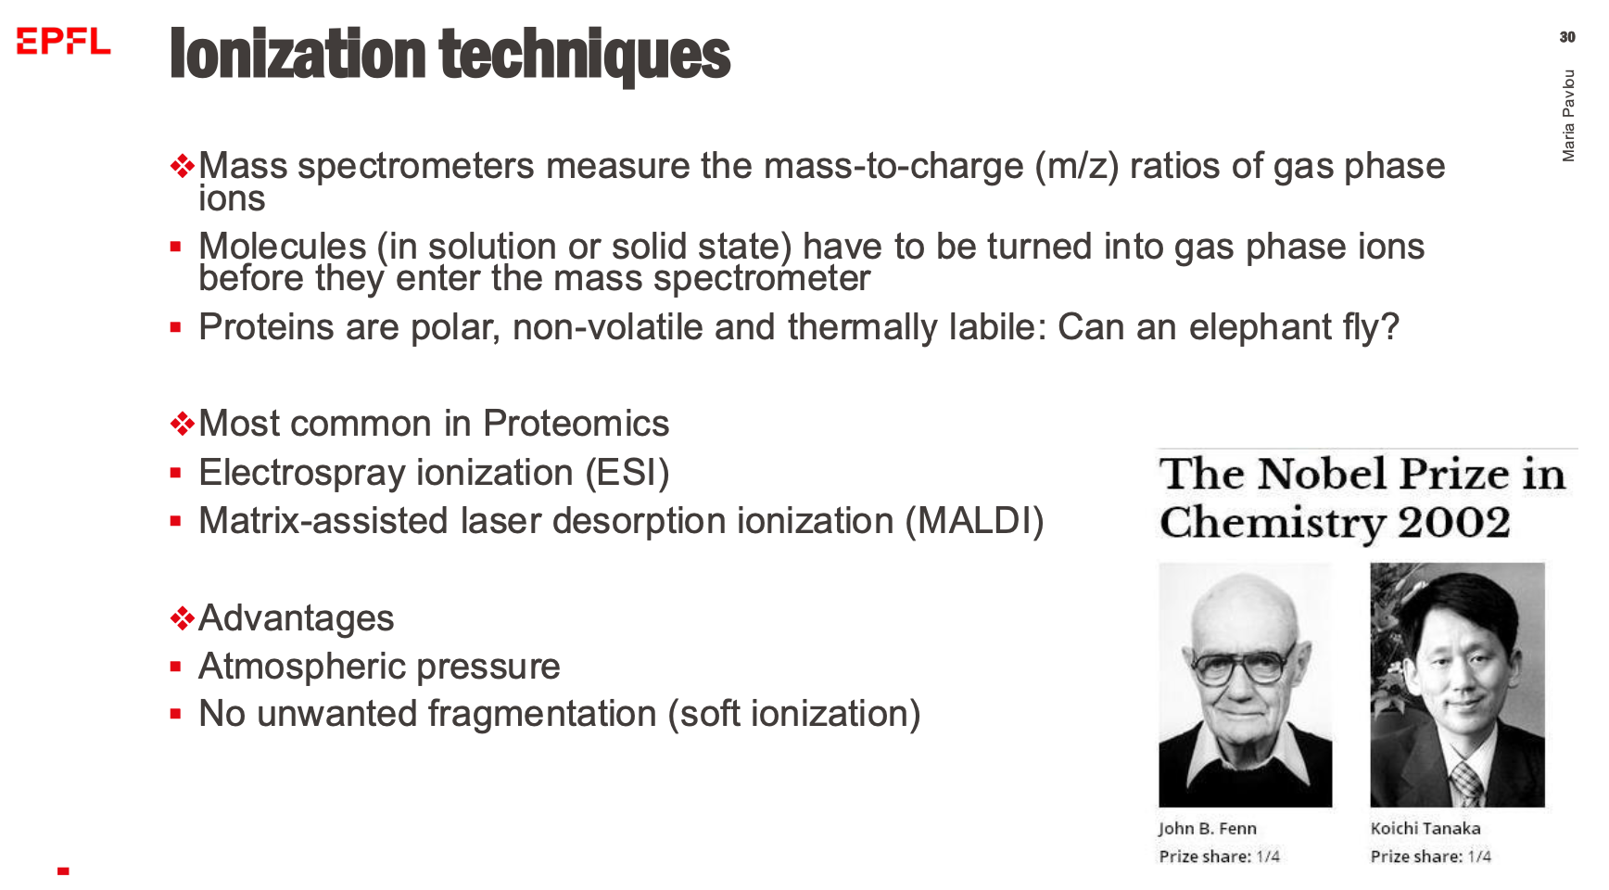
Q4
Electron ionization is one technique necessary to cause an analyte to accelerate in the vacuum of the machine.
What causes the ionization?

Slide 10
Q5
Draw a schematic of how three different analytes with distinct m/z behave in a quadrupole mass separator.
The setup is chosen to be optimal for one of the three analytes.

Slide 11
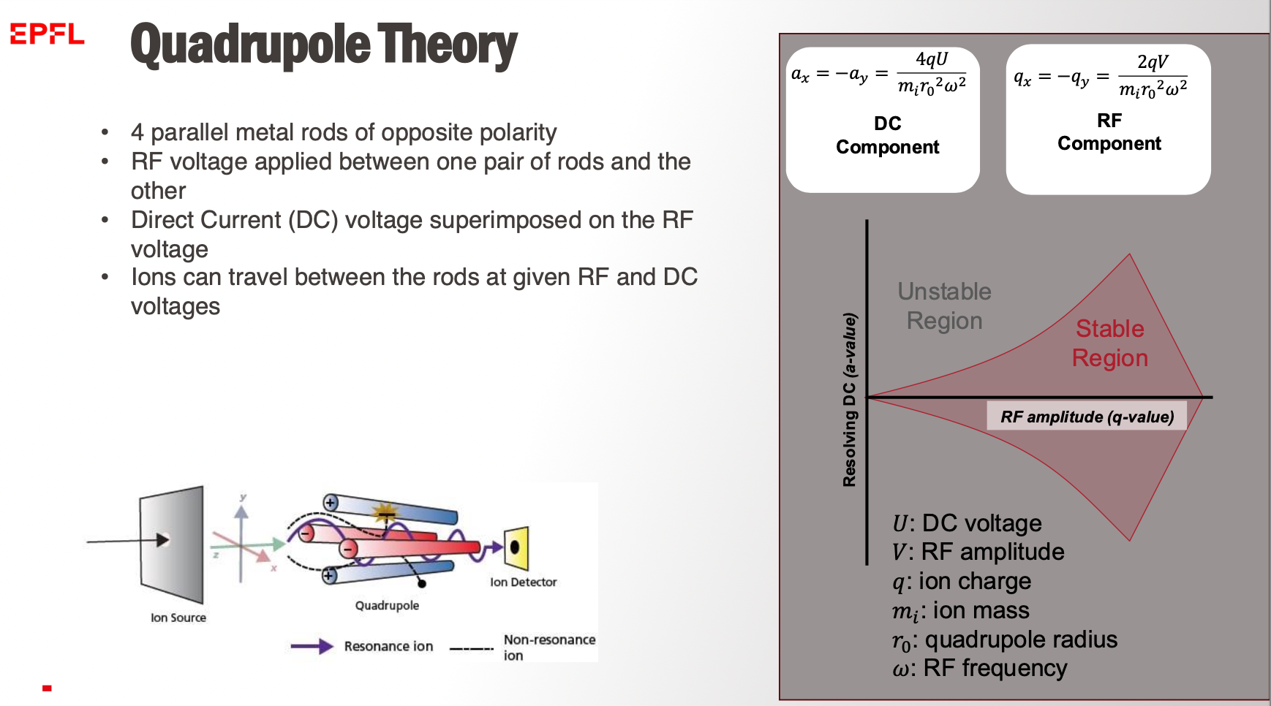
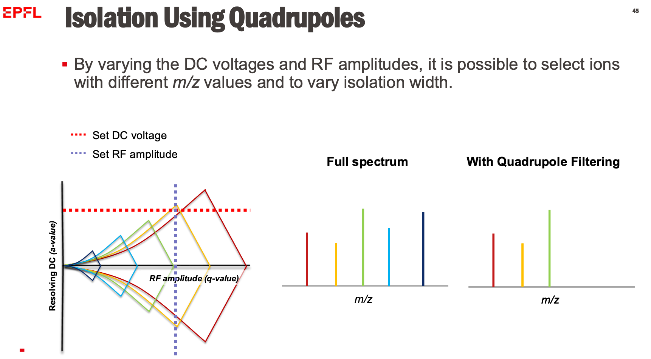
Q5
Draw a schematic of how three different analytes with distinct m/z behave in a quadrupole mass separator.
The setup is chosen to be optimal for one of the three analytes.

Slide 12
Q6
What is MS-MS? What does MS1 and MS2 refer to?

Slide 13
Q6
What is MS-MS? What does MS1 and MS2 refer to?

Slide 14
Q7
Explain what happens during fast atom bombardment, what information do we get out of it?

Slide 15
Q8
What is an Ion Trap? Why is it important for the usage in an MS-MS setup?

Slide 16
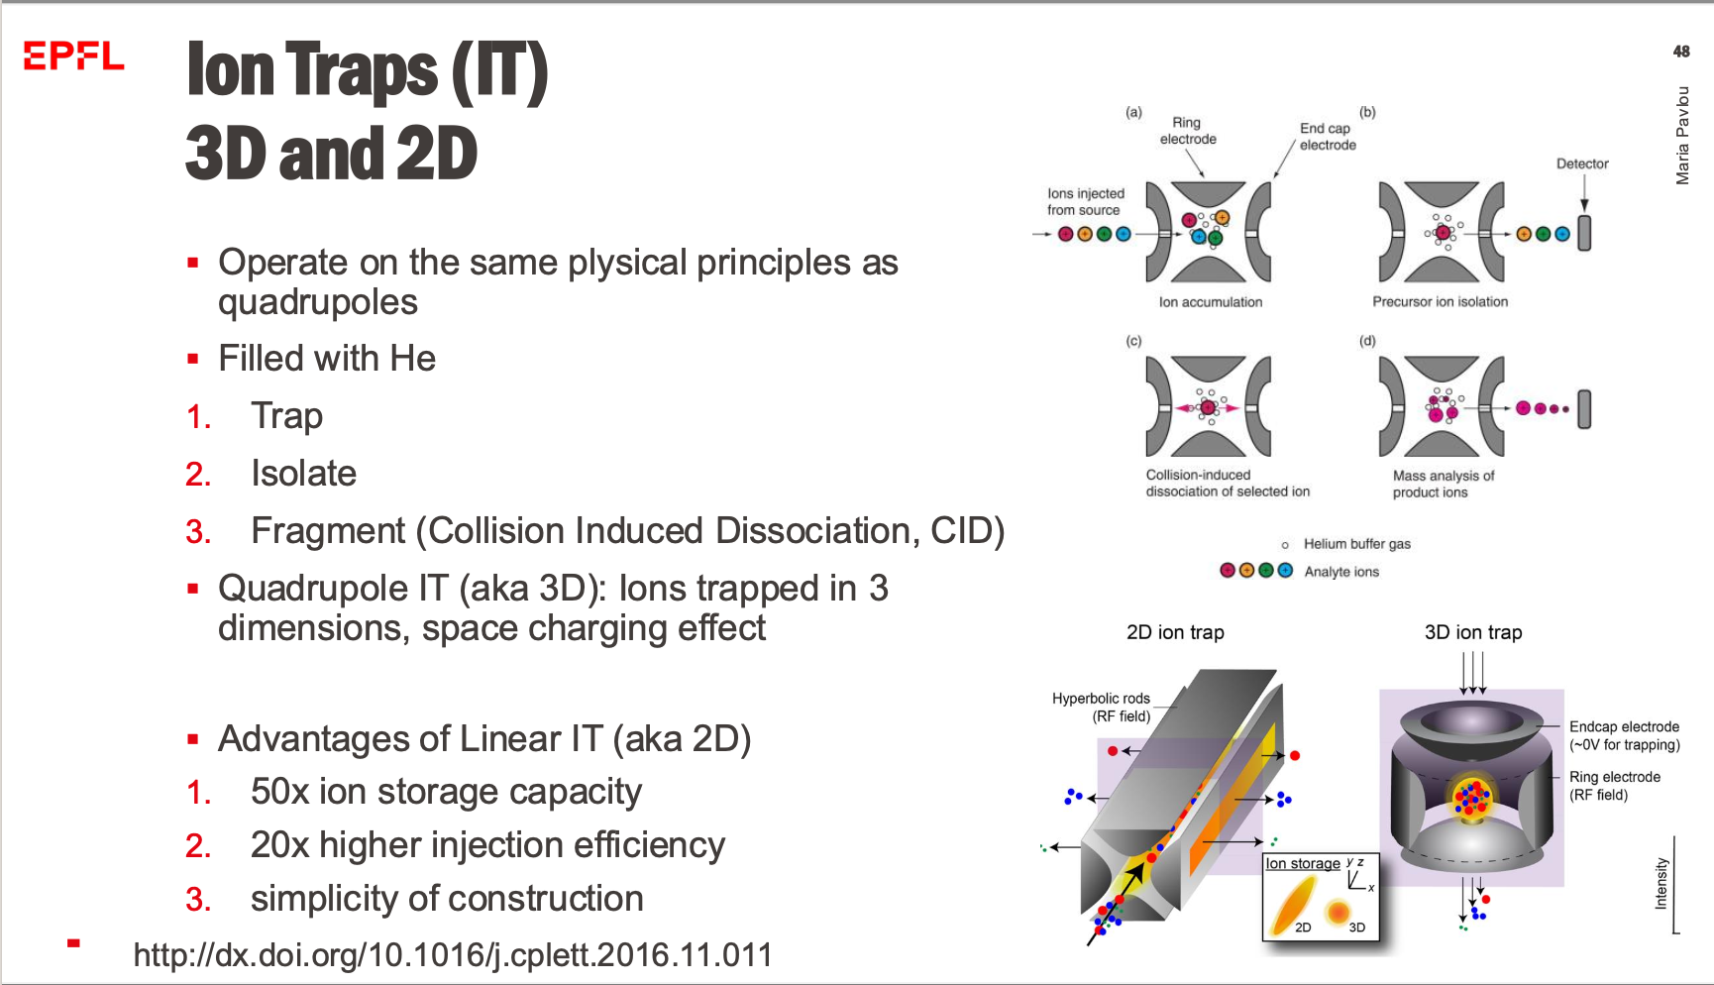
Q8
What is an Ion Trap? Why is it important for the usage in an MS-MS setup?

Slide 17
Q9
How can you get structural information about a protein using mass spec?

Slide 18
Q10
How does peptide fingerprinting work?

Slide 19
Q11
Consider protein 1 with a mass of 3150 and a charge of 4+ and protein 2 with a mass of 3040 and a charge of 4+.
What is the relative time of flight t1/t2?

Slide 20
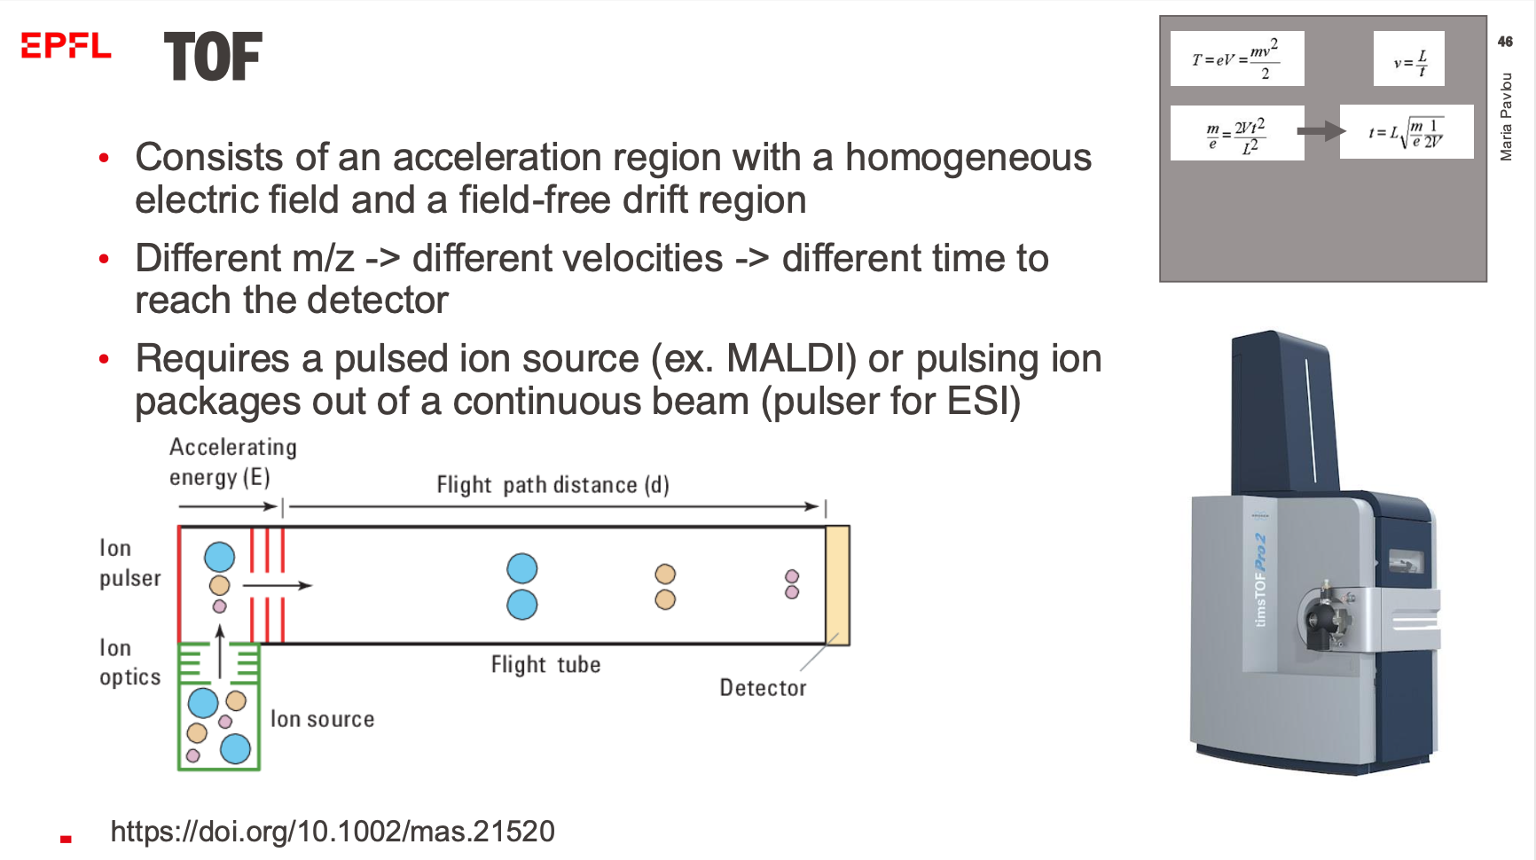
Q11
Consider protein 1 with a mass of 3150 and a charge of 4+ and protein 2 with a mass of 3040 and a charge of 4+.
What is the relative time of flight t1/t2?

Slide 21
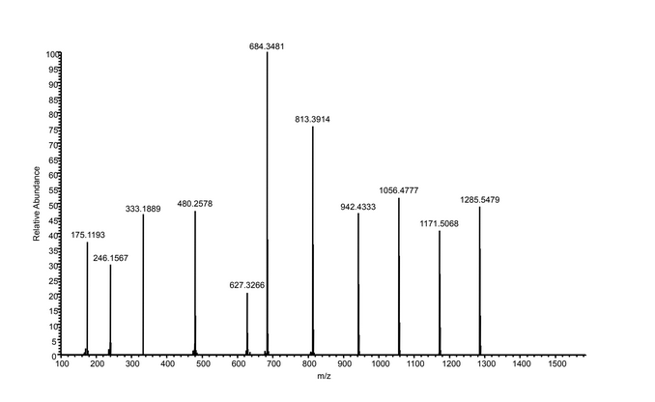
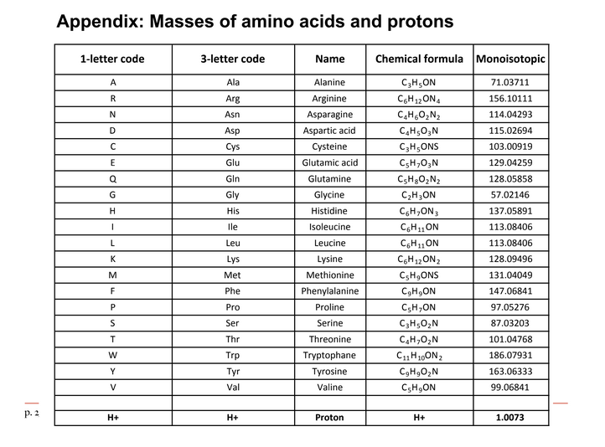
Q12
Determine the amino acid sequence of the MS-MS spectrum on the next page.
This peptide produced only fragments of the y-ion series
Use the table below (next page), which includes the residue MWs of all amino acids.
The MW of oxygen is 15.99491463 and of hydrogen 1.007825035.

Slide 22
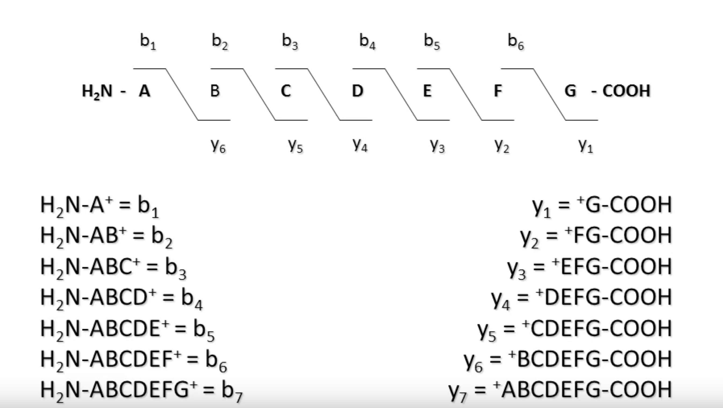
Q12
Determine the amino acid sequence of the MS-MS spectrum on the next page.
This peptide produced only fragments of the y-ion series
Use the table below (next page), which includes the residue MWs of all amino acids.
The MW of oxygen is 15.99491463 and of hydrogen 1.007825035.

Slide 23
Q12
Determine the amino acid sequence of the MS-MS spectrum on the next page.
This peptide produced only fragments of the y-ion series
Use the table below (next page), which includes the residue MWs of all amino acids.
The MW of oxygen is 15.99491463 and of hydrogen 1.007825035.
114

Slide 24
Q12
Determine the amino acid sequence of the MS-MS spectrum on the next page.
This peptide produced only fragments of the y-ion series
Use the table below (next page), which includes the residue MWs of all amino acids.
The MW of oxygen is 15.99491463 and of hydrogen 1.007825035.
114
N
N or C terminal?

Slide 25
Q12
Determine the amino acid sequence of the MS-MS spectrum on the next page.
This peptide produced only fragments of the y-ion series
Use the table below (next page), which includes the residue MWs of all amino acids.
The MW of oxygen is 15.99491463 and of hydrogen 1.007825035.
H2N
N
COOH
114
N

Slide 26
Q12
Determine the amino acid sequence of the MS-MS spectrum on the next page.
This peptide produced only fragments of the y-ion series
Use the table below (next page), which includes the residue MWs of all amino acids.
The MW of oxygen is 15.99491463 and of hydrogen 1.007825035.
H2N
N
COOH
115
114
N

Slide 27
Q12
Determine the amino acid sequence of the MS-MS spectrum on the next page.
This peptide produced only fragments of the y-ion series
Use the table below (next page), which includes the residue MWs of all amino acids.
The MW of oxygen is 15.99491463 and of hydrogen 1.007825035.
H2N
N D
COOH
115
114
D
N

Slide 28
Q12
Determine the amino acid sequence of the MS-MS spectrum on the next page.
This peptide produced only fragments of the y-ion series
Use the table below (next page), which includes the residue MWs of all amino acids.
The MW of oxygen is 15.99491463 and of hydrogen 1.007825035.
H2N
N D
COOH
57
71
87
147
147
129
129
114
115
114
D
N

Slide 29
Q12
Determine the amino acid sequence of the MS-MS spectrum on the next page.
This peptide produced only fragments of the y-ion series
Use the table below (next page), which includes the residue MWs of all amino acids.
The MW of oxygen is 15.99491463 and of hydrogen 1.007825035.
H2N
N D N E E G F F S A
COOH
57
71
87
147
147
129
129
114
115
114
S
F
F
G
E
E
N
D
N
A

Slide 30
Q12
Determine the amino acid sequence of the MS-MS spectrum on the next page.
This peptide produced only fragments of the y-ion series
Use the table below (next page), which includes the residue MWs of all amino acids.
The MW of oxygen is 15.99491463 and of hydrogen 1.007825035.
H2N
N D N E E G F F S A
COOH
57
71
87
147
147
129
129
114
115
114
S
F
F
G
E
E
N
D
N
A
??

Slide 31
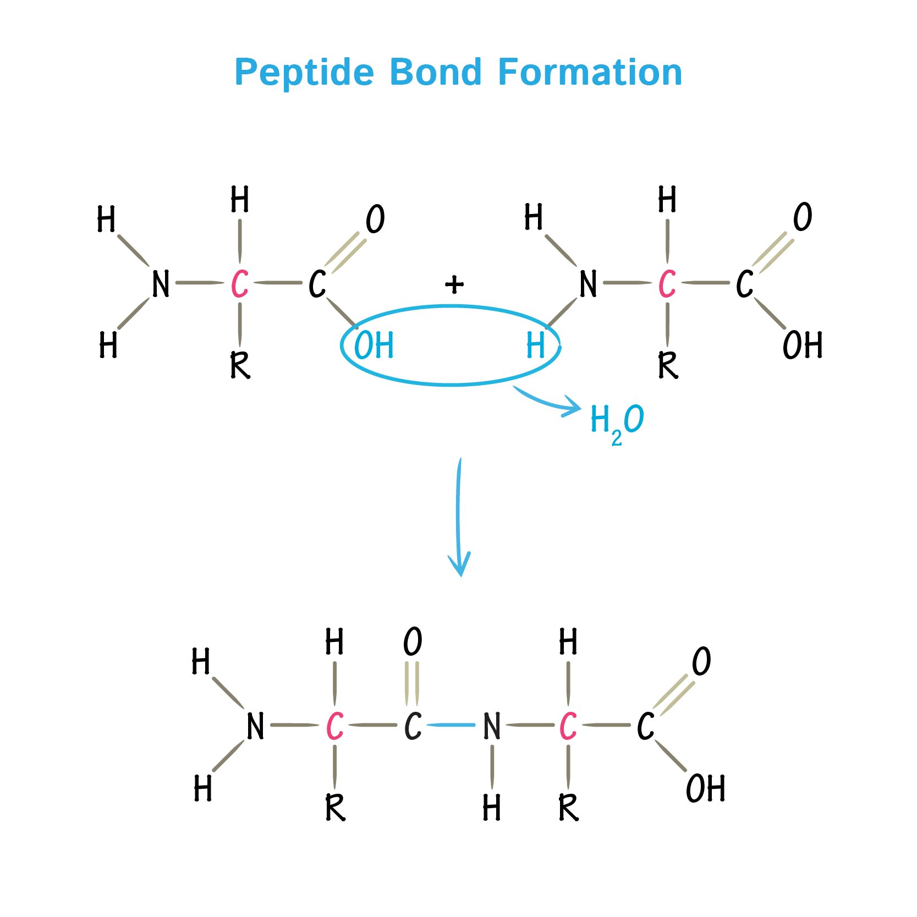
Q12
Determine the amino acid sequence of the MS-MS spectrum on the next page.
This peptide produced only fragments of the y-ion series
Use the table below (next page), which includes the residue MWs of all amino acids.
The MW of oxygen is 15.99491463 and of hydrogen 1.007825035.

Slide 32
Q12
Determine the amino acid sequence of the MS-MS spectrum on the next page.
This peptide produced only fragments of the y-ion series
Use the table below (next page), which includes the residue MWs of all amino acids.
The MW of oxygen is 15.99491463 and of hydrogen 1.007825035.
H2N
N D N E E G F F S A
COOH
57
71
87
147
147
129
129
114
115
114
S
F
F
G
E
E
N
D
N
A
??
AA weight = 175 – 16 – 2 – 1 = 156

Slide 33
Q12
Determine the amino acid sequence of the MS-MS spectrum on the next page.
This peptide produced only fragments of the y-ion series
Use the table below (next page), which includes the residue MWs of all amino acids.
The MW of oxygen is 15.99491463 and of hydrogen 1.007825035.
H2N
N D N E E G F F S A R
COOH
57
71
87
147
147
129
129
114
115
114
R
S
F
F
G
E
E
N
D
N
A
AA weight = 175 – 16 – 2 – 1 = 156
Oxygen
2 Hydrogens
1 proton (ion)

Slide 34
Q12
Determine the amino acid sequence of the MS-MS spectrum on the next page.
This peptide produced only fragments of the y-ion series
Use the table below (next page), which includes the residue MWs of all amino acids.
The MW of oxygen is 15.99491463 and of hydrogen 1.007825035.
Trypsin cleaves after R or K!
H2N
N D N E E G F F S A R
COOH
57
71
87
147
147
129
129
114
115
114
R
S
F
F
G
E
E
N
D
N
A
AA weight = 175 – 16 – 2 – 1 = 156
Oxygen
2 Hydrogens
1 proton (ion)

