Slide 1
Exercise 3
Discussion
Notes:
Movement, Respiration, Sensitivity, Nutrition, Excretion, Reproduction and Growth

Slide 2
Q1
List the different types of detergents. What are their differences?
Notes:
Movement, Respiration, Sensitivity, Nutrition, Excretion, Reproduction and Growth

Slide 3
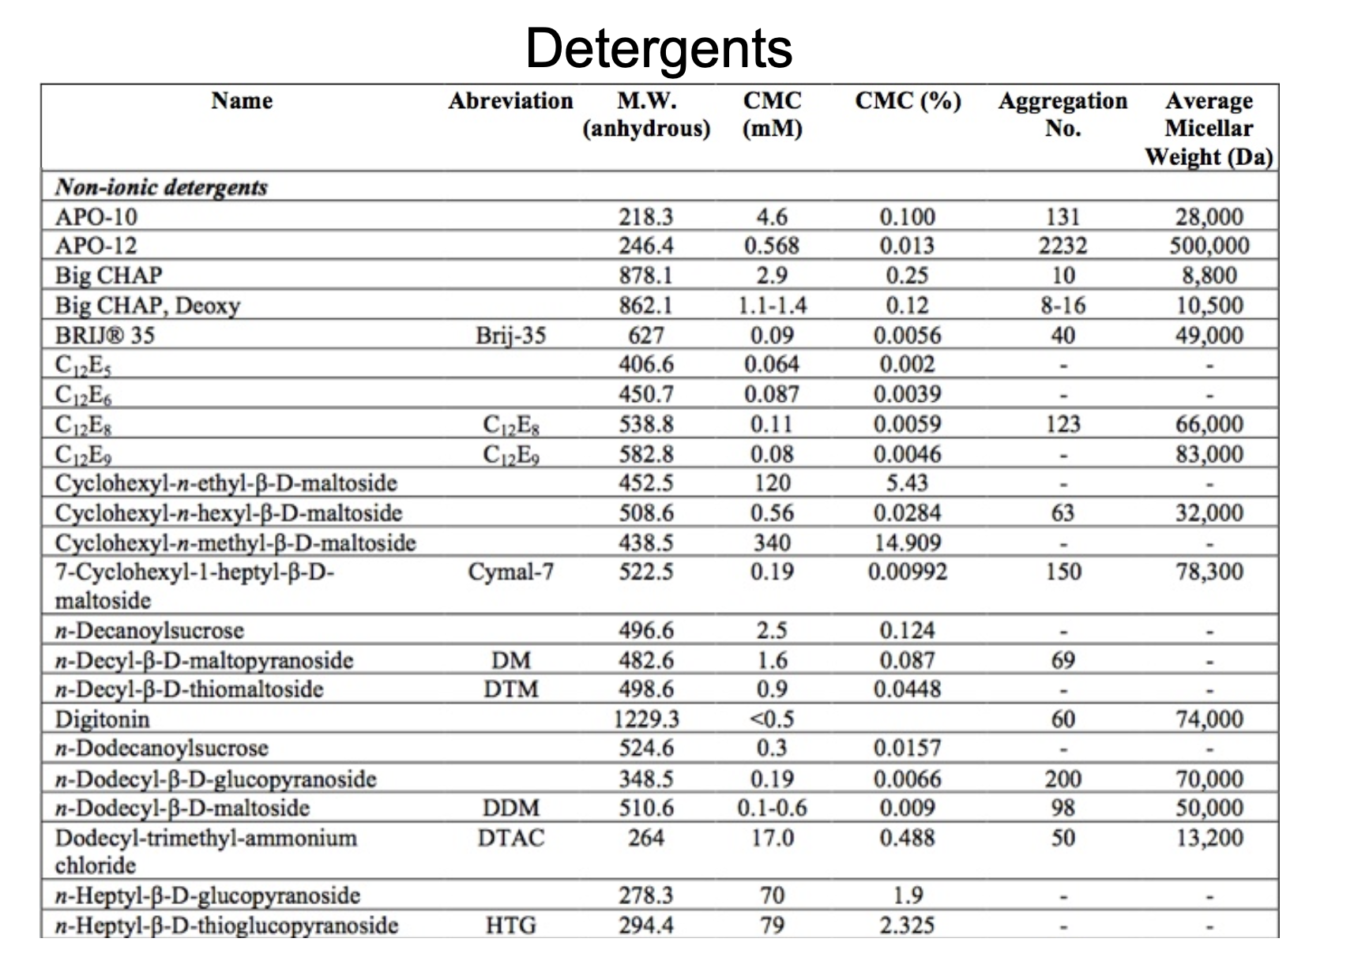
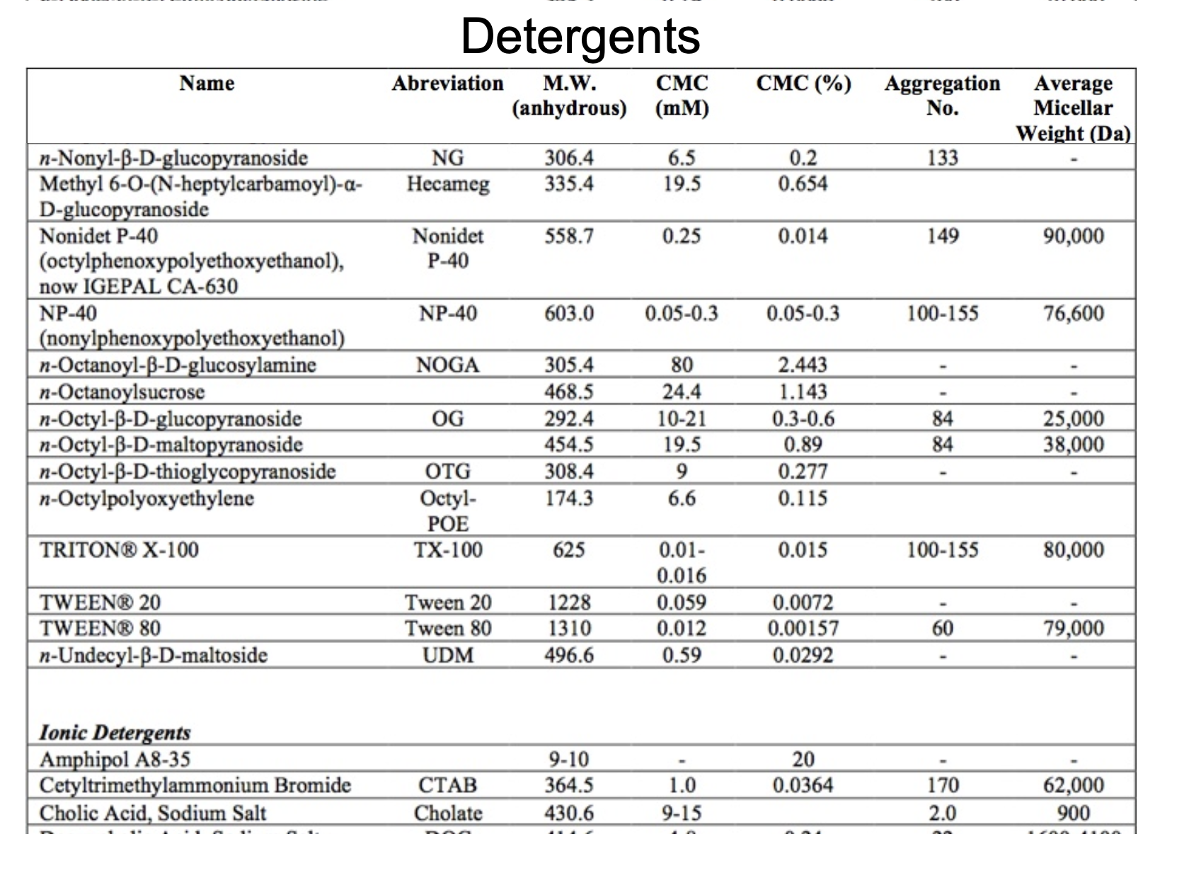
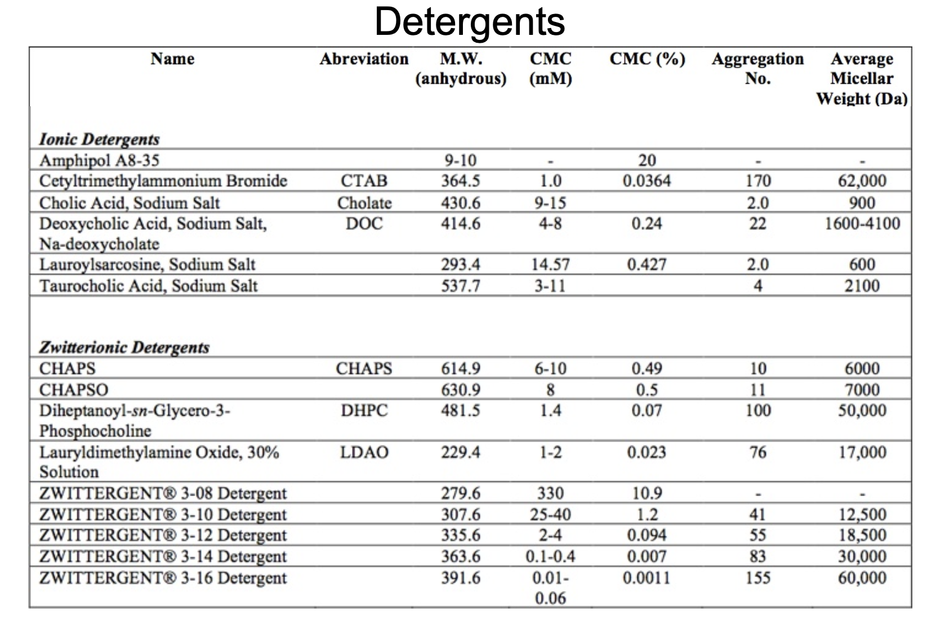
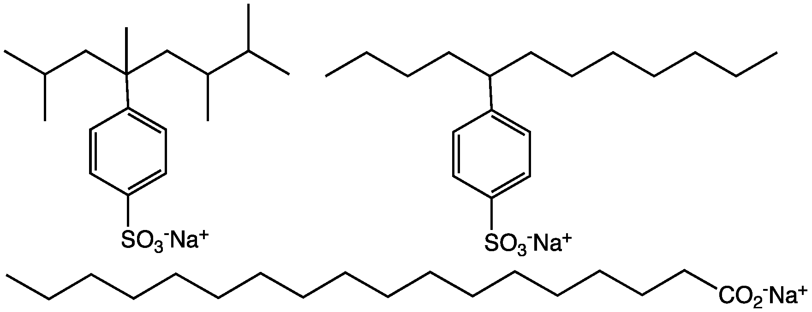
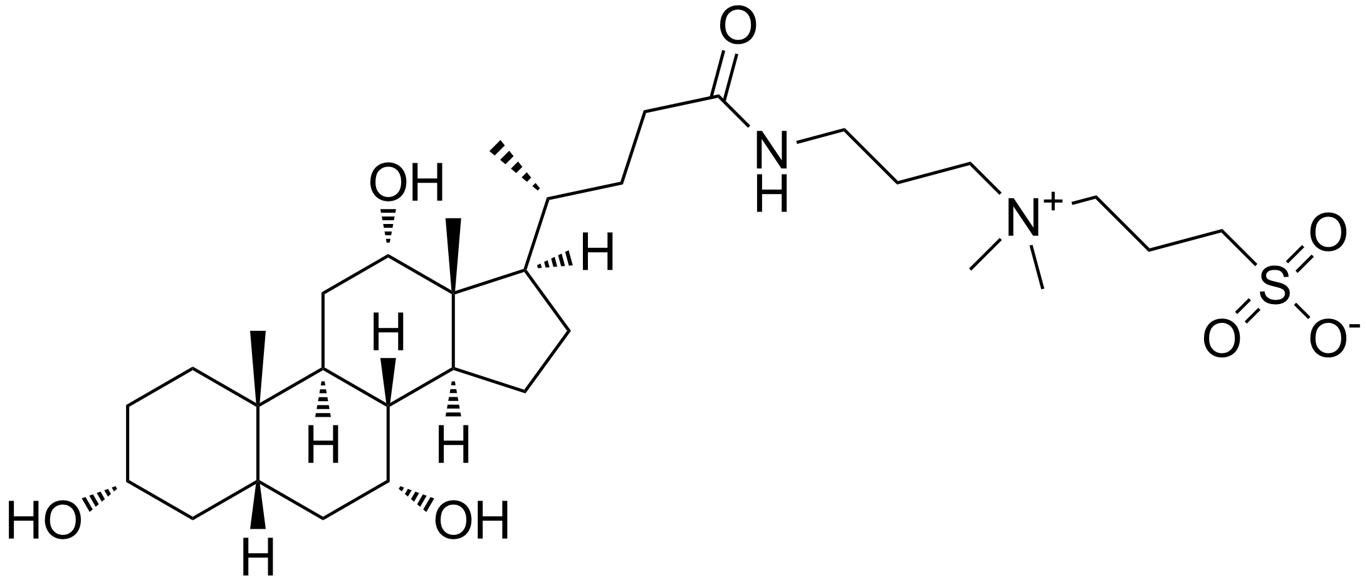
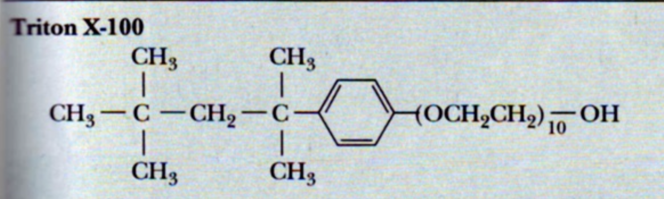
Q1
List the different types of detergents. What are their differences?
Non-ionic:
Ionic:
Zwitteronic:
Charged components but overall neutral
E.g. most soaps, SDS
E.g, CHAPS
Notes:
Movement, Respiration, Sensitivity, Nutrition, Excretion, Reproduction and Growth

Slide 4
Q1
The CMC is a measure for the strength of a detergent. Explain. What factors influence the CMC?
Notes:
Movement, Respiration, Sensitivity, Nutrition, Excretion, Reproduction and Growth

Slide 5
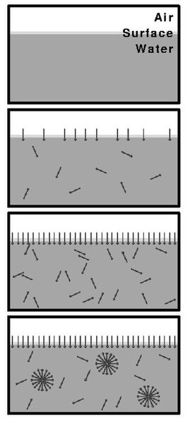
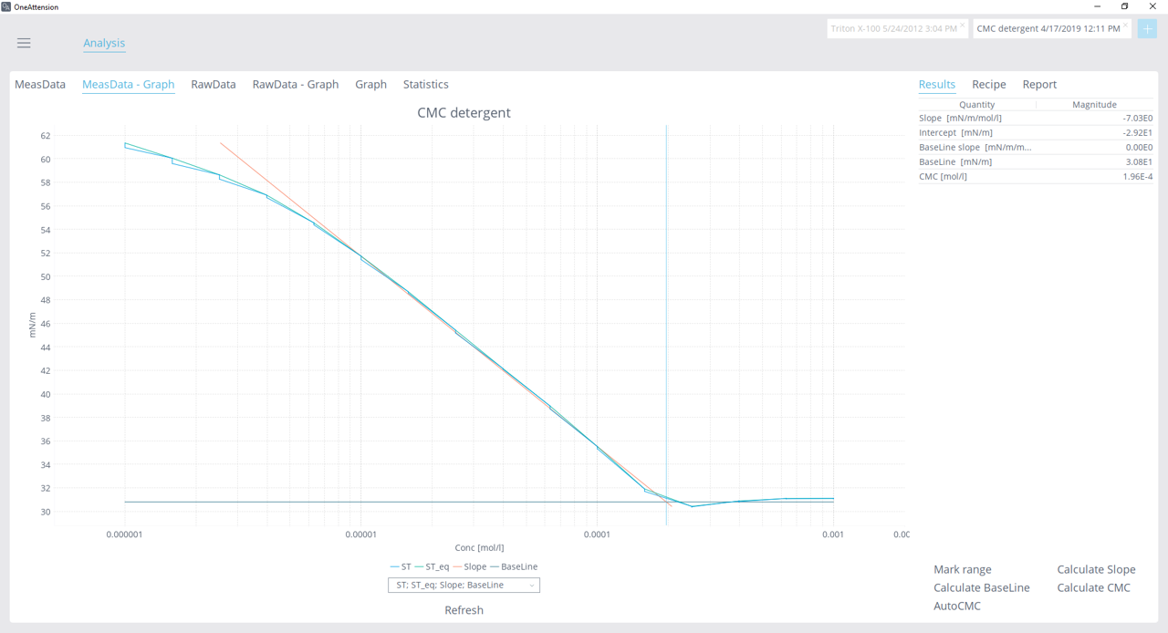
Q1
The CMC is a measure for the strength of a detergent. Explain. What factors influence the CMC?
How to measure:
Notes:
Movement, Respiration, Sensitivity, Nutrition, Excretion, Reproduction and Growth

Slide 6
Q1
You want to isolate a membrane protein and analyse it. What kind of detergent would you choose?
Notes:
Movement, Respiration, Sensitivity, Nutrition, Excretion, Reproduction and Growth

Slide 7
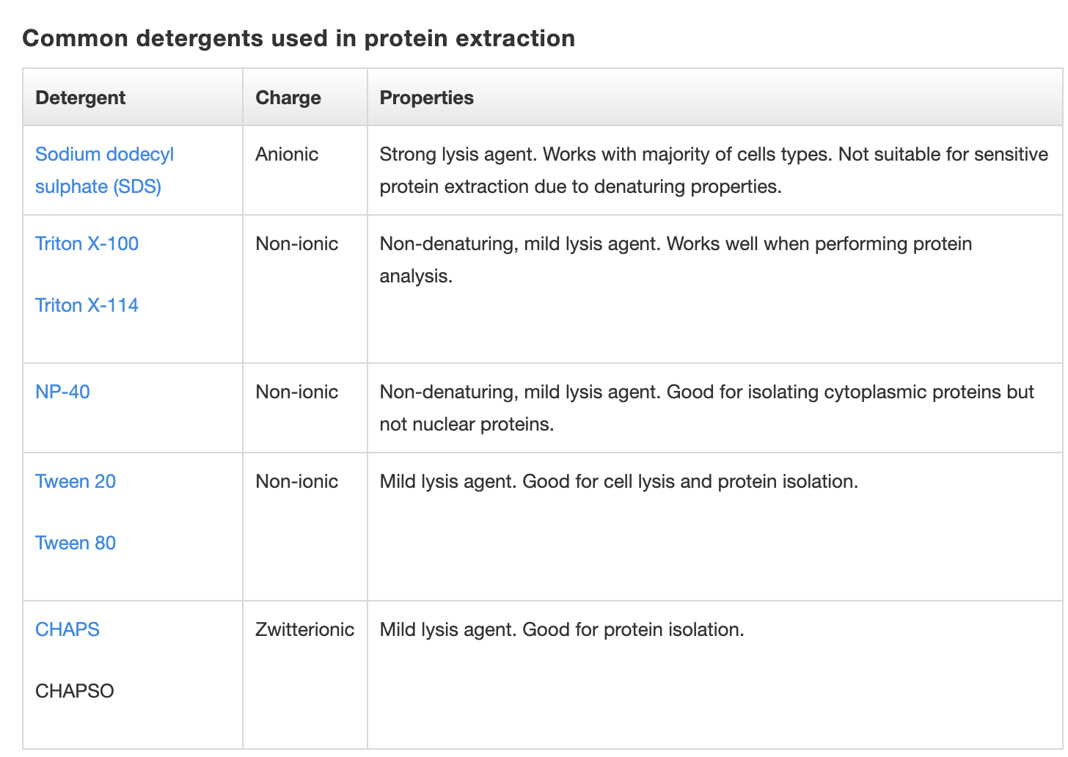
Q1
You want to isolate a membrane protein and analyse it. What kind of detergent would you choose?
Source: ThermoFisher
Notes:
Movement, Respiration, Sensitivity, Nutrition, Excretion, Reproduction and Growth

Slide 8
Q2
As a small deviation: Proteins are built from amino acids (aa) of which 20 different ones exist in nature,
each with individual properties. The protein sequence dictates the latter three-dimensional arrangement
of the fully folded protein. This is based on the physico-chemical interactions between the aa and their surroundings.
Below, you find all 20 aa, with their name, three -and single letter code as well as their chemical structure.
Try to group them into different classes:
  Hydrophobic
  Hydrophilic
  Aromatic
  Basic
  Acidic
  Polar
For all hydrophobic aa, highlight the corresponding regions on the structure.
Notes:
Movement, Respiration, Sensitivity, Nutrition, Excretion, Reproduction and Growth

Slide 9
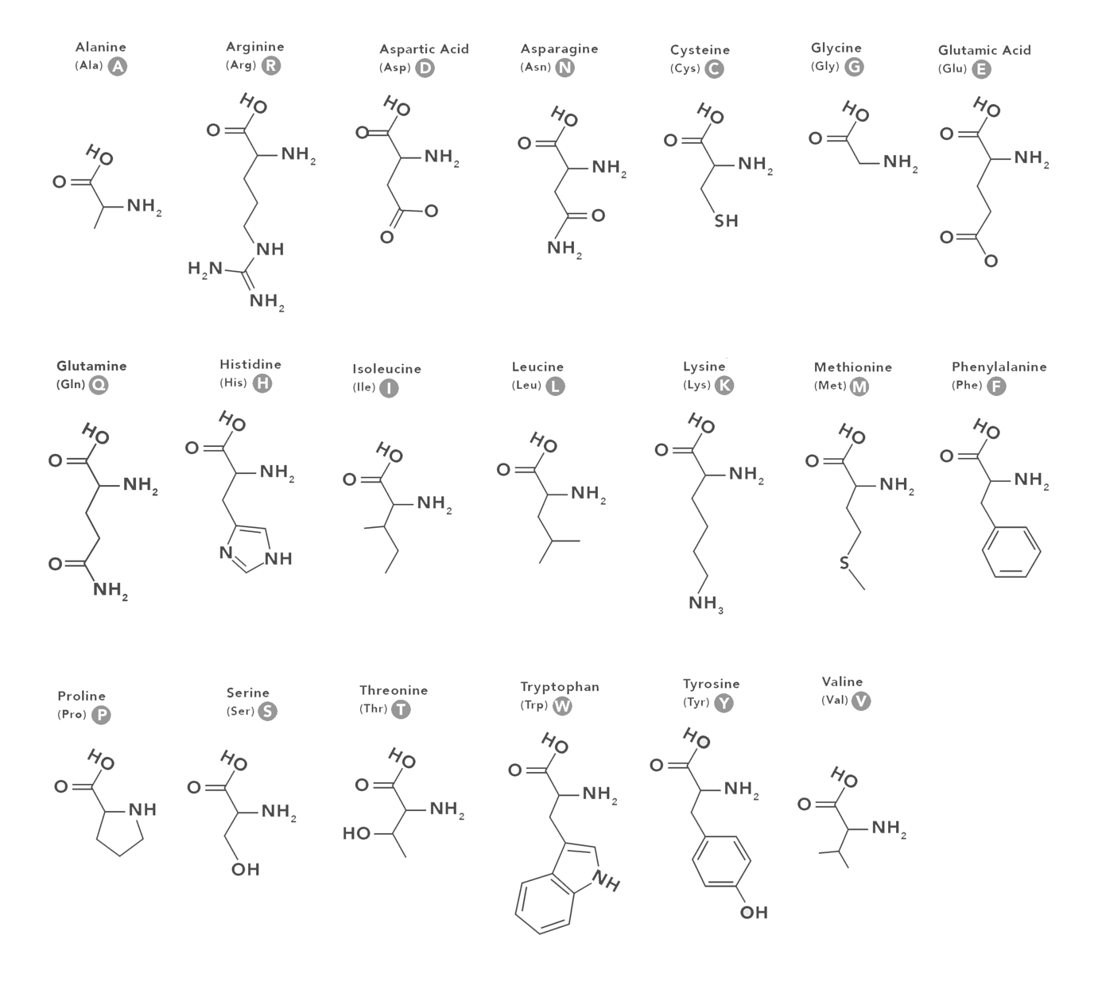
Q2
Notes:
Movement, Respiration, Sensitivity, Nutrition, Excretion, Reproduction and Growth

Slide 10
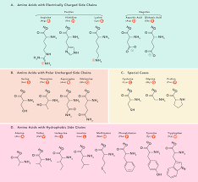

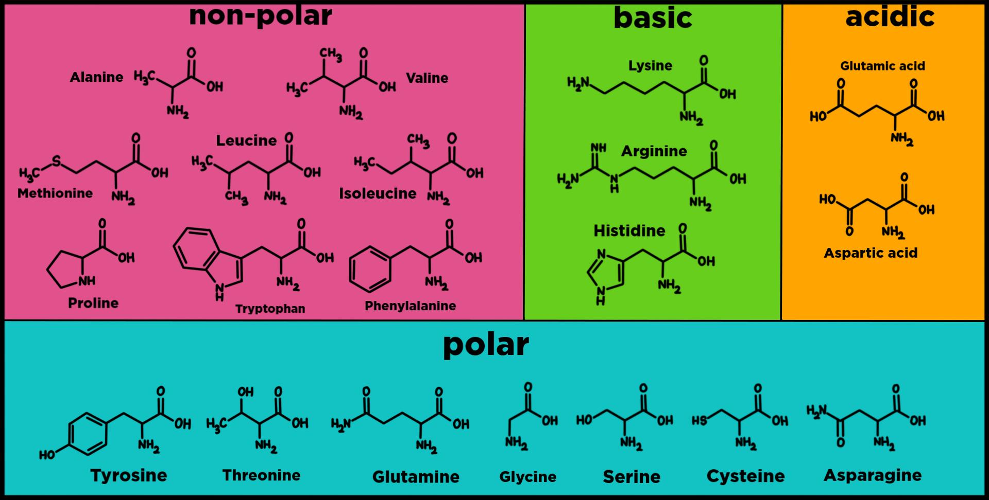
Q2
  Hydrophobic
  Hydrophilic
  Aromatic
  Basic
  Acidic
  Polar
Notes:
Movement, Respiration, Sensitivity, Nutrition, Excretion, Reproduction and Growth

Slide 11
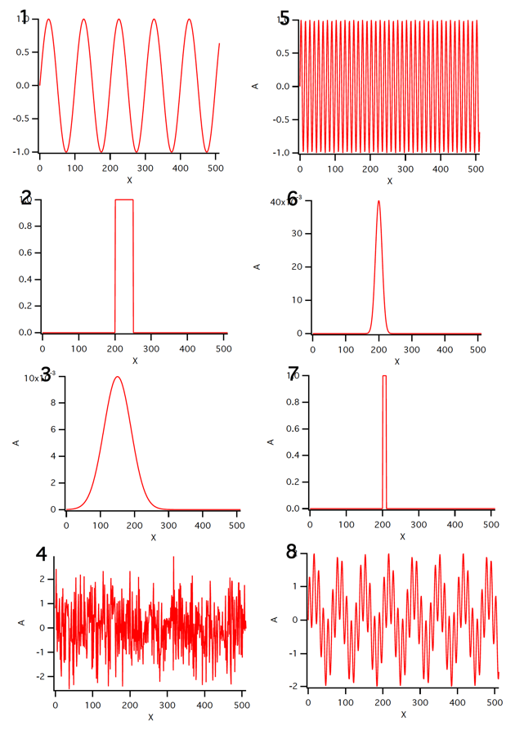
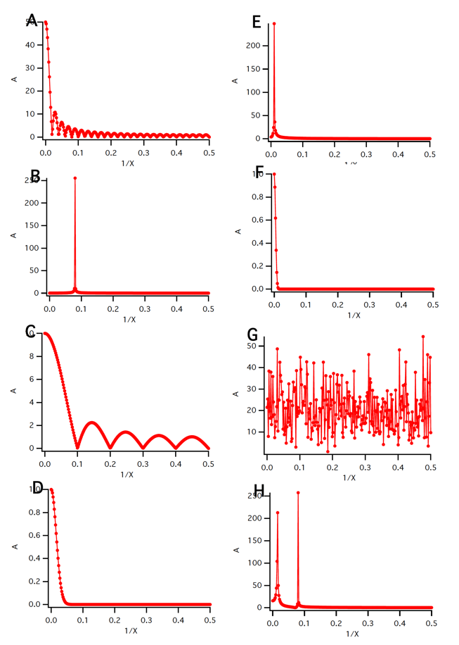
Q3
Correlate the functions from real-space (1-8) with the corresponding Fourier space
Notes:
Movement, Respiration, Sensitivity, Nutrition, Excretion, Reproduction and Growth

Slide 12
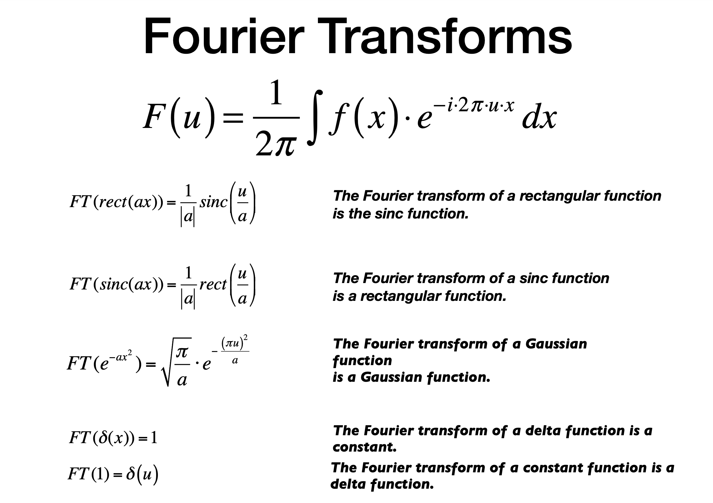
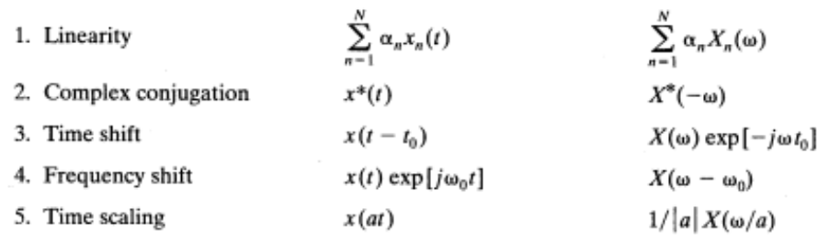
Q3
Correlate the functions from real-space (1-8) with the corresponding Fourier space
  Cheat sheet
Notes:
Movement, Respiration, Sensitivity, Nutrition, Excretion, Reproduction and Growth

Slide 13
Q3
Correlate the functions from real-space (1-8) with the corresponding Fourier space
Notes:
Movement, Respiration, Sensitivity, Nutrition, Excretion, Reproduction and Growth

Slide 14
Q3
Correlate the functions from real-space (1-8) with the corresponding Fourier space
Notes:
Movement, Respiration, Sensitivity, Nutrition, Excretion, Reproduction and Growth

Slide 15
Q3
Correlate the functions from real-space (1-8) with the corresponding Fourier space
Notes:
Movement, Respiration, Sensitivity, Nutrition, Excretion, Reproduction and Growth

Slide 16
Q3
Correlate the functions from real-space (1-8) with the corresponding Fourier space
Notes:
Movement, Respiration, Sensitivity, Nutrition, Excretion, Reproduction and Growth

Slide 17
Q3
Correlate the functions from real-space (1-8) with the corresponding Fourier space
Notes:
Movement, Respiration, Sensitivity, Nutrition, Excretion, Reproduction and Growth

Slide 18
Q3
Correlate the functions from real-space (1-8) with the corresponding Fourier space
Notes:
Movement, Respiration, Sensitivity, Nutrition, Excretion, Reproduction and Growth

Slide 19
Q3
Correlate the functions from real-space (1-8) with the corresponding Fourier space
Notes:
Movement, Respiration, Sensitivity, Nutrition, Excretion, Reproduction and Growth

Slide 20
Q3
Correlate the functions from real-space (1-8) with the corresponding Fourier space
Notes:
Movement, Respiration, Sensitivity, Nutrition, Excretion, Reproduction and Growth

Slide 21
Q3
Correlate the functions from real-space (1-8) with the corresponding Fourier space
Notes:
Movement, Respiration, Sensitivity, Nutrition, Excretion, Reproduction and Growth

Slide 22
Q3
Correlate the functions from real-space (1-8) with the corresponding Fourier space
Notes:
Movement, Respiration, Sensitivity, Nutrition, Excretion, Reproduction and Growth

Slide 23
Q3
Correlate the functions from real-space (1-8) with the corresponding Fourier space
Notes:
Movement, Respiration, Sensitivity, Nutrition, Excretion, Reproduction and Growth

Slide 24
Q3
Correlate the functions from real-space (1-8) with the corresponding Fourier space
Notes:
Movement, Respiration, Sensitivity, Nutrition, Excretion, Reproduction and Growth

Slide 25
Q3
Correlate the functions from real-space (1-8) with the corresponding Fourier space
Notes:
Movement, Respiration, Sensitivity, Nutrition, Excretion, Reproduction and Growth

Slide 26
Q3
Correlate the functions from real-space (1-8) with the corresponding Fourier space
Notes:
Movement, Respiration, Sensitivity, Nutrition, Excretion, Reproduction and Growth

Slide 27
Q3
Correlate the functions from real-space (1-8) with the corresponding Fourier space
Notes:
Movement, Respiration, Sensitivity, Nutrition, Excretion, Reproduction and Growth

Slide 28
Q3
Correlate the functions from real-space (1-8) with the corresponding Fourier space
Notes:
Movement, Respiration, Sensitivity, Nutrition, Excretion, Reproduction and Growth

Slide 29
Q4
Explain in plain language, what the correlation between two functions is,
and what the convolution between two functions is.
Notes:
Movement, Respiration, Sensitivity, Nutrition, Excretion, Reproduction and Growth

Slide 30
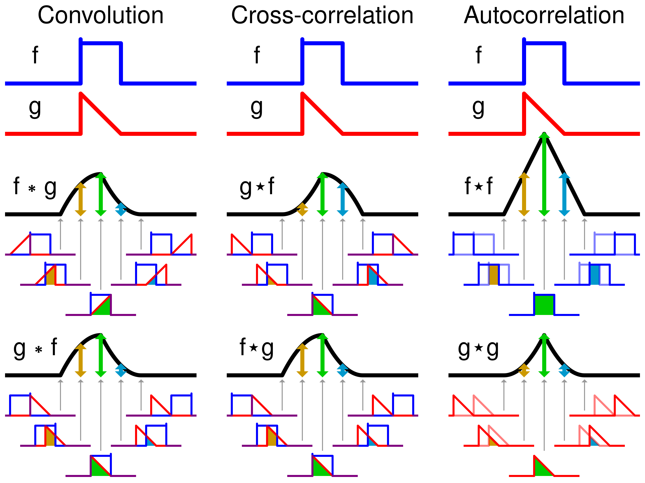
Q4
Explain in plain language, what the correlation between two functions is,
and what the convolution between two functions is.
Notes:
Movement, Respiration, Sensitivity, Nutrition, Excretion, Reproduction and Growth

Slide 31
Q5
You recorded an image with a light microscope at a magnification of 5000x.
The pixel-size of your camera in the microscope is 40 um.
  What is the maximally possible theoretical resolution (at the specimen level) that you can expect (Nyquist frequency)?
  Is this realistic? If not, why?
Notes:
Movement, Respiration, Sensitivity, Nutrition, Excretion, Reproduction and Growth

Slide 32

Q5
You recorded an image with a light microscope at a magnification of 5000x.
The pixel-size of your camera in the microscope is 40 nm.
  What is the maximally possible theoretical resolution (at the specimen level) that you can expect (Nyquist frequency)?
  Is this realistic? If not, why?
$$f_{nyquist}=\frac{f_{sample}}{2}$$
$$d_{nyquist}=d_{pixel}⋅2=80 nm$$
Notes:
Movement, Respiration, Sensitivity, Nutrition, Excretion, Reproduction and Growth

Slide 33
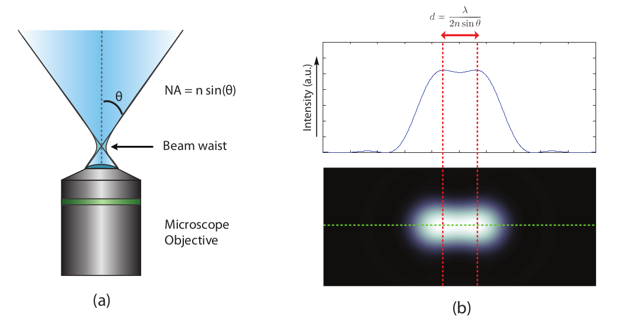
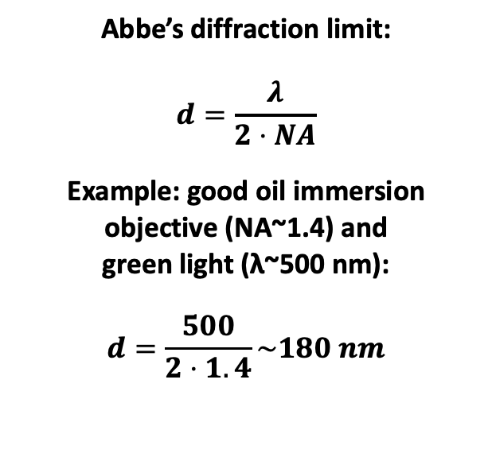
Q5
You recorded an image with a light microscope at a magnification of 5000x.
The pixel-size of your camera in the microscope is 40 nm.
  What is the maximally possible theoretical resolution (at the specimen level) that you can expect (Nyquist frequency)?
  Is this realistic? If not, why?
$$f_{nyquist}=\frac{f_{sample}}{2}$$
$$d_{nyquist}=d_{pixel}⋅2=80 nm$$
Abbe’s diffraction limit:
$$d=\frac{λ}{2⋅NA}$$
Example: good oil immersion objective (NA~1.4) and
green light (λ~500 nm):
$$d=\frac{500}{2⋅1.4}\sim 180 nm$$
Notes:
Movement, Respiration, Sensitivity, Nutrition, Excretion, Reproduction and Growth

