Slide 1
Exercise 12
Discussion

Slide 2
Q1a
Make a drawing of the setup of a gel electrophoresis apparatus,
label the elements, explain in a few words how it is used.

Slide 3
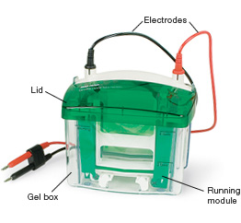
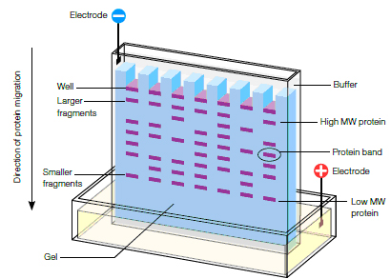
Q1a
Make a drawing of the setup of a gel electrophoresis apparatus,
label the elements, explain in a few words how it is used.

Slide 4
Q1b
What is the difference between a native gel and a denaturing gel? Explain.

Slide 5
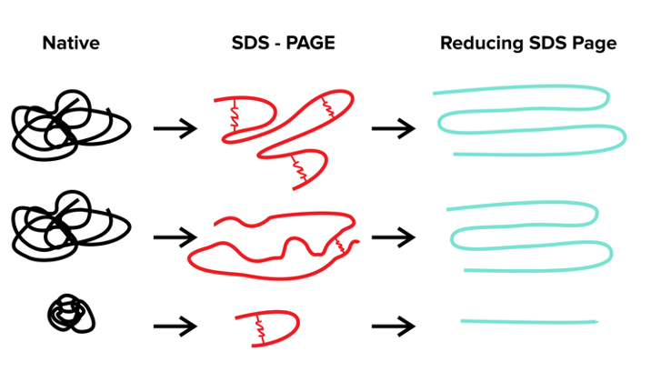
Q1b
What is the difference between a native gel and a denaturing gel? Explain.

Slide 6
Q1c
What is a 2D gel? How can it be used to characterize the entire proteome of a cell culture?

Slide 7
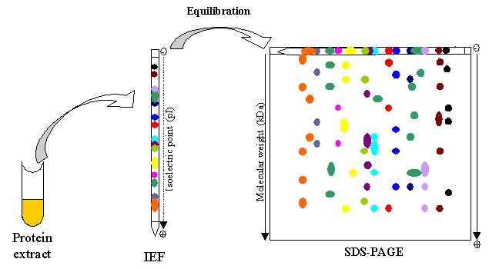
Q1c
What is a 2D gel? How can it be used to characterize the entire proteome of a cell culture?

Slide 8
Q1d
What is an isoelectric focusing gel?

Slide 9
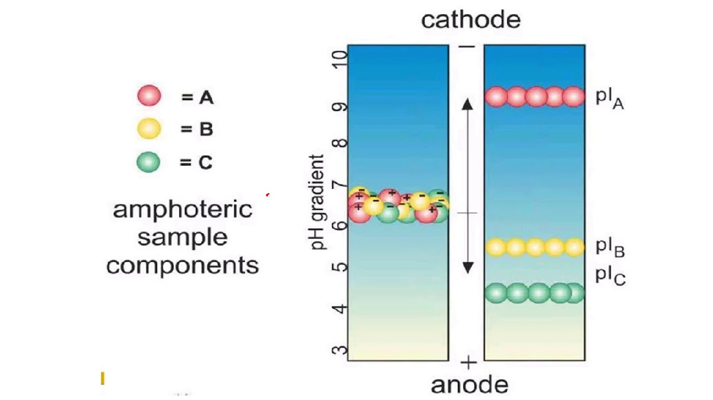
Q1d
What is an isoelectric focusing gel?

Slide 10
Q2a
What is the electrical charge of a protein that consists of four amino acids Ala-Phe-His-Asp at pH 8 ?

Slide 11
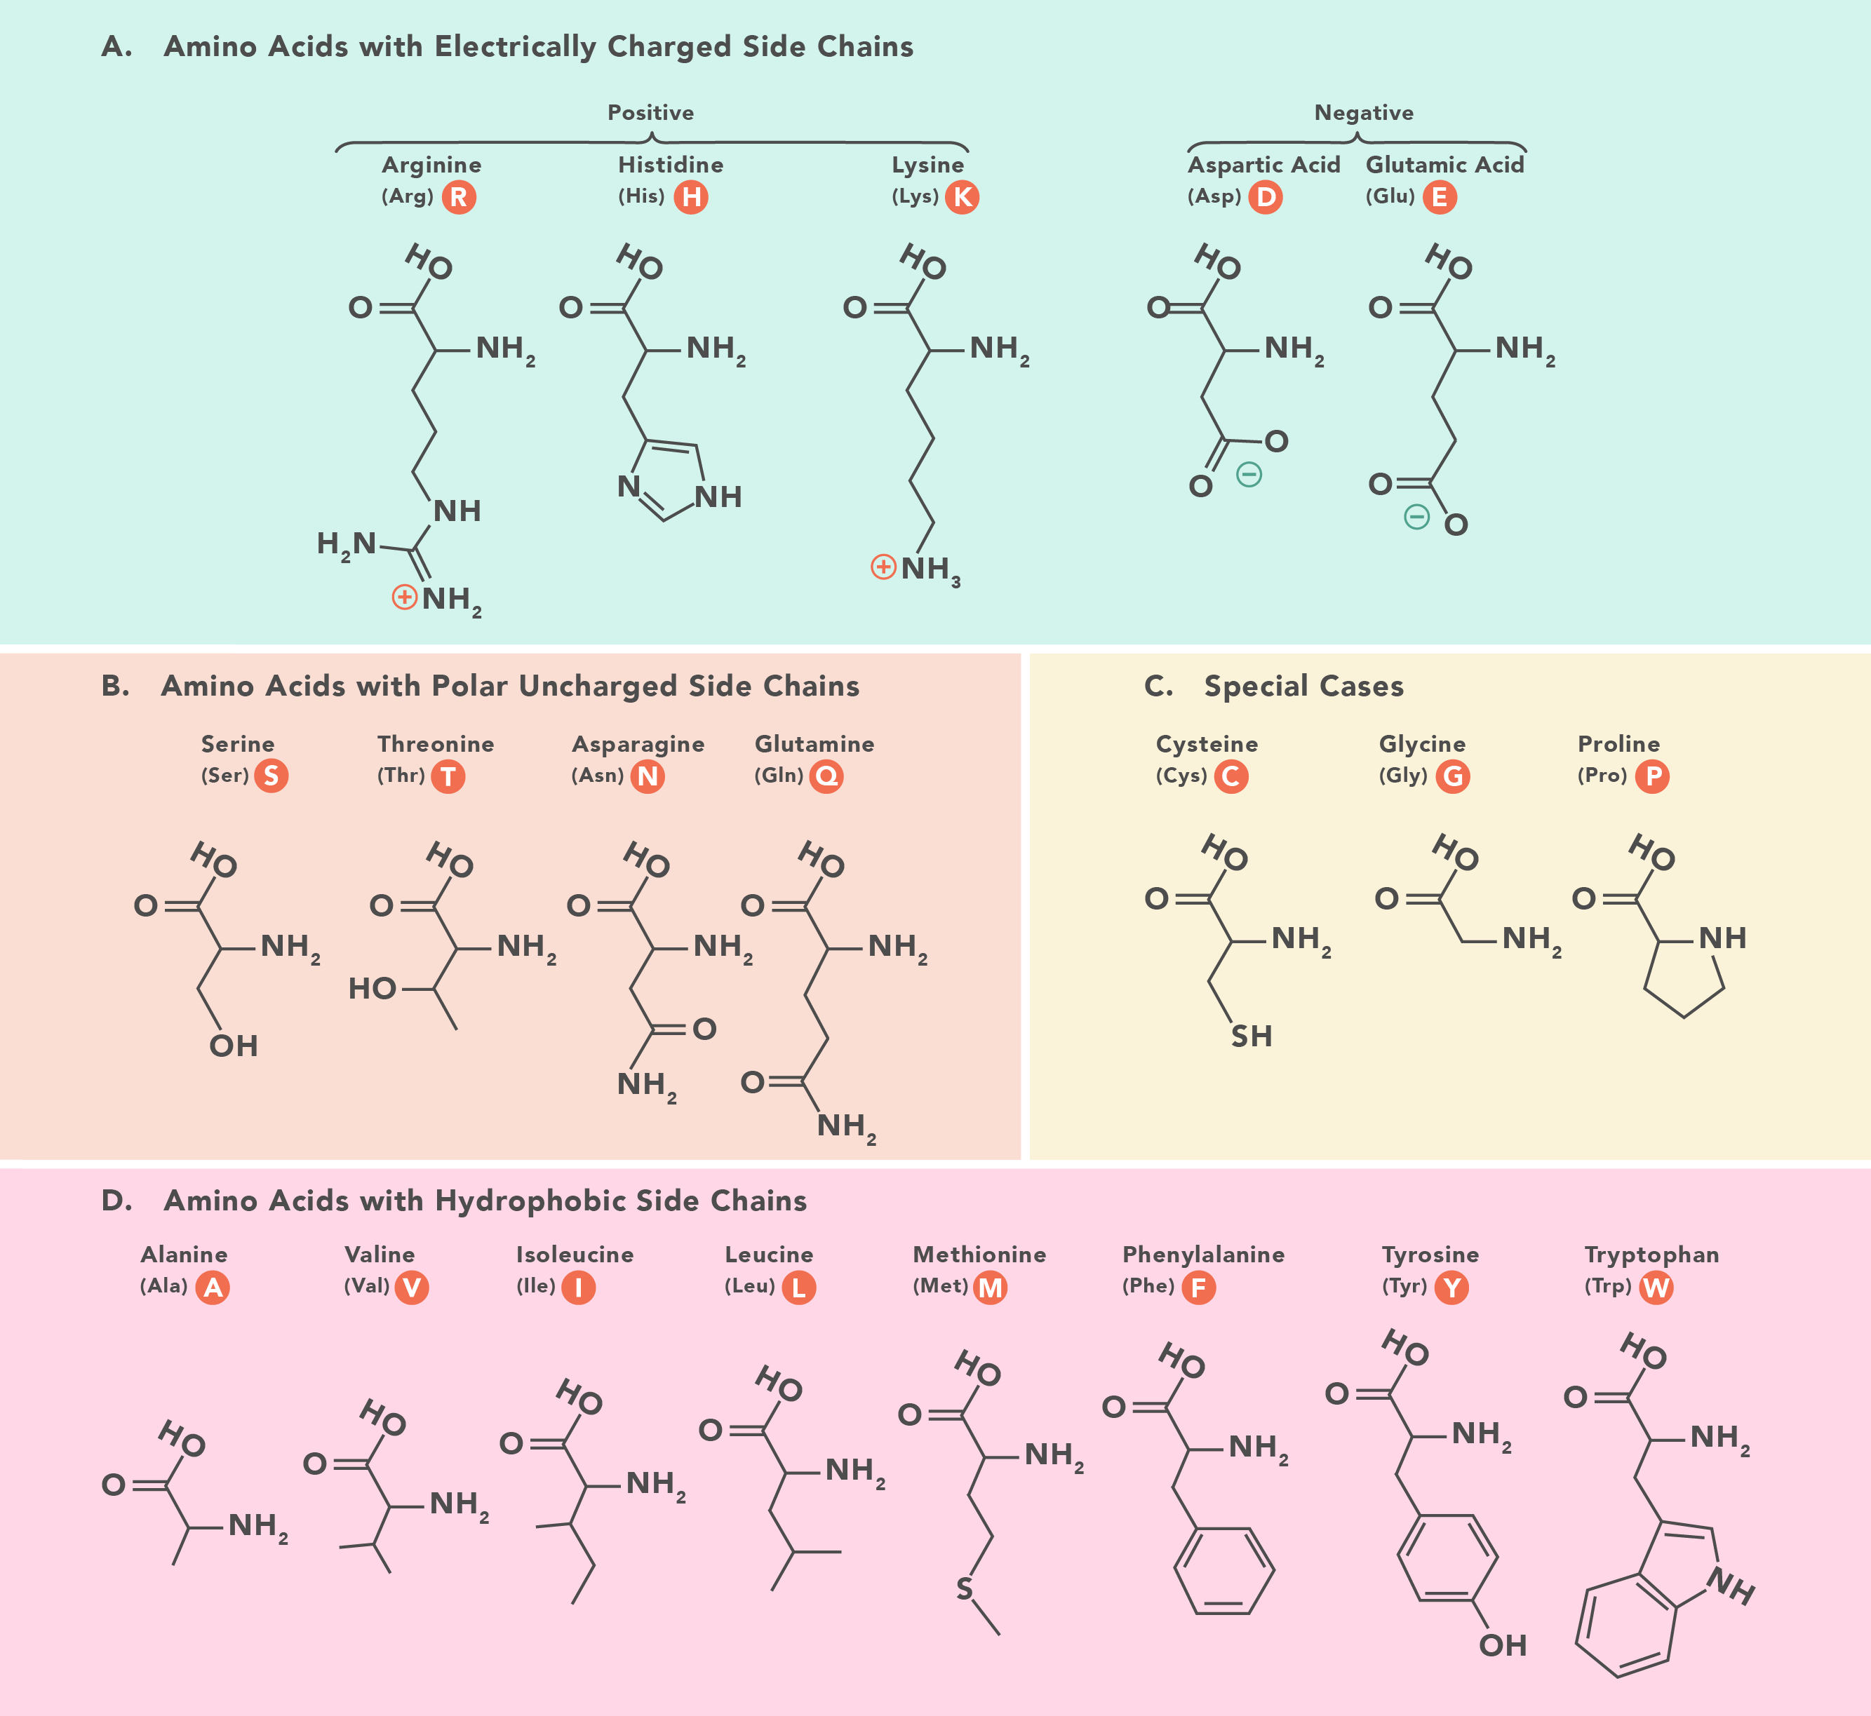
Q2a
What is the electrical charge of a protein that consists of four amino acids Ala-Phe-His-Asp at pH 8 ?
Amino Acid Pkas: https://www.vanderbilt.edu/AnS/Chemistry/Rizzo/stuff/AA/AminoAcids.html

Slide 12
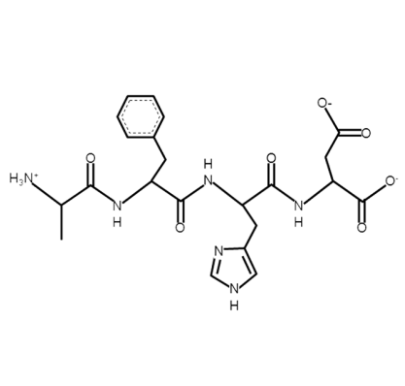
Q2a
What is the electrical charge of a protein that consists of four amino acids Ala-Phe-His-Asp at pH 8 ?
The peptide:
Phe
Asp
Ala
His

Slide 13
Q2a
What is the electrical charge of a protein that consists of four amino acids Ala-Phe-His-Asp at pH 8 ?
The possible protonation sites:
Phe
Asp
Ala
His
The question is in which protonation state these 4 sites are at pH8.
To know this, we need to look at their pKa:
pH > pKa: the site is not protonated
pH < pKa: the site is protonated
Amino Acid Pkas: https://www.vanderbilt.edu/AnS/Chemistry/Rizzo/stuff/AA/AminoAcids.html

Slide 14
Q2b
What is the electrical charge of a protein that consists of four amino acids Ala-Phe-His-Asp at pH 8 ?
Phe
pKa ~ 3.9
Asp
Ala
His
pKa ~ 2
pKa ~ 10
pKa ~ 6

Slide 15
Q2b
What is the electrical charge of a protein that consists of four amino acids Ala-Phe-His-Asp at pH 8 ?
at pH 8:
pH > pKa
–1
Phe
Asp
Ala
His
pH > pKa
–1
pH < pKa
+1
pH > pKa
neutral
Total charge = +1 + 0 –1 –1 = –1

Slide 16
Q2b
What about the same peptide at pH4?
at pH 4:
pH > pKa
–1
Phe
Asp
Ala
His
pH > pKa
–1
pH < pKa
+1
pH < pKa
+1
H⁺
Total charge = +1 + 1 –1 –1 = 0

Slide 17
Q3
What is the difference between dynamic and relative viscosity?

Slide 18
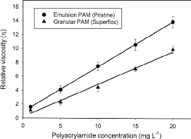
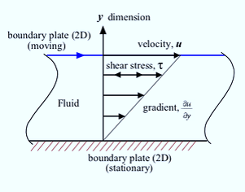
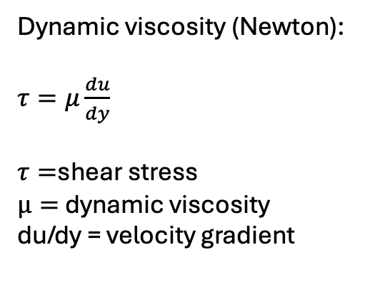
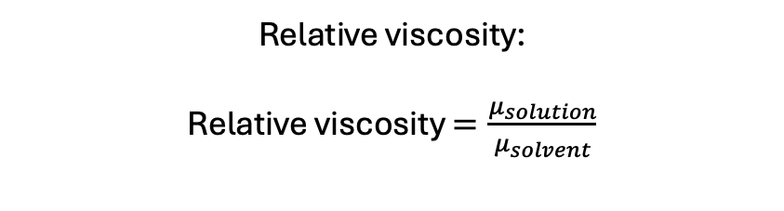
Q3
What is the difference between dynamic and relative viscosity?
Dynamic viscosity (Newton):
$τ=μ\frac{du}{dy}$​
$τ=$shear stress
$μ=$ dynamic viscosity
du/dy = velocity gradient
Relative viscosity:
Relative viscosity $=\frac{μ_{solution}}{μ_{solvent}}$​

