Slide 1
Exercise 11
Discussion

Slide 2
Q1
What is the main advantage of using EM compared to other microscopy techniques?

Slide 3
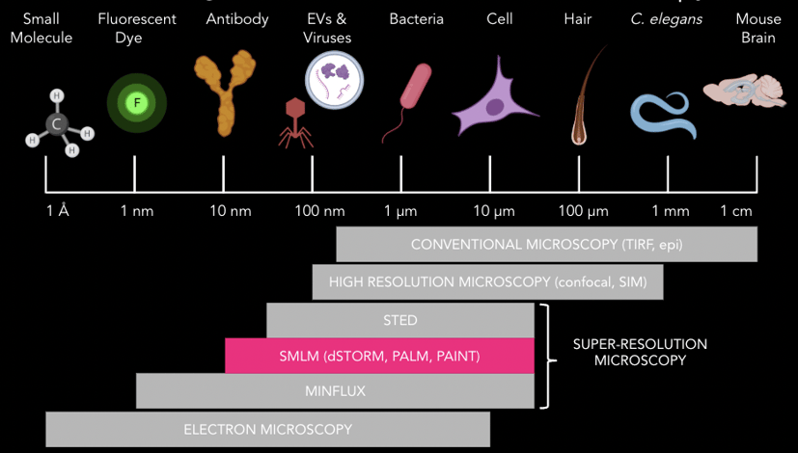
Q1
What is the main advantage of using EM compared to other microscopy techniques?

Slide 4
Q2
How do electrons interact with a sample (consider different types of scattering)?

Slide 5
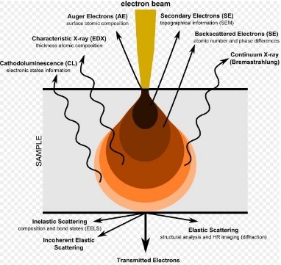
Q2
How do electrons interact with a sample (consider different types of scattering)?

Slide 6
Q3
What are some of the challenges when using EM on biological samples?

Slide 7
Q4
Explain in your own words what the back focal plane is and why it is the Fourier transform of the projection of the sample. How is the scattering angle related to the size of an observed structure (think of proteins)?

Slide 8
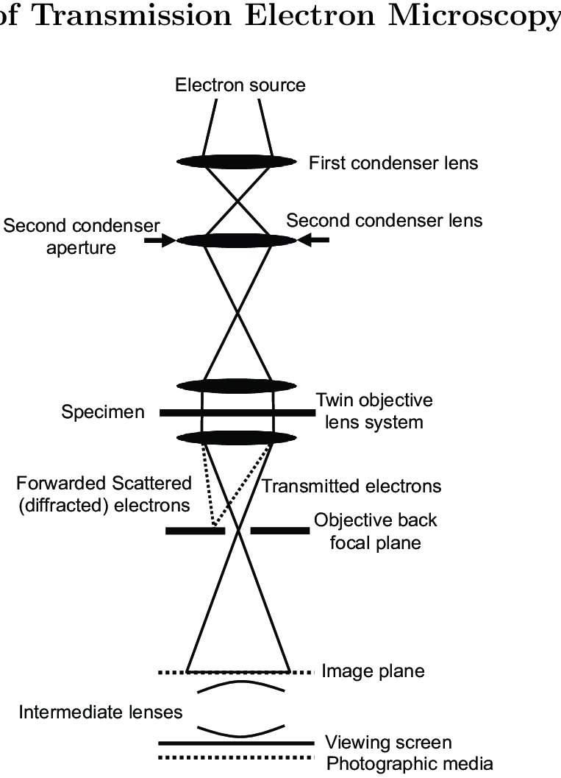
Q4
Explain in your own words what the back focal plane is and why it is the Fourier transform of the projection of the sample. How is the scattering angle related to the size of an observed structure (think of proteins)?

Slide 9
Q5
Explain what the CTF is. Why is the CTF an issue for imaging proteins and determining their structure?

Slide 10
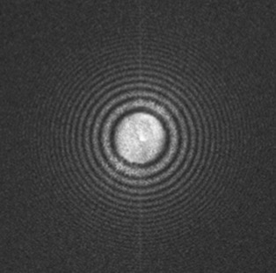
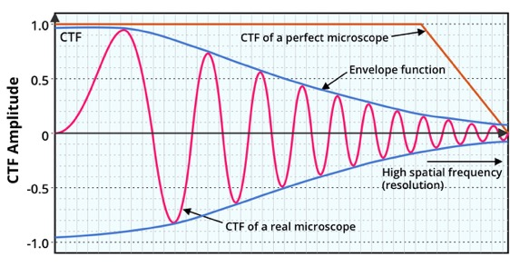
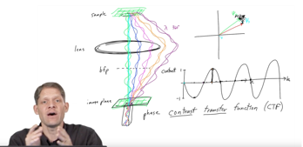
Q5
Explain what the CTF is. Why is the CTF an issue for imaging proteins and determining their structure?
Highly recommended video:
https://www.youtube.com/watch?v=mPynoF2j6zc

Slide 11
Q6
For what reason are samples stained with heavy metals in RT-TEM? Why does Cryo-TEM have higher resolution than RT-TEM?

Slide 12
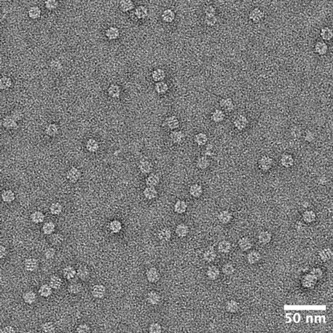
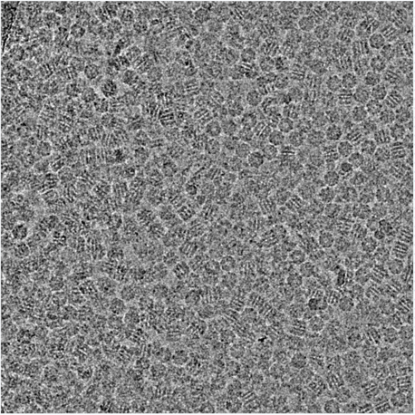
Q6
For what reason are samples stained with heavy metals in RT-TEM? Why does Cryo-TEM have higher resolution than RT-TEM?
RT-TEM
Cryo-TEM

Slide 13
Q7
What are the differences between RT-TEM, Cryo-TEM, SEM and SBF-SEM (consider sample preparation, electrons recorded / scattering, resolution, etc.).

Slide 14
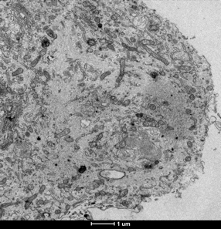
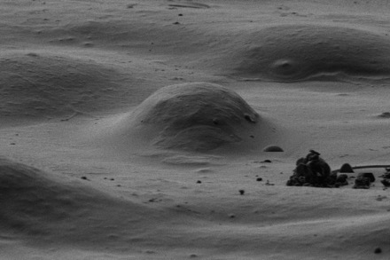
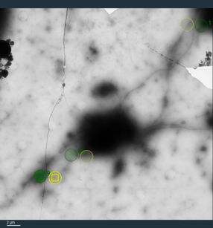
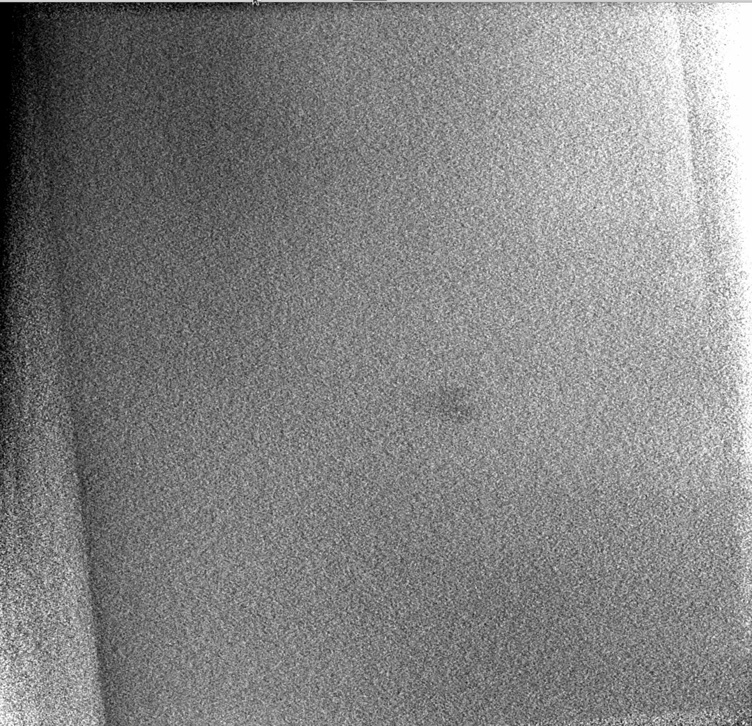
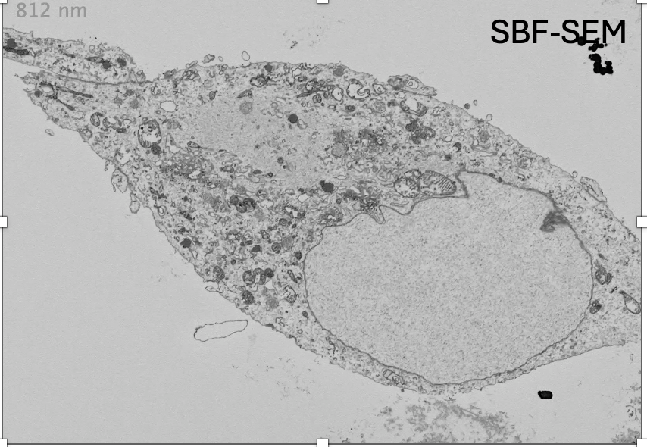
Q7
What are the differences between RT-TEM, Cryo-TEM, SEM and SBF-SEM (consider sample preparation, electrons recorded / scattering, resolution, etc.).
RT-TEM
SEM
cryo-TEM

Slide 15
Q8
Why do we image cryo-EM samples on a holey carbon grid instead on one with a continuous carbon film?

Slide 16
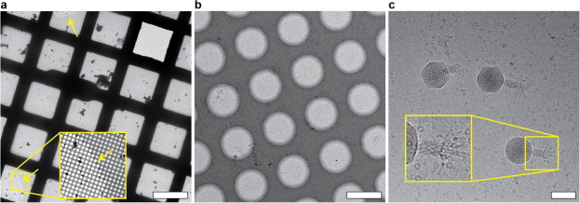
Q8
Why do we image cryo-EM samples on a holey carbon grid instead on one with a continuous carbon film?
Holey Carbon:

Slide 17
Q8b
Why do we image cryo-EM samples on a holey carbon grid instead on one with a continuous carbon film? Could you think of a reason when to use a grid with a continuous film for imaging? What could be the advantages, what the disadvantages?

Slide 18
Q9
Why are cryo-EM images so noisy?

Slide 19
Q10
What is the issue for cryo-EM when your sample is heterogeneous?

Slide 20
Q11
Why is it important to reach 3Å resolution?

Slide 21
Q11
Why is it important to reach 3Å resolution?
https://www.sciencedirect.com/science/article/pii/S0959440X16300847

Slide 22
Q12
Microfluidic devices are promising improvements in the overall workflow in cryo-EM. What are these improvements?

Slide 23
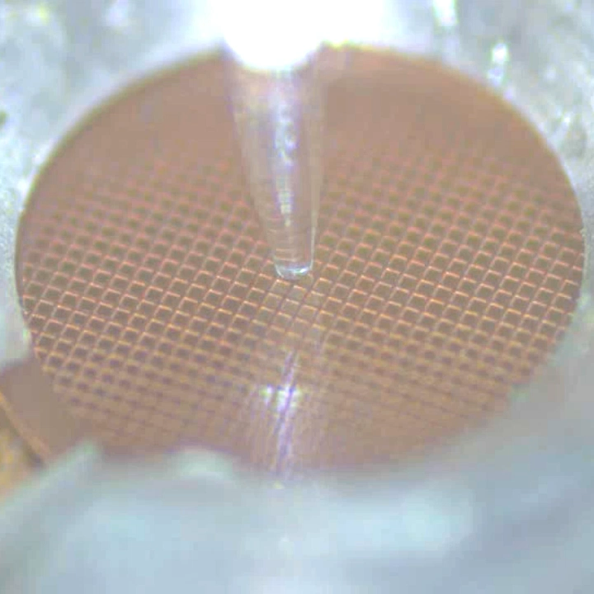
Q12
Microfluidic devices are promising improvements in the overall workflow in cryo-EM. What are these improvements?
https://cryowrite.ch/cryowriter-grid-preparation-robot/

