Slide 1
Exercise 10
Discussion

Slide 2
Q1
What are the different types of ionizing radiation? Explain the differences

Slide 3
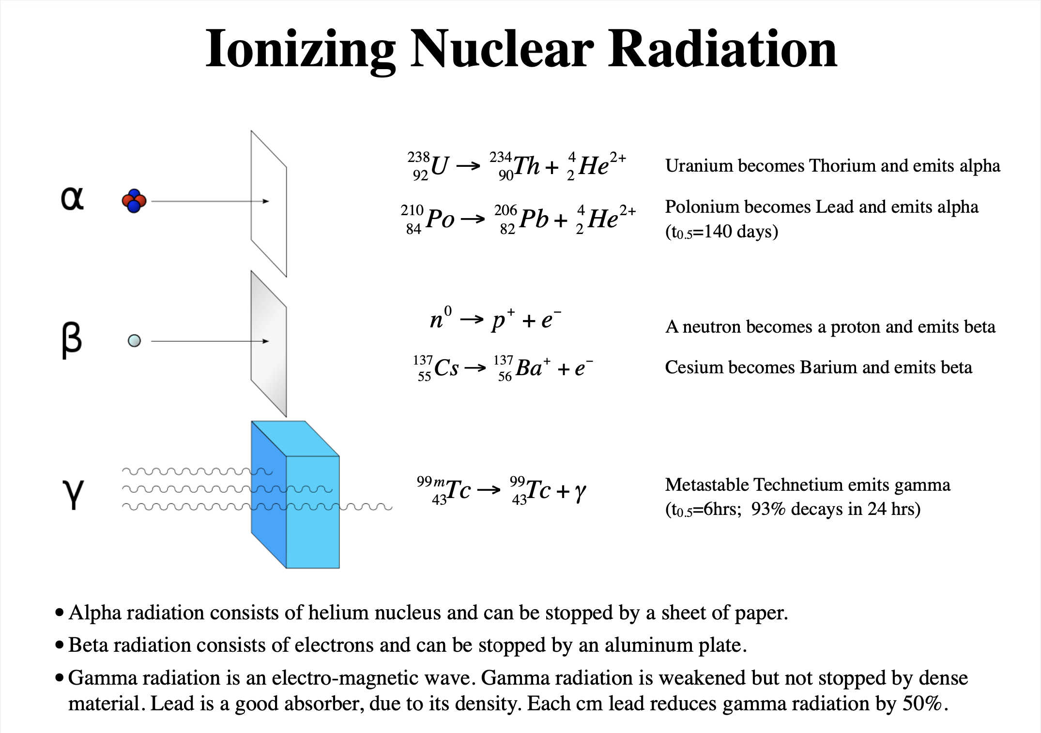
Q1
What are the different types of ionizing radiation? Explain the differences

Slide 4
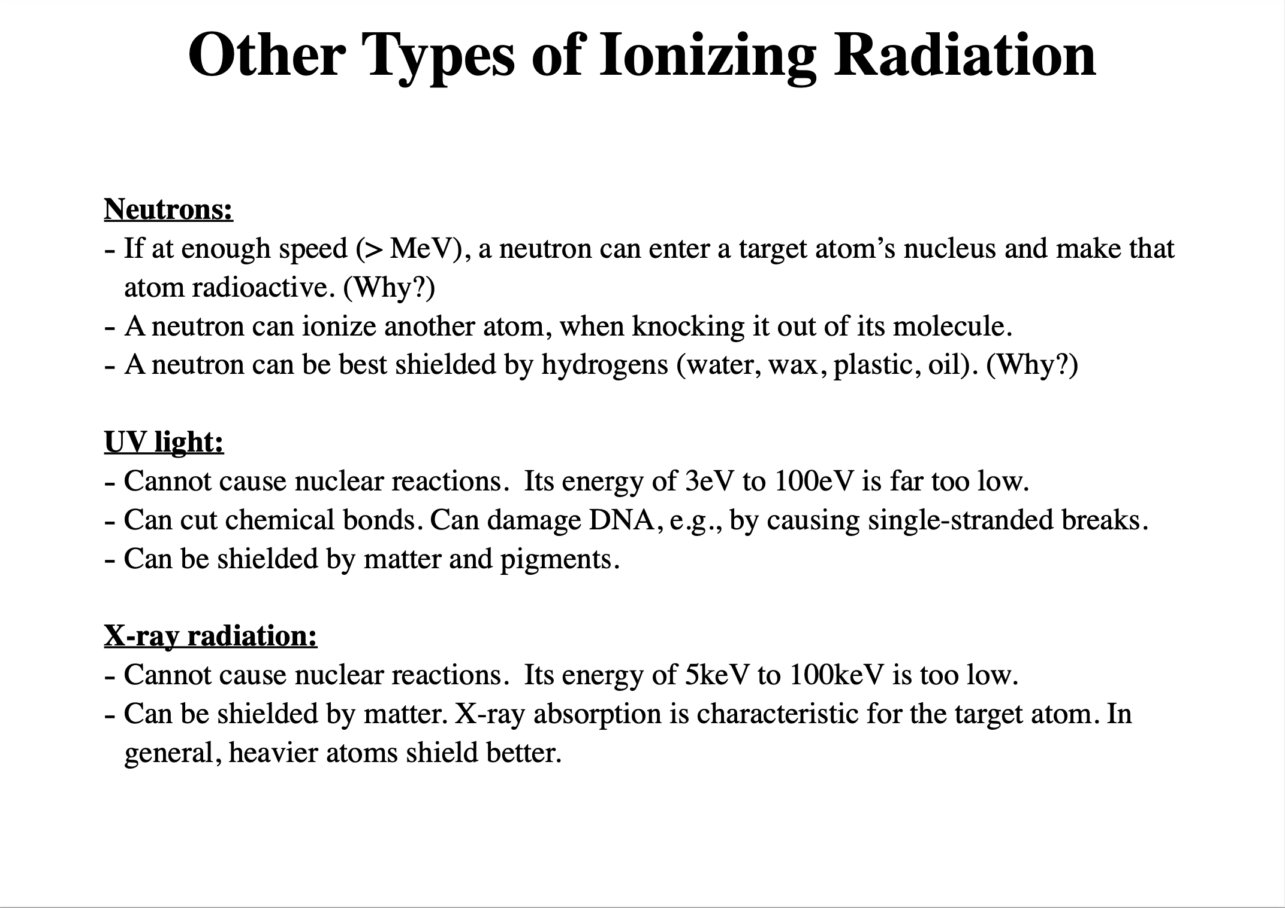
Q1
What are the different types of ionizing radiation? Explain the differences

Slide 5
Q2
How many protons and neutrons are in each of the atoms below?
Search for the different isotopes and list the protons and neutrons for the corresponding elements
Boron
Aluminium
Iron
Radon
Notes:
Radon does not have any stable isotopes

Slide 6
Q3
There are various ways to quantify radiation.
Why is it necessary to have so many? What would be the implications if we would only measure in Becquerels?

Slide 7
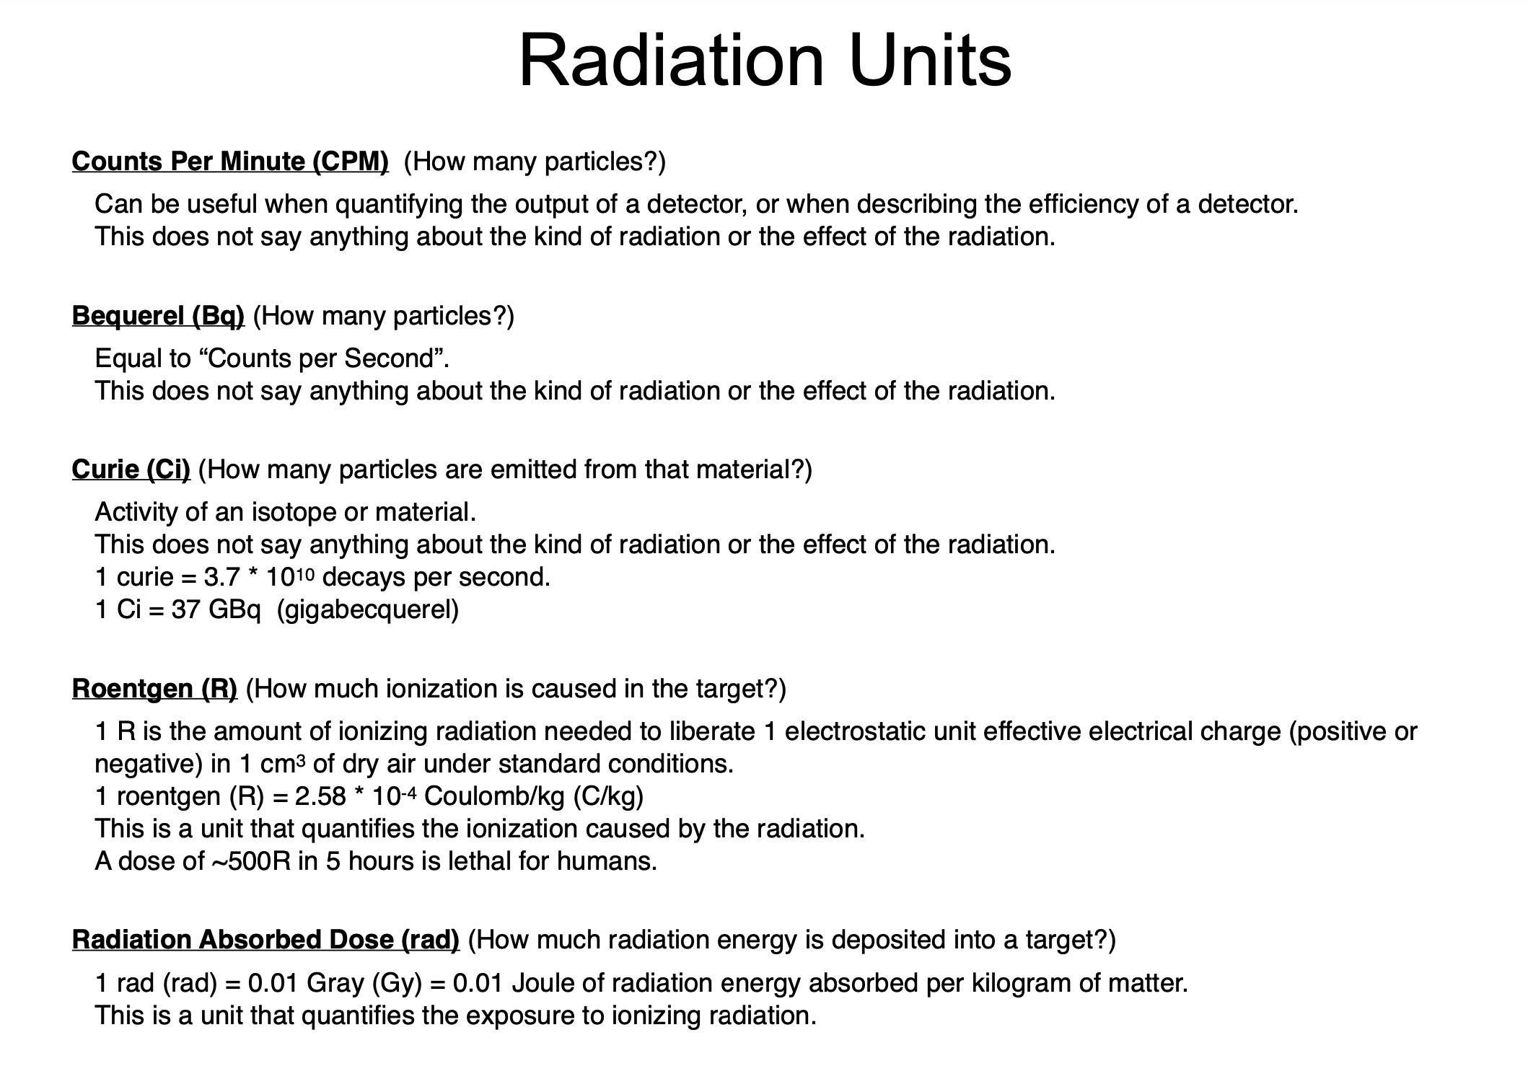
Q3
There are various ways to quantify radiation.
Why is it necessary to have so many? What would be the implications if we would only measure in Becquerels?

Slide 8
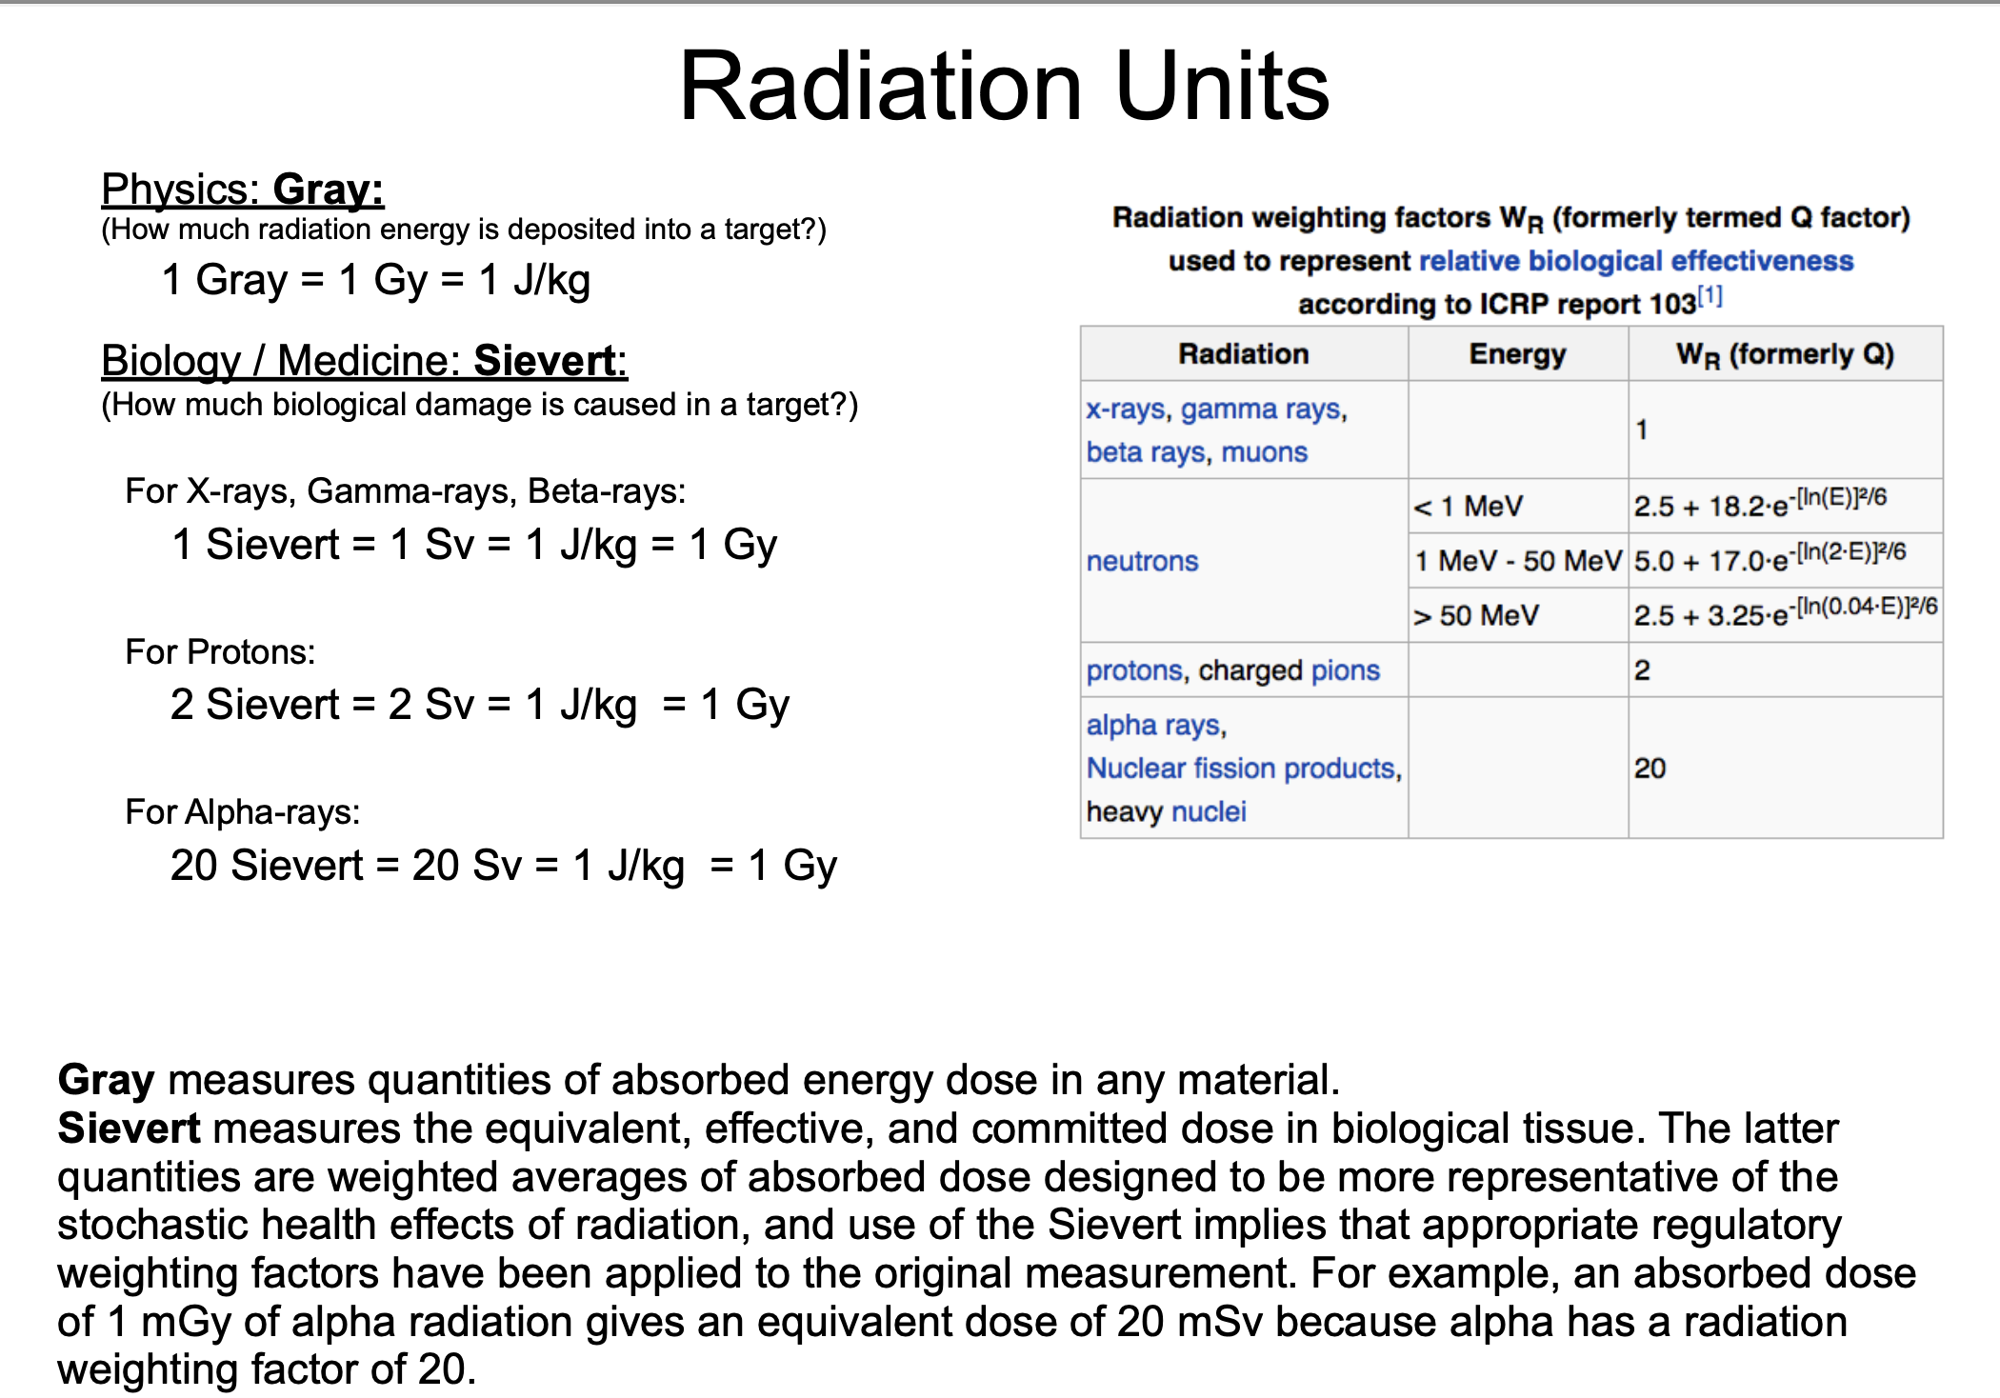
Q3
There are various ways to quantify radiation.
Why is it necessary to have so many? What would be the implications if we would only measure in Becquerels?

Slide 9
Q4
Define nuclear fission. Under which conditions does this generate energy, and how much?

Slide 10
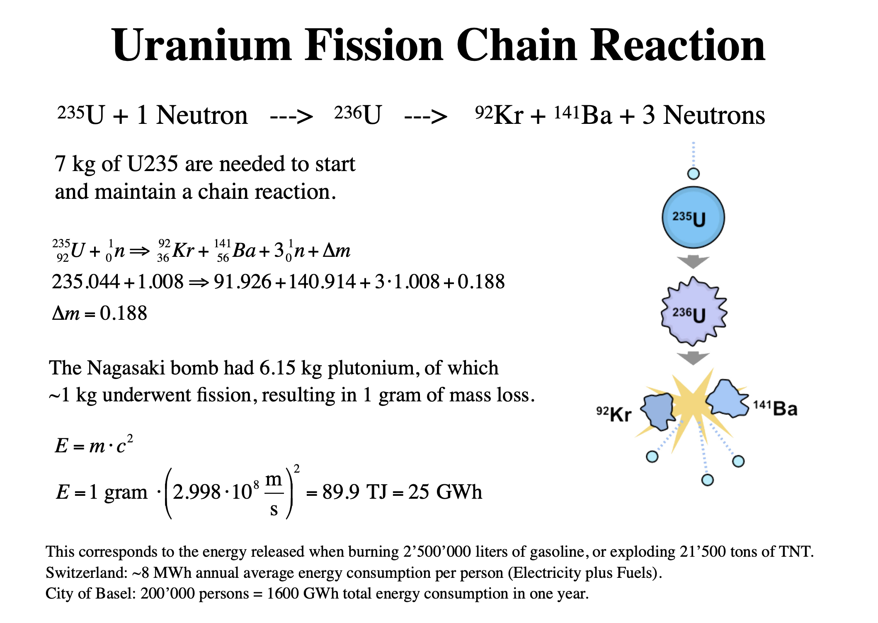
Q4
Define nuclear fission. Under which conditions does this generate energy, and how much?

Slide 11
Q5
Radiation exposure causes damage to biological tissue. Explain how this damage occurs.

Slide 12
Q6
We often think of radiation as dangerous, but how can we use it to gain benefits from it? Elaborate on different techniques and methods.

Slide 13
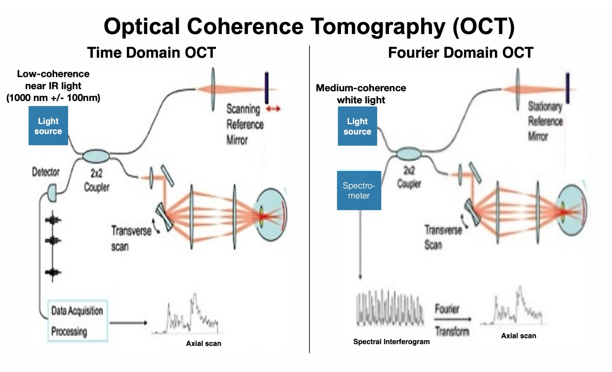
Q7
Explain in your own words the working principle of OCT in the Time Domain and in the Fourier Domain.
How can the two different instruments detect the 3D density of the tissue in X, Y and Z ?

Slide 14
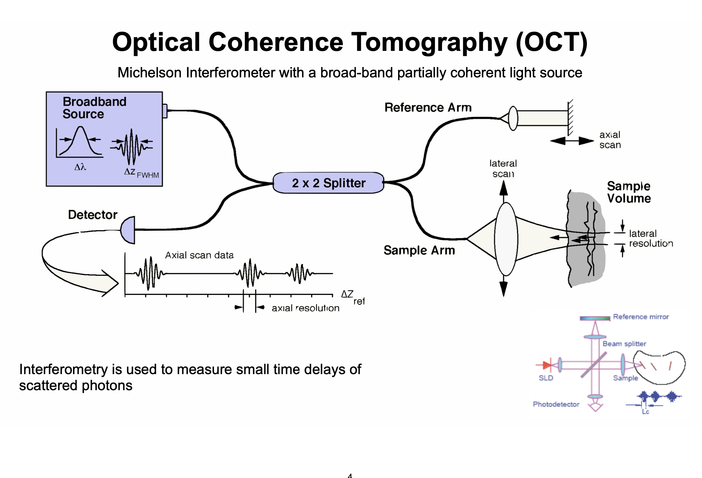
Q7
Explain in your own words the working principle of OCT in the Time Domain and in the Fourier Domain.
How can the two different instruments detect the 3D density of the tissue in X, Y and Z ?

Slide 15
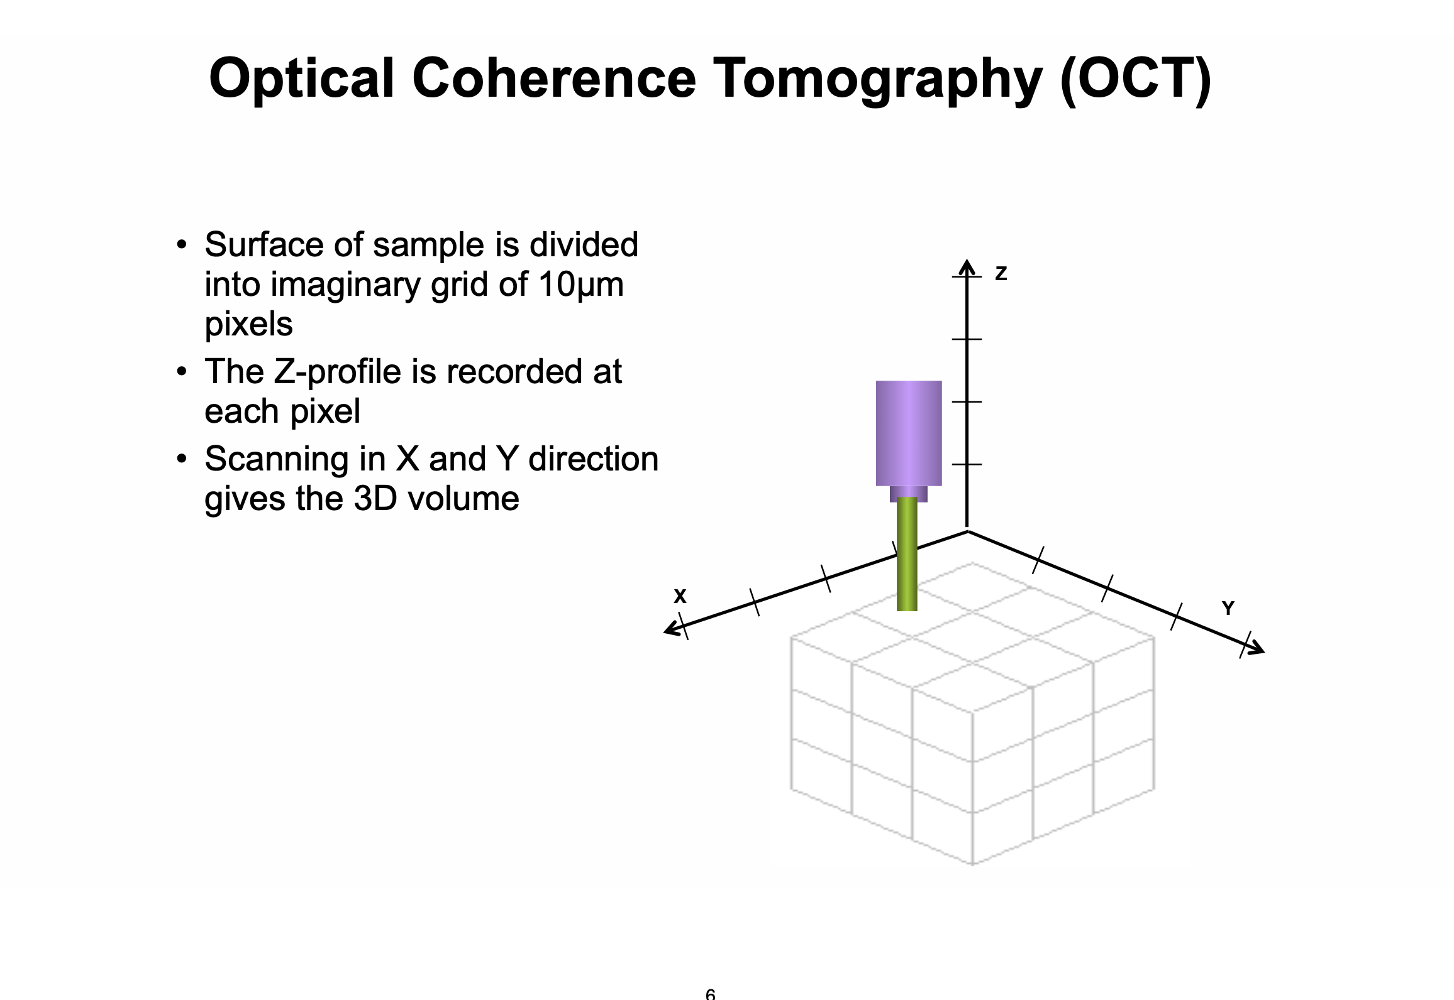
Q7
Explain in your own words the working principle of OCT in the Time Domain and in the Fourier Domain.
How can the two different instruments detect the 3D density of the tissue in X, Y and Z ?

Slide 16
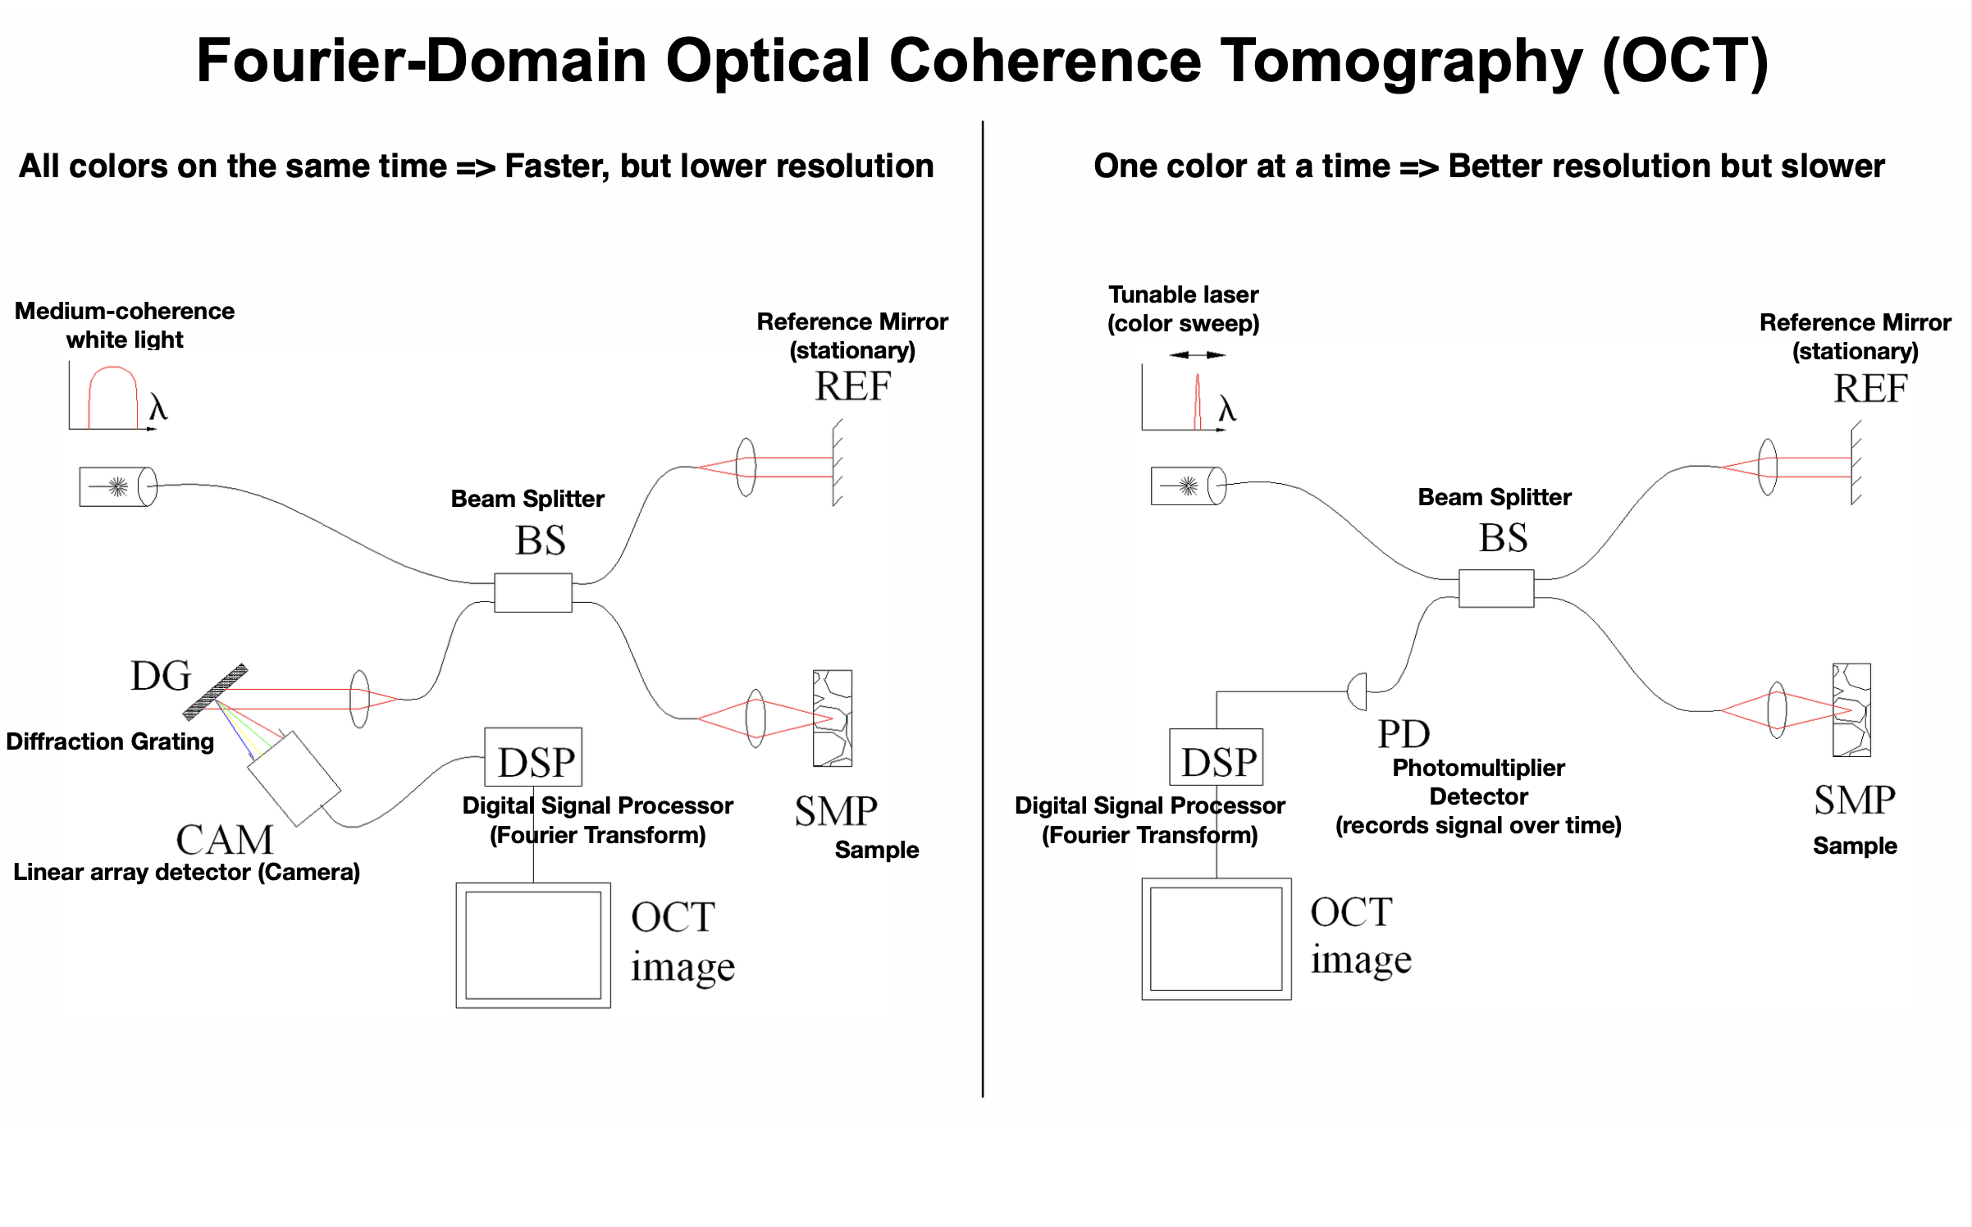
Q7
Explain in your own words the working principle of OCT in the Time Domain and in the Fourier Domain.
How can the two different instruments detect the 3D density of the tissue in X, Y and Z ?

Slide 17
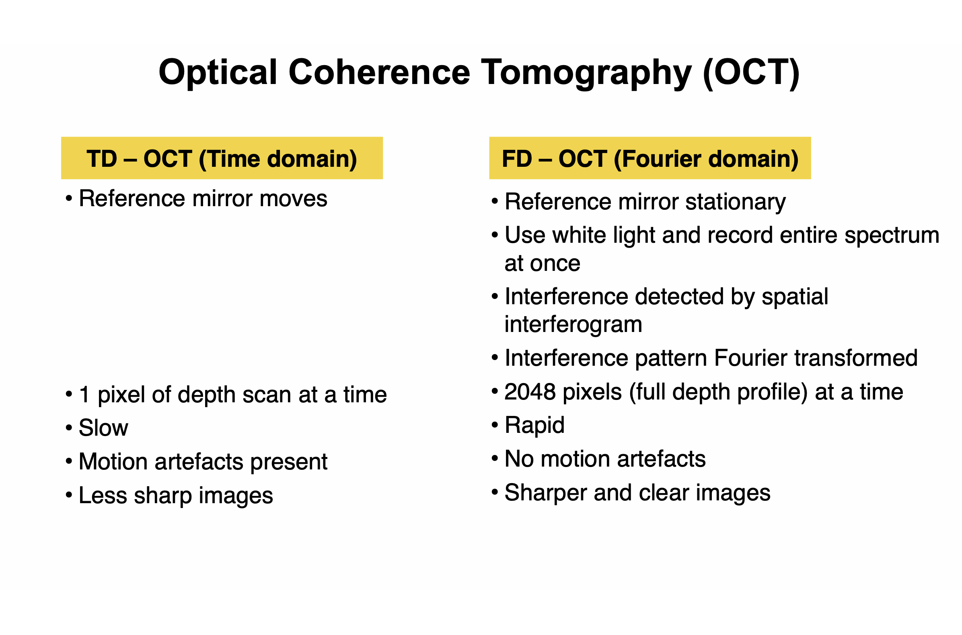
Q7
Explain in your own words the working principle of OCT in the Time Domain and in the Fourier Domain.
How can the two different instruments detect the 3D density of the tissue in X, Y and Z ?

