Slide 1
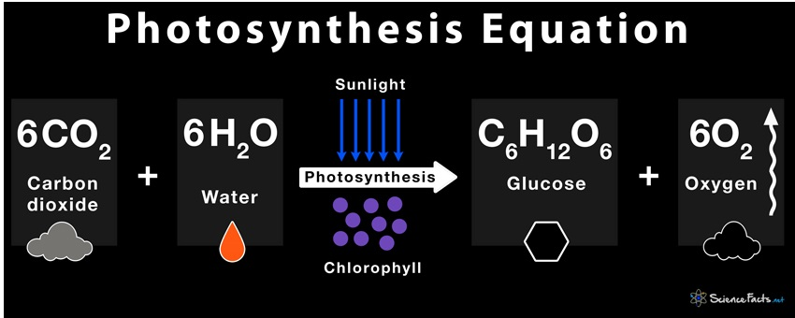

Slide 2
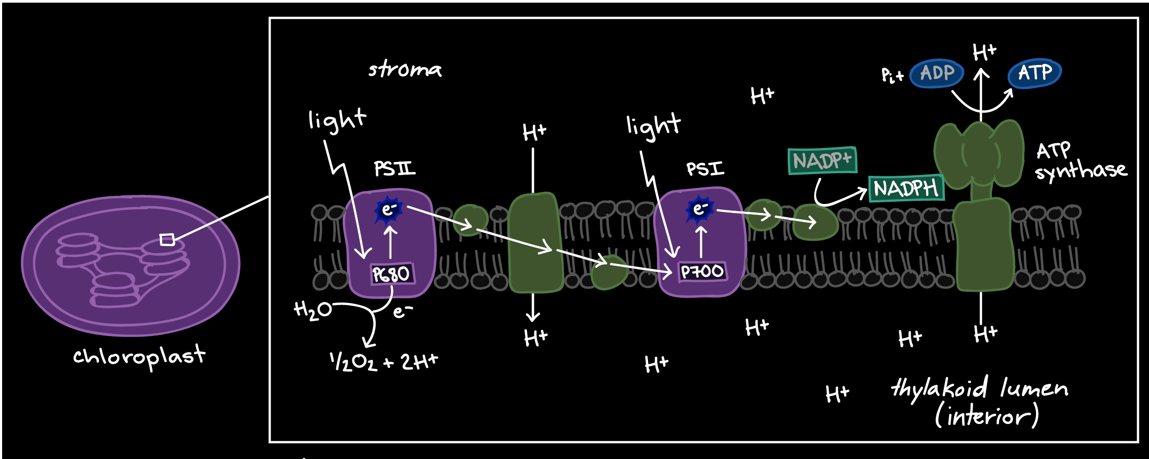

Slide 3
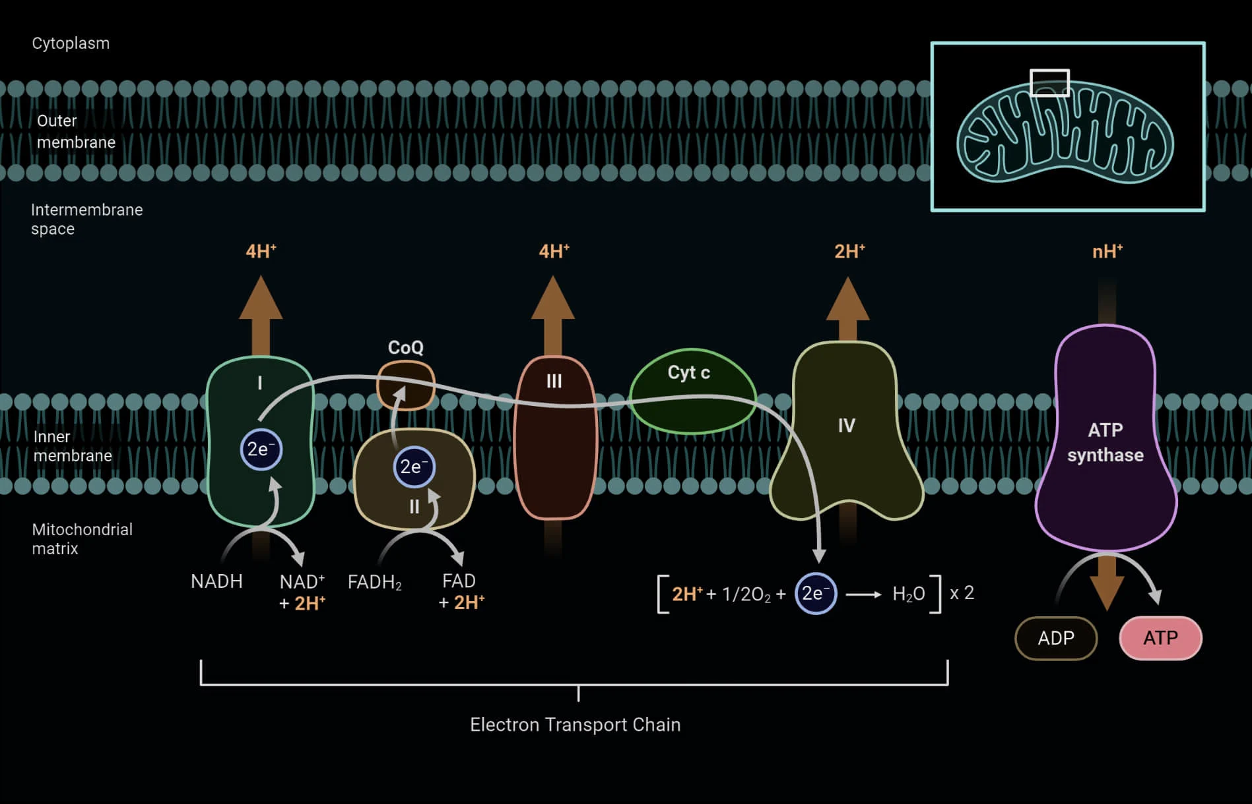

Slide 4
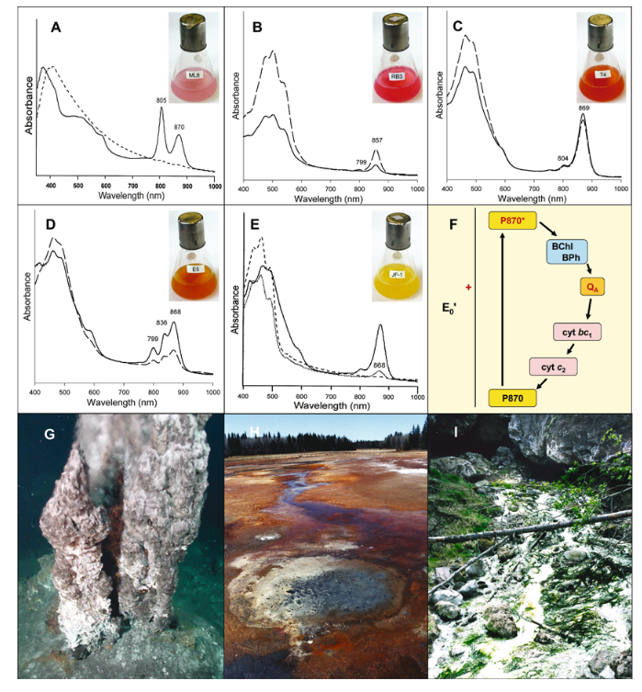

Slide 5
https://naturedocumentaries.org/10031/purple-bacteria-photosynthesis-chromatophore-molecular-structure/

Slide 6
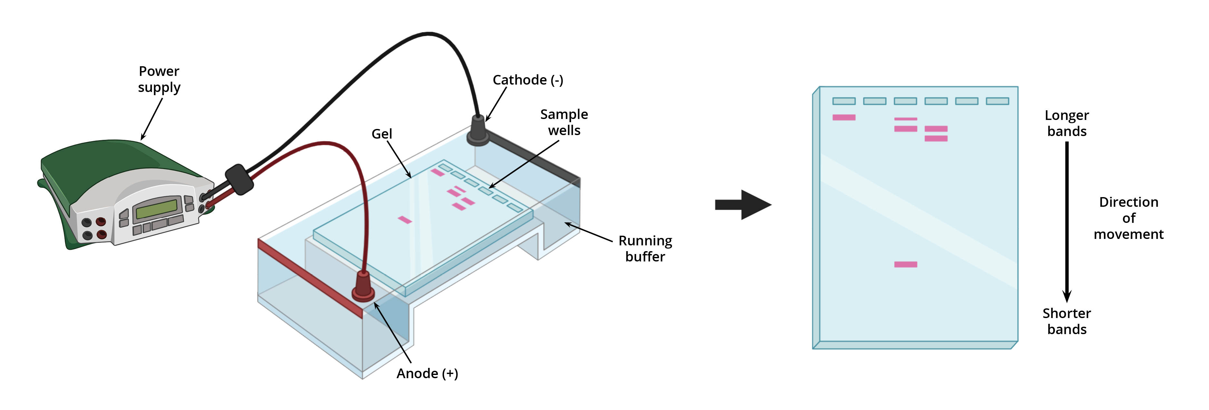
Electrophoresis

Slide 7
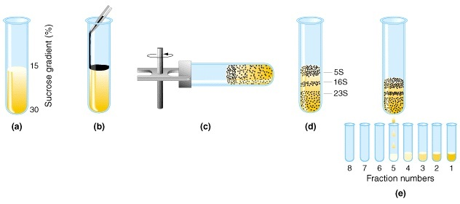
Sucrose gradient centrifugation
https://www.mun.ca/biology/scarr/Gr10-23.html

Slide 8
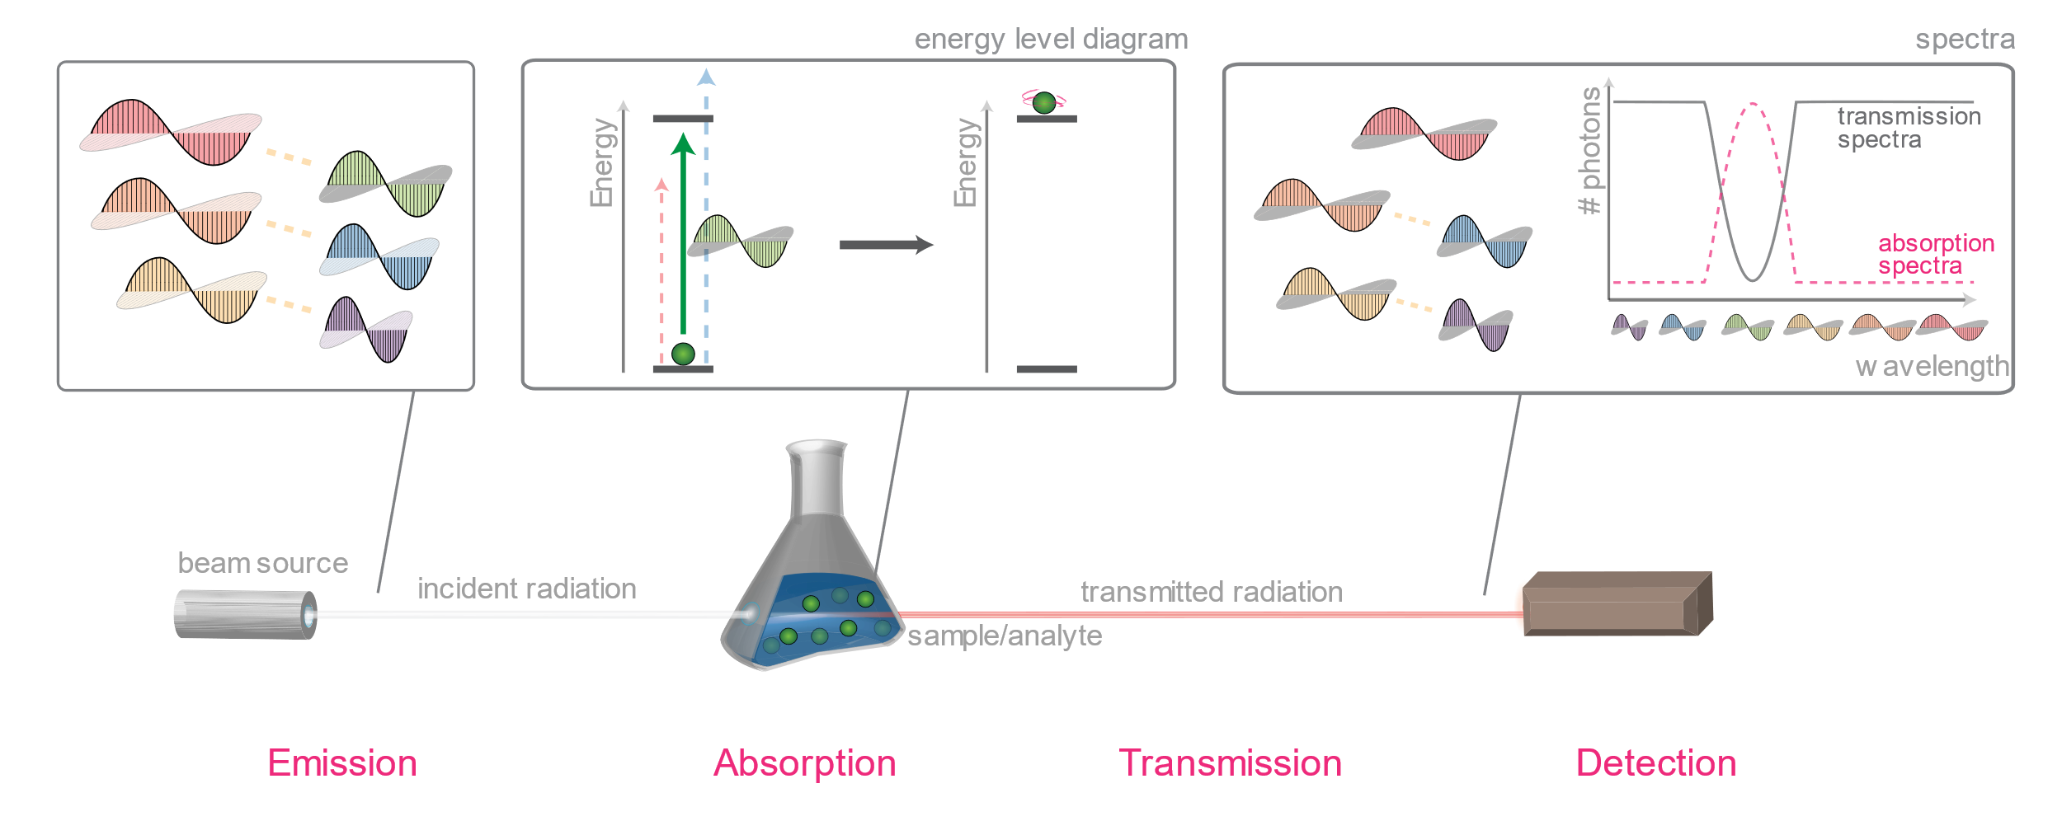
Spectroscopy

Slide 9
https://physicsworld.com/a/is-photosynthesis-quantum-ish/

Slide 10
https://www.youtube.com/watch?v=nqENuLk5bHA

