Slide 1

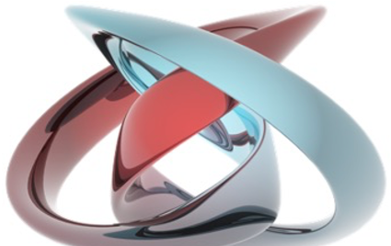
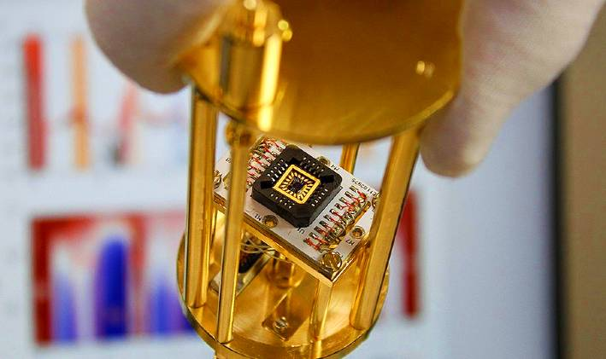
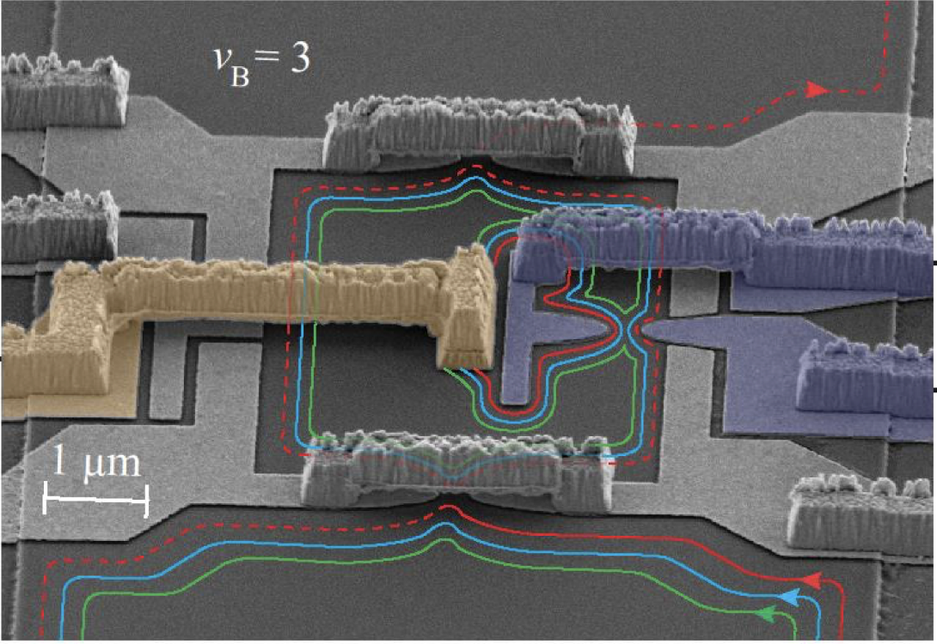
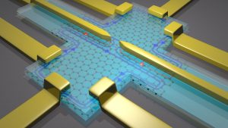
Laboratory of Quantum Physics: Topology and Correlations
Quantum transport in Mesoscopic systems
(PHYS-462)

Slide 2

Outlines
Twisted bilayer graphene
Introduction to moiré superlattices
Electronic structures
Fractal energy spectrum under magnetic field

Slide 3
Outlines
Introduction to moiré superlattices
Electronic structures
Fractal energy spectrum under magnetic field

Slide 4
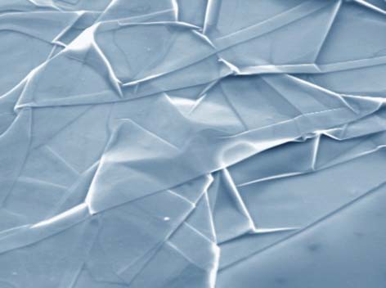
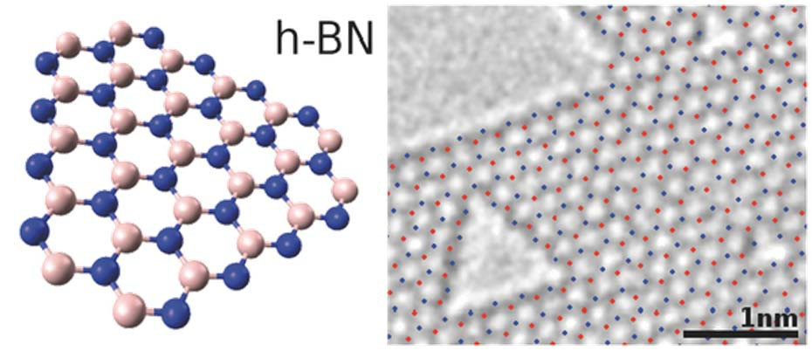
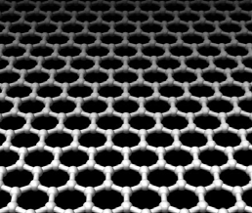
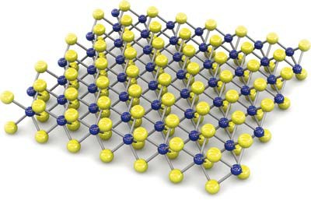
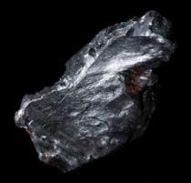
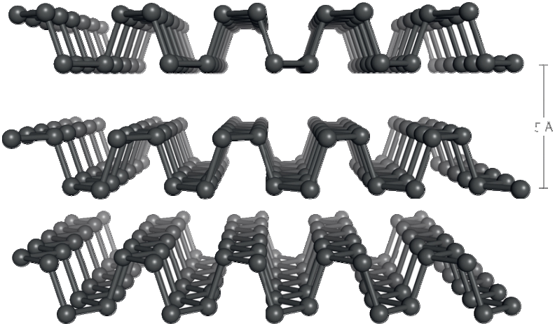
Family of Atomic Layers
Graphene hexagonal BN
TMDs
Phosphorene

Slide 5
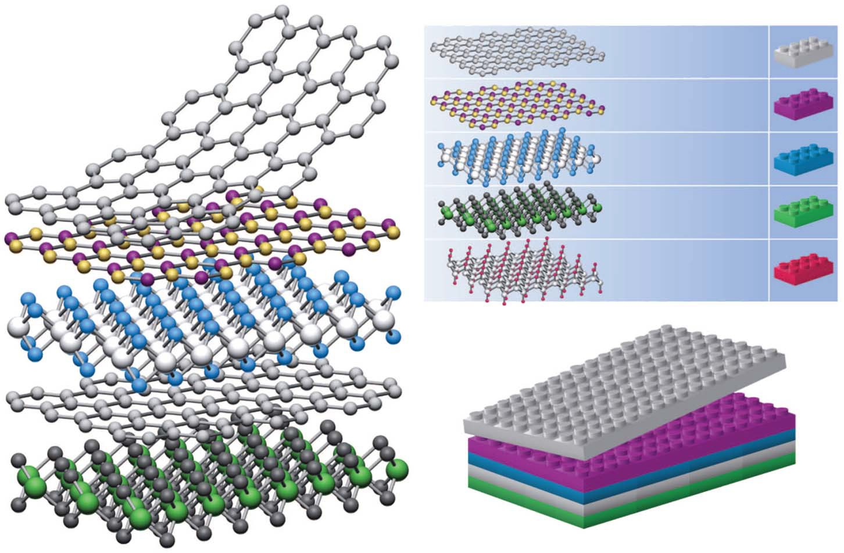
van der Waals Superlattice
graphene
hBN MoS₂ WSe₂
Fluorographene
A. K. Geim and I. V. Grigorieva, Nature 499, 419 (2013)
layer by layer stacking of 2-D lattices
→ extra periodicity along in-plane direction !!

Slide 6

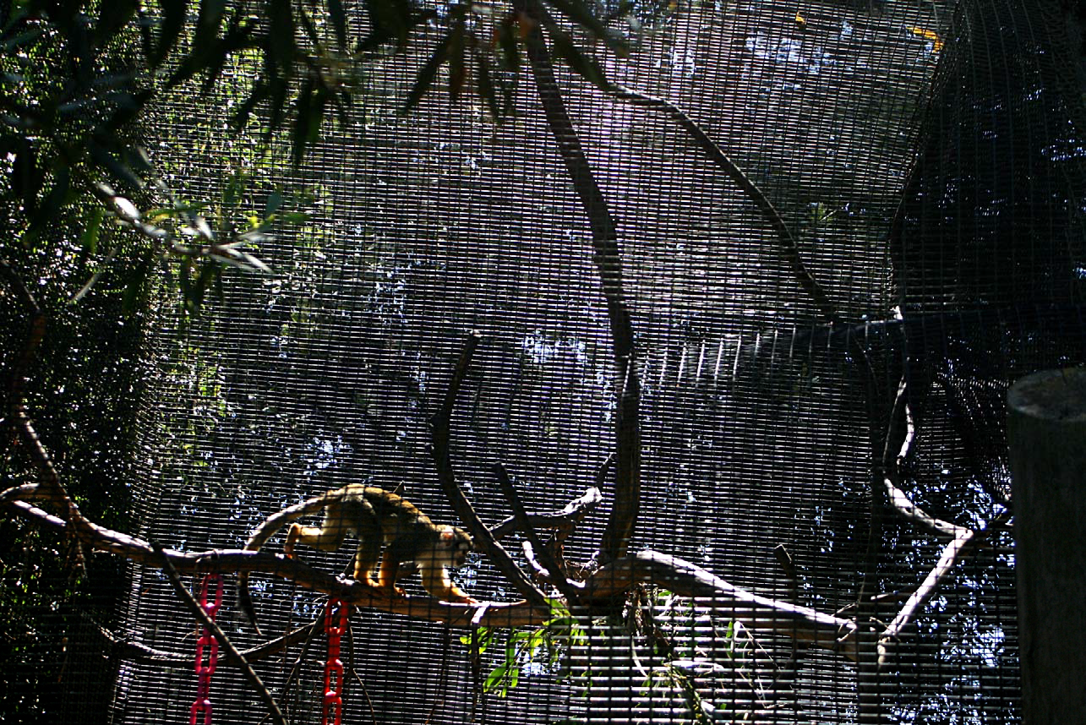
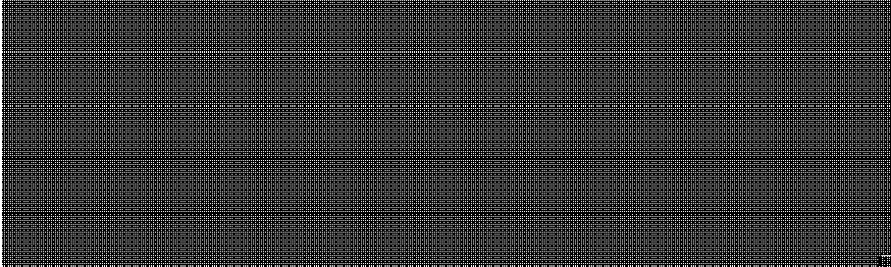
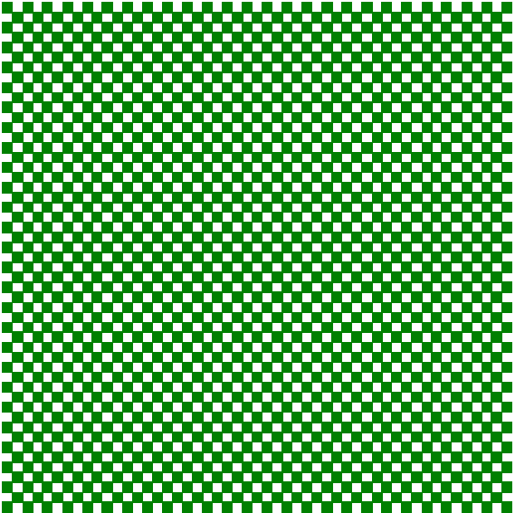
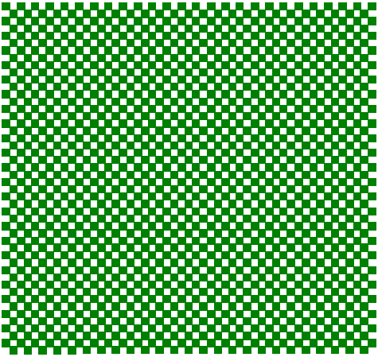
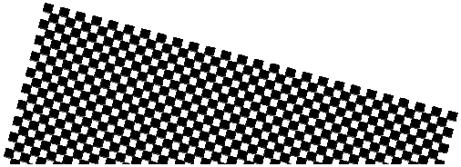
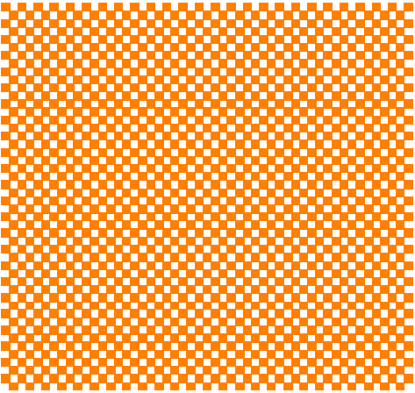
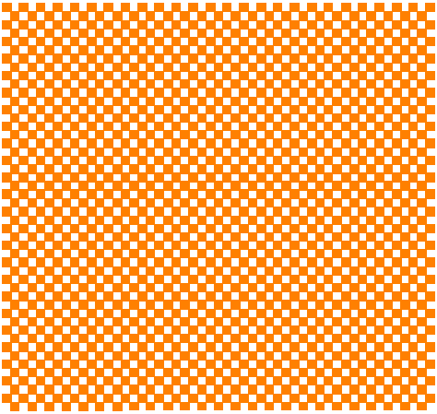
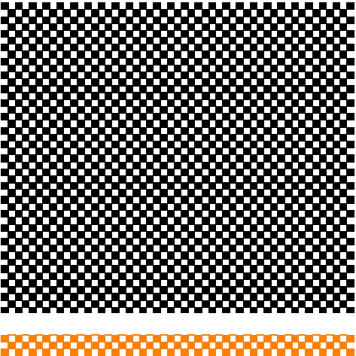
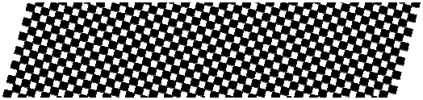
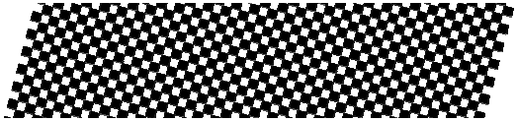
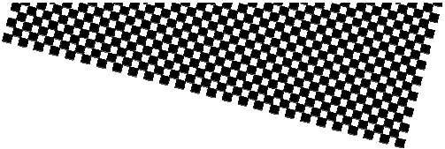

Moiré Pattern
Interference of periodic patterns
lattice period
difference in lattice period difference in lattice orientation
moiré interference in macroscopic world

Slide 7
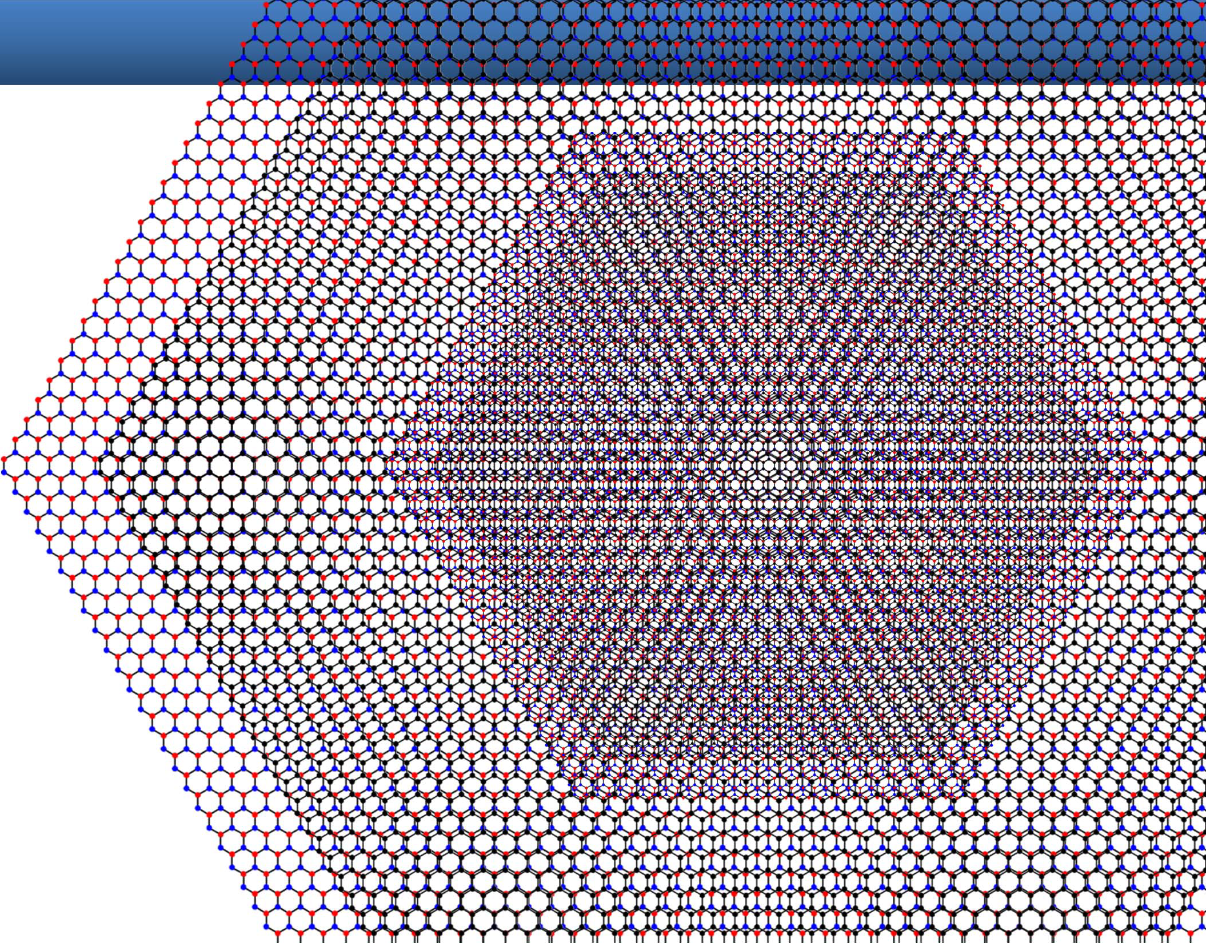
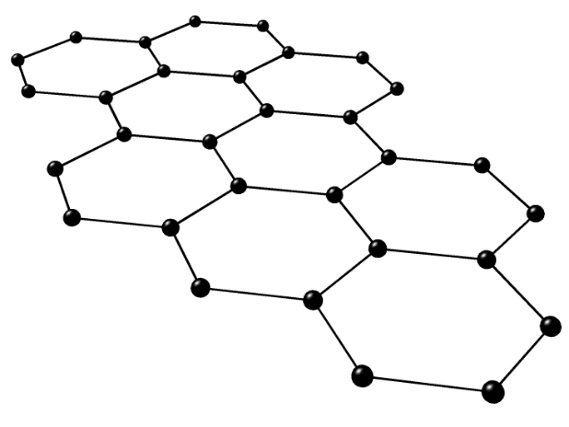
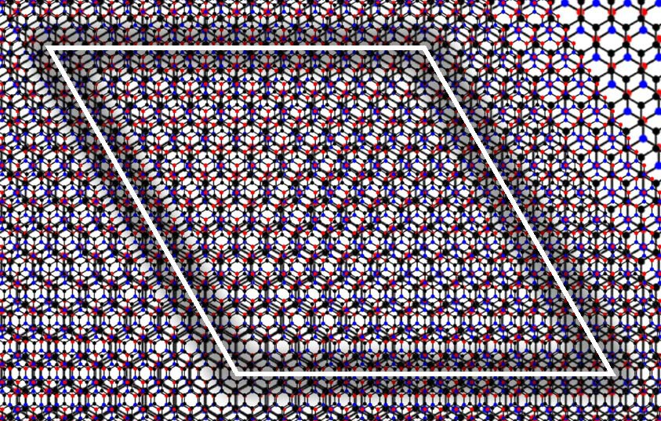
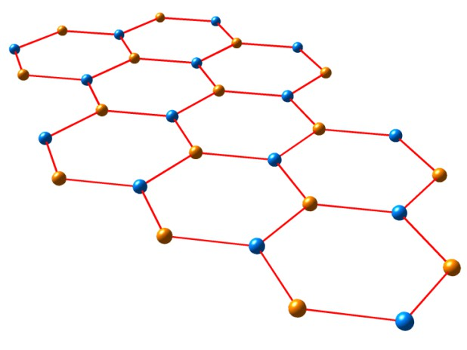
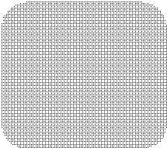
Moiré Superlattice: Graphene/hBN
a₀ = 0.246 nm
Graphene
L_{M}
a₀ = 0.250 nm
hexagonal BN
Related theory:
(1+ ε )
ε ² + 2 (1+ ε )(1− cosθ )
(ε: lattice mismatch,
θ : lattice misorientation)
Kindermann et al, PRB 86, 115415 (2012).
L_{M} =
a₀
Wallbank et al, PRB 87, 245408 (2013).
Jung et al, arXiv:1312.7723 (2013).
Moon and Koshino, PRB 90, 155406 (2014).

Slide 8
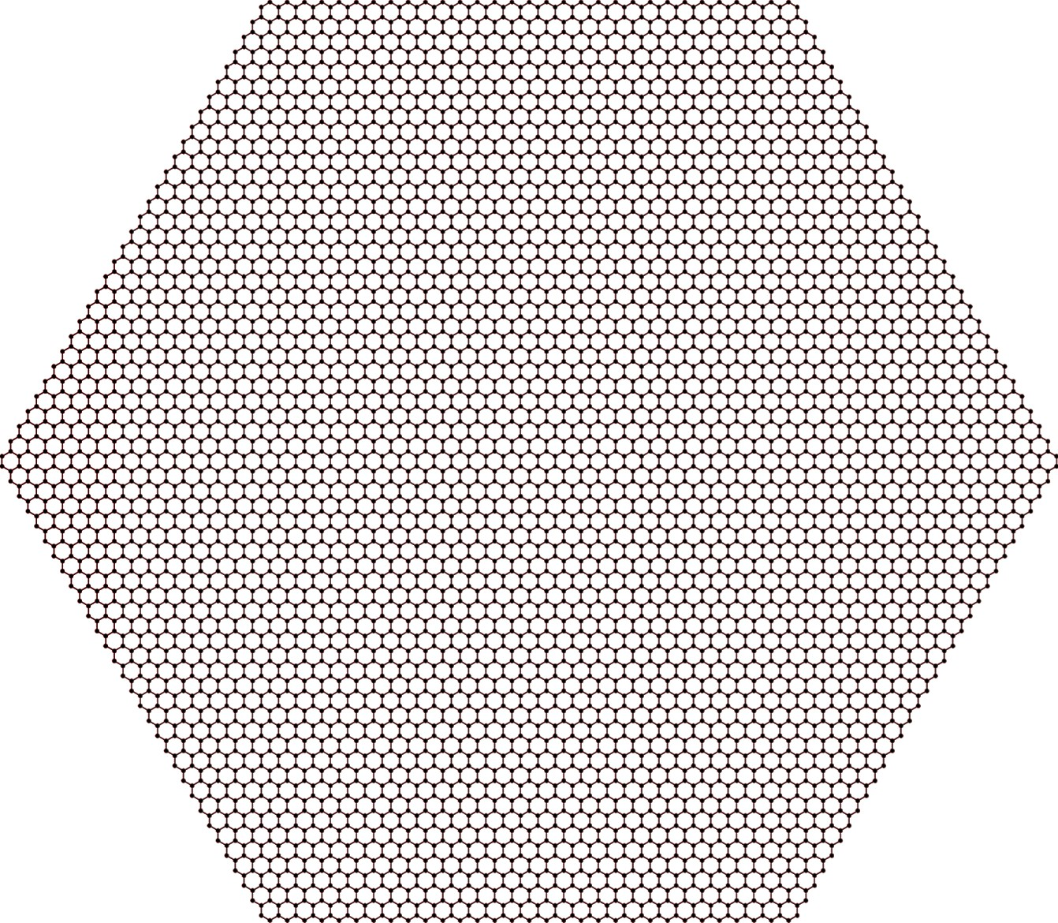
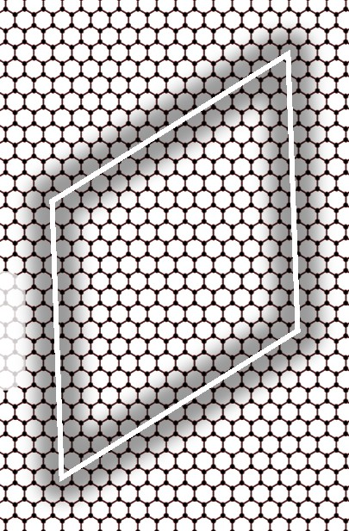
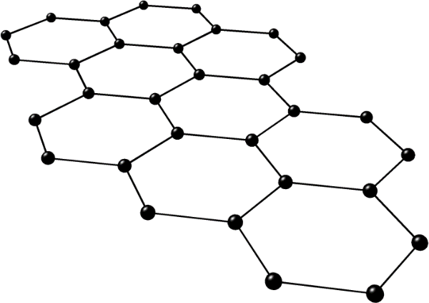
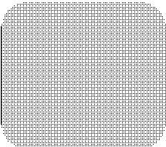
Moiré Superlattice: Twisted Bilayer Graphene
L_{M}
a₀ = 0.246 nm
Graphene
Related theory:
J. M. B. Lopes dos Santos et al., PRL 99, 256802 (2007).
S. Shallcross et al., PRL 101, 056803 (2008).
G. Trambly de Laissardière et al., Nano Lett. 10, 804 (2010).
E. J. Mele, PRB 81, 161405(R) (2010).
E. S. Morell et al., PRB 82, 121407(R) (2010).
Moon and Koshino, PRB 85, 195458 (2012).
Moon and Koshino, PRB 87, 205404 (2013).
Moon, Koshino, and Son, PRB 90, 155427 (2014).
L =
1
2 (1− cosθ )
a
0 (θ: lattice misorientation)
M

Slide 9
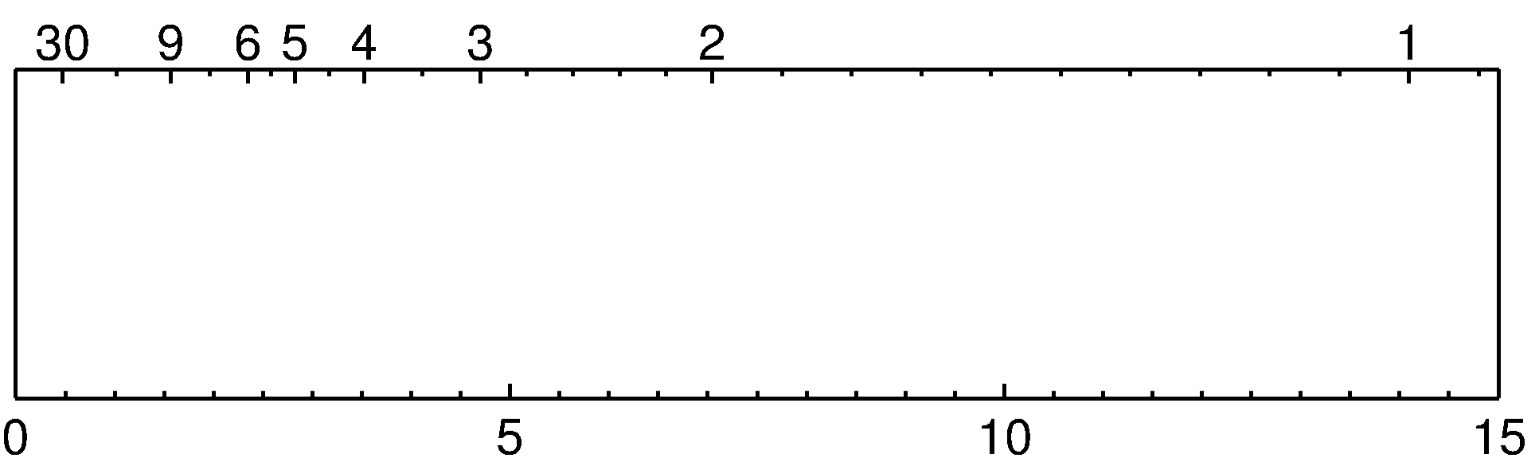
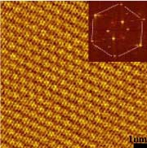
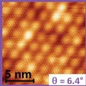
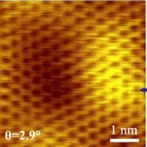
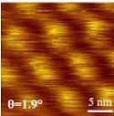
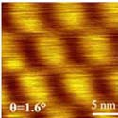
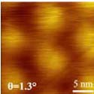
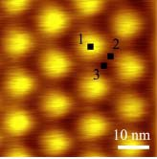
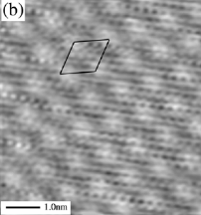
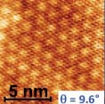
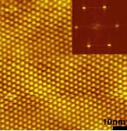
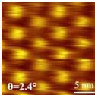
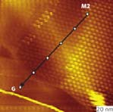
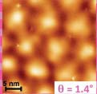
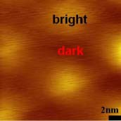
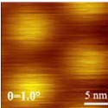
Lattice Period (Twisted Bilayer Graphene)
rotation angle (°)
moiré lattice constant (nm)
STM images (twisted bilayer graphene) from
J. Hass et al., PRL 100, 125504 (2008), G. Li et al., Nature Phys. 6, 109 (2010),
A. Luican et al., PRL 106, 126802 (2011), W. Yan et al., PRL 109, 126801 (2012),
I. Brihuega et al., PRL 109, 196802 (2012)
conventional materials: a₀ ~ 0.1-1 nm
moiré superlattices: L_{M} ~ 1-100 nm (*)
* tunable with interlayer registry

Slide 10
Outlines
Introduction to moiré superlattices
Electronic structures
Fractal energy spectrum under magnetic field

Slide 11

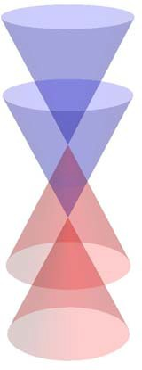
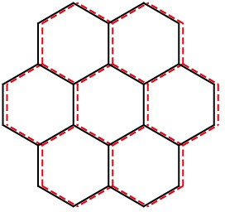

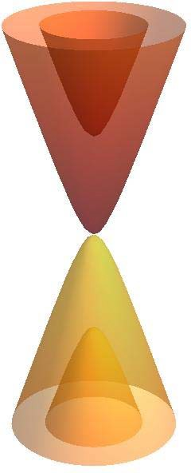




Regularly-stacked Bilayer Graphene
energy
AA-stack graphene
E = $±vp±γ_{1}$
linear (massless)
_{momentum} dispersion
energy
AB-stack graphene
parabolic (massive)
_{momentum} dispersion
($γ_{1}$ : interlayer coupling)
Purpose:
role of interlayer interaction in moiré superlattice
E = $±γ_{1}±\sqrt{v^{2}p^{2}+{\left(\frac{γ_{1}}{2}\right)}^{2}}$

Slide 12










Effective Model
Moiré structures (incommensurate) ≈
Continuous patchwork of commensurate structures
Local structure
≈ non-rotated bilayer with shift δ
δ=0
δ
δ
Interlayer coupling in moiré bilayer: U (δ (r ))
Moon and Koshino, Phys. Rev. B 87, 205404 (2013), Phys. Rev. B 90, 155406 (2014),
Moon, Koshino, and Son, Phys. Rev. B 90, 155427 (2014).

Slide 13

Brillouin Zone and Band Structure: Graphene
K
K’
K
K’
K
K’
Brillouin zone
Dirac cone

Slide 14

Band Structures

Slide 15



















Lowest (Degenerate) Conduction Bands
arxiv:1605.05475
from monolayer K′
K
r(1)
_{K}r(2)
-1
w=0
-1
80
$$\overline{K}$$
(1)
_{K}(2)
60
K
$$\overline{M}$$
40
$$\overline{K′}$$
$$\overline{Γ}$$
+1
w=0
+1
20
0 meV
from monolayer K

Slide 16






Band Structures: Twisted Bilayer Graphene
Moon and Koshino, Phys. Rev. B 85, 195458 (2012), Phys. Rev. B 87, 205404 (2013).
L
Fermi velocity
See also: J. M. B. Lopes dos Santos, N. M. R. Peres, and A. H. Castro Neto, PRL 99, 256802 (2007), S. Shallcross,
S. Sharma, and O. A. Pankratov, PRL 101, 056803 (2008), G. Trambly de Laissardière, D. Mayou, and L. Magaud, Nano Lett. 10, 804 (2010), E. J. Mele, PRB 81, 161405(R) (2010), E. Suárez Morell et al., PRB 82, 121407 (2010).

Slide 17
Outlines
Introduction to moiré superlattices
Electronic structures
Fractal energy spectrum under magnetic field

Slide 18



Moiré Superlattice in Magnetic field
B
B (tesla)
hybridized by U(δ(r))
B (tesla)
E (meV)
E (meV)
How the spectrum looks like?

Slide 19











How Nature
Electron in Periodic Lattice
allowed energies
_{e}-
orbidden nergies
“energy bands” (finite widths)
Felix Bloch
52, 555 (1929)
Electron in Magnetic Field
lowed
^{e-} nergies
“energy levels” (discrete)
Lev Landau
64, 629 (1930)*
...(*age 22)
Electron energy
Electron energy
al e
f e
harmonizes the two?
Zeitschrift für Physik
Zeitschrift für Physik

Slide 20







Electron in a Periodic Potential AND a Magnetic Field
E. Brown,
Phys. Rev. 133, A1038 (1963)
Zak,
J.
P
hys. Rev. 134, A1602 (1963)
M. Ya. Azbel,
J. Exptl. Theoret. Phys. 46, 929 (1964)
. Langbein,
hys. Rev. 180, 633 (1968)
R. Hofstadter,
ys. Rev. B 14, 2239 (1976)
P. G. Harper,
Proc. Phys. Soc. A68, 879 (1955)
D
P
D.
Ph
Energy
Magnetic flux

Slide 21




Hofstadter Butterfly
Energy (in unit of band width)
_{e}-
0
Φ ⎛ ₌ BA ⎞
1
_{Φ} ⎜
h / e ⎟
₀ ⎝ ⎠
Φ magnetic flux
Φ₀ magnetic flux quantum
B magnetic field
D. R. Hofstadter,
Phys. Rev. B 14, 2239 (1976)

Slide 22




Fractal (Self-Similar) Energy Spectrum
10
1.5
8
1st generation 2nd generation
6
1
4
0.5
2
0
0
−2
−4
−6
−0.5
−1.0
−8
−10
0
1 1 1 1
6 5 4 3
1
2
2 3 4 5
3 4 5 6
1
−1.5
1
5
6 5 4 3
2924 19 14
2
9
3 4 5 6
13 17 2125
1
4
0.02
0.15
4th generation
3rd generation
0.015
0.1
0.01
0.005
0.05
0
0
−0.005
−0.05
−0.01
−0.1
−0.015
−0.02
24
115
43
206
62 81 100 119
297 388 479 570
19
91
−0.15
5
24
29 24 19 14
139115 91 67
9
43
13
62
17 21 25
81 100119
4
19
139115 91 67
666551 436 321

Slide 23

Condition to Observe Hofstadter Butterfly
The two scale are quite different !!
unit cell size
L (~ 0.1 nm)
magnetic length
l_{B} = $ℏ$ / (eB)
B (T)
l_{B} (nm)
1
10
⁞
10,000
25.7
8.11
⁞
0.257

Slide 24





^{Φ} = ^{BA} ∝ O (1)
Φ₀ h / e
Hofstadter Butterfly by High Magnetic Field
B ~ O(10⁴ T) for usual crystalline solids [L ~ O(0.1 nm)]
45 T, continuous, NHMFL, USA
730 T, pulsed, destructive (but not destroying the lab),
ISSP, Japan
e ,
VNIIEF, Russia
image court
Energy (in unit of band width)
2,800 T
1
0
Φ / Φ ₀ (∝ B )
~80,000 T
2,800 T, puls
d, blowing off the lab (bunker)
esy of Dr. Chuck Mielke (LANL)
spectrum obtained by blowing off the facility

Slide 25

Hofstadter Butterfly by Large Lattice
^{Φ} = ^{BA} ∝ O (1)
Φ₀ h / e
B₀ (Tesla)
feasible magnetic field
Unit cell length (nm)
ordinary crystalline lattice

Slide 26







Hofstadter Butterfly by Large Lattice
Moiré S
superlattice stacking of
uperlattice
by incoherent atomic lattices
θ = 0°
θ = 4°
θ = 8°
Φ / Φ₀ ≥ 1 R. Bistritzer and A. H. MacDonal (strong field regime) Phys. Rev. B 84, 035440 (2011).
Φ / Φ₀ ≥ 0 Moon and Koshino,
(entire regime) Phys. Rev. B 85, 195458 (2012)
d,
Hofstadter butterfly at moderate B !
.

Slide 27







Bilayer graphene / hBN
Monolayer graphene / hBN
B. Hunt, J. D. Sanchez-Yamagishi, A. F. Young,
M. Yankowitz, B. J. LeRoy, K. Watanabe,
T. Taniguchi, P. Moon, M. Koshino,
P. Jarillo-Herrero, and R. C. Ashoori, Science 340, 1427 (2013).
C. R. Dean, L. Wang, P. Maher, C. Forsythe,
F. Ghahari, Y. Gao, J. Katoch, M. Ishigami,
P. Moon, M. Koshino, T. Taniguchi, K. Watanabe,
K. L. Shepard, J. Hone, and P. Kim,
Nature 497, 598 (2013).
( : theory)

Slide 28

Quantum Hall Effect in Twisted Bilayer Graphene
Y. Kim, P. Herlinger, P. Moon, M. Koshino, T. Taniguchi, K. Watanabe, J. Smet, arXiv:1605.05475 (2016)

