Slide 1

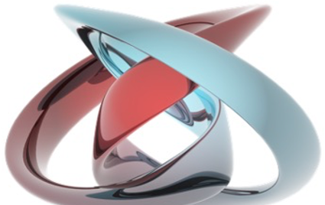
mesoscopic and nanoscale physcis
Laboratory of Quantum Physics: Topology and Correlations
Quantum transport in Mesoscopic systems
(PHYS-462)
Mitali Banerjee (LQP)
mesoscopic physics deals with the physics of small objects consisting of a collection of atoms
nanometer scale
Length scale
atoms
molecules & clusters
electron mean free path
bulk materials
micro
meso
macro
Ref: Supriyo Dutta/ H.S.J. van der Zant (TU Delft)

Slide 2
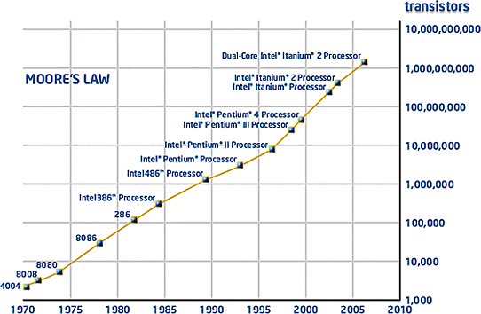
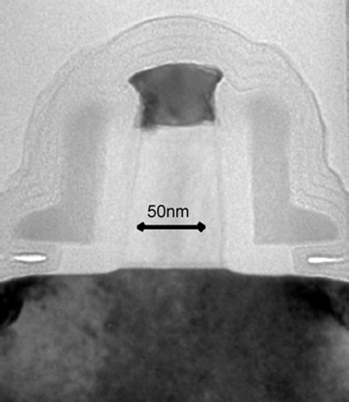
modern electronic devices belong to mesoscopic scale
The development of the modern microelectronics industry is made possible by IC technology: the INTEGRATION of large numbers of TRANSISTORS into densely-packed integrated circuits
To satisfy the demand for IC with improved MEMORY and SPEED characteristics the size of transistors (nowadays: submicron) continues to SHRINK at a RAPID rate
The SCALING of transistor sizes in integrated circuits is governed by an EMPIRICAL principle known as MOORE’S LAW
TRANSISTOR WITH 50 nm GATE LENGTH BY INTEL Corp.
MOORE’S LAW … THE TRANSISTOR DENSITY ON A CHIP DOUBLES EVERY EIGHTEEN MONTHS

Slide 3
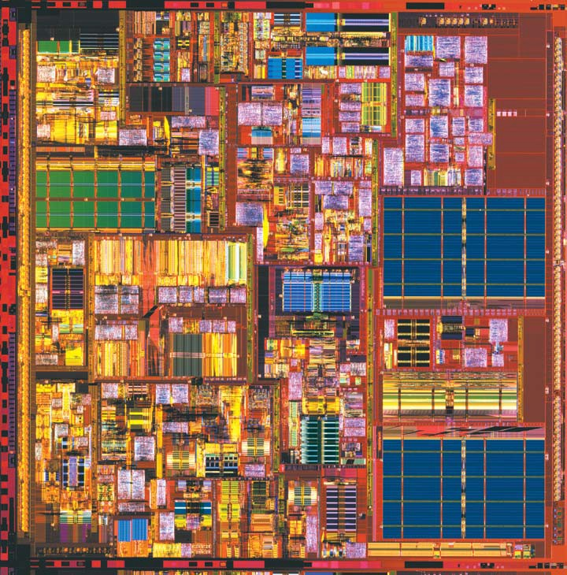
CMOS Technology
Intel’s Prescott processor (released March 2004):
150 million transistors
90 nm design rules
3.4 GHz clock frequency
DRAM chips:
4 Gb chips demonstrated (~ 10⁹ transistors/cm²)
Intel’s Norwood (Pentium 4 -
130 nm)
processor
We are already inside nanotechnology!

Slide 4
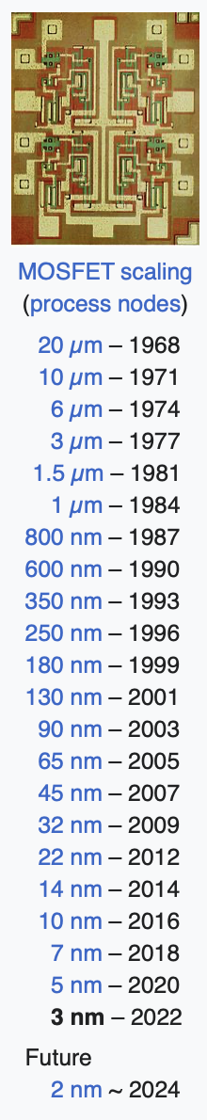
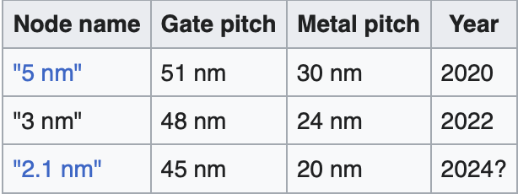
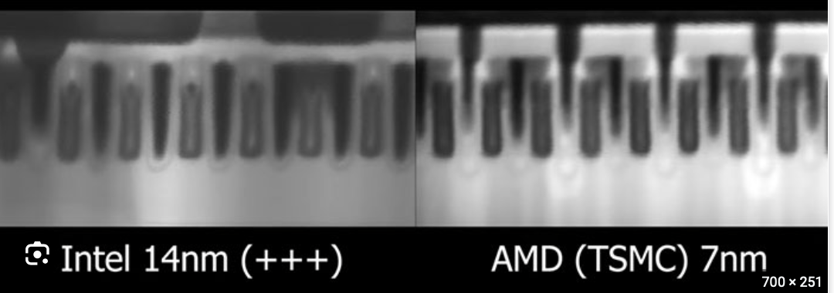
modern electronic devices belong to mesoscopic scale

Slide 5
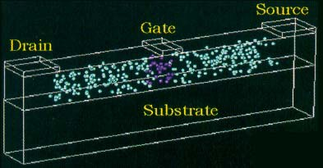
modern integrated circuits cannot be scaled down to the atomic level
When the thickness of the GATE OXIDE in MOSFETs is reduced to less than few nm TUNNELING between the gate and channel can become a serious problem
The definition of WELL-DEFINED doping profiles becomes extremely DIFFICULT
As the DISCRETE nature of the dopants becomes resolved the electrical behavior of transistors should exhibit large device-to-device FLUCTUATIONS
A TRANSISTOR STRUCTURE WITH A GATE THAT IS 24 nm LONG AND 42 nm WIDE
… THERE ARE ONLY ROUGHLY 36 DOPANTS UNDER THE GATE!

Slide 6
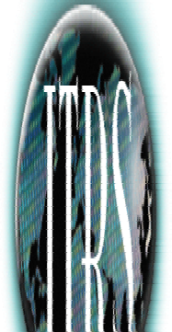

mesoscopic and nanoelectronics
The reduction of device dimensions to the NANOMETER scale offers the possibility of realizing a range of NEW technologies, which are based on the exploitation of QUANTUM- MECHANICAL transport phenomena
DEVICE | RESONANT TUNNELING DIODE | SINGLE ELECTRON TRANSISTOR | RAPID SINGLE QUANTUM FLUX LOGIC | QUANTUM CELLULAR AUTOMATA | NANOTUBE DEVICES | MOLECULAR DEVICES
TYPES | 3-Terminal | 3-Terminal | Josephson Junction + Inductance | Electronic & Magnetic | 3-Terminal | 2-Terminal & 3-Terminal
ADVANTAGES | Density Performance RF | Density Power Function | High Speed Robust | High Density Speed Low Power | Density Power | Molecular Functionality Size
CHALLENGES | Matching Device Properties Across Wafer | New Device, Dimensional Control, Noise, Lack Drive Current | Low Temperatures, Complex Circuitry | Limited Fan Out, Dimensional Control, Architecture | New Device & System, Difficult Route for Circuit Fabrication | Stability,
MATURITY | Demonstrated | Demonstrated | Demonstrated | Demonstrated | Demonstrated | Demonstrated
SOURCE: NATIONAL TECHNOLOGY ROADMAP FOR SEMICONDUCTORS
2001 Ed., http://public.itrs.net/

Slide 7
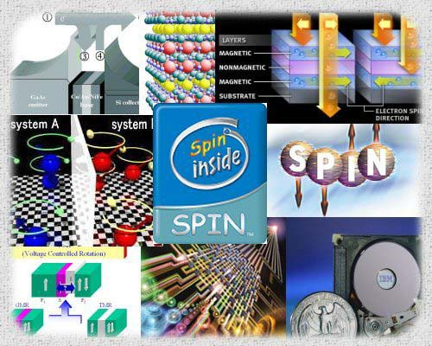
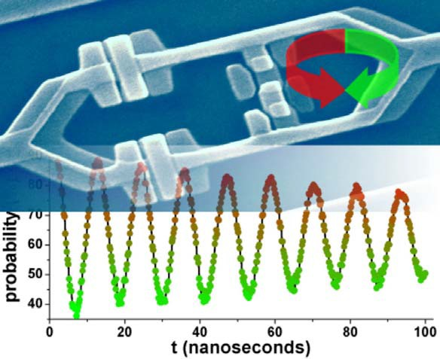
a few other examples of new device concepts (not treated in this course)
QUANTUM COMPUTING in which the SUPERPOSITION states of quantum-mechanical systems are exploited to implement purely QUANTUM-MECHANICAL algorithms for computing with MASSIVE speedup compared to classical calculations (for some types of problems)
SPINTRONICS: devices in which the intrinsic electron spin states electron are used to realize new logic devices
OPTOELECTRONIC devices that can be used to generate or detect radiation with SINGLE photon accuracy

Slide 8
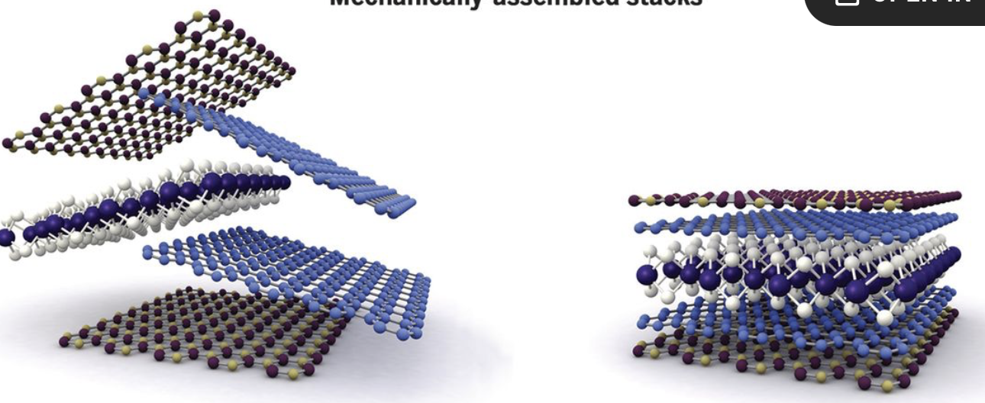
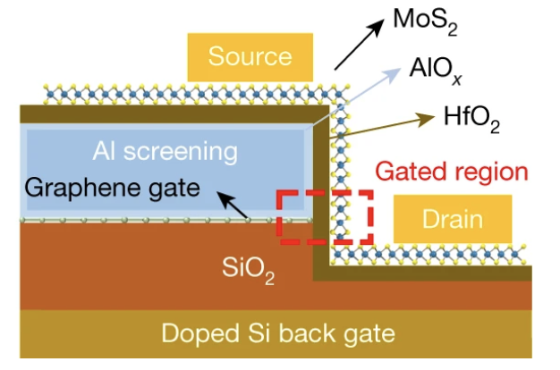
2d van der Waals materials: can go extra mile?
Nature volume 603, pages 259–264 (2022)

Slide 9
this course: mesoscopic and nanoscale physics
The development of new technologies requires a FULL understanding of the basic QUANTUM MECHANICAL, ELECTRONIC-TRANSPORT processes that occur in nanoelectronic devices
The AIM of this course is to develop an understanding of the basic PHYSICS of electron transport in nanostructures involving concepts such as:
⇒ QUANTIZATION of the electronic density of states and its implications for the electrical properties of nanostructures
⇒ CONDUCTANCE QUANTIZATION due to ballistic transport in low-dimensional electron systems
⇒ QUANTUM-INTERFERENCE phenomena arising from the wave-mechanical properties of the electron
⇒ TUNNELING AND COULOMB BLOCKADE phenomena
⇒ QUANTUM HALL EFFECT: integer and fractional
⇒ THERMAL CONDUCTANCE: universal quantization

Slide 10
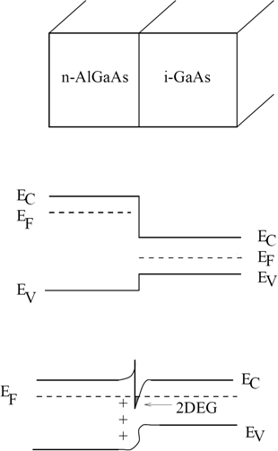


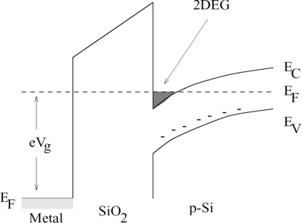
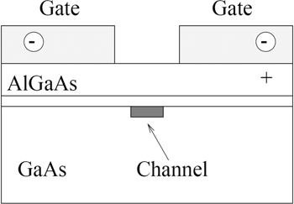
two-dimensional electron gas
2DEG is a generic object for new physics
band gap engineering
Nobel Prizes 1985, 1998,
2000
It serves as a building block for electronic devices
Metal-Oxide- Semiconductor (MOS) structures
2DEG is formed at the semiconductor-insulator interface
semiconductor heterostructure
2DEG is formed at the interface between two semiconductors
gates define device structures

Slide 11






rewrite using
rewrite using

Slide 12

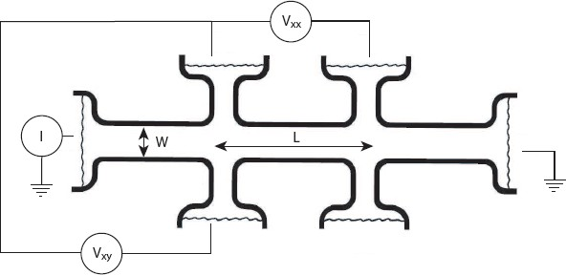
Resistance per Square
2D: resistivity and resistance: same units
resistance per square example: Hall bar

Slide 13

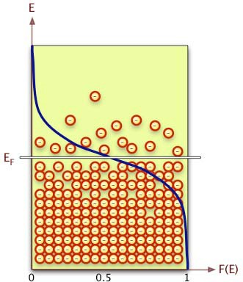

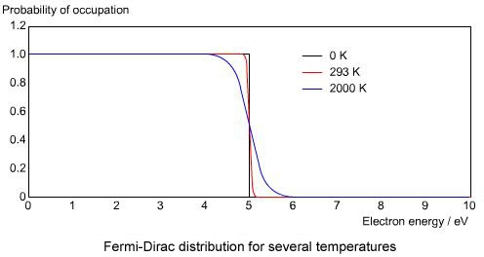
Fermi-Dirac distribution
mK
meV

Slide 14


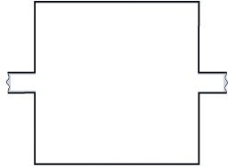
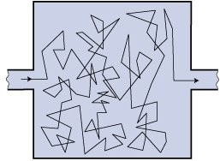
diffusion constant
`

Slide 15
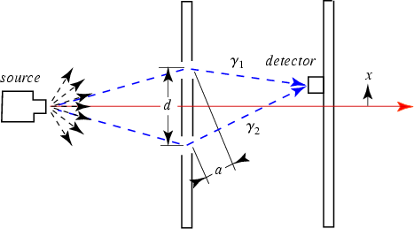




L₁
L₂
interference
interference suppressed to 1 / e
ballistic
diffusive
due to interactions...
randomized

Slide 16

finite due to coupling of electrons to environment: dynamic scattering mechanisms
electron phonon scattering
electron – electron scattering
large energy exchange
quasi elastic scattering (Nyquist mechanism)
spin flip scattering (magnetic impurities)
electron – photon scattering
etc

Slide 17
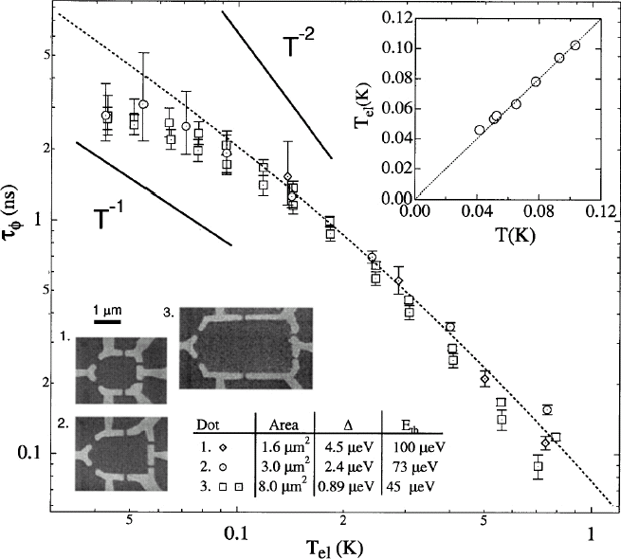


Huibers et al., PRL 1999
e-e direct
e-e quasi-elastic (Nyquist)
e-phonon: small (T < 1K)

Slide 18


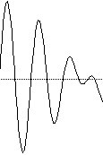


: thermal smearing
L
kT
λ₁
E₁
λ₂
+
E₂
ballistic
diffusive

Slide 19

ratio of Coulomb energy to kinetic energy
characterizes “strength” of electron interactions
non interacting weakly interacting
strongly interacting

Slide 20
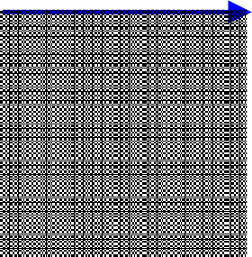



B
flux quantum
magnetic flux = A . B = L^{2 .} B

Slide 21
Thouless Energy
crossing time: L/v_{F}
Thouless energy: E_{T} =
~V_{F}
L
E_{T} =
~V
√
F
A

Slide 22
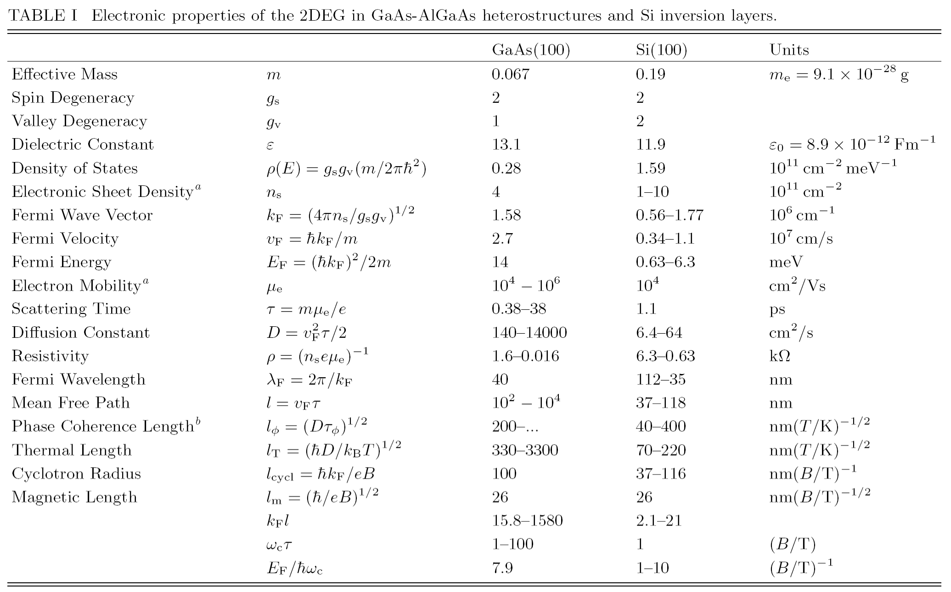

Slide 23
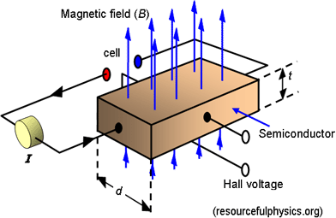
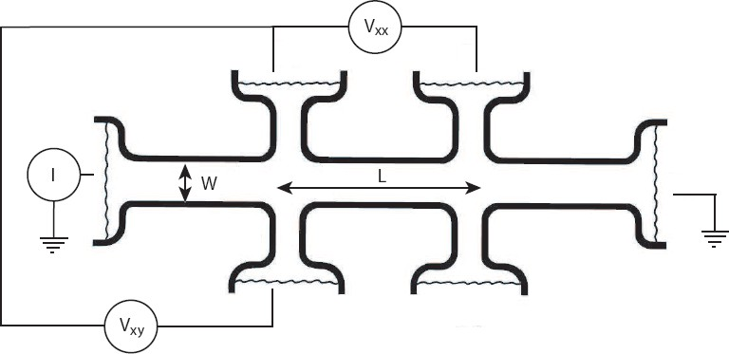



2D: thickness t drops out
Hall bar

Slide 24

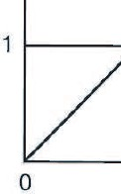


/ ρ
^{ρ}xx
^{ρ}xy
^{ρ}xx

Slide 25


B
cyclotron frequency, radius
quantization condition: circumference = N λ_{F}

Slide 26
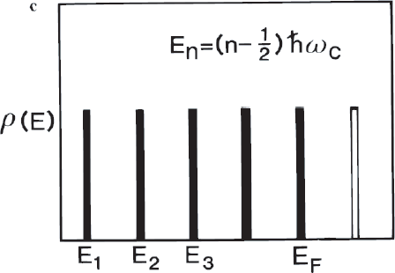

density of states
Landau levels

Slide 27

all zero field states within range in energy of ħω_{c} condense in one Landau level
Landau level filling factor
number N of Landau levels with E < E_{F} : integer

Slide 28
Quantum Hall Effect: Transport
ν = N : scattering possible, resistance
disorder broadening

Slide 29
Quantum Hall Effect: Transport
ν <> N : scattering NOT possible, ZERO resistance (ρ_{xx})
E_{F}
disorder broadening

Slide 30
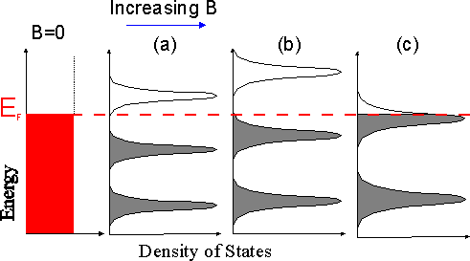
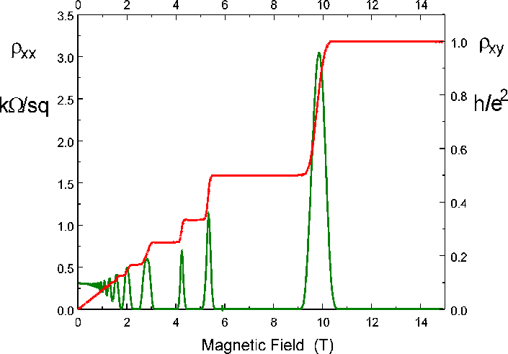

Quantum Hall Effect: B dependence
Integer Quantum Hall Effect

Slide 31
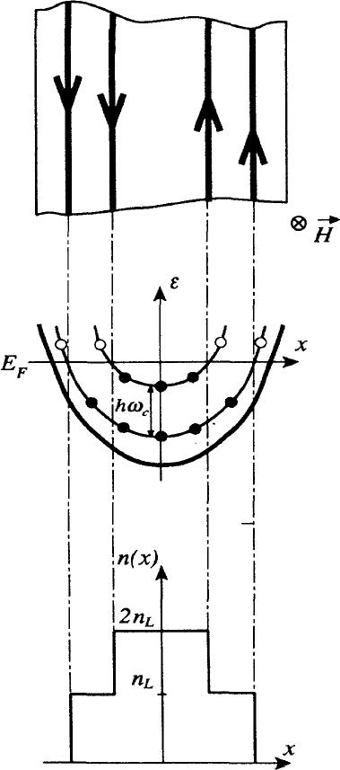
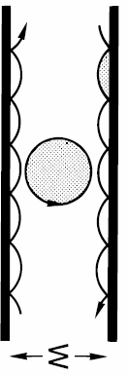
Quantum Hall Effect: edge states / skipping orbits

Slide 32
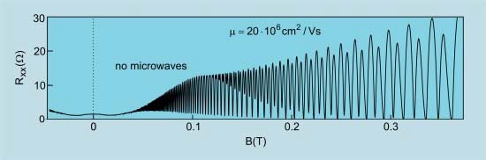


Shubnikov-de-Haas Oscillations
orbital Landau levels
spin polarized Landau levels

Slide 33

three cases:
free electrons in magnetic field (U = 0)
confined, B = 0 (constriction, QPC)
confined and in magnetic field

Slide 34





Slide 35



harmonic oscillator
... textbook ...
zero point energy pure quantum effect no classical analog

Slide 36



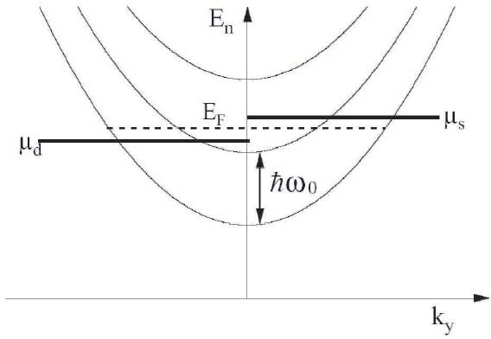

... textbook ...
as for free electrons

Slide 37

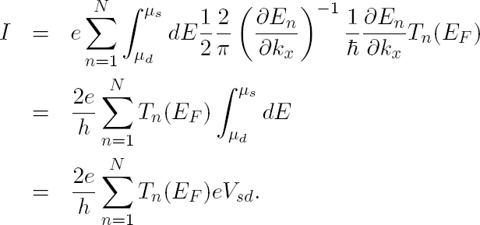
Transport through a Constriction
QUANTIZED!!

Slide 38



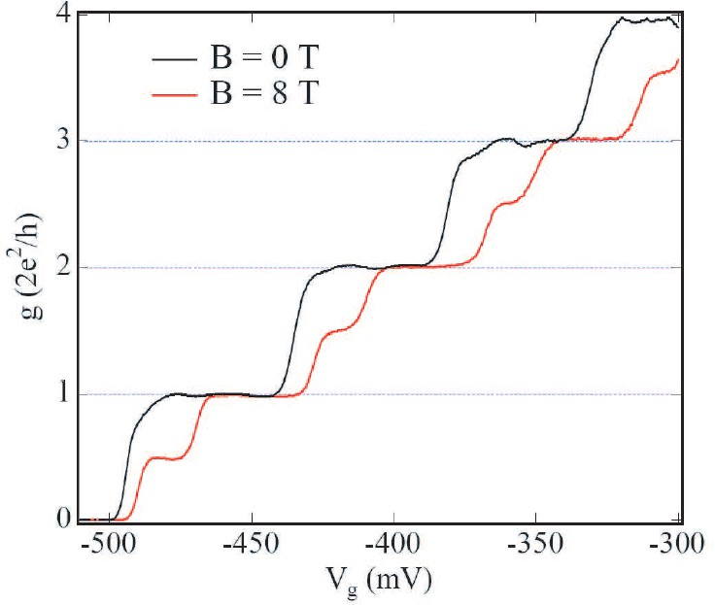
Transport through a Constriction: Conductance Quantization

Slide 39

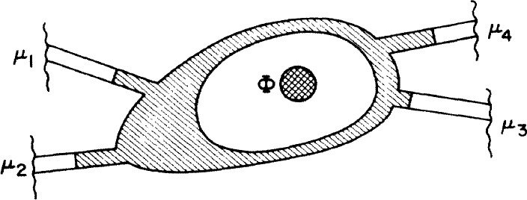


Landauer – Büttiker Formalism
greek: leads roman: modes

