Slide 1
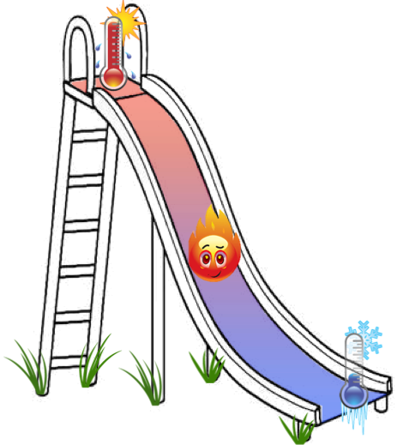
quantization of heat flow

Slide 2
Pendry’s theory for 1D heat transport
1D channel
non-interacting particles
J B Pendry
Quantum limits to the flow of information and entropy
J. Phys. A: Math. Gen. 16 (1983) 2161-2171
thermal energy = temperature x entropy
entropy = log 2 x information
universal upper limit of information transfer
hence, a limit of thermal conductance KT < κ₀T

Slide 3
1D ballistic transport
quantum of thermal conductance

Slide 4
Wiedemann – Franz ballistic 1D channel
for non-interacting electrons

Slide 5
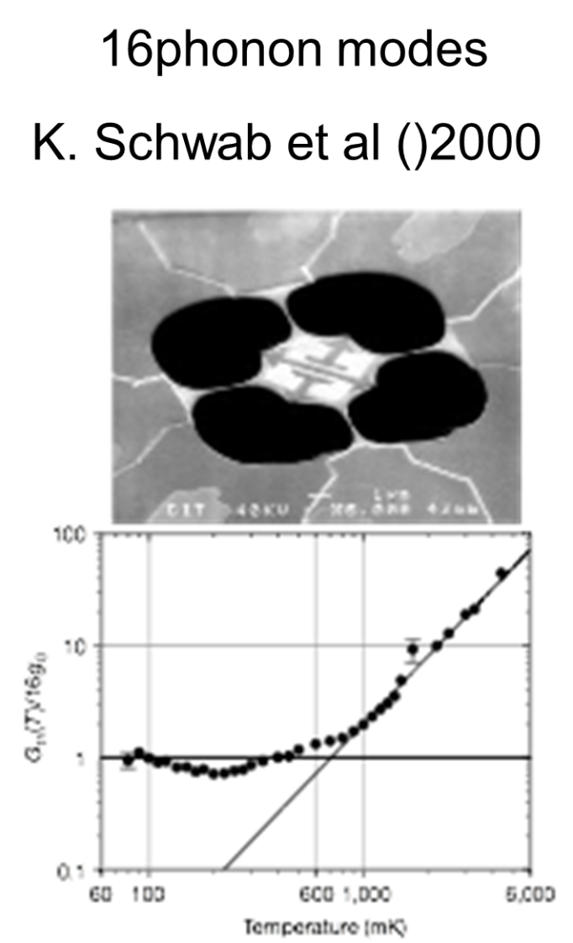
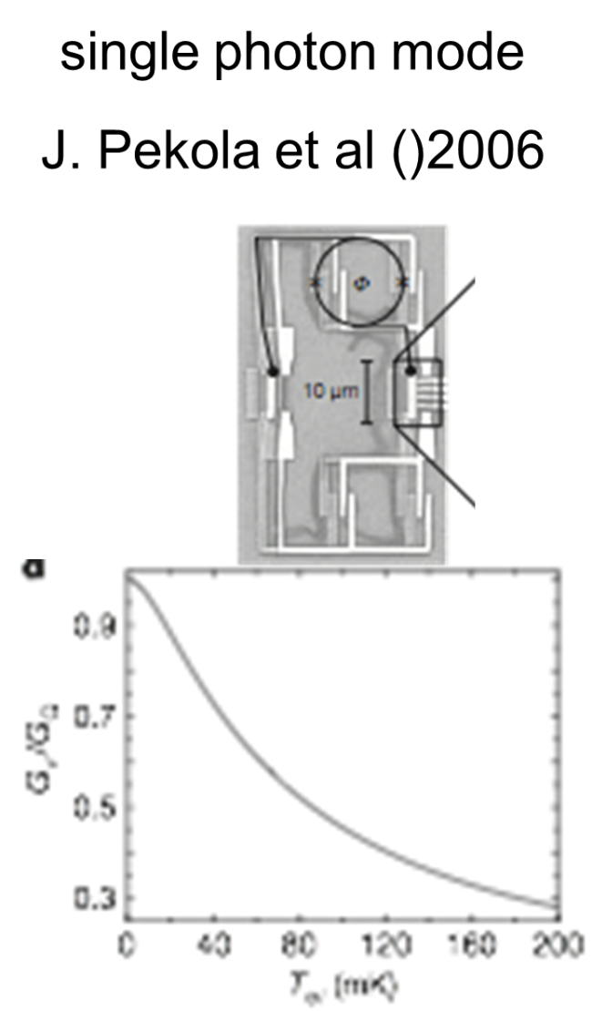
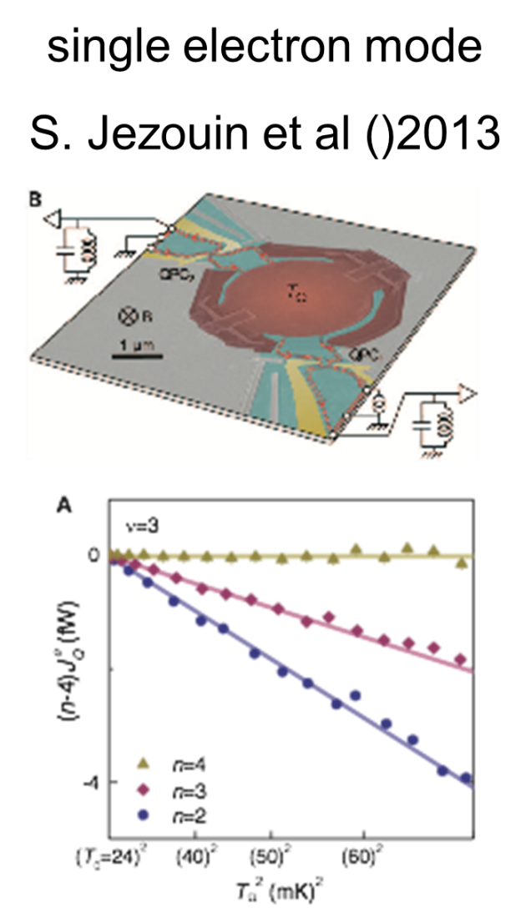
past experiments…. in accord with theory
16 phonon modes single photon mode single electron mode
Schwab et al, 2000 Meschke et al, 2006 Jezouin et al, 2013
Wiidemann – Franz

Slide 6
Pendry’s general theory of non-interacting particles in 1D
was extended for interacting particles
our 1D interacting system……FQHE
Kane, C. L. & Fisher, M. P. A.
Quantized thermal transport in the fractional quantum Hall effect
Phys. Rev. B 55, 15832–15837 (1997)
interactions should not affect
the thermal conductance
Κ ≤ κ₀
_{Wiedemann - Franz breaks down}

Slide 7
without reproducible interference in fractional states…
thermal transport may distinguish
non abelian vs abelian

Slide 8
why thermal conductance K ?
topological number, determined by bulk wave - function
reveals the NET chirality of modes….down - up
independent of edge – reconstruction….may add modes
may provide proof of non-abelian states (w/ Majorana)

Slide 9
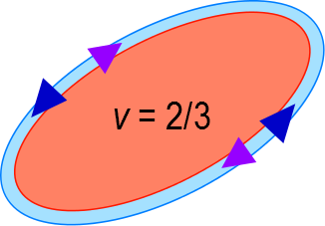
particle - like ν = 1/3
Κ = κ₀
hole - like ν = 2/3 polarized
v = 2/3 = 2/3 – neutral_{upstream}
Κ = 0
Kane, C. L., Fisher, M. P. A. & Polchinski, J.
Randomness at the edge:
theory of quantum Hall transport at filling 2/3
Phys. Rev. Lett. 72, 4129–4132 (1994)

Slide 10
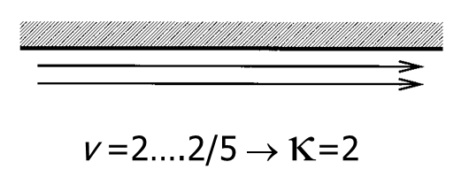
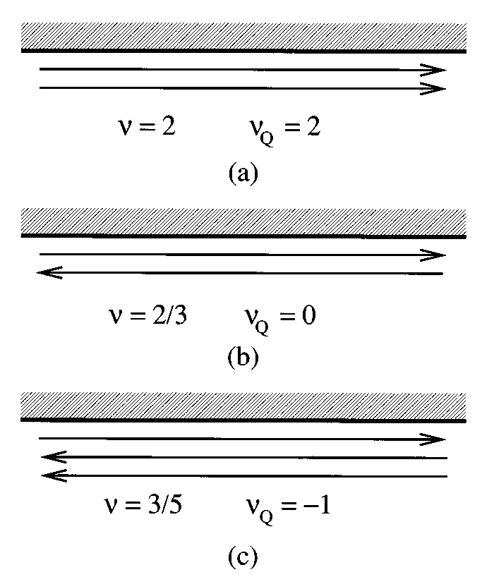
Κ in lowest LL…Kane & Fisher 1997
v =1/3 → κ₀
1 composite fermion mode
v =2/5 → 2κ₀
2 composite fermion modes
v =2/3 → 0
1 charge down + 1 neutral up
v =3/5 → -κ₀
1 charge down + 2 neutral up

Slide 11
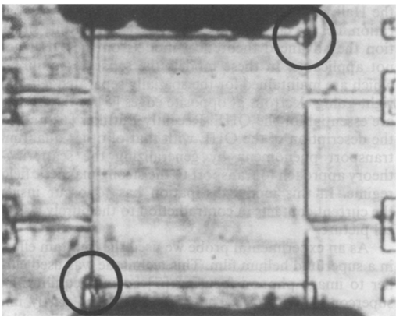
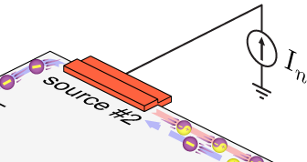

excitation of neutral modes at ohmic contact
qp
‘back side’ of ohmic contact
He4 bubbles
upstream
hot spot
E_{F}+eV_{n}
E_{F}
U. Klass, W. Dietsche, K. von Klitzing & K. Ploog
Image of the dissipation in gated
quantum Hall effect samples
Surface Science 263, 97-99 (1992)
dissipated power = 0.5 I_{n}V_{n}

Slide 12
the experiments

Slide 13


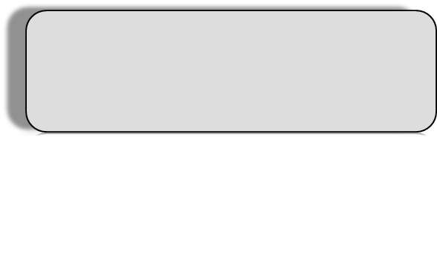
working principle
electrons
phonons
flow of dissipated power…..
hot reservoir
cold reservoir
J_{e}
Tm
T0
1D electronic channel
dissipated power
β = (3-7) nW K⁻⁵
Wellstood, F. C., Urbina, C. & Clarke, J.
Hot-electron effects in metals.
Phys. Rev. B 49, 5942–5955 (1994)
input power

Slide 14
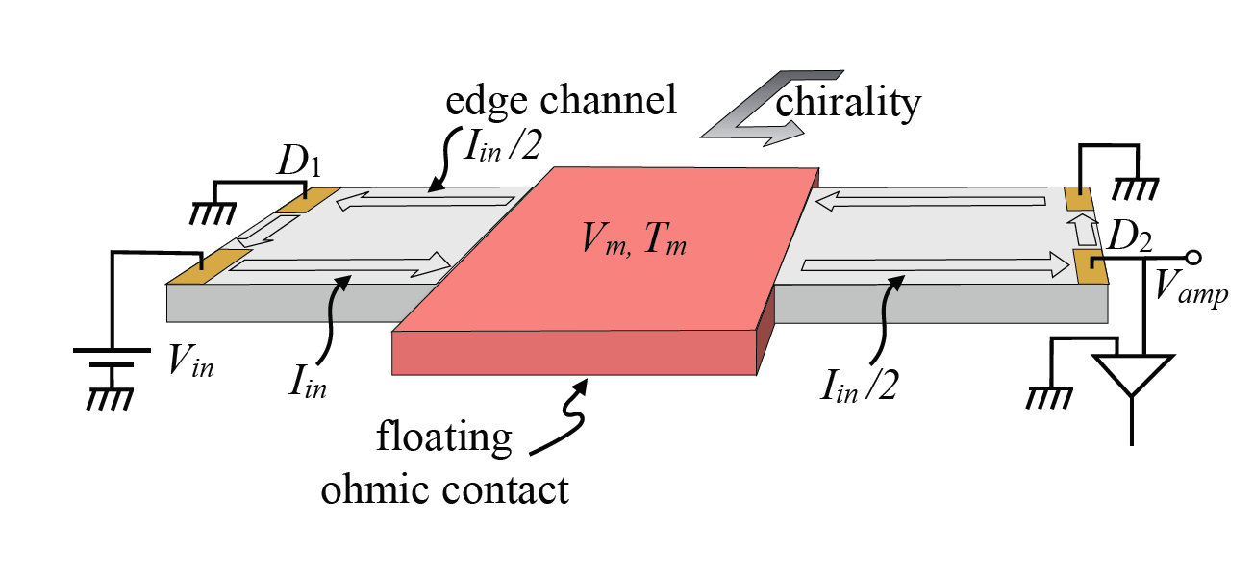
replacing
heating reservoir w/ current …
V_{in} , I_{in}
G_{Hall}
ΔP =P_{in} - P_{out}
I_{out} = I_{in}/2 + I_{in}/2 = I_{in}
V_{m} =V_{in} /2
P_{out}=P_{in} /2
ΔP= P_{in}-P_{out}=P_{in} /2
Jezouin et al. Science 2013

Slide 15
N – arm device
3
Iin
dissipated power
Vin
1
Tm
2
4
N =4

Slide 16
we measure only…
electron temperature in grounded contacts…..T₀
electron temperature in heated reservoir…….T_{m}
small T……….phonon term irrelevant
high T………..phonon term subtracted
K determined

Slide 17
measuring T₀ ……shot noise
I_{S}
t
e*=2e/3
± 0.5mK

Slide 18
measuring T_{m} ……Johnson-Nyquist noise
Tm
current fluctuations
A
dissipated power, ΔP
4k_{B}T_{m}G
modes leave contact with noise 4k_{B}T_{m}G
even if modes cool down with distance…
low frequency current fluctuations conserved

Slide 19
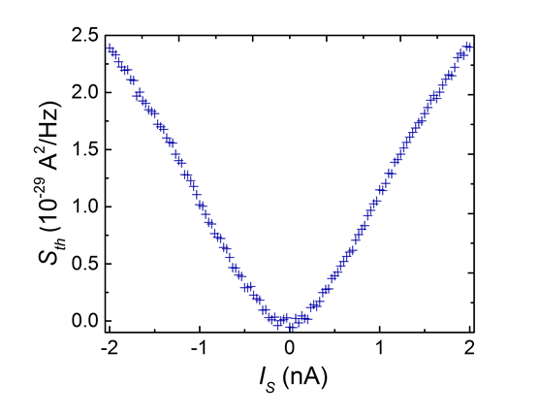
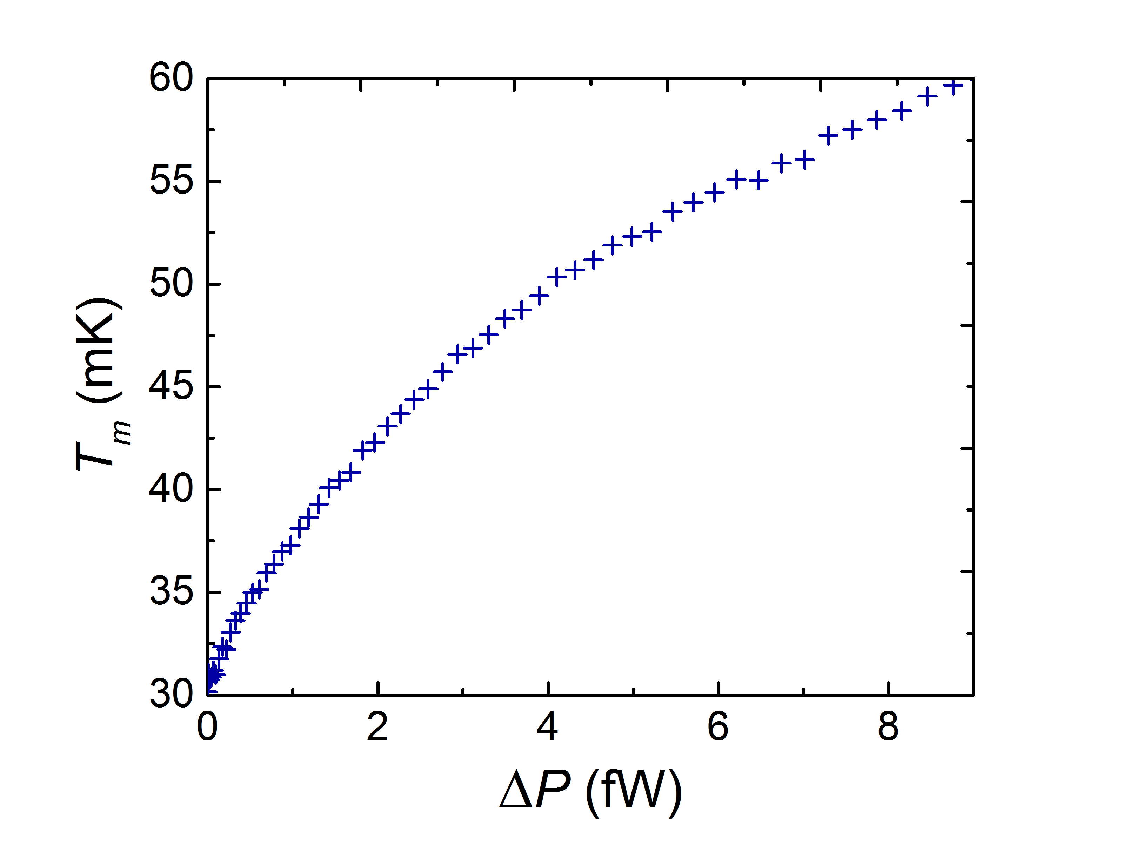
measuring T_{m} ……excess Johnson-Nyquist noise
measured noise

Slide 20
determining thermal conductance
calculated dissipated power
phonons dissipation from ‘floating reservoir’ depends ONLY on its T_{m}
for T_{m} large….subtracting procedure
same T_{m}
phonon contribution subtracted

Slide 21
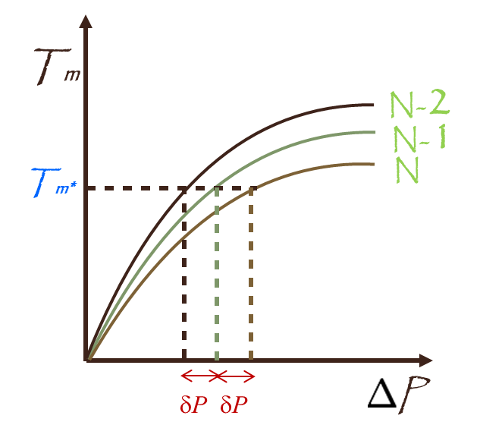
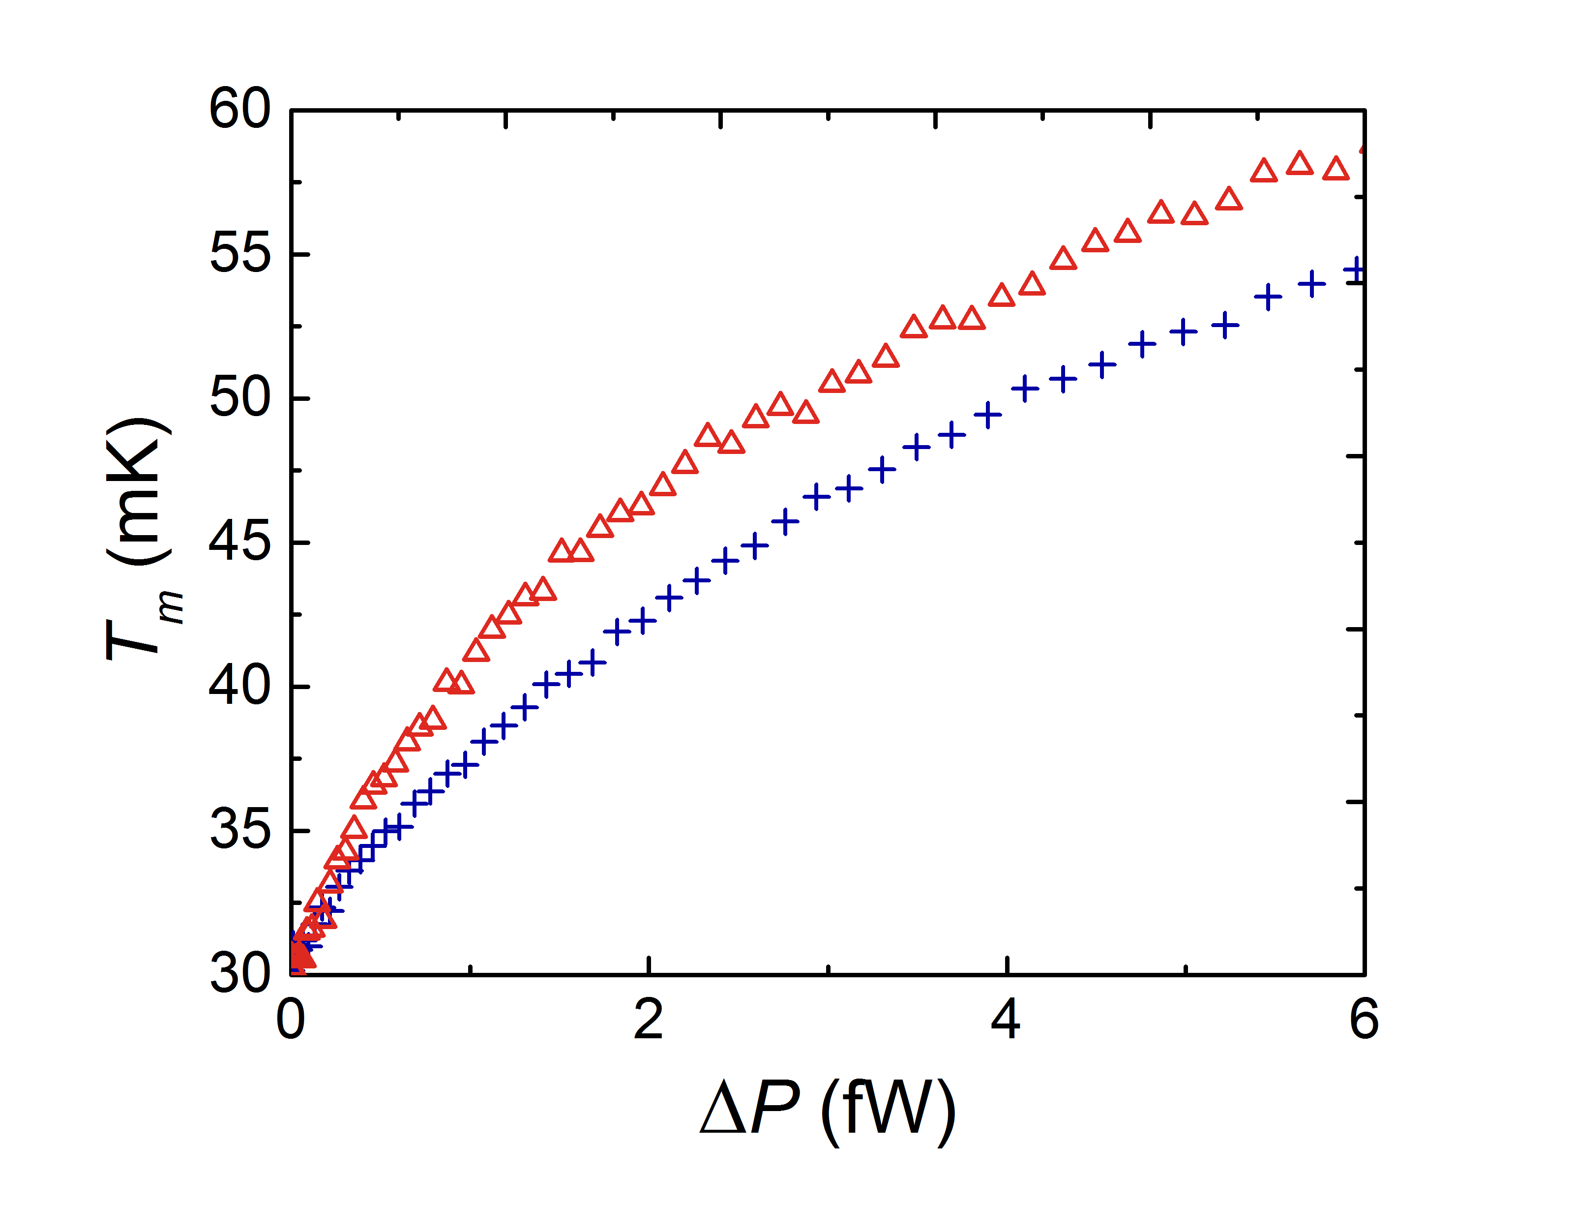
subtracting phonon contribution
subtracting channels at T_{m}
N = 2
N = 4

Slide 22

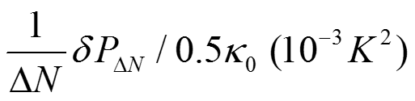
getting K /κ_{0 ……an example}
κ₀
T₀²

Slide 23
realization…….N = 4
QPC2
5µm
QPC1
QPC3
Iin
A
source
QPC4

Slide 24
N = 3
QPC pinched
Iin
A

Slide 25
heart of structure
N =2 v =2 v_{QPC}=1

Slide 26
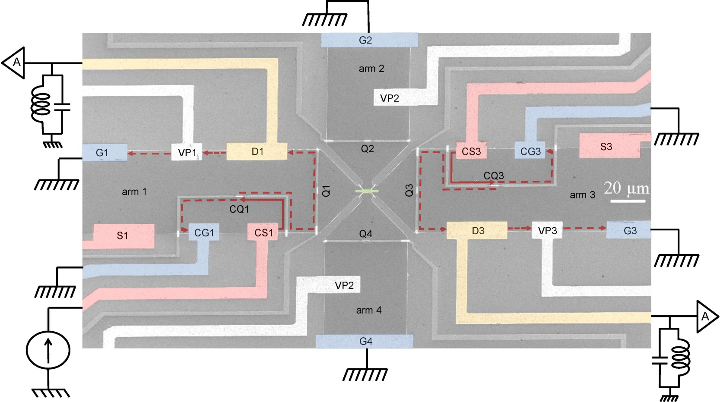
typical actual structure

Slide 27
points of consideration not an easy experiment
electrons fully equilibrate in the small floating reservoir T_{m}
outgoing charge channels carry only Johnson-Nyquist noise
without shot noise
no presence of bulk energy modes (may increase the apparent thermal conductance)
length of arms is limited (~150µm, temperature equilibration between up-down modes)
equal splitting between arms, amplifier gain determination, contacts’ resistance, …

Slide 28
integers.…………………v = 1, 2
lowest Landau level
particle-like fractions.…..v = 1/3
hole-like fractions………v = 2/3, 3/5, 4/7
first excited Landau level
v = 7/3, 5/2, 8/3

Slide 29
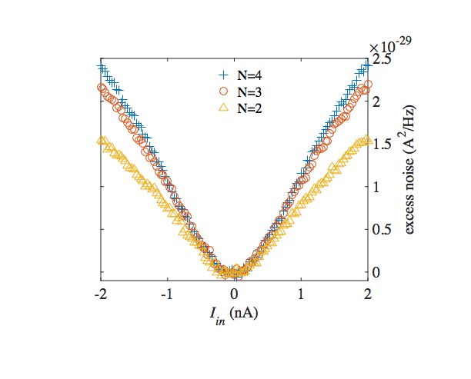
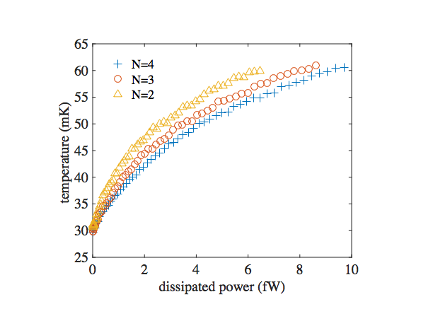
T₀=30mK

Slide 31
v =1/3 → K =κ₀

Slide 32
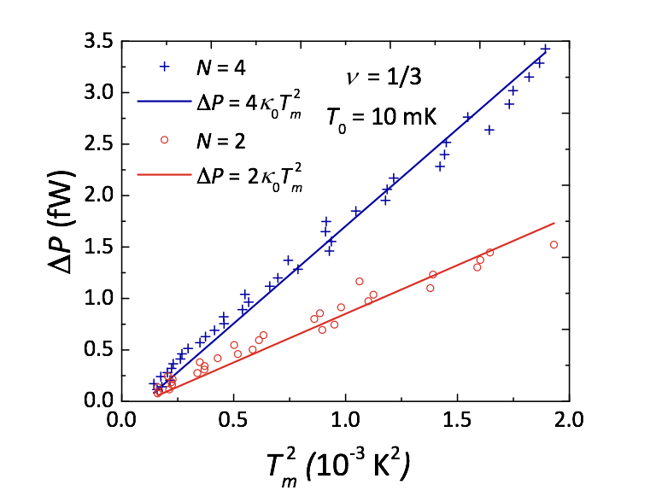
v =1/3
no phonon contribution

Slide 34
Κ of hole - states…Kane & Fisher 1997
v =2/5 → 2κ₀
predicted….’bulk-edge’ correspondence
2 CF modes
v =2/3 → Κ=0
1 charge down + 1 neutral up
v =3/5 → -κ₀
1 charge down + 2 neutral up
v =4/7 → -2κ₀
1 down charge + 3 neutrals up

Slide 35
v =2/3 …… why Κ = 0 ?
I_{S}
hot upstream neutral mode
hot downstream 2e/3 charge mode
G
T_{m}
G
neutral heat returns
charge heat returns
cold downstream charge mode
cold upstream neutral mode
equal number of down and up modes
full equilibration ONLY at large length…..all emitted heat returns

Slide 36
v =2/3
T_{m}
d
non-interacting
T₀
u
L
T_{m}
interacting
long equilibration length, ξ
modes do not equilibrate
ξ
T₀
equal number of down and up modes
heat diffuses in v =2/3
length dependence thermal conductance
‘thermal conductivity’

Slide 37



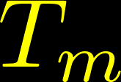
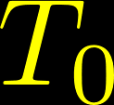
calculating T (x) & Κ …… v =2/3
upper edge
n_{d} =n_{u}=1
Downstream
lower edge
Newton’s law of cooling

Slide 38

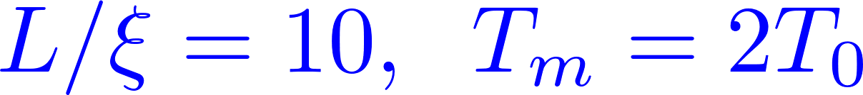






temperature profile, v =2/3
length dependence diffusive heat transport
thermal conductivity

Slide 39
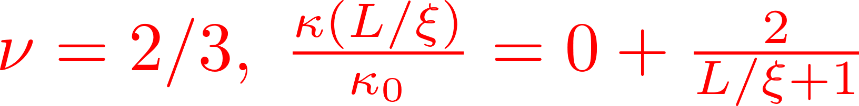


heat conductance w/length

Slide 40
thermal noise

Slide 41
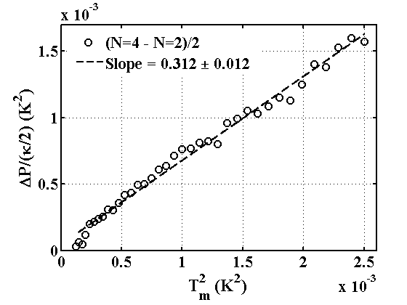
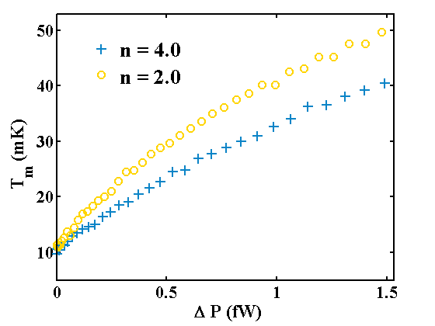
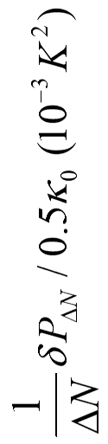
v =2/3
ΔN =2
slope=0.33±0.01
K > 0…..symmetric up and down of arms…..…. K / 2 each side of arm

Slide 43
v =2/3

Slide 44
calculating T (x) & Κ …… v =3/5
upper edge
n_{d} =1 n_{u}=2
Downstream
lower edge

Slide 45

temperature profile, v =3/5

Slide 46
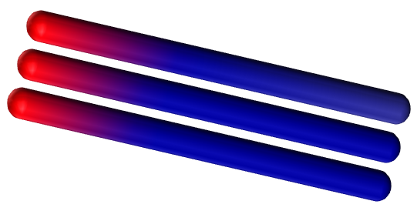
v =3/5
T_{m}
d
T₀
unequal number of down and up modes
T₀
L
shorter ξ
nodes equilibrate
ξ

Slide 47

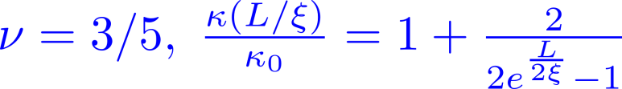
heat conductance w/length
v =3/5

Slide 48
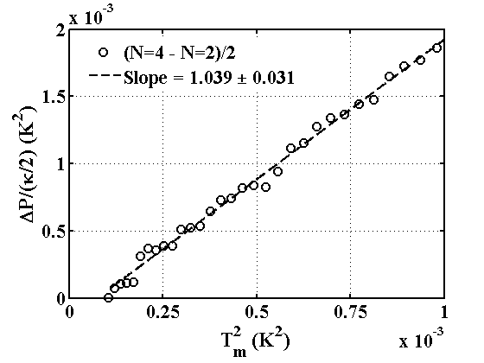
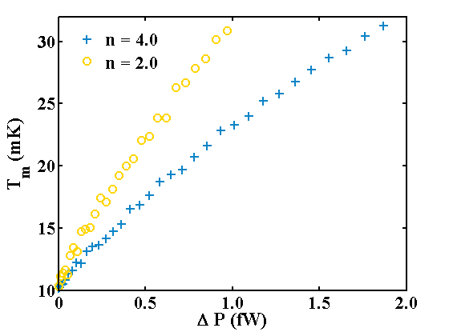
v =3/5
ΔN =2

Slide 49
v =4/7 → ⏐-2κ₀ ⏐
v =3/5 → ⏐-κ₀ ⏐
v =2/3 → κ >0
hole-states with upstream neutral modes

Slide 50
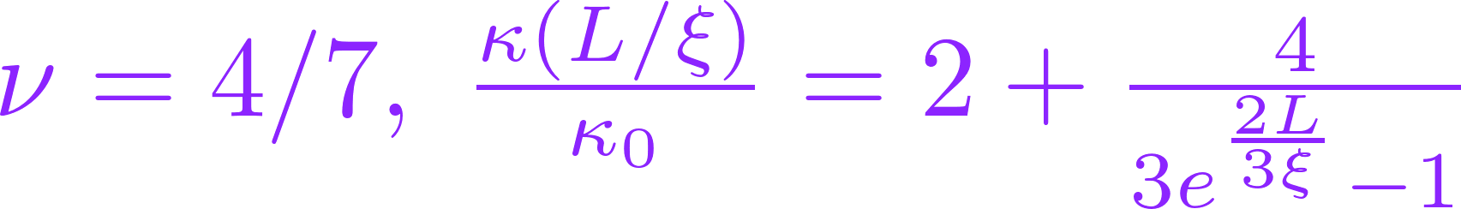
heat conductance w/length

Slide 51
fractional interacting 1D mode
and neutral mode
K = κ₀

Slide 52


Slide 53
second Landau level
already known for v =5/2 = 2 + 1/2
charge e /4
upstream neutral modes
likely, spin polarized

Slide 54
composite fermions (CFs) model
Jain, 1989
flux attachment
2Φ₀
composite fermion
Φ₀ Φ₀
B
e⁻
B_{1/2}
n_{e}
e
Fermi liquid of correlated electrons at B_{1/2}
external field canceled
mean field approximation
B_{1/2}
CFs feel a reduced lower field, B –B _{1/2}
expected to be independent particles
B _{1/2} = 2n_{e}Φ₀

Slide 55

Moore - Read theory 1991
ν=5/2 = 2+1/2
ΔB =0
B_{ext}
R_{xx}=0 …superconductor
p-wave Cooper pair
BCS of polarized composite fermions
w/ odd orbital angular momentum

Slide 56
zero energy Majorana anyons
B –B_{1/2} >0 induces vortices in bulk
zero energy quasiparticle (Majorana) in vortex + e /4
Majorana’s come in pairs…..forming fermionic state γ₁ ± i γ₂
ground state degeneracy of n vortices……. 2^{n / 2} (non-abelian)

Slide 57
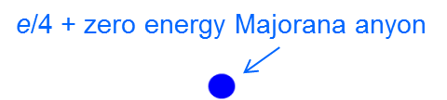
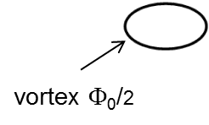
5/2 state Moore – Read, Pfaffian state
bulk – edge correspondence
1D edge liquid + Majorana anyon
Majorana – half fermion…. K = κ₀ / 2

Slide 58
abelian
non - abelian
SU(2)₂ |  | κ = 4.5
Pfaffian |  | κ = 3.5
PH - Pfaffian |  | κ = 2.5
Anti - Pfaffian |  | κ = 1.5
Anti - SU(2)₂ |  | κ = 0.5
331 |  | κ = 4
K =8 |  | κ = 3
113 |  | κ = 2
Anti-331 |  | κ = 1
integer, e, κ = 1
fraction, e/4, κ = 1
neutral, 0, κ = 1
Majorana, 0, κ = 0.5

Slide 59
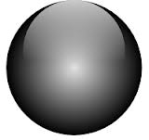
exchange statistics due to ground state degeneracy
degenerate ground state
exchange → unitary
non-abelian anyons

Slide 60
difficulties in 5/2 material
‘bulk heat conductance’…..free electrons in the donor layers
poor contact of floating reservoir – reflections of inner modes
instability and hysteresis of QPC’s

Slide 61
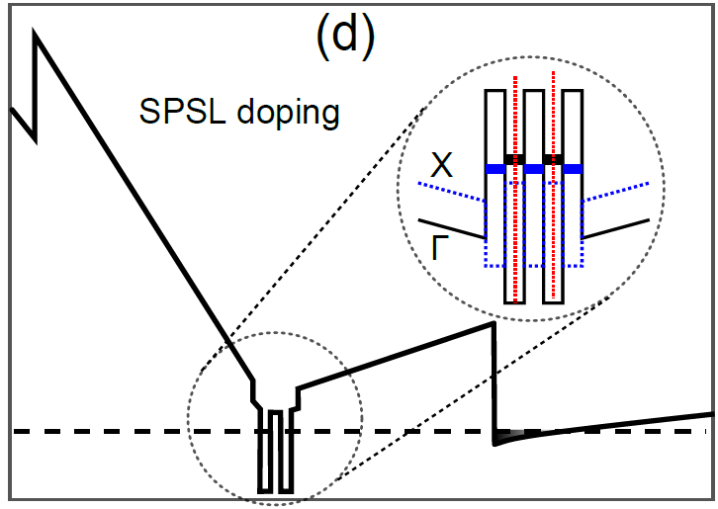
doping for X-high mobility 2DEG
5/2 state affected by long-range scattering from ionized dopants
improve spatial correlation & screening via excess free electrons at donor layers
Pfeiffer, 2000’s
short period AlAs/GaAs super-lattice (SPSL)

Slide 62
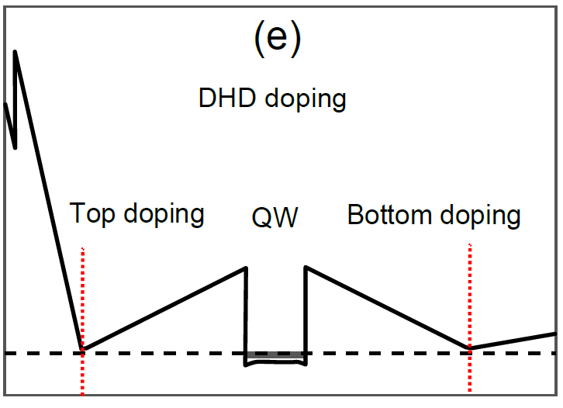

employing SL doping
large activation gap achieved by over-doping or by over-doping + illumination
parallel conductance
    bulk thermal conductance
    unstable gates

Slide 63
our approach….. shallow DX centers + over doping γ
delta doping in Al_{x}Ga_{1-x}As (x=23÷25 %)
δ-doping
E_{F}
2DEG in QW
NO illumination
NO parallel conductance
    NO bulk thermal conductance
    stable gates (QPC’s replaced by continuous gate)
    weak reflection from floating contact reservoir

Slide 64
non-standard MBE growth for v =5/2
low x(Al) in the doping layers
working in dark (NO illumination)
avoiding parallel conduction
    NO bulk thermal conductance
    stable gates (QPC’s replaced by continuous gates)
    small reflection from floating contact reservoir

Slide 65

non-standard MBE growth for v =5/2
5/2
PH-Pfaffian
7/3
8/3
    neglibable bulk thermal conductance

Slide 66
  measured
  v =7/3 v = 2 + 1/3 particle like, downstream K = 3κ₀
v =8/3 v = 2 + 2/3 hole-like, down - up K = (2+ε)κ₀
  v =5/2 v = 2 + ½

Slide 67
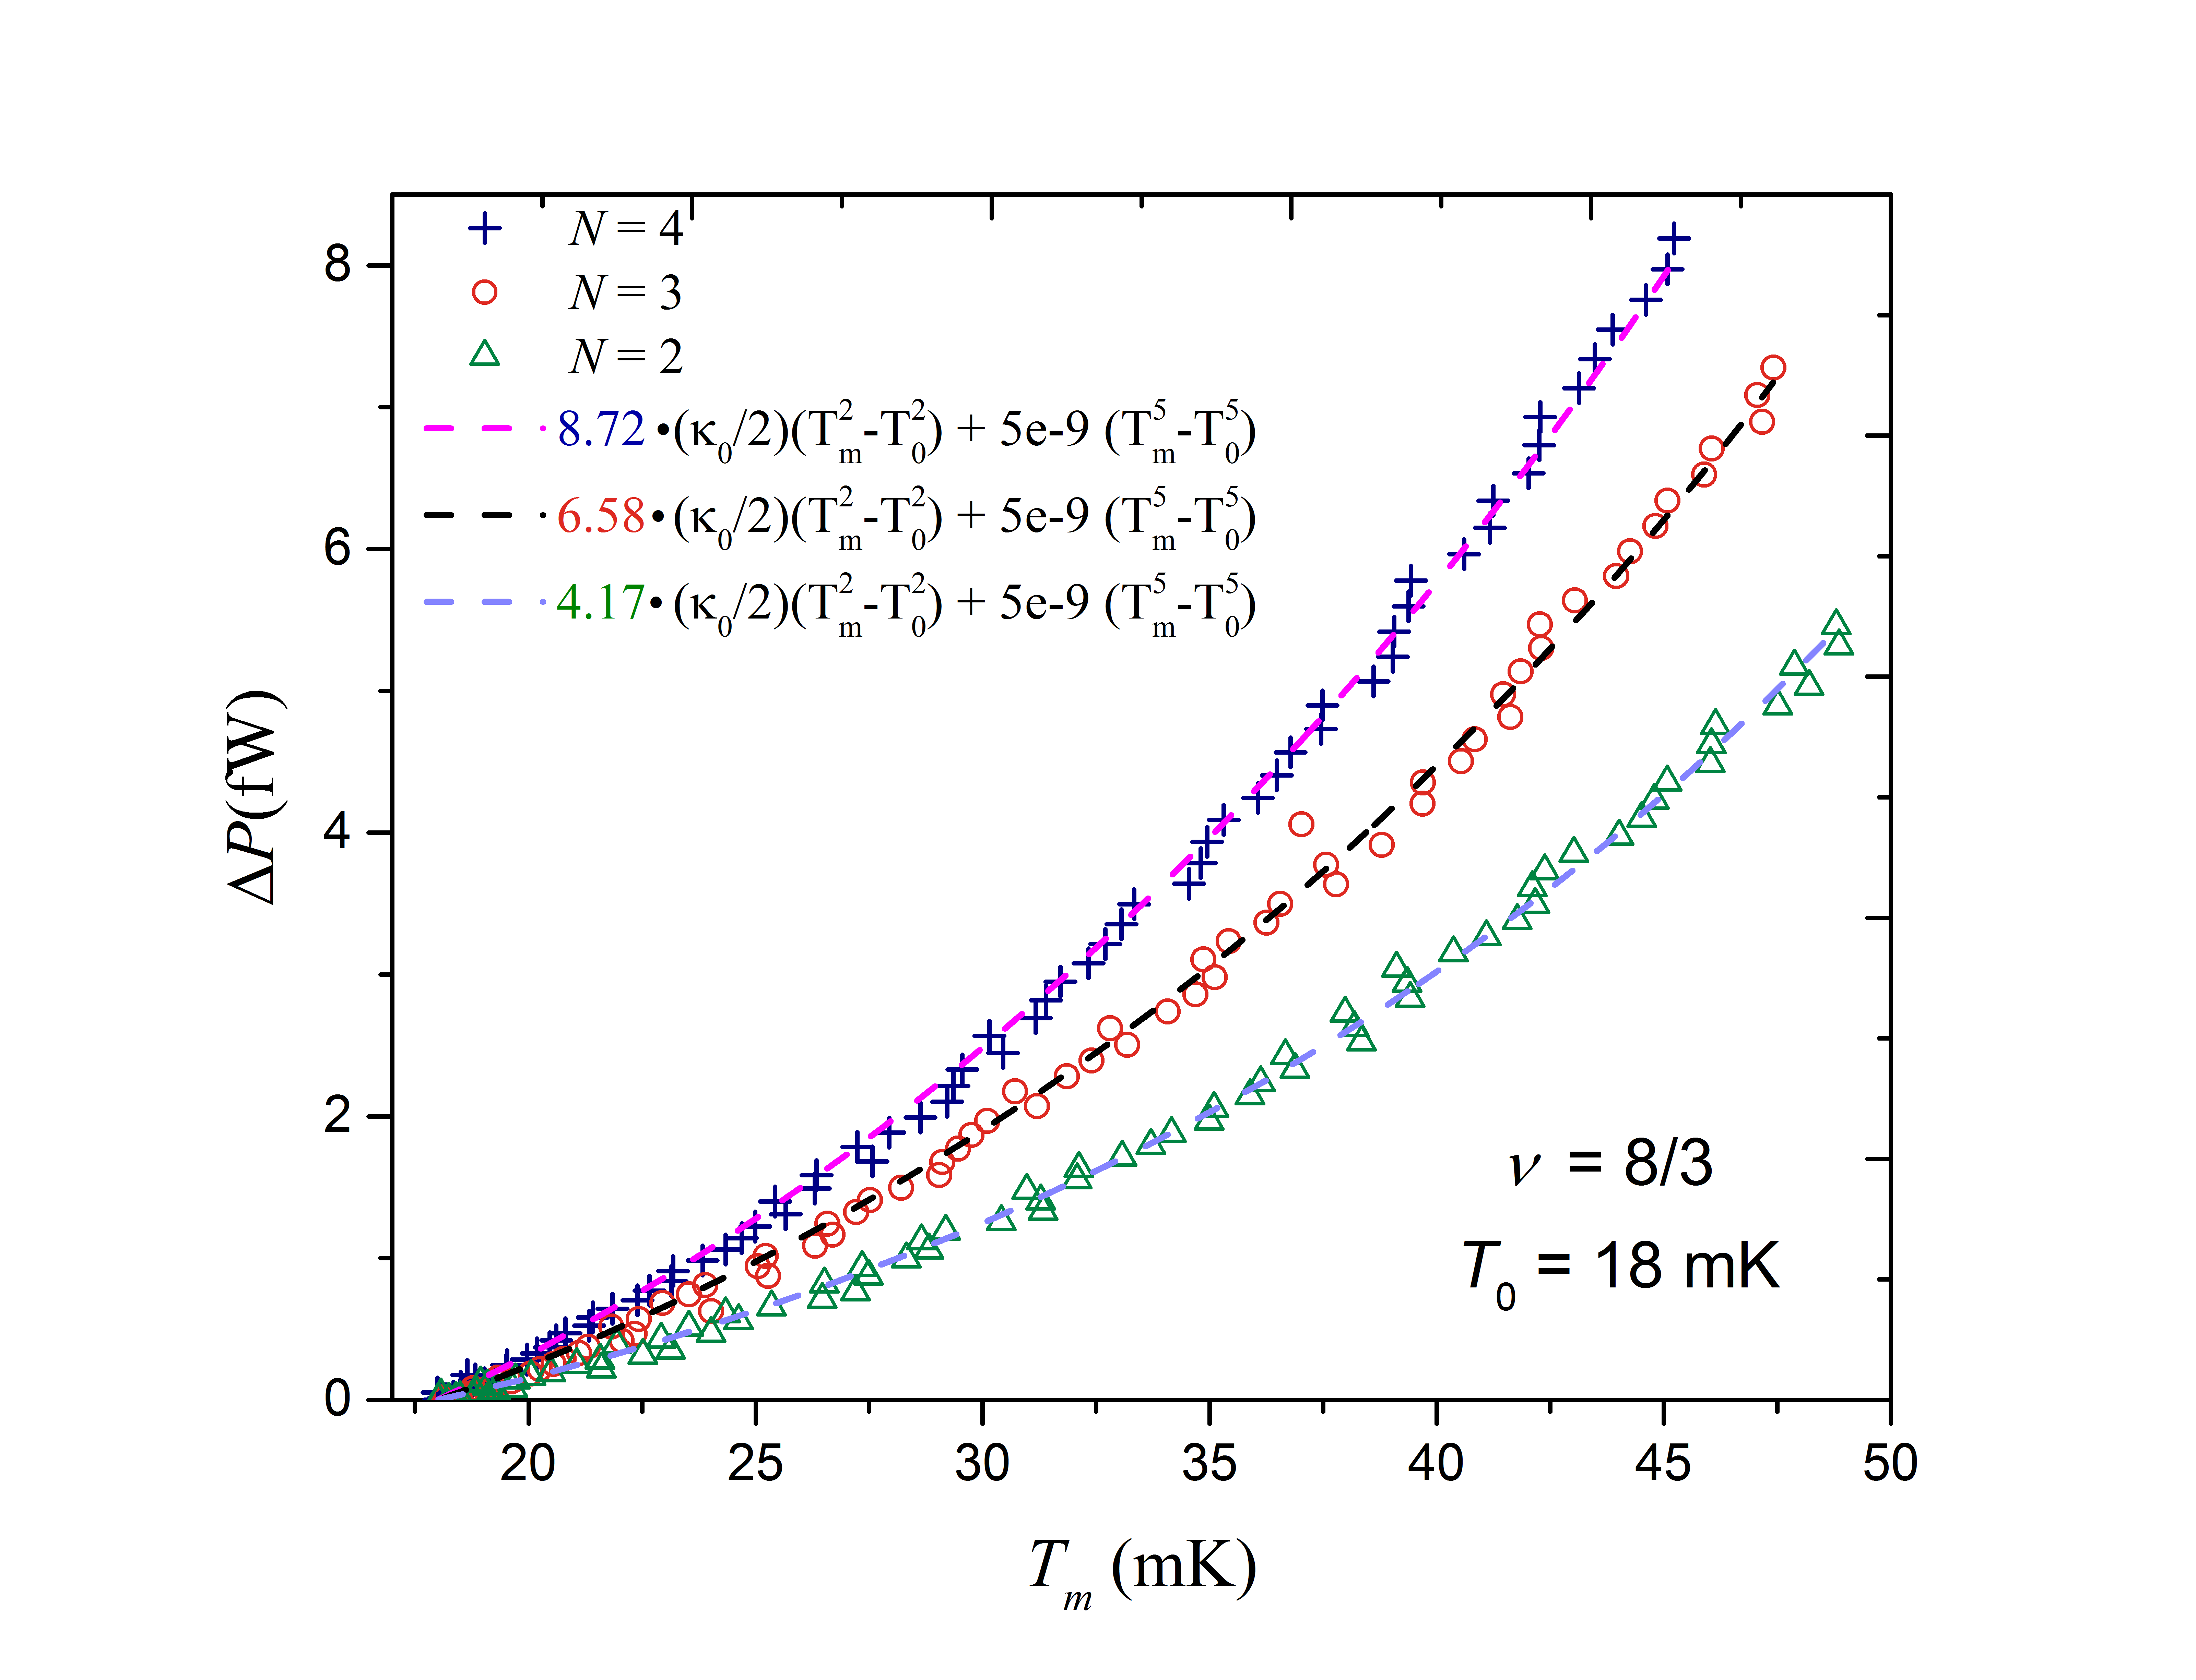
thermal conductance of v =8/3 R_{xx}>0
K_{8/3} = 2.16 κ₀

Slide 68
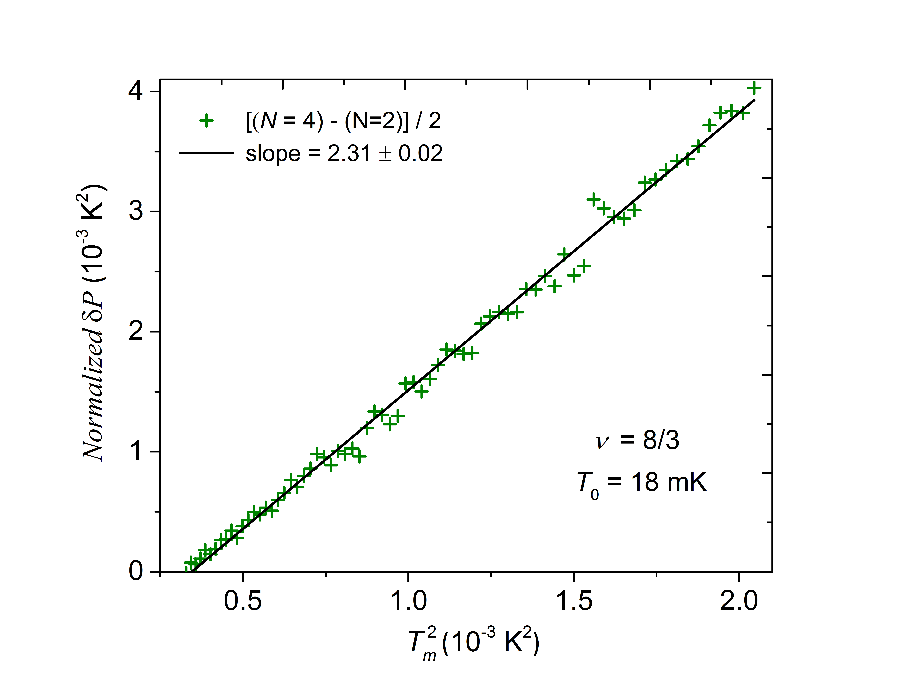

Slide 69
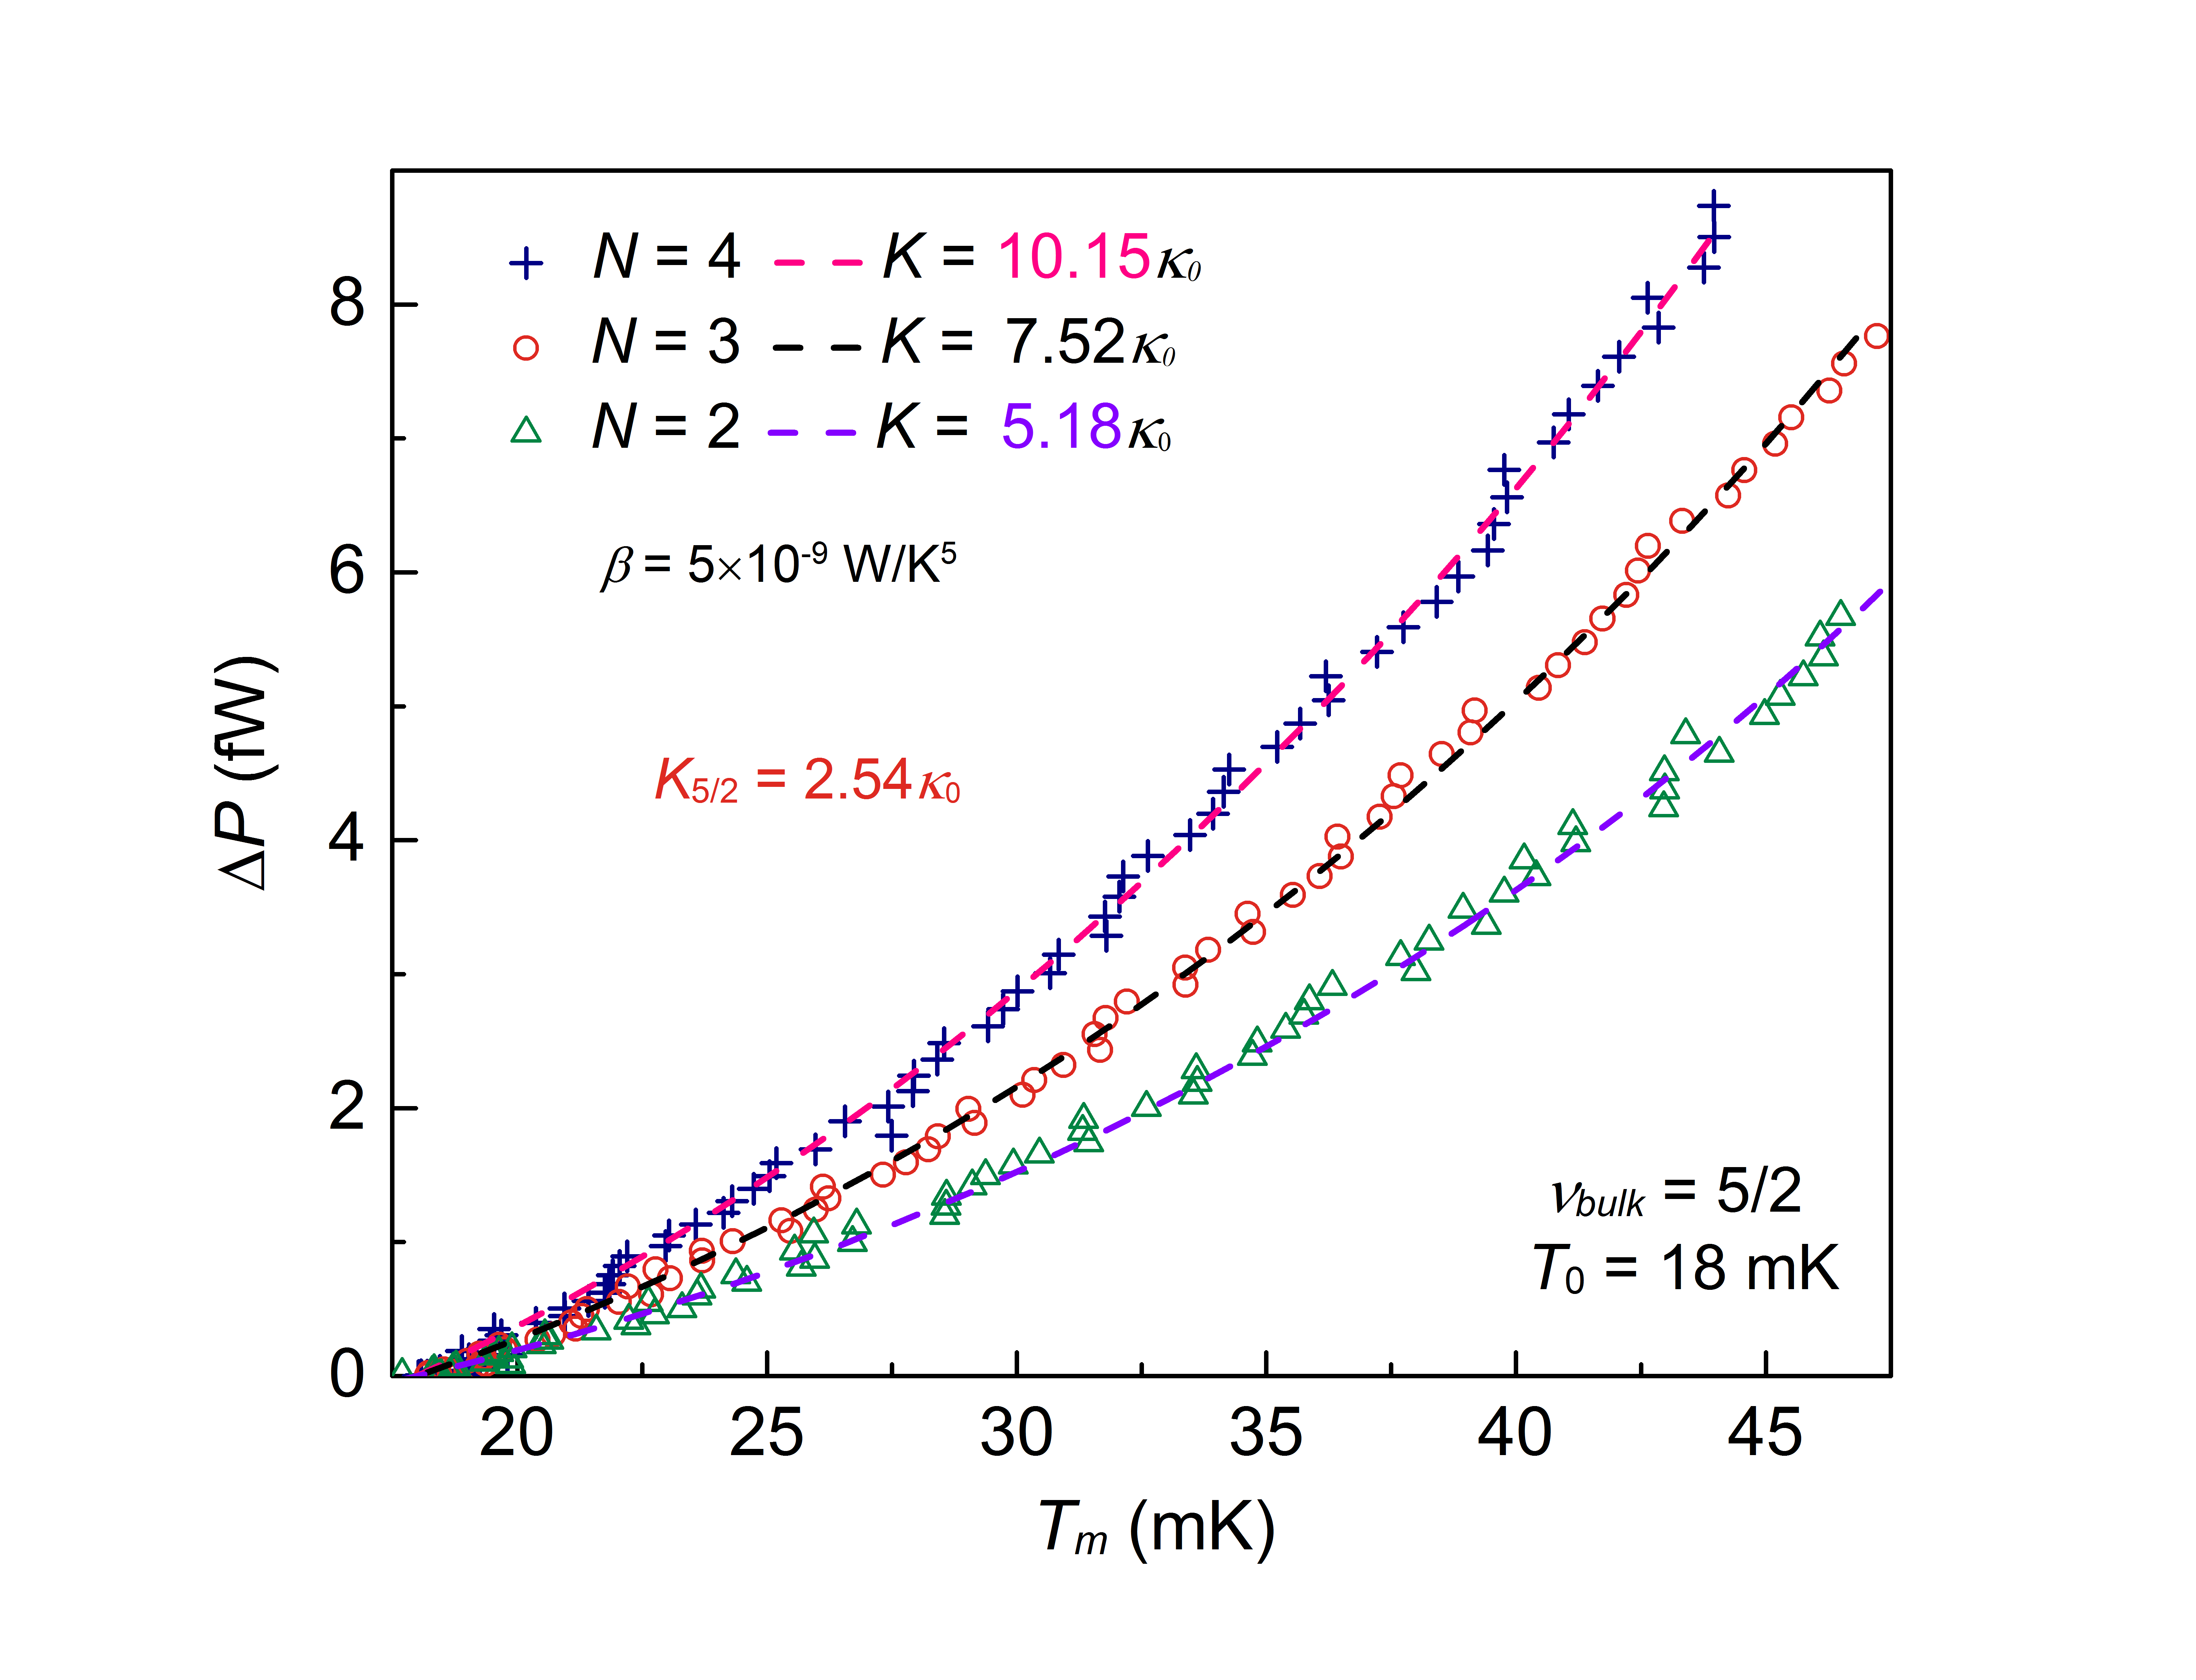
conductance determination with
estimated phonons contribution

Slide 70
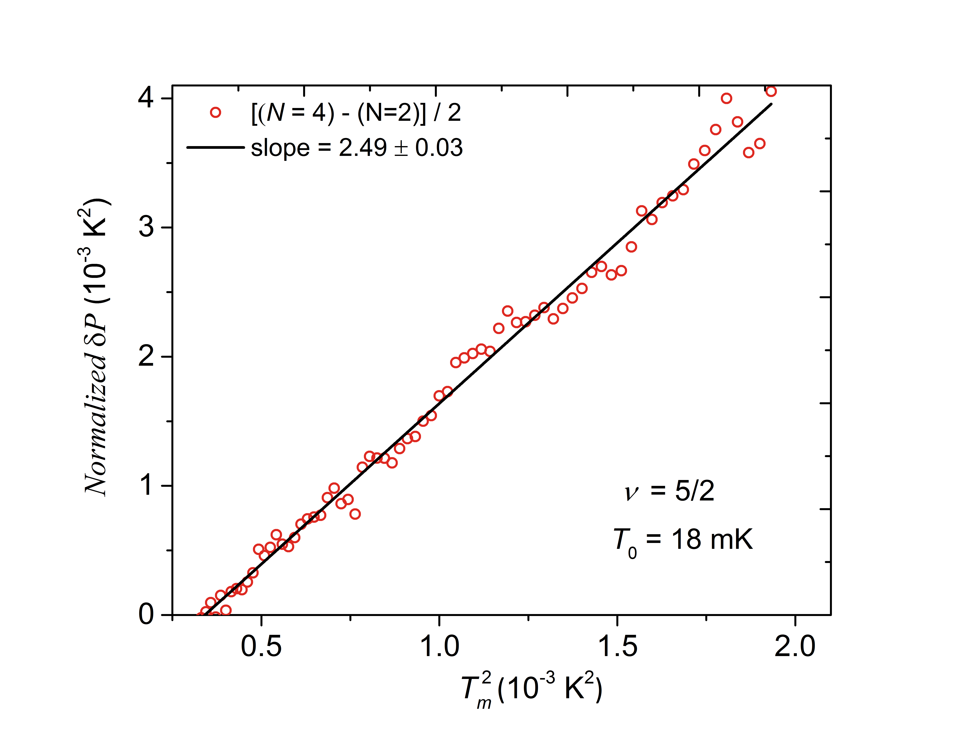
thermal conductance determination via
‘subtraction procedure’
ΔN = 4 - 2

Slide 71
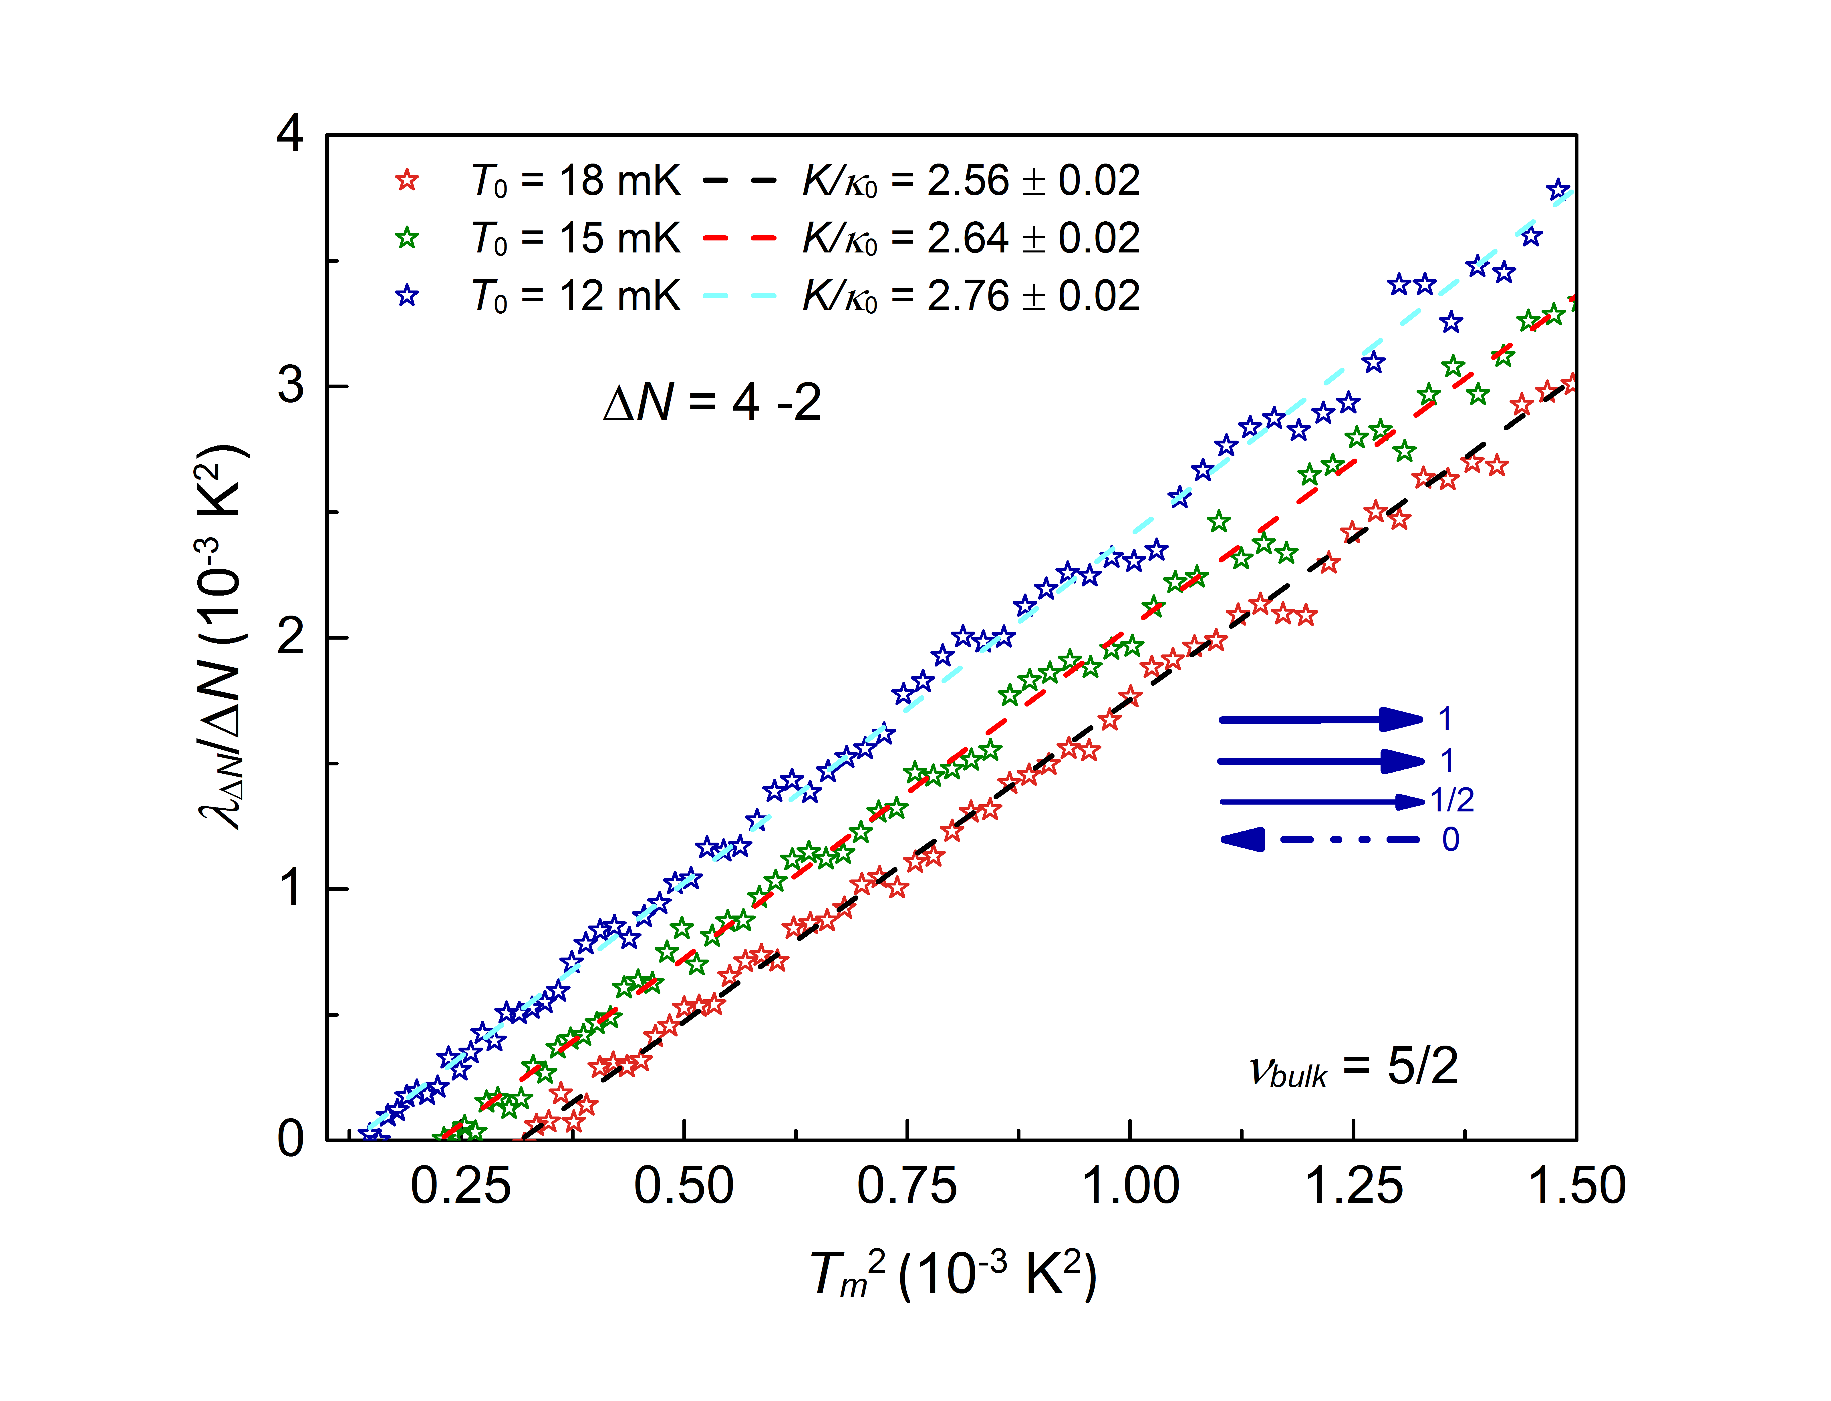

Slide 72
three thermal cycling
17 measurements
different temperatures
three location of the 5/2 plateau

Slide 73
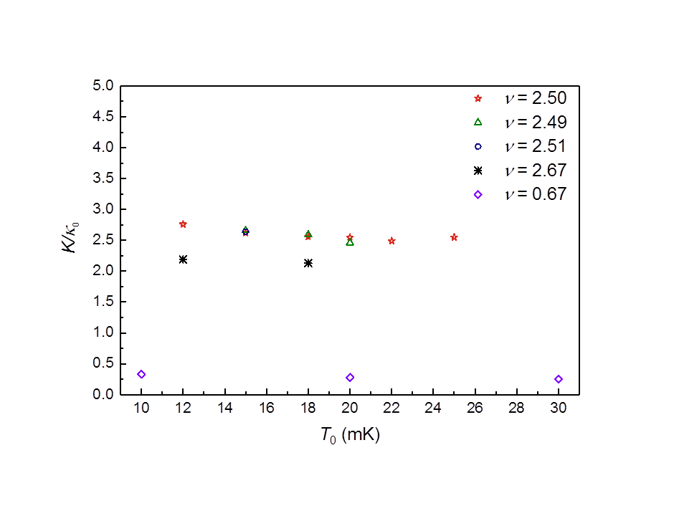
SU(2)₂
increasing equilibration length at lower temperature
Pfaffian
PH-Pfaffian
PH - Pfaffian
v=8/3
Anti - Pfaffian
Anti - SU(2)₂
v=2/3

Slide 74
5/2
PH-Pfaffian
7/3
8/3
3κ₀
2.5κ₀
2.15κ₀

Slide 75
abelian
non - abelian
SU(2)₂ |  | κ = 4.5
Pfaffian |  | κ = 3.5
PH - Pfaffian |  | κ = 2.5
Anti - Pfaffian |  | κ = 1.5
Anti - SU(2)₂ |  | κ = 0.5
331 |  | κ = 4
K =8 |  | κ = 3
113 |  | κ = 2
Anti-331 |  | κ = 1
integer, e, κ = 1
fraction, e/4, κ = 1
neutral, 0, κ = 1
Majorana, 0, κ = 0.5

Slide 76
v = 5/2……..non-abelian
measuring thermal conductance
reveals hidden information

Slide 77
5/2
8/3

Slide 78
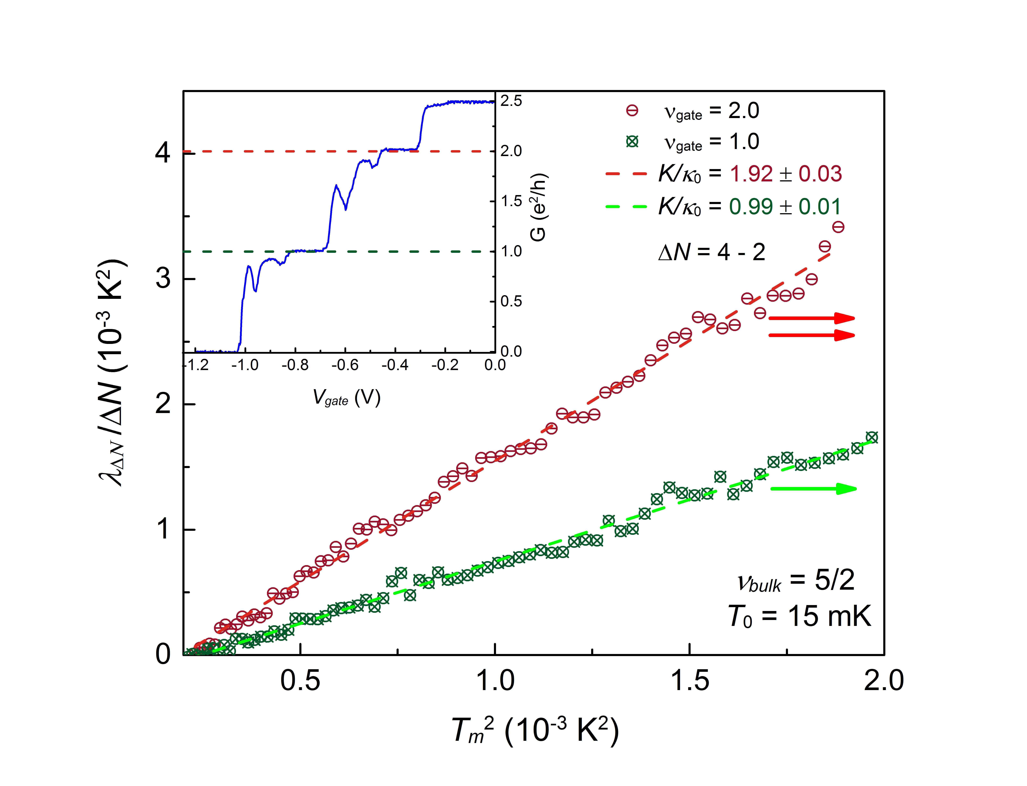
measuring v =1,2 @ v_{B}=5/2

Slide 79
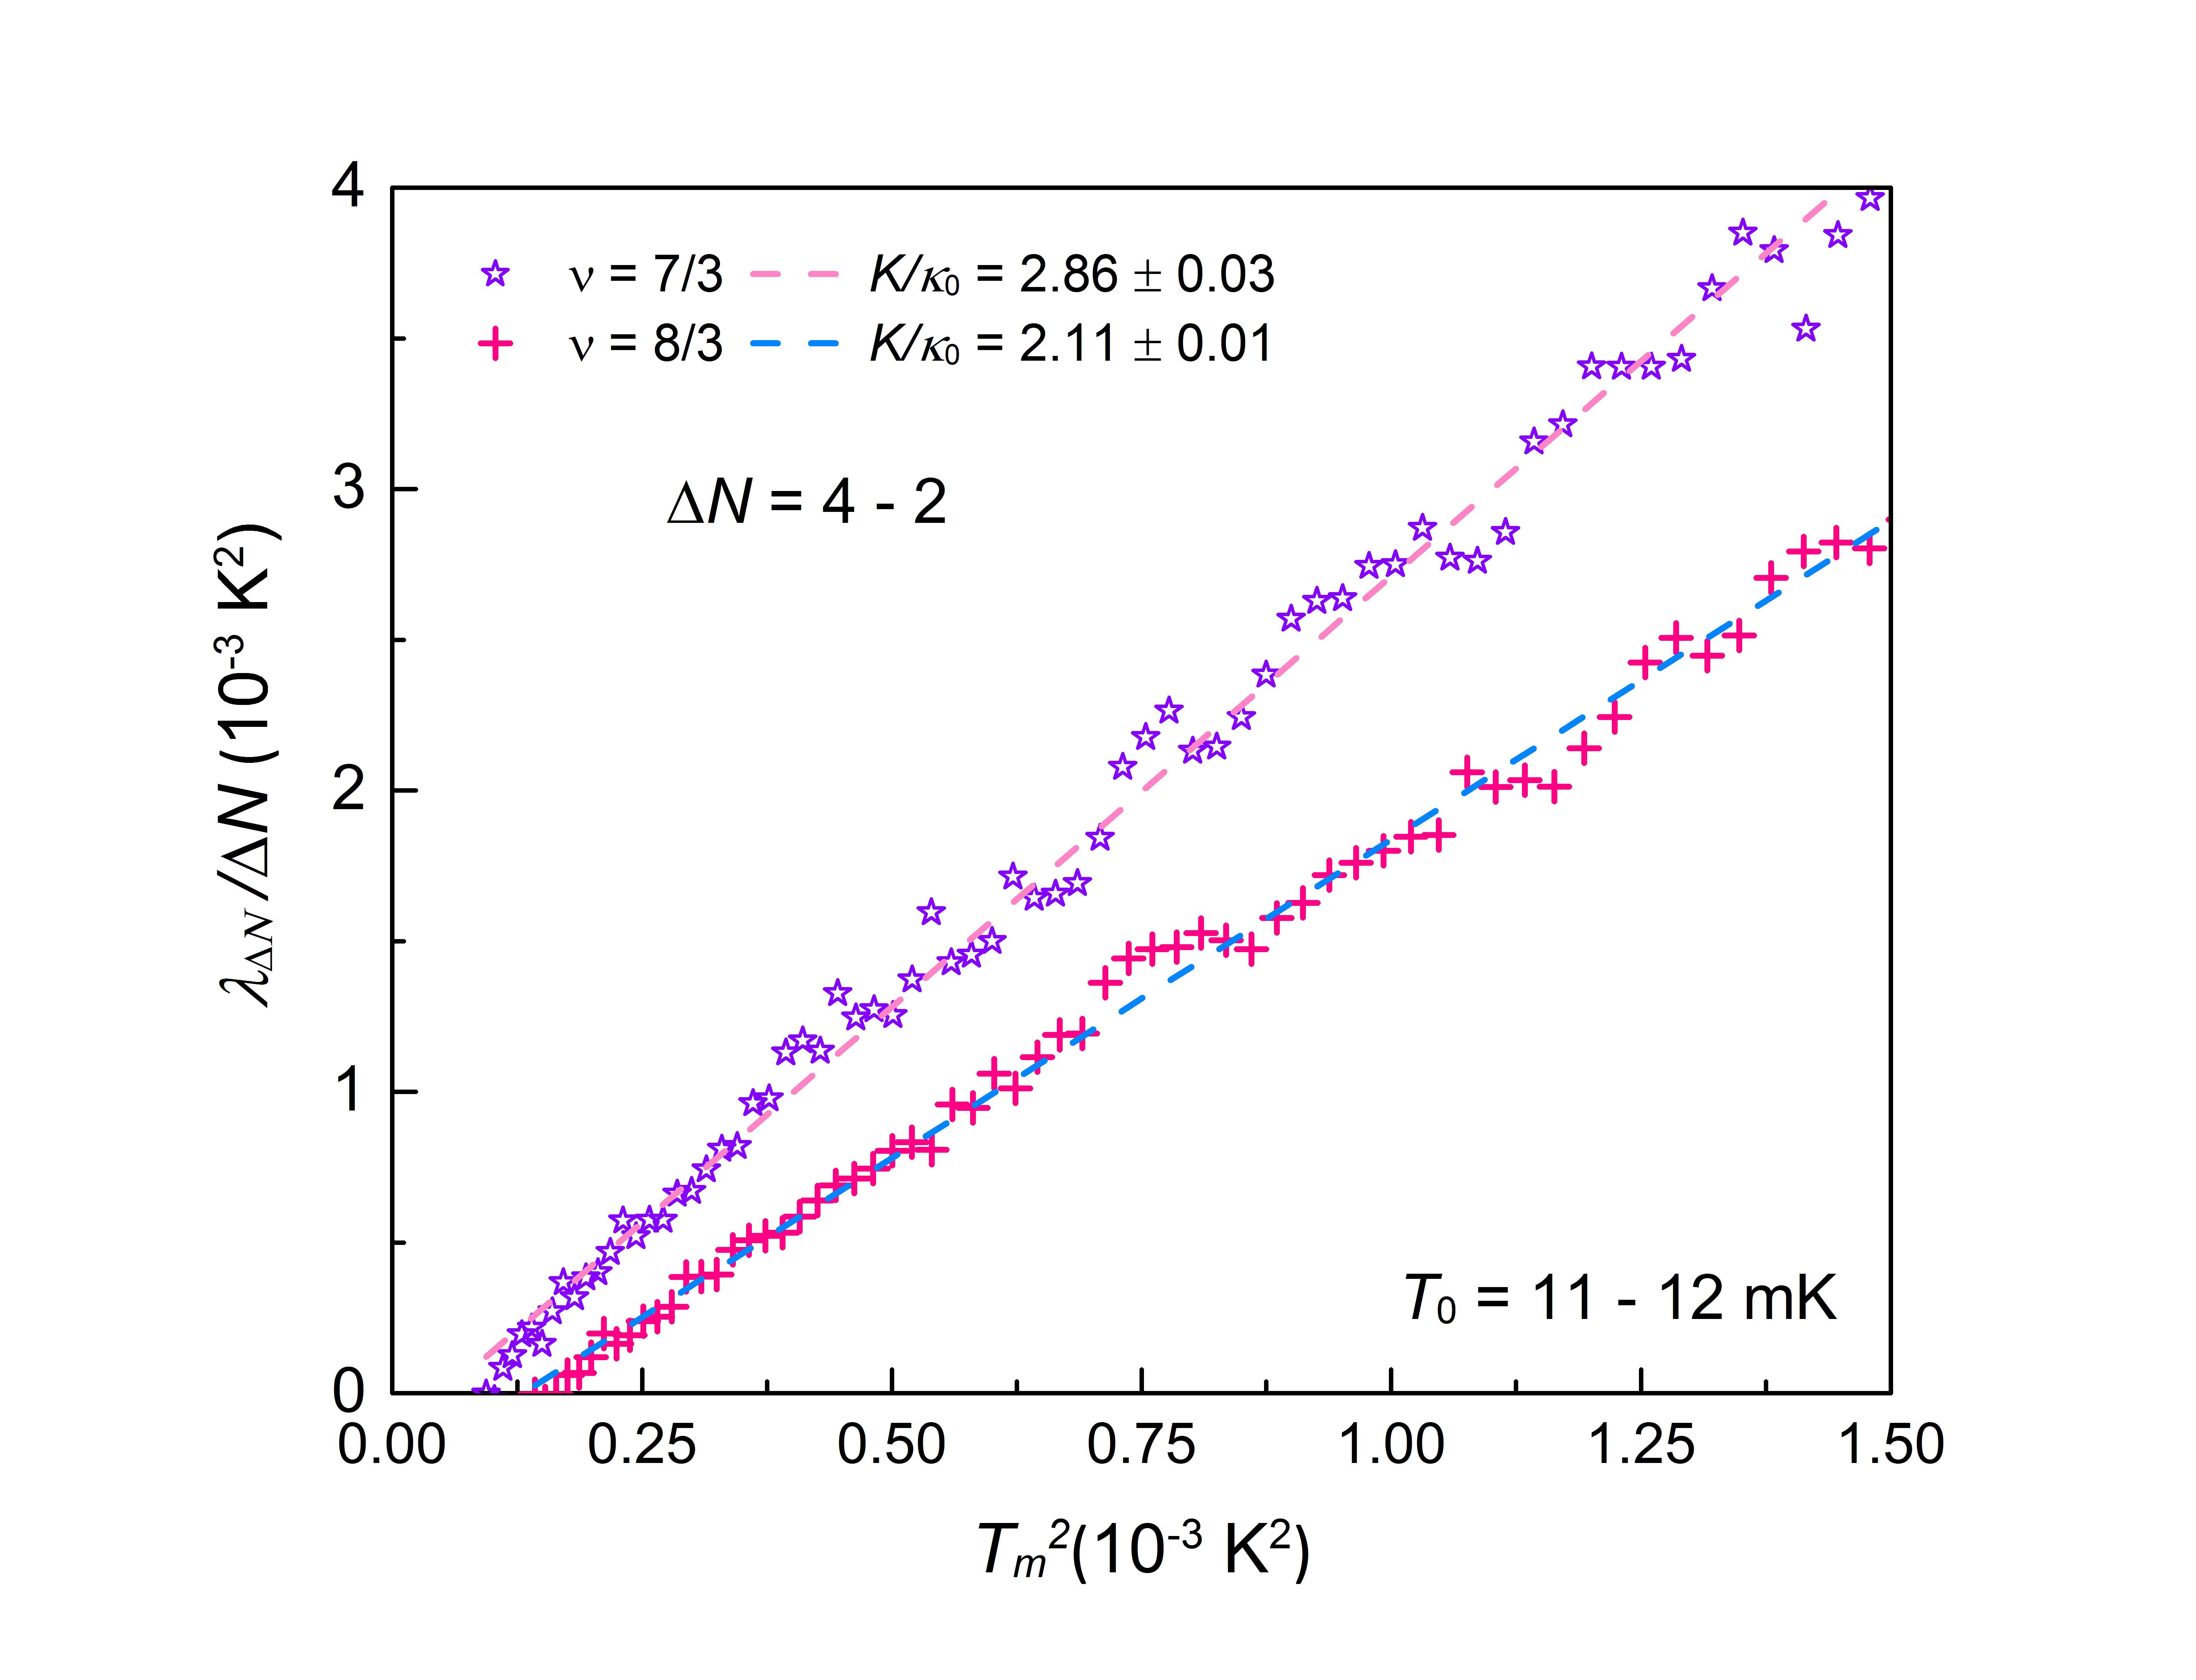
~3
~2

Slide 80
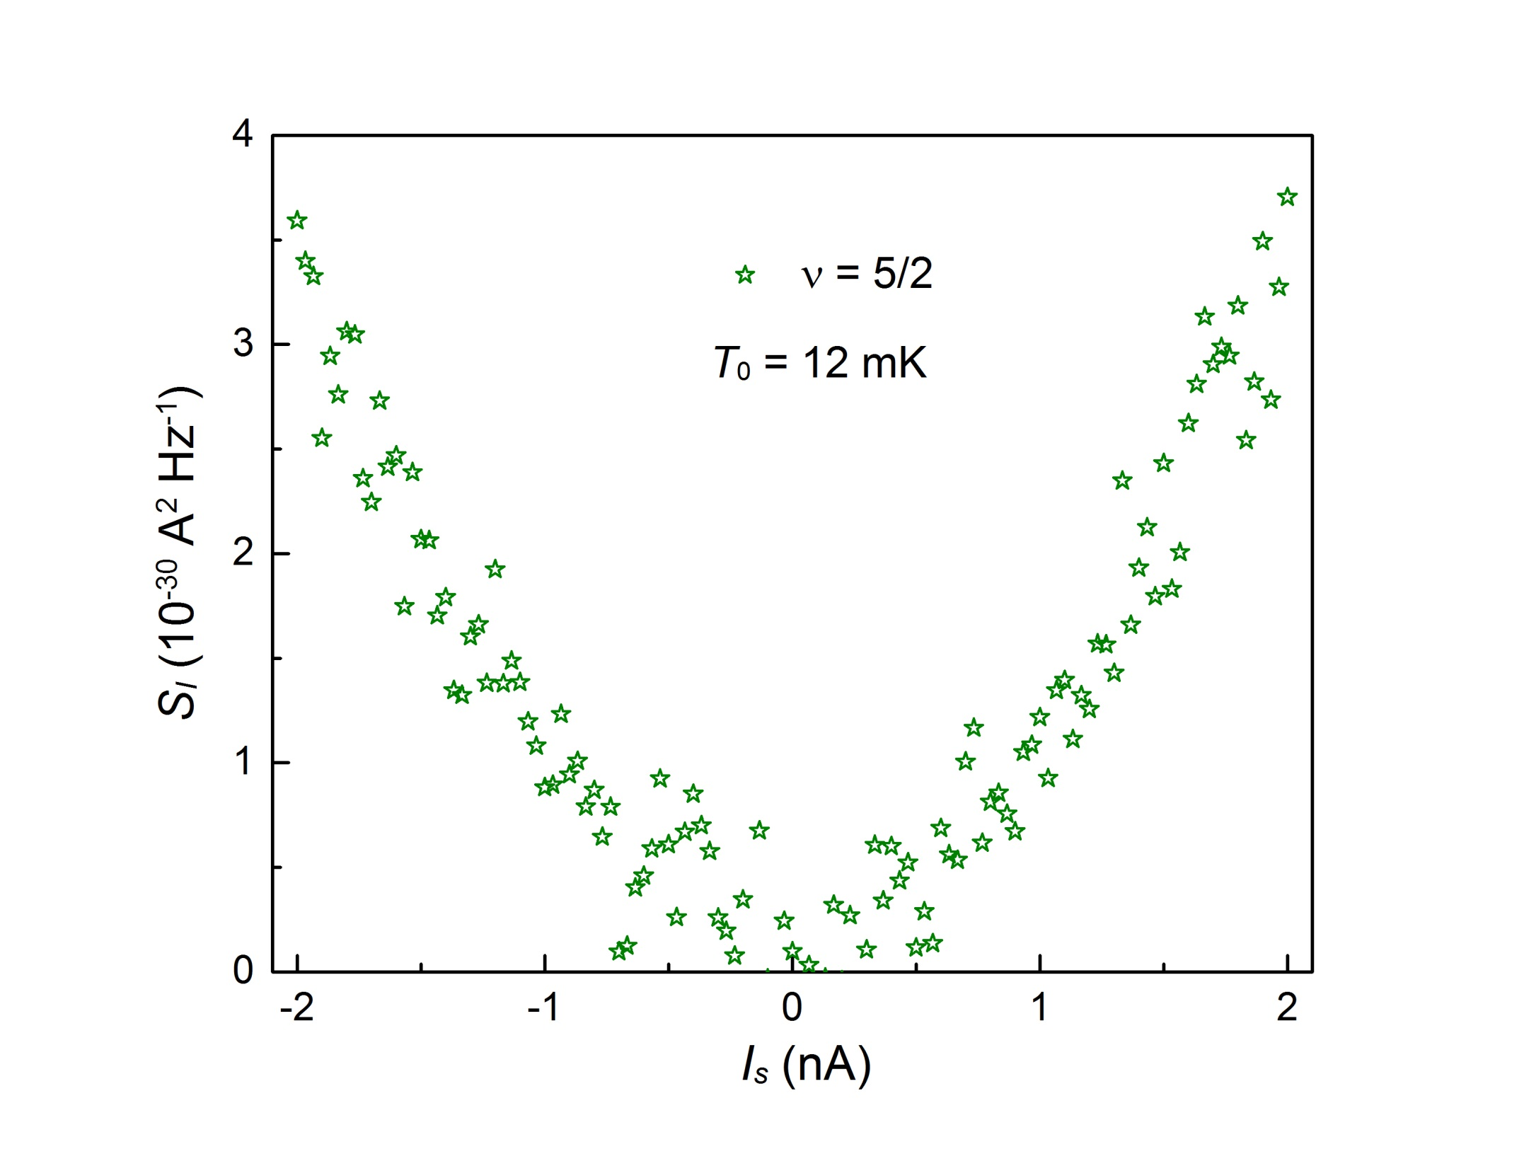
Neutral Noise

Slide 81
zero energy Majorana anyons
B –B_{1/2} >0 induces vortices in the p-wave BCS condensate
zero energy quasiparticle (Majorana) in vortex + e /4
Majorana - chargeless and spinless
Majorana’s come in pairs…..forming fermionic state γ₁ ± i γ₂
occupied & unoccupied at zero energy
ground state degeneracy of n vortices……. 2^{n / 2}

