Slide 1


Télécharger l'app sur votre smartphone ou sur votre tablette
Ou accéder à la page web suivante :
https://student.turningtechnologies.eu/#/
Connectez-vous sur la session
medphys2022
entrez sous
guest/invité

Slide 2
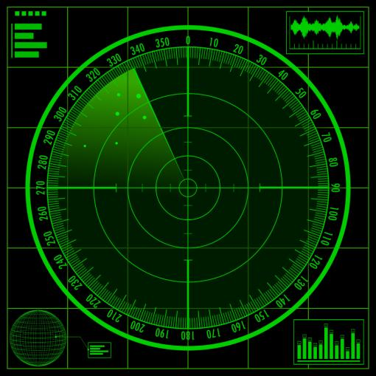
Master of Science EPF-ETH degree in Nuclear Engineering Medical Radiation Physics Receiver operating characteristics (ROC)
Prof François Bochud
Institute of Radiation physics (IRA)
UNIL - CHUV

Slide 3
Learning objectives
Explain the meaning of a ROC curve
Calculate a posteriori probabilities with Bayes' theorem and other simple methods
Define the basic principles of a detection experiment
Be able to build a ROC curve from a detection experiment
Communicate efficiently the meaning of a ROC analysis

Slide 4

ROC theory 1. Quantification of image quality

Slide 5
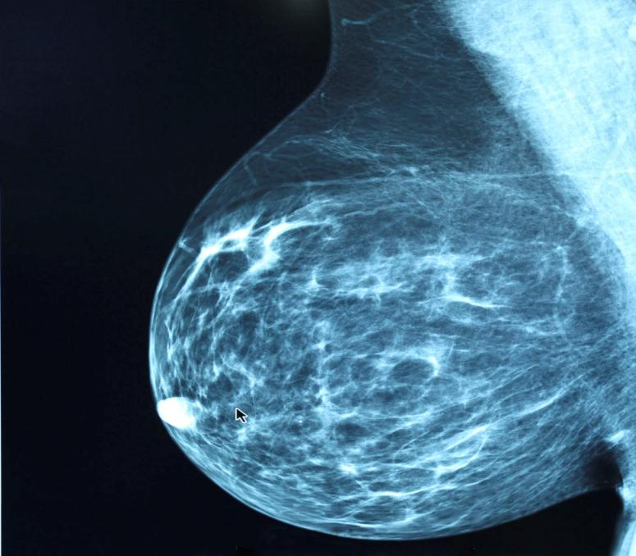
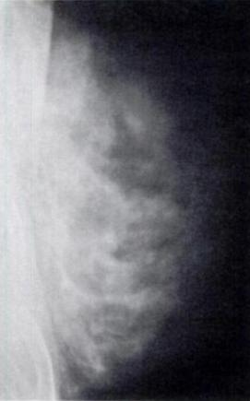
Which image has the best quality?
2016
1939

Slide 6
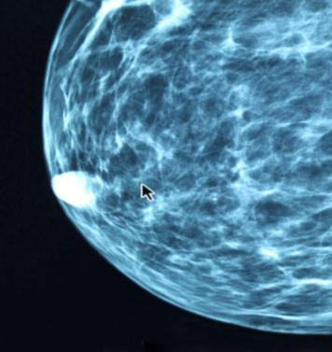
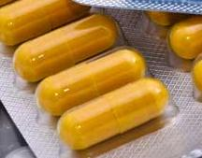
Technical Physical measurements (MTF, SNR, etc.)
Diagnostic accuracy Agreement between diagnoses and truth
Diagnostic thinking Physician certainty about the diagnostic
Therapeutic Treatment of management of the patient
Outcome Result of treatment
Societal Value to society
Non-toxicity
Efficiency
ICRU Report 79, Receiver Operating Characteristic Analysis in Medical Imaging (2008)

Slide 7
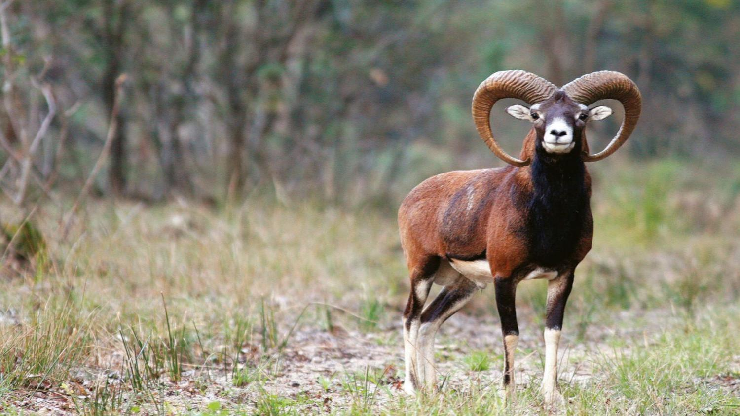
Can you detect the bighorn?

Slide 8
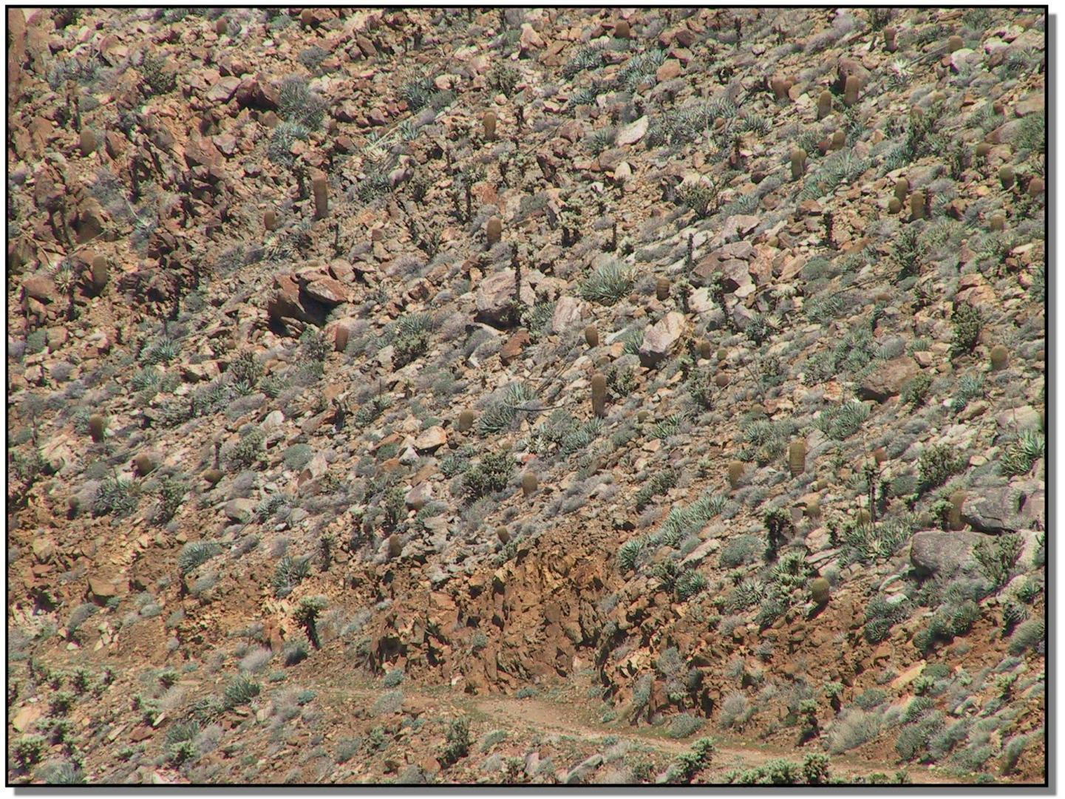
Cyril Castella, PhD thesis, 2009

Slide 9
Things are easier when we know where to look...

Slide 10
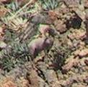

Slide 11
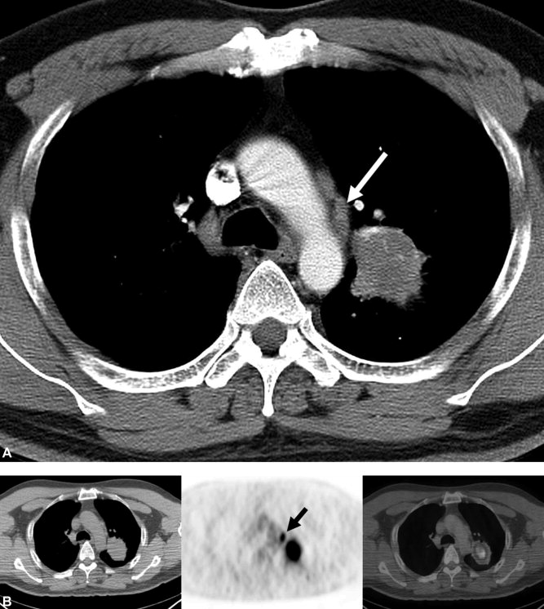
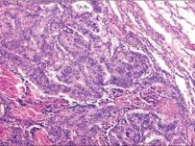
TRUE
Positive mediastinal lymph node metastasis
PET
Additional PET/CT image
positive again
CT
Pathology
positive again
Kim et al, doi 10.1002/cncr.22518 (2008)
Notes:
Figure 1: True-positive mediastinal lymph node metastasis at integrated PET/CT in a 53-year-old man with lung adenocarcinoma. (A) Mediastinal-window transverse enhanced CT scan (5.0-mm collimation, 170 mA) obtained at level of azygos arch shows 3.6-cm-sized mass in left upper lobe and 6.0-mm-sized lymph node (arrow) in short-axis diameter in aortopulmonary window area (nodal station, 5). (B) Integrated PET/CT scans obtained at a similar level to a demonstrate node showing strongly increased FDG uptake (maximum SUV = 7.4) (arrow) suggesting malignant node, which proved to contain metastatic adenocarcinoma cells.

Slide 12
What would you propose to characterize the quality of a detection?
And if you were a patient?

Slide 13
Diagnostic
Negative
Positive
pathology
absent
TN true negative
FP false positive
Truth
pathology
present
FN false negative
TP true positive

Slide 14
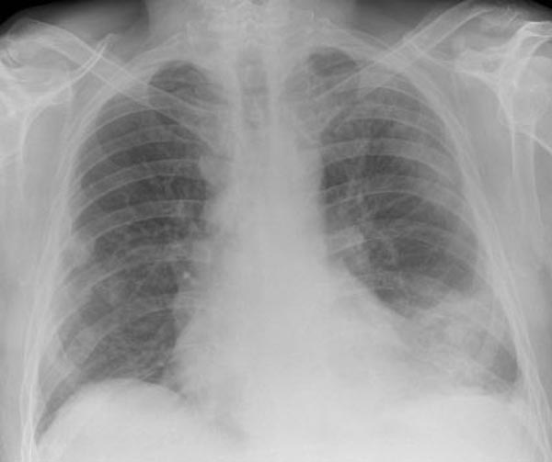
diagnostic
negative
t_{c}
positive
pathology
absent
pathology
present
observer response
(level of certainty)

Slide 15
μ₀
μ₁
probability density function
Pathology
absent
Pathology
present
σ₀
σ₁
observer response
this signal-to-noise ratio is also known as "detectability index"

Slide 16
diagnostic
negative
t_{c}
positive
probability density function
Pathology
absent
Pathology
present
observer response

Slide 17
diagnostic
negative
t_{c}
positive
probability density function
Pathology
absent
Pathology
present
TN
specificity
observer response
FP

Slide 18
diagnostic
negative
t_{c}
positive
probability density function
Pathology
absent
Pathology
present
TP
sensitivity
observer response
FN

Slide 19
Receiver
Operating
Characteristic
ROC-curve
True positive (TP)
False positive (FP)

Slide 20
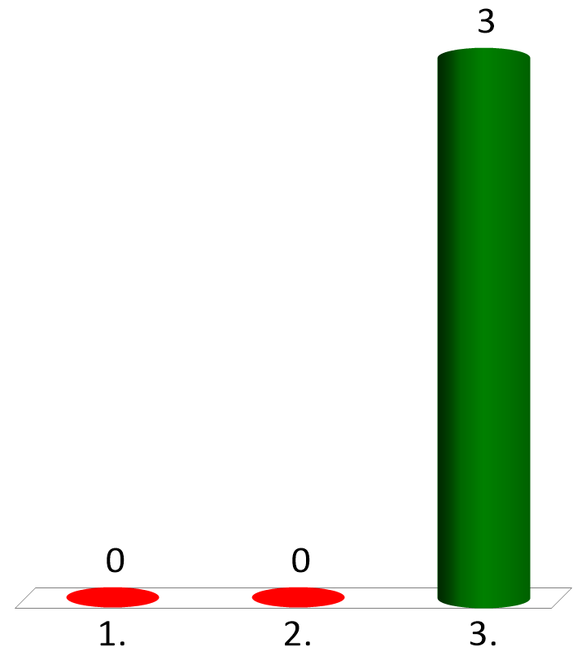
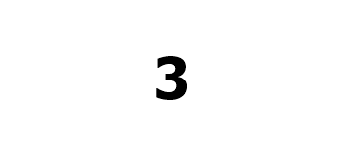
Which point of the ROC-curve corresponds to threshold = -∞?
3
Pathology
absent
Pathology
present
2
= sensitivity
True positive (TP)
observer response
1
False positive (FP)
threshold
= 1-specificity

Slide 21
3
3
2
1
Pathology
absent
Pathology
present
2
True positive (TP)
observer response
1
False positive (FP)
threshold

Slide 22
ROC curve: low threshold

Slide 23
ROC curve: medium threshold

Slide 24
ROC curve: high threshold

Slide 25
In general, the larger the area under the curve (AUC) the better the diagnostic system
SNR= 0
no information
average system
perfect system
TP
TP
TP
AUC = 0.5
AUC = 0.75
AUC = 1
FP
FP
FP
AUC: Area Under the (ROC) Curve

Slide 26
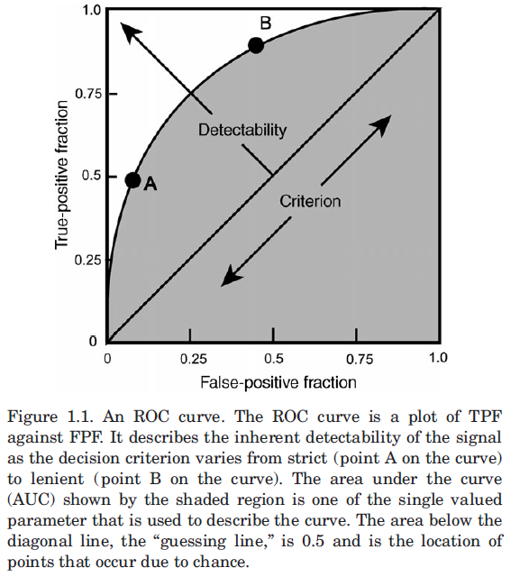
sensitivity
1 - specificity
ICRU Report 79, Receiver Operating Characteristic Analysis in Medical Imaging (2008)

Slide 27
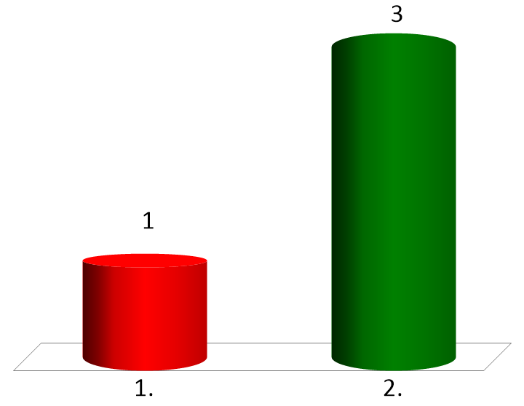

Which physician do you prefer?
physician1
if you are sick, positive diagnostic with probability 95%
if you are healthy, positive diagnostic with probability 95%
physician 2
if you are sick, positive diagnostic with probability 50%
if you are healthy, positive diagnostic with probability 5%
physician 1
physician 2
Notes:
Le médecin 1 n'apporte aucune information

Slide 28
ROC curve
worst system
sick or healthy patients have the same probability to be diagnosed positive
sensitivity (True Positive Fraction)
= portability of a positive diagnostic for a healthy patient
1 - specificity (False Positive Fraction)

Slide 29

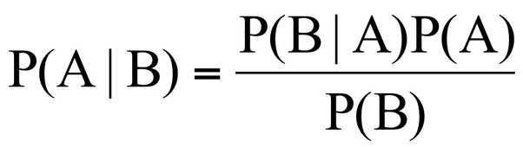
ROC theory 2. Bayes' theorem

Slide 30
sick patients
healthy patients
whole population (for instance, ensemble of possible CT images of the liver)

Slide 31
positive diagnostics
negative diagnostics
whole population (for instance, ensemble of possible CT images of the liver)

Slide 32
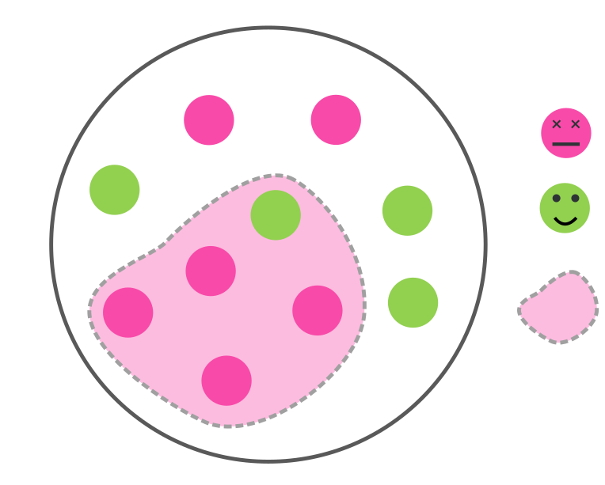
Sick
Healthy
Positive test
whole population (for instance, ensemble of possible CT images of the liver)

Slide 33
Sick
Healthy
Positive test
Probabity to be sick & positive
whole population (for instance, ensemble of possible CT images of the liver)

Slide 34
Sick
Healthy
Positive test
Probabity to be healthy & positive
whole population (for instance, ensemble of possible CT images of the liver)

Slide 35
positive diagnostics
negative diagnostics
whole population (for instance, ensemble of possible CT images of the liver)

Slide 36
correct answer (true positive)
wrong answer (false negative)
sick & negative
healthy & positive
sick & positive
healthy & negative
wrong answer (false positive)
correct answer (true negative)

Slide 37

Exercise
Derive the Bayes' theorem
Press "1" when you are finished
Hint: start by expressing

Slide 38
Exercise (solution)
sick & negative
healthy & positive
sick & positive
healthy & negative
blackboard

Slide 39
Exercise (solution)

Slide 40
Exercise
What is the probability to be sick with the following data
Prevalence: 50 %
Sensitivity: 50 %
Specificity: 90 %
Diagnostic: Positive
Press "1" when you are finished

Slide 41
Exercise (solution)
What is the probability to be sick with the following data
Prevalence: 50 %
Sensitivity: 50 %
Specificity: 90 %
Diagnostic: Positive
response
response
blackboard

Slide 42
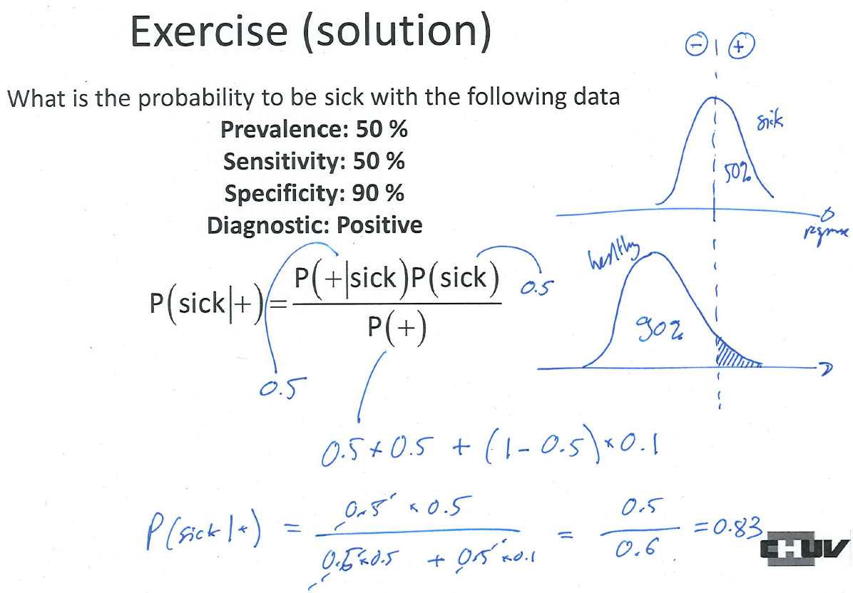

Slide 43
Exercise
Express the Bayes' theorem in terms of
sensitivity (correct positive answers among the sick)
specificity (correct negative answers among the healthy)
prevalence (proportion of the population with the sickness)
Press "1" when you are finished

Slide 44
Exercise (solution)
Express the Bayes' theorem in terms of
sensitivity
specificity
prevalence

Slide 45
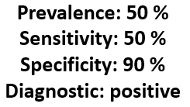
Same problem: tree method
1 000 patients
prevalence 50 %
sick
500 patients
500 patients
healthy
sensitivity 50 %
specificity 90 %
+
-
+
-
250 patients
250 patients
50 patients
450 patients
probability to be sick after a positive diagnostic: 250 / (250+50) = 0.83 = 83 %

Slide 46

ROC theory 3. Gold standard

Slide 47
The gold standard: Achilles tendon of the ROC theory
Clinical and pathological verification
Highest level of verification
Biopsy is the standard method for verifying the presence of cancer and many other disease processes (performance of pathology is tested by ROC studies…)
Patient clinical course may also provide information about the image content
Verification using imaging procedure
Previous or subsequent imaging procedure (better to use another procedure that the one being tested)
Lack of change in a mass after imaging observation over a number of years may be evidence that it is benign
ICRU Report 79, Receiver operating characteristic analysis in medical imaging

Slide 48
The gold standard: Achilles tendon of the ROC theory
Verification by consensus among experts
Consensus ≠ truth
Even experts disagree about subtle cases (and such cases may be important in the study)
When expert panel is the only way to establish a diagnostic, an appropriate method to combine the judgments has to be used
ICRU Report 79, Receiver operating characteristic analysis in medical imaging

Slide 49
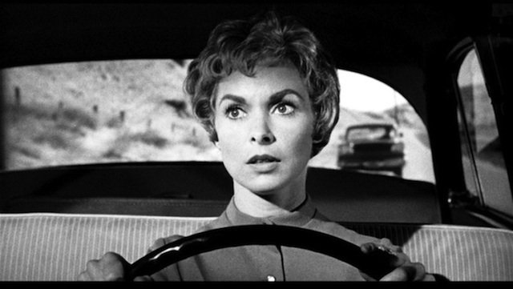
ROC theory 4. Psychophysical experiments

Slide 50
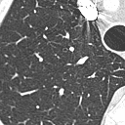
Psychophysical (human) experiments can estimate different parameters of the ROC-curve
positive/negative (YES/NO) detection experiment provides one point
one image at a time
is the signal present?
positive
negative
TP
FP

Slide 51
Psychophysical (human) experiments can estimate different parameters of the ROC-curve
Rating experiment provides the several points of the curve
one image at a time
is the signal present?
No, very likely
No, probably
Maybe
Yes, probably
Yes, very likely
TP
FP

Slide 52
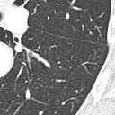
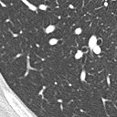
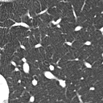
Psychophysical (human) experiments can estimate different parameters of the ROC-curve
1
2
M-alternative forced-choice (M-AFC) experiment provides the area under the curve (AUC)
3
4
TP
AUC
4-AFC
Which image is the most likely to contain the signal?
1, 2, 3, 4
FP

Slide 53
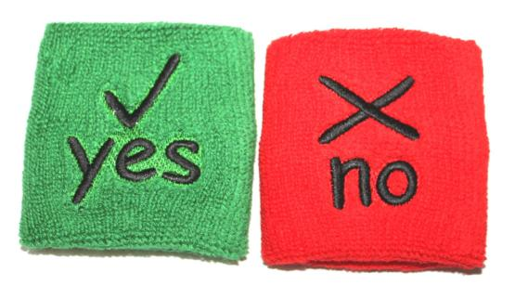
ROC theory 4.1 Detection experiments YES/NO experiment

Slide 54
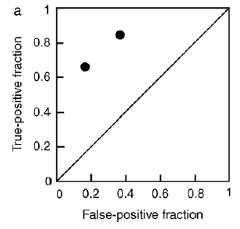
Result of a YES/NO experiment
one observer produces one result
ICRU Report 79, Receiver Operating Characteristic Analysis in Medical Imaging (2008)

Slide 55
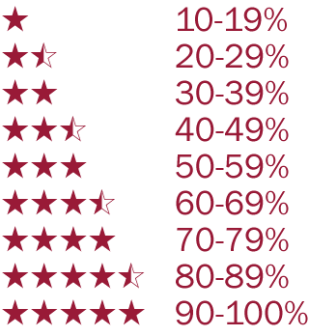
ROC theory 4.2 Detection experiments Rating experiment

Slide 56
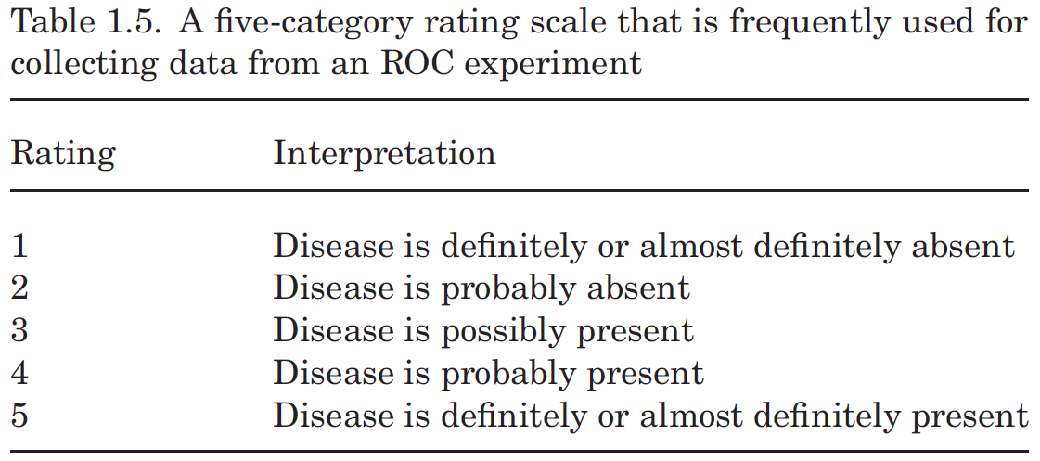
Rating experiment: example of scale
ICRU Report 79, Receiver Operating Characteristic Analysis in Medical Imaging (2008)

Slide 57
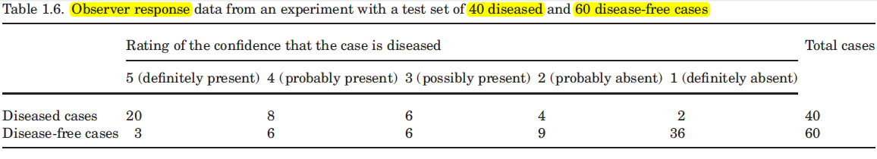
ICRU Report 79, Receiver Operating Characteristic Analysis in Medical Imaging (2008)

Slide 58
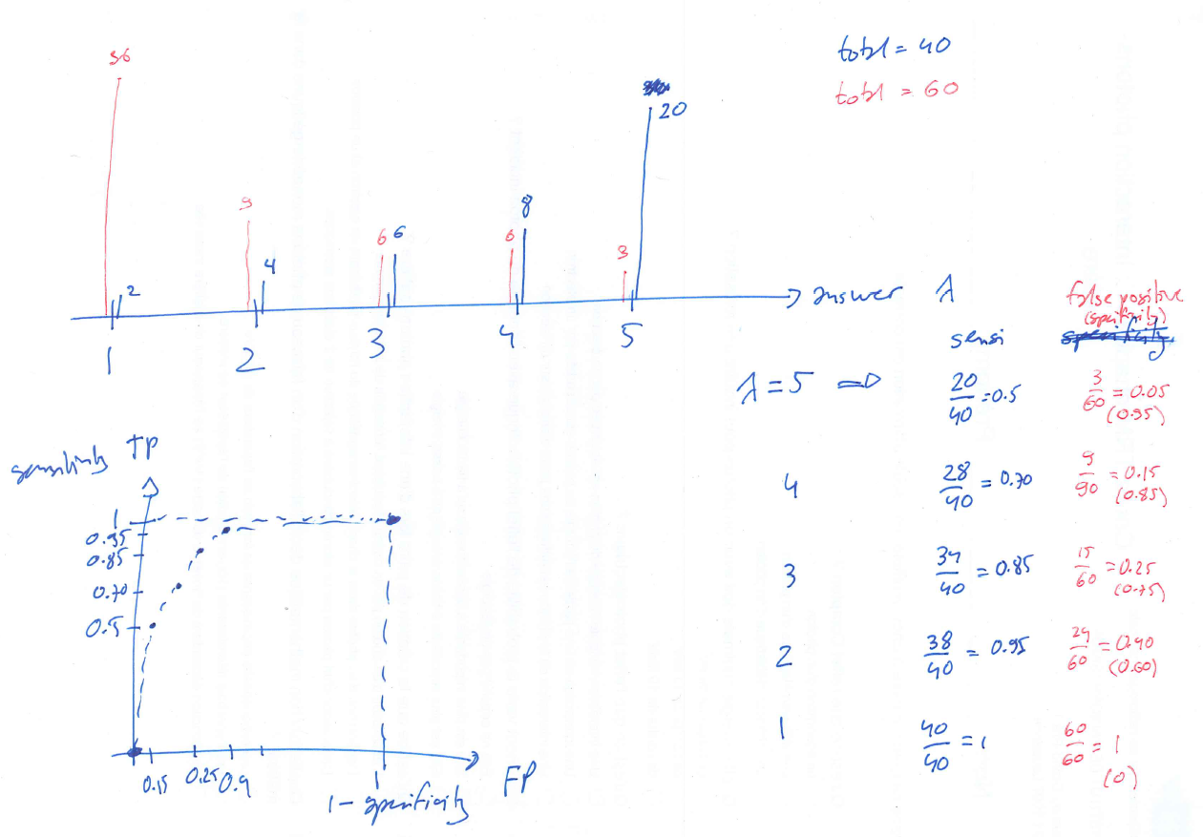

Slide 59
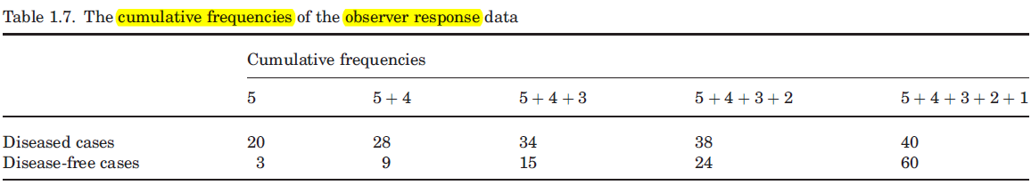
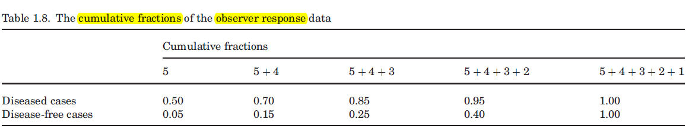
ICRU Report 79, Receiver Operating Characteristic Analysis in Medical Imaging (2008)

Slide 60
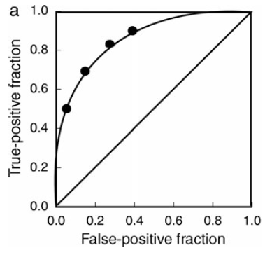
ICRU Report 79, Receiver Operating Characteristic Analysis in Medical Imaging (2008)

Slide 61
The usual method consist in performing a maximum likelihood estimation to fit a binormal ROC curve
i.e. by supposing that both responses are Gaussian (not necessarily with the same variances)
Fitting programs can be found on the web:
http://www.mips.ws
http://xray.bsd.uchicago.edu/krl/index.htm
ICRU Report 79, Receiver Operating Characteristic Analysis in Medical Imaging (2008)

Slide 62
Real experiment
You will be shown a series of 20 images.
10 will contain a signal and a noise
10 will contain only noise
The images will be presented in a random order
Your task is to rate each image according to this scale
1 sure, there is no signal | 2 | 3 | 4 | 5 | 6 | 7 | 8 | 9 sure, there is a signal

Slide 63
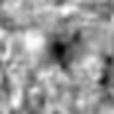
Example of signal present
1/2
VEO reconstruction
CTDI_{vol} = 0.8 mGy
Contrast = 20 HU
Signal diameter = 6 mm

Slide 64
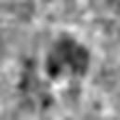
Example of signal present
2/2
VEO reconstruction
CTDI_{vol} = 0.8 mGy
Contrast = 20 HU
Signal diameter = 6 mm

Slide 65
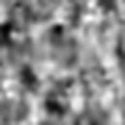
Example of noise only
1/2
VEO reconstruction
CTDI_{vol} = 0.8 mGy

Slide 66
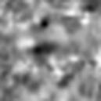
Example of noise only
2/2
VEO reconstruction
CTDI_{vol} = 0.8 mGy

Slide 67
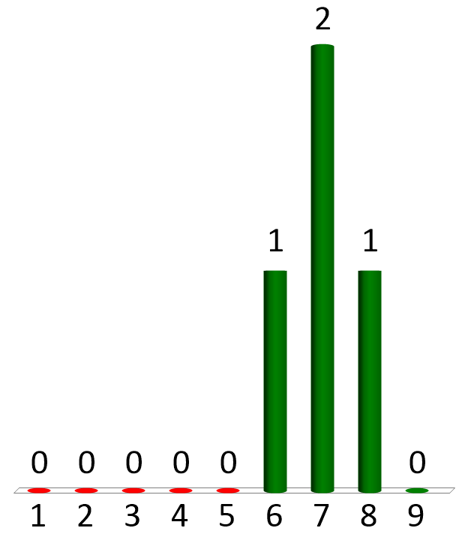
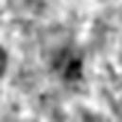
Example of rating How do you rate this image?
Only noise
Signal present
signal present
Notes:
Signal present

Slide 68
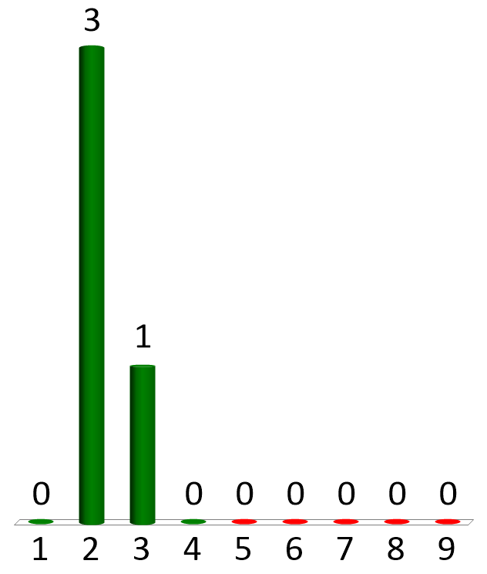
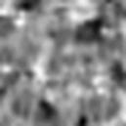
Example of rating How do you rate this image?
Only noise
Signal present
signal absent
Notes:
Signal ABSENT

Slide 69
Get ready to start the experiment
20 images will be presented

Slide 70
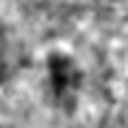
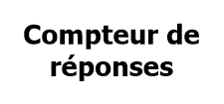
How do you rate this image?
Only noise
Signal present
image 1/20
Notes:
SIGNAL

Slide 71
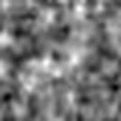
How do you rate this image?
Only noise
Signal present
image 2/20
Notes:
noise

Slide 72
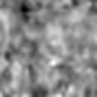
How do you rate this image?
Only noise
Signal present
image 3/20
Notes:
noise

Slide 73
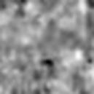
How do you rate this image?
Only noise
Signal present
image 4/20
Notes:
noise

Slide 74
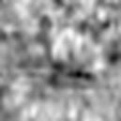
How do you rate this image?
Only noise
Signal present
image 5/20
Notes:
SIGNAL

Slide 75
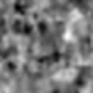
How do you rate this image?
Only noise
Signal present
image 6/20
Notes:
SIGNAL

Slide 76
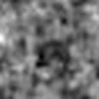
How do you rate this image?
Only noise
Signal present
image 7/20
Notes:
SIGNAL

Slide 77
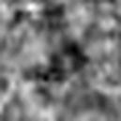
How do you rate this image?
Only noise
Signal present
image 8/20
Notes:
SIGNAL

Slide 78

How do you rate this image?
Only noise
Signal present
image 9/20
Notes:
noise

Slide 79

How do you rate this image?
Only noise
Signal present
image 10/20
Notes:
noise

Slide 80

How do you rate this image?
Only noise
Signal present
image 11/20
Notes:
SIGNAL

Slide 81

How do you rate this image?
Only noise
Signal present
image 12/20
Notes:
SIGNAL

Slide 82

How do you rate this image?
Only noise
Signal present
image 13/20
Notes:
noise

Slide 83

How do you rate this image?
Only noise
Signal present
image 14/20
Notes:
SIGNAL

Slide 84

How do you rate this image?
Only noise
Signal present
image 15/20
Notes:
noise

Slide 85

How do you rate this image?
Only noise
Signal present
image 16/20
Notes:
noise

Slide 86

How do you rate this image?
Only noise
Signal present
image 17/20
Notes:
noise

Slide 87

How do you rate this image?
Only noise
Signal present
image 18/20
Notes:
SIGNAL

Slide 88

How do you rate this image?
Only noise
Signal present
image 19/20
Notes:
SIGNAL

Slide 89

How do you rate this image?
Only noise
Signal present
image 20/20
Notes:
noise

Slide 90

Computation of the ROC-curve
Export the individual results
Transfer them into a spreadsheet in order to group noise and signal+noise images
Excel file
Transfer the results in order to compute the histograms and the ROC-curve
Igor file

Slide 91
Obtained results (2019)

Slide 92
Obtained results (2019)

Slide 93

ROC theory 4.3 Detection experiments Multi-alternative forced-choice experiment (M-AFC)

Slide 94

Where is the nodule ?

Slide 95
1
2
The nodule will be present in one (and only one) of the four locations
3
4

Slide 96

1
2
3
4

Slide 97

Where is the nodule ?
1
2
1
2
3
4
3
4

Slide 98


Did you see a gorilla?
yes
no

Slide 99
1
2
3
4

Slide 100
Exercise
Demonstrate that in a 2-AFC experiment, we have the following relationship
Press "1" when you are finished

Slide 101
Exercise (solution)
Demonstrate that in a 2-AFC experiment, we have the following relationship

Slide 102


Slide 103

ROC theory 6. Summary questions

Slide 104

What should the patient think if the result of the diagnostic is positive?
I am sick
After a positive test, the interesting question is:
Doctor, what is the probability that I am actually sick?

Slide 105

Your patient is 40 years old and participate in a mammography screening Information - about 1% of 40 years-old women have breast cancer - sensitivity 80% - specificity 90% If the diagnostic is positive, what is the probability that your patient actually has a breast cancer?
0.075%
0.75%
7.5%
75%

Slide 106
Mammography screening: positive predicting value
prevalence: 0.01 sensitivity: 0.80 specificity: 0.90
threshold
false positive
zoom
true positive

Slide 107
Mammography screening: positive predicting value
prevalence: 0.01 sensitivity: 0.80 specificity: 0.90
Bayes' theorem

Slide 108
Mammography screening: positive predicting value
(alternative description)
prevalence: 0.01 sensitivity: 0.80 specificity: 0.90
10 000 patients
1% prevalence
100
develop a breast cancer
9 900
do not develop a breast cancer
80% sensitivity
90% specificity
80 positive
20 negative
990 positive
8 910 negative

Slide 109

What is presented by the ROC curve? (several possible answers)
sensitivity versus specificity
specificity versus sensitivity
sensitivity versus 1-specificity
true positive fraction versus false positive fraction

Slide 110

What is the sensitivity?
Probability of correct responses for a sick patient
Probability of correct responses for a healthy patient
Probability to be sick with a positive diagnostic
Probability to be healthy with a negative diagnostic

Slide 111

Does sensitivity depend on the prevalence?
YES
NO

Slide 112

What is the negative predicting value?
Probability of correct responses for a sick patient
Probability of correct responses for a healthy patient
Probability to be sick with a positive diagnostic
Probability to be healthy with a negative diagnostic

Slide 113

Does the predictive negative value depend on the prevalence?
YES
NO

Slide 114
Low prevalence pathology
A sickness has a prevalence of 1/10'000
A test has the following characteristics
specificity 0.95
sensitivity 1.00
The test gives a positive result
What is the probability to be sick?

Slide 115


Probability to be sick? (sensitivity= 100% ; specificity = 95% ; prevalence = 0.01%)
less than 1%
1 to 3%
3 to 10%
10 to 30%
more than 30%

