Slide 1

Part VI: Legislation for radiopharmaceuticals
Institut de Radiophysique/CHUV
ruslan.cusnir@chuv.ch

Slide 2

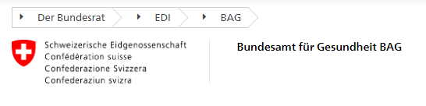
In Switzerland we have two main legal authorities which control radiopharmaceutical production:
Swissmedic
Federal Office of Public Health

Slide 3
Swissmedic
Authorisations for import of radiopharmaceuticals
Authorisations for clinical studies
Authorisation production (in-house production of radipharmaceuticals)
Registrations of radiopharmaceuticals in Switzerland
GMP (Good Manufacturing Practice) inspections
Quality System inspections

Slide 4
Federal Office of Public Health
All requests on (new) radiopharmaceuticals are approved by the FOPH for radiation safety aspects.
Authorisation radioactive substances (manipulation and administration)
Conformity of controlled zones (radioprotection)
Radiation protection / dosimetry
Quality assurance of activity measurements
Guidelines for kit preparations
→ Strong collaboration between Swissmedic and the FOPH concerning radiopharmaceuticals and their applications.

Slide 5
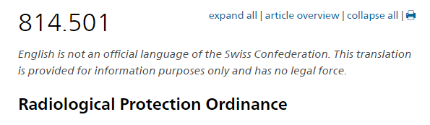
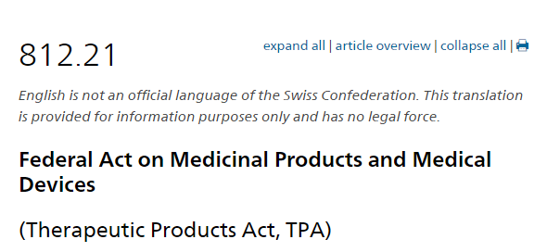
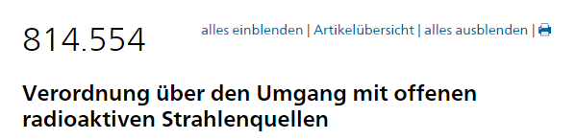

Guidelines and legal documents…
Legal notices and texts from FOPH and Swissmedic
Swiss Pharmacopoeia
European Pharmacopoeia → individual “monographs” per product
GMP Guidelines (PIC/S)

Slide 6
Summary Part VI
Swissmedic checks the radiopharmaceutical quality aspects and compliancy of radiopharmaceutical production with GMP norms.
The FOPH checks for radiation safety and quality assurance of the productions (ex. qualification of radioactivity measurement instruments, infrastructure, etc…). The FOPH checks the compliancy of quality aspects in small scale radiopharmacies.
Regular inspections by the FOPH take place in small scale and big scale radiopharmacies.
Inspections by Swissmedic are only performed in radiopharmacies having an authorization for in-house fabrications (mainly industry and university hospitals). Small scale radiopharmacies with Kit and ready-to-use preparations are so far not inspected regularly by Swissmedic. The laws and guidelines of Swissmedic have to be applied though.

Slide 7
Course Summary… After having followed this module on radiopharmacy, you should be able to…
… describe the different production modes of radionuclides for radiopharmaceuticals.
… cite the different categories of radiopharmaceuticals
… summarise the different options for quality control methods used for radiopharmaceuticals preparations and fabrications
… highlight some applications of radiopharmaceuticals in nuclear medicine.
… list the different needs for infrastructure.
… evaluate which authorities in Switzerland are responsible for the legal aspects related to radiopharmaceutical productions.

Slide 8
References
https://www.who.int/medicines/publications/pharmacopoeia/Radgenmono.pdf
https://www-pub.iaea.org/MTCD/Publications/PDF/TE-1856web.pdf
https://www.ncbi.nlm.nih.gov/pmc/articles/PMC5824710/pdf/41181_2018_Article_38.pdf
https://onlinelibrary.wiley.com/doi/pdf/10.1002/j.2051-3909.2011.tb00155.x
https://www.intechopen.com/books/newest-updates-in-rheumatology/molecular-imaging-2018-10

