Slide 1
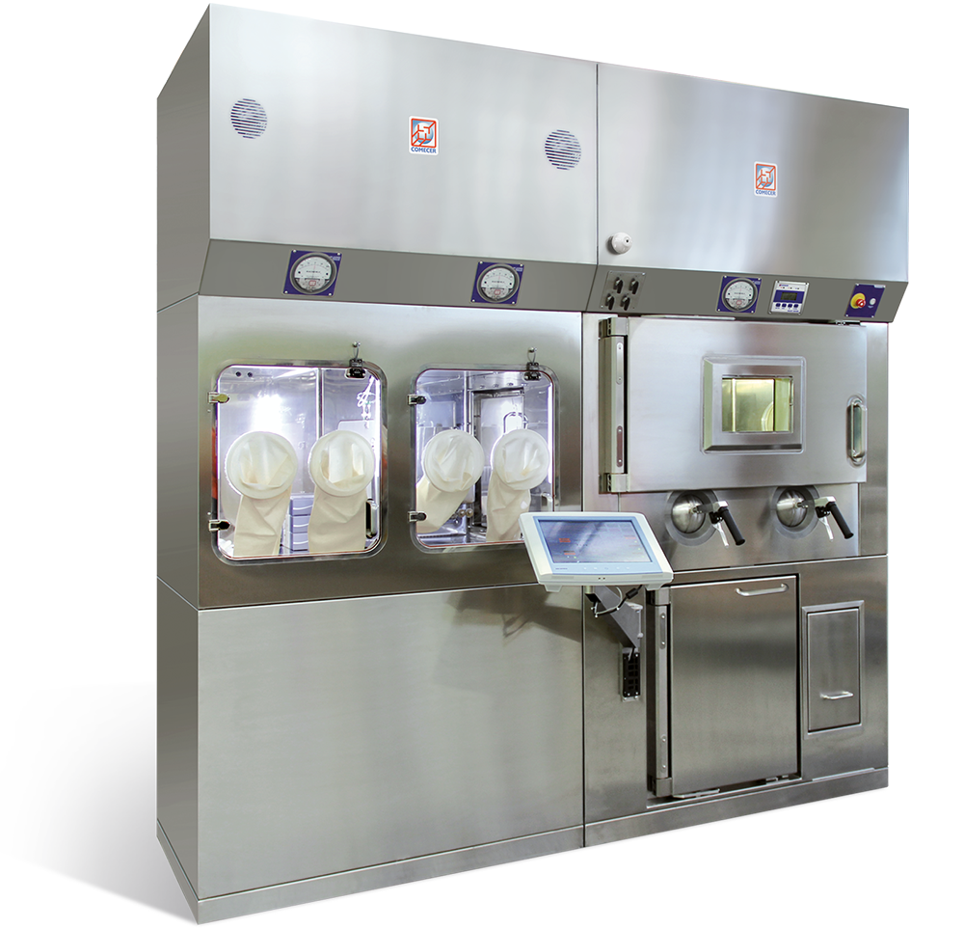
Part V: Radiopharmaceutical facilities
Institut de Radiophysique/CHUV
ruslan.cusnir@chuv.ch

Slide 2
Requirements for radiopharmaceutical facilities
Production in hot laboratories
Aseptic working techniques to be respected
Radiopharmaceuticals have to be prepared in a class A environment
  Shielded Laminar Flow Hood
  Hot Cell
If the radiopharmaceuticals are obtained from “in-house productions” (e.g. synthesis), the room of the preparation needs to be classified microbiologically → GMP Laboratories!

Slide 3
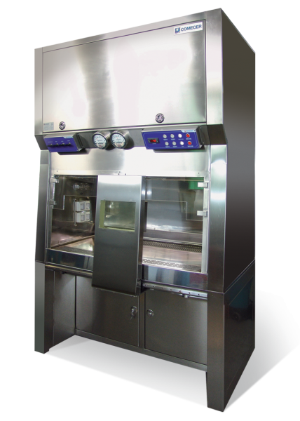
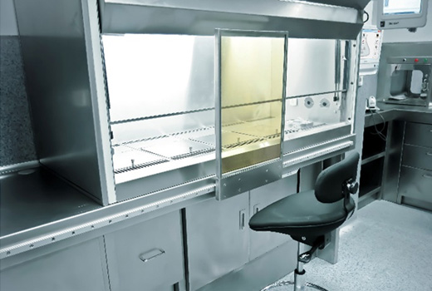
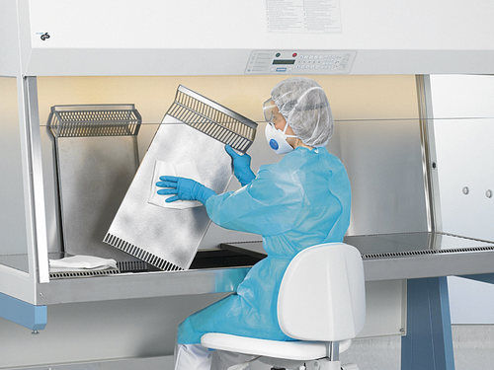
Small-scale radiopharmacies
(KIT and ready-to-use therapeutic preparations)
Personnel trained in aseptic working and radiation protection
Ideally dedicated room for production
Shielded Laminar Flow Hood, Class A

Slide 4
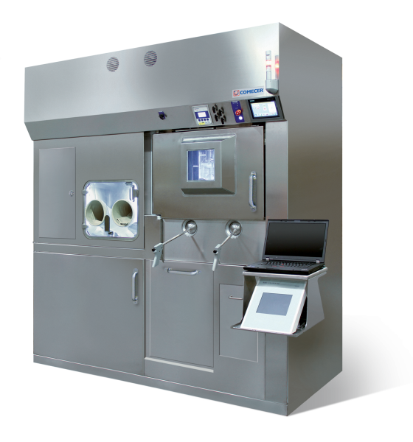
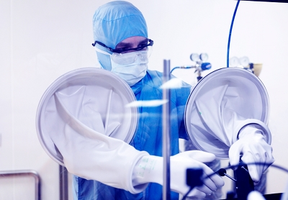
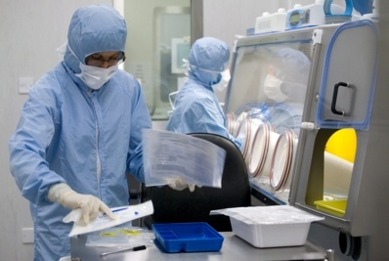
Large-scale radiopharmacies, University Hospitals
(KITs, ready-to-use therapeutic preparations, in-house production)
Personnel trained in aseptic working and radiation protection
Supervision of a radiopharmacist for the production
Dedicated room for production, dedicated room for QC
Hot cell Class A, environment class B, C or D
GMP certified by the authorities

Slide 5
GMP: Good Manufacturing Practice
Adequate premises, space, equipment and materials
Appropriately qualified and trained personnel
Clear definition of manufacturing processes
Validation of critical steps in the process
Validation of any significant changes to the process
Approved instructions and procedures for production, quality control, product release, etc.
Quality assurance and quality control independent of production
Traceability of manufacture
Examination of complaints and investigation of quality defects
….

Slide 6
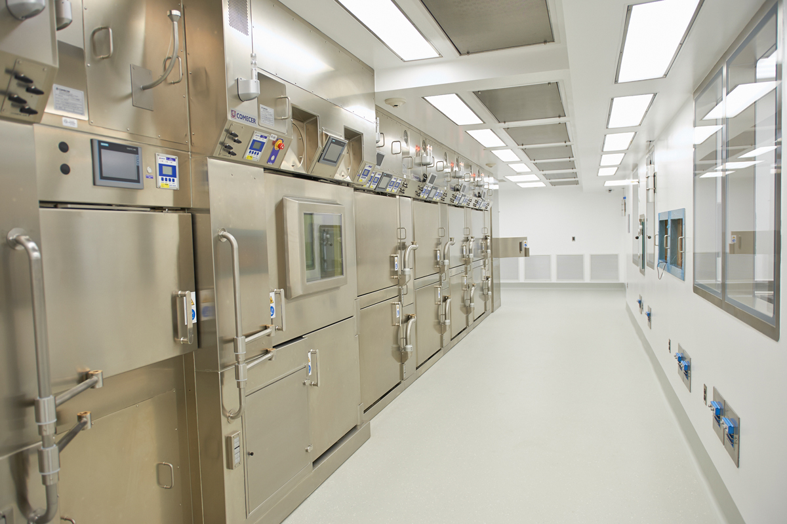
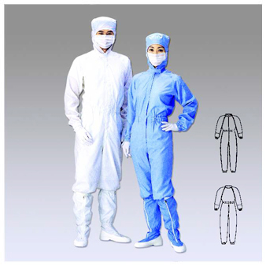
Industrial production…

Slide 7
Summary Part IV
Relatively “simple” facilities for kit and ready-to-use preparations
Less exhaustive quality systems for kit and ready-to-use preparations
Small nuclear medicine departments do not have the means to offer in-house syntheses and production
Productions are mainly carried out industry or university hospitals with large nuclear medicine facilities
→ GMP facilities mandatory, certification by authorities, regular inspections take place

