Slide 1
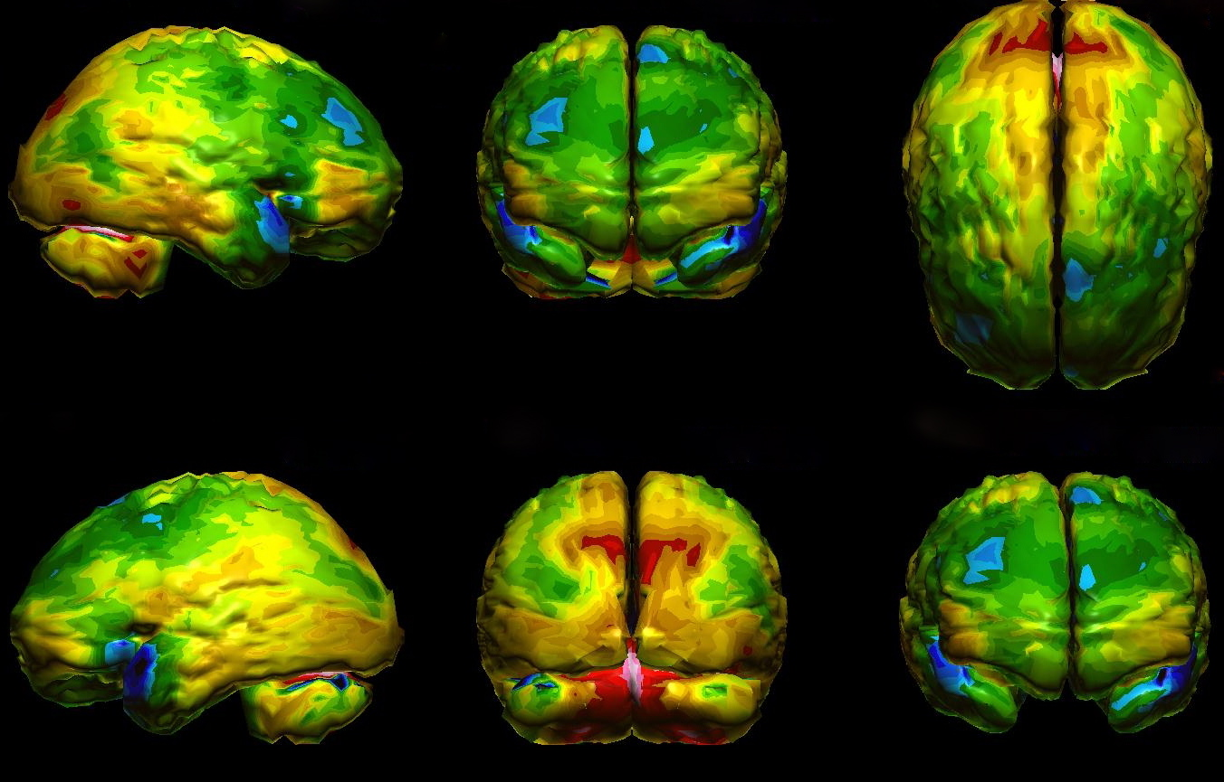
Part IV
Applications in Nuclear Medicine
Institut de Radiophysique/CHUV
ruslan.cusnir@chuv.ch
http://brainattacks.net/author/brain34/

Slide 2
Part IV: Applications in Nuclear Medicine
PET radionuclides
SPECT radionuclides
Therapeutic radionuclides
Theranostics

Slide 3
Applications in Nuclear Medicine
Molecular imaging
Molecular imaging uses small doses of substances labelled with a radioactive atom to probe bodily functions by exploiting the property of these substances to bind to receptors or being taken up by tumor cells. Using special detection equipment, the radioactive substances can be traced dinymically in the body to see where and when they concentrate in real time.
In contrast to CT, MRI or US examination that show only structural pathologies, radionuclide methods allow imaging of functional changes that occur in the course of the disease and usually are featured by a very high specificity.

Slide 4
Applications in Nuclear Medicine
Imaging
  Gamma or positron emitting isotopes
    ^{99m}Tc (γ), ¹¹¹In (γ), ¹⁸F(β⁺), ¹¹C (β⁺), ⁶⁴Cu (β⁺)
  Visualisation of a biological process
    Cancer, myocardial perfusion agents,…
Therapy
  Particle emitters
  Alpha, beta, (gamma)
    ¹⁸⁸Re, ⁸⁹Sr, ⁹⁰Y, ²¹²Bi, ²²⁵Ac, ¹³¹I, ¹⁷⁷Lu, ²²³Ra…
  Treatment of disease
    Cancer, hyperthyroidism, …

Slide 5
Criteria used to select radionuclides
Physical half-life (should be reasonable for its application)
Purity
Nuclear properties
Wide availability
Effective half-life
High target to non-target ratio
Simple preparation
Biological stability
Production costs

Slide 6
Ideal Nuclear Properties for imaging agents
Reasonable energy emissions.
  Radiation able to penetrate several layers of tissue (ideal: 120 – 150 keV)
No particle (β, α) emission (gamma only)
Short effective half-life
Cost effective

Slide 7
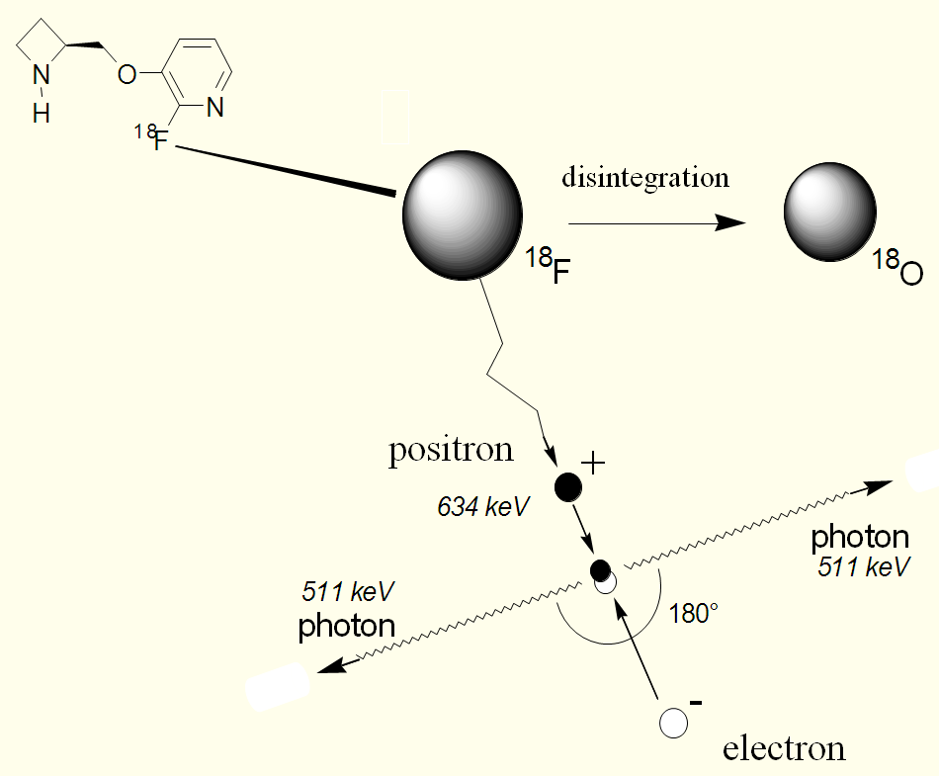
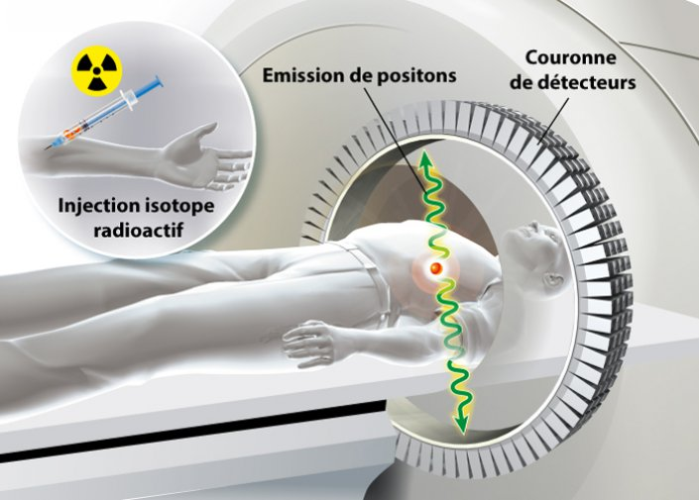
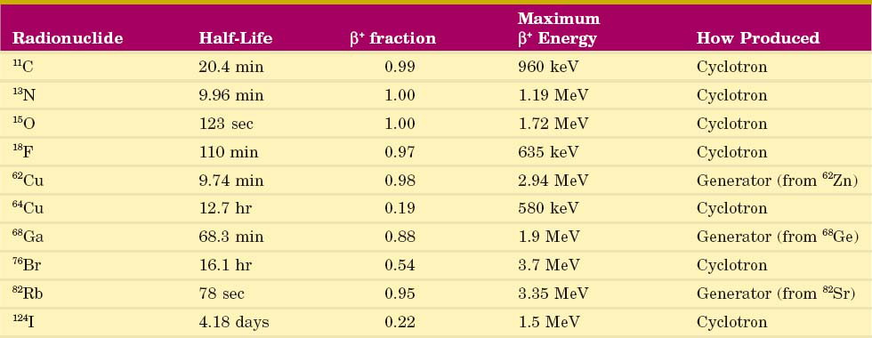
Principle of PET (positron emission)
Notes:
PET tracers emit positrons that annihilate with electrons up to a few millimeters away, causing two gamma photons to be emitted in opposite directions.

Slide 8
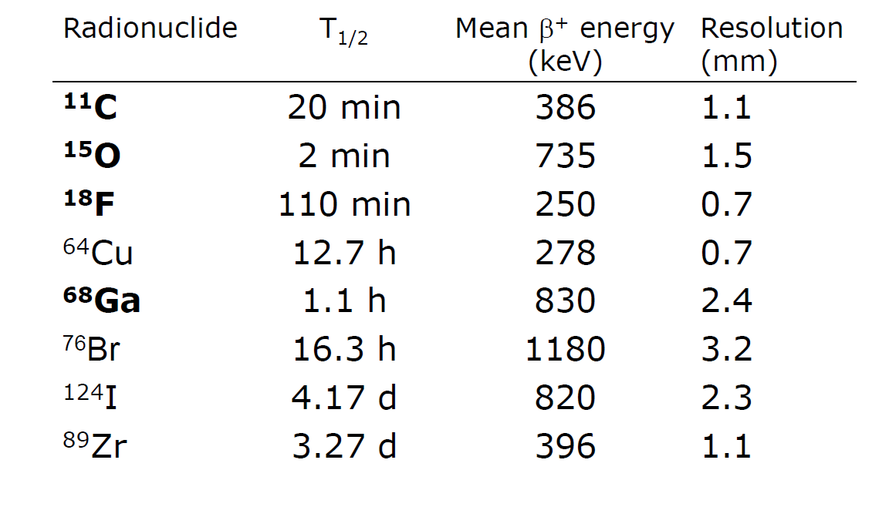
Important PET radionuclides

Slide 9
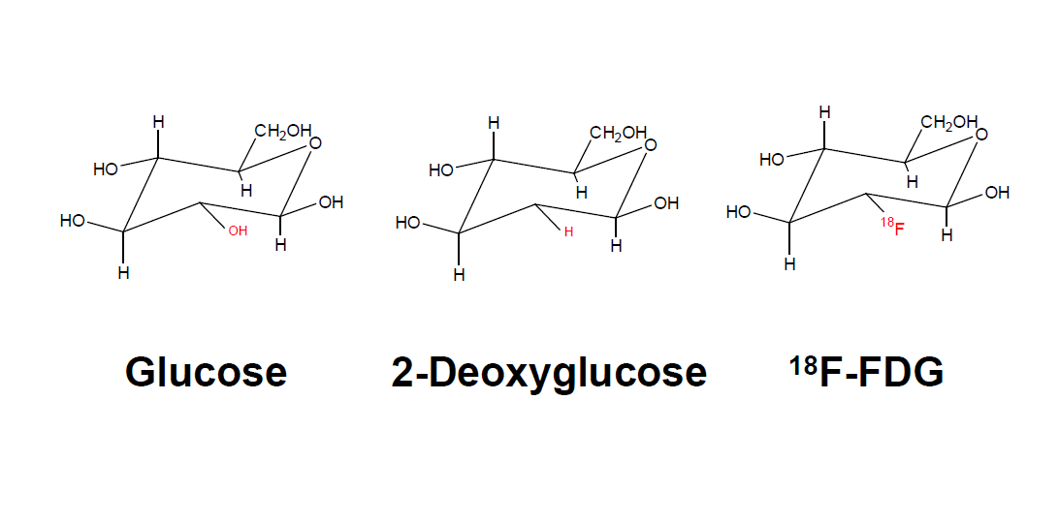
A very commonly used radiopharmaceutical used in PET-CT studies is fluorodeoxyglucose (¹⁸F-FDG), which is a structural glucose analog. Areas of increased tracer uptake indicate the intensification of metabolic processes associated with increased glucose demand. This feature can be found both in a tumor and inflammatory settings.

Slide 10
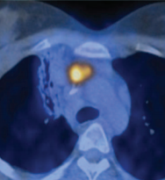
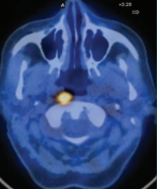
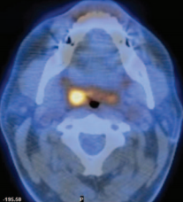
Commonly used: ¹⁸Fluorodeoxyglucose (FDG)
β⁺ emission
PET scans
Sugar metabolic pathway
Rate dependence on cell type
  Brain, heart, tumor…
  Dementia, Alzheimer’s,
  Drug abuse…

Slide 11
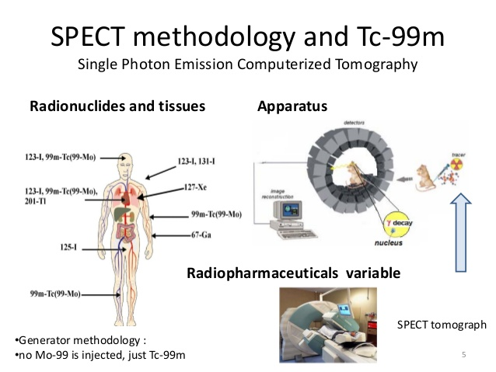
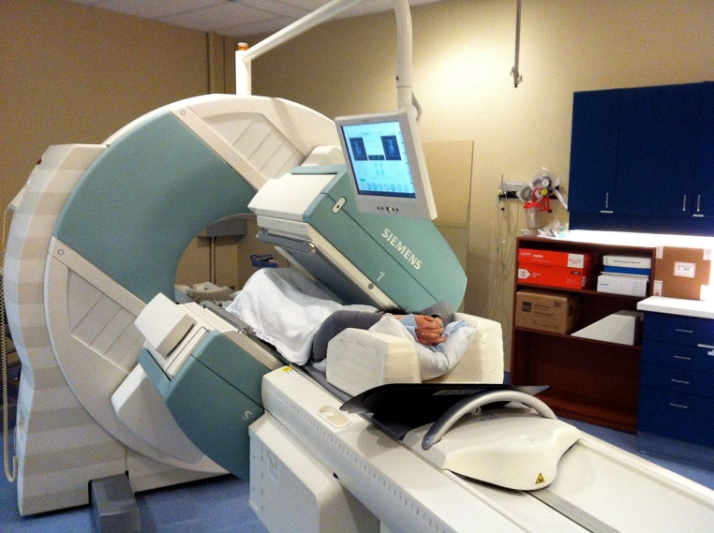
Principle of SPECT (gamma emitting radioisotopes)
Notes:
Tracers used in SPECT emit gamma radiation that is measured directly

Slide 12
Important SPECT radionuclides (gamma)
Radionuclide T_{1/2} gamma (%)
Tc-99m 6.02 hr 140 KeV (89)
Tl-201 73 hr 167 KeV (9.4)
In-111 2.21 d 171(90), 245(94)
Ga-67 78 hr 93 (40), 184 (20), 300(17)
I-123 13.2 hr 159 (83)
I-131 8d 284(6), 364(81), 637(7)
Xe-133 5.3 d 81(37)

Slide 13
PET
SPECT
PET tracers emit positrons that annihilate with electrons, causing two gamma photons:
Biologically useful isotopes
(¹¹C, ¹³N, ¹⁵O, ¹⁸F)
Very short T_{1/2}
Production on site (cyclotron)
Very expensive
Tracers used in SPECT emit gamma radiation that is measured directly:
Complex and larger molecules.
(^{99m}Tc, ¹²³I, ¹¹¹In, …)
Longer half lives
Available world wide (No special production equipment needed)
Less expensive

Slide 14
Important radionuclides for therapy
Radionuclide |  | T_{1/2} |  | Particle (MeV)
I-131(MIBG) |  | 8 d |  | β ⁻ (0.6) max
Sm-153 |  | 1.9 d |  | β ⁻ (0.8) max
Re-186 |  | 3.8 d |  | β⁻ (1.1) max
Sr-89 |  | 50.6 d |  | β ⁻ (1.5) max
P-32 |  | 14.3 d |  | β ⁻ (1.7) max
Re-188 |  | 17 hrs |  | β ⁻ (2.1) max
Y-90 (SIR-Spheres) |  | 2.7 d |  | β ⁻ (2.3) max
Lu-177 (Luthathera) |  | 6.6 d |  | β ⁻ (0.5) max
Bi-212 |  | 1 hr |  | α (6.05) max
Ra-223 (Xofigo) |  | 11.4 d |  | α (5.78) max

Slide 15
Effective half-life (physical and biological)
Rate of accumulation or elimination of the radioactive
substance in the organism.
Nuclear Decay (T_{1/2})
  Inherent statistical decay of the nuclide
Biological T_{1/2}
  Uptake/washout of the radiopharmaceutical
  Equilibration
  Decomposition

Slide 16
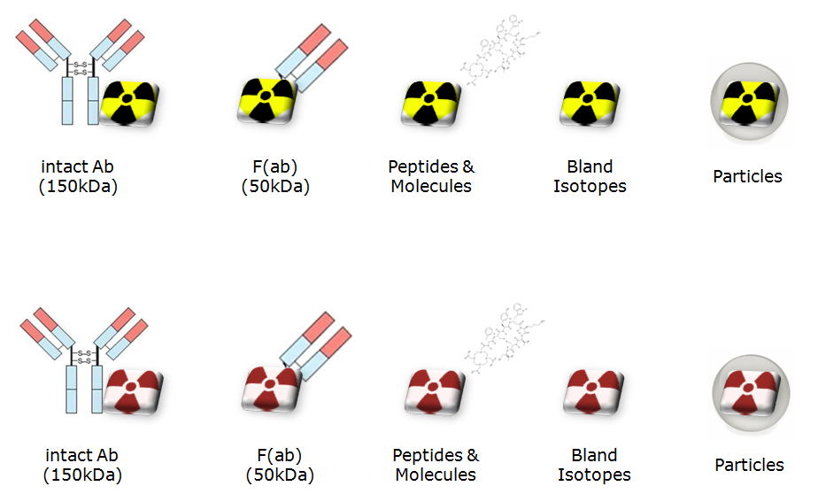
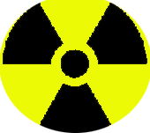
Evolution of theranostics - new therapeutic nuclides
Theranostics is a new field of nuclear medicine which combines specific targeted therapy with specific targeted diagnostic tests. Theranostics uses specific biological pathways in the human body, to acquire diagnostic images and also to deliver a therapeutic dose of radiation to the patient.
Diagnostic
(Low Dose)
Therapy
(High Dose)
http://theranostics.com.au/what-is-theranostics/

Slide 17
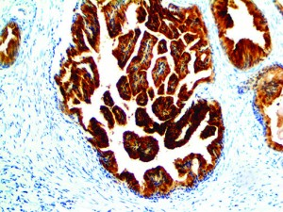
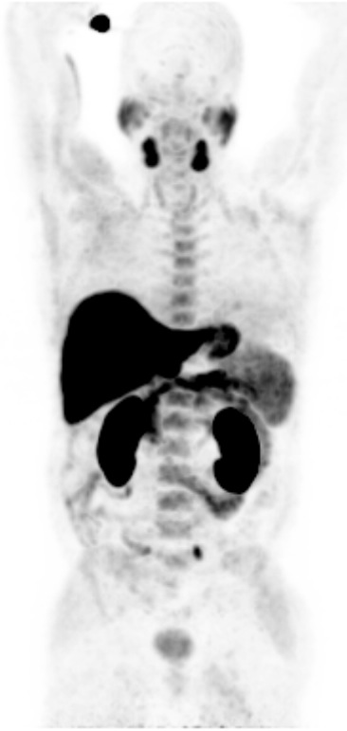
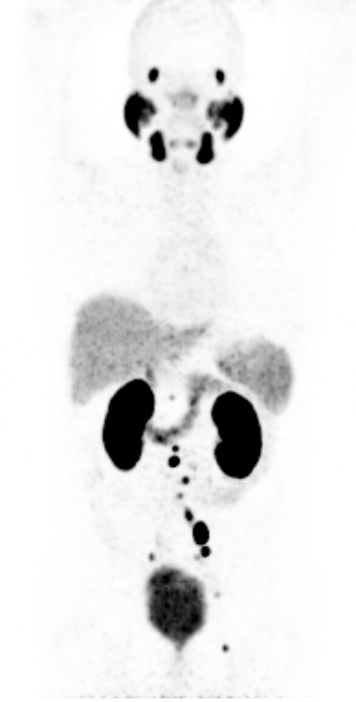
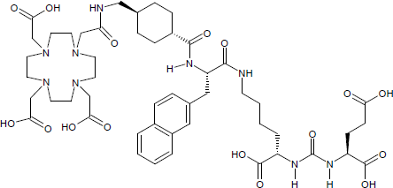
Prostate Cancer (Gallium-68 PSMA)
PSMA – R +++
Metastatic Prostate Cancer
Ga68
⁶⁸Ga-PSMA-617
PET
¹⁸F-choline (Standard)
PET
⁶⁸Ga-PSMA-617

Slide 18
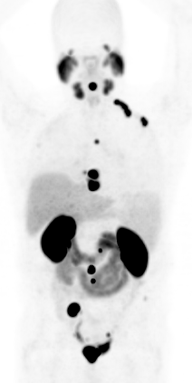
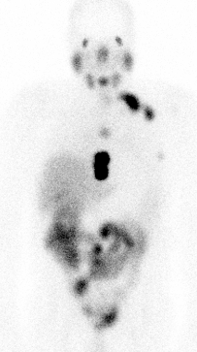
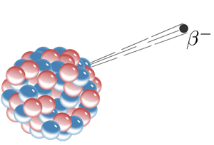
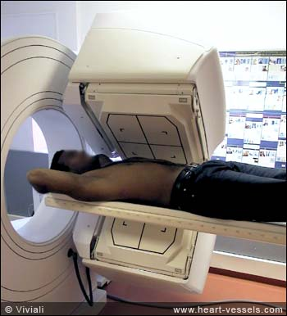
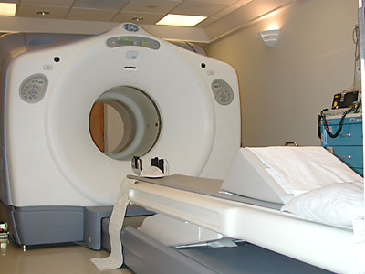
⁶⁸Ga / ¹⁷⁷Lu PSMA-617
Lu177
+
Ga68
¹⁷⁷Lu-PSMA-617
⁶⁸Ga-PSMA-617

Slide 19
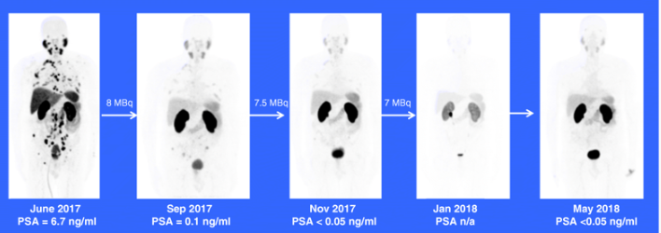
⁶⁸Ga-PSMA-11 / ²²⁵Ac-PSMA-617
²²⁵Ac-PSMA-617 in chemotherapy-naive patients with advanced prostate cancer: a pilot study (Mike Sathekge et al.)
⁶⁸Ga-PSMA-11-PET/CT → complete response after 3 cycles of ²²⁵Ac-PSMA-617;
symptom-free on 11-month follow-up
https://link.springer.com/article/10.1007/s00259-018-4167-0

Slide 20
Summary Part IV
Choice of radionuclide to use depends on application (diagnostic or therapeutic)
Ideally, short-lived for diagnostics, longer lived for therapeutics
New approaches in the fields of so called ‘theranostics’:
- Similar characteristics, same binding sites
- Imaging and therapy combined
→ Focus on development in antibody and peptide labeled radiopharmaceuticals.

Slide 21
Exercise
Q1: Describe the ideal characteristics for an imaging radiotracer
Q2: Describe the ideal characteristics for a therapeutic radiotracer
Q3: Describe the ideal characteristics for a theranostic radiotracer

