Slide 1

Part III: Quality Control Methods
Institut de Radiophysique/CHUV
ruslan.cusnir@chuv.ch

Slide 2
High quality and sterility of the product has to be guaranteed!
Patients (especially patients suffering from cancer) are susceptible to infections (ex. by surgery and by the bone marrow-damaging effects of chemotherapy and radiation). Due to a possible lack of white blood cells (leukocytes), the body's immune system can be so weakened that even harmless pathogens can be dangerous to the patient.
Aseptic preparation of radiopharmaceuticals
Asepsis is understood in medicine as the state of sterility. Aseptic or aseptic measures prevent microbial contamination.

Slide 3
Quality of the product has to bee guaranteed
Side effects to be avoided…
Bad image quality if radiochemical impurities or not enough activity…
Chemical impurities may cause side effects and symptoms to the patient…
Administration of the wrong nuclide can cause severe side effects or lead to death…
But: How do we know what the “right” quality is?

Slide 4
Where do you find the information for the quality control…
SPC (Summary of Product Characteristics) of KITs and other radiopharmaceuticals.
Pharmacopoeia monographs
Legal Notices FOPH/Swissmedic
Publications/Literature

Slide 5
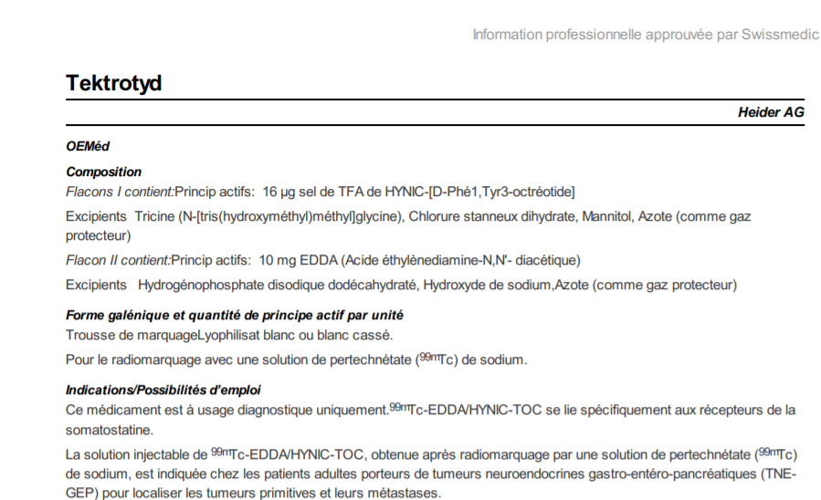
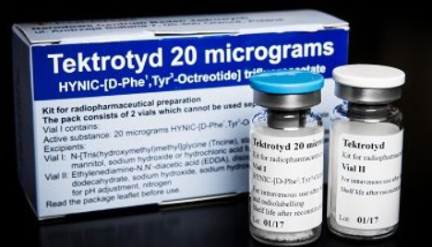

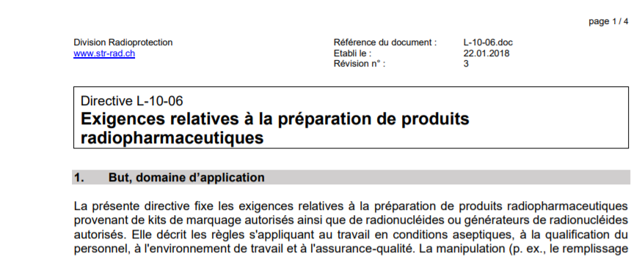
Information QC…
SPC
Ph.Eur. Monographs
Legal Notices FOPH

Slide 6
Quality Control (QC) Methods
Detection and measurement of radioactivity
Chromatographic systems for separation of impurities
TLC and paper chromatography (radiochemical purity)
HPLC (identification, radiochemical purity, quantification)
GC (residual solvents)

Slide 7
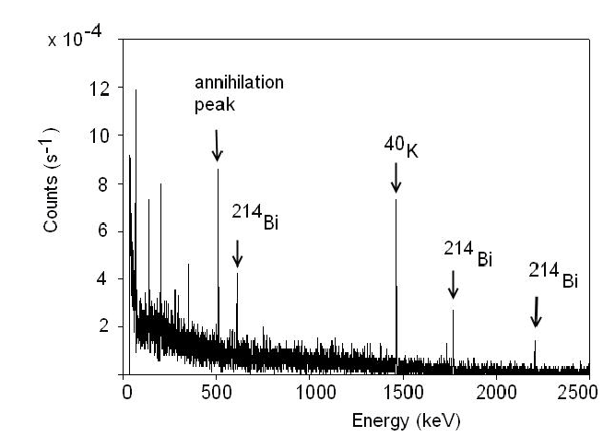
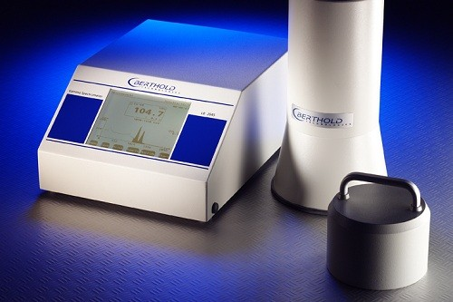
QC of ready to use radiopharmaceuticals
To check for:
(Isotope identification)
Activity
Other quality parameters as sterility, apyrogenicity, radionuclidic purity, radiochemical purity, chemical purity,… are guaranteed by the company.

Slide 8
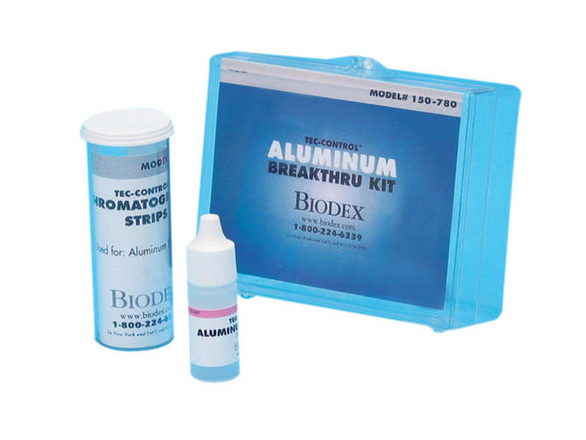

QC of Generators
Generators are producing the eluates used for KIT preparations. In some cases, the elution can be used directly as a radiopharmaceutical (ex. ^{99m}TcO₄⁻). A generator is delivered with a so called SPC (summary of product characteristics) where the tests for the QC are described.
^{99m}Tc generators: to be checked for ⁹⁹Mo break-through
⁶⁸Ga generators: to be checked for ⁶⁸Ge break-through
Aluminium content
pH

Slide 9
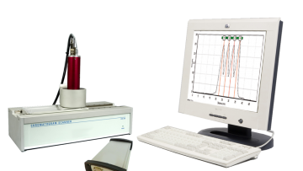
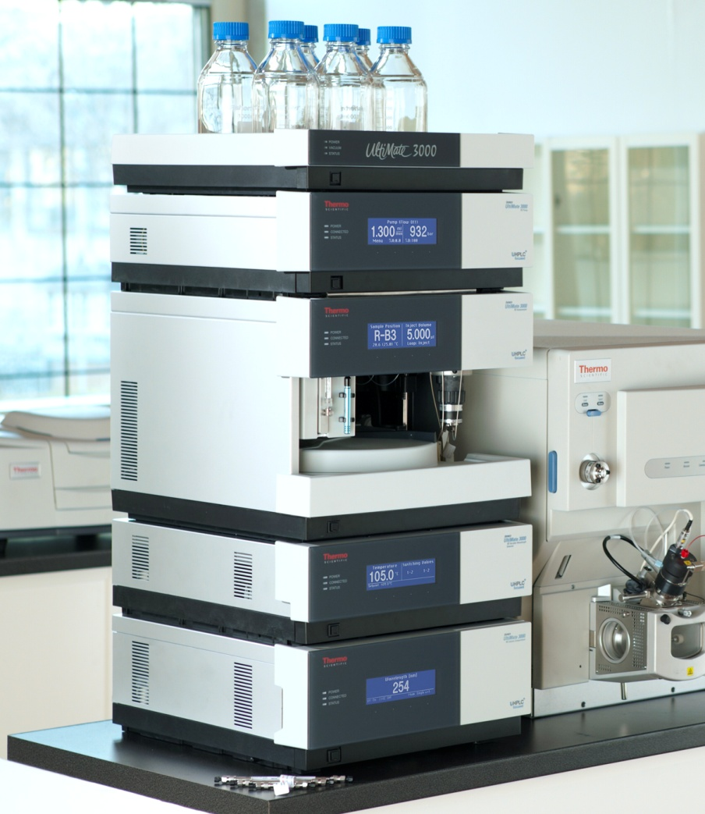
QC radionuclide precursors… Production
Production of radiopharmaceuticals requires special facilities, sophisticated QC instruments and specially trained personnel.
In Switzerland, production of radiopharmaceuticals can only be done under the supervision of an EANM Radiopharmacist (or equivalent).
Exhaustive QC parameters are required:
Radionuclidic purity
Amount of radioactivity
Chemical purity
Radiochemical purity
Particle size
pH
Sterility and endotoxins
Break-through of mother nuclide
Quantification of residual solvents from synthesis process
…

Slide 10
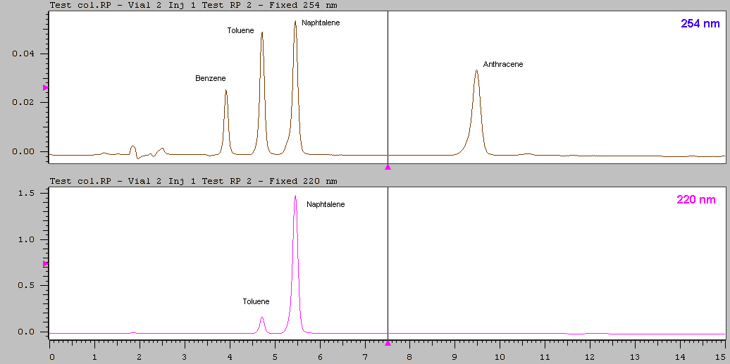
A pressurized liquid solvent containing the sample mixture flows through a column filled with a solid adsorbent material which retains the individual components.
HPLC quality control
HPLC separates, identifies, and quantifies each component in a radiopharmaceutical.
Module Radioactivity (labeled)
Module UV-Visible (non labeled)

Slide 11
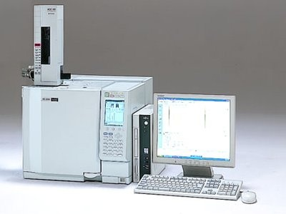
Gas Chromatography (GC)
Used for separating and analyzing compounds that can be vaporized without decomposition.
Used for testing the purity of a particular substance, or separating the different components of a mixture.
Relative amounts of such components can be determined.
Quantification of residual solvents such as ethanol or acetone
Physiological effect of solvents, Ph.Eur. limits must be respected

Slide 12
QC Recommendations for a Kit (^{99m}Tc Kit)
Amount of radioactivity
Radiochemical rurity
(pH Value)
For commercial Kits, the chemical purity, apyrogenicity, particle size and pH value are generally guaranteed by the manufacturer.

Slide 13
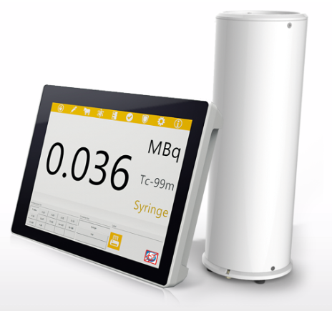
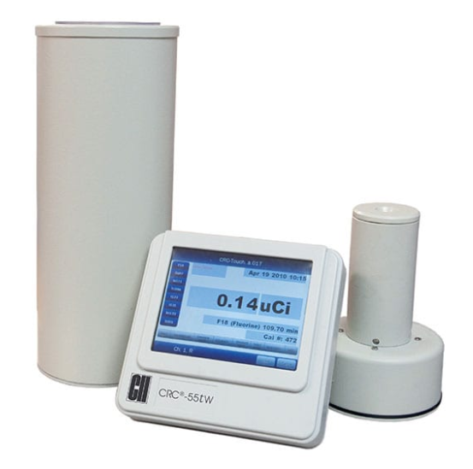
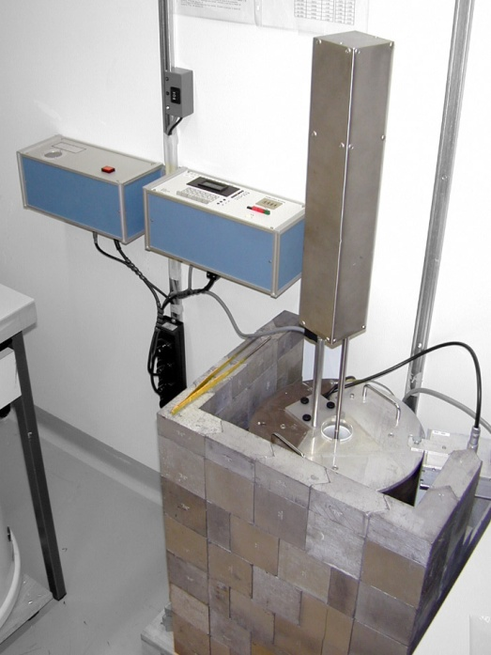
Amount of radioactivity
Dose calibrator (activity measurement)
Individual radionuclides with specific calibration factor
Geometry of measured sample is important
Intercomparaison
IRA
Veenstra
Capintec

Slide 14
Radiochemical purity
Radiochemical impurities may originate from…
radiopharmaceutical preparation;
subsequent chemical reactions;
incomplete preparative separation;
chemical changes during storage.
The determination of radiochemical purity requires separation of the different chemical substances containing the radionuclide and determination of the percentage of radioactivity of the radionuclide concerned associated with the stated chemical form.

Slide 15
Paper and thin-layer chromatography
Analytical method used to separate substances.
The mobile phase is generally an alcohol solvent mixture
The stationary phase is a strip of chromatography paper

Slide 16
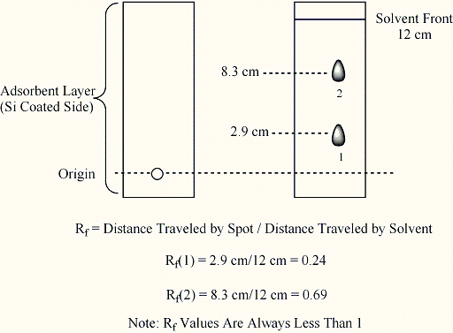
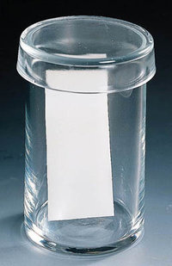
If R_{ƒ} value of a solute is zero, the solute remains in the stationary phase and thus it is immobile.
If R_{ƒ} value = 1 then the solute has no affinity for the stationary phase and travels with the solvent front.

Slide 17
Radiochemical Purity
Paper and thin-layer chromatography
A radio TLC scanner comprises a radioactivity detector placed at a fixed distance from a movable, motor driven scanning platform where the radio TLC is positioned. As radioactivity detector, a proportional counter or collimated NaI or scintillation detectors can be used.
The platform moves along an axis so that the entire surface is scanned during a single run. The detector is connected to a counting device. The radioactivity distribution on the TLC plate is automatically recorded, and the profile describes peaks having areas proportional to the distances.
https://www-pub.iaea.org/MTCD/Publications/PDF/TE-1856web.pdf

Slide 18
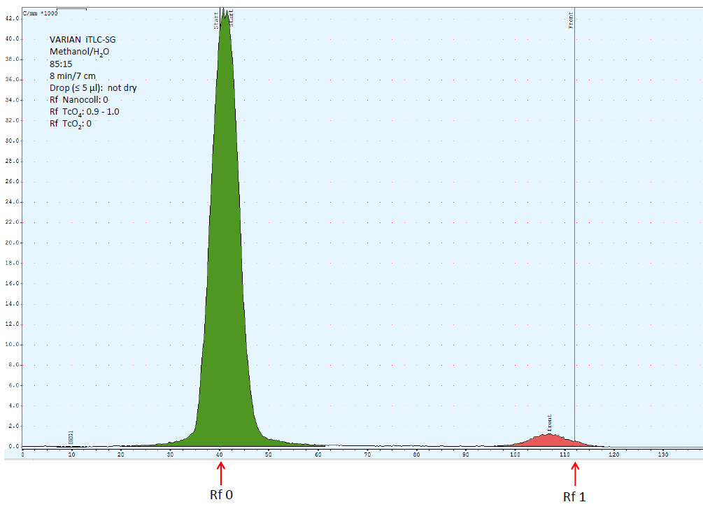
Impurity
% Impurity =
x 100
(Impurity + Radioph.)
Radiopharmaceutical
Impurities

Slide 19
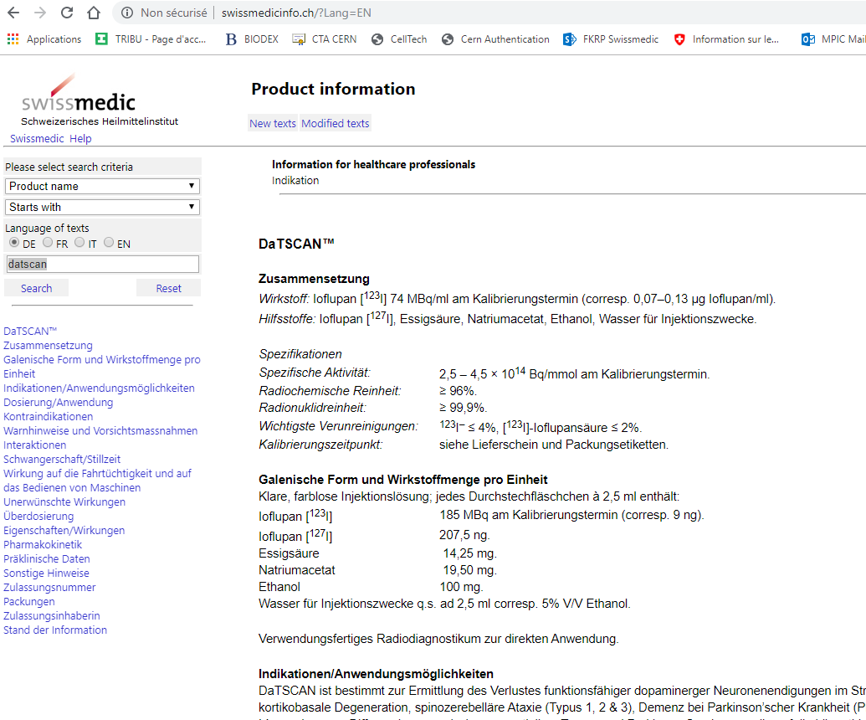
Information on radiopharmaceuticals
http://www.swissmedicinfo.ch

Slide 20
Summary Part III
QC is essential to avoid side effects/interferences with the product
QC requested depends on the category of radiopharmaceutical products
QC techniques are mainly based on dose calibrator, TLC, HPLC and GC measurements

