Slide 1
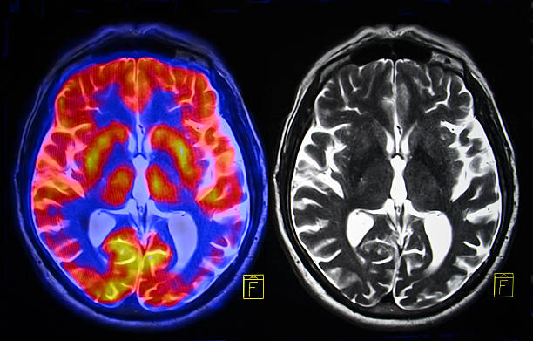
Part II: Radiopharmaceutical Products
Institut de Radiophysique/CHUV
ruslan.cusnir@chuv.ch
https://www.istockphoto.com/ch/foto/gehirn-mri-gm494930234-76746823

Slide 2
Types of radiopharmaceuticals
Ready to use radiopharmaceuticals (ex. therapeutic doses)
Radionuclide precursors (any radionuclide produced for radiolabelling of another substance prior to administration, ex. synthesis of ⁶⁸Ga peptides)
Generators
Radiopharmaceutical kits (to be reconstituted or combined with radionuclides)

Slide 3
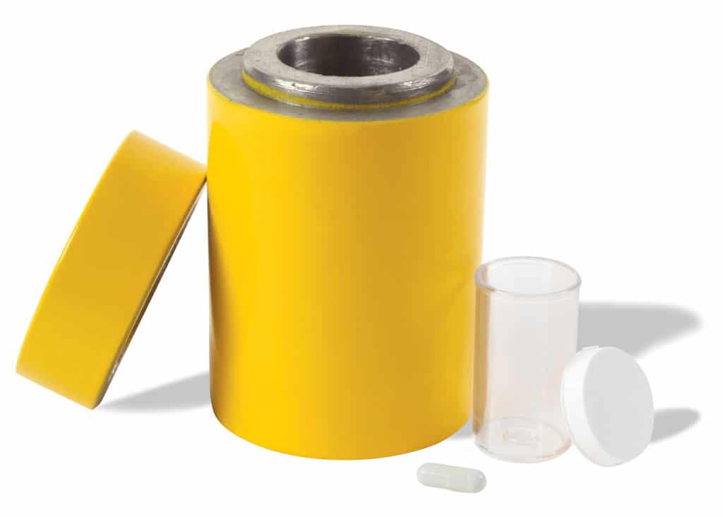
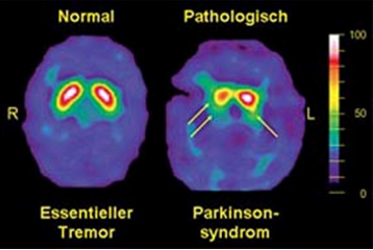
Ready to use…. Diagnostic Radiopharmaceuticals
Eluate ^{99m}Tc generators: [^{99m}Tc]NaTcO₄ sodium pertechnetate
¹³¹I capsules: Draximage®
¹²³I DaTscan…
Example DaTscan
Essential tremor on the left (normal DaT Scan)
Parkinsonian syndrome on the right (decreased DaT Scan)

Slide 4
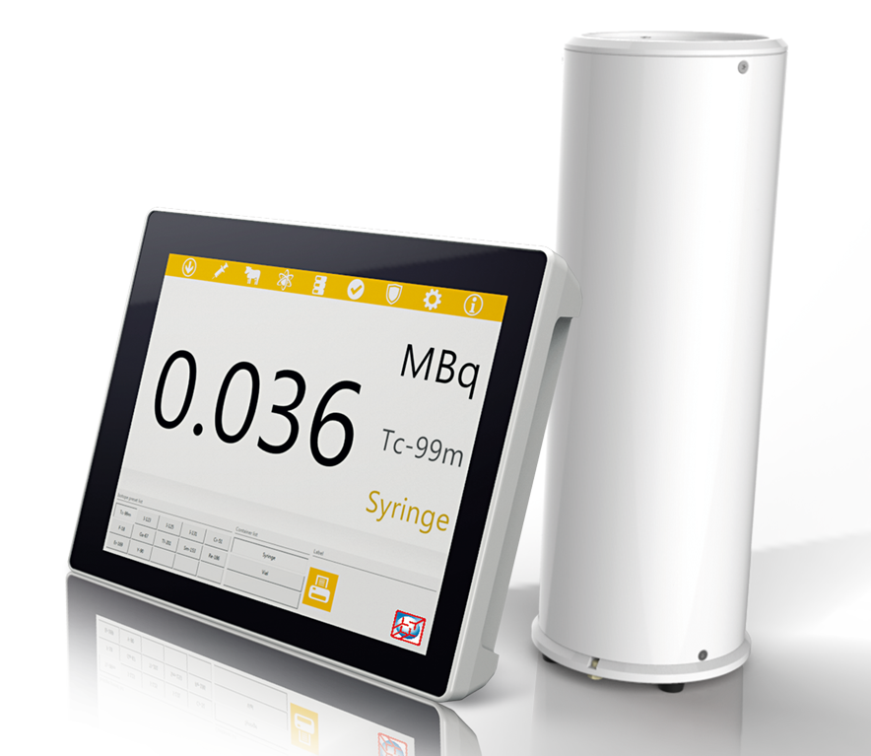
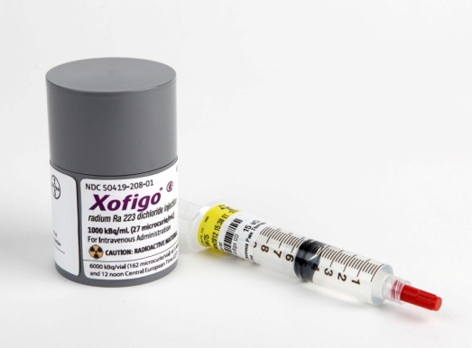
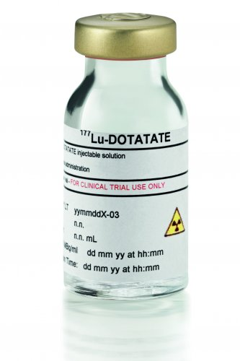
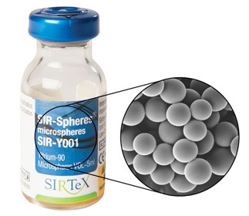
Ready to use… Therapeutic Radiopharmaceuticals
The therapeutic pharmaceuticals often require a simple patient preparation. The product is delivered in its final from and only the patient syringe with the necessary activity needs to be prepared (measurement of dose in dose calibrator). → No additional quality control (QC) required.

Slide 5
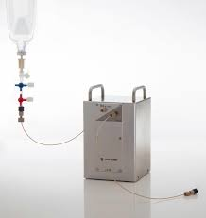
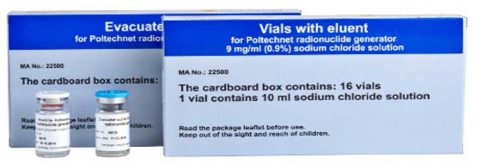
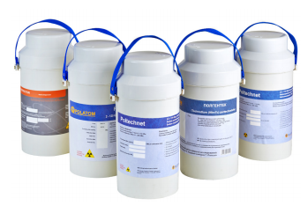
Generators…
Generators supply the radionuclides used for KIT preparations. In some cases, the elution can be used directly as a radiopharmaceutical (ex. [^{99m}Tc]TcO₄⁻). A generator is delivered with a so called SPC (summary of product characteristics) where the tests for quality control are described.
^{99m}Tc generators
⁶⁸Ga generators….

Slide 6
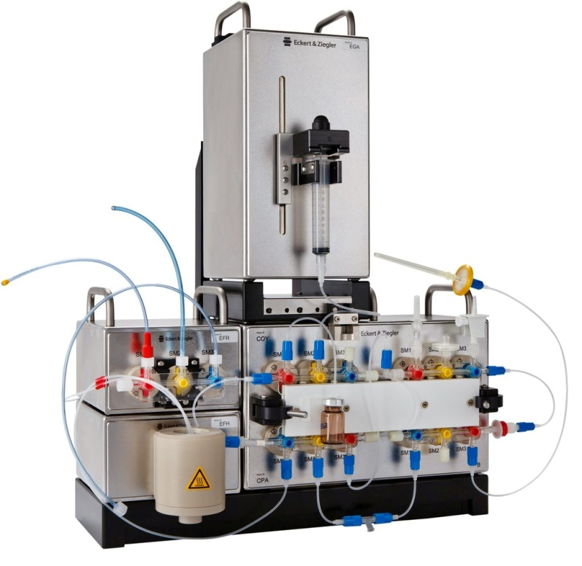
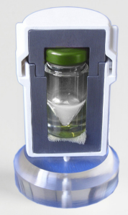
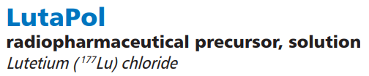
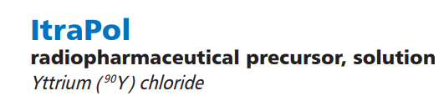
Radionuclide precursors…
Any in-house fabricated radiopharmaceutical, ex. by synthesis modules.
Peptides or antibodies labelled with a radionuclide (ex. from a generator)

Slide 7
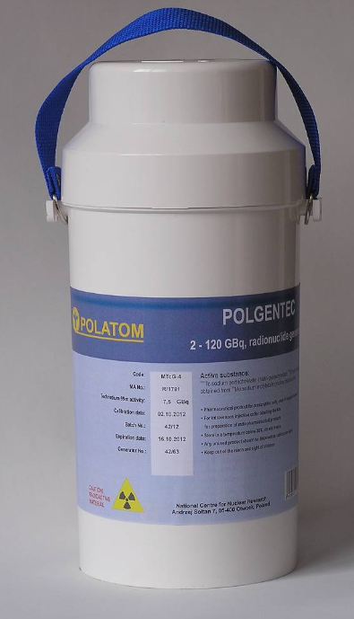
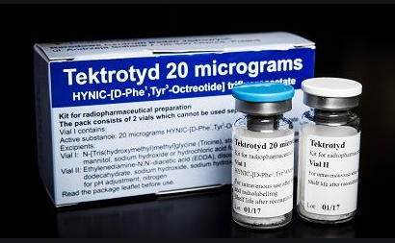
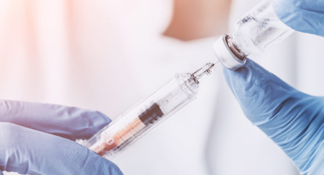
Radiopharmaceutical kits…
A radiopharmaceutical kit is normally commercialised and the initial quality of the kit is guaranteed by the producer. The kit vial contains a dry powder with all components. The ^{99m}Tc is added to this vial.
Labelling and preparation
+

Slide 8
Radiopharmaceutical kits (ex. ^{99m}Tc Kits)
Components of a kit (Pharmaceutical)
Active ligand system
Reducing agents (^{99m}Tc needs to be in a reduced oxidation state for efficient binding to the ligand)
Antioxidants
Buffer components (physiological pH)
Auxiliary ligand systems
Auxiliary components
→ Addition of radioactive solution, for example eluate from a generator immediately before use (reconstitution)

Slide 9
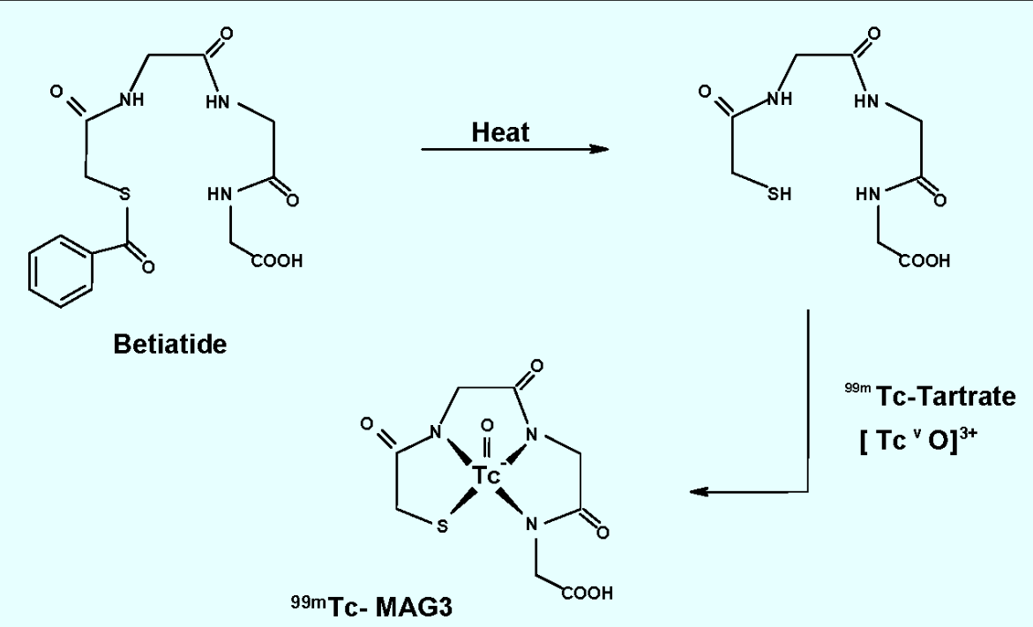
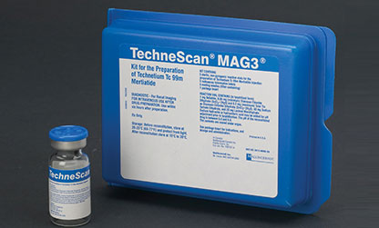
Kit MAG3 (^{99m}Tc Kit)
Renal function imaging agent
Cold kit with active substance ‘tartrate’
Addition of ^{99m}Tc eluate (^{99m}TcO₄⁻) to the active substance
Labelling of the kit (heating and incubation)

Slide 10
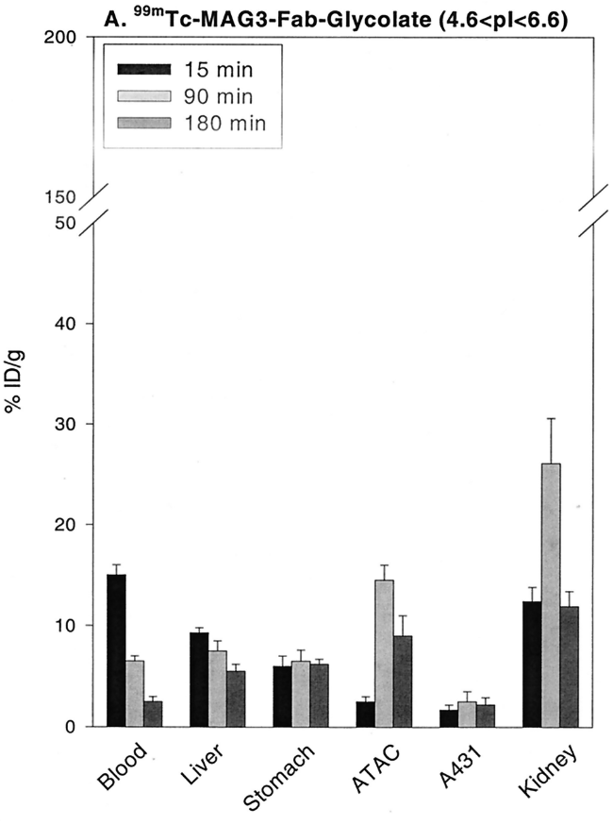
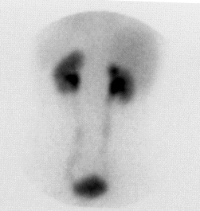
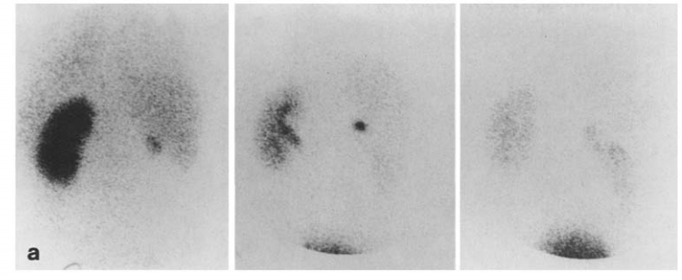
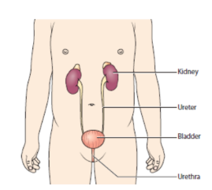
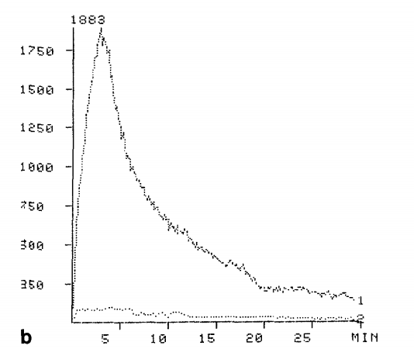
MAG3: Affinity for kidneys (imaging agent)
Normal renal function
Abnormal renal function
Kidneys
Bladder
→ Diagnostic imaging agent for disturbed renal function.

Slide 11
Summary Part II
Types of radiopharmaceuticals
Ready to use radiopharmaceuticals
Radionuclide precursors
Generators
Kit radiopharmaceuticals

