Slide 1
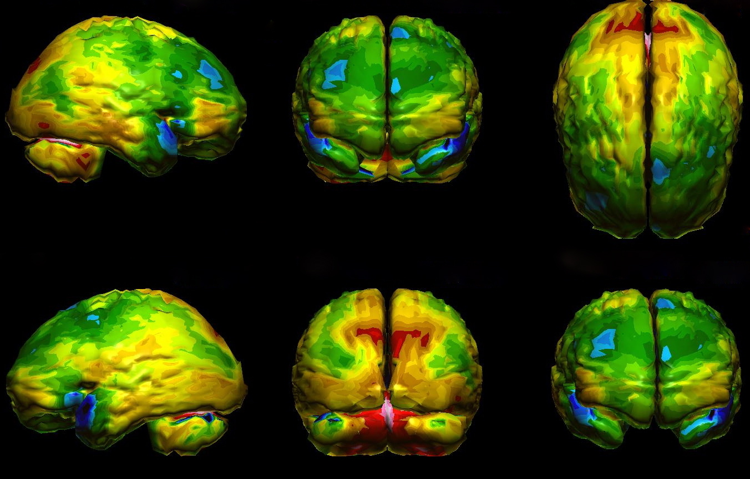
Radiopharmaceuticals in Nuclear Medicine
Institut de Radiophysique/CHUV
ruslan.cusnir@chuv.ch
http://brainattacks.net/author/brain34/

Slide 2
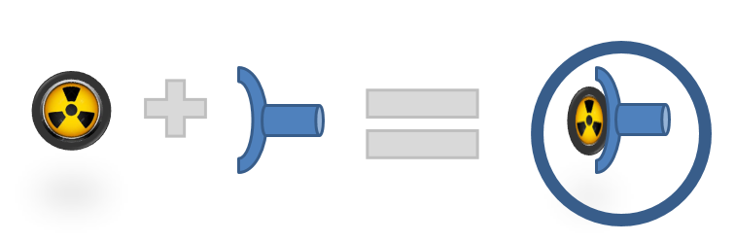
What is a radiopharmaceutical?
A radioactive tracer, or a radiopharmaceutical is a radioactive compound used to assess bodily functions, diagnose a condition, and treat diseases.
Radionuclide + Pharmaceutical

Slide 3
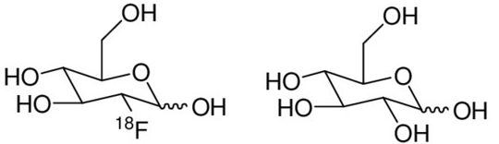
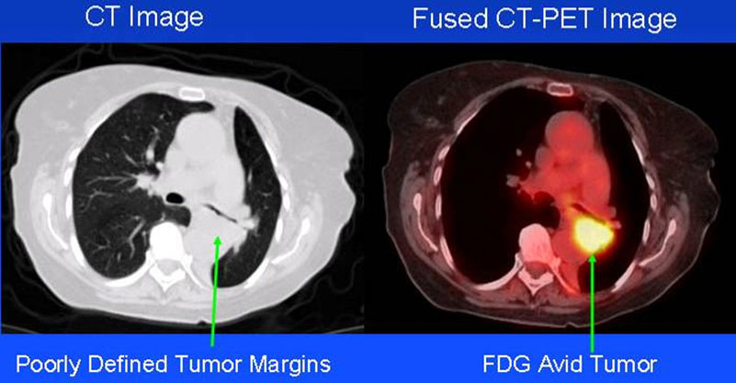
What is a radiopharmaceutical?
«radioactive sugar»
[¹⁸F]fluorodeoxyglucose
glucose – a universal
source of energy
¹⁸F – radioactive isotope of fluorine – t_{1/2} 1.8 h
nibib.nih.gov/science-education/science-topics/nuclear-medicine

Slide 4
What is a radiopharmaceutical?
Definition European Pharmacopoeia
“Radiopharmaceutical preparations or radiopharmaceuticals are medicinal products which, when ready for use, contains 1 or more radionuclides (radioactive isotopes) for a medicinal purpose.”
Radiopharmaceutical preparations cover:
Radionuclide generators: any system incorporating a radionuclide that decays to produce a daughter radionuclide that is to be obtained by elution or by any other method and used in a radiopharmaceutical preparation;
Kits for radiopharmaceutical preparation: any preparation to be reconstituted or combined with radionuclides in the final radiopharmaceutical preparation, usually prior to its administration;
Radionuclide and chemical precursors: any radionuclide produced for radiolabelling, or a chemical used in the synthesis of another substance prior to administration.

Slide 5
Program
Part I Radionuclide Production
Part II Radiopharmaceutical Products
Part III Quality Control Methods
Part IV Applications in Nuclear Medicine
Part V Facilities
Part VI Legislation for Radiopharmaceuticals

Slide 6
Part I: Radionuclide production
Nuclear reactors, fission products
Cyclotron production (accelerators)
Generators

Slide 7
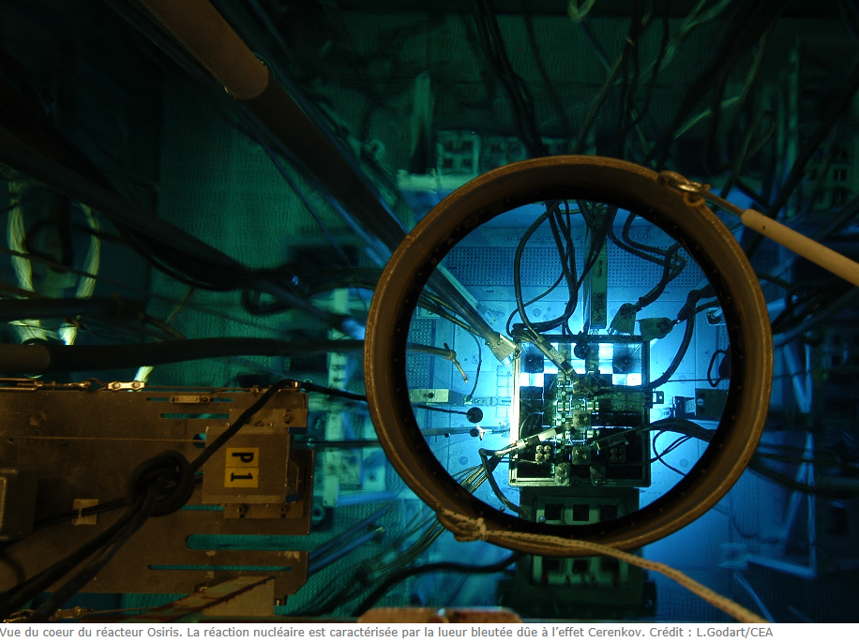
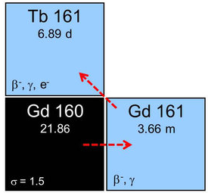
Bombardment with electrically neutral particles
Radioisotopes that can be produced by irradiating a specific target inside a nuclear research reactor.
Type of particles: neutrons
Source of particles: nuclear reactor
psi.ch/en/media/our-research/cancer-medicine-using-psis-neutron-source

Slide 8
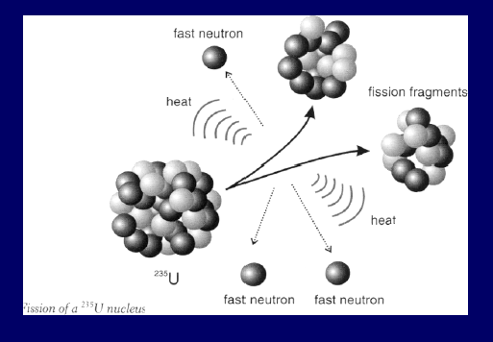
Fission produced radionuclides
Fission of ²³⁵U produces nearly 200 different radionuclides…
Nuclides with high atomic number are fissionable and a common reaction is the fission of uranium-235 by neutrons in a nuclear reactor. For example, iodine-131, molybdenum-99 and xenon-133 can be produced in this way. Radionuclides from such a process must be carefully controlled in order to minimize the radionuclide impurities.

Slide 9
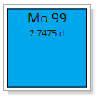
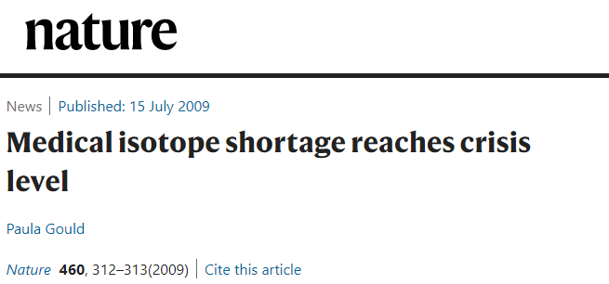
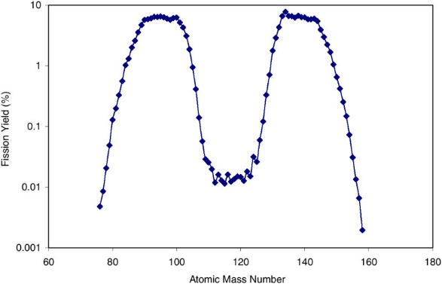
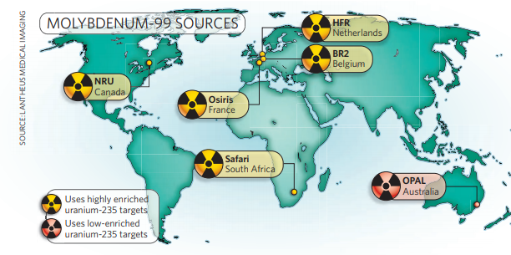
Nuclear fission products
Only limited number of production sites
Risk of worldwide shortages if there occur problems at one site
ncbi.nlm.nih.gov/books/NBK215133/

Slide 10
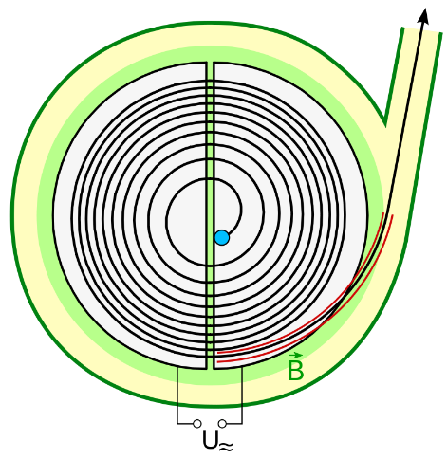
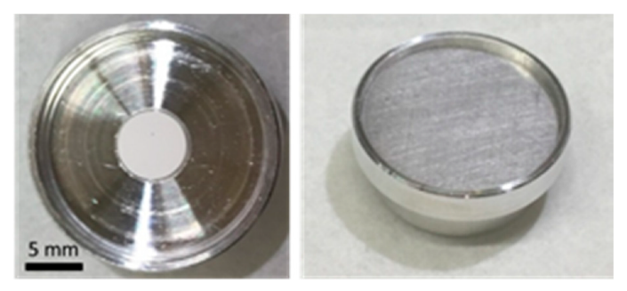
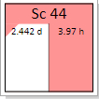
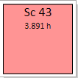
Bombardment with electrically charged particles
Particles are accelerated using magnetic fields (cyclotrons)
Type of particles generally accelerated: protons H⁻ and deuterons D⁻
to target
CaO target:
Ca (p,n) ⁴⁴Sc
Medical cyclotrons (10 MeV-18MeV)
Industrial cyclotrons (15 MeV to 70 MeV)
mdpi.com/1420-3049/25/20/4706/htm#app1-molecules-25-04706
Notes:
Negative ions accelerated

Slide 11
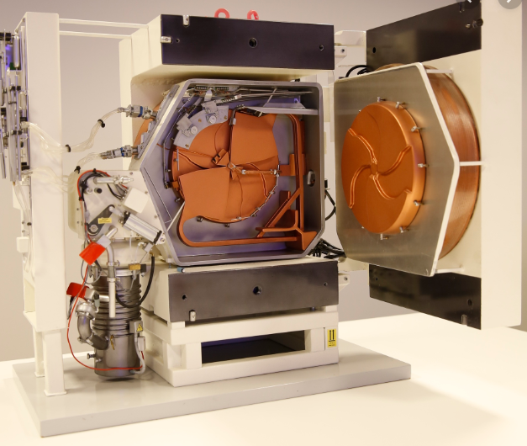
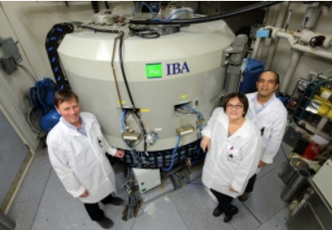

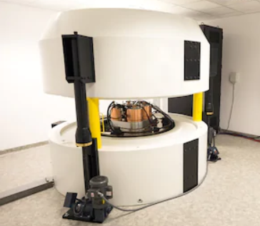
Small medical cyclotrons
A European network for medical radionuclides
prismap.eu/radionuclides/educational

Slide 12
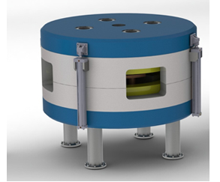
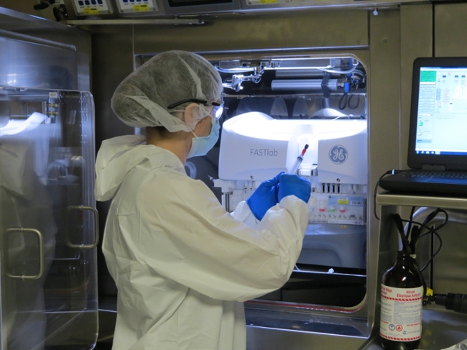
Main radionuclides produced : ¹¹C, ¹⁵O, ¹³N, ¹⁸F
Energy required : in the range of 10 MeV to 18 MeV
Size: easy to implant in hospitals
Targets: solid, gas or liquid (very quick transfer from the irradiation site to the « hot » lab for the radioactive synthesis)
iaea.org/newscenter/multimedia/videos/what-is-a-particle-accelerator

Slide 13
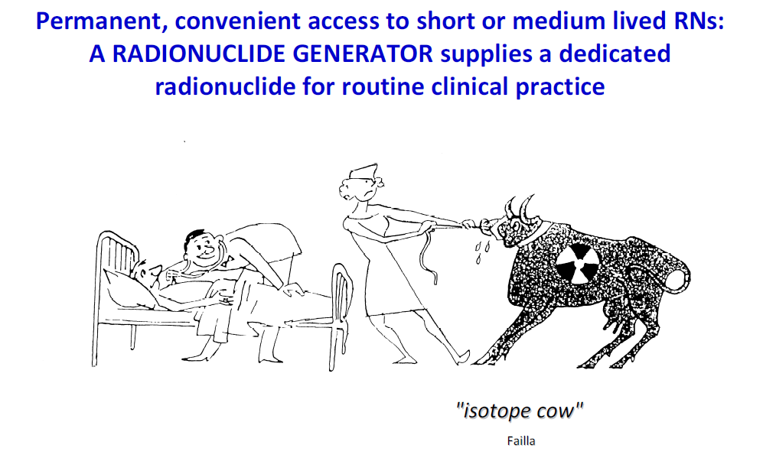
Radionuclide generators

Slide 14
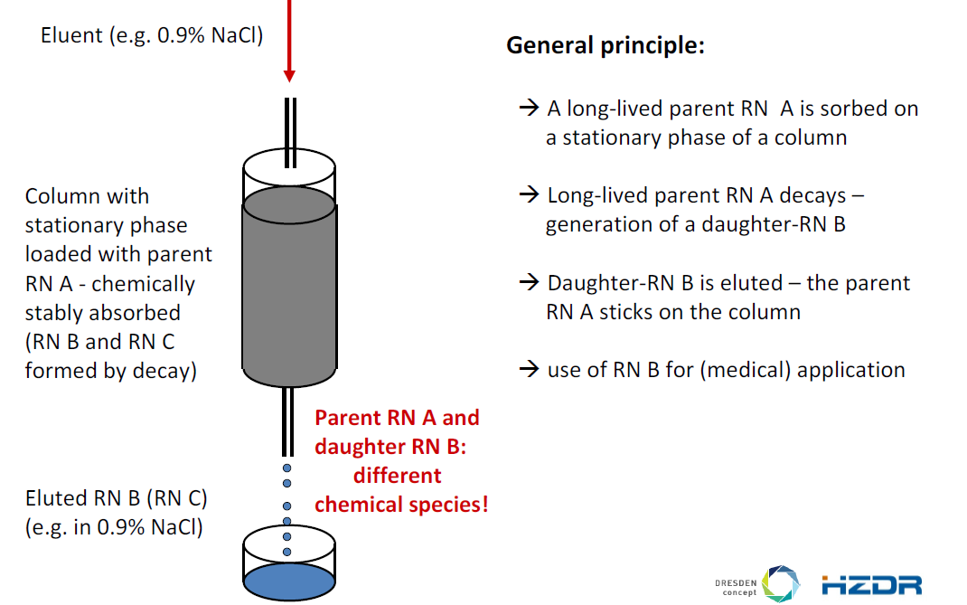

Slide 15
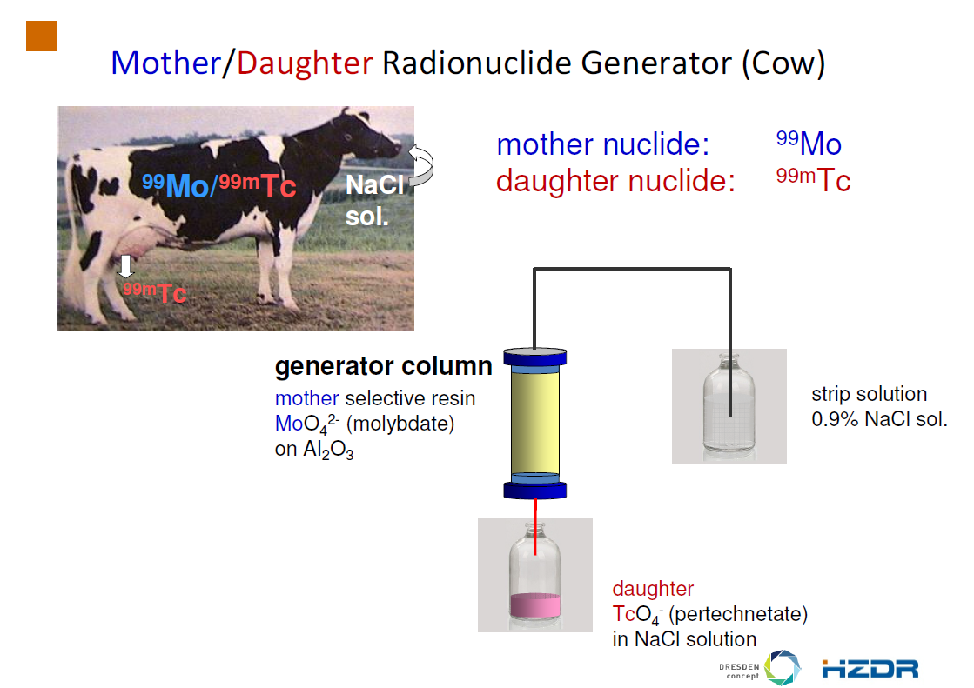

Slide 16
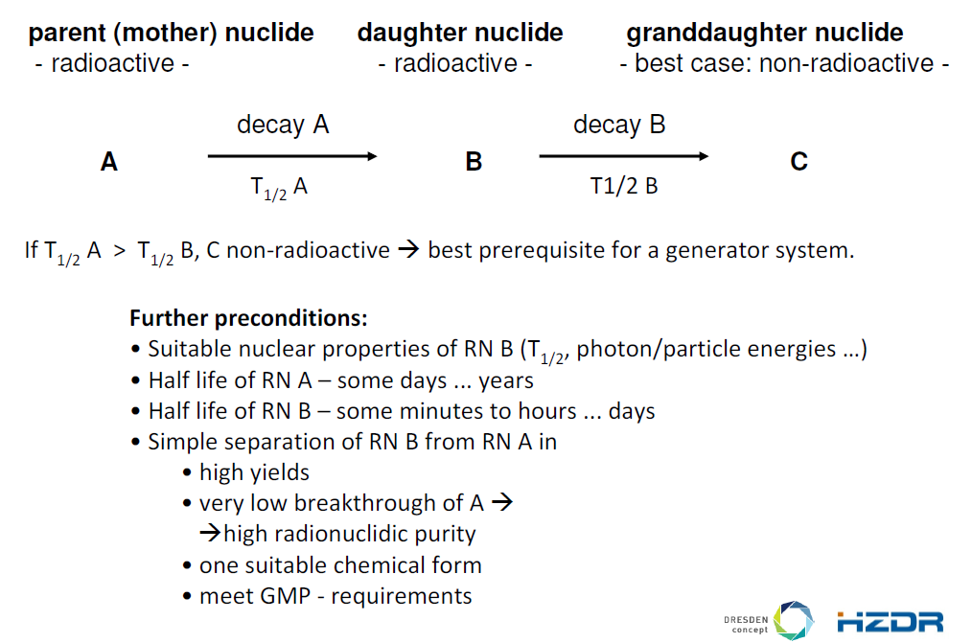
Working principle of a generator

Slide 17
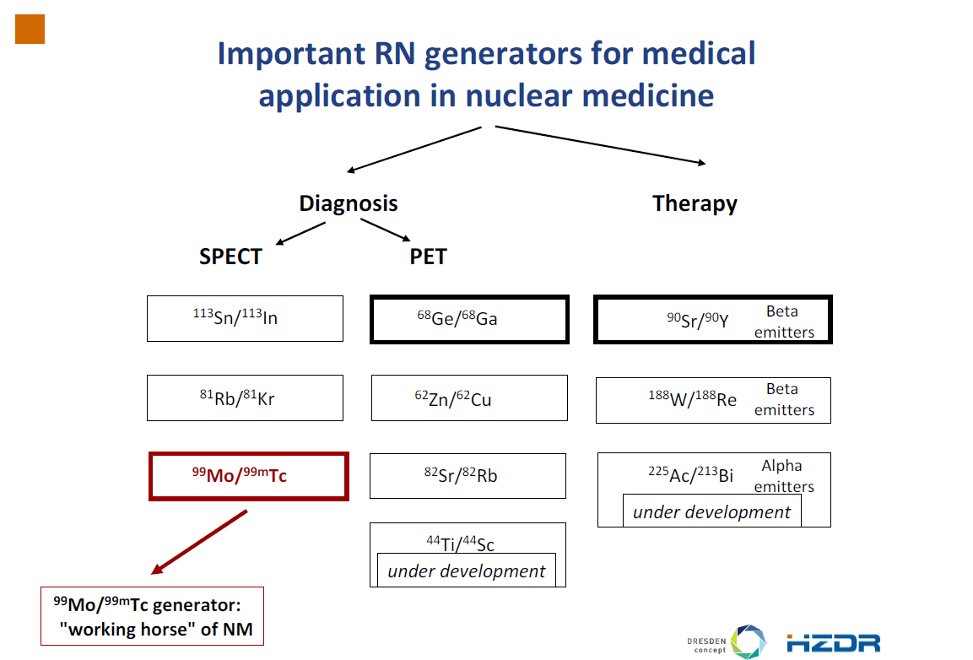

Slide 18
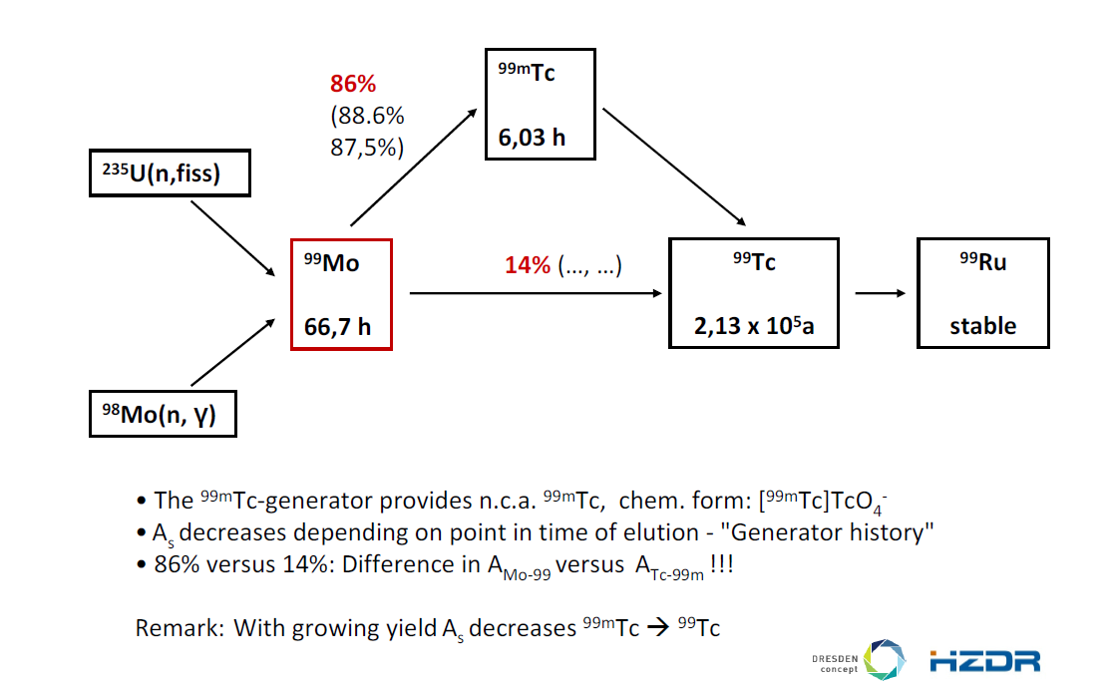

Slide 19
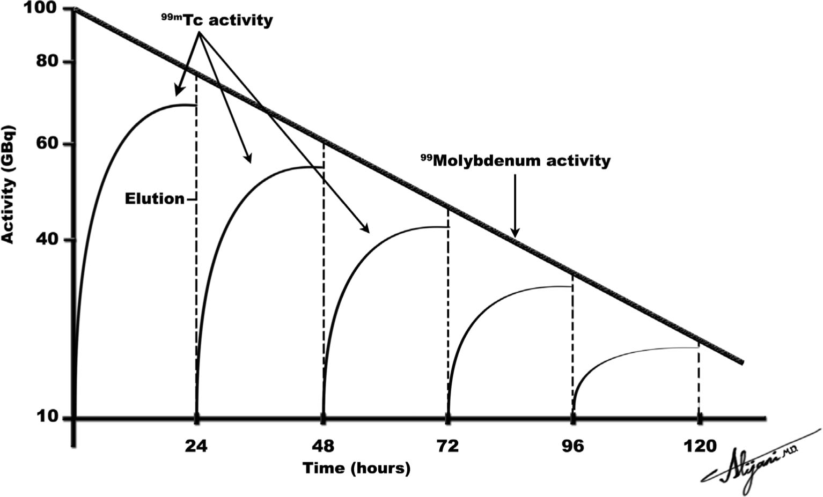

Slide 20


Practical Exercise
"Practical_Generator.pdf"

Slide 21
SOLUTION
361 MBq
270 MBq
248 MBq

Slide 22
Pro and Contra Generator Systems
Advantages
Radionuclides always available for use
Easy to deliver and simple operation of the generator systems
Disadvantages
Not for all systems the eluate can be used directly
Long-lived generators: risk of mother nuclide break-through or radiolysis of column material
Risk for breakthrough of the long-lived mother increases with each elution
Shelf life of generators is relatively short
Supply of mother radionuclides is often critical → Shut down of one site can create shortage of delivery

Slide 23
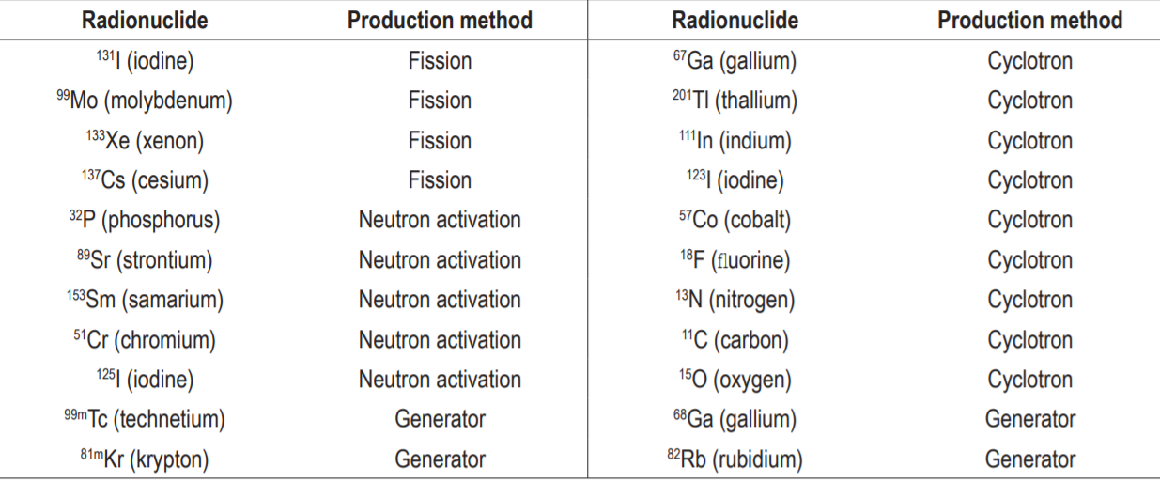
Summary Part I
Different productions modes of radiopharmaceuticals (Fission, Cyclotrons, Generators)

Slide 24
Summary Part I
Fission produced radionuclides risk shortages if one production site is down. Most generator systems, widely used in nuclear medicine, are based on fission produced radionuclides.
Cyclotron production is challenging and requires developed infrastructures and trained staff. The market for medical cyclotrons is continuously growing.
Generators are widely used, ^{99m}Tc for most kit pharmaceuticals, and in combination with special kits and fabrications for radionuclides like ⁶⁸Ga.

