Slide 1
Transverse Dynamics ::
Equation of Motion and Solutions
Laboratory for Particle Accelerator Physics, EPFL

Slide 2
Introduction Linear Dynamics
accelerator = series of elements for beam guiding (bending, focusing) and acceleration; often arranged in a closed loop (ring)
guiding fields must ensure long term (h) stability of circulating particles
questions to be answered:
How to ensure bound motion of a particle beam?
What are conditions for stability?
Amplitude and frequency of particle oscillations?
Statistical beam properties like beam width and angular spread?
How to design magnet lattices (arrangements of dipoles and quads in a line)?
What is the impact of field errors in bending and focusing magnets?

Slide 3
References and Accessible Reading Material
available on the internet:
P. Schmüser & J. Rossbach, Basic course on accelerator optics:
https://cds.cern.ch/record/247501/files/p17.pdf
F.Tecker, Longitudinal Dynamics:
https://arxiv.org/pdf/1601.04901.pdf
Book, H.Wiedemann, Particle Accelerators, download pdf
https://link.springer.com/book/10.1007%2F978-3-319-18317-6
M. Sands, Physics of Electron Storage Rings: An Introduction.
https://digital.library.unt.edu/ark:/67531/metadc865991/
CERN Accelerator School (CAS) proceedings homepage (huge!)
http://cas.web.cern.ch/cas/CAS_Proceedings.html
CERN Accelerator School on Medical Applications:
https://cds.cern.ch/record/2271793/files/33-8-PB.pdf
books, papers:
M.Conte and W.McKay, An Introduction to the Physics of Particle Accelerators, World Scientific, 2008
S.Peggs, T.Satogata, Introduction to Accelerator Dynamics, Cambridge University Press, 2017
A. Wolski, Beam Dynamics in high energy particle accelerators, Imperial College Press, 2014
A. W. Chao, M. Tigner, Handbook of Accelerator Physics and Engineering, World Scientific 1999
E. D. Courant and H. S. Snyder, Annals of Physics: 3, 1-48 (1958)

Slide 4
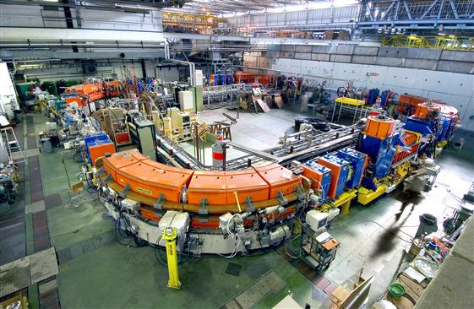
Make Particles Circulate
Main Dipoles
Main Dipoles
Main Dipoles
Main Dipoles

Slide 5
Focusing the Particles
Main Dipoles
Main Dipoles
Main Dipoles
Quadrupoles

Slide 6
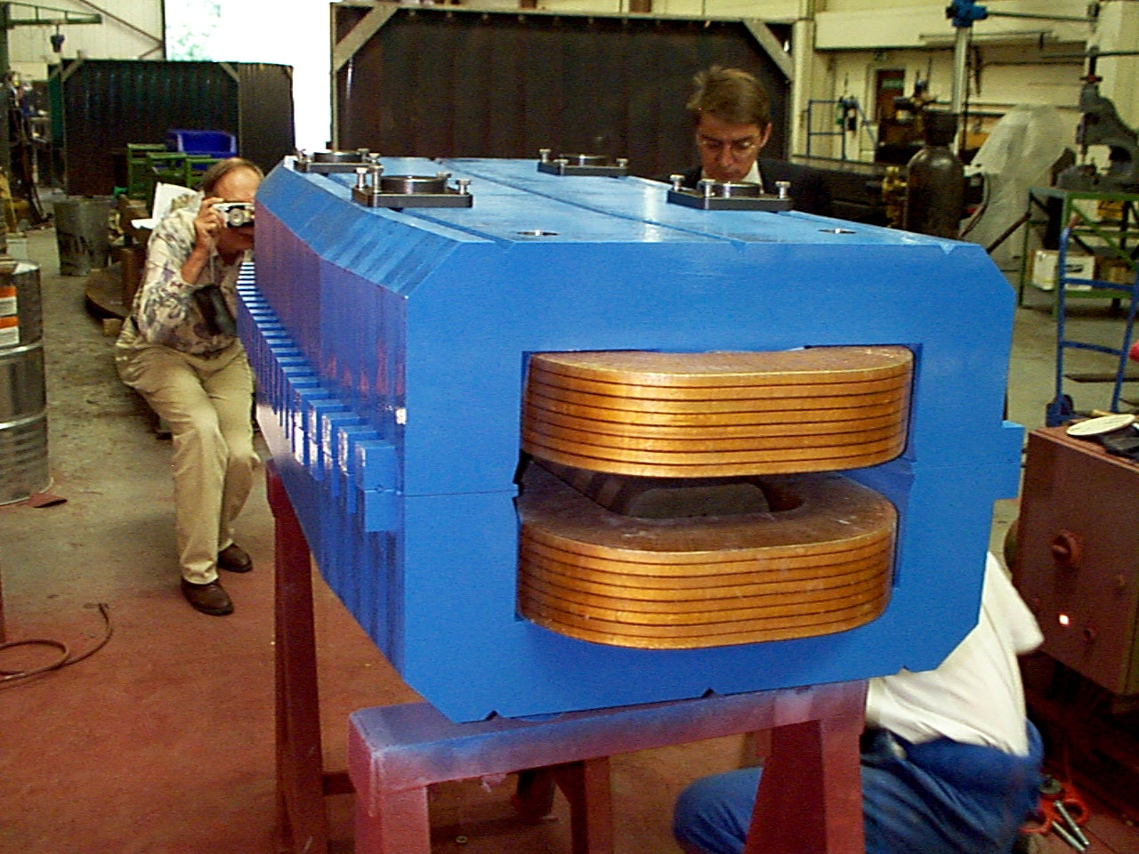
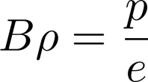
Bending Magnet - SLS dipole
magnetic rigidity:

Slide 7
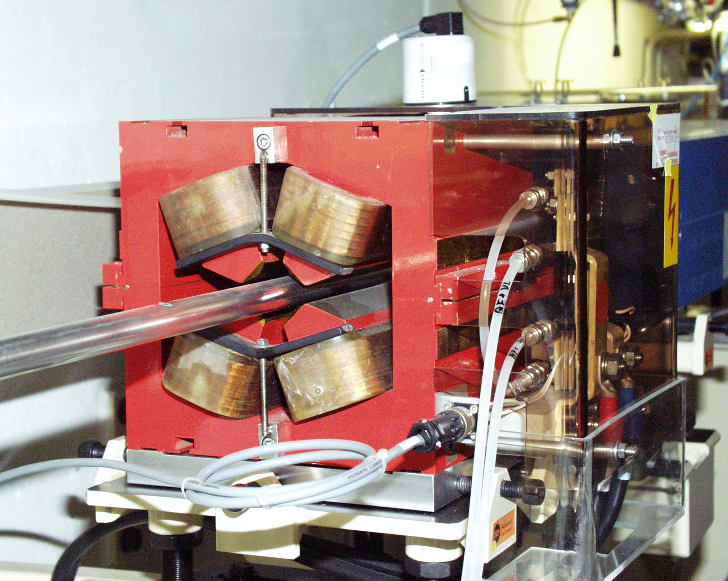
Quadrupole Magnet - Focusing Element

Slide 8
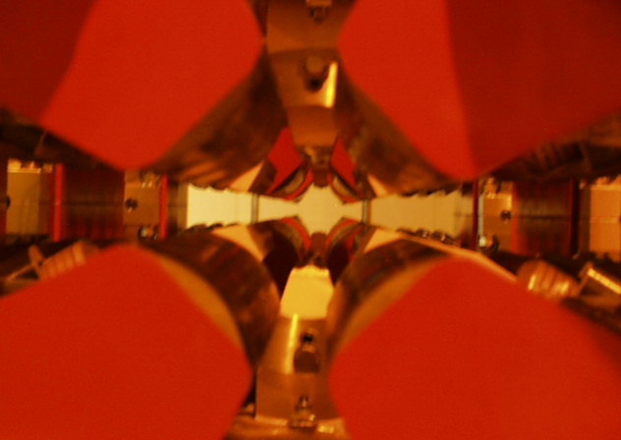
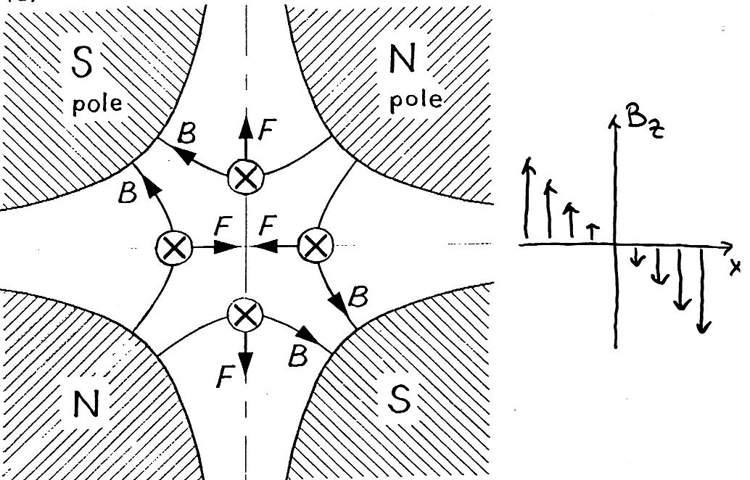
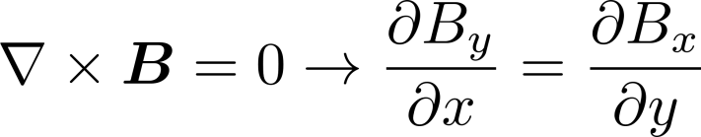

Quadrupole Lens
Defocusing
Focusing in one plane
Defocusing in the other plane
N
S
Focusing
S
N
$$B_{y}$$

Slide 9
Next: Equation of Motion
suited coordinate system
linearizing forces and deriving differential equation

Slide 10
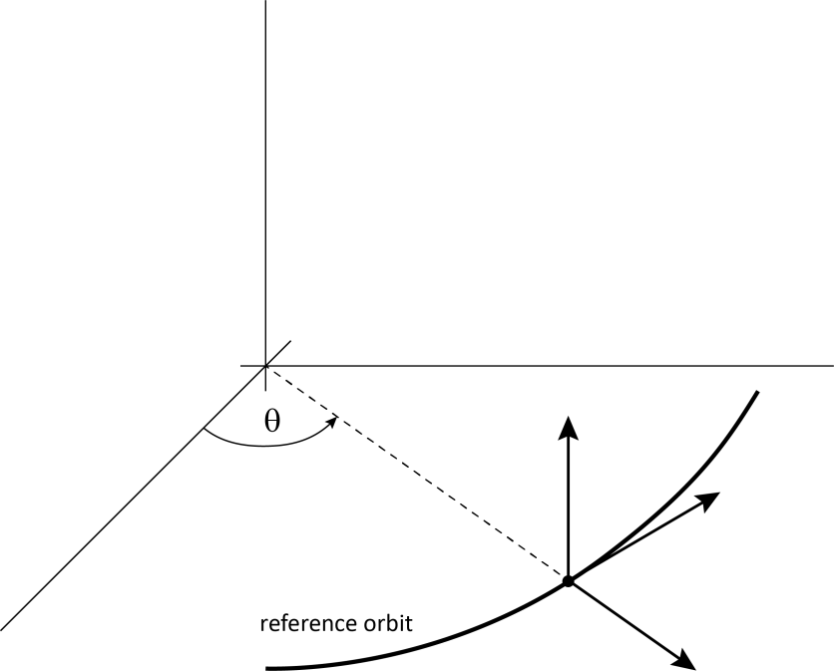



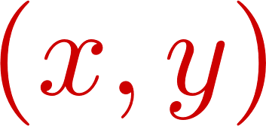

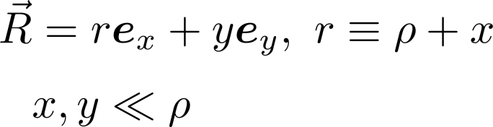
Curvilinear Coordinate System
aim: derive a set of equations that describe the motion of a single particle wrt. a curved coordinate system around the reference orbit of a beam, ( x, y )
particle coordinate:
see also: Frenet-Serret coordinates, e.g. Wiedemann chap 4.3

Slide 11
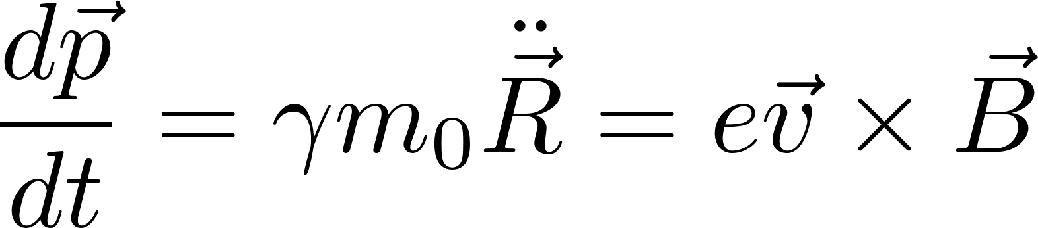
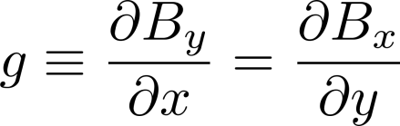
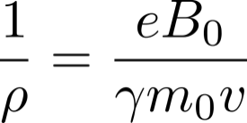
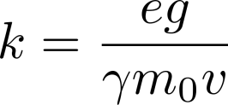
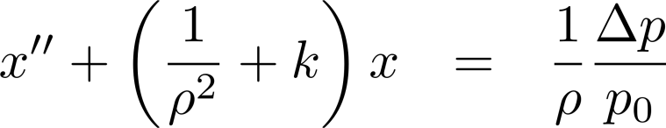
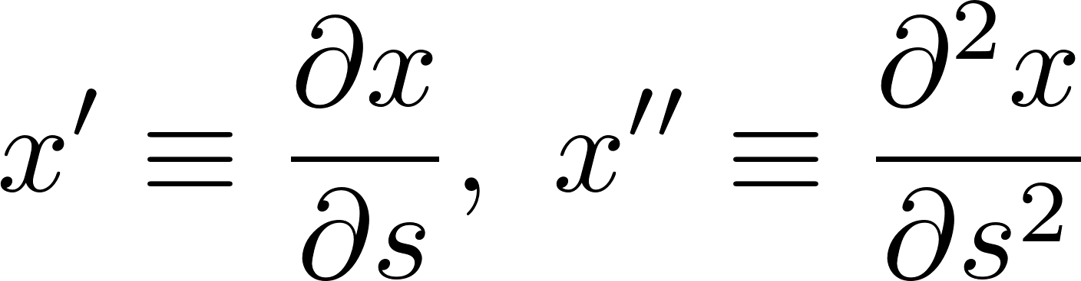
Deriving the Equation of Motion (see Appendix)
starting with general equation of motion:
dipole and quadrupole field
field gradient
varying sign convention !
orbit curvature
k – value [m⁻²]
the effect of the curved coordinate system, i.e. the moving unit vectors e_{x}, e_{s} must be included in the calculation
k - value
off momentum term
curved coordinates
derivative w.r.t. path-length s, not time t
Notes:
describe deviation from nominal orbit, x,y
start from equation of motion, consider only linear fields and introduce path length as independent variable instead of time
field parametrized as vertical dipole field plus quadrupole fields; dipole 1/rho, quad k

Slide 12
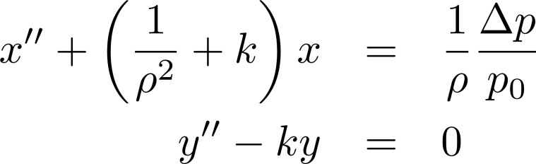
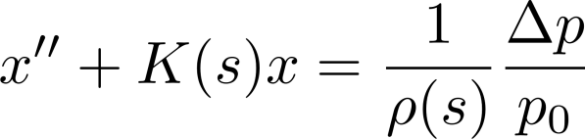
Equation of Motion
DE is valid for drift spaces, Quadrupoles (k≠0), combined function magnets (k≠0, 1/ρ≠0) and for off-momentum particles (Δp≠0, first order)
we discuss solutions of different cases of this equations in single accelerator magnets, depending on K(s), ρ(s), Δp
generalised form:
see also Wiedemann sec. 1.5.8

Slide 13
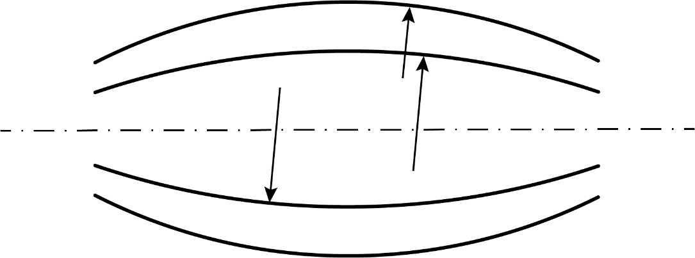
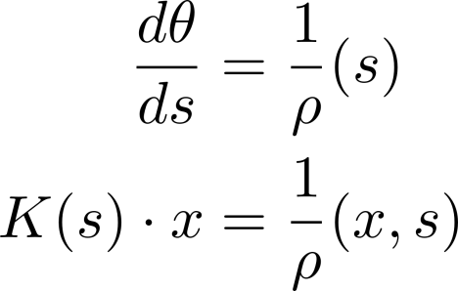
geometric meaning of coefficients
= curvature
1/ρ [m⁻¹]
K = amplitude dependent curvature K[m⁻²]
inside quadrupole field

Slide 14
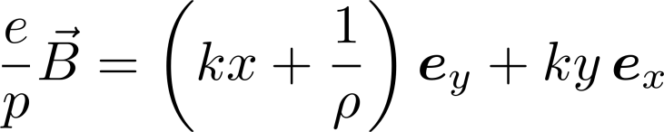
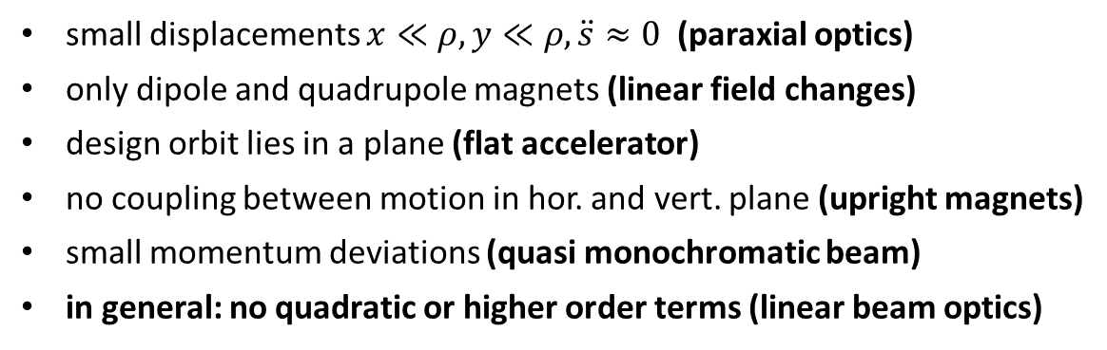
Summary on Approximations used
small displacements $x≪ρ, y≪ρ, \ddot{s}≈0$ (paraxial optics)
only dipole and quadrupole magnets (linear field changes)
design orbit lies in a plane (flat accelerator)
no coupling between motion in hor. and vert. plane (upright magnets)
small momentum deviations (quasi monochromatic beam)
in general: no quadratic or higher order terms (linear beam optics)
linear parametrization of magnetic field:

Slide 15
Next: Solving the Equation of Motion using Matrices
matrix approach using principal trajectories
drift space, focusing and defocusing quadrupole

Slide 16
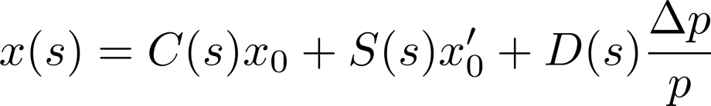



Piecewise solution of trajectory equation in terms of principal trajectories
see also Wiedemann sec. 5.5
Dispersion Trajectory
(= particular solution of eq.)
Sinelike Trajectory
Cosinelike Trajectory
C(s), S(s) are independent solutions of the homogeneous equation:

Slide 17
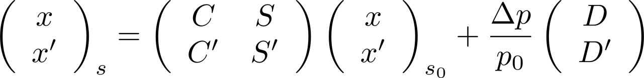
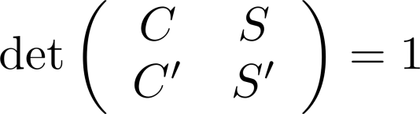
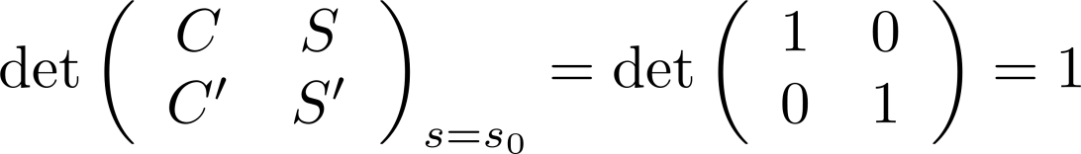
Formulation as Transport Matrix
proof:
→ det = 1 initially, and it does not change as motion proceeds

Slide 18

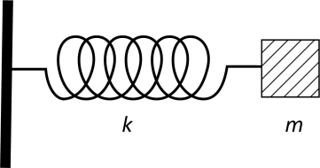
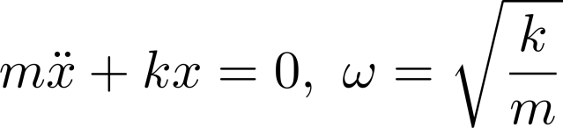
Piecewise Solution of Equation
general form of equation similar to harmonic oscillator with three cases: K=0, K<0, K>0
K is piecewise constant, in a ring it repeats at least after one turn (s=C)
K(s)
C
s

Slide 19
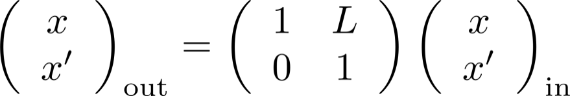



Drift Space
particle moves straight
1.) K=0: Drift Space
L

Slide 20
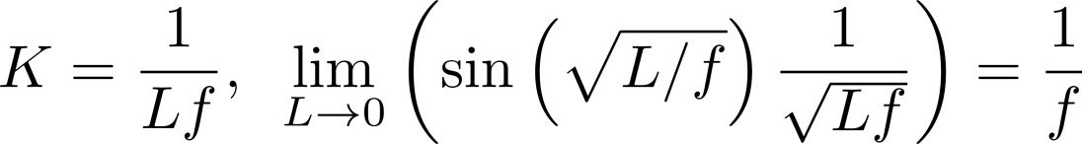
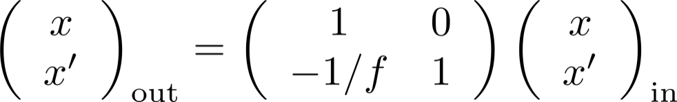
Focusing Quadrupole
2.) K > 0: Focusing Quadrupole
thin lens approximation:
x
f

Slide 21
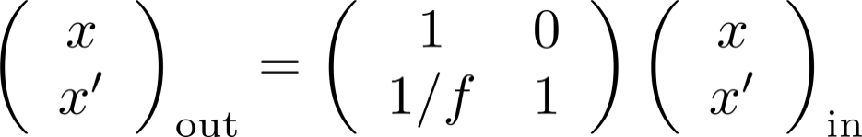
Defocusing Quadrupole
3.) K < 0: Defocusing Quadrupole
thin lens approximation for defocusing quad:
x
f

Slide 22
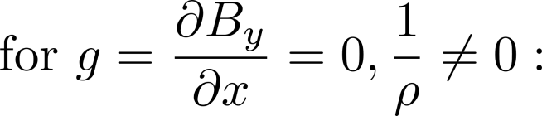
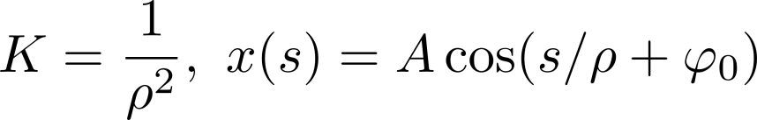

Special Case: Weak Focusing
→ one oscillation per turn as expected for „weak focusing“
particle orbit
reference orbit

Slide 23
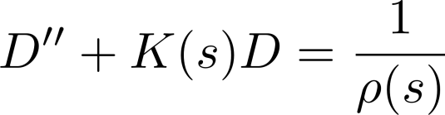
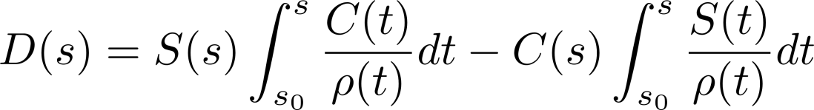
Dispersion Trajectory
is solution of equation:
is constructed from homogeneous solutions C(s), S(s):
proof: by insertion in above DE and by using CS´- C´S=1.
compare components of particle trajectory:

Slide 24
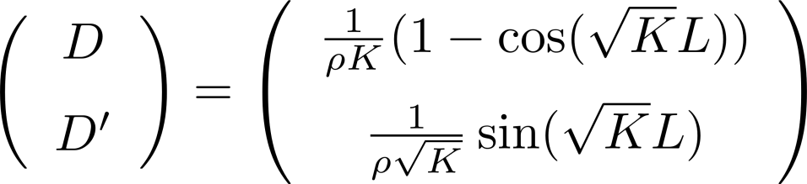
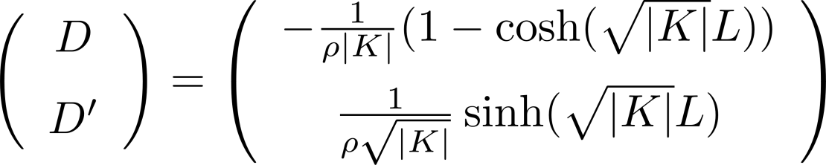
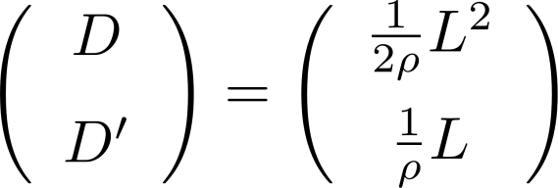
Dispersion Trajectory in combined function magnet (Dipole & Quadrupole)
for K > 0
for K < 0
for K = 0
→ Dispersion is generated by bending fields
→ Dispersion oscillates in Quadrupoles like particle trajectories

Slide 25
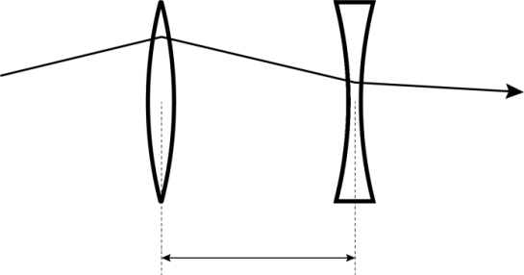
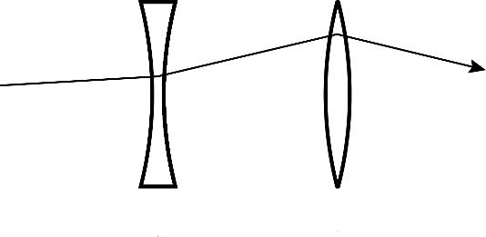
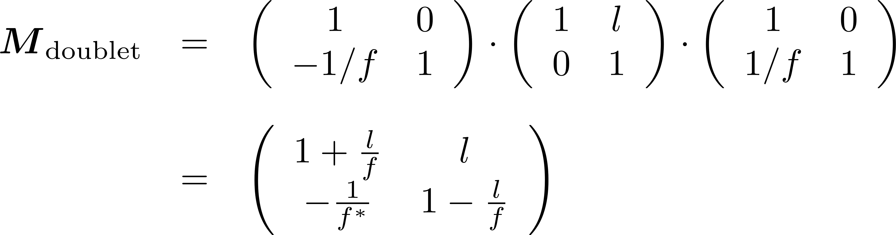
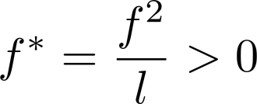
Quadrupole Doublet
concatenation of particle transport through a series of elements:
(M = transport matrix 2x2)
l
[thin lens approximation]
→ M_{doublet} is always focusing

Slide 26
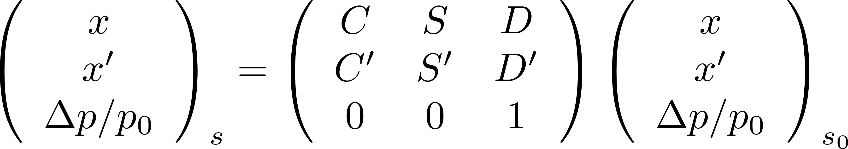
3x3 transport matrix for off-momentum particles
can be re-formulated as a single matrix multiplication:
this formulation is convenient when computing the dispersion function

Slide 27
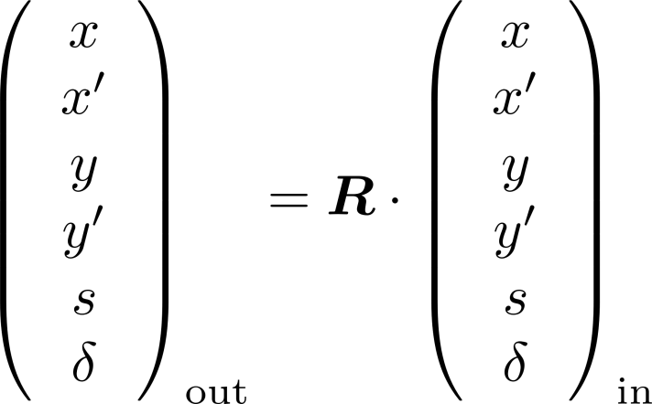
Matrix Notation
… is one approach to describe particle trajectories in accelerators – for each element a matrix for linear computation can be defined.
The matrix can be extended to all six dimensions of phase space:
x, x’, y, y’, s, δ
energy deviation δ=ΔE/E₀
path length
In this case R contains 36 parameters, some of which have practical importance for example in coupling horizontal and vertical motion.
The matrix notation can be generalised to higher order dependencies. For example a tensor of rank 3 holds coefficients T_{ijk} for a quadratic map of particle coordinates.

Slide 28
Next: Stability and Twiss Matrix
Eigenvalues and Stability
Twiss Matrix Decomposition

Slide 29
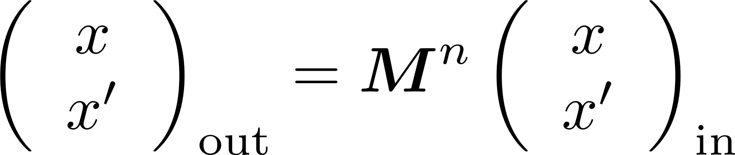
Stability Criterion
for stable oscillation in a ring these coordinates must stay finite for n → ∞:
M = transport matrix of entire ring
to assess stability use decomposition of M in Eigenvectors:
then:
thus it is sufficient analysing the Eigenvalues to assess stability of linear motion
λ^{n} must be bounded for n → ∞ (λ = complex number in general)

Slide 30
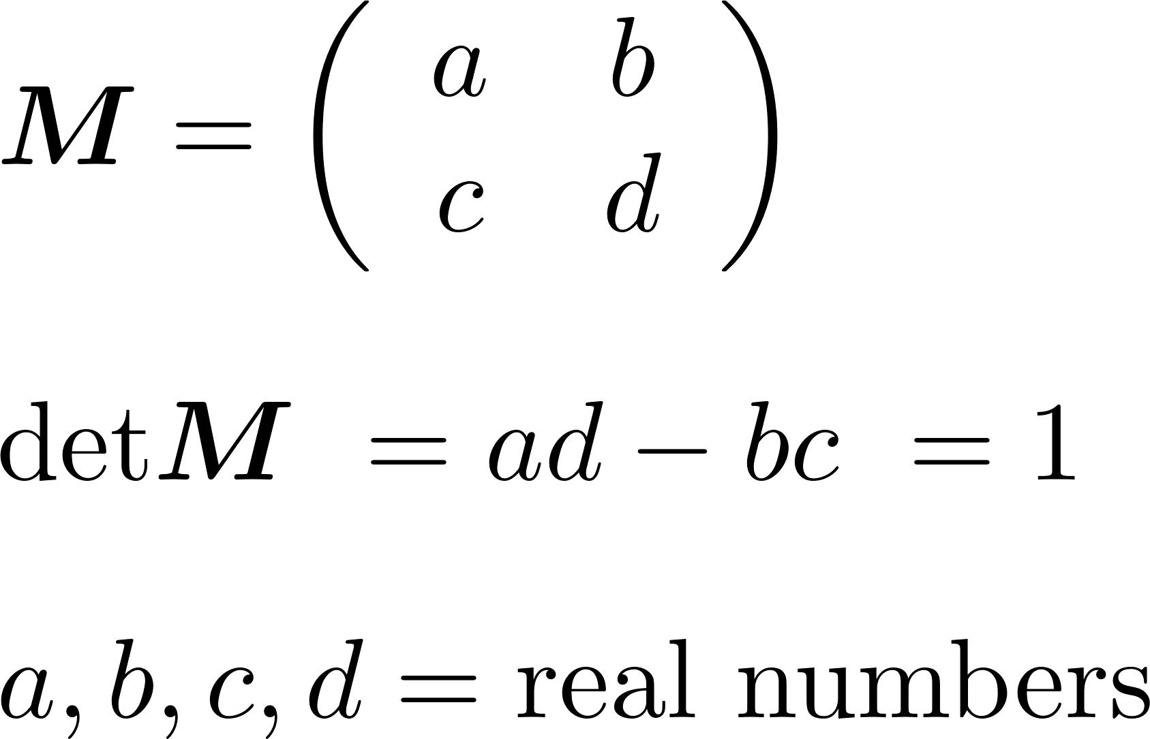
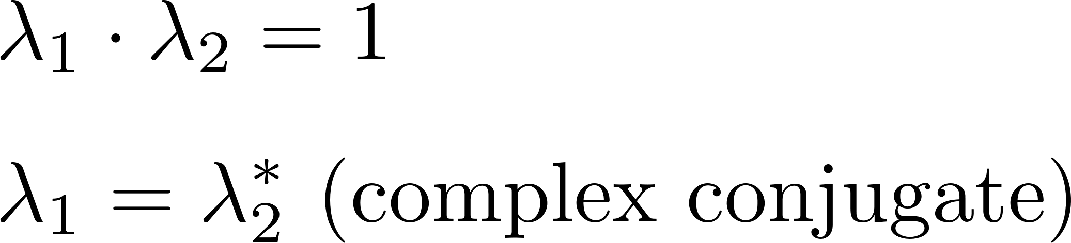
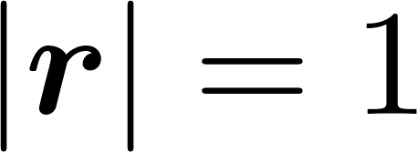
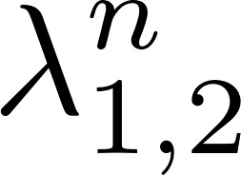

Stability Criterion :: Matrix & EV Properties
transfer matrix M has properties that can be used:
from that follows:
this can be extended to 4dim matrices (coupled horizontal + vertical)
Im
bounded for
Re
with μ = real number
stable = EVs on unit circle

Slide 31


Stability Criterion – the Trace of M
Computation of eigenvalues via characteristic polynomial:
2x2 matrix: characteristic polynomial
quadratic equation for eigenvalues λ
solution: values λ₁, λ₂
motion is stable if |Tr M|<2, which also means that μ is real
see also Schmüser/Rossbach, and sect. 4.1, Wiedemann chap. 10.1.2

Slide 32
Summary Matrix Treatment
equation of motion is piecewise solved for constant K(s)
x, x’ are propagated by concatenated multiplication with 2x2 matrices
defocusing and focusing quadrupoles are combined in overall focusing doublets
linear motion in a ring is stable if |Tr M|<2
det M = 1 (also: M symplectic)
K(s)
C
pattern repeats
s

Slide 33
Next: Analytical Solution
Hills equation
Beta function
phase space ellipse
include momentum offset
tune Q_{x}, Q_{y}

Slide 34


Solution of Hill´s equation
First used by an astronomer George Hill in his studies of the motion of celestial bodies, a motion under the influence of periodically changing forces
1838 -- 1914

Slide 35





Hill: Solution for periodic K
the beta function [m] is a scaling factor for the amplitude of orbit oscillations, and their local wavelength
A, ϕ₀ are constants of motion
- well known Betafunction of accelerators
variables are not related to relativistic factors
(sorry for the historic nomenclature)
weak quads
strong quads

Slide 36




Comparison to Classical Harmonic Oscillator
amplitude is fixed:
phase grows linear with time:
conserved (energy):

Slide 37




Hill Equation (pseudo harmonic equation)
Twiss
Parameters:
amplitude varies:
phase increases monotonically but growth rate varies as 1/β :
conserved (action J):

Slide 38




Computing the Beta Function in three ways
1.) from the transport matrix of a closed ring
2.) by solving a DE for β (DE without proof)
3.) by using a transport matrix for Twiss parameters (C,S principal trajectories)

Slide 39

Computing the transport matrix from Twiss Parameters
transport matrix s=s₀ →s₁ (arbitrary section):
β₀, α₀ at s₀
β, α at s₁
Δϕ = phase advance between s₀, s₁

Slide 40


The one turn matrix M_{rev}
transport matrix for one revolution, “One Turn Matrix”
same location: β = β₀
Δϕ = 2πQ phase advance for complete turn, Q = “Tune” of accelerator
special case: choose symmetry point α = 0

Slide 41



Twiss Matrix
this expression has similar properties as
it holds:

Slide 42

Beta Function in a Drift
β
in a field free region β follows a quadratic function
the coefficients are related to the TWISS parameters
at β_{min} we have a waist
β* = β_{min}
s

Slide 43


Adding Dispersion
where D(s) is a solution of:
outside bending magnets D behaves like particle trajectories
note:
D(s) = dispersion function as lattice solution – not exactly the same as
the previously introduced dispersion trajectory for single elements
η(s) = used in some literature instead dispersion function D(s)

Slide 44
Phase Space Ellipse
x’
4
2
1
J = particle action (oscillation amplitude)
observing the coordinates of a particle at one location in a ring for consecutive turns
x, x’ describe an ellipse in phase space when ϕ is varied
example φ= Q×2π ≈ 0.37×2π phase advance per turn
x
3
see also Schmüser/Rossbach sect. 4.3/4.4, Wiedemann chap. 8.1.2

Slide 45



Courant-Snyder Invariant
at one location this phase space ellipse is sampled by a particle with action J
when moving along the magnet lattice, the ellipse is changing size, but it stays an ellipse
the area of the ellipse is invariant (Courant-Snyder Invariant) and equals 2π × action.
the unit is [m⋅rad], or often [mm⋅mrad]
this constant of motion refers to a single particle, emittance is a statistical property
x’
x
E.D. Courant and H.S. Snyder, Theory of the Alternating Synchrotron, Annals of Physics 3 (1958) 1

Slide 46
Courant-Snyder Invariant
at one location this phase space ellipse is sampled by a particle with action J
when moving along the magnet lattice, the ellipse is changing size, but it stays an ellipse
the area of the ellipse is invariant (Courant-Snyder Invariant) and equals 2π × action.
the unit is [m⋅rad], or often [mm⋅mrad]
this constant of motion refers to a single particle, emittance is a statistical property
x’
x
E.D. Courant and H.S. Snyder, Theory of the Alternating Synchrotron, Annals of Physics 3 (1958) 1

Slide 47
Courant-Snyder Invariant
at one location this phase space ellipse is sampled by a particle with action J
when moving along the magnet lattice, the ellipse is changing size, but it stays an ellipse
the area of the ellipse is invariant (Courant-Snyder Invariant) and equals 2π × action.
the unit is [m⋅rad], or often [mm⋅mrad]
this constant of motion refers to a single particle, emittance is a statistical property
x’
x
E.D. Courant and H.S. Snyder, Theory of the Alternating Synchrotron, Annals of Physics 3 (1958) 1

Slide 48
Courant-Snyder Invariant
at one location this phase space ellipse is sampled by a particle with action J
when moving along the magnet lattice, the ellipse is changing size, but it stays an ellipse
the area of the ellipse is invariant (Courant-Snyder Invariant) and equals 2π × action.
the unit is [m⋅rad], or often [mm⋅mrad]
this constant of motion refers to a single particle, emittance is a statistical property
x’
x
E.D. Courant and H.S. Snyder, Theory of the Alternating Synchrotron, Annals of Physics 3 (1958) 1

Slide 49


Action vs. Emittance
single particles are associated with a particular ellipse
when observing a beam with a wire scanner a (projected) rms width σ_{x} is measured; one ellipse corresponds to σ_{x}
emittance ε is the average value of action J
σ_{x}
→ more on emittance next lesson

Slide 50
What beam will fit into the machine?
Example: Acceptance of a lengthy aperture restriction (limits amplitude and angle)
y’
Unmatched beam emittance
Matched beam emittance
h/d
Electron
Trajectories
-h/2
h/2
h
y
`
-h/d
d
F. Sannibale

Slide 51



Admittance of an accelerator
admittance = the largest ellipse that can be accepted
  at any point along the accelerator
  units = phase space area [mm⋅mrad]
  if the available half-aperture is d(s)
  there is at some s a minimum of
  so in general:
  Special case: uniform aperture d(s) = d
  the minimum occurs at β_{max}

Slide 52



The Betatron Frequency Q (tune of accelerator)
Tune = Number of Betatron Oscillations per Turn (remember Q≈1 for purely weak focusing)
the choice of tune is important to avoid resonances
Both integer and fractional part are important
for machine design
around ring

Slide 53




Resonance Plot
condition for resonance:
order of resonance:
LHC working point
Q_{x}
[R.Steinhagen, CERN]

Slide 54




Tunes and Orbit in LHC
Example Orbit Oscillations:
LHC Tunes:
Q_{x} = 62.31
Q_{y} = 60.32
relevant for stability: non-integer part
$$A=πr^{2}$$
$$A=πr^{2}$$
Example Measured Beam Spectrum:
LHC Revolution Frequency: 11.3kHz
peak position: 3.5kHz = 0.31×11.3kHz
$$\frac{oscillations}{second}=\frac{oscillations}{revolution}×\frac{revolution}{second}$$

Slide 55




Smooth Approximation
simplify:
can be used to estimate important parameters:
note: Q ∝ R, i.e. proportional to size
compare cyclotron: Q ∝ γ, independent of size!

Slide 56



Normalized Coordinates
in normalized coordinates the particle describes a circle in phase space
x‘
x_{n}‘
x
x_{n}
unit of normalized coordinates:
→ this re-scaling of coordinates is related to the Floquet theorem (see appendix)

Slide 57
Next: Summary of this Lesson

Slide 58



Summary Linear Beam Dynamics I
1) Matrix Treatment
2) Analytical Treatment
varies with s
off-momentum part

Slide 59


Summary Beam Dynamics - I
x’
x
phase space area is preserved
single particle vs. emittance
tune = number of oscillations per turn:

Slide 61



Appendix, Derivation: Equation of Motion I
starting with general equation of motion:
used here:
comment: the main purpose here is to correctly treat the effect of the curved coordinate system, i.e. the moving unit vectors e_{x}, e_{s}

Slide 62




Derivation: Equation of Motion II
right side of equation, the force:
use:
assumptions:
no B_{s}
B_{x}(y=0) = 0
result: two equations hor/vert from x,y components:
in literature g has varying sign conventions
Wiedemann, Table 6.2: g=+dB_{y}/dx
Schmüser/Hillert: g= -dB_{y}/dx

Slide 63





Derivation: Equation of Motion III
introduce path length s as independent variable:
use:

Slide 64




Derivation: Equation of Motion IV
use:

Slide 65


Floquet Theorem :: related to normalized coordinates
has two solutions in the form:
with:
[envelope functions]
for accelerators we note:
see also Schmüser/Rossbach sect. 4.2, Wiedemann chap. 10.2.1

Slide 66




Applying Floquet to transport matrix
transport matrix M can be factorized in an „oscillatory“ and an „envelope“ part; oscillatory part describes a circle in normalised coordinates
then for k turns in accelerator (M = one turn matrix):
with:

