Slide 1
Introduction to Particle Accelerators 2024-2025
Tutorial 6 - 17.10.2024, BSP 626
Prof. Mike Seidel
Teaching Assistants:
Werner Herr, Tatiana Pieloni, Léon Van Riesen-Haupt, Christophe Lannoy, Raziyeh Dadashi, Yi Wu

Slide 2
Adiabatic Damping
Beam emittance has been defined as a statistical quantity of the beam distribution.
When we accelerate the beam, what happens to 𝜀?
It becomes smaller
It remains constant
It becomes larger

Slide 3










Answer A is correct
The emittance shrinks when we accelerate the beam
This is sometimes referred to as ”adiabatic damping”, but is actually a purely kinematic effect and a result of the way we define emittance [(x, x’) coordinates].
During acceleration, the longitudinal momentum is increased thanks to the rf system, while the transverse momenta remain constant. This leads to an overall decrease in x’ (and y’)
Before acceleration
$$x′$$
$$P_{x}$$
$$x′$$
$$x$$
$$P_{z}$$
After acceleration
$$x′$$
$$P_{x}$$
$$x′$$
$$x$$
$$P_{z}$$

Slide 4
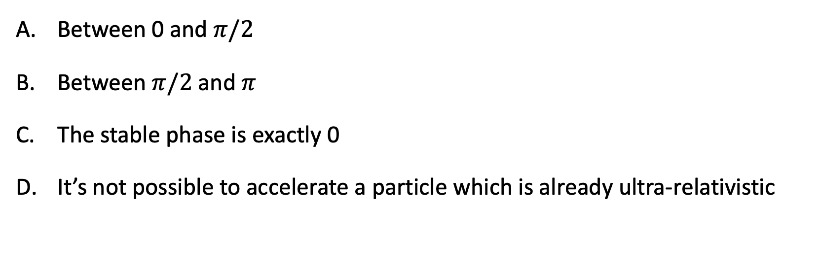
Phase stability in synchrotrons
Consider an ultra-relativistic proton (above transition) being accelerated. Where is the stable phase region of the sinusoidal RF voltage located?
Between 0 and $π/2$
Between $π/2$ and $π$
The stable phase is exactly 0
It’s not possible to accelerate a particle which is already ultra-relativistic

Slide 5
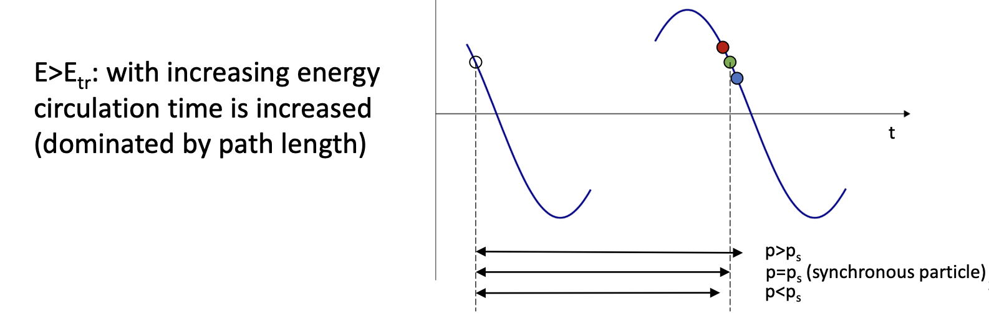
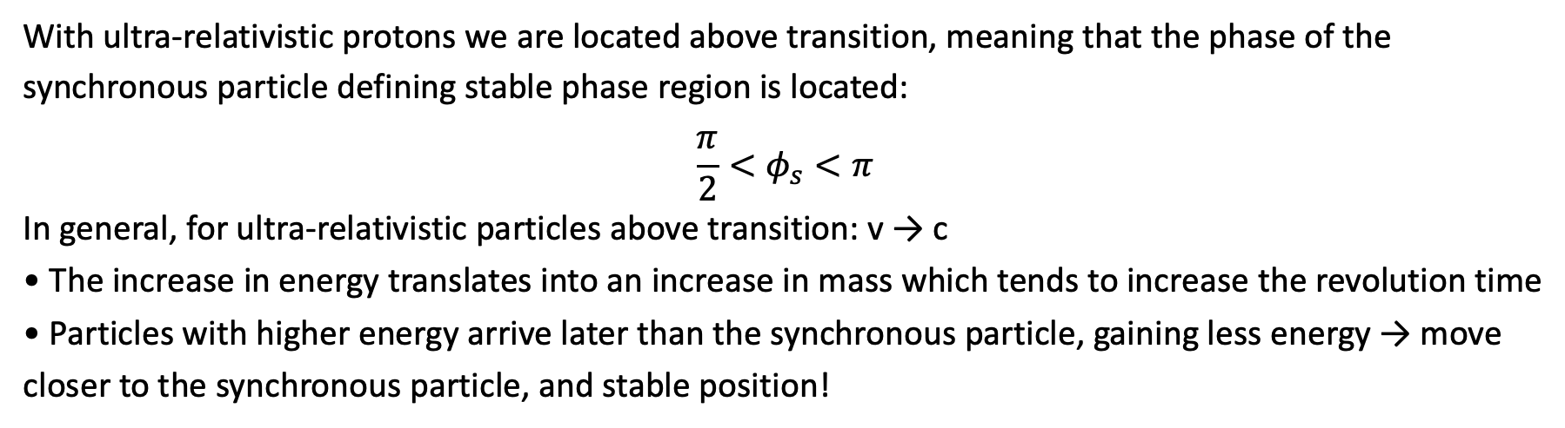
B is the correct answer
With ultra-relativistic protons we are located above transition, meaning that the phase of the synchronous particle defining stable phase region is located:
$$\frac{π}{2}<φ_{s}<π$$
In general, for ultra-relativistic particles above transition: v → c
• The increase in energy translates into an increase in mass which tends to increase the revolution time
• Particles with higher energy arrive later than the synchronous particle, gaining less energy → move closer to the synchronous particle, and stable position!

Slide 6
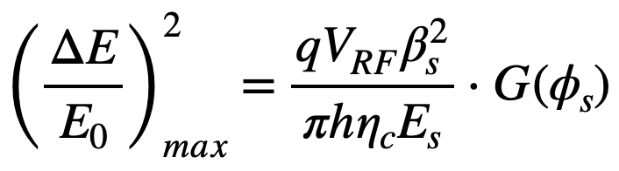
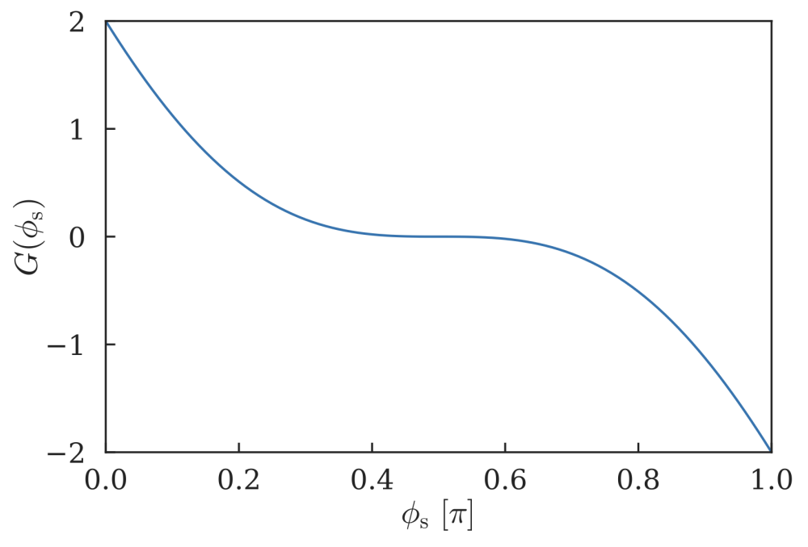

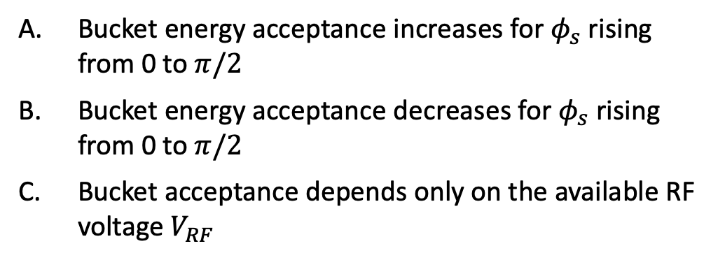
Bucket acceptance
Consider a stationary bucket. If the energy acceptance of the bucket is given as
Which of the following is correct
Bucket energy acceptance increases for $φ_{s}$ rising from 0 to $π/2$
Bucket energy acceptance decreases for $φ_{s}$ rising from 0 to $π/2$
Bucket acceptance depends only on the available RF voltage $V_{RF}$
Evolution of function $G$ as a function of $φ_{s}$

Slide 7
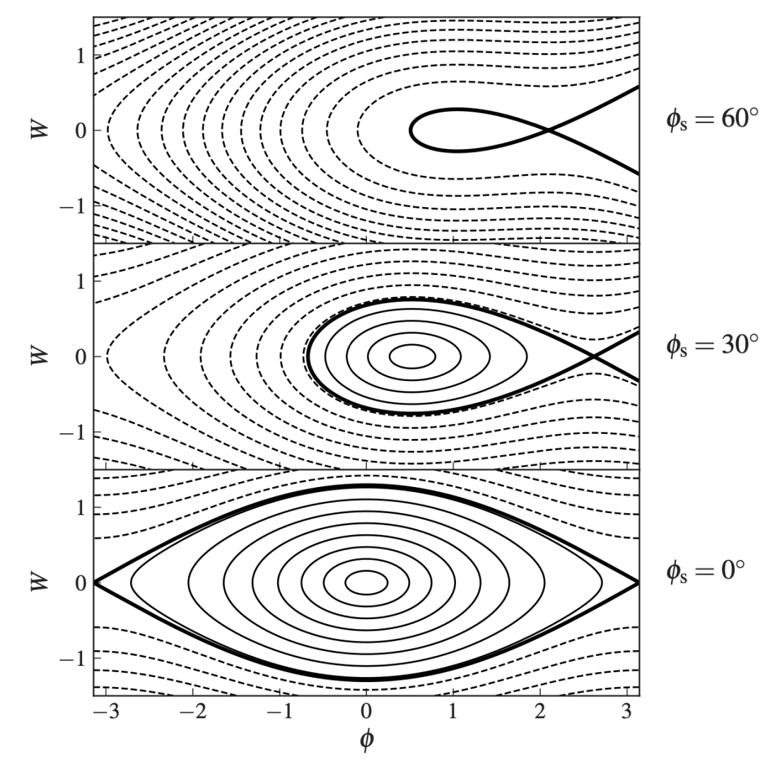
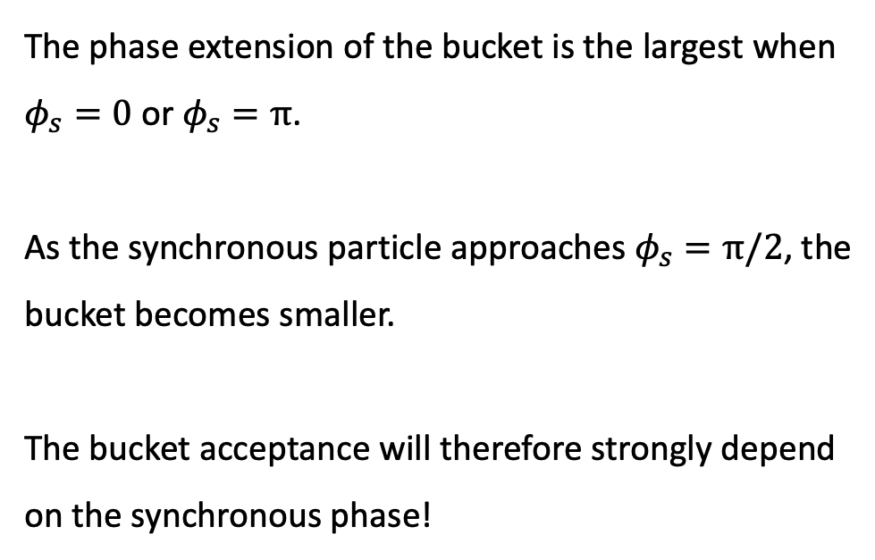
B is the correct answer
The phase extension of the bucket is the largest when $φ_{s}=0$ or $φ_{s}=π$.
As the synchronous particle approaches $φ_{s}=π/2$, the bucket becomes smaller.
The bucket acceptance will therefore strongly depend on the synchronous phase!

Slide 8
Assume there is a horizontal orbit distortion (caused by dipole error or displaced quadrupole). What happens to the ellipse in (x, x’) plane at the position of the kick after introducing such distortion?
Orbit displacement
Horizontal beam size σ is increased (ellipse becomes ”flatter”)
Horizontal beam divergence σ’ is increased (ellipse becomes ”more upright”)
The particle ellipse is moved in the ± x direction
The particle ellipse is moved in the ± x′ direction
Nothing

Slide 9
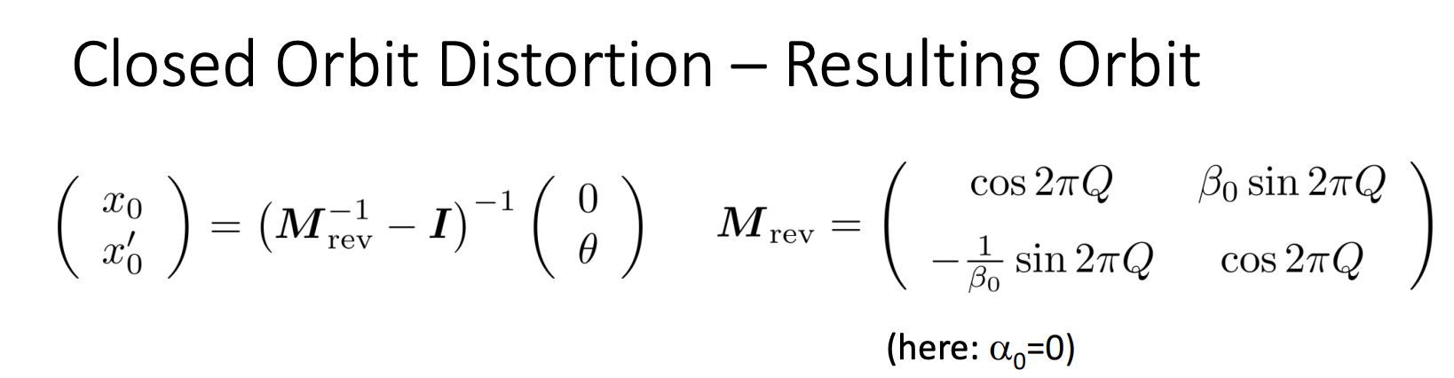
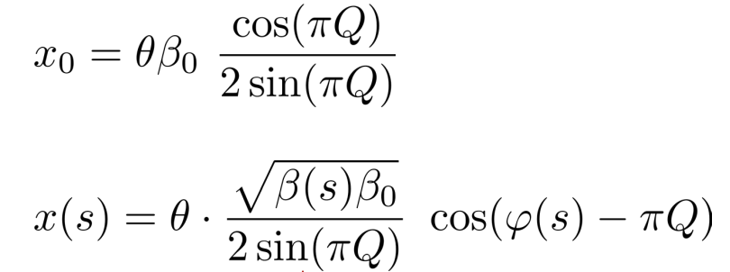
C, D are the correct answer
Closed orbit defines the centre of the ellipse,
the oscillation in is always around the centre of the closed orbit.
➔ The centre of the ellipse have a shift in both x and x’

Slide 10
Chromaticity is obtained by measuring the change of tune after changing the momentum. What can be derived by measuring the change of orbits (x,y) when varying the momentum?
Orbit and momentum change
The horizontal β_{x}
The vertical β_{y}
The horizontal dispersion D_{x}
The vertical dispersion D_{y}
Longitudinal positioning errors of the quadrupoles
Nothing

Slide 11
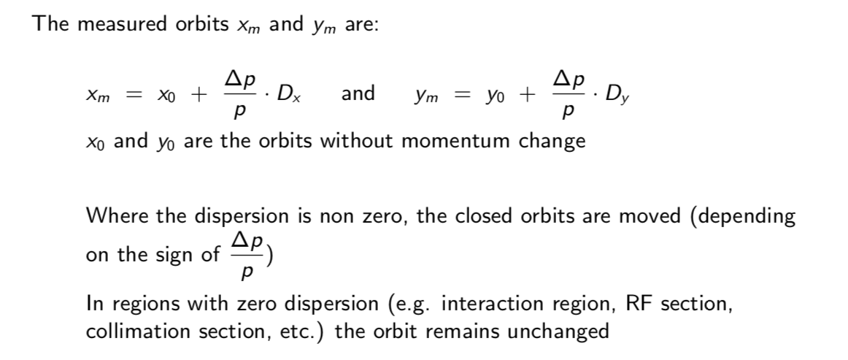
C, D are the correct answer

Slide 12
Assume LEP running at particle energy of 50 GeV. For physics measurements very exact knowledge of beam energy is needed, but not achieved (at the beginning) → energy changed with time ... ! Possible reasons?
Environmental Impact
Magnetic field at collision energy 0.06 T. Precise control of power converters at low current more difficult
Tidal effects
Earth magnetic field
Closed orbit measurement and orbit correction not precise enough
Communication problems with SNCF (French railroad system)
Water level Lac Leman and time of the day …
All of them

Slide 13
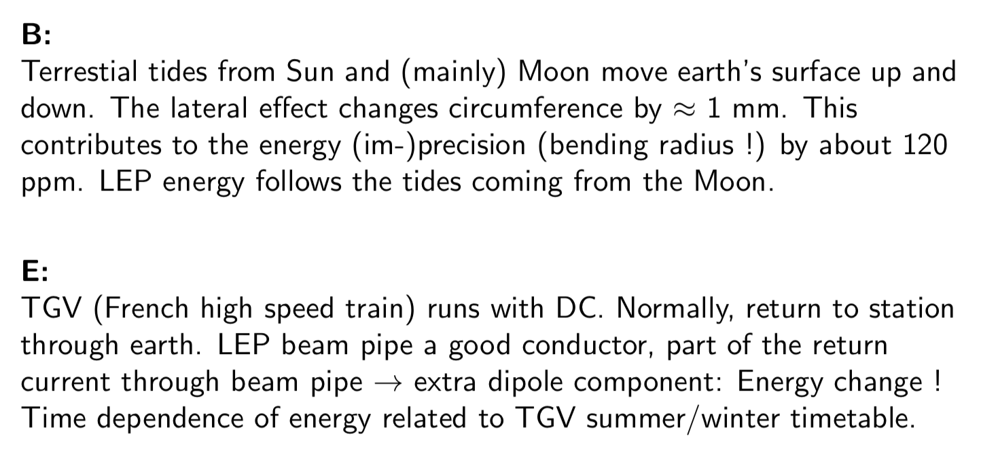
Correct answer: All of them! Important and unexpected problems were B and E

