Slide 1
Introduction to Particle Accelerators
2024-2025
Tutorial 3 - 26.09.2024, BSP 626
Prof. Mike Seidel
Teaching Assistants:
Werner Herr, Tatiana Pieloni, Léon Van Riesen-Haupt, Christophe Lannoy, Raziyeh Dadashi, Yi Wu

Slide 2
Beam separation
In the LHC (proton-proton) and in LEP (electron-positron) the counterrotating beams travel partly on the same trajectory and partly on separate trajectories, i.e. the beams must be separated in part of the machine. What are the options to separate the beams ?
Both with magnetic fields
LHC with magnetic fields and LEP with electric fields
LHC with electric fields and LEP with magnetic fields
Both with electric fields

Slide 3
B is the correct answer
proton-proton, same charge, opposite velocity direction → opposite force under the same magnetic field
electron-positron, opposite charge → opposite force under the same electric field

Slide 4
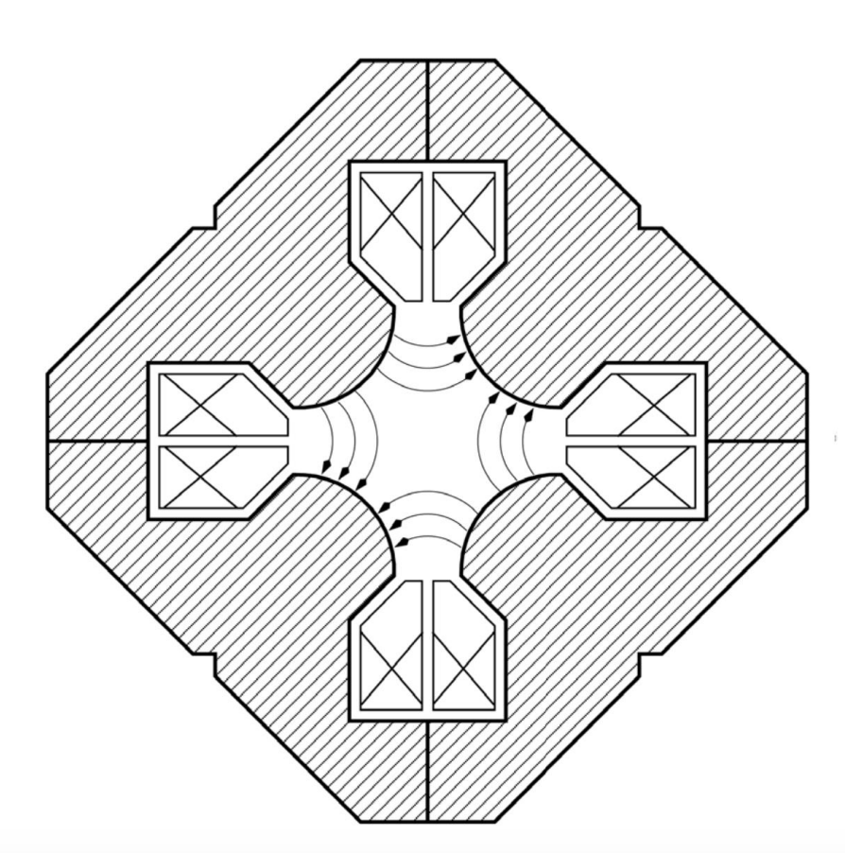
Magnet type
Considering an electron beam coming out of the plane (i.e. towards you), what kind of magnet is represented on the figure? (consider the horizontal plane)
Dipole
Focusing quadrupole
Defocusing quadrupole
Skew quadrupole
Sextupole

Slide 5
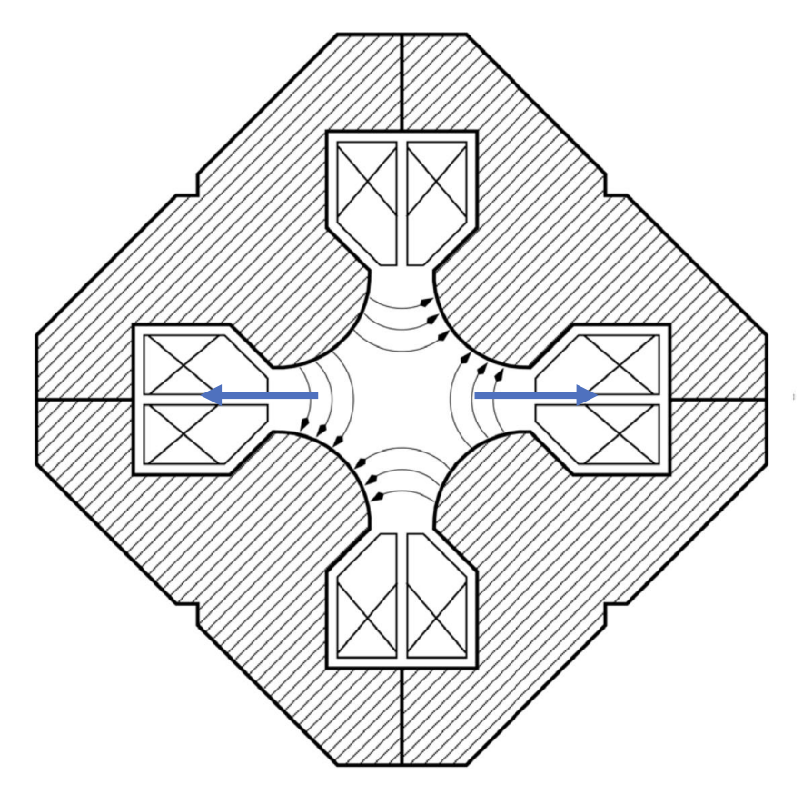
C is the correct answer
Use the right-hand rule and take into account the negative charge of the particle

Slide 6
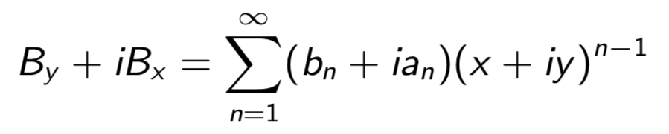
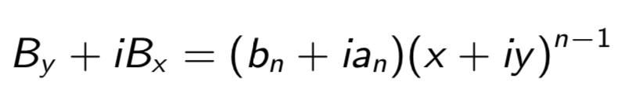
Multipoles
The magnetic fields can be written as an expansion of the multipoles (see lecture 2). That is (European convention):
for a ”pure” multipole:
Which of the statements are correct, more than one correct answer (ignore the constant coefficients, i.e. strengths ) ?
B_{y} ∝ (x⁴ − 6x²y² + y⁴) is an octupole
B_{x} ∝ y is a quadrupole
B_{y} ∝ (x² − y²) is a sextupole
B_{y} ∝ (x³ − 3xy²) is an octupole
B_{x} ∝ (3x²y − y³) is a sextupole
n=5 decapole
n=2 quadrupole
B, C, D are the correct
n=3 sextupole
n=4 octupole
n=4 octupole

Slide 7
Phase space ellipse
The phase space ellipse of a particle is different at different locations in the beam line. Suppose the initial ellipse looks like this, which one could be the ellipse after the focusing quadrupole?
A.
x’
B.
x’
x’
x
x
x
x’
x’
C.
D.
x
x

Slide 8






A is the correct answer
x’
$$x=x_{0}$$
Focusing quad
x
$$x^{′}=x_{0}^{′}−x_{0}/f$$
What is B and C ?
Defocusing quad
$$x=x_{0}$$
Drift
$$x=x_{0}+x_{0}^{′}⋅s$$
$$x^{′}=x_{0}^{′}+x_{0}/f$$
$$x^{′}=x_{0}^{′}$$
x’
x’
x
x

