Slide 1
Introduction to Particle Accelerators
2024-2025
Tutorial 1 - 12.09.2024, BSP 626
Prof. Mike Seidel
Teaching Assistants:
Werner Herr, Tatiana Pieloni, Léon Van Riesen-Haupt, Christophe Lannoy, Raziyeh Dadashi, Yi Wu

Slide 2
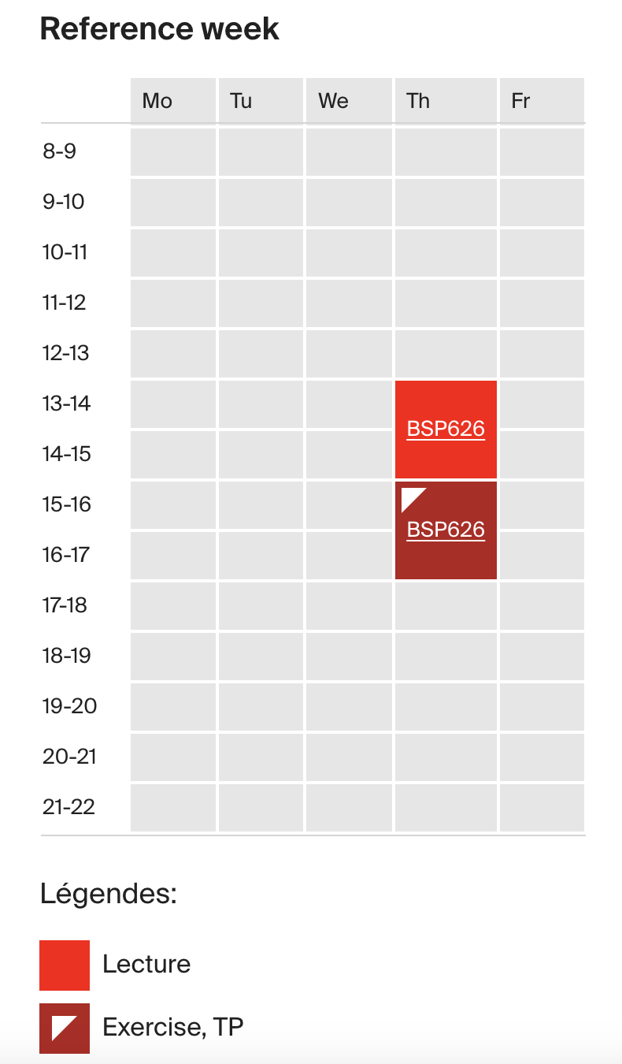
Info about the course
Official EPFL course webpage here.
2 hours of lectures followed by 2 hours of tutorial every week.
Moodle web page:
  Lecture slides + exercise sheets uploaded before each lecture.
  Exercise solutions uploaded after each tutorial session.
Use of moodle material is allowed during the final (written) exam.

Slide 3
Info about the course
Most tutorials involve solving problem sheets
Some tutorials will be "hands-on" by solving exercises with the help of Jupyter notebooks.
A Forum for discussion is set up on Moodle and Ed in order to ask questions, clarify your doubts and interact with other students.

Slide 4
Tutorial session
First part of the tutorial: "plenary quiz" on the topics covered in the tutorial of the day. The quiz is not meant to judge you, it is just an interactive session for open discussion.
Second part will be working on the exercise sheets. You can ask question and clarify some concepts while solving the exercises with the tutor(s) present in the classroom.
During the week you can finalize your homework and submit them on moodle. Corrections of the homework will be provided without grade.
Participating in the tutorial session and handing in homework are not mandatory but highly recommended since the final exam is written.

Slide 5
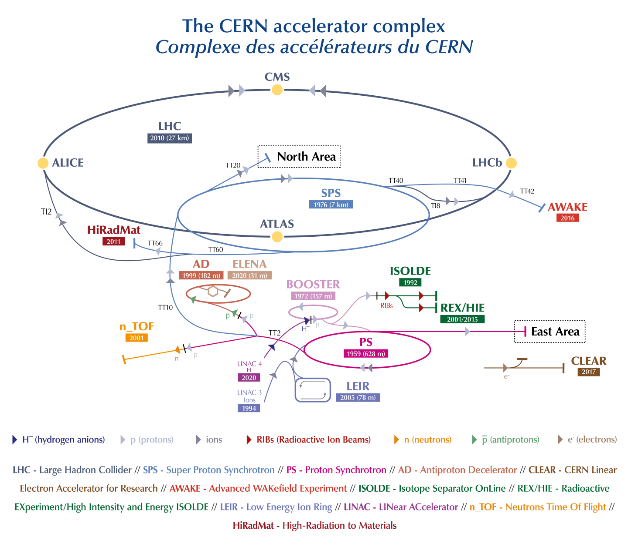

Slide 6
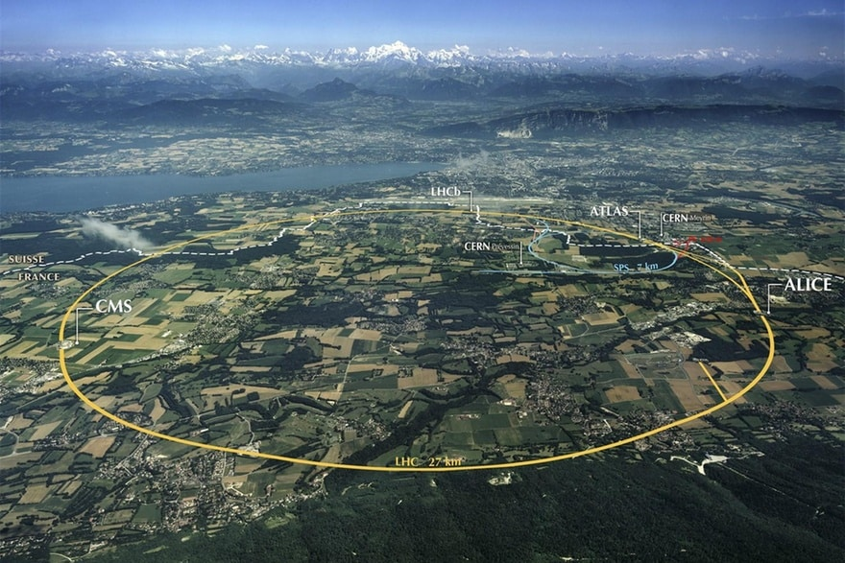
Energy in the LHC
Beam energy: 6.5 TeV
In calories: ~2.5e-7 cal
Number of particles per beam: ~1e14 protons
~25 000 kcal per beam
~10 days worth of food for a man
~7 kg of butter

Slide 7
1) Which units can be used for energy?
Calories
Joules
Electronvolts
All above
Conversion factors:
1 eV = 1.602e-19 J
1 eV = 3.829e-20 cal

Slide 8
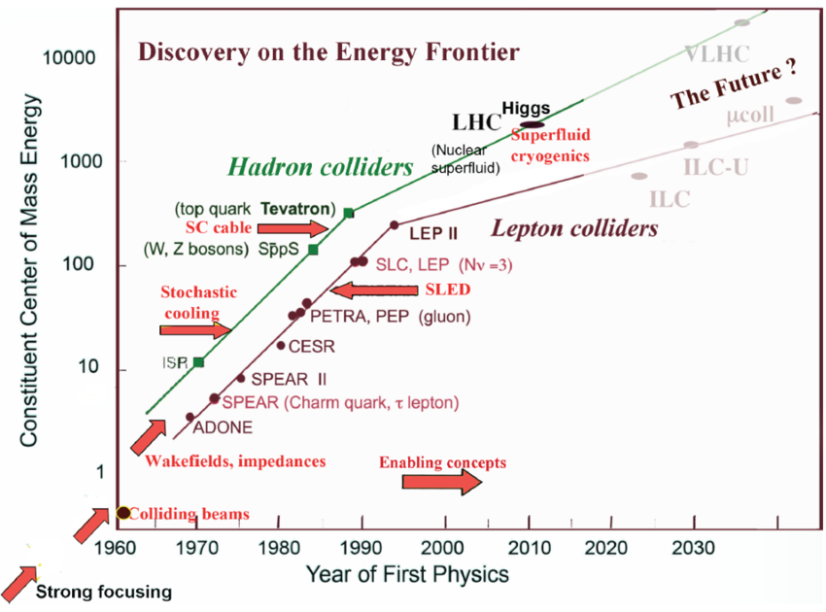
“Livingston plot”
M. Stanley Livingston:
“advances in accelerator technology increase the energy records achieved by new machines by a factor of 10 every six years.”
—— has become a hallmark in the field of accelerator physics.

Slide 9
2) The energy of a flying mosquito is equivalent to few TeV which is close to the energy of the LHC proton beams... why do we accelerate particles and not mosquitos?
We do not have enough mosquitos in the whole world.
It is not fair to smash mosquitos.
Mosquitos are too big.

Slide 10
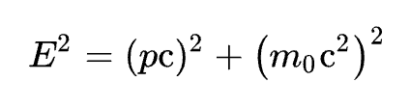

3) What do you need to know to calculate the total energy of a certain particle?
The momentum of the particle.
The mass and the momentum of the particle.
The gamma factor and the mass of the particle.
Options B and C.

Slide 11
4) In order to explore the infinitely small structure, you need
light particles
particles with high kinetic energy
big microscopes

Slide 12
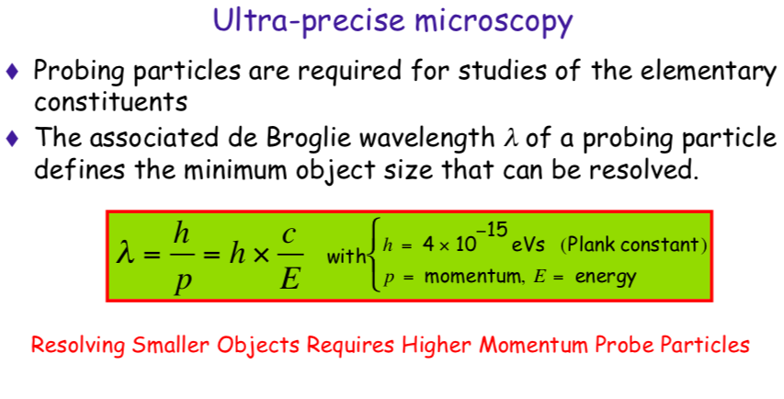

Slide 13
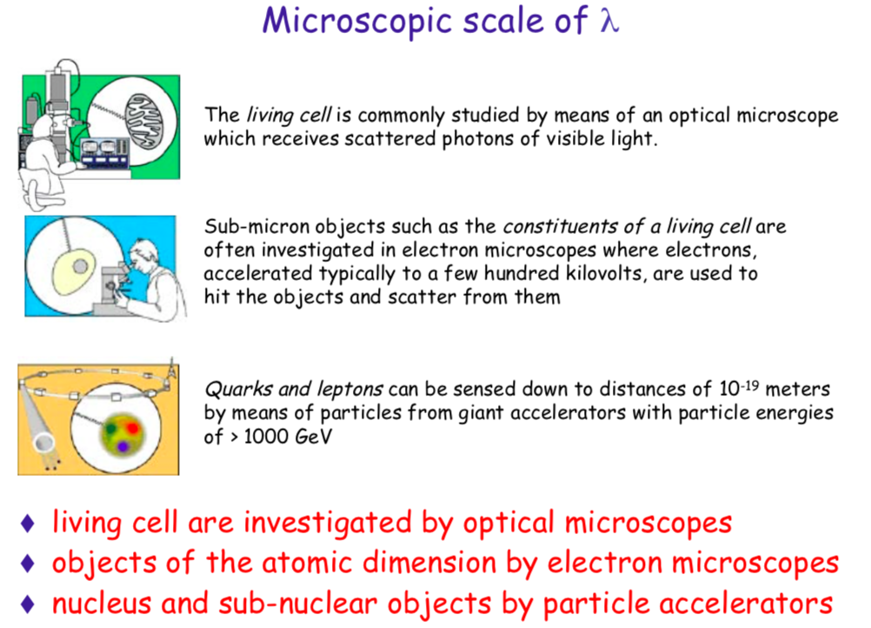

Slide 14
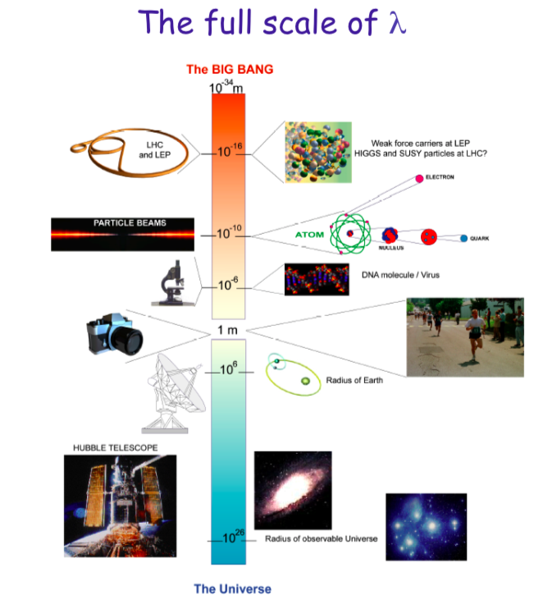
Observation instruments
Object size

Slide 15
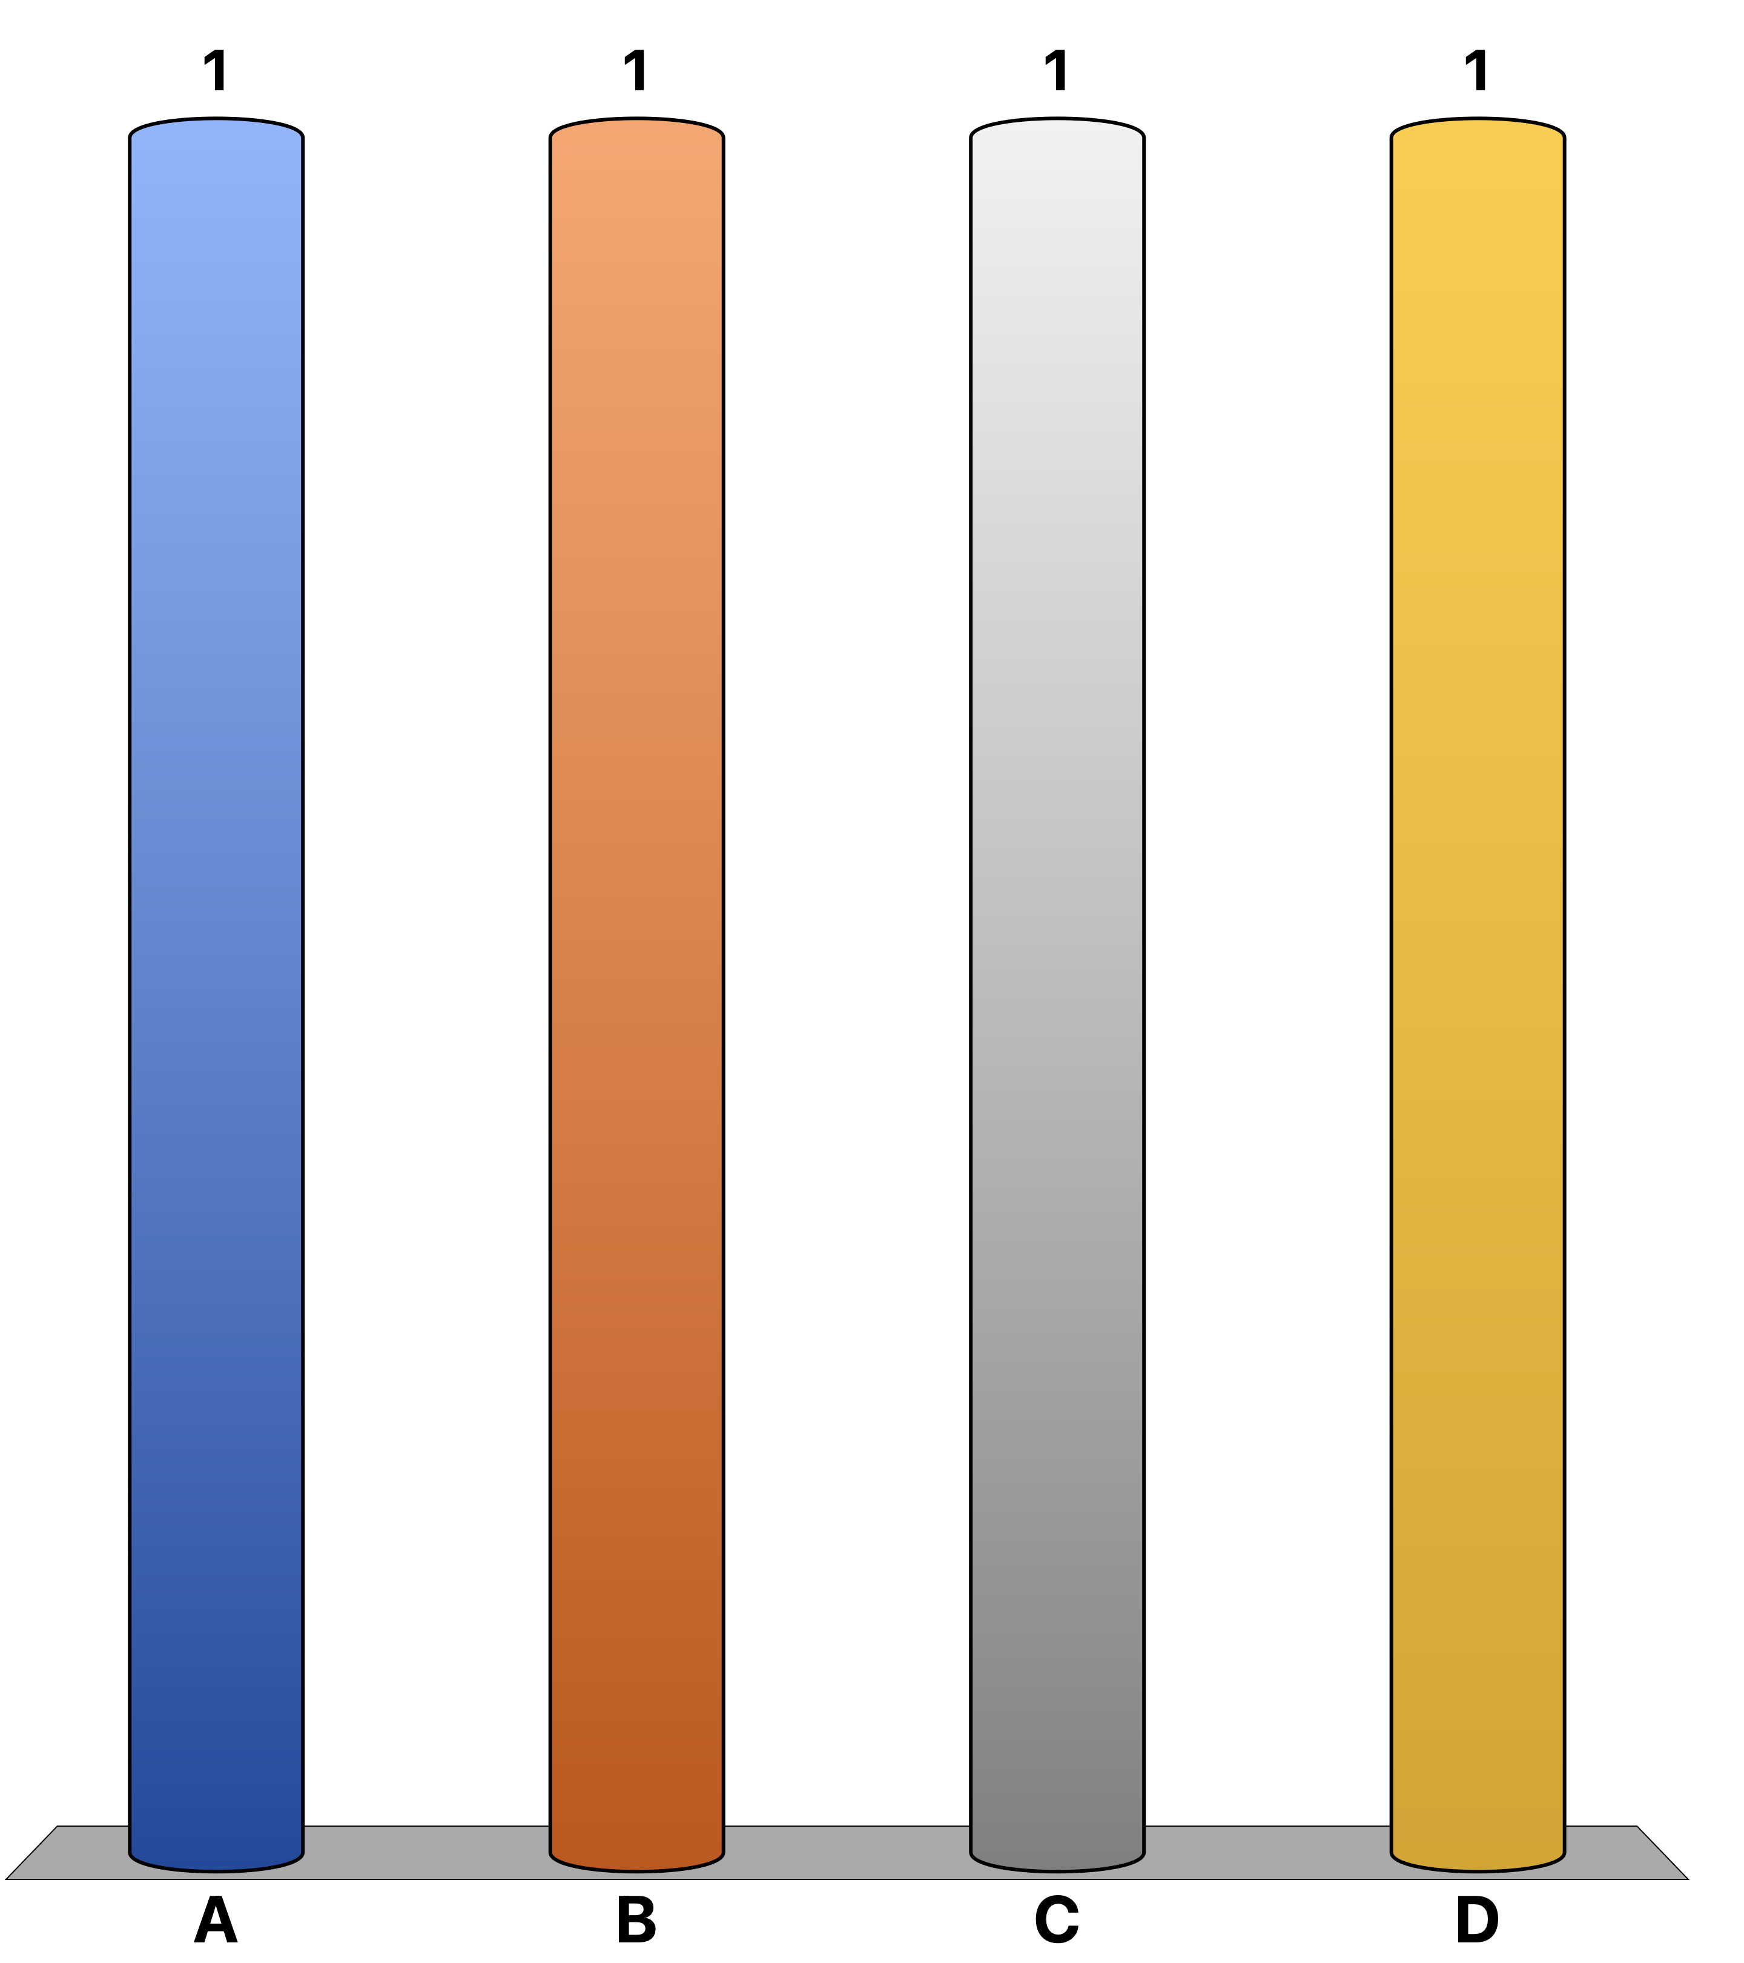
5) Consider a fixed electrical potential difference, which particle gains more energy passing through it?
Electron
Positron
Proton
All of the above.

