Slide 1
The detector
(Wavelength
Control)
Excitation source
(e.g. laser)
Focusing optics
The detector properties should match the light that needs to be measured.
The main detector characteristics are:
Size and structure (single detector / array)
Useful range (wavelengths/photon energy)
Responsivity (output signal per light intensity)
Noise level
Speed
We look here at several types of detectors:
Thermal detectors:
Thermopile
Bolometer
Pyroelectric detector
Photon detectors:
Photomultiplier
Semiconductor photodiode
CCD/CMOS camera
(Environmental
Control)
Sample
Collecting and focusing optics
Wavelength
control
Dispersive element
Detector

Slide 2
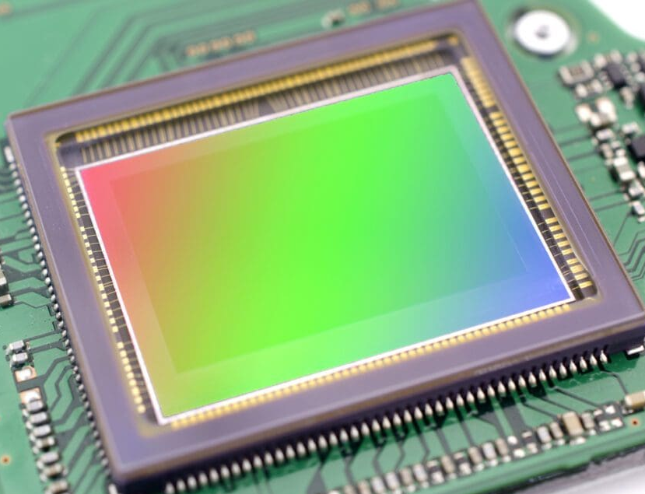
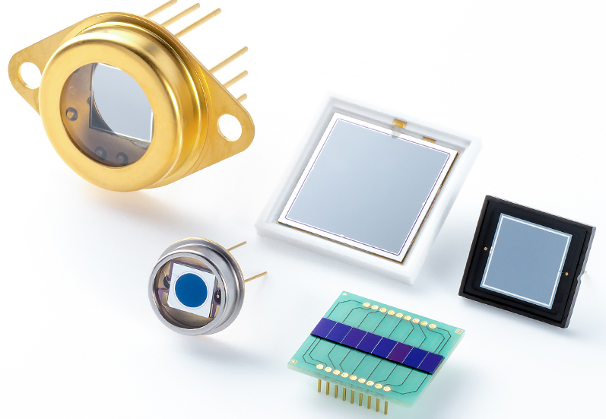
Definition of detector parameters (1)
Size and structure: Single detectors have mostly sizes of 0.1-10 mm. Array detectors and cameras (CCD and CMOS), with 1-25 μm size pixels, are also used in spectroscopy, to produce a full spectrum in a single measurement.
Responsivity/Sensitivity S (output signal per light intensity): Most detectors produce electrons (current) in response to photons (light intensity). The responsivity is defined as current output per light input, its units are A/W. Usually an external amplifier transforms the current to voltage (in some cases a small resistor is enough). In photon detectors, we can define the QE (quantum efficiency): the number of electrons (<1) generated by an incoming photon.
Useful range: the usable wavelength range of the detector, usually defined at the 1% responsivity or QE. It can be very wide (e.g. for thermal detectors) or narrow (for some photodiodes). Sometimes it is expressed in energy units: E(eV)=1.24/λ(μm).
GaAs PD
https://www.it-service24.com/wp-content/uploads/2022/06/ccd-sensor-2048x1356.jpg
https://www.hamamatsu.com/blobs/1328783866354?blobheadername1=content-disposition&blobheadervalue1=inline%3Bfilename%3Dk_top_photodiode.jpg&ssbinary=true

Slide 3
Definition of detector parameters (2)
Noise level: The noise current generated with or without light input. It can have several sources:
Johnson noise, related to the detector's resistance.
Shot noise, related to leakage (dark) current.
Generation-recombination noise in semiconductors.
The noise is usually temperature-dependent, so in many cases the detector must be cooled to perform better. The noise can be characterized by different parameters:
Noise current I_{n} (units: A/√Hz): direct indication of the noise .
Noise-equivalent power (NEP): NEP=I_{n}/S (units: W/√Hz): normalization of the noise current by the detector's sensitivity, allowing direct comparison of the noise to signal power. Smaller is better!
Detectivity D* : D*= √A/NEP (units: cm.W √Hz ), A= detector area, further normalization by the detector area (in many cases noise is proportional to detector size). Higher is better!
Speed: For most spectroscopy applications, detector speed is not an issue. When cameras are used, the large number of pixels requires faster pixel readout speed (1M pixels read at 1 MHz require 1s readout time!). Some special applications (photon correlation, lifetime measurements) require very fast (<1ns) detectors.
GaAs PD

Slide 4
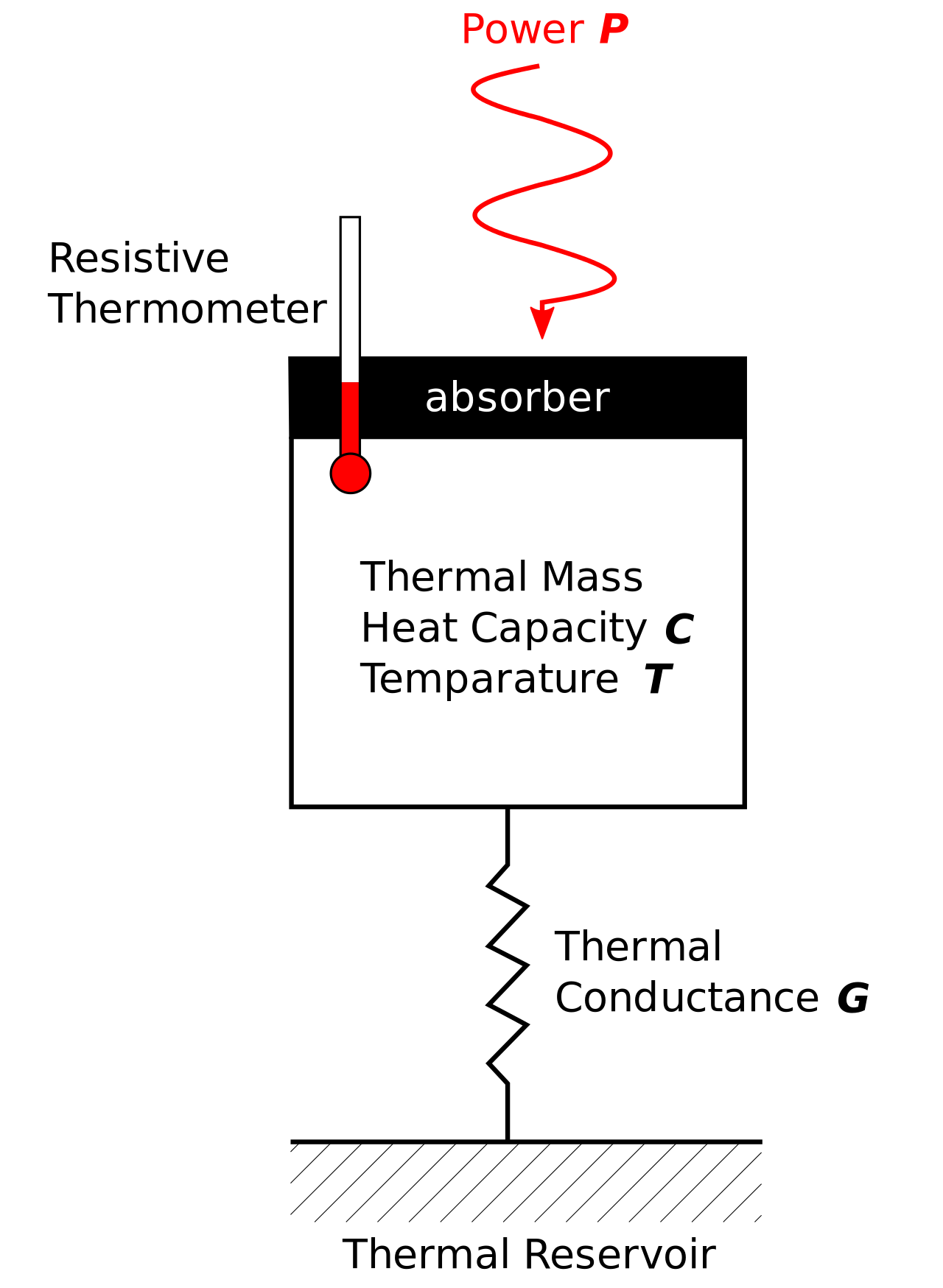
Thermal detectors - General
Thermal detectors react to the radiation energy (heat); they are equally sensitive to all wavelengths.
Thermal detectors are usually constructed of two parts:
An absorber that gets heated by the incoming radiation.
A means of measuring the temperature change of the absorber.
There are many methods to detect the temperature change, leading to different detectors:
By the Seebeck effect (thermocouple)
By resistance change (bolometer)
By the pyroelectric effect (pyroelectric detector)
The first two detector types can measure constant radiation power,
the last one is sensitive only to temperature changes so can detect
only pulsed (or chopped) radiation.
Some of these detectors can be miniaturized and are used as linear or
rectangular array detectors / cameras.
Another type is superconducting photodetectors (see below).
Main use: to measure IR/FIR radiation, e.g. in FTIR spectrometers.
Main advantages: sensitivity is independent of photon energy.
Main disadvantages: low sensitivity, slow response.
https://upload.wikimedia.org/wikipedia/commons/thumb/1/1e/Bolometer_conceptual_schematic.svg/1280px-Bolometer_conceptual_schematic.svg.png

Slide 5
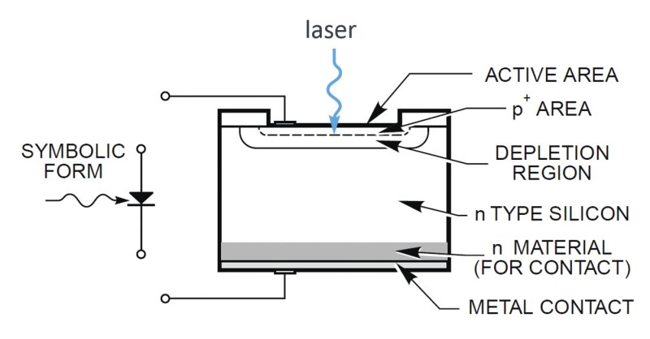
Photon detectors - General
Photon detectors are based on semiconductors: incoming photons generate electron-hole pairs that are transformed to electric current.
The semiconductor bandgap determines the longest wavelength that can be detected (photon energy must be higher than the bandgap), but also the noise properties of the detector.
The main types are:
Photomultiplier (PMT)
Photodiode (linear and avalanche)
CCD/CMOS camera
We usually distinguish between:
Wide-medium band semiconductors, can detect up to 1 μm.
Narrow-band semiconductors, can detect above 1 μm.
Main use: To measure UV/VIS/NIR(FIR) radiation in all spectrometers
Main advantages: high sensitivity (down to the single photon level), low noise.
Main disadvantages: far-IR and single-photon detectors need cooling (sometimes down to 77K!) to reduce noise.
https://www.newport.com/n/photodiode-physics
https://www.hamamatsu.com/blobs/1328783866354?blobheadername1=content-disposition&blobheadervalue1=inline%3Bfilename%3Dk_top_photodiode.jpg&ssbinary=true

Slide 6
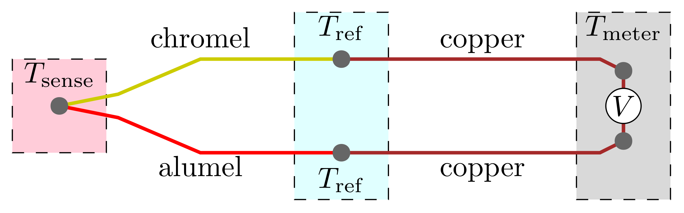
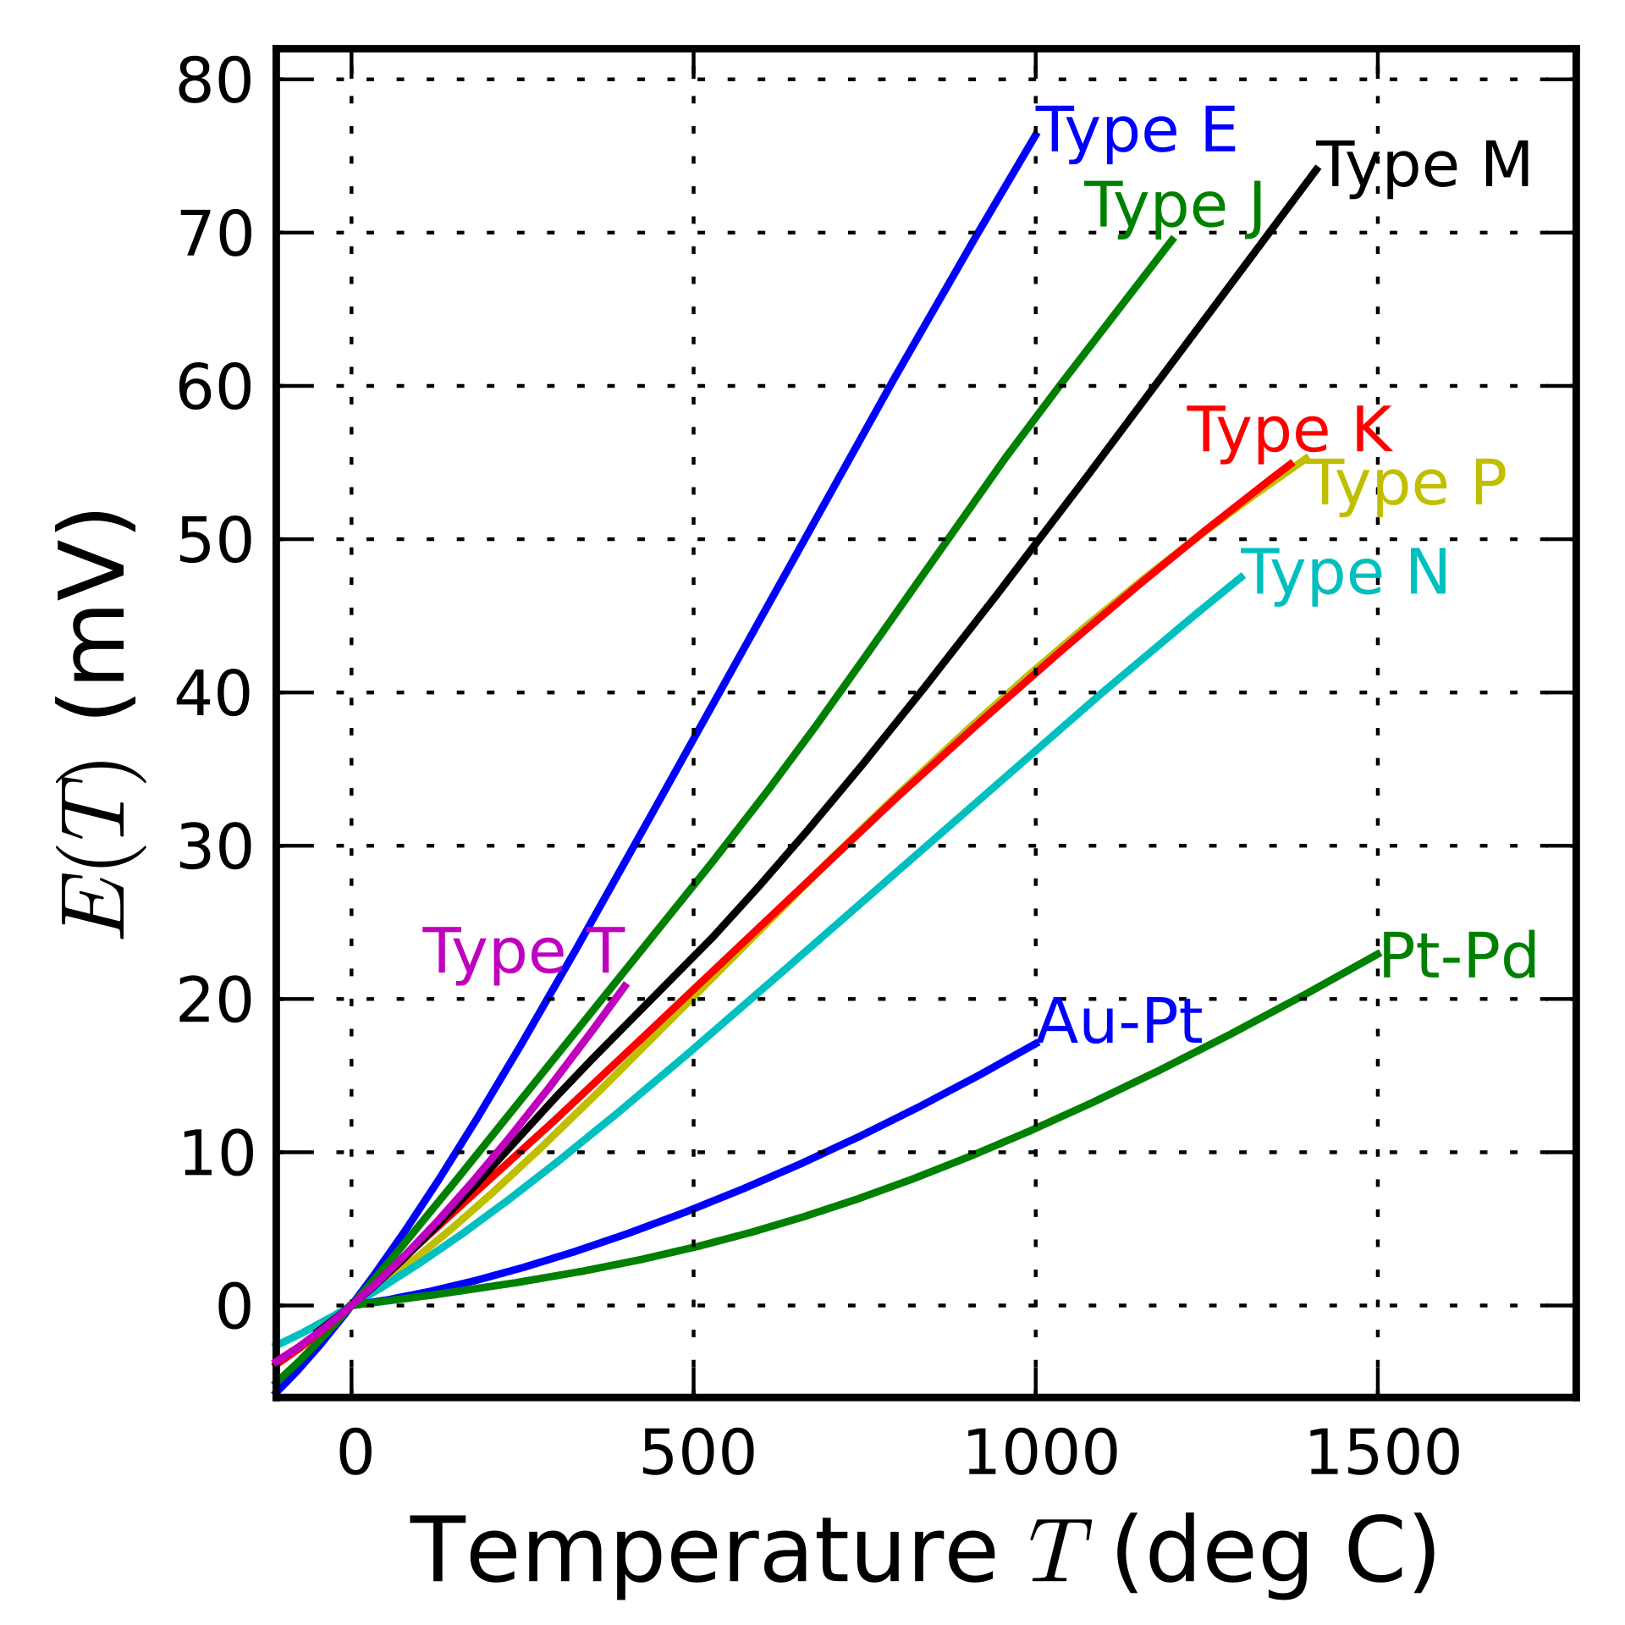
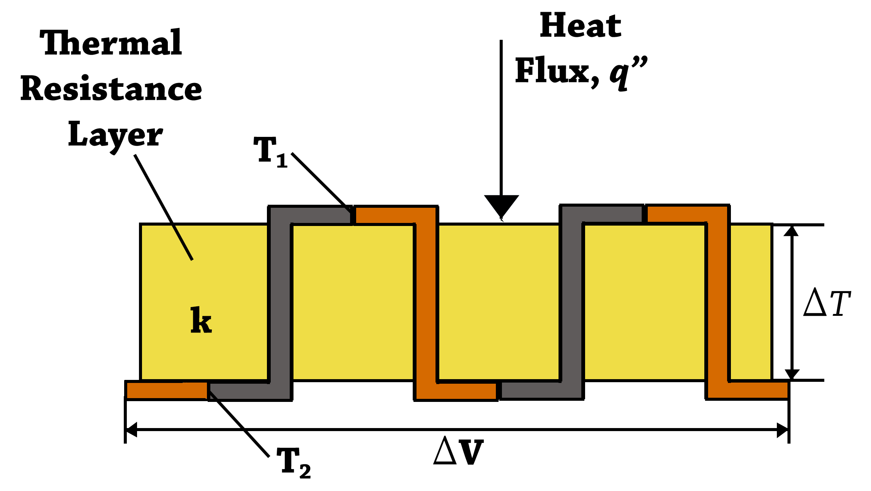
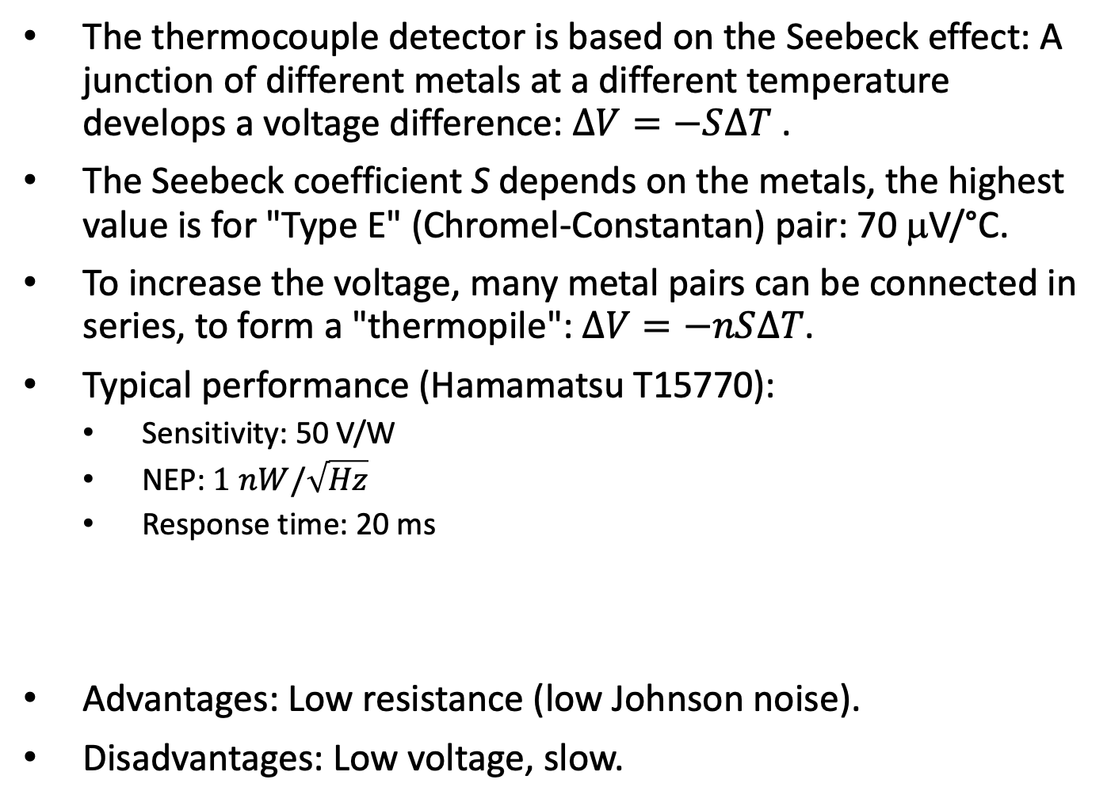
Thermocouple/thermopile detectors
The thermocouple detector is based on the Seebeck effect: A junction of different metals at a different temperature develops a voltage difference: $∆V=−S∆T$ .
The Seebeck coefficient S depends on the metals, the highest value is for "Type E" (Chromel-Constantan) pair: 70 μV/°C.
To increase the voltage, many metal pairs can be connected in series, to form a "thermopile": $∆V=−nS∆T$.
Typical performance (Hamamatsu T15770):
Sensitivity: 50 V/W
NEP: $1 nW/\sqrt{Hz}$
Response time: 20 ms
Advantages: Low resistance (low Johnson noise).
Disadvantages: Low voltage, slow.
https://en.wikipedia.org/wiki/Thermopile
https://en.wikipedia.org/wiki/Thermocouple

Slide 7
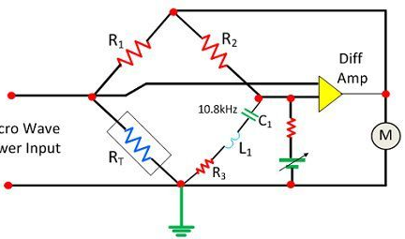
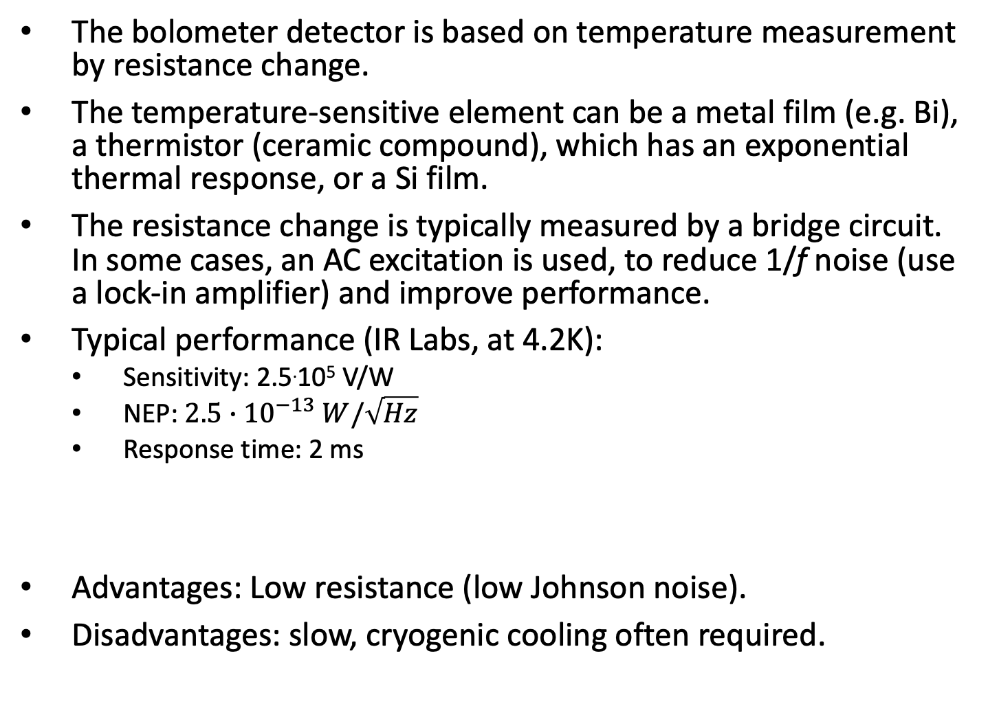
Bolometer detectors
The bolometer detector is based on temperature measurement by resistance change.
The temperature-sensitive element can be a metal film (e.g. Bi), a thermistor (ceramic compound), which has an exponential thermal response, or a Si film.
The resistance change is typically measured by a bridge circuit. In some cases, an AC excitation is used, to reduce 1/f noise (use a lock-in amplifier) and improve performance.
Typical performance (IR Labs, at 4.2K):
Sensitivity: 2.5.10⁵ V/W
NEP: $2.5∙{10}^{−13} W/\sqrt{Hz}$
Response time: 2 ms
Advantages: Low resistance (low Johnson noise).
Disadvantages: slow, cryogenic cooling often required.
https://circuitglobe.com/bolometer.html
https://www.irlabs.com/

Slide 8
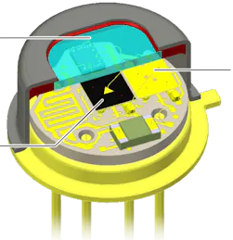
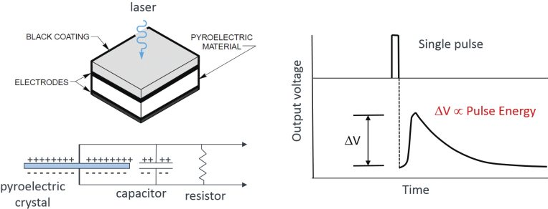
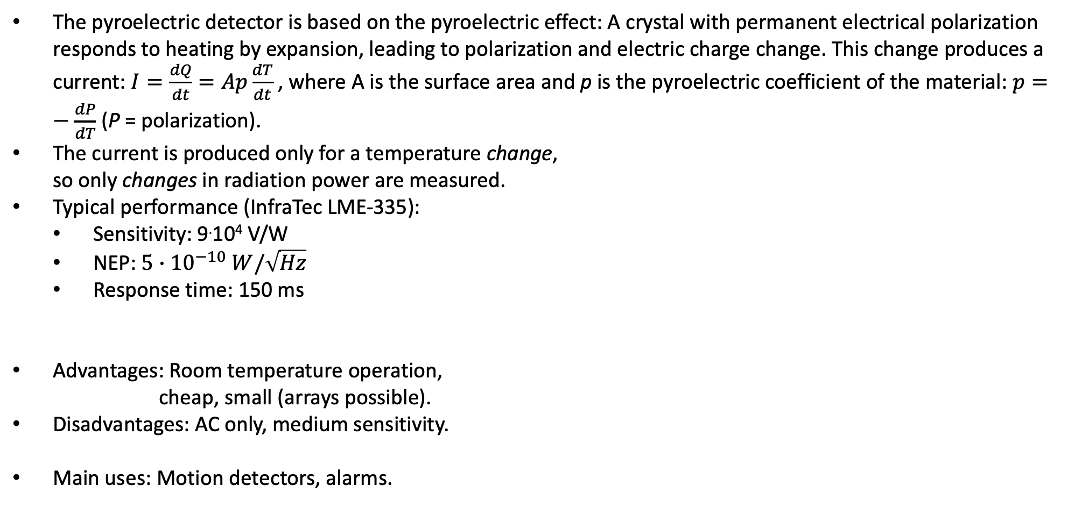
The pyroelectric detector
The pyroelectric detector is based on the pyroelectric effect: A crystal with permanent electrical polarization responds to heating by expansion, leading to polarization and electric charge change. This change produces a current: $I=\frac{dQ}{dt}=Ap\frac{dT}{dt}$ , where A is the surface area and p is the pyroelectric coefficient of the material: $p=−\frac{dP}{dT}$ (P = polarization).
The current is produced only for a temperature change,
so only changes in radiation power are measured.
Typical performance (InfraTec LME-335):
Sensitivity: 9.10⁴ V/W
NEP: $5∙{10}^{−10} W/\sqrt{Hz}$
Response time: 150 ms
Advantages: Room temperature operation,
cheap, small (arrays possible).
Disadvantages: AC only, medium sensitivity.
Main uses: Motion detectors, alarms.
https://www.google.com/url?sa=i&url=https%3A%2F%2Fwww.infratec.eu%2Fsensor-division%2Fservice-support%2Fglossary%2Fpyroelectric-detector%2F&psig=AOvVaw2djeC2dsW0B7AF2N0Xx7tJ&ust=1731511602137000&source=images&cd=vfe&opi=89978449&ved=0CBQQjRxqGAoTCJDLj-iN14kDFQAAAAAdAAAAABCDAg
https://www.newport.com/n/pyroelectric-physics

Slide 9
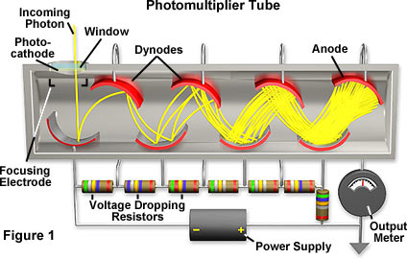
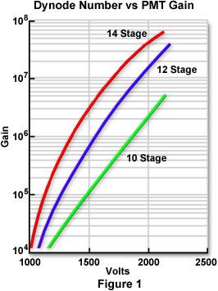
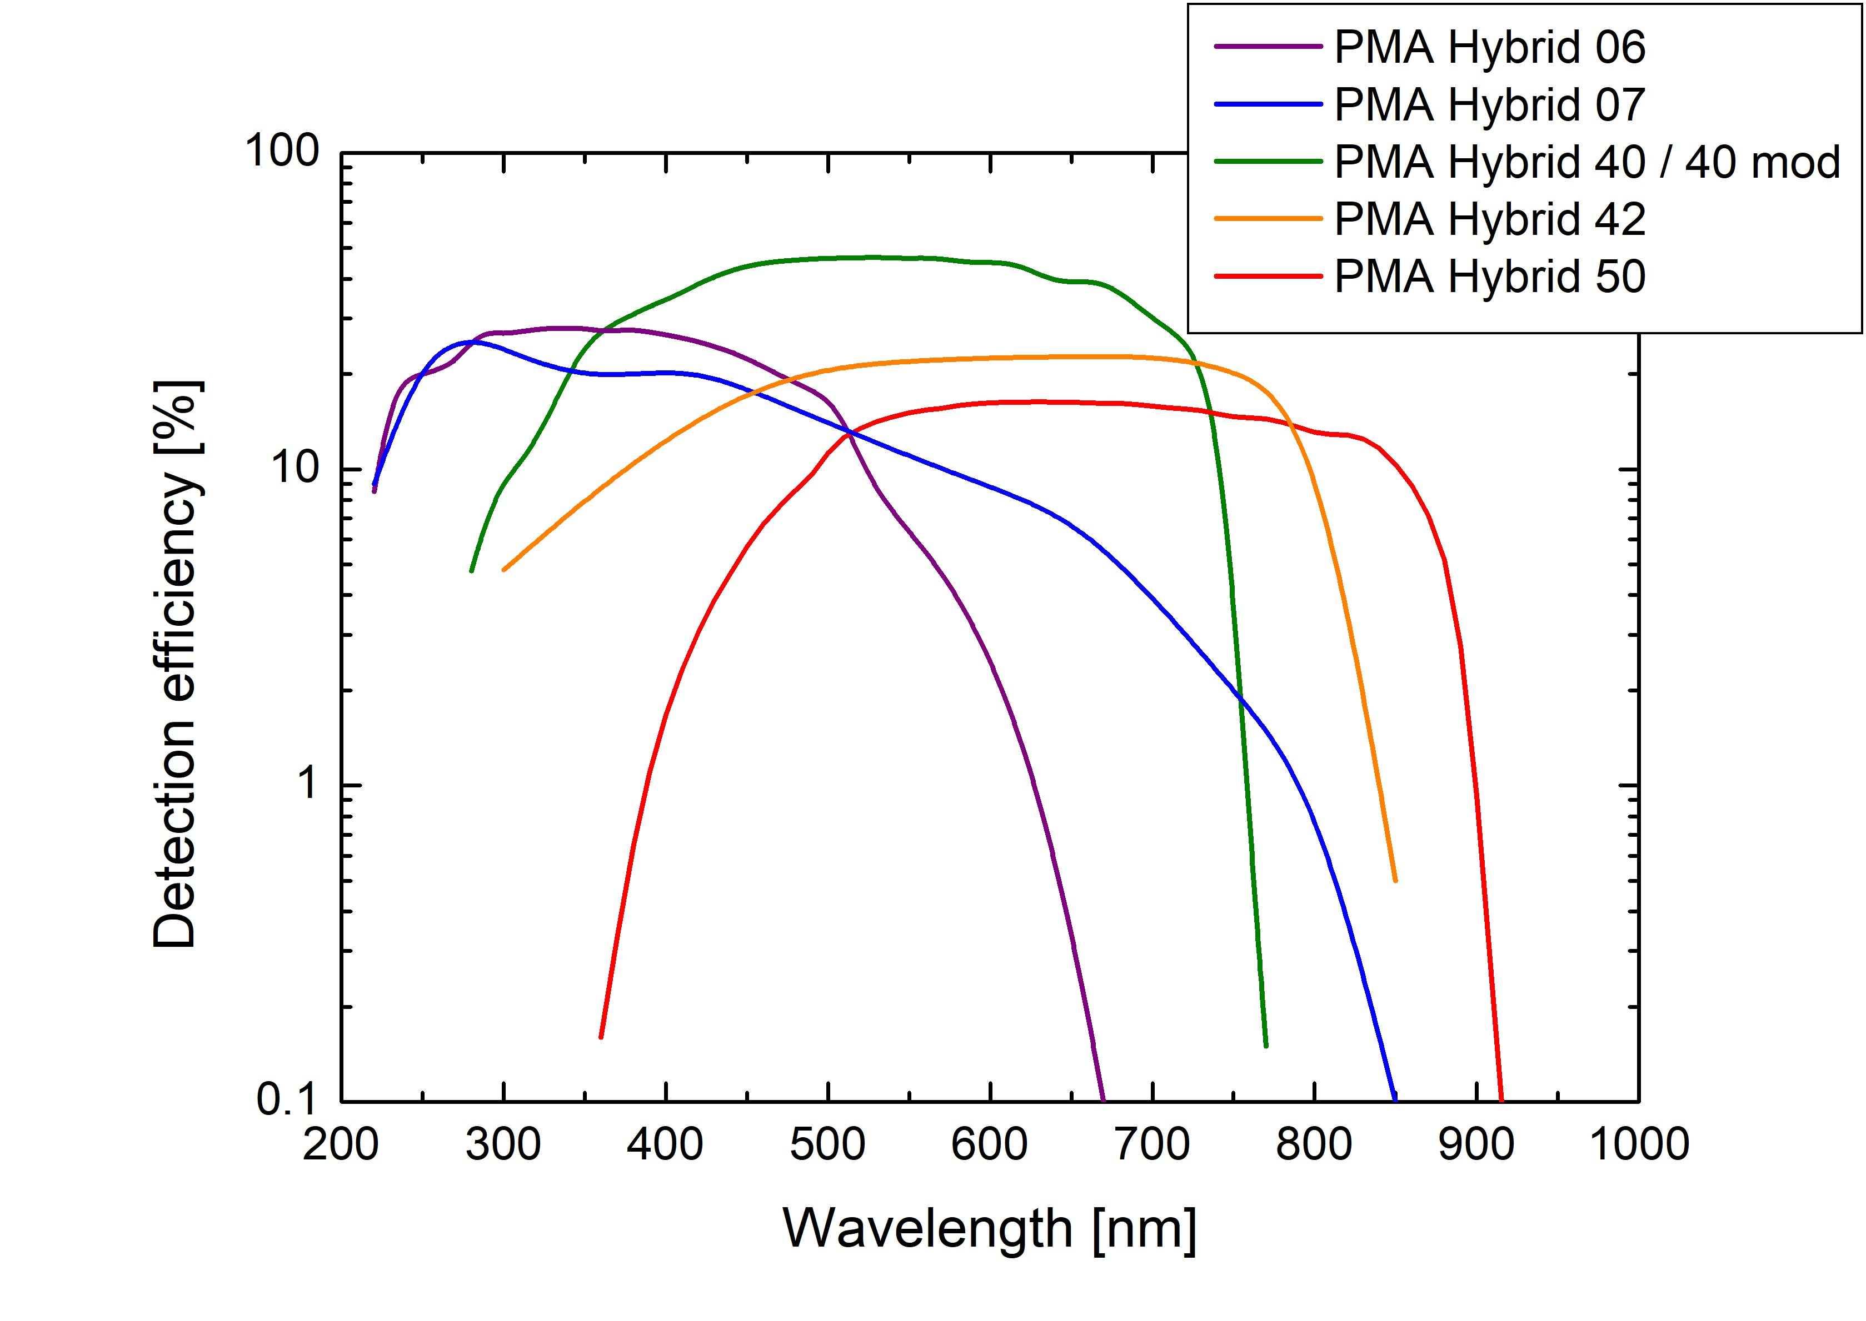
Photon detectors: the photomultiplier
The photomultiplier is composed of a photocathode, which emits electrons when illuminated, and a set of dynodes, that multiply the electron flux. This setup is contained in a vacuum tube, with an external voltage maintaining the potential difference (100-300V) between successive dynodes, to accelerate the electrons and increase the electron yield.
A typical photomultiplier has up to 14 dynodes, yielding a total gain of 10⁵-10⁷ electrons/photon.
The photocathode is made of alkali metals, with low work function, giving the wavelength response
of the tube: the photon energy must be
higher than the work function – this defines
the long-wavelength cutoff of the tube.
Maximum wavelength: 900 nm.
https://www.olympus-lifescience.com/fr/microscope-resource/primer/digitalimaging/concepts/photomultipliers/
https://www.picoquant.com/products/category/photon-counting-detectors/pma-hybrid-series-hybrid-photomultiplier-detector-assembly

Slide 10
Continuous and pulse-response photomultipliers
The photomultiplier can function in a continuous mode: light (photon flux) is converted to electron flux, which is multiplied to give the output current. Typical sensitivity is: 50-100 mA/W.
Photomultipliers can also measure individual photons: each photon produces a photoelectron, yielding 10⁵-10⁷ electrons or a short current pulse at the output. This current pulse can be counted, to give the count of photons. Fast photomultipliers can have very short response time, down to 50 ps.
Noise is related to spontaneous electron emission from the electrodes, which can be reduced by cooling: from 100-1000 counts/s at room temperature, down to 1 count/s at -40°C.
Advantages: High sensitivity, low noise, high speed.
Disadvantages: Bulky, limited wavelength, high voltages needed.
Main uses: high-sensitivity / high-speed UV_VIS detection.
https://www.hamamatsu.com/resources/pdf/etd/R3809U-50_TPMH1067E.pdf

Slide 11
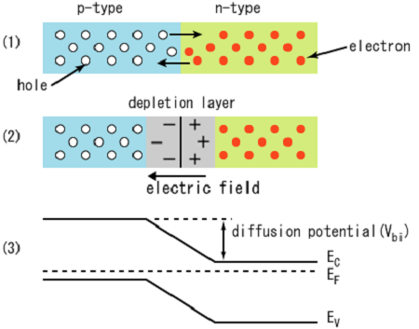
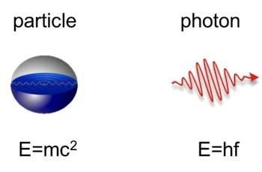
Photon detectors: the linear photodiode
Photon detectors are based on a semiconductor diode (p-n junction), which has a wide carrier-free "depletion layer". This layer has a strong internal electric field.
The diode structure is special: thin top p layer, to let light enter with low absorption, and a thick depletion region, where most light should be absorbed.
The absorbed light in the depletion layer generates electron-hole pairs, which are separated by the junction field and collected by electrodes, generating a current.
E_{gap}
Light input
E_{gap}
http://www.osioptoelectronics.com/application-notes/an-photodiode-parameters-characteristics.pdf

Slide 12
Photon detectors: the linear photodiode
The photon energy must be higher than the semiconductor energy gap. This determines the longest wavelength that can be detected.
The I/V curve of a photodiode is the same as a typical diode curve; light displaces the curve to negative currents.
Advantages: High sensitivity, low noise, high linearity, cheap, any size (from 0.1 mm high-speed detectors to many m² solar panels).
Disadvantages: Longest wavelength is limited by bandgap (e.g. 1.1 μm for the most common Si photodiode).
Main uses: General-purpose and high-sensitivity UV – VIS - NIR detection.
E_{gap}
Light intensity
http://www.osioptoelectronics.com/application-notes/an-photodiode-parameters-characteristics.pdf

Slide 13
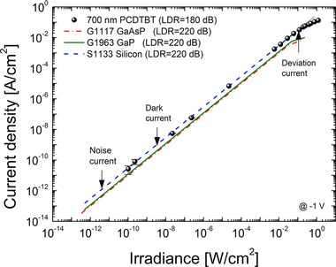
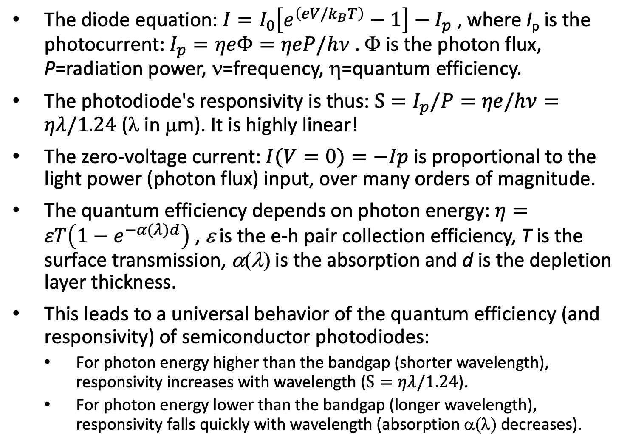
The linear photodiode equation
The diode equation: $I=I_{0}\left[e^{\left(eV/k_{B}T\right)}−1\right]−I_{p}$ , where I_{p} is the photocurrent: $I_{p}=ηeΦ=ηeP/hν$ . Φ is the photon flux, P=radiation power, ν=frequency, η=quantum efficiency.
The photodiode's responsivity is thus: $S=I_{p}/P=ηe/hν=ηλ/1.24$ (λ in μm). It is highly linear!
The zero-voltage current: $I(V=0)=−Ip$is proportional to the light power (photon flux) input, over many orders of magnitude.
The quantum efficiency depends on photon energy: $η=εT\left(1−e^{−α(λ)d}\right)$ , ε is the e-h pair collection efficiency, T is the surface transmission, α(λ) is the absorption and d is the depletion layer thickness.
This leads to a universal behavior of the quantum efficiency (and responsivity) of semiconductor photodiodes:
For photon energy higher than the bandgap (shorter wavelength), responsivity increases with wavelength ($S=ηλ/1.24$).
For photon energy lower than the bandgap (longer wavelength), responsivity falls quickly with wavelength (absorption α(λ) decreases).
Light intensity
https://www.researchgate.net/figure/Linear-Dynamic-Range-LDR-of-a-700nm-PCDTBTPC70BM-OPD-and-commercially-available_fig5_264428141

Slide 14
Electrical model of the photodiode
The electrical model of the photodiode contains the photocurrent source I_{ph} , the ideal diode, a shunt resistance R_{sh} (10⁷-10⁹ Ω) and junction capacitance C_{j} . The output has also a small series resistance R_{s} (10²-10³ Ω).
The junction capacitance C_{j} depends strongly on reverse bias: It's highest at zero bias, and decreases with bias voltage.
The photodiode is usually used in either zero-biased ("photovoltaic mode") or with negative bias ("photoconductive mode").
The difference: at zero bias we have zero leakage current (lower noise), but higher junction capacitance (slower response).
The diode leakage current is low up to the breakdown voltage, where it starts to increase exponentially with bias voltage.
Light intensity

Slide 15
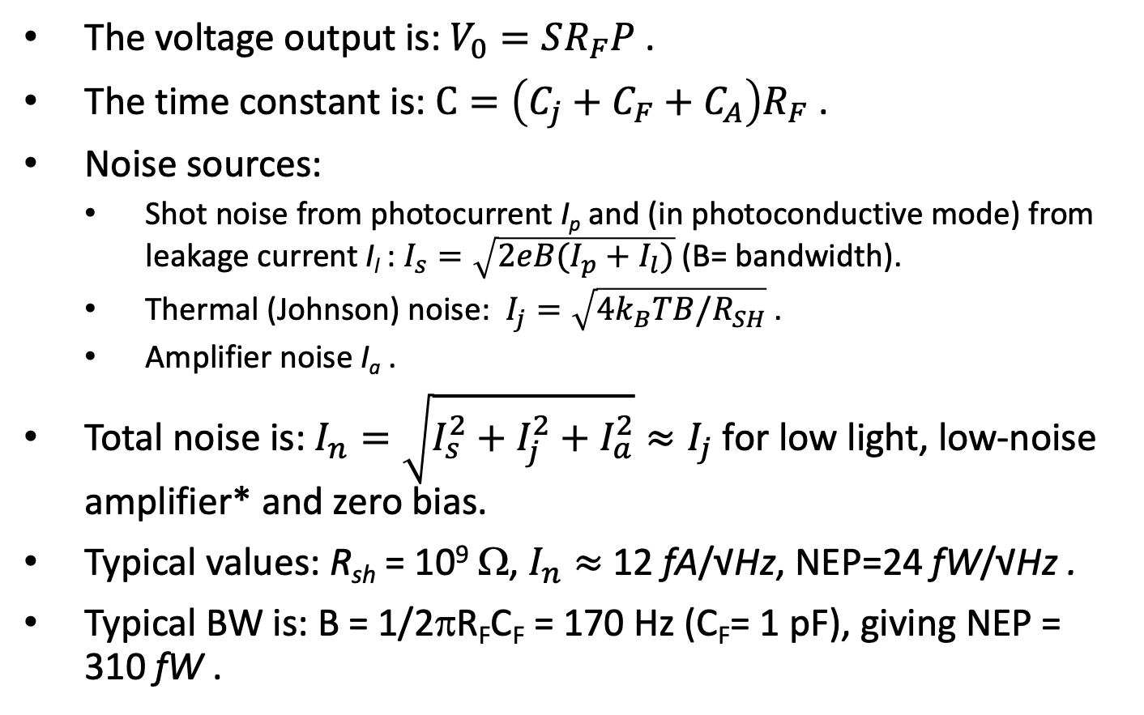
Photon detectors: typical circuits and noise
The voltage output is: $V_{0}=SR_{F}P$ .
The time constant is: $C=\left(C_{j}+C_{F}+C_{A}\right)R_{F}$ .
Noise sources:
Shot noise from photocurrent I_{p} and (in photoconductive mode) from leakage current I_{l} : $I_{s}=\sqrt{2eB(I_{p}+I_{l})}$ (B= bandwidth).
Thermal (Johnson) noise: $I_{j}=\sqrt{4k_{B}TB/R_{SH}}$ .
Amplifier noise I_{a} .
Total noise is: $I_{n}=\sqrt{I_{s}^{2}+I_{j}^{2}+I_{a}^{2}}≈I_{j}$ for low light, low-noise amplifier* and zero bias.
Typical values: R_{sh} = 10⁹ Ω, $I_{n}≈$12 fA/√Hz, NEP=24 fW/√Hz .
Typical BW is: B = 1/2πR_{F}C_{F} = 170 Hz (C_{F}= 1 pF), giving NEP = 310 fW .
Photovoltaic mode
*Example: Maxim MAX44261 op amp: I_{a}= 1.2fA/√Hz
Photoconductive mode

Slide 16
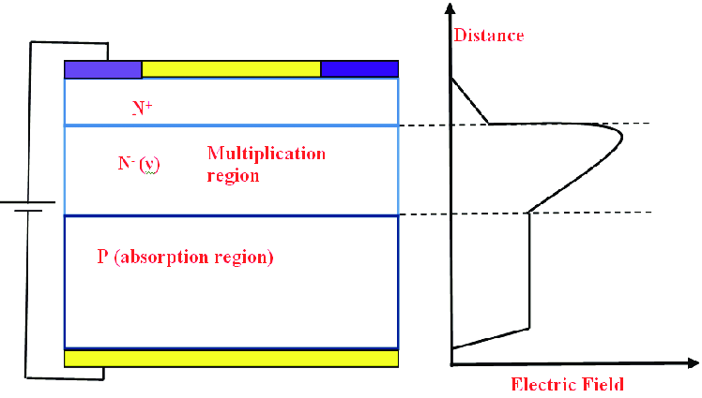
Photon detectors: the avalanche photodiode
When the electric field in the depletion zone is high, electrons get accelerated and can excite other electrons. This is the avalanche effect, which increases the gain of the photodiode (each photon creates many electrons).
There are two modes of operation:
Linear mode: moderate field, has linear photocurrent gain .
"Geiger" mode: high field, each photon generates a high current pulse, needs electronic "quenching" to return to zero current.
Avalanche photodiodes can replace photomultipliers with similar performance (pulse response of 100-200 ps).
Advantages: High sensitivity, low noise, high speed, small size, broader wavelength range than photomultipliers.
Disadvantages: less performant (ultimate sensitivity, speed) than photomultipliers.
Main uses: high-sensitivity fast UV-VIS-NIR detection.
Linear
Geiger
Reverse bias (V)
A. Singh and R. Pal, Defence Science Journal 67, 159( 2017)
https://www.hamamatsu.com/resources/pdf/ssd/si-apd_kapd9007e.pdf

Slide 17
Photon detectors: narrow-bandgap materials
The Silicon photodiode is the cheapest and most popular photodiode, but its bandgap limits the wavelength to 1.1 μm.
To detect longer wavelengths, we need narrow-bandgap semiconductors: InGaAs, InSb, InAsSb, MCT (HgCdTe).
Narrow-bandgap materials suffer from thermal generation-recombination noise, so they must be cooled to low temperatures.
Advantages: High sensitivity, longer wavelengths than for Si photodiodes.
Disadvantages: Expensive, needs cooling.
Main uses: high-sensitivity NIR-FIR detection, thermal imaging.
D* (V/W)
Wavelength (μm)
https://www.hamamatsu.com/resources/pdf/ssd/e06_handbook_compound_semiconductor.pdf

Slide 18
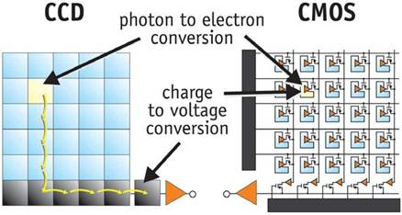
Array detectors: CCD and CMOS
Both CCD and CMOS cameras are made of large arrays of silicon photodiodes, but their readout is different:
In the CCD camera, the photocurrent charges a capacitor. This charge is moved between the pixels first along the column and then along the row, arriving serially at a single output amplifier (charge to voltage converter).
In the CMOS camera, each photodiode has an integrated amplifier to produce the voltage, then electronic switches are used for the readout.
https://meroli.web.cern.ch/img/lecture/spatial/clip_image002.jpg

Slide 19
Array detectors: Comparing CCD and CMOS
As is shown in the table, CCD technology is better suited for cooled high-sensitivity "scientific cameras".
Parameter | CCD | Scientific CMOS
Sensitivity | 60% – 95%, though high QE sensors are very expensive | 75% – 95%
Speed – read out in megapixels per second (MPS) | 1 to 40 MPS | 100 to 400 MPS
Read Noise – how much noise in electrons is produced at each pixel when the sensor is read | 5-10 electrons for standard CCDs, 1 electron for more complex electron multiplying devices (EMCCD) | 1-3 electrons is common for modern CMOS sensors
Cooling | High cooling is relatively easily achieved | Sensors generate a large amount of heat and cannot operate at extreme cold temperatures
Pixel Size | 3 to 25 microns | 2 to 9 microns
Well Depth – how many electrons can each pixel hold | 40,000 to 200,000 | 30,000 to 75,000. Can be mitigated via stacking given low read noise.
A/D Converter bits | 16 bits | Usually 12; some chips now use dual gain to create 16-bit images but with some pitfalls
Binning – combining pixels for sensitivity | Easily achieved at an analog level with zero added noise, extremely high binning levels possible | On-chip analog binning is extremely limited
Amp Glow – on-board electronics create some light | Easily mitigated by powering down readout transistors | This is a bigger problem with CMOS, since there can be millions of on-board transistors.
Infrared Imaging | Deep Depletion sensors can achieve high QE at 650 to 1000 nm | Currently not possible with CMOS
Fixed Pattern Noise | Occasional hot columns, easily mitigated | Fixed pattern noise can be a significant problem, but technology is improving rapidly
https://diffractionlimited.com/ccd-versus-cmos-better/

Slide 20
Typical properties of the "scientific" CCD camera
Operating temperature is low (-70 to -150C), yielding very low noise: 0.002 electrons/s (dark current noise) + 7 electrons (readout noise).
Pixel size is quite big, up to 25 μm, to increase light gathering.
To increase efficiency, light enters the chip from the (thinned) substrate. This avoids the obstruction by electrodes, and increases absorption in the active part.
Pixels can be read in groups (binning) to reduce noise. Example: in spectroscopy, when the spectral dispersion is along the X-axis, we can sum many pixels along the Y-axis to get the maximum signal.
Readout speed is low (33-100 kHz).
Dynamic range: 1:10⁶.
Color is not needed!
Quantum efficiency of CCD chips
Temperature pependence of dark-current noise
back-illuminated
front-illuminated
https://andor.oxinst.com/assets/uploads/products/andor/documents/andor-idus-420-specifications.pdf

Slide 21
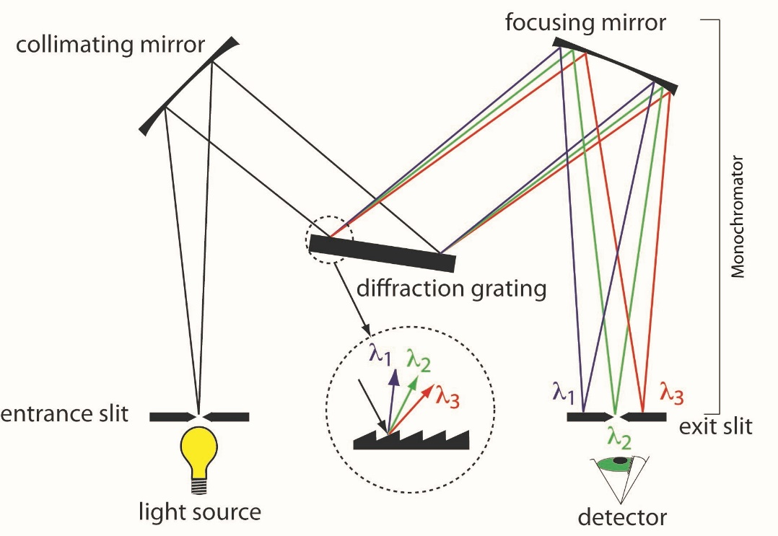

Reminder: The grating monochromator
There are two modes of operation:
Spectrometer: A narrow output slit selects the output wavelength, then a single detector measures the intensity. To obtain the full spectrum, we turn the grating according to: $\sin{β}−\sin{α}=\frac{mλ}{a}$ .
Spectrograph: A camera or detector array at the output measures simultaneously a full or partial spectrum. The position of the spectrum peak on the detector is determined by: $\sin{\frac{y}{L}}−\sin{α}=\frac{mλ}{a}$ . If the detector size is D, the measured spectral range is: $∆λ≈\frac{aD}{mL}$ . For a larger spectral range, several spectra should be measured by turning the grating.
Single detector
Camera/array detector
Typical values:
a=0.83 μm
L=550 mm
D=25mm
=> Δλ=38 nm
https://www.researchgate.net/profile/Jianwei_Qin/publication/312956040/figure/fig1/AS:456608141582336@1485875272925/Wavelength-dispersive-imaging-spectrographs-a-prism-grating-prism-PGP-transmission.png
https://blogs.maryville.edu/aas/wp-content/uploads/sites/1601/2015/04/monochromater.jpg

Slide 22
Camera vs. single detector for spectroscopy
Using a camera has several advantages:
A full spectrum is acquired in a single image (500-2000 pixels), while a single detector requires monochromator sweep which is much slower.
The vertical dimension can be used:
To integrate several pixels to increase the signal.
To measure a 1D spatially resolved spectrum of the sample.
The camera has a few disadvantages:
Low-noise "scientific" cameras are expensive!
Pixel size is smaller than in single detectors, so light gathering ability might be lower (not always – high resolution spectroscopy requires a small slit width, equivalent to a small pixel).
Most cameras are silicon-based – wavelength range is limited to 200-1000 nm.
Low-noise measurements need cooling (built-in in modern cameras).
Main uses of cameras: High-sensitivity, high-resolution UV-VIS-NIR spectroscopy.
Other array detectors:
Cooled InGaAs arrays, with wavelength range of 0.9-1.7 μm – have similar performance but higher noise.
Thermal detector arrays (bolometer, pyroelectric etc.) – for FIR detection; performance is similar to the single detectors, pixel size is 50-100 μm.

Slide 23
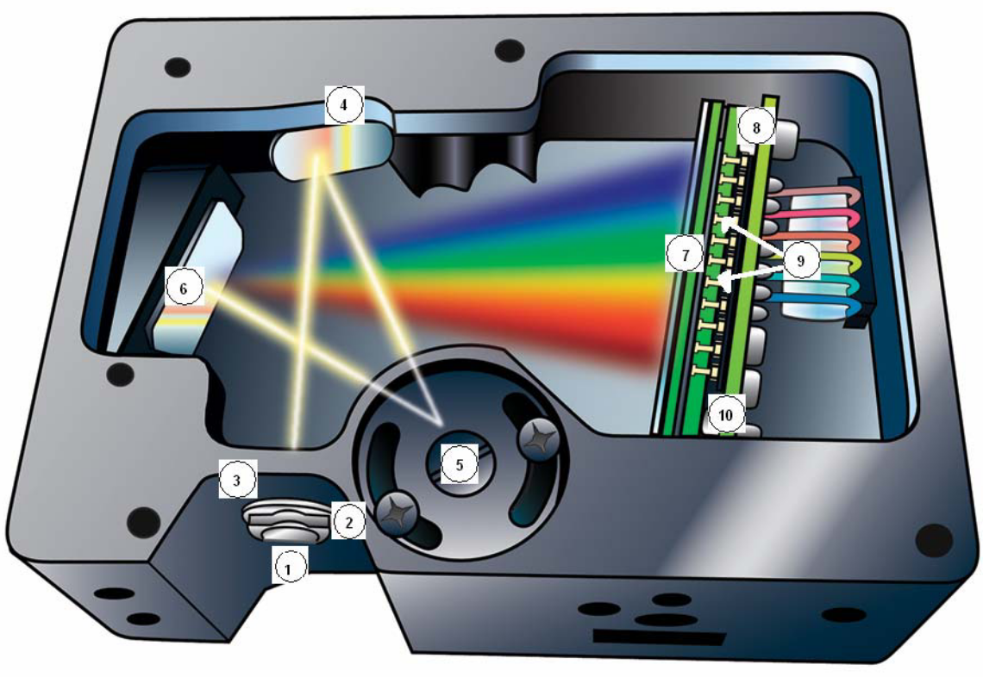

Compact spectrometers
For simple applications (UV-VIS-NIR) at room temperature, compact low-cost spectrometers are popular.
Input is by an optical fiber for flexibility, output is directly to the PC (USB).
The spectrometer is based on a fixed grating with curved mirrors, and the spectrum (λ=200-1100 nm) is projected to a Si CCD array with 2048 pixels.
S/N is 400:1 at 10 ms scan, can be increased by longer scans.
Resolution: < 1 nm
Dynamic range: 10⁴.
Instrument size: 15x10x5 cm!
CCD array
Curved mirrors
Fixed Grating
Entrance (fiber)
https://focenter.com/media/wysiwyg/documents/Ocean-Optics-Inc-Ocean-Optics-USB4000-Fiber-Optic-Spectrometer-Fiber-Optic-Center.pdf

Slide 24
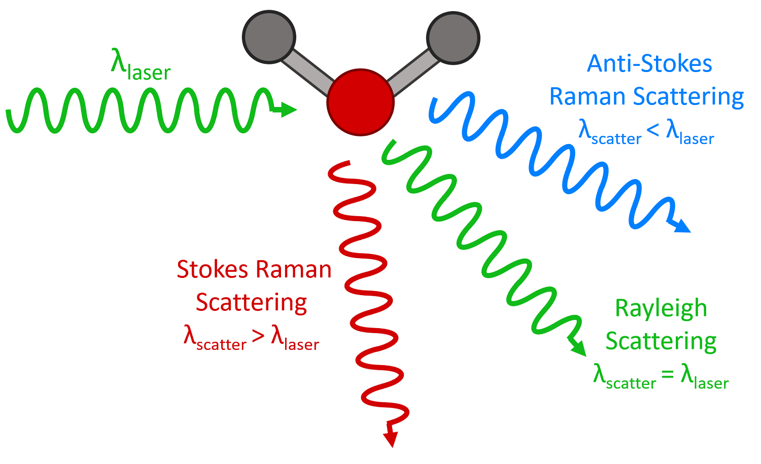
Raman spectroscopy
Raman spectroscopy studies the interaction between photons and phonons.
The process is inelastic scattering of photons from molecules, where the scattered photon gains or loses energy by interaction with phonons (molecular vibrations, rotations etc.). The emitted photon's wavelength is thus longer (Stokes) or shorter (anti-Stokes) than of the excitation photon. There is usually no absorption of the excitation photons.
The intensity of the scattered light is usually much lower (10⁻⁶ - 10⁻⁷) than elastically scattered light. The Stokes scattering amplitude is higher than the anti-Stokes amplitude, as it's easier to emit a phonon than to find an existing phonon.
https://www.edinst.com/blog/what-is-raman-spectroscopy/

Slide 25
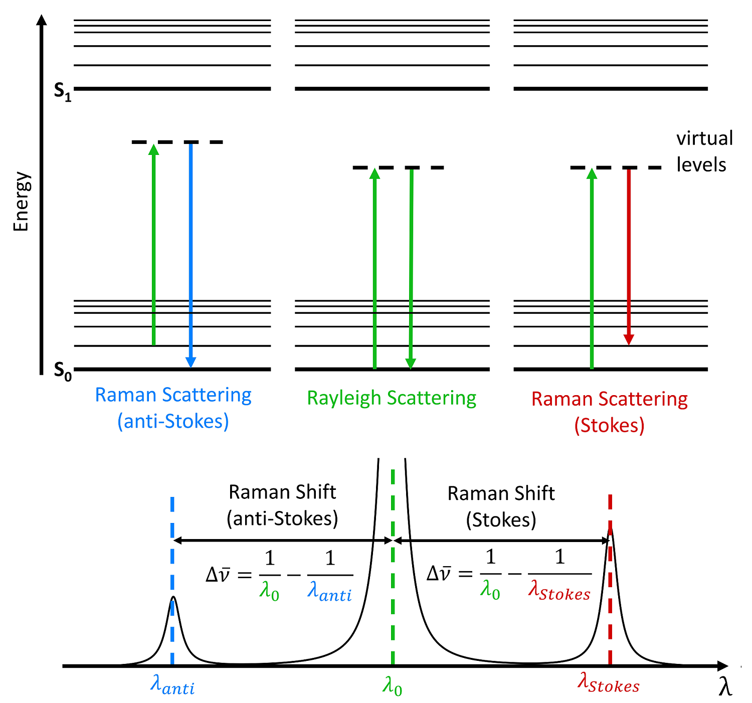
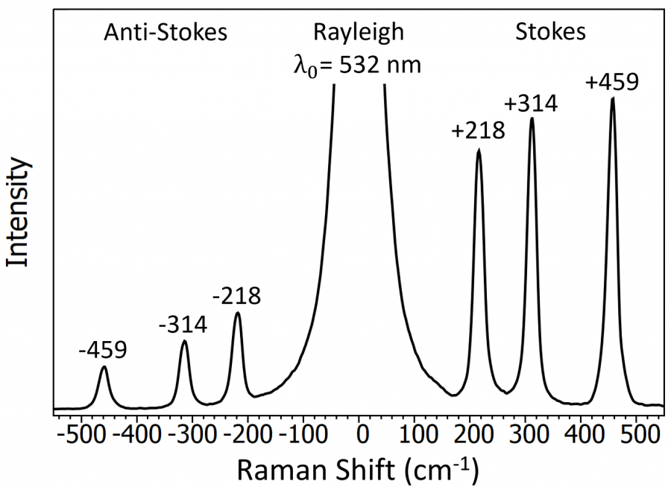
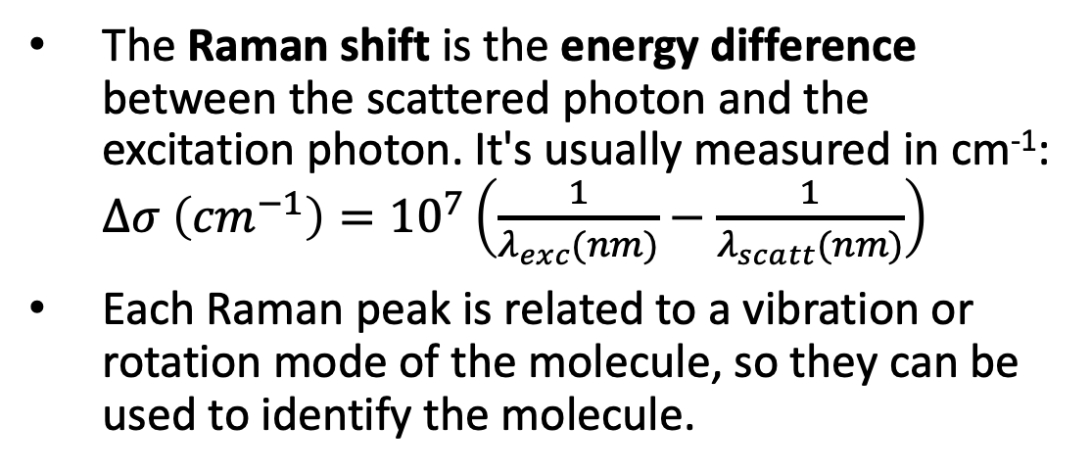
Raman spectroscopy - principles
Conduction band
The Raman shift is the energy difference between the scattered photon and the excitation photon. It's usually measured in cm⁻¹: $∆σ \left({cm}^{−1}\right)={10}^{7}\left(\frac{1}{λ_{exc}(nm)}−\frac{1}{λ_{scatt}(nm)}\right)$
Each Raman peak is related to a vibration or rotation mode of the molecule, so they can be used to identify the molecule.
Raman spectrum of CCl₄
Δσ
Δσ
https://www.edinst.com/blog/what-is-raman-spectroscopy/
D. W. Shipp et al., Advances in Optics and Photonics Vol. 9, 2, 315-428 (2017)

Slide 26
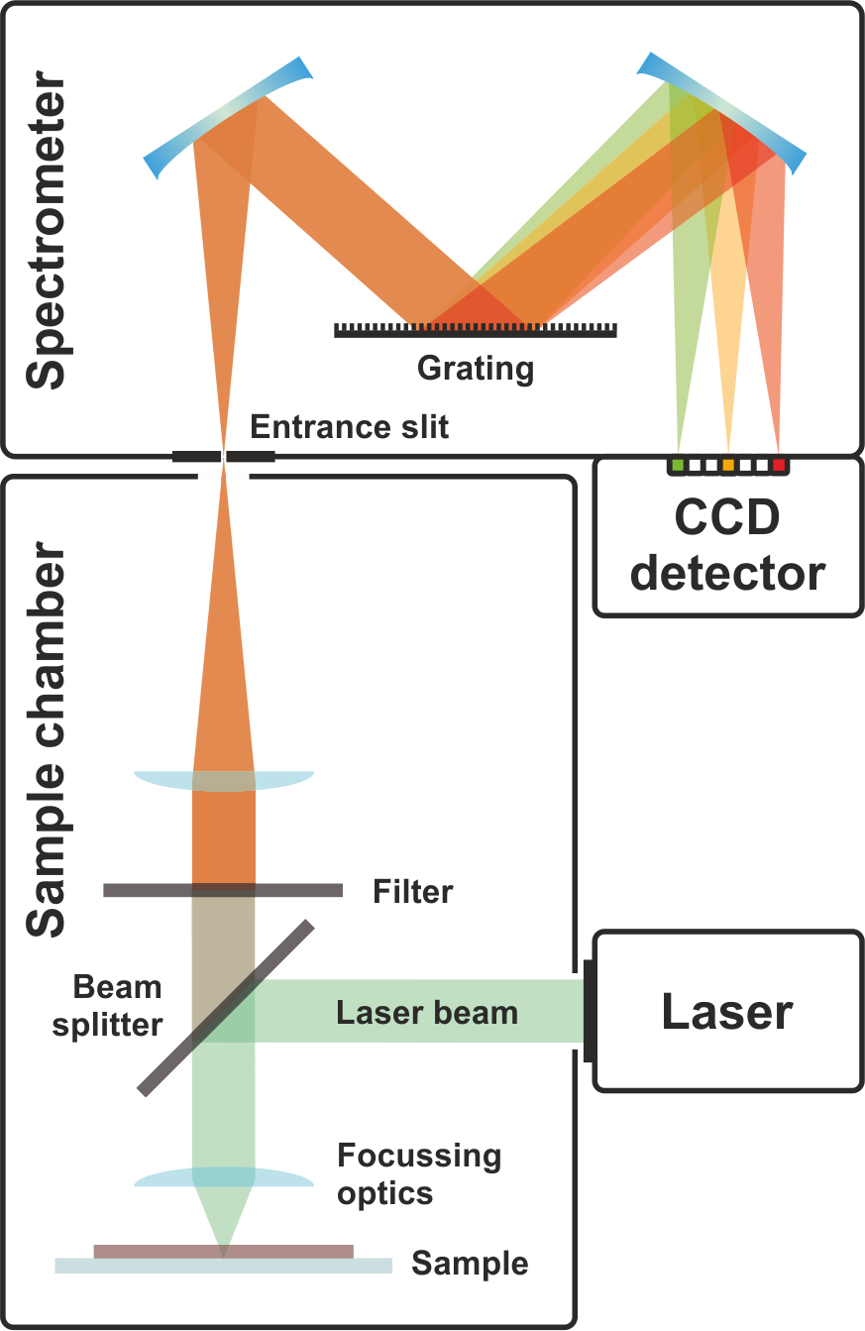
Raman spectroscopy - setup
The Raman spectroscopy setup is similar to a photoluminescence setup: Laser source, focusing optics, sample, collection optics, monochromator, detector.
The main differences from photoluminescence:
The light source is always a laser, which produces high power, stable, monochromatic light.
The monochromator should have a very high rejection (1:10⁶) of the excitation wavelength, which is very close to the weak signal (Raman-shifted) wavelength. Usually a narrow-band rejection filter at the laser wavelength precedes the monochromator. Sometimes a double monochromator is needed for high rejection.
Key features:
Laser wavelength (standards: 532, 628, 785, 1064 nm).
Laser power
Minimum Stokes shift (cm⁻¹) – related to excitation rejection.
Resolution (cm⁻¹).
Noise.
https://en.wikipedia.org/wiki/Raman_spectroscopy

Slide 27
Imaging (hyperspectral) Raman spectroscopy
In life sciences, a confocal microscope is integrated with a Raman spectroscopy setup. Organic and live matter (cells) can be probed in a non-destructive way, with good optical spatial resolution (sub-μm).
The excitation laser passes through a dichroic mirror to improve rejection (only the Stokes-shifted wavelength passes to the monochromator).
A lens-pinhole set gives spatial filtering to increase resolution.
To get a mapping of the sample, it is scanned under the microscope objective by a piezoelectric stage.
Video imaging
Laser filter (notch)
D. W. Shipp et al., Advances in Optics and Photonics Vol. 9, 2, 315-428 (2017)

Slide 28
Raman spectroscopy vs. FTIR spectroscopy
Both Raman spectroscopy and FTIR spectroscopy are used to detect molecules and follow chemical reactions. However, they have different sensitivities, especially with molecules that have a center of inversion, which render Raman and FTIR spectroscopies mutually exclusive.
Raman Spectroscopy is better when studying:
Carbon bonds in aliphatic and aromatic rings.
Bonds between identical atoms (0-0, N=N, C=C) and weak dipoles.
Reactions in aqueous media and particles in solution, e.g. for polymorphism.
Inorganic Oxides.
Lattice modes in crystals
FTIR Spectroscopy is better when studying:
Reactions in which reaction components fluoresce.
Bonds with strong dipole changes are important (e.g. C=O, O-H, N=O).
Reactions in which reagents and reactants are at low concentration.
Reactions in organic solvents with a strong Raman signal.
Reactions in which intermediates that form are IR active

Slide 29
Applications of Raman spectroscopy: organic molecules
Typical Raman spectra of DNA and RNA (a), proteins (b), lipides (c) and carbohydrates (d):
We can see peaks that are associated with specific parts of the molecules, such as C-C and C=C bonds, CH₂ groups, etc.
These can be used to identify the molecules and track chemical changes, e.g. in a cell.
D. W. Shipp et al., Advances in Optics and Photonics Vol. 9, 2, 315-428 (2017)

Slide 30
Cathodoluminescence
Optical spectroscopy excited by electrons
Electrons in semiconductors can be excited by photons (PL) or electrons (CL).
The analysis/detection parts of the system are similar to PL

Slide 31
Main parts of a CL system
Electron beam focused on the sample at required position
Sample can be cooled if needed
Mirror collects most of emitted light to produce parallel beam focused on the input slit of a monochromator
Dispersed light is detected by single (PMT) or array (CCD) detector
Optionally, secondary electrons (SE) and sample current (EBIC) are detected
Inside SEM vacuum chamber
https://en.wikipedia.org/wiki/Cathodoluminescence#/media/File:Cl-scheme.svg

Slide 32
Electron beam sources
The electron beam can be generated by:
A standard SEM column
A STEM column – rare (expensive, high voltage, TEM resolution not needed)
A specially constructed SEM column (integrated CL system)
https://d32ogoqmya1dw8.cloudfront.net/images/research_education/geochemsheets/techniques/UWSEM.jpg
https://uwaterloo.ca/metrology/tem-stem
https://attolight.com/wp-content/uploads/2018/07/attolight_allalin_web.pdf

Slide 33
Generation of the CL signal
The electron beam interacts with the sample:
Primary beam has high energy, small spot size
Auger and secondary electrons (< 50 eV) are limited in range
Scattered electrons have largest range
All these electrons can generate a CL signal!
https://en.wikipedia.org/wiki/Electron_microscope#/media/File:Electron_Interaction_with_Matter.svg

Slide 34
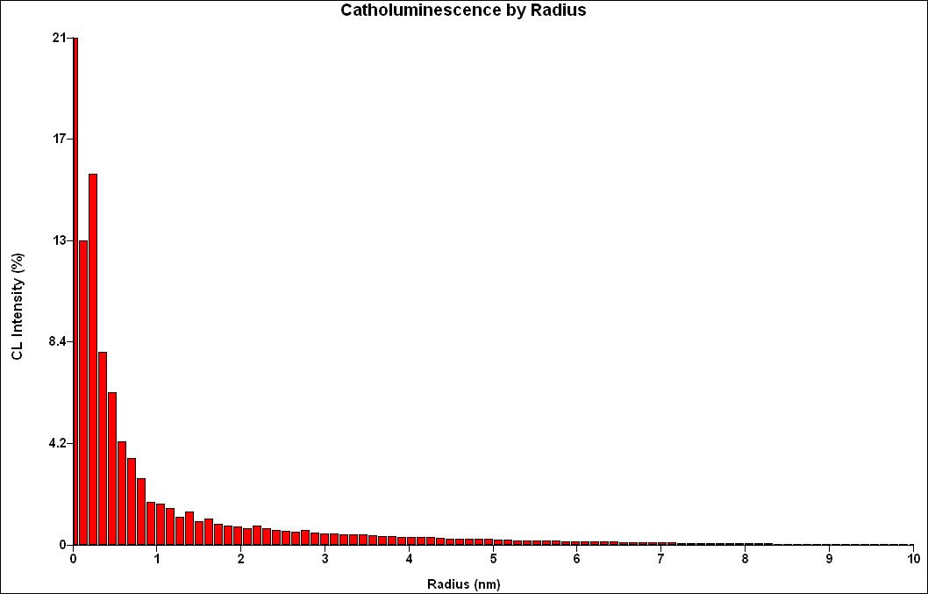
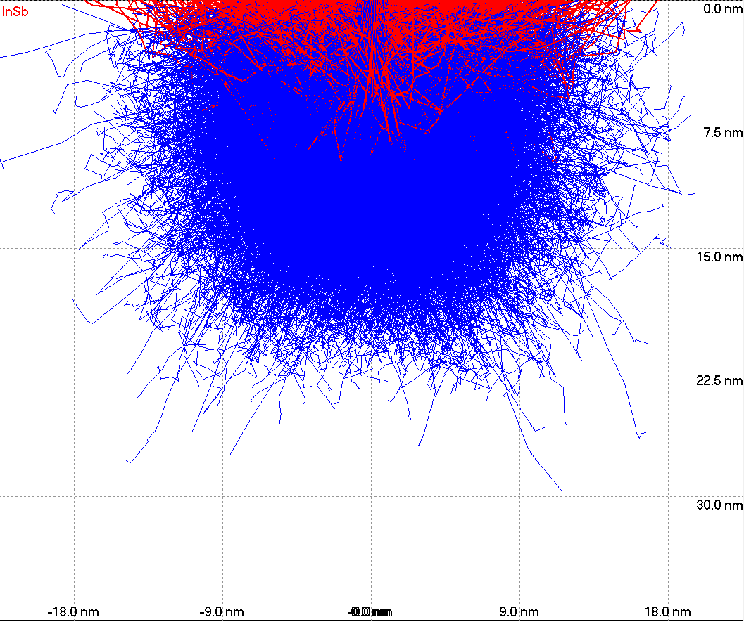
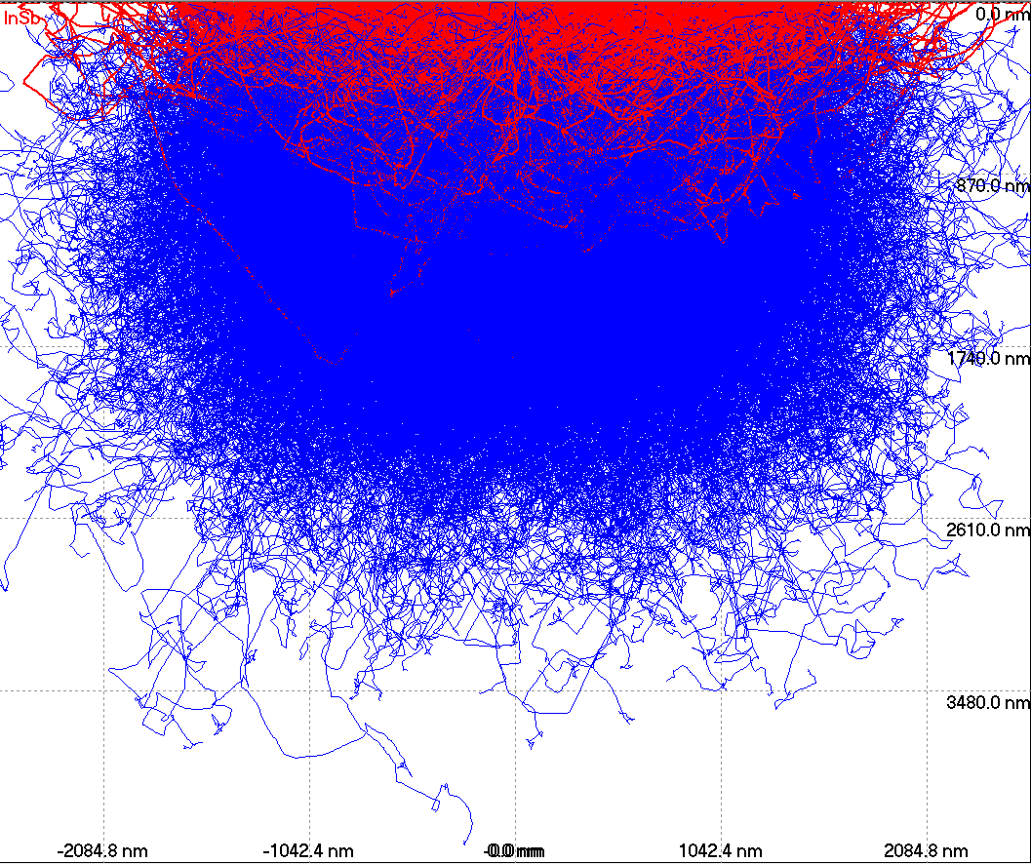
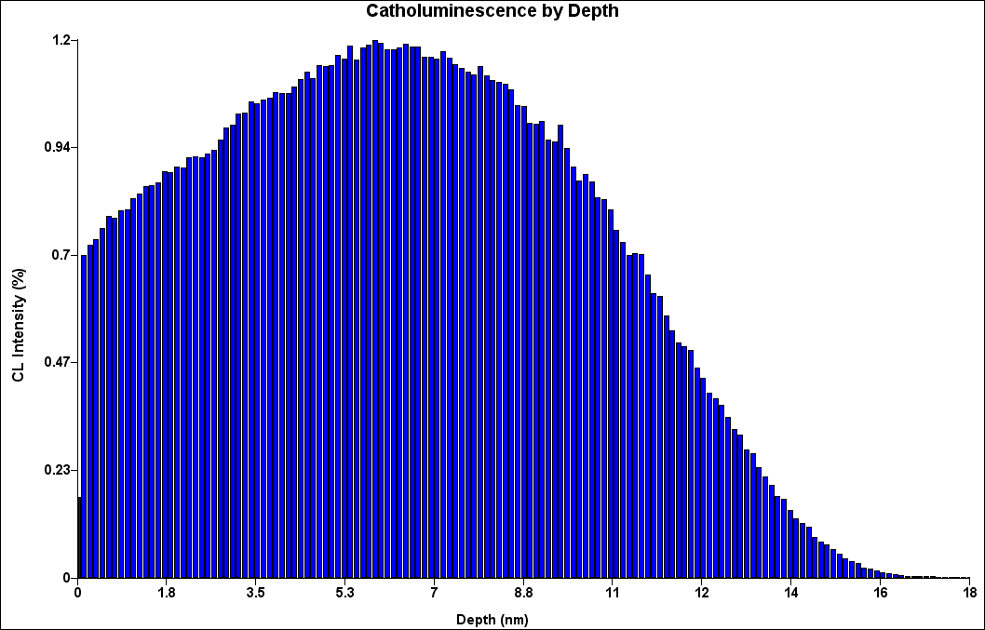
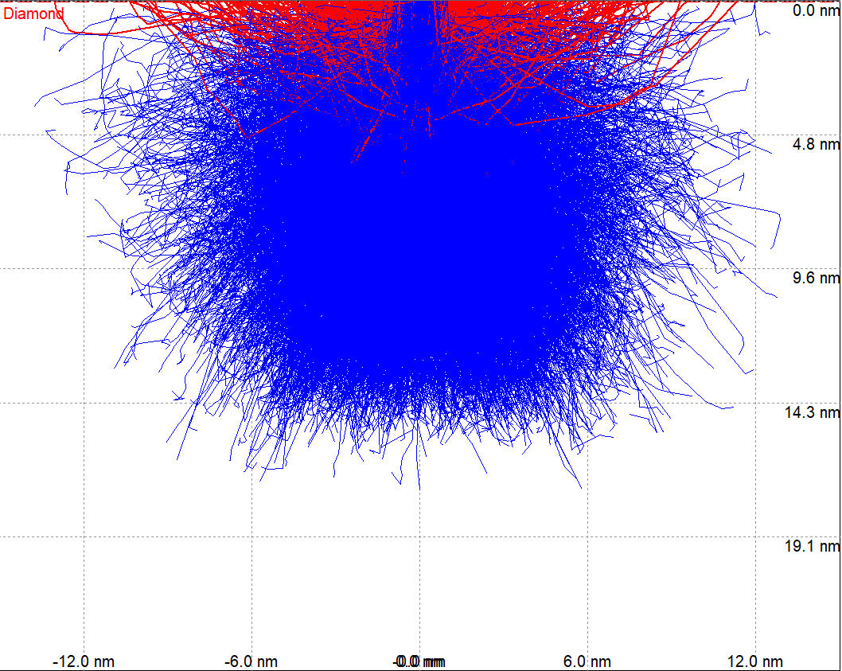
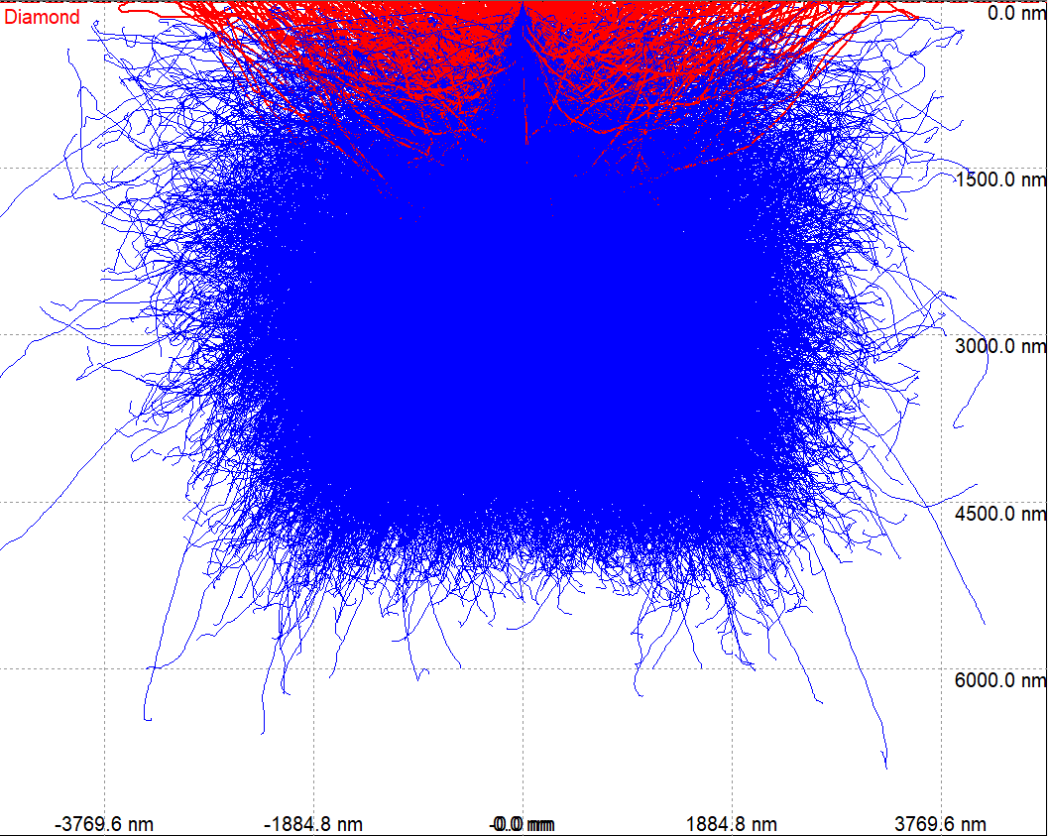
Distribution of scattered electrons
Statistics of electron distribution:
As function of R (at Z=0)
As function of Z (at x=0)
Monte-Carlo simulations of trajectories:
Scattered electrons’ range strongly depends on energy and material (Z)
Shape of electron distribution does not change much, but scale does!
InSb 1kV
InSb 30kV
Diamond 1kV
Diamond 30kV
https://www.gel.usherbrooke.ca/casino/What.html

Slide 35
Distribution of scattered electrons – high energy
Summary of statistics of electron distribution, for a large range of electron energies:
As function of Z (at x=0)
As function of R (at Z=0)
The range (depth and radius) is many microns for energies above 10 keV – incompatible with high resolution measurements! This excludes most TEMs…

Slide 36
Distribution of scattered electrons – low energy
The range (depth and radius) is below 100 nm for energies below 3-6 keV (depending on material density) – this is the electron energy used for high resolution measurements
Usually this energy range is readily available in a SEM

Slide 37
Electron beam current
To generate a sufficient optical signal, we need a relatively high electron current.
The best source is the Schottkey field-emission gun, which can deliver more than 100 nA in a relatively small beam (a few nm)
https://d32ogoqmya1dw8.cloudfront.net/images/research_education/geochemsheets/techniques/UWSEM.jpg
https://attolight.com/wp-content/uploads/2018/07/attolight_allalin_web.pdf

Slide 38
CL standard optics
The CL optics has to collect the emitted light and transmit it to the spectrometer with high efficiency.
A parabolic mirror placed close to the sample collects most of emitted light, to produce parallel beam. A small hole in the mirror lets the electron beam go through.
The light beam exits the vacuum chamber through a window, chosen to be transparent at the wavelength range of interest.
The light is then focused on the input slit of the spectrometer.
https://en.wikipedia.org/wiki/Cathodoluminescence#/media/File:Cl-scheme.svg

Slide 39
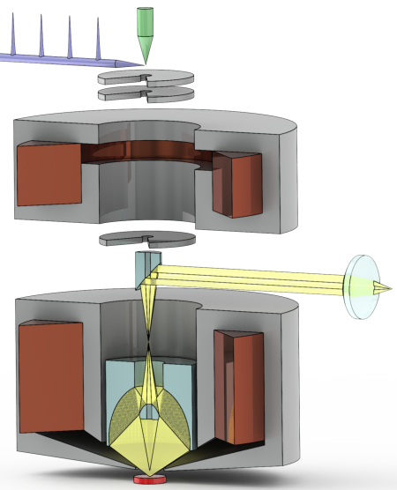
Advanced CL – developed at EPFL (1)
A better system has been developed at EPFL through a start-up company (Attolight)
The optics (Coaxial mirror objective inside the SEM lens) has a much better collection efficiency over a large (300 μm) field.
The light beam exits the vacuum chamber through a coaxial mirror and a window, transparent at a wide wavelength range (e.g. UV-VIS-NIR).
The light is then focused on the input slit of the spectrometer.
https://attolight.com/cathodoluminescence-spectroscopy-technology/

Slide 40
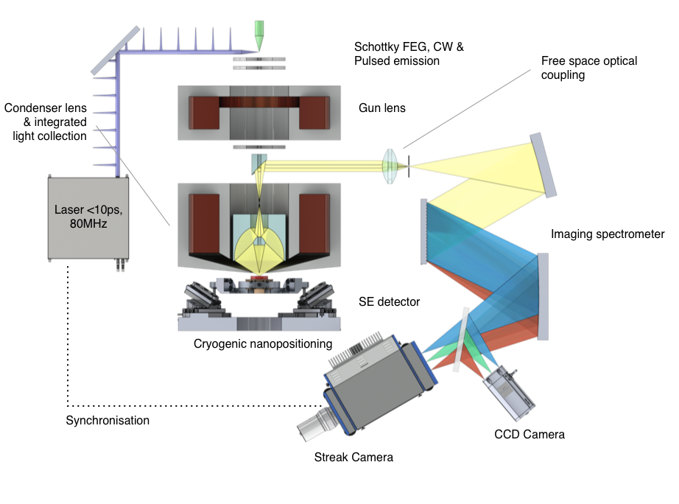
Advanced CL – developed at EPFL (2)
An important option is Time-resolved CL: The electron source is a photoemission cathode excited by a high-power pulsed (ps) UV laser beam. The emitted light from each sample point is analyzed in 2D: wavelength and time, by a spectrometer coupled to a streak camera.
A lot of data is generated: 2D imaging, plus time and wavelength at each point: I(x,y,λ,t).
https://attolight.com/cathodoluminescence-spectroscopy-technology/

Slide 41
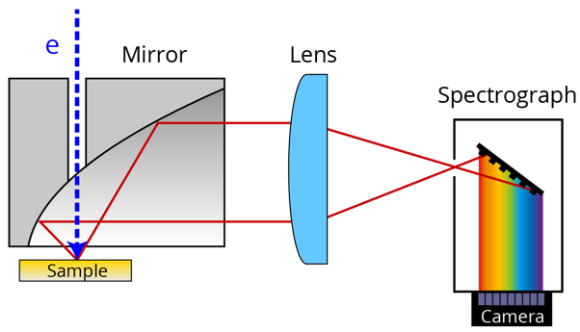
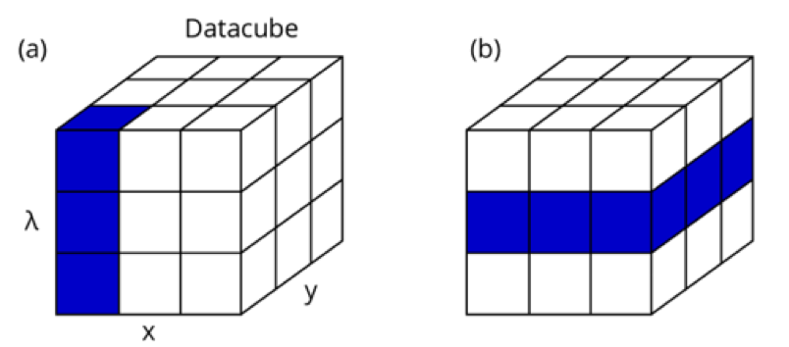
CL data analysis
The collected data can be analyzed in several ways:
A spectrum I(λ) can be displayed at a specific sample point (x,y) on the sample, or integrated over a region.
An image I(x,y) can be displayed at a specific wavelength, showing the spatial extent of a specific spectral feature.
A false-color image can be obtained by mapping spectral wavelengths to image colors, then displaying at each pixel (x,y) the color corresponding to 3 predefined wavelength bands.
The spectral images can sometimes be combined with the SE image.
https://www.nanoscience.com/techniques/cathodoluminescence/hyperspectral-cathodoluminescence-imaging/

Slide 42
Examples of sample analysis: 1. GaP microdisk with GaPN QWs
Pierre Guillemé et al., Optics Lett. 43, 1766 (2018)
A GaP microdisk has whispering-gallery optical modes (SEM and PL above).
They’re excited by emission from GaPN QWs in the disk
CL imaging, plus background removal (right), show the spatial and wavelength mapping of the modes.

Slide 43
Examples of sample analysis: 1. GaP microdisk with GaPN QWs
CL imaging, plus background removal, show the spatial and wavelength mapping of the modes, which correspond well to theory
Pierre Guillemé et al., Optics Lett. 43, 1766 (2018)

Slide 44
Examples of sample analysis: 2. ZnO Nanowires
ZnO nanowires (NWs) have a high gap, emit at UV (3.3 eV).
CL imaging shows the spatial and energy mapping of the emission across the NW.
We can see confinement energy, mode shape, etc.
Side view of a NW: SEM CL map
SEM image of a group of NWs
L.J. Brillson et al. Mat. Sci. in Semi. Proc. 57, 197 (2017)

