Slide 1
Optical spectroscopy
B. Dwir IPHYS, EPFL

Slide 2
Optical spectroscopy
Outline
Introduction
Excitation sources
Dispersive elements
Photodetectors
Special spectroscopy methods:
Raman spectroscopy
Cathodoluminescence
Applications

Slide 3
Optical and other spectroscopy techniques
Goals of optical spectroscopy:
Characterize the electronic energy levels of a system by exciting electrons and observing the energy of emitted light
Excitation can be done by light (photo-luminescence, PL) or by electrons (cathodoluminescence, CL)
In some systems, optical absorption is measured (photoluminescence excitation spectroscopy, PLE, absorption spectroscopy, or spectrophotometry/FTIR)
Other related techniques:
Raman spectroscopy (inelastic scattering of photons)
EDS (emission of X-ray photons, excitation by electrons)
AES (emission of electrons, excitation by UV/X-ray photons)
EELS (energy loss of scattered electrons)

Slide 4
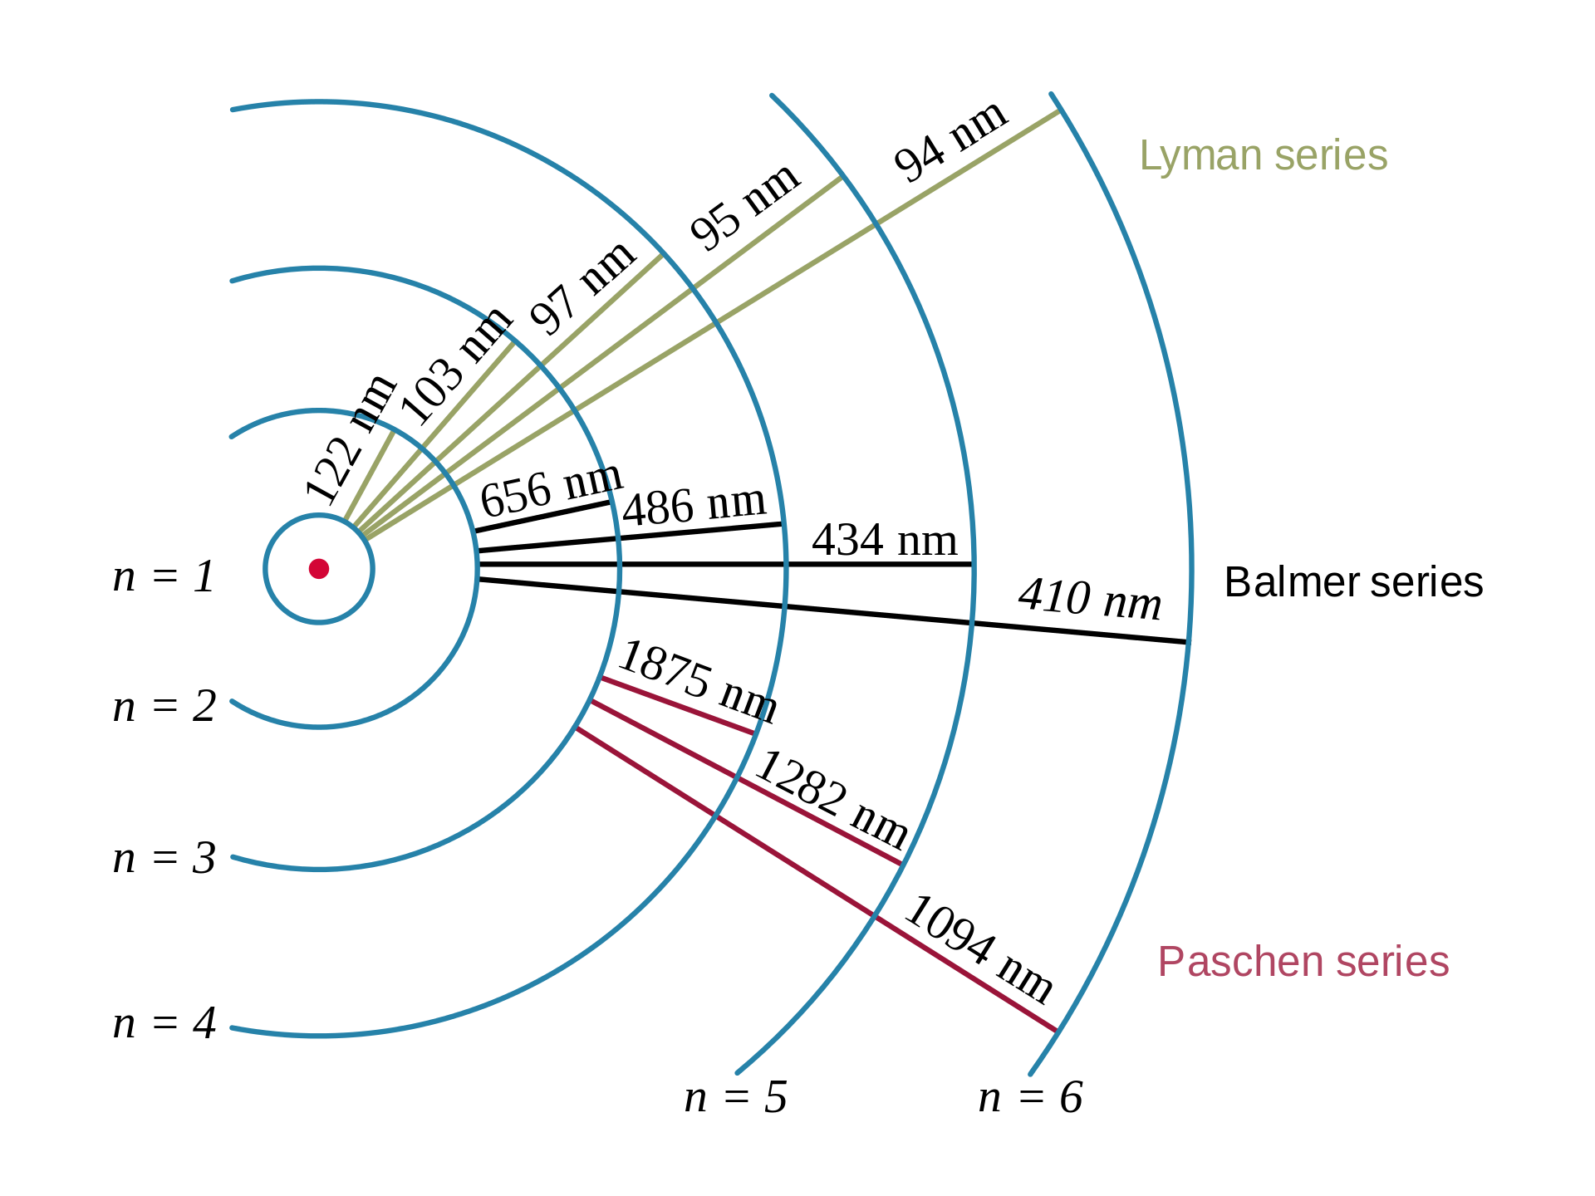
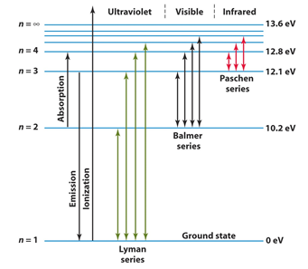
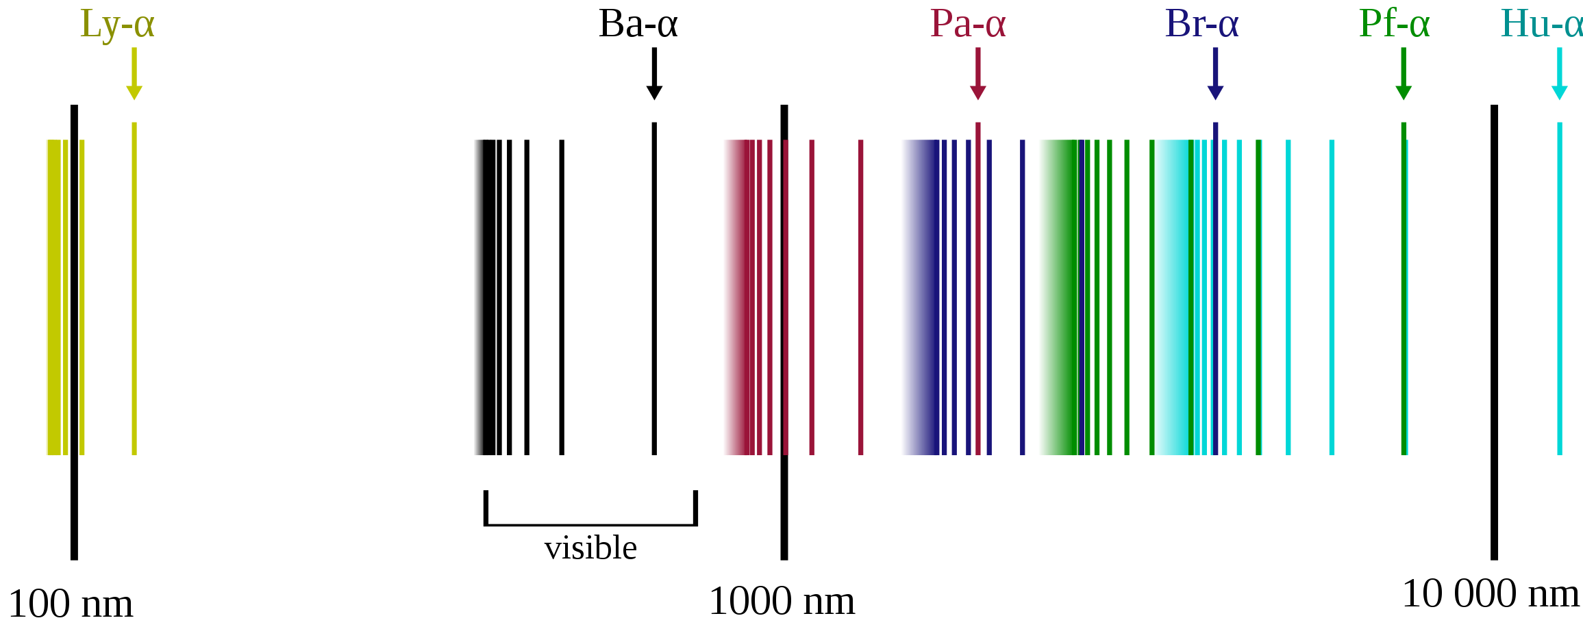
Example: The Hydrogen atom
The electron in the Hydrogen atom can occupy any of many energy levels, from its ground state (n=1, defined here at E=0 eV), to a free electron (ionized atom), at n=∞ and E=13.6 eV.
Excitation by an electron (e.g. in a discharge tube) or a photon of sufficient energy can excite the electron to any level, from which it will fall to a lower level (event. to the ground state) by the emission of a photon.
The photon energy corresponds to the energy difference between the levels, and can thus be in the UV, visible, or IR range.
The excitation energy should be sufficiently high! E.g. to see the full Lyman series, we need to excite with deep UV (E>13.6 eV or λ<90 nm). The emitted photon energy will be between 10.2 and 13.6 eV. The Balmer series will show a photon energy between 1.9 and 3.4 eV (excitation E>3.4 eV, λ<360 nm), etc.
https://en.wikipedia.org/wiki/Hydrogen_spectral_series
https://files.askiitians.com/cdn1/images/20171212-202759211-7917-paschen-series.png

Slide 5
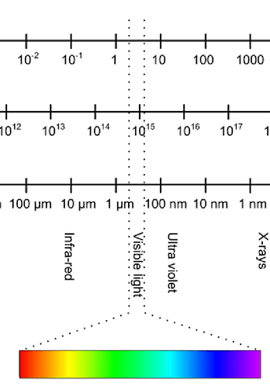
Energy range
Important classification: according to wavelength (energy) range
The electronic energy levels of the system determine the wavelength of emitted light:
Near UV range (100<λ<400 nm): E = 3-12 eV (electronic levels in atoms, insulators)
Visible - near-IR range (400<λ<1500 nm): E = 0.8-3 eV (electronic levels in semiconductors)
IR range (1.5<λ<10 μm): E = 0.1-0.8 eV (vibration/rotation levels in molecules, dopants and subbands in semiconductors)
The energy range determines the type of excitation source and detector to be used
Photon energy (eV)
Frequency (Hz)
Wavelength
https://www.researchgate.net/profile/Roland_Macana/publication/326705984/figure/fig2/AS:669064661831684@1536528854132/Electromagnetic-spectrum-showing-the-energy-of-one-photon-the-frequency-and-wavelength.ppm

Slide 6
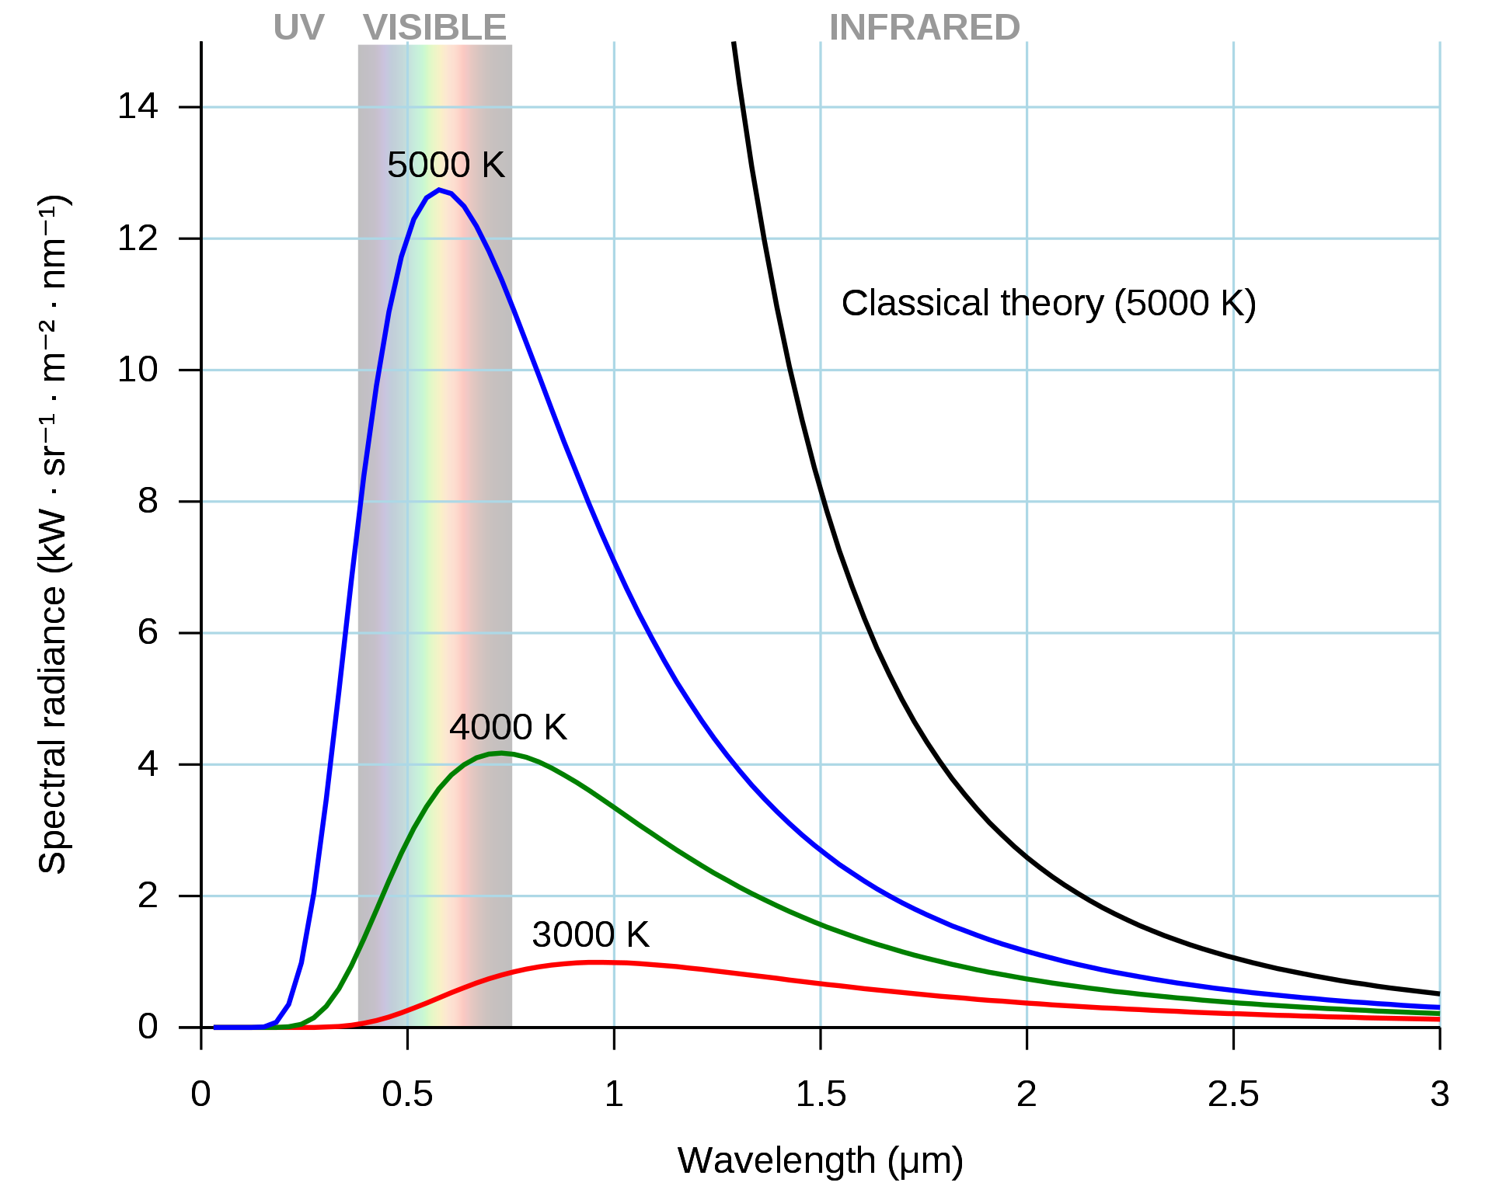
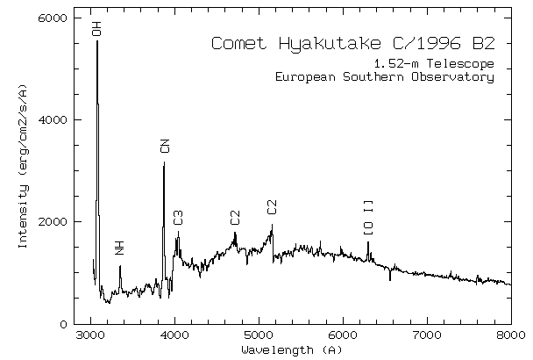
Typical applications of optical spectroscopy(1)
In astronomy:
Blackbody radiation allows to measure the temperature of stars, their velocity (Doppler shift) and distance.
Absorption lines allow to identify elements and molecules in the atmosphere of stars and planets.
Reflected light spectra can show the composition of comets.
https://upload.wikimedia.org/wikipedia/commons/thumb/1/19/Black_body.svg/1920px-Black_body.svg.png
http://www.eso.org/public/usa/news/eso9620/

Slide 7
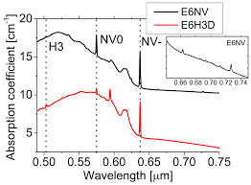
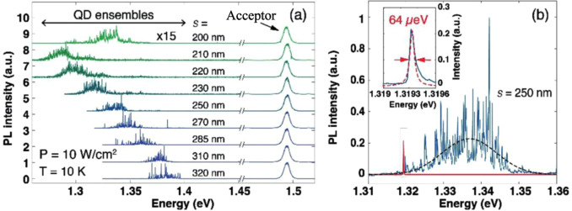
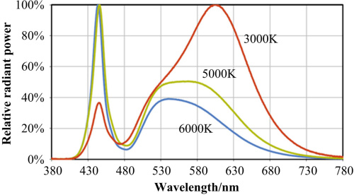
Typical applications of optical spectroscopy(2)
In semiconductor research:
Measurement of energy gap in compound semiconductors.
Measurement of light emission of LEDs and laser diodes.
Study of impurities and and defects in semiconductors.
Physics research of semiconductor nanostructures: Quantum dots, nanowires, layered 2D semiconductors, graphene, nanotubes,…
Emission spectra of NV centers in diamond
Emission spectra of quantum dot ensembles (10 QDs)
Emission spectra of different white LEDs
https://ars.els-cdn.com/content/image/1-s2.0-S0022024816306947-gr2.jpg
https://encrypted-tbn0.gstatic.com/images?q=tbn:ANd9GcR4eHGKK98inoVPUgh6ynlL7RlmnEFf7gZx9w&usqp=CAU
DO - 10.1109/TEC.2006.888024
http://imagebank.osa.org/getImage.xqy?img=dTcqLmxhcmdlLGFvLTU4LTMxLTg1NDItZzAwMg

Slide 8
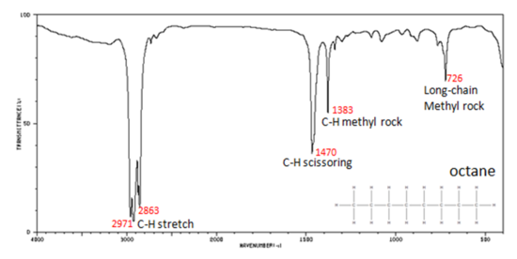
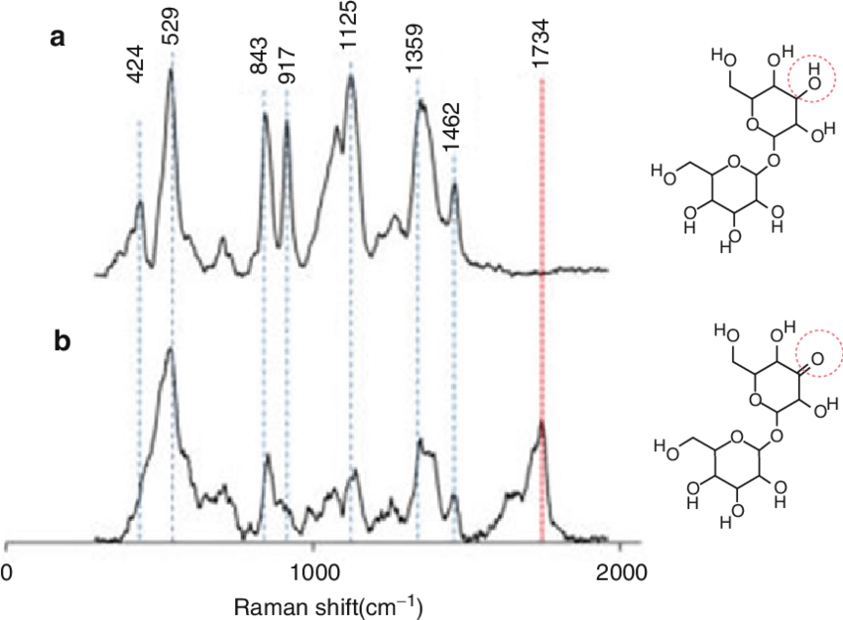
Typical applications of optical spectroscopy(3)
In (bio)chemistry:
Identification of elements by atomic emission spectroscopy (AES).
Identification of molecules by UV-VIS-IR absorption spectroscopy.
Characterization of chemical reactions by ultrafast spectroscopy.
Investigation of chemical bonds by Raman spectroscopy.
https://www.researchgate.net/profile/Ewan_Blanch/publication/284921406/figure/fig16/AS:660946137649163@1534593247730/Chemical-structures-right-and-Raman-spectra-left-of-a-5-w-v-aqueous-solution-of.png
https://s3-us-west-2.amazonaws.com/courses-images/wp-content/uploads/sites/1518/2017/10/05153652/octane_1.png

Slide 9
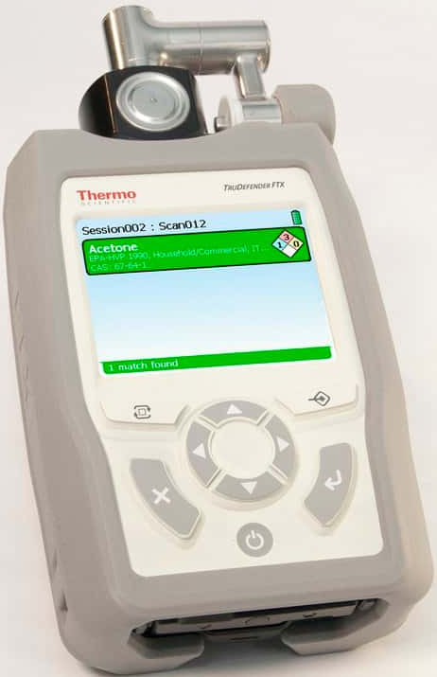
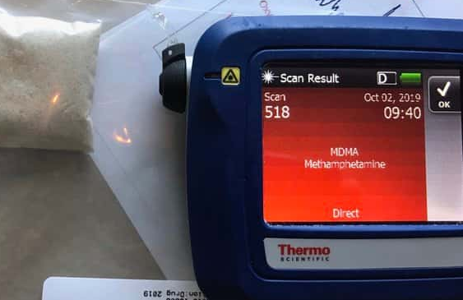
Typical applications of optical spectroscopy(4)
In police work:
Quick automatic identification of drugs, explosives and other substances by UV-VIS-IR absorption spectroscopy or VIS Raman spectroscopy.
https://www.thermofisher.com/TFS-Assets/CAD/product-images/Trunarc-new-screen-mdma.jpeg-650.jpg
https://www.thermofisher.com/TFS-Assets/CAD/product-images/F202194.jpg-650.jpg

Slide 10
Optical spectroscopy: Energy vs. Wavelength
Most optical spectroscopy is done with dispersive optics: prisms, gratings, etc.
The link between energy and wavelength: E=hν and ν=c/λ, or: E(eV)=hc/eλ=1.24/λ(μm)
Typical photon energy in the visible range: λ ≈ 500nm, E ≈ 2.5 eV
Resolution depends on the derivative of the dispersion: ΔE=Δλ.dE/dλ=-1.24.Δλ/λ²
It's much more precise to measure optical wavelength than photon energy!
Example: In the visible range (e.g. λ ≈ 500 nm) we can easily measure Δλ = 5 pm, equivalent to ΔE = 25 μeV. It's difficult to find a photon detector with similar energy resolution!
Particle (e.g. electron) and X-ray spectroscopy is usually done with energy-dispersive instruments or direct energy-sensitive detectors (Si or Ge diodes etc.). It's possible to measure energies of 1-10 keV with a precision of 1-2 eV.
Thermal effects (phonons): At room temperature E = 26meV, which can cause spread in detected energy. It might be useful to cool the sample! Detectors might need cooling too.
In Raman and IR spectroscopy, it is customary to use energy units called Wavenumber: σ=1/λ (unit=cm⁻¹). So for λ=500nm, σ=20,000cm⁻¹ ; at λ=5μm, σ=2,000cm⁻¹ .
The unit conversion is: E(eV)=(100hc/e).σ = 1.24.10^{-4.}σ .

Slide 11
Optical spectroscopy: Energy vs. Wavelength
Table of unit conversions:
Photon energy (eV)
Frequency (Hz)
Wavelength

Slide 12
Optical spectroscopy: Experimental setup – micro-PL
In many systems there is an external excitation source. Its energy can sometimes be tuned
The sample might need to be held at low temperature to avoid phonon interactions
(Wavelength
Control)
Excitation source
(e.g. laser)
Focusing optics
(Environmental
Control)
Sample
Collecting and focusing optics
Wavelength
control
Dispersive element
Detector
Typical low-temperature micro-plotoluminescence system

Slide 13
Optical spectroscopy: Experimental setup – PL
In some cases large-area and room-temperature PL is enough, leading to a simplified system.
The laser source might be inclined to avoid reflections into the spectrometer
Grating
spectrometer
Grating
spectrometer
Detector
Detector
Source Laser
Source Laser
sample
sample
Typical room-temperature plotoluminescence systems

Slide 14
Excitation sources
(Wavelength
Control)
Excitation source
(e.g. laser)
Focusing optics
In most systems there is an external excitation source. Its energy must be higher than that of the studied transitions!
Typical exceptions: characterization of light sources (LEDs, lasers), discharge or flame spectroscopy, astronomy.
The excitation source can be broadband (white light or discharge lamp) or monochromatic (broad source plus filter / monochromator, laser).
Comparison of excitation sources:
(Environmental
Control)
Sample
Collecting and focusing optics
Wavelength
control
Dispersive element
Detector
Source type: | Broadband | Broadband + Filter | Broadband + Monochromator | LED | Laser
Advantages: | Cheaper High light output | Cheaper Selectable wavelength | Monochromatic light at any wavelength | Cheaper High power at a narrow wavelength band | High intensity monochromatic light Some tuning is possible
Disadvantages: | No wavelength selection Source energy is spread over band | Power loss in filter Filter is usually broadband | Expensive Very low light output per unit wavelength | No tuning | Expensive Tuning range is sometimes limited

Slide 15
Broadband sources
(Wavelength
Control)
Excitation source
(e.g. laser)
Focusing optics
Three main types of broadband sources:
Thermal filament (e.g. Halogen-tungsten)
Gas discharge at high pressure
White LED (recent types can emit high power)
Typical image and spectra of broadband light sources:
(Environmental
Control)
Sample
Collecting and focusing optics
Wavelength
control
Dispersive element
Detector
Halogen spectrum is blackbody (very smooth, but low in UV)
High-pressure discharge lamps have many broad peaks that form a quasi-continuous spectrum
White LED has a moderately wide spectrum

Slide 16
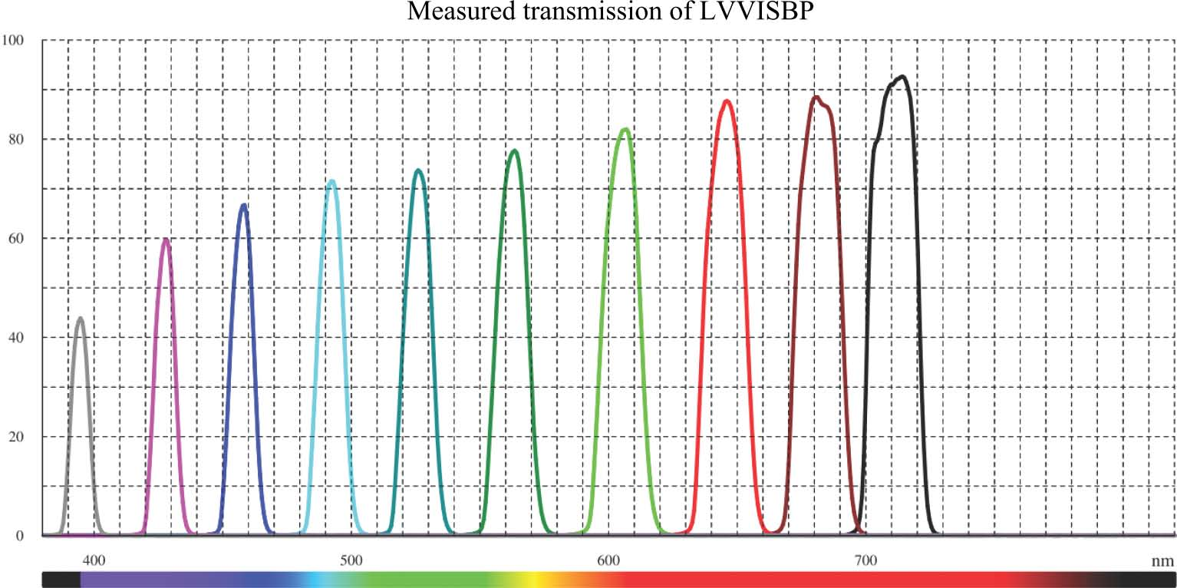
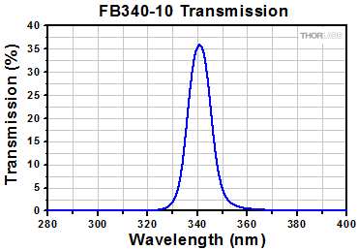
Broadband source + filters
(Wavelength
Control)
Excitation source
(e.g. laser)
Focusing optics
To obtain a narrower bandwidth, the light from a broadband sources is filtered by a bandpass optical filter of fixed or variable wavelength
Typical bandwidth: 10-20 nm at WL=400-700 nm
Typical power at 340 nm, distance 25cm, filter D= 25mm, BW=10 nm:
Halogen lamp: 0.014 mW
Hg lamp: 1.4 mW
(Environmental
Control)
Sample
Collecting and focusing optics
Wavelength
control
Dispersive element
Detector
Transmission of a visible-range linear optical bandpass filter (at 10 positions)
Transmission of a fixed UV optical bandpass filter
https://www.deltaopticalthinfilm.com
https://www.thorlabs.com/

Slide 17
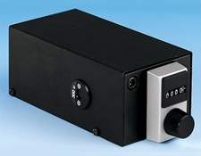
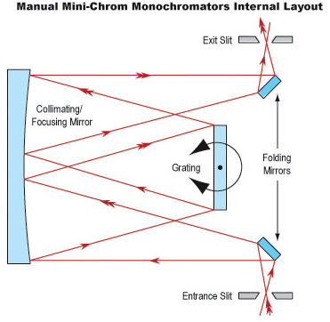
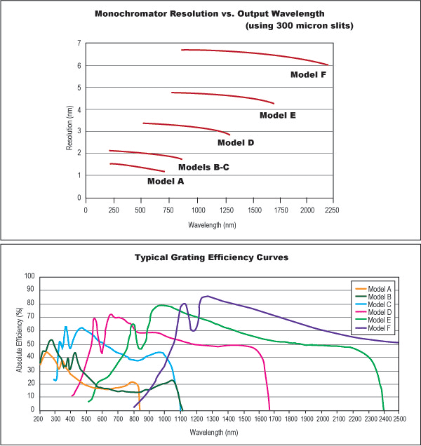
Broadband source + monochromator
(Wavelength
Control)
Excitation source
(e.g. laser)
Focusing optics
To obtain a very narrow and variable bandwidth, the light from a broadband sources is filtered by a simple grating monochromator (see below)
The bandwidth and transmission are determined by the monochromator slit width: a simple 7.4 cm monochromator has a dispersion of 5.3 nm/mm, so a slit of 1 mm width will have a spectral width of 5.3 nm. Light intensity is also proportional to the slit width…
(Environmental
Control)
Sample
Collecting and focusing optics
Wavelength
control
Dispersive element
Detector
Typical power at 340 nm, distance 25cm:
Halogen lamp: 70 nW
Hg lamp: 7 μW
Monochromator efficiency
https://www.edmundoptics.com/f/manual-mini-chrom-monochromators

Slide 18
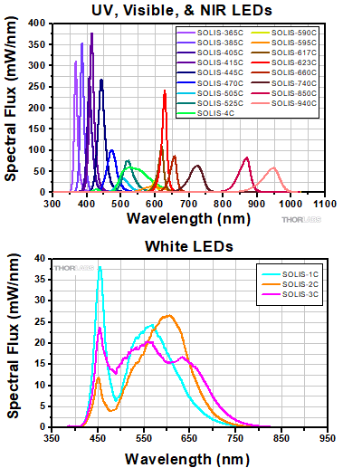
LED sources
(Wavelength
Control)
Excitation source
(e.g. laser)
Focusing optics
New LED sources can emit at one wavelength band ("colored LEDs") or broadband ("White LEDs"):
"White" LED has higher UV emission than a halogen lamp
The UV source at 365 nm has a bandwidth of 10 nm and emits a power of 3W – more than any broadband source.
(Environmental
Control)
Sample
Collecting and focusing optics
Wavelength
control
Dispersive element
Detector

Slide 19
Laser sources
Some high-power lasers
(Wavelength
Control)
Excitation source
(e.g. laser)
Focusing optics
Laser sources have several advantages:
Monochromatic light (<< 1 nm): all the energy is concentrated in one wavelength
Parallel beam of small diameter (mm): easy to focus
The main disadvantage: limited or no tunability.
Main types of lasers:
Gas lasers (HeNe, Ar, CO₂, …)
Organic dye lasers* (less used now)
Excimer lasers (ArF, KrF, …)
Solid crystal lasers (Ti:Saphire*, Nd:Yag, …)
Diode lasers
Fiber lasers
Free-electron lasers (huge, very expensive!)
*Continuously tunable
(Environmental
Control)
Sample
Collecting and focusing optics
Wavelength
control
Dispersive element
Detector

Slide 20
Main laser sources used in spectroscopy
Excitation source
(e.g. laser)
(Wavelength
Control)
Focusing optics
Laser sources for spectroscopy usually have power of 1 mW – 1W, tunability is a plus
Fixed-wavelength types, for simple applications:
HeNe (628 nm)
Fixed-wavelength diode lasers (wavelength can be chosen)
Nd:Yag and Doubled Nd:Yag (DPSS) (1062 and 532 nm)
For UV excitation, high-power pulses:
Excimer lasers (ArF, KrF, …)
Tunable lasers:
Ti:Saphire
Some diode lasers
(Environmental
Control)
Sample
Collecting and focusing optics
Wavelength
control
Dispersive element
Detector
Some high-power lasers

Slide 21
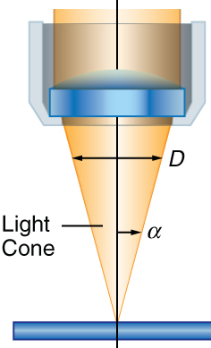
Focusing optics
(Wavelength
Control)
Excitation source
(e.g. laser)
Focusing optics
The focusing optics brings the light from the source to the sample, covering the required area: from cm² (liquid absorption) to μm² (micro-photoluminescence, μPL)
In many systems, the light intensity is controlled by attenuators
In some cases, the light polarization is also controlled
In the case of large areas, illumination homogeneity can be important; sometimes a "white" diffuser is needed.
When focusing on small areas, microscope objectives are used to obtain a diffraction-limited spot (D=1.22λ/NA)
Optical fibers can also be used to bring the excitation light to the sample. They have the advantage of small size and flexibility (e.g. in moving systems)
In rare cases, an elliptical excitation spot is needed; the optics should then include a cylindrical lens.
(Environmental
Control)
Sample
Collecting and focusing optics
Wavelength
control
Dispersive element
Detector
NA=sin(α)

Slide 22
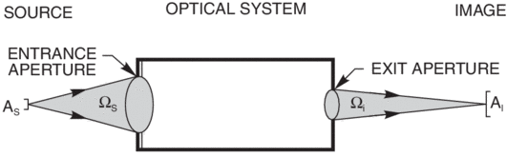
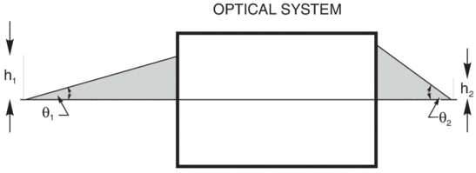
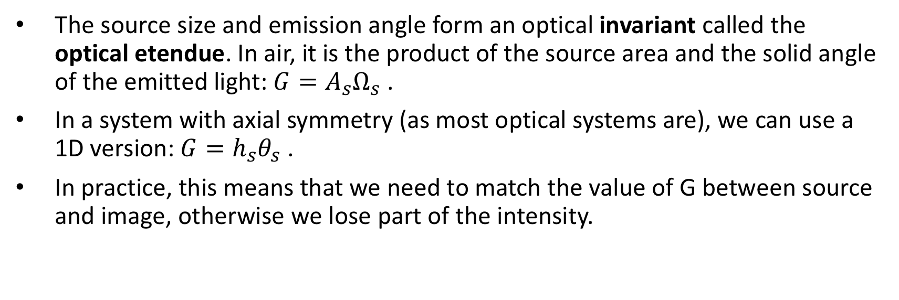
Size considerations – optical etendue
(Wavelength
Control)
Excitation source
(e.g. laser)
Focusing optics
The source size and emission angle form an optical invariant called the optical etendue. In air, it is the product of the source area and the solid angle of the emitted light: $G=A_{s}Ω_{s}$ .
In a system with axial symmetry (as most optical systems are), we can use a 1D version: $G=h_{s}θ_{s}$ .
In practice, this means that we need to match the value of G between source and image, otherwise we lose part of the intensity.
(Environmental
Control)
Sample
Collecting and focusing optics
Wavelength
control
Dispersive element
Detector
https://www.newport.com/t/light-collection-and-systems-throughput

Slide 23
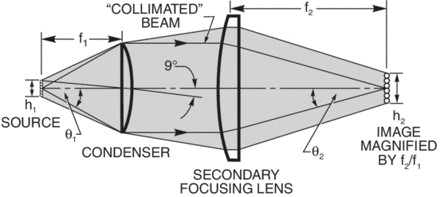
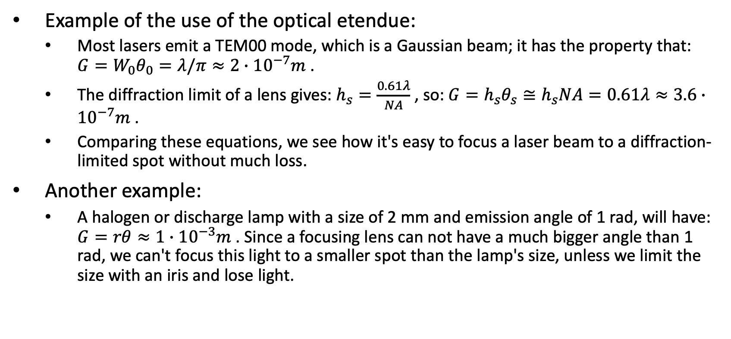
Size considerations – optical etendue
(Wavelength
Control)
Excitation source
(e.g. laser)
Focusing optics
Example of the use of the optical etendue:
Most lasers emit a TEM00 mode, which is a Gaussian beam; it has the property that: $G=W_{0}θ_{0}=λ/π≈2∙{10}^{−7}m$ .
The diffraction limit of a lens gives: $h_{s}=\frac{0.61λ}{NA}$ , so: $G=h_{s}θ_{s}≅h_{s}NA=0.61λ≈3.6∙{10}^{−7}m$ .
Comparing these equations, we see how it's easy to focus a laser beam to a diffraction-limited spot without much loss.
Another example:
A halogen or discharge lamp with a size of 2 mm and emission angle of 1 rad, will have: $G=rθ≈1∙{10}^{−3}m$ . Since a focusing lens can not have a much bigger angle than 1 rad, we can't focus this light to a smaller spot than the lamp's size, unless we limit the size with an iris and lose light.
(Environmental
Control)
Sample
Collecting and focusing optics
Wavelength
control
Dispersive element
Detector

Slide 24
Collecting optics
(Wavelength
Control)
Excitation source
(e.g. laser)
Focusing optics
The collecting optics brings the light from the sample to the dispersive element, covering the required area: from cm² (liquid absorption) to μm² (micro-photoluminescence, μPL)
When collecting from a small area (in μPL systems), microscope objectives with high numerical aperture are used to collect the maximum light. The same optics is then used for excitation and collection. Semi-transparent mirrors are used to direct the incoming and outgoing beams.
In many cases, especially when the same lens is used, filters are needed to remove the (much stronger) reflected excitation light from the dispersive element entrance.
In some cases, the light polarization is also controlled, and can also be used to distinguish between the reflected excitation and the signal.
Optical fibers can also be used, sometimes a single fiber can send the excitation light and bring back the PL light. They have the advantages of very compact size and flexibility, but the disadvantage of a small optical etendue. Fiber luminescence can sometimes be a problem.
(Environmental
Control)
Sample
Collecting and focusing optics
Wavelength
control
Dispersive element
Detector
NA=sin(α)

Slide 25
The dispersive element
(Wavelength
Control)
Excitation source
(e.g. laser)
Focusing optics
The dispersive element is the most important part of the system. It allows to distinguish between different photon energies (wavelengths)
The type of dispersive element to be used depends on the needs:
Resolvance or resolution (distinguish between close wavelengths)
In some cases (e.g. Raman spectroscopy), the rejection ratio is very important
Wavelength range of operation
Throughput (or efficiency, or losses): the transmission of the element
Speed and ease of use
We look here at several types of dispersive elements:
The diffraction grating (the most common)
The FTIR spectrometer (also very popular)
The refractive prism
The Fabri-Perot interferometer
(Environmental
Control)
Sample
Collecting and focusing optics
Wavelength
control
Dispersive element
Detector

Slide 26
The diffraction grating spectrometer
The diffraction grating spectrometer is the most widely used in physics research and industry.
It combines high resolution, wide spectral range, moderately high efficiency, and simple use.
Its operation is based on the wavelength dispersion properties of the diffraction grating.

Slide 27
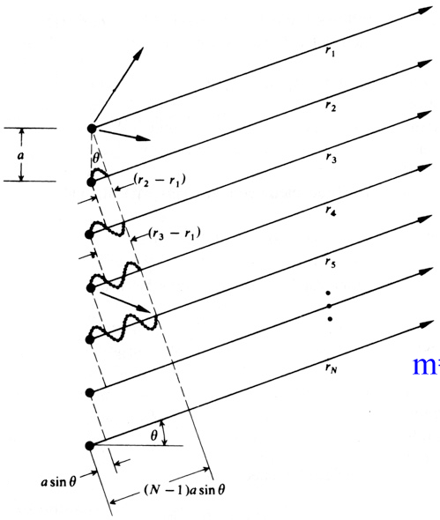
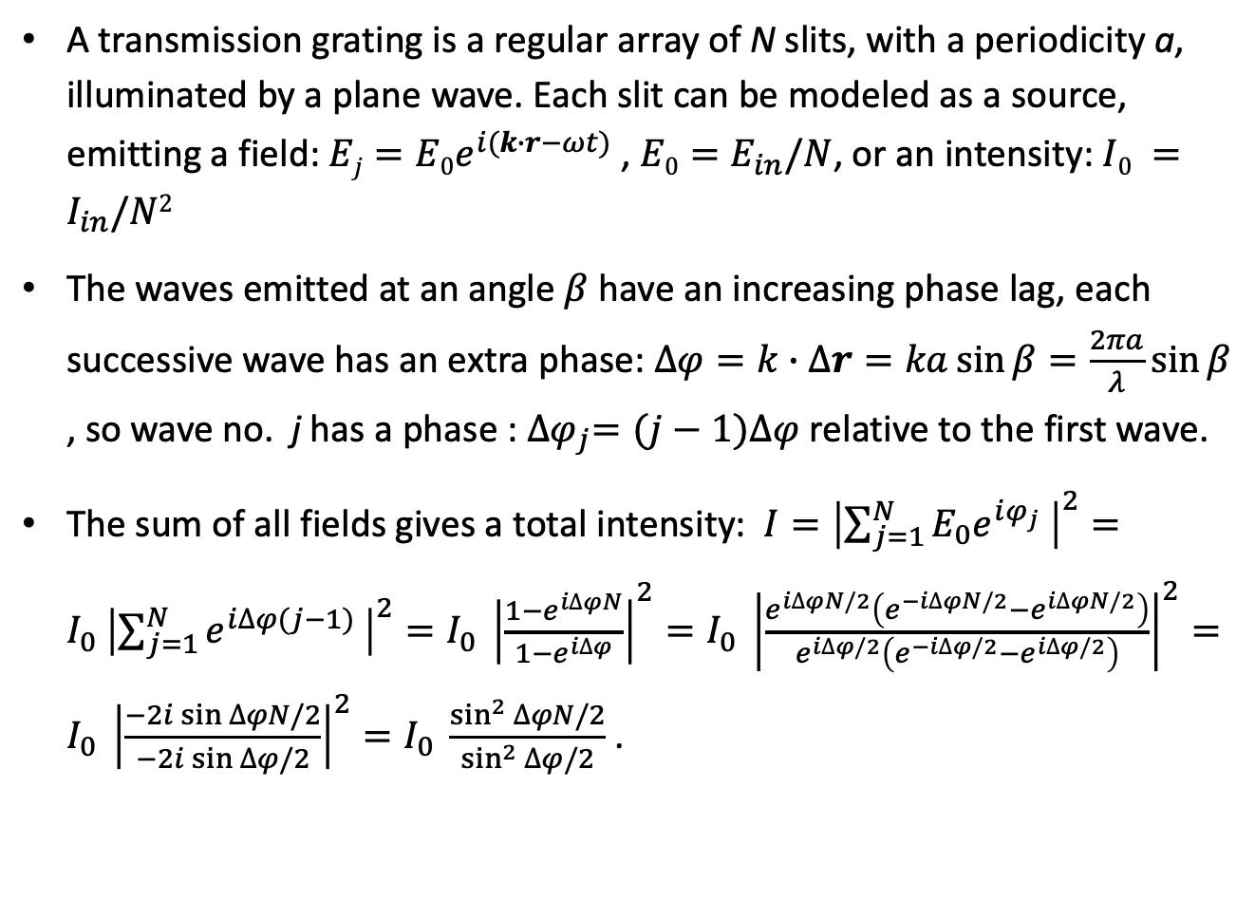
The diffraction grating – physics (1)
A transmission grating is a regular array of N slits, with a periodicity a, illuminated by a plane wave. Each slit can be modeled as a source, emitting a field: $Ej=E0e^{i(k∙r−ωt)}$ , $E0=E_{in}/N$, or an intensity: $I0 =I_{in}/N2$
The waves emitted at an angle $β$ have an increasing phase lag, each successive wave has an extra phase: $∆φ=k∙Δr=ka\sin{β}=\frac{2πa}{λ}\sin{β}$ , so wave no. j has a phase : ${∆φ}_{j}=(j−1)∆φ$ relative to the first wave.
The sum of all fields gives a total intensity: $I={\left|\sum_{j=1}^{N}{E_{0}{e^{iφ_{j}}}_{ }}\right|}^{2}={I_{0}}_{ }{\left|\sum_{j=1}^{N}{{e^{i∆φ(j−1)}}_{ }}\right|}^{2}={I_{0}}_{ }{\left|\frac{1−e^{i∆φN}}{1−e^{i∆φ}}\right|}^{2}={I_{0}}_{ }{\left|\frac{e^{i∆φN/2}\left(e^{−i∆φN/2}−e^{i∆φN/2}\right)}{e^{i∆φ/2}\left(e^{−i∆φ/2}−e^{i∆φ/2}\right)}\right|}^{2}={I_{0}}_{ }{\left|\frac{−2i\sin{∆φN/2}}{−2i\sin{∆φ/2}}\right|}^{2}={I_{0}}_{ }\frac{\sin^{2}{∆φN/2}}{\sin^{2}{∆φ/2}}$ .
β
β
β

Slide 28
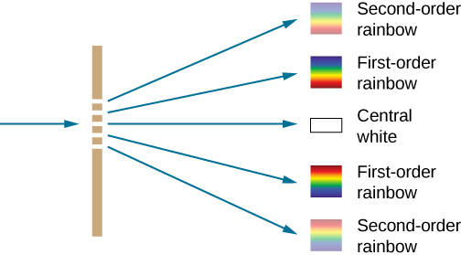

The diffraction grating – physics (2)
The total intensity is: $I={I_{0}}_{ }\frac{\sin^{2}{∆φN/2}}{\sin^{2}{∆φ/2}}$ . Let's analyze this expression:
The big peaks correspond to: $\sin^{2}{∆φ/2}=0$, or: Δϕ_{max} = 2mπ .
m=…,-2,-1,0,1,2,… is the diffraction order. The intensity is: I=N²I₀=I_{in} .
The minima (I=0) correspond to: $\sin^{2}{∆φN/2}=0$, or: Δϕ_{min} = 2m'π/N.
The small peaks correspond to: $\sin^{2}{∆φN/2}=1$ , or: Δϕ_{max'} = (2m'+1)π/N .
The emerging waves are parallel, so a lens (or curved mirror) is needed to focus them on a screen. If its focal length is L, the focused point on the screen will correspond to: y≈Lβ .
In a typical grating, N = 10⁵ ; the function $\sin^{2}{∆φN/2}$ is extremely narrow! The first zero corresponds to: Δϕ₀ = 2π/N≈10⁻⁴.
y
L
https://sites.google.com/site/puenggphysics/home/Unit-II/diffraction-due-to-n-slits

Slide 29
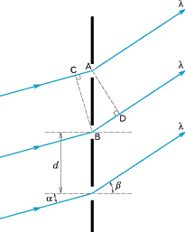
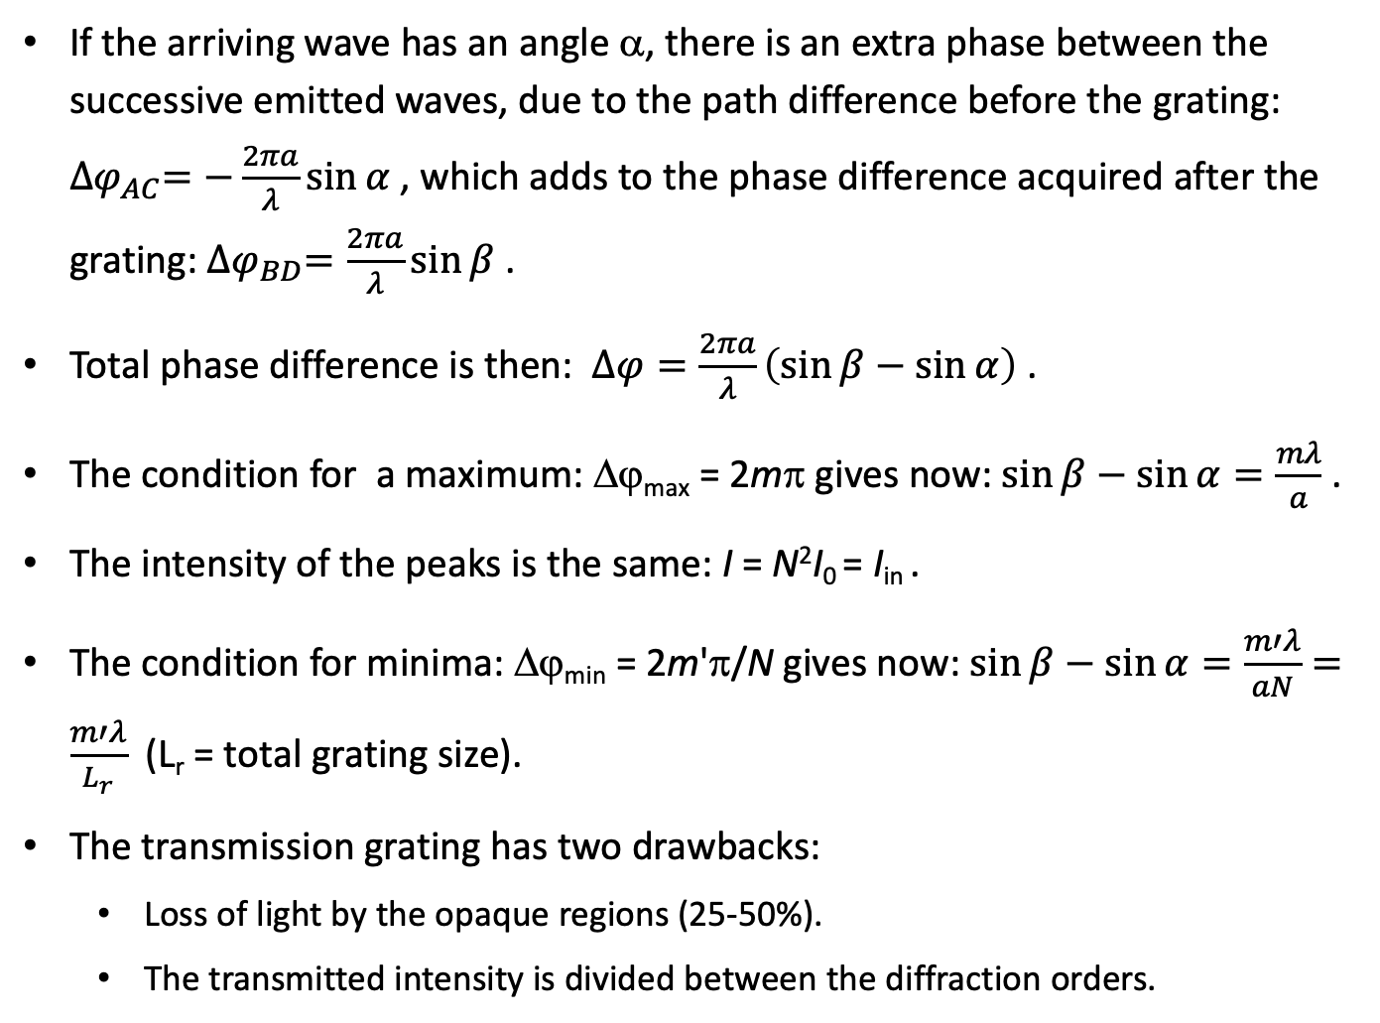
The diffraction grating – physics (3)
If the arriving wave has an angle α, there is an extra phase between the successive emitted waves, due to the path difference before the grating: ${∆φ}_{AC}=−\frac{2πa}{λ}\sin{α}$ , which adds to the phase difference acquired after the grating: ${∆φ}_{BD}=\frac{2πa}{λ}\sin{β}$ .
Total phase difference is then: $∆φ=\frac{2πa}{λ}\left(\sin{β}−\sin{α}\right)$ .
The condition for a maximum: Δϕ_{max} = 2mπ gives now: $\sin{β}−\sin{α}=\frac{mλ}{a}$ .
The intensity of the peaks is the same: I = N²I₀ = I_{in} .
The condition for minima: Δϕ_{min} = 2m'π/N gives now: $\sin{β}−\sin{α}=\frac{m′λ}{aN}=\frac{m′λ}{L_{r}}$ (L_{r} = total grating size).
The transmission grating has two drawbacks:
Loss of light by the opaque regions (25-50%).
The transmitted intensity is divided between the diffraction orders.

Slide 30
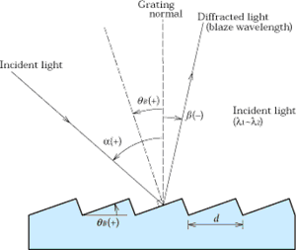

The diffraction grating – physics (4)
It is more efficient to use a grating of mirrors (reflective grating). It allows to choose the mirror angle $θ_{B}$.
The condition for the maxima is the same: $\sin{β}−\sin{α}=\frac{mλ}{a}$ .
Choosing the angle allows to maximize the reflected intensity in a specific diffraction order, by satisfying the reflection condition: $α−β=2θ_{B}$ as well ("blazing"). This gives: $2sin{θ_{B}}\cos{(α−θ_{B})}=\frac{mλ_{max}}{a}$ , so λ_{max} is determined by system geometry (α , θ_{B}). The optimized "blazed" wavelength can reach >80% efficiency; for other wavelengths, the intensity is lower.
$${ θ}_{B}$$
$$θ_{B}$$
https://www.horiba.com/uk/scientific/products/diffraction-gratings/for-industrial-applications/holographic-plane-gratings/

Slide 31
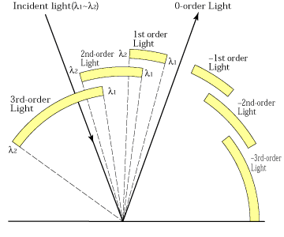

The diffraction grating – physics (5)
Let's suppose that wavelengths $λ_{1}$ of an order m and $λ_{2}$ of an order m+1 are diffracted into the same angle β . The grating equation gives: $\sin{β}−\sin{α}=\frac{mλ_{1}}{a}=\frac{(m+1)λ_{2}}{a}$ , or: $mλ_{1}=(m+1)λ_{2}$ .
The difference is: $∆λ=λ_{1}−λ_{2}=\frac{λ_{2}}{m}=\frac{λ_{1}}{m+1}$ .
The result: there is an overlap between half the first order and the second order, a third of the second order and the third order, etc.
https://s3-us-west-2.amazonaws.com/courses-images-archive-read-only/wp-content/uploads/sites/222/2014/12/20111410/Figure_28_04_01a.jpg
https://www.shimadzu.com/sites/shimadzu.com/files/opt/guide/diffraction/k25cur0000003vph-img/oh80jt0000001uxj.gif

Slide 32
The grating monochromator/spectrograph
A typical grating spectrometer is composed of two spherical mirrors and a grating:
Optical path inside the monochromator
Detector (CCD)
Inside view
In1
Outputs:
Spherical mirrors
Grating
Out 2
In 2
Out 1
In 1
http://www.horiba.com/us/en/scientific/products/monochromators/

Slide 33
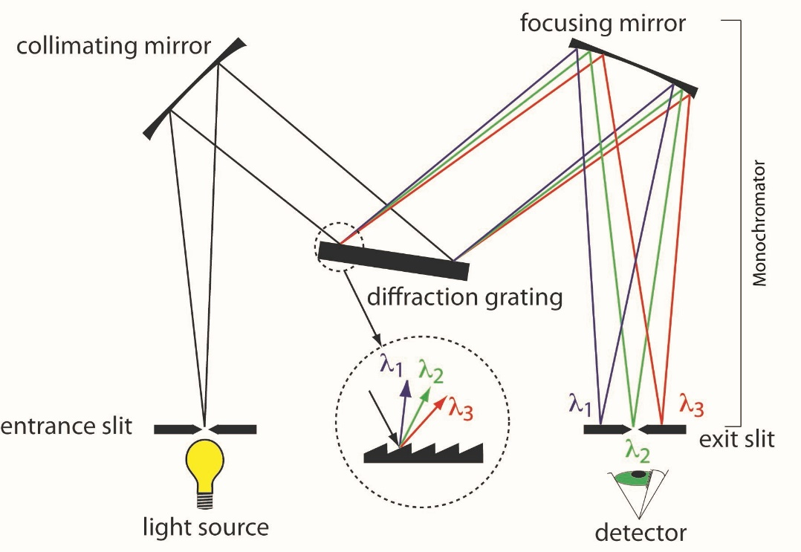

Using the grating monochromator
As a filter, using a broadband light source at the input to obtain a (low efficiency) source of monochromatic light.
To measure the spectrum of the sample emission. There are two modes of operation:
Spectrometer: A narrow output slit selects the output wavelength, then a single detector measures the intensity. To obtain the full spectrum, we turn the grating according to: $\sin{β}−\sin{α}=\frac{mλ}{a}$ .
Spectrograph: A camera or detector array at the output measures simultaneously a full or partial spectrum. The position of the spectrum peak on the detector is determined by: $\sin{\frac{y}{L}}−\sin{α}=\frac{mλ}{a}$ . If the detector size is D, the measured spectral range is: $∆λ≈\frac{aD}{mL}$ . For a larger spectral range, several spectra should be measured by turning the grating.
Typical values:
a=0.83 μm
L=550 mm
D=25mm
=> Δλ=38 nm
https://www.researchgate.net/profile/Jianwei_Qin/publication/312956040/figure/fig1/AS:456608141582336@1485875272925/Wavelength-dispersive-imaging-spectrographs-a-prism-grating-prism-PGP-transmission.png
https://blogs.maryville.edu/aas/wp-content/uploads/sites/1601/2015/04/monochromater.jpg

Slide 34
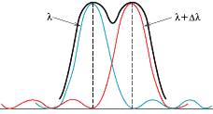
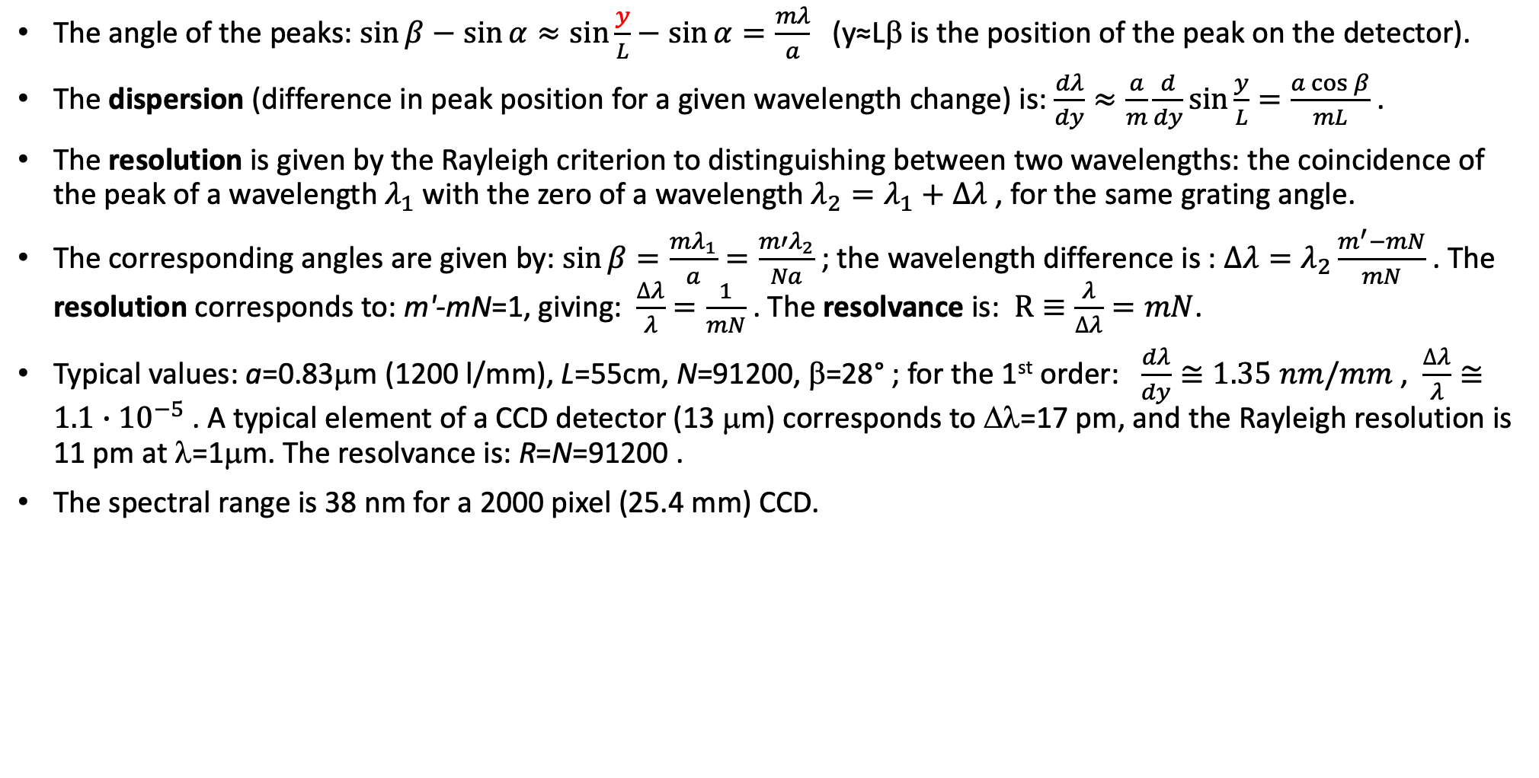
Performance of the grating spectrometer/spectrograph
The angle of the peaks: $\sin{β}−\sin{α}≈\sin{\frac{y}{L}}−\sin{α}=\frac{mλ}{a}$ (y≈Lβ is the position of the peak on the detector).
The dispersion (difference in peak position for a given wavelength change) is: $\frac{dλ}{dy}≈\frac{a}{m}\frac{d}{dy}\sin{\frac{y}{L}}=\frac{a\cos{β}}{mL}$ .
The resolution is given by the Rayleigh criterion to distinguishing between two wavelengths: the coincidence of the peak of a wavelength $λ_{1}$ with the zero of a wavelength $λ_{2}=λ_{1}+∆λ$ , for the same grating angle.
The corresponding angles are given by: $\sin{β}=\frac{mλ_{1}}{a}=\frac{m′λ_{2}}{Na}$ ; the wavelength difference is : $∆λ=λ_{2}\frac{m^{′}−mN}{mN}$ . The resolution corresponds to: m'-mN=1, giving: $\frac{∆λ}{λ}=\frac{1}{mN}$ . The resolvance is: $R≡\frac{λ}{∆λ}=mN$.
Typical values: a=0.83μm (1200 l/mm), L=55cm, N=91200, β=28° ; for the 1st order: $\frac{dλ}{dy}≅1.35 nm/mm$ , $\frac{∆λ}{λ}≅1.1∙{10}^{−5}$ . A typical element of a CCD detector (13 μm) corresponds to Δλ=17 pm, and the Rayleigh resolution is 11 pm at λ=1μm. The resolvance is: R=N=91200 .
The spectral range is 38 nm for a 2000 pixel (25.4 mm) CCD.

Slide 35
Summary of grating spectrometer properties
Advantages:
High resolvance
Large spectral range
Weak dependence of resolution on wavelength
Disadvantages:
High resolution instruments are large, expensive
Medium efficiency, wavelength and polarization-dependent
Main applications:
"Workhorse" spectrometer in most physics laboratories,
when high resolution and large spectral range are needed

Slide 36
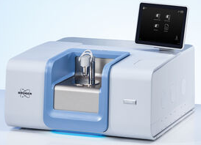
The FTIR spectrometer
The Fourier-Transform IR (FTIR) spectrometer is widely used in (bio-)chemistry research and industry, where it is used to measure the absorption spectra of molecules.
It combines moderately high resolution, wide spectral range (usually 1-10 μm), high efficiency, and simple (automatic) use.
Its operation is based on light interference in the Michelson interferometer.
https://www.bruker.com/fileadmin/_processed_/csm_Bruker-Optics_FTIR-Spectrometer-INVENIO-S_Touch-Display_Platinum-ATR_Kachel_d9fc2bdbea.jpg

Slide 37
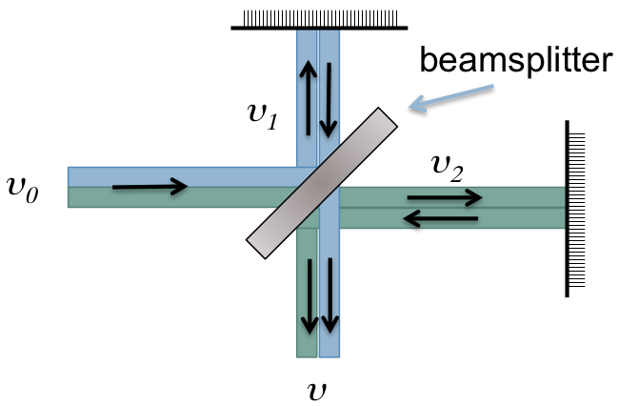
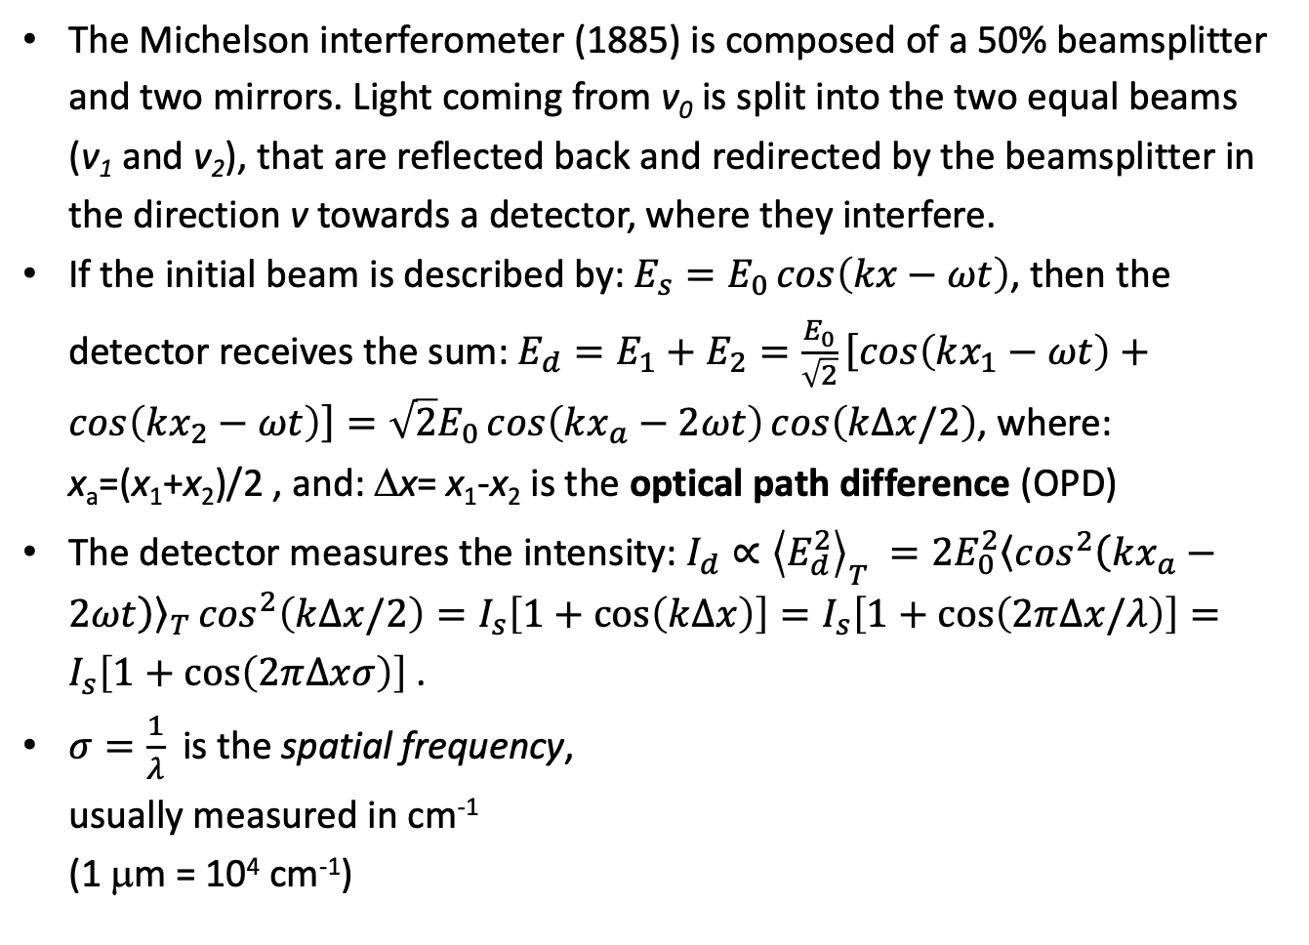
The Michelson interferometer
The Michelson interferometer (1885) is composed of a 50% beamsplitter and two mirrors. Light coming from v₀ is split into the two equal beams (v₁ and v₂), that are reflected back and redirected by the beamsplitter in the direction v towards a detector, where they interfere.
If the initial beam is described by: $E_{s}=E_{0}\cos\left(kx−ωt\right)$, then the detector receives the sum: $E_{d}=E_{1}+E_{2}=\frac{E_{0}}{\sqrt{2}}\left[\cos\left(kx_{1}−ωt\right)+\cos\left(kx_{2}−ωt\right)\right]=\sqrt{2}E_{0}\cos\left(kx_{a}−2ωt\right)\cos\left(k∆x/2\right)$, where: x_{a}=(x₁+x₂)/2 , and: Δx= x₁-x₂ is the optical path difference (OPD)
The detector measures the intensity: $I_{d}∝{\left\langle E_{d}^{2}\right\rangle }_{T} =2E_{0}^{2}{\left\langle \cos^{2}\left(kx_{a}−2ωt\right)\right\rangle }_{T}\cos^{2}\left(k∆x/2\right)=I_{s}\left[1+\cos\left(k∆x\right)\right]=I_{s}\left[1+\cos\left(2π∆x/λ\right)\right]=I_{s}\left[1+\cos\left(2π∆xσ\right)\right]$ .
$σ=\frac{1}{λ}$ is the spatial frequency,
usually measured in cm⁻¹
(1 μm = 10⁴ cm⁻¹)
Δϕ=ωΔr/c

Slide 38
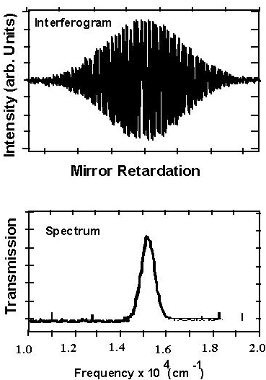
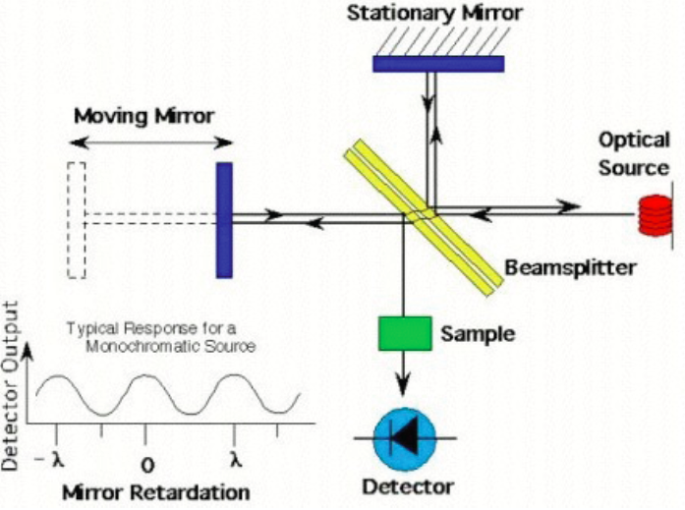

The Michelson interferometer can produce a spectrum
We build an interferometer with one fixed and one moving mirror. The detected intensity varies with the moving mirror's position x : $I_{d}=I_{s}\left[1+\cos\left(2πσ∆x\right)\right]$.
If the source contains two frequencies, the intensity will be their sum:
$I_{d}(∆x)=I_{σ_{1}}\left(∆x\right)+I_{σ_{2}}\left(∆x\right)=I_{s}\left(σ_{1}\right)+I_{s}\left(σ_{2}\right)+I_{s}\left(σ_{1}\right)\cos\left({2πσ}_{1}∆x\right)+I_{s}\left(σ_{2}\right)cos⁡(2πσ_{2}∆x)$
For a multitude of frequencies: $I_{d}\left(∆x\right)=\sum_{i}{I_{s}\left(σ_{i}\right)}+\sum_{i}{I_{s}\left(σ_{i}\right)\cos\left(2πσ_{i}∆x\right)}=I_{s,total}+ℱ\left(I_{s}\left(σ\right)\right)$ is the Fourier transform of the spectrum $I_{s}\left(σ\right)$ .
The spectrum is the inverse Fourier transform of the interferogram $I_{d}\left(∆x\right)$ : $I_{s}\left(σ\right)=ℱ^{−1}\left(I_{d}\left(∆x\right)\right)$ .
x₂
+
x₁
I-FFT
=
Δx

Slide 39
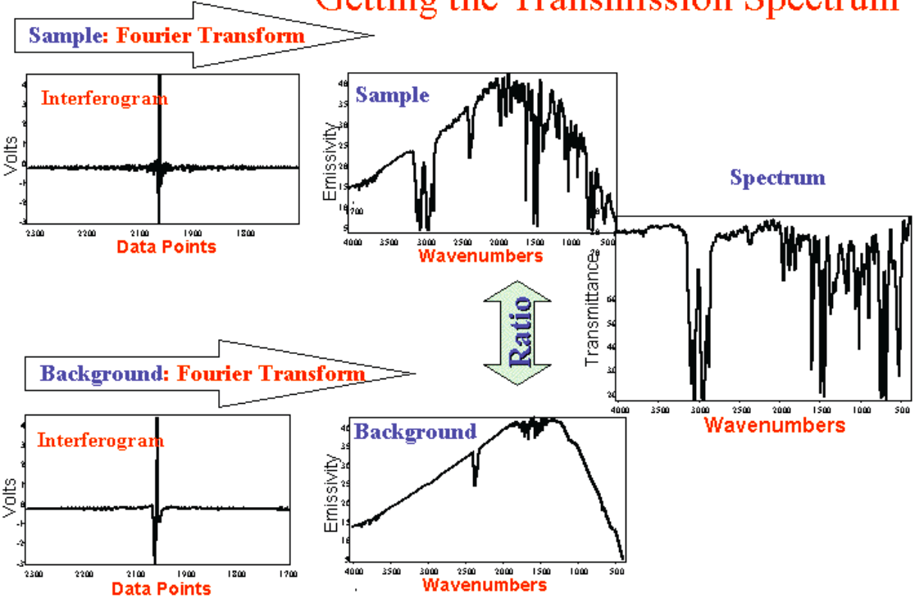
The FTIR spectrometer
The FTIR spectrometer is usually used to measure the absorption spectra of molecules. We measure the spectrum of a broadband (white) light source, then insert in the optical path the solution and measure again . The absorption spectrum is obtained as the ratio of the two spectra.
FTIR spectrometer
https://www.bruker.com/fileadmin/_processed_/csm_Bruker-Optics_FTIR-Spectrometer-INVENIO-S_Touch-Display_Platinum-ATR_Kachel_d9fc2bdbea.jpg
http://www.ece.ucdavis.edu/misl/Web/Pages/LSMweb/FTtran99.htm

Slide 40
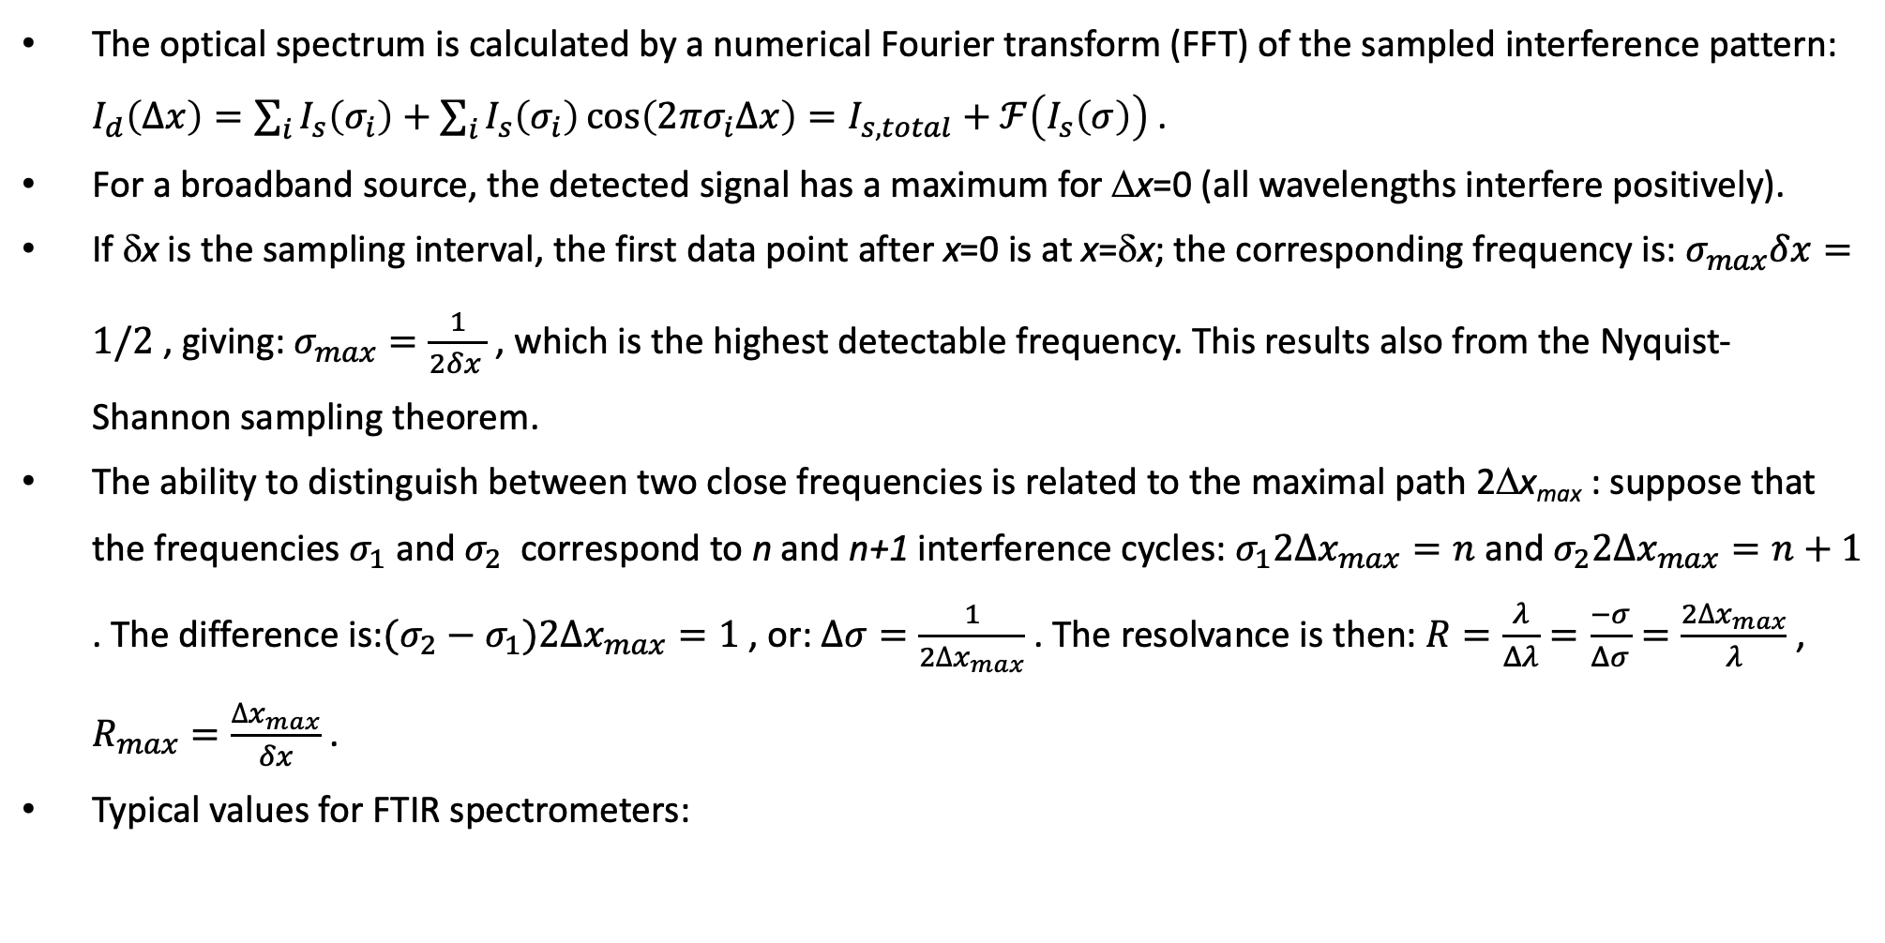
The FTIR spectrometer: performance
The optical spectrum is calculated by a numerical Fourier transform (FFT) of the sampled interference pattern: $I_{d}\left(∆x\right)=\sum_{i}{I_{s}\left(σ_{i}\right)}+\sum_{i}{I_{s}\left(σ_{i}\right)\cos\left(2πσ_{i}∆x\right)}=I_{s,total}+ℱ\left(I_{s}\left(σ\right)\right)$ .
For a broadband source, the detected signal has a maximum for Δx=0 (all wavelengths interfere positively).
If δx is the sampling interval, the first data point after x=0 is at x=δx; the corresponding frequency is: $σ_{max}δx=1/2$ , giving: $σ_{max}=\frac{1}{2δx_{ }}$ , which is the highest detectable frequency. This results also from the Nyquist-Shannon sampling theorem.
The ability to distinguish between two close frequencies is related to the maximal path 2Δx_{max} : suppose that the frequencies $σ_{1}$ and $σ_{2}$ correspond to n and n+1 interference cycles: $σ_{1}{2∆x}_{max}=n$ and $σ_{2}{2∆x}_{max}=n+1$ . The difference is:$(σ_{2}−σ_{1}){2∆x}_{max}=1$ , or: $∆σ=\frac{1}{{2∆x}_{max}}$ . The resolvance is then: $R=\frac{λ}{Δλ}=\frac{−σ}{Δσ}=\frac{{2∆x}_{max}}{λ}$ , $R_{max}=\frac{{∆x}_{max}}{δx}$ .
Typical values for FTIR spectrometers:
δx (μm) | ΔX_{max} (cm) | σ_{min}=Δσ (cm⁻¹) | σ_{max} (cm⁻¹) | λ_{min} (μm) | R
0.633 | 0.3 | 1.7 | 7.9.10³ | 1.27 | 4.7.10³
0.633 | 3 | 0.17 | 7.9.10³ | 1.27 | 4.7.10⁴
0.633 | 30 | 0.017 | 7.9.10³ | 1.27 | 4.7.10⁵

Slide 41
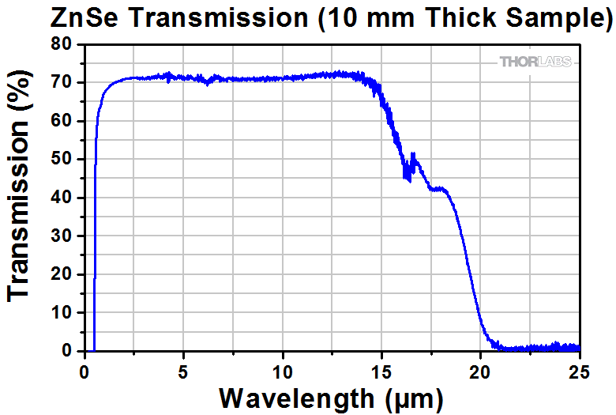
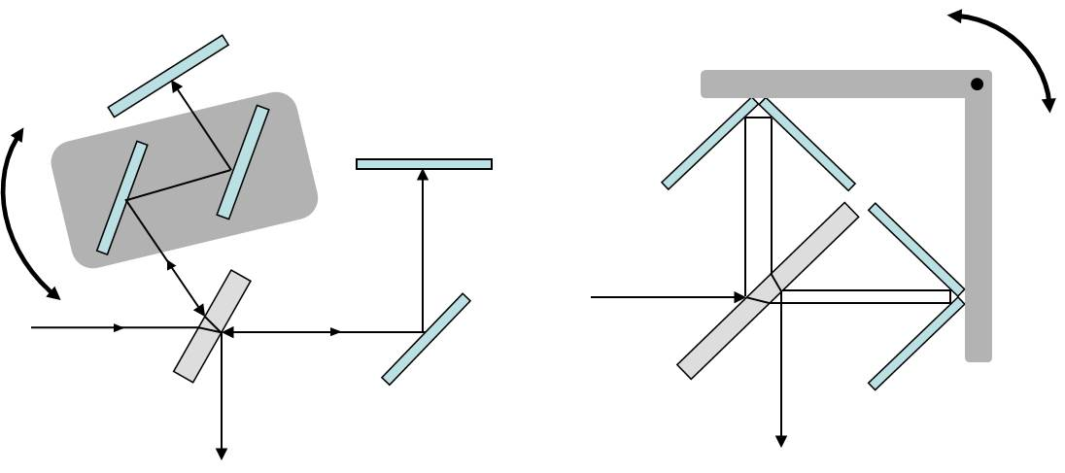
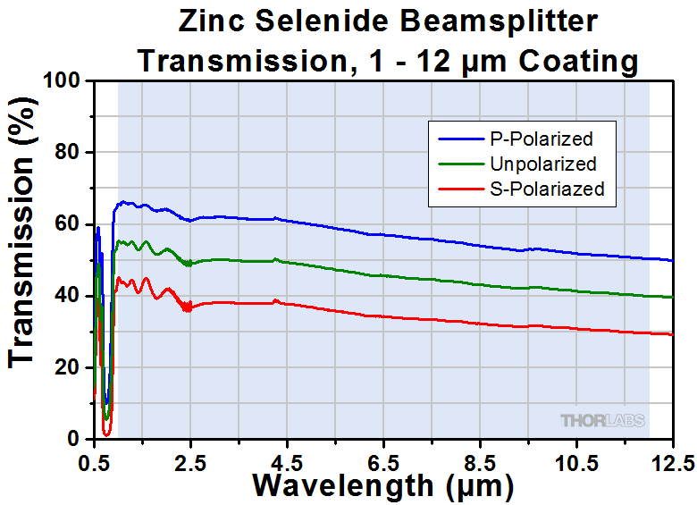

Material and structure issues
The performance of the FTIR cspectrometer depends on the beam splitter
To work at long IR wavelengths, special materials are needed: ZnSe (to 20 μm), KBr (to 25 μm), CsI (to 50 μm).
The detector should also be broadband (vis to FIR), usually a bolometer.
To avoid water absorption, the spectrometer volume is filled with dry N₂ .
Another issue is the stability of the moving mirror along its trajectory (< 0.5 μm) and beam alignment.
In some instruments, alternative methods are used (cube retroreflectors, rotating mirror assemblies).
https://www.thorlabs.com/newgrouppage9.cfm?objectgroup_id=4805
https://upload.wikimedia.org/wikipedia/commons/8/8e/Interferometer_schematics.jpg

Slide 42
How to increase resolution
To obtain high resolution at long wavelength, we need a long mirror trajectory with high-resolution, stable linear movement. This is not easy to achieve!
A simple method to overcome the mechanical deficiencies is to add an internal standard. Usually it's a HeNe laser, emitting at 632.816 nm. It passes through the interferometer in parallel to the source beam, and into a separate detector, which provides a reference sinusoidal voltage corresponding to the spatial frequency of λ=0.633 μm, which gives the precise position of the mirror independent of the mechanics.
The zero point of the mirror path Δx=0 is also detected as the strong maximum of the
interferogram at that point, which also coincides with a maximum of the reference
signal.
HeNe Laser
Detector

Slide 43


The use of the FTIR spectrometer
The FTIR spectrometer is usually used to measure the absorption spectra of molecules as the ratio of the light passing through the molecules and the source's light.
Typical absorption peaks are related to molecular properties:
Rotational levels
Vibrational levels
σ (cm⁻¹)
Transmission (%)
σ (cm⁻¹)
http://www.ece.ucdavis.edu/misl/Web/Pages/LSMweb/FTtran99.htm
https://s3-us-west-2.amazonaws.com/courses-images/wp-content/uploads/sites/1518/2017/10/05153652/octane_1.png
σ (cm⁻¹)
https://www.bruker.com/fileadmin/_processed_/csm_Bruker-Optics_FTIR-Spectrometer-INVENIO-S_Touch-Display_Platinum-ATR_Kachel_d9fc2bdbea.jpg
https://upload.wikimedia.org/wikipedia/commons/thumb/d/d9/IR-spectroscopy-sample.svg/2880px-IR-spectroscopy-sample.svg.png

Slide 44
Summary of FTIR properties
Advantages:
High transmittance (full beam size is used, no slits)
Hi speed (full spectrum taken in one fast sweep), averaging can be used to reduce noise.
Wide wavelength range (1 → >10 μm)
No strange resonances
Disadvantages:
Low resolvance, unless long trajectory
Needs good alignment and stability of moving mirror path
Main applications:
Organic chemistry and bio-chemistry laboratories
Forensic laboratories
σ (cm⁻¹)
Notes:
1

Slide 45



The prism spectrometer
The oldest (Newton 1670) and simplest spectrometer is the prism spectrometer.
It uses the dispersion of light by a glass prism.
https://upload.wikimedia.org/wikipedia/commons/b/bd/Dispersive_Prism_Illustration.jpg
http://www.scitechantiques.com/special%20instruments/090HTML/images/90PrismSpectroscopeB.jpg

Slide 46


The refractive prism – physics(1)
The simple glass prism can be used as a dispersive element.
The deviation angle de of light passing through a prism is:
$δ≡θ_{d}=θ−α+\sin^{−1}\left[\sqrt{n^{2}−\sin^{2}{θ}}\sin{α}−\sin{θ}\cos{α}\right]$
$δ$ depends on $θ,α$ and n. The dependence of $δ$ on $θ$has a minimum at δ =δ_{m} ; this angle corresponds to the symmetrical situation when the beam travels inside the prism parallel to its base.
In this case, we can find n through: $n=\frac{\sin\left[\left(δ_{m}+α\right)/2\right]}{\sin\left(α/2\right)}$
Total deviation angle δ
Symmetric case

Slide 47




The refractive prism – physics(2)
The usefullness of the prism in spectroscopy is beacause n depends on wavelength: n=n(λ)
The relation between δ_{m} and n produces: $\sin\left[\left(δ_{m}+α\right)/2\right]=\frac{n(λ)}{\sin\left(α/2\right)}$
Choice of the prism material allows to get the wanted change in n(λ).
Dense glasses (La-doped) are best
A way to characterize glasses is by the Abbé number: $V_{d}=\frac{n_{d}−1}{n_{F}−n_{C}}$ ; d, F, C = atomic spectral lines (587.6, 486.1, 656.3 nm)
Refraction index n_{d}
Abbé number V

Slide 48



Using the prism spectrometer
A lens is used to transform light coming from an entrance slit to a parallel beam entering the prism. A similar lens focuses the parallel beam coming from the prism onto an exit slit.
To maintain the condition of minimum deviation, both entrance and exit angles should change simultaneously. This is not very convenient!
A solution of this problem is the Pellin-Broca prism, which is a double 30° top prism plus internal reflection at 90°. In this prism, the beam deviation is always δ_{m} =90° if: $\sin\left(θ_{i}\right)=n/2$ .
In this configuration, we keep entrance and exit optics at 90° to each other, and turn the prism to satisfy the refraction condition $\sin\left(θ_{i}\right)=n(λ)/2$ . This allows to filter a single wavelength(according to the slit width), either as a filtered source or as a spectrometer.
D=0.87.e
Focal distance f
dx

Slide 49


Performance of the prism spectrometer
The prism equation: $\sin\left[\left(δ_{m}+α\right)/2\right]=n\sin\left(α/2\right)$ allows us to calculate the prism dispersion (difference in angle for a given wavelength change) is: $\frac{dδ_{m}}{dλ}=2{\left(1/\sin^{2}\left(α/2\right)−n^{2}\right)}^{−1/2}\frac{dn}{dλ}=K\frac{dn}{dλ}$ . Typical values for α=60°, n=1.5: $K=0.756$ . If the focal length of the focusing lens is f, the linear dispersion is: $\frac{dx}{dλ}=Kf\frac{dn}{dλ}$ .
The resolution is given by the size of the diffraction-limited focused spot: ${dx}_{min}=1.2\frac{λ}{NA}=1.2\frac{λ}{D/2f}$ . Using the equation above, we get the resolution : $∆λ=\frac{2.4λ}{KD\frac{dn}{dλ}}$ , and the resolvance: $R≡\frac{λ}{∆λ}=\frac{KD}{2.4}\frac{dn}{dλ}$ . Typical values at λ=500nm: K=0.756, D=76mm, $\frac{dn}{dλ}=5.6∙{10}^{−2}$ μm⁻¹ ; Δλ=0.37 nm , R=1340 .
D=0.87.e
Focal distance f
dx

Slide 50

Material issues
The performance of a prism cspectrometer depends directly on the material properties:
The resolvance is proportional to: $\frac{dn}{dλ}$ (in most materials it's non-linear, changing strongly with wavelength).
The material should be transparent at the required wavelength (limited wavelength range).
Typical example: Fused quartz
Can be used from UV (200 nm) to IR (3.5μm).
Refraction index varies a lot (from 0.95 μm⁻¹ at λ= 220 nm to 0.011 μm⁻¹ at λ=1.3 μm) and in a non-linear way.
https://refractiveindex.info/?shelf=glass&book=fused_silica&page=Malitson
https://www.heraeus.com/media/media/hca/doc_hca/products_and_solutions_8/optics/Data_and_Properties_Optics_fused_silica_EN.pdf

Slide 51
Summary of prism spectrometer properties
Advantages:
High transmission efficiency (close to 100%)
Large spectral range
Cheap
Disadvantages:
Transmission wavelength range depends on prism material
Non-linear dispersion, depends on n(λ) curve.
Medium resolvance
Resolvance depends on material, can vary a lot for different wavelengths
Main applications:
Simple spectrometer in demonstration laboratories
As a filter to choose the diffraction order of a grating
Filtered light sources

Slide 52



The Fabri-Pérot cavity spectrometer: principles (1)
The Fabry-Pérot cavity is made of two high-reflectivity mirrors, each with transmission t and reflection r, separated by a distance L. The light beam enters the cavity from the left, and gets partially reflected and partially transmitted at each passage, exiting at the right.
Each passage (back and forth) in the cavity contributes a component: $E_{{out}_{j}}=E_{{out}_{j−1}}r^{2}e^{i2kL}$ . The total output field is: $E_{out}=E_{0}t^{2}e^{ikL}\sum_{j=0}^{∞}{{\left(r^{2}e^{i2kL}\right)}^{j}}=E_{0}t^{2}e^{i∆φ/2}\sum_{j=0}^{∞}{r^{2j}e^{i∆φj}}=E_{0}t^{2}e^{i∆φ/2}\frac{1}{1−r^{2}e^{i∆φ}}$ , with $∆φ=2kL$ .
The output intensity is: $I_{out}=I_{0}t^{4}{\left|\frac{1}{1−r^{2}e^{i∆φ}}\right|}^{2}=\frac{I_{0}t^{4}}{\left(1−r^{2}e^{i∆φ}\right)\left(1−r^{2}e^{−i∆φ}\right)}=\frac{I_{0}t^{4}}{1+r^{4}−r^{2}\left(e^{i∆φ}+e^{−i∆φ}\right)}=\frac{I_{0}t^{4}}{1+r^{4}−2r^{2}\cos{∆φ}}=\frac{I_{0}t^{4}}{1+r^{4}−2r^{2}\left(1−2\sin^{2}{∆φ/2}\right)}=\frac{I_{0}t^{4}}{{\left(1−r^{2}\right)}^{2}+4r^{2}\sin^{2}{∆φ/2}}=\frac{I_{max}}{1+{\left(\frac{2ℱ}{π}\right)}^{2}\sin^{2}{∆φ/2}}$ , with: $I_{max}≡\frac{I_{0}t^{4}}{{\left(1−r^{2}\right)}^{2}}=I_{0}$ , and $ℱ≡\frac{πr}{1−r^{2}}=\frac{π⋅\sqrt{R}}{1−\sqrt{R}}$ , where R=r² is the mirror reflectivity.
To increase F, R should be close to 1:
To reach such high R, dielectric mirrors
are needed.
R | $$ℱ$$
0.73134 | 10
0.9690737 | 100
0.99686334 | 1000

Slide 53



The Fabri-Pérot cavity spectrometer : principles (2)
The output intensity: $I_{out}=\frac{I_{max}}{1+{\left(\frac{2ℱ}{π}\right)}^{2}\sin^{2}{∆φ/2}}$ , with: $∆φ=2kL=\frac{4πL}{λ}$ , $ℱ≡\frac{πr}{1−r^{2}}=\frac{π⋅\sqrt{R}}{1−\sqrt{R}}$ .
We have maximal intensity $I_{out}=I_{max}$ when: $\sin^{2}{∆φ/2}=0$ , or: Δϕ_{max}=2πm (m=1,2,3,…) . This corresponds to: L=λm/2 . The phase difference between peaks is thus: Δϕ_{p-p}=2π , corresponding to ΔL = λ.
The width at half-maximum is obtained when: ${\left(\frac{2ℱ}{π}\right)}^{2}\sin^{2}{∆φ_{1/2}/2}=1$. For F>4 we can use the linear approximation of the sinus, giving: Δϕ_{1/2} = π/F . The ratio of p-p distance and full width at half-maximum (FWHM) δϕ=2Δϕ_{1/2} is: R = Δϕ_{p-p}/δϕ = F .
As the width at half-maximum is small, most of the phase values lead to low intensity, with the minimal intensity occuring when:
$\sin^{2}{∆φ/2}=1$ , or: Δϕ_{min}=π(2m+1) (m=1,2,3,…) , or: L=λ(2m+1)/4 .

Slide 54

The Fabri-Pérot cavity spectrometer : principles (3)
We saw that the maxima correspond to: L=λm/2. Typically, L=10mm, so: m=2L/λ=2.10⁴.
To pass from one maximum to the next, we need to change L by λ/2, or change the wavelength by: Δλ=λ²/2L. We call Δλ the free spectral range (FSR). In our example, L=10mm, λ=1μm, so Δλ=50pm !
The wavelength resolution is the FWHM: δλ=Δλ/F . In our example, and with F=1000, δλ=50fm ! The resolvance is R = F .
Due to the small values of Δλ and δλ, we often state them in MHz/GHz (f=c/λ): Δf=cΔλ/λ² = 3.10²⁰Δλ . In our example: Δf=15GHz , δf=15MHz .
In a plane mirrors cavity, if the angle between the beam and the mirror is not precisely 90°, the beam will go out of the cavity after several reflections, which will reduce F to a much smaller value.
To maintain a finesse F, the maximal angle error is : α_{max}=tg⁻¹(H/2FL), where H is the mirror radius. In our example, for H= c cm, F =1000, we get: α_{max}=0.06° !

Slide 55


The Fabri-Pérot cavity spectrometer : instrument
We saw that the maxima correspond to: L=λm/2. Typically, L=10mm, so: m=2L/λ=2.10⁴.
The Fabri-Pérot spectrometer is usually constructed with spherical mirrors, to avoid the sensitivity to beam misalignment. This design often doubles the optical path, giving the condition for maxima: L=λm/4.
To obtain precise cavity tuning, a piezoelectric actuator is used to displace the mirrors. Typical movement range is of a few μm, with a resolution of a few nm.
Only dielectric mirrors have sufficient reflectivity needed for a high finesse value.
L=50 mm
Dielectric mirror for FP cavity
Reflectivity of common metals

Slide 56
The Fabri-Pérot cavity spectrometer : use
The special property of the Fabry-Pérot spectrometer: periodic series of very narrow transmission peaks.
The main use: linewidth analysis of light sources (e.g. lasers, quantum dots). The cavity is a very narrow filter, and we sweep the transmission peak through a small wavelength range to trace the form of the measured spectrum. The FWHM (resolution) of the transmission peak must be much smaller than the measured linewidth.
Mesured output intensity reconstructs the input peak form
input peak form
(periodic) F.P. Transmission peaks
F.P. peak sweep direction

Slide 57
Summary of Fabri-Pérot cavity spectrometer properties
Advantages:
High transmission efficiency (close to 100%)
Extremely high resolution – better than other spectrometers.
Disadvantages:
Periodic transmission peaks – no absolute wavelength measurement.
The high-reflectivity mirrors can work over a limited wavelength range (about 20% of the center wavelength).
Main applications:
Linewidth measurement of narrow emission lines.
input peak form
(periodic) F.P. Transmission peaks
F.P. peak sweep direction

Slide 58
Comparison of spectrometer types

