Slide 1
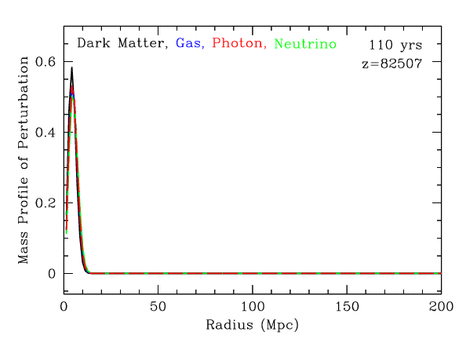
BAO animation
https://scholar.harvard.edu/deisenstein/book/export/html/28634

Slide 2
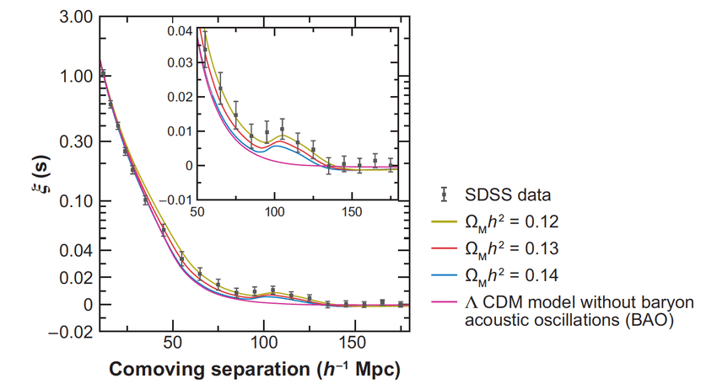
BAO detection by SDSS

Slide 3
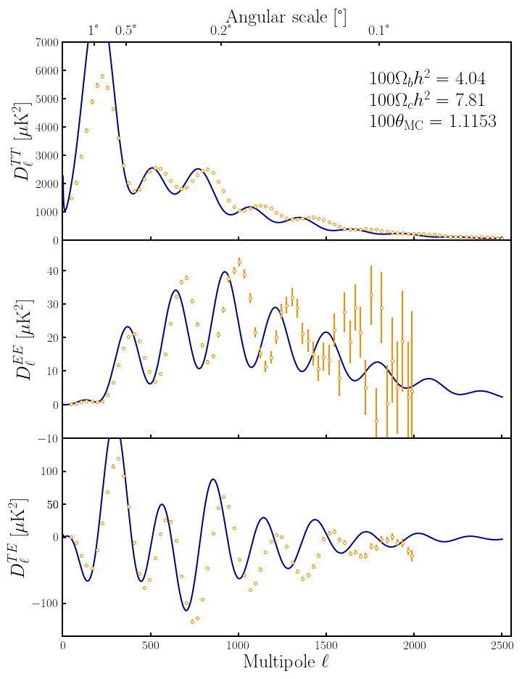
CMB animation

Slide 4
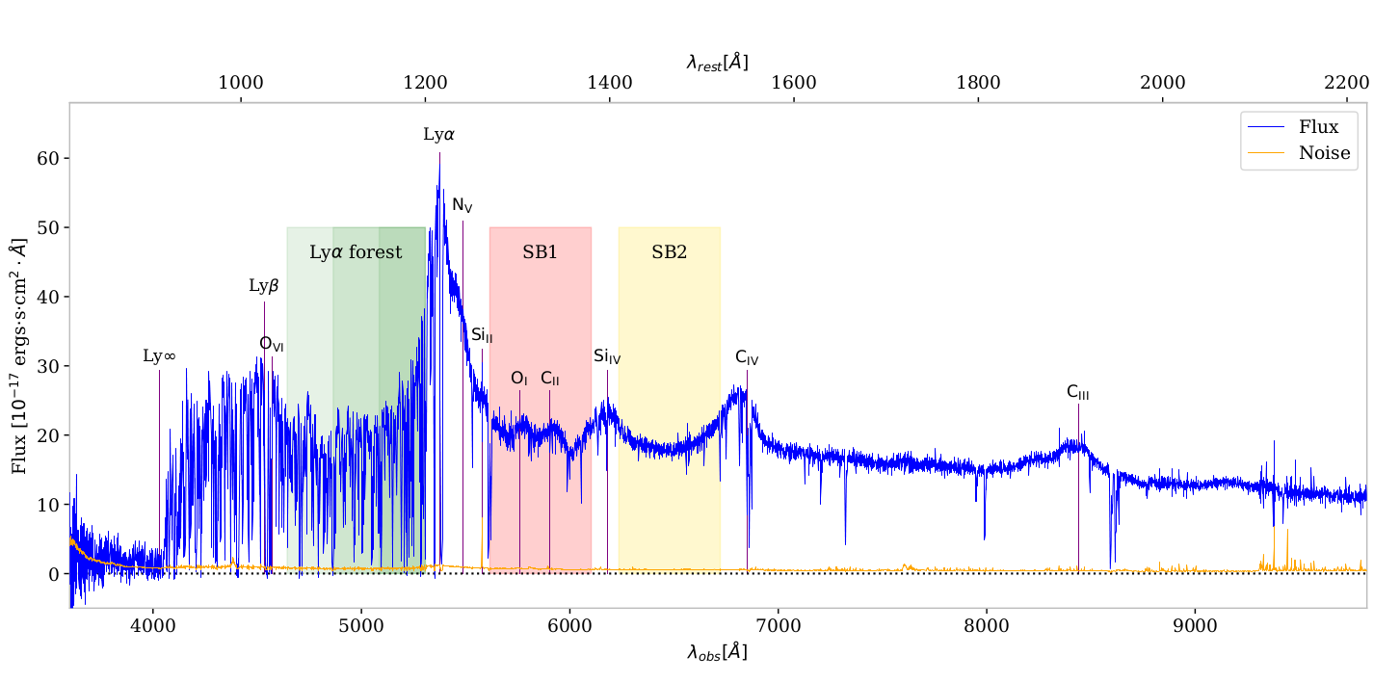
QSO spectra from DESI instrument at z=3.42
Lyman alpha forest video:
https://www.youtube.com/watch?v=6Bn7Ka0Tjjw

