Slide 1
Course content
Topics (lectures):
Introduction to the cell (1-3)
Biological membranes (4-5)
Proteins (6-7)
Dynamics (8-9)
Genomes (10-12)
Course structure:
Introduction to systems and concepts
Description of observations and measurements
Estimates of relevant numbers / development of quantitative models
Analysis of research articles

Slide 2
Lecture 4: Biological membranes
Goal: Calculate energy cost for bending membranes away from their equilibrium configurations
The nature of biological membranes (descriptive)
On the springiness of membranes (model)
Structure, energetics, and function of vesicles (example)
PBOC Chapter 11.1, 11.2

Slide 3
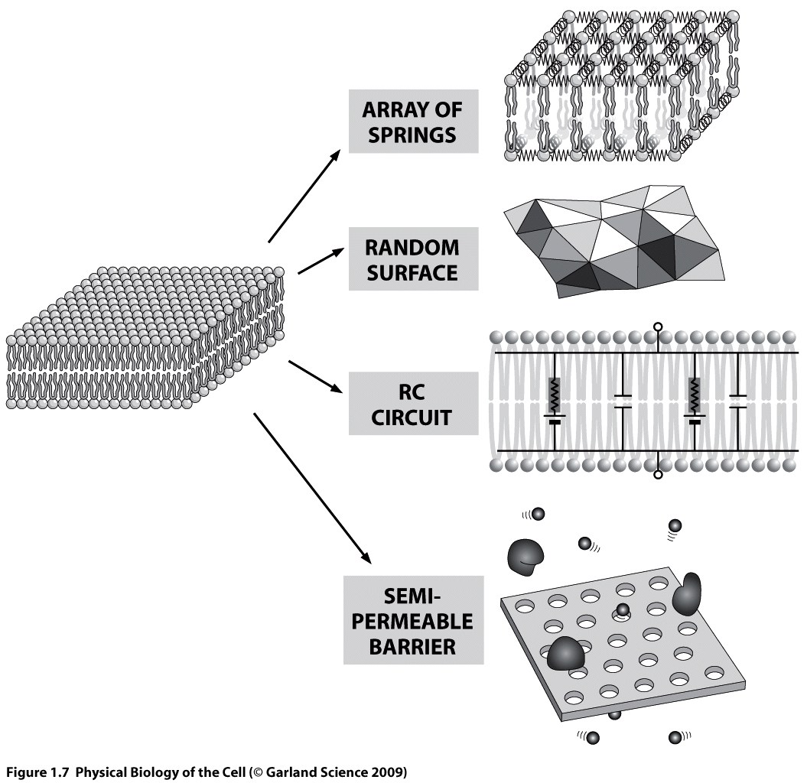
Biological membranes
Lecture 4, 5
Lecture 7

Slide 4
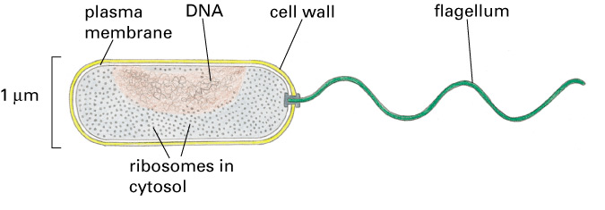
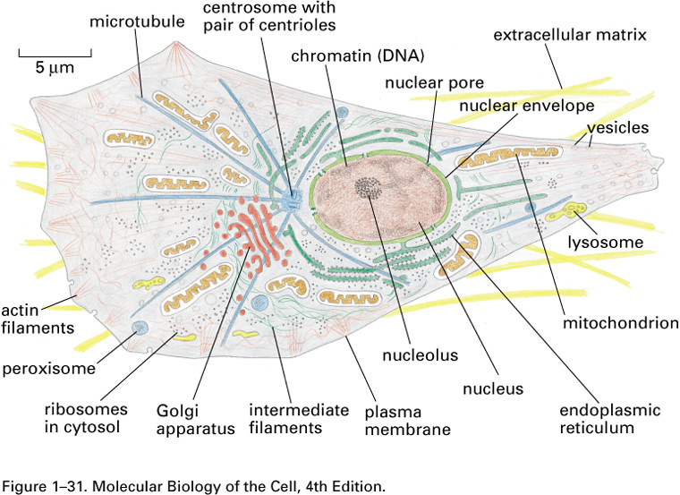
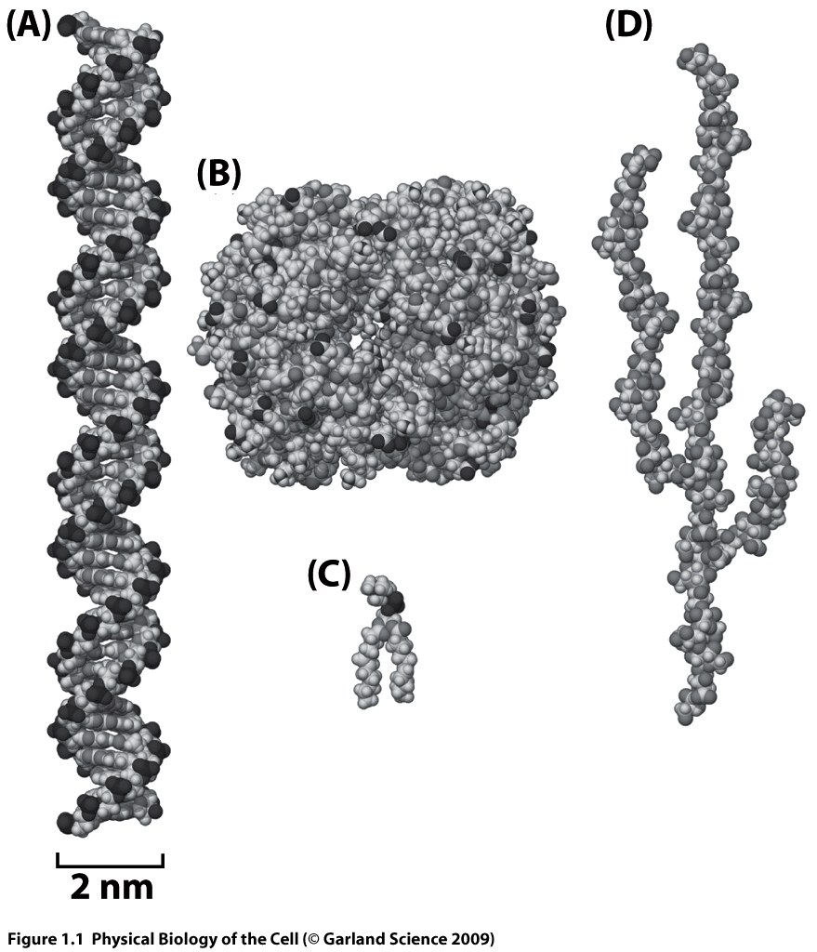
Basic facts about cells
Prokaryotes and Eukaryotes
Previously:
Notes:
Membranes are a critical part of all forms of life on Earth because they separate
the cellular contents from the external world, maintaining vast differences
in chemical composition between a cell and its surroundings. At the same time,
membranes must enable the passage of critical nutrients into the cell and the
passage of waste products out. They must also be physically flexible to enable
cells to grow or otherwise change shape and they must have malleable topologies,
for example, such that a single cell can divide into two such that each
have a completely closed, contiguous membrane. Membranes in biological systems
have balanced these multiple demands by exploiting the special physical
properties of the molecules that make them up.

Slide 5
Basic facts about cells
Prokaryotes and Eukaryotes
Previously:
Notes:
Membranes are a critical part of all forms of life on Earth because they separate
the cellular contents from the external world, maintaining vast differences
in chemical composition between a cell and its surroundings. At the same time,
membranes must enable the passage of critical nutrients into the cell and the
passage of waste products out. They must also be physically flexible to enable
cells to grow or otherwise change shape and they must have malleable topologies,
for example, such that a single cell can divide into two such that each
have a completely closed, contiguous membrane. Membranes in biological systems
have balanced these multiple demands by exploiting the special physical
properties of the molecules that make them up.

Slide 6
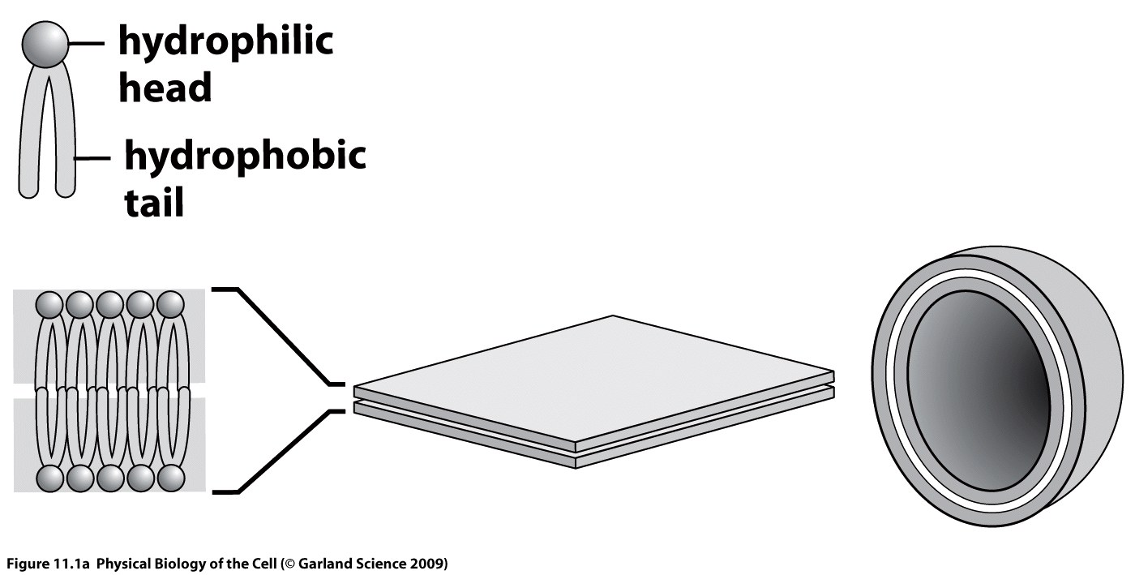
The nature of biological membranes
Lipid molecules
Notes:
The primary constituent of any biological membrane must be a molecule
with two physically separated subdomains, one part of which is hydrophilic
(able to form hydrogen bonds with water) and one part of which is hydrophobic.
The most common membrane constituent is a lipid molecule as illustrated
in fig. 11.1(A). The nearly cylindrical shape of most membrane lipids makes
the bilayer the most common geometrical organization for spontaneous self-assembly
of lipid molecules in water. When lipid molecules are present in water
at a sufficiently high concentration, they will spontaneously organize into structures
with the hydrophobic tails sequestered such as in the bilayered plasma
membrane that surrounds living cells.
One spontaneous arrangement of these molecules consists
of a bilayer, two molecules thick, where all the head groups are arranged on the
two surfaces and the tails span the space in between. Membrane bilayers of this
kind can be extremely large. In order to avoid edge effects, it is common for
bilayers to form closed structures such as the sphere shown here. (B)
How do we know the lipids in cells form bilayers?

Slide 7
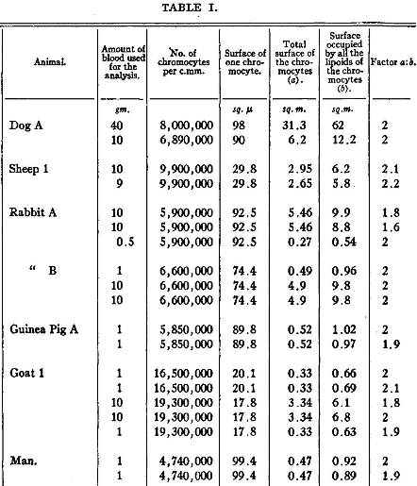
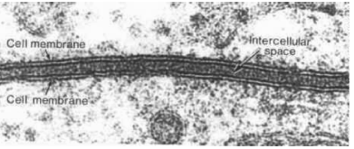
The nature of biological membranes
Lipid bilayers
1958
1924
Gorter & Grendel
Notes:
First EM in 1930s. First EM of cell membranes showing bilayer 1958.
Clever experiments in 1920s to figure out structure of cell membrane. Prof. Dr. Evert Gorter (1881–1954) and F. Grendel of Leiden University approached the problem from a different perspective, spreading the erythrocyte lipids as a monolayer on a Langmuir-Blodgett trough. When they compared the area of the monolayer to the surface area of the cells, they found a ratio of two to one.
sheet-like structure, two molecules thick (6-10 nm), non-covalent (self assembles)
...the chromocytes [erythrocytes] of different animals are covered by a layer of lipoids
[lipids] just two molecules thick...every chromocyte is surrounded by a layer of lipoids,
of which the polar groups are directed to the inside and to the outside [of the cell] in
much the same way as Bragg (1) supposes the molecules to be oriented in a 'crystal' of a
fatty acid, and as the molecules of a soap bubble are according to Perrin (2). On the
boundary of the two phases, one being the watery solution of hemoglobin, and the other the
plasma, such an orientation seems a priori to be the most probable one.(Gorter and
Grendel, 1925, p.439)

Slide 8
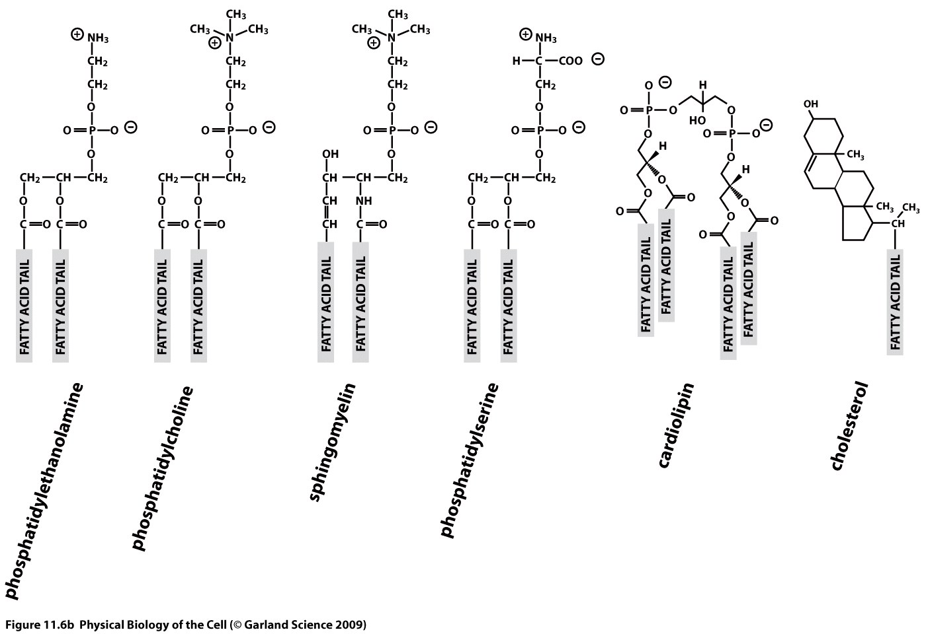
The nature of biological membranes
Lipid species
Notes:
molecular structures share an elongated hydrophobic domain, usually
made up of fatty acid tails, associated with a hydrophilic headgroup. The
hydrophilic headgroups are easily incorporated in the hydrogen bonding network
of the surrounding waters. In contrast, the hydrophobic tails are generally
obliged to be sequestered from contact with water, and typically form bilayers.
The conflicting relationships between different regions of lipid molecules and
water has resulted in the designation of such molecules as amphipathic which
signifies their love-hate relationship with water. There is a great diversity of
molecular structures for both the hydrophilic and hydrophobic domains, but
this common overall organization allows different lipids to happily assemble
together to form mixed membranes.
Cholesterol is dramatically different in structure (see fig. 11.5(C)). The hydrophobic
portion consists of a rigid planar array of four rings and the headgroup
is just a tiny (polar) hydroxyl. Animal cell membranes found in different organelles and
different cell types mix together glycerol-based phospholipids, sphingolipids and
cholesterol in varying proportions which gives the membranes very different
physical properties including fluidity and microdomain structure. The concentration
of different lipids in various organellar membranes for a single kind of
animal cell is shown in fig. 11.6.
saturated indicates that the maximum possible number of hydrogen atoms are bonded to each carbon in the molecule

Slide 9
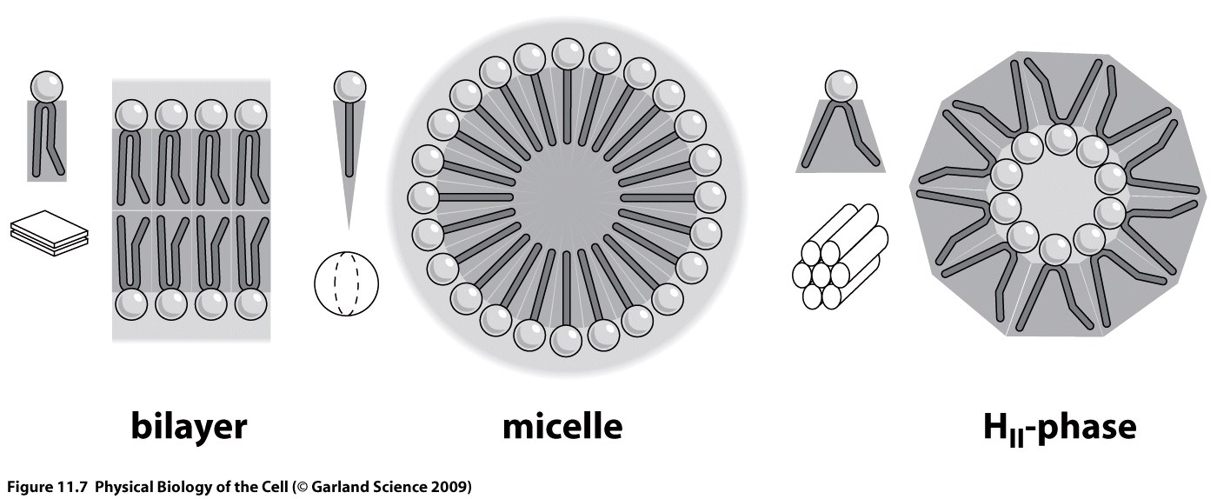
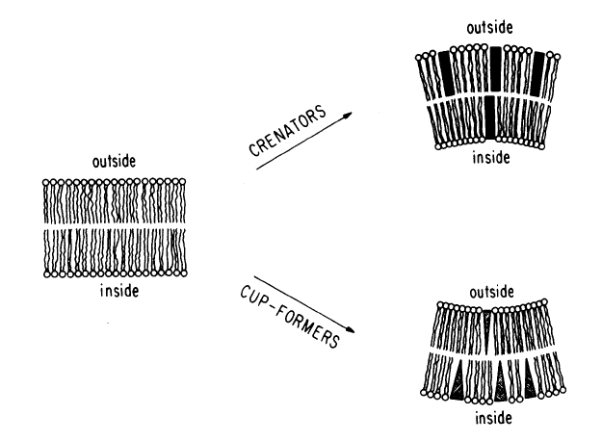
The nature of biological membranes
Lipid shape and self-assembly
Notes:
Geometrical shape of lipids. This figure shows a coarse-grained
representation of lipid geometries that is useful in developing intuition for the
spontaneous curvature induced by different lipid types. The small insets show
the kinds of three dimensional geometries adopted by these lipids.
Crenators intercalate preferentially into the exterior half of the bilayer,
causing it to expand relative to the cytoplasmic half, thereby
producing the observed crenation (. Cup-formers do the opposite.

Slide 10
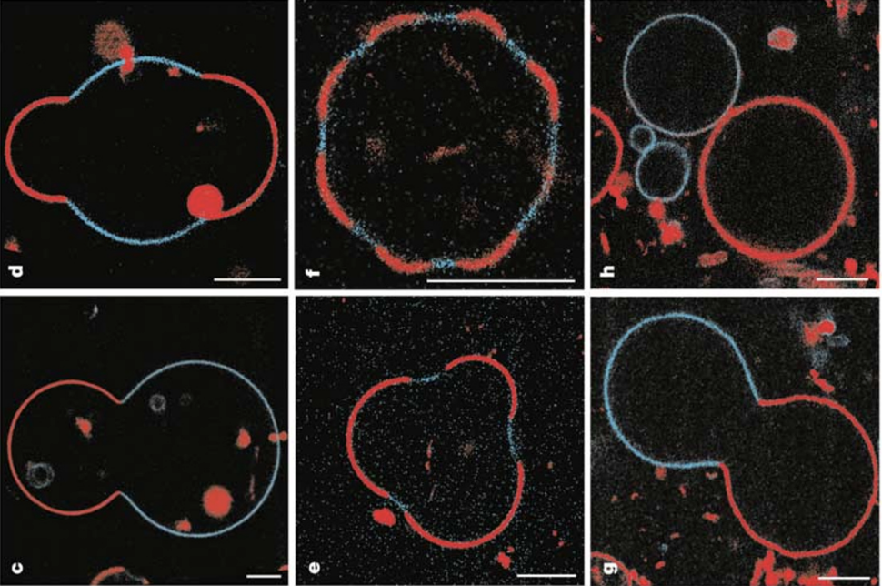
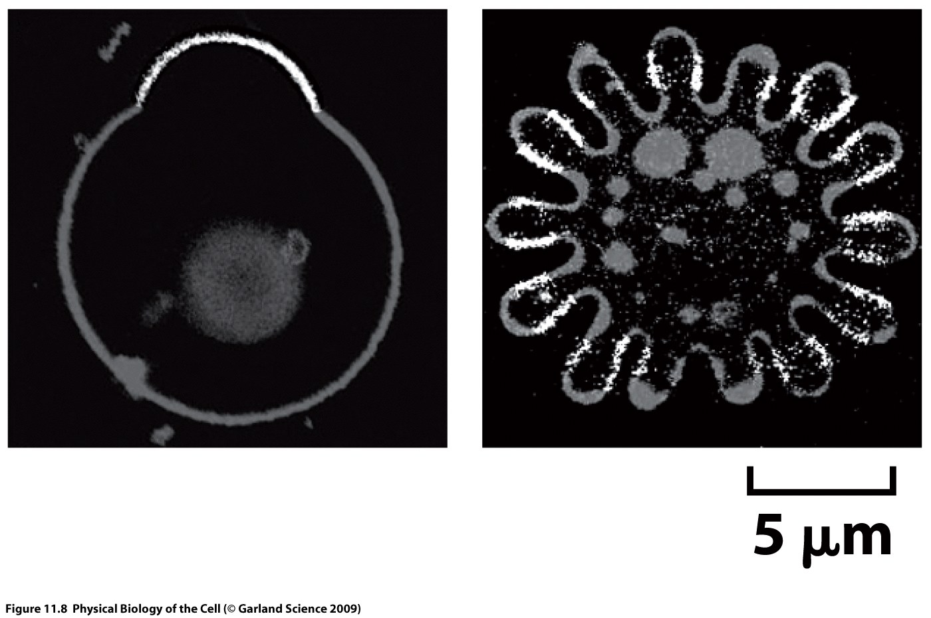
The nature of biological membranes
Lipid phase separation and membrane curvature
Notes:
membranes containing multiple
types of lipids that tend to mix non-ideally can have a complex organization in
which structurally compatible lipids assemble into microdomains.
When two or more lipids with different geometries must coexist in a single
structure they sometimes tend to segregate into separate domains. Under some
conditions, this spontaneous segregation can induce the generation of complex
vesicle geometries where different domains have different curvatures as shown
in fig. 11.8. Inside of cells, this kind of lipid heterogeneity together with the
influence of membrane-associated proteins as discussed below can contribute to
formation of elaborate intracellular membrane systems.
Structures of multicomponent vesicles. Vesicles made of more than
one species of lipid give rise to structures with complex geometries. Different
lipid species are labeled with different fluorescent dyes, shown here in different
shades of gray. On the left, a vesicle made up of a lipid tending to produce
sheets with low intrinsic curvature (dark) and another tending to high intrinsic
curvature (light) has spontaneously segregated into two domains. On the right,
a similar two-component vesicle has formed a much more complicated shape,
again segregating regions of low intrinsic curvature (light) from high (dark).
(Adapted from T. Baumgart et al., Nature, 425:821, 2003.)

Slide 11
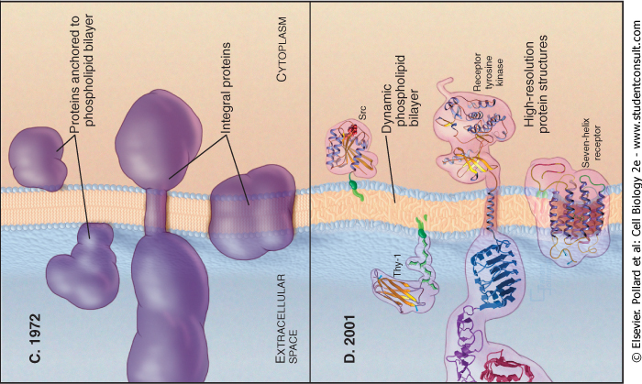
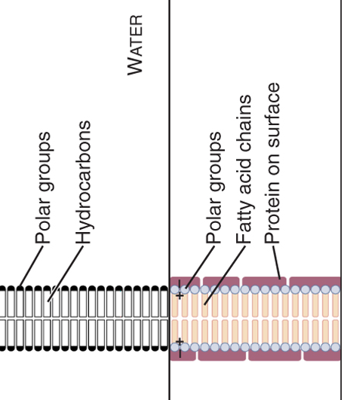
The nature of biological membranes
Structure of biological membranes
Notes:
The starting point for thinking about membrane organization is that its
shape is dictated by the physical properties of the two layers of phospholipids
that make up the lipid bilayer. This lipid bilayer is two lipid molecules thick,
riddled with a dazzling array of membrane proteins. Fig. 11.4 shows several
generations of models for cell membrane structure. The fluid mosaic model of
Singer and Nicolson (1972) envisioned a lipid bilayer as a two-dimensional fluid
in which embedded membrane proteins were able to easily move laterally in the
plane of the membrane, but could not move out of the plane. Later versions of
this model acknowledged the fact that there is a great deal of structural heterogeneity
within the lipid bilayer.

Slide 12
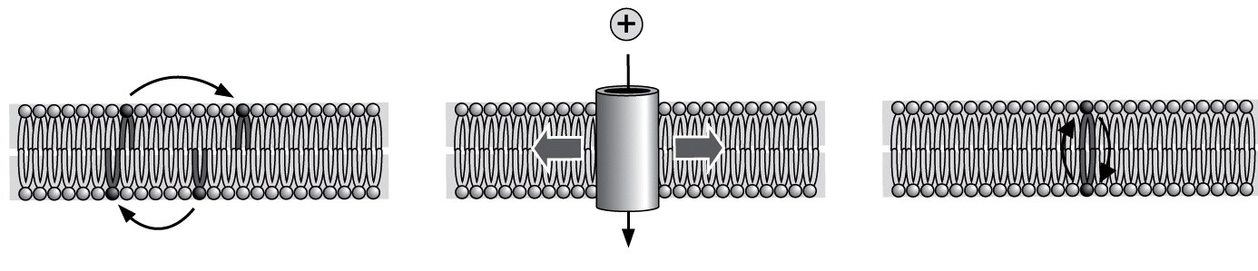
The nature of biological membranes
Biological membranes are fluidlike in-plane
Notes:
Within
the lipid bilayer, individual molecules can move in several ways. Lipid molecules
may spontaneously diffuse laterally within each of the two leaflets within the
bilayer. Protein molecules embedded in the bilayer may also diffuse laterally,
and in addition, some interesting membrane proteins may undergo conformational
changes that open selective channels, for example, to allow the passage
of charged ions across the hydrophobic barrier. At a very slow spontaneous
rate, individual lipids may flip over from one leaflet to the other. This process
of flipping may be sped up by certain membrane proteins called flippases.
The hydrophobic barrier
also makes it an extremely slow process for a single lipid molecule to flip from
one leaflet of the bilayer to the other since this would require its hydrophilic head
group to pass through the hydrophobic region. In contrast, lateral movements
of lipids within a single leaflet can be very fast, essentially diffusive.

Slide 13
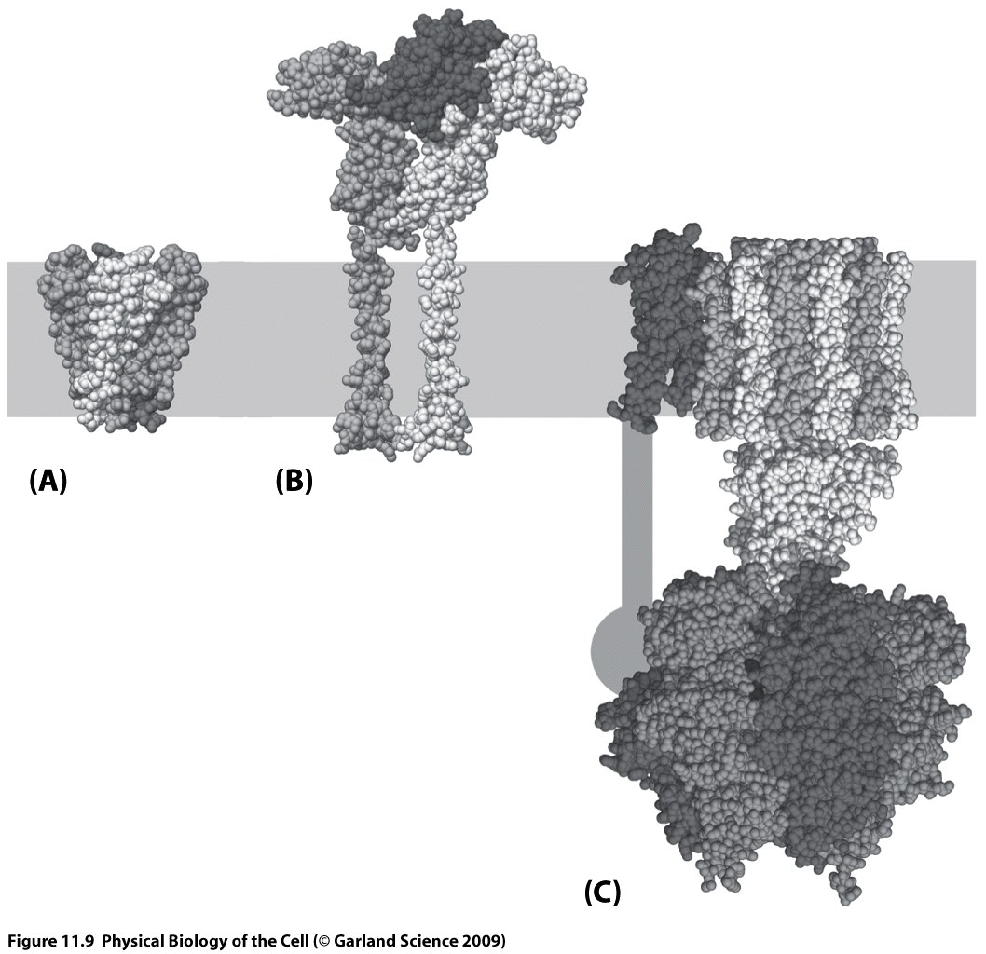
The nature of biological membranes
Transmembrane proteins
Notes:
Despite the
extreme thinness of these membranes, the hydrophobic region between the pairs
of head groups nevertheless forms a formidable barrier against diffusion of any
hydrophilic molecule. Passage of a hydrophilic molecule, such as an ion or an
amino acid nutrient, requires the activity of particular proteins embedded in the
bilayer that can serve as selective channels or pumps.
Examples of various membrane proteins which are responsible for
the flow of information and material across membranes. (A) Potassium channel,
(B) growth hormone receptor, and (C) ATP synthase.
one of the most biologically important classes of membrane proteins
are the transporters that facilitate the movement of these molecules across
membranes. Some of these transporter proteins act as channels that selectively
increase the permeability for a molecule to move down its concentration gradient.
In many cases, these channels are gated to open only when a certain signal
is received in the form of a ligand binding or a change in transmembrane voltage.
An example of this is the potassium channel shown in fig. 11.9(A). An even
more interesting type of transporter uses the cell energy to actively transport
a small molecule up its concentration gradient. These active transporters (or
pumps) are used by cells to accumulate nutrients from the environment such as
sugars and amino acids, and play a critical role in establishing large concentration
gradients of ions such as K+, Na+ and H+. A particularly important class
of these proteins are those that pump ions across membranes using the energy
resulting from the absorption of a photon of light. This is the initial event in
photosynthesis, and is ultimately the energy source for almost the entire web
of life on the surface of planet Earth. Cells can use ion concentration gradients
established by transporters and pumps in many ways, for example, to drive yet
more transport processes, to generate ATP, and in cells such as neurons, to
generate electrical signals.

Slide 14
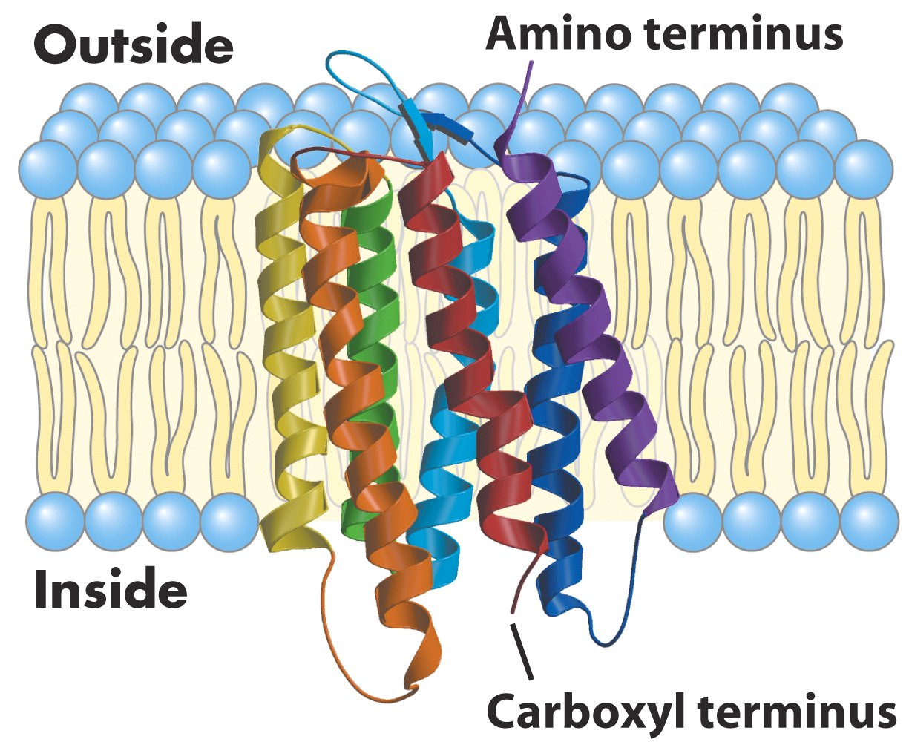
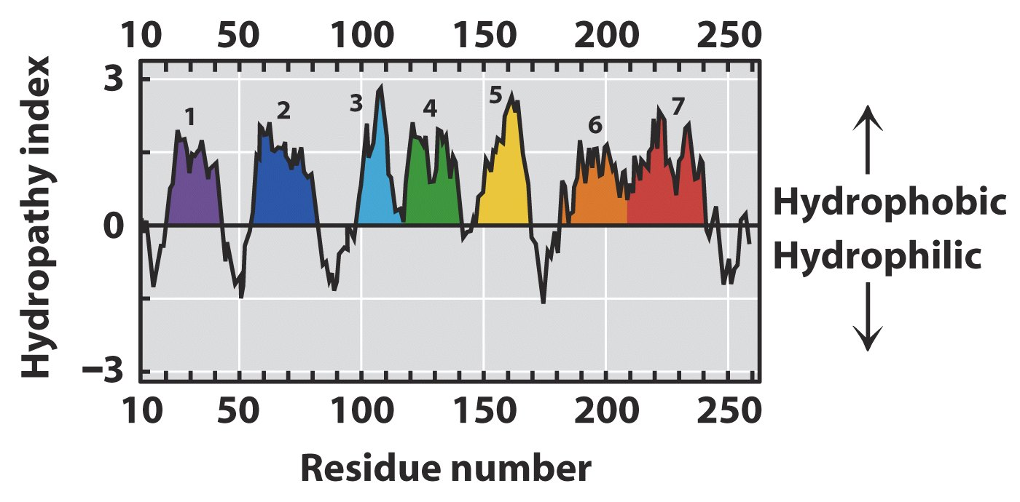
The nature of biological membranes
Transmembrane proteins
7 helices connected by hydrophilic loops

Slide 15
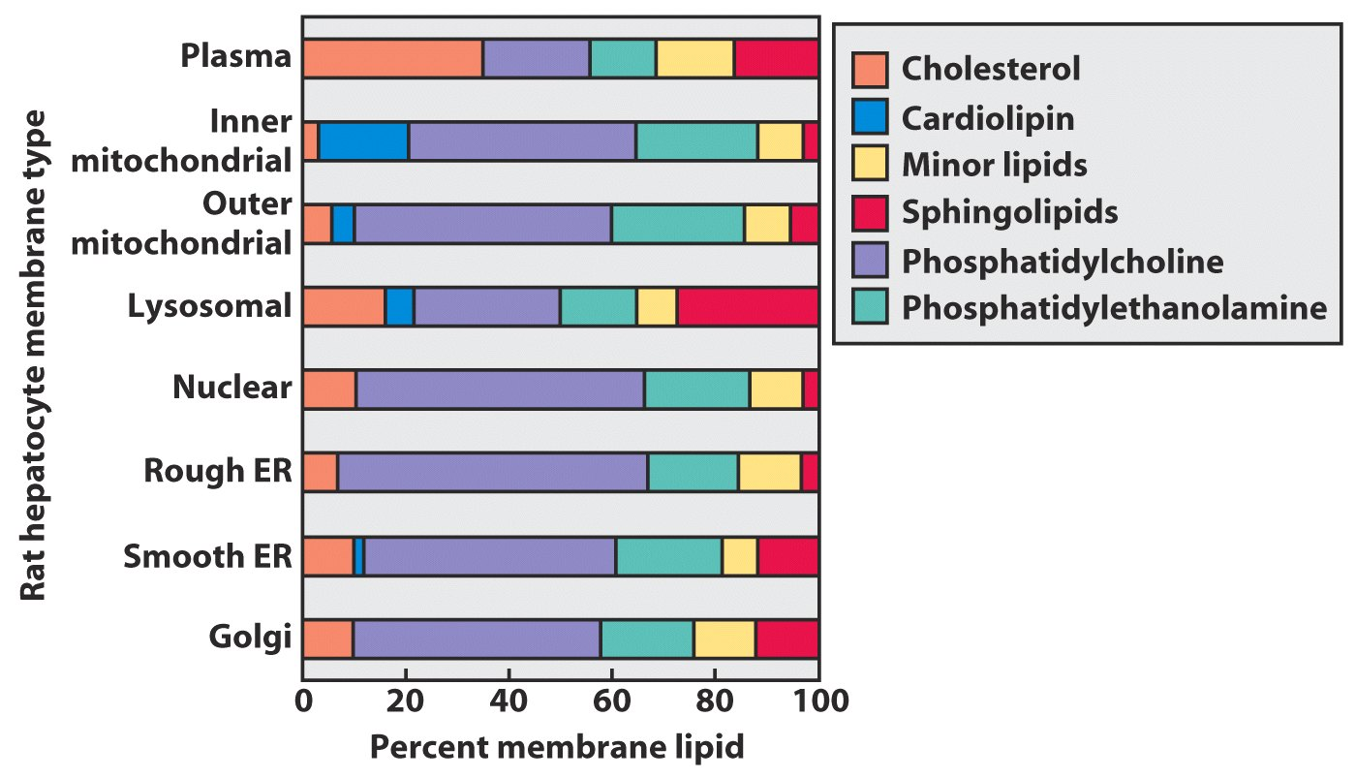
The nature of biological membranes
Lipid composition of organelles

Slide 16
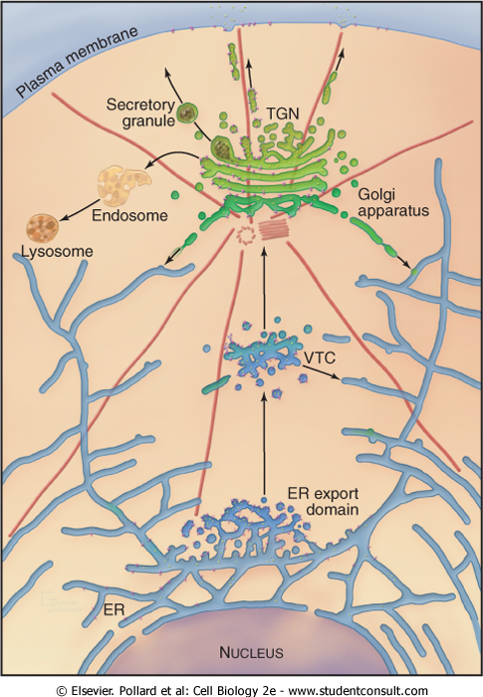
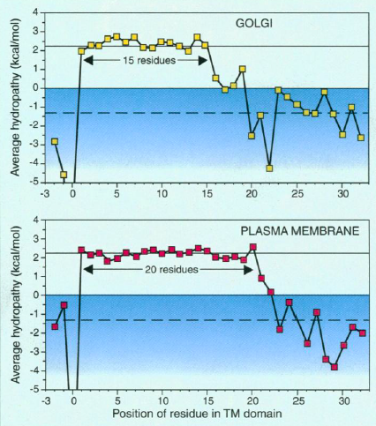
The nature of biological membranes
Transmembrane proteins
Notes:
Along similar
lines, membrane proteins can generate local order in the lipids that surround
them and lipid domains can strongly influence protein organization.

Slide 17
Lecture 4: Biological membranes
Summary
Notes:
Membranes are composed of lipids and proteins
Membranes can self-assemble through hydrophobic interactions, which lower the free energy of the system
Additional organization comes from proteins and demixing of lipid types
Proteins in membranes can form channels to transport molecules and ions across

Slide 18
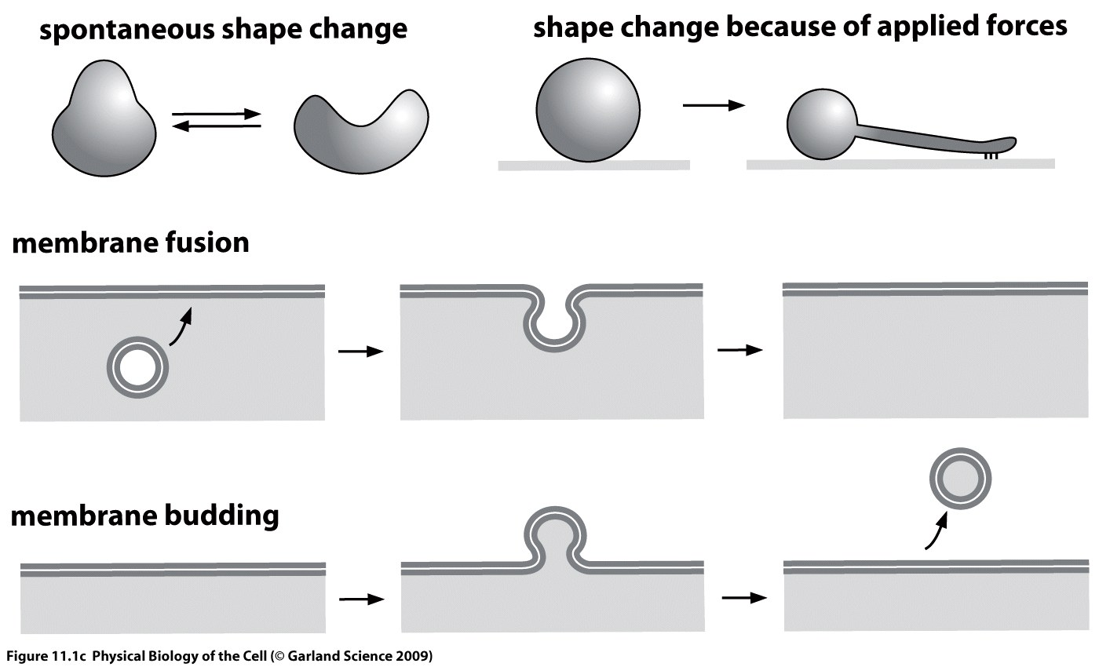
The springiness of biological membranes
Membrane shape changes
Notes:
Membrane shape changes associated with biological function. All membranes
undergo spontaneous shape changes and fluctuations due to thermal energy.
Application of external forces, for example by molecular motor proteins, can
further deform equilibrium membrane shapes. A common geometry is the extrusion
of a tube. Membranes may also undergo fusion and fission (or budding)
to change their topology.

Slide 19
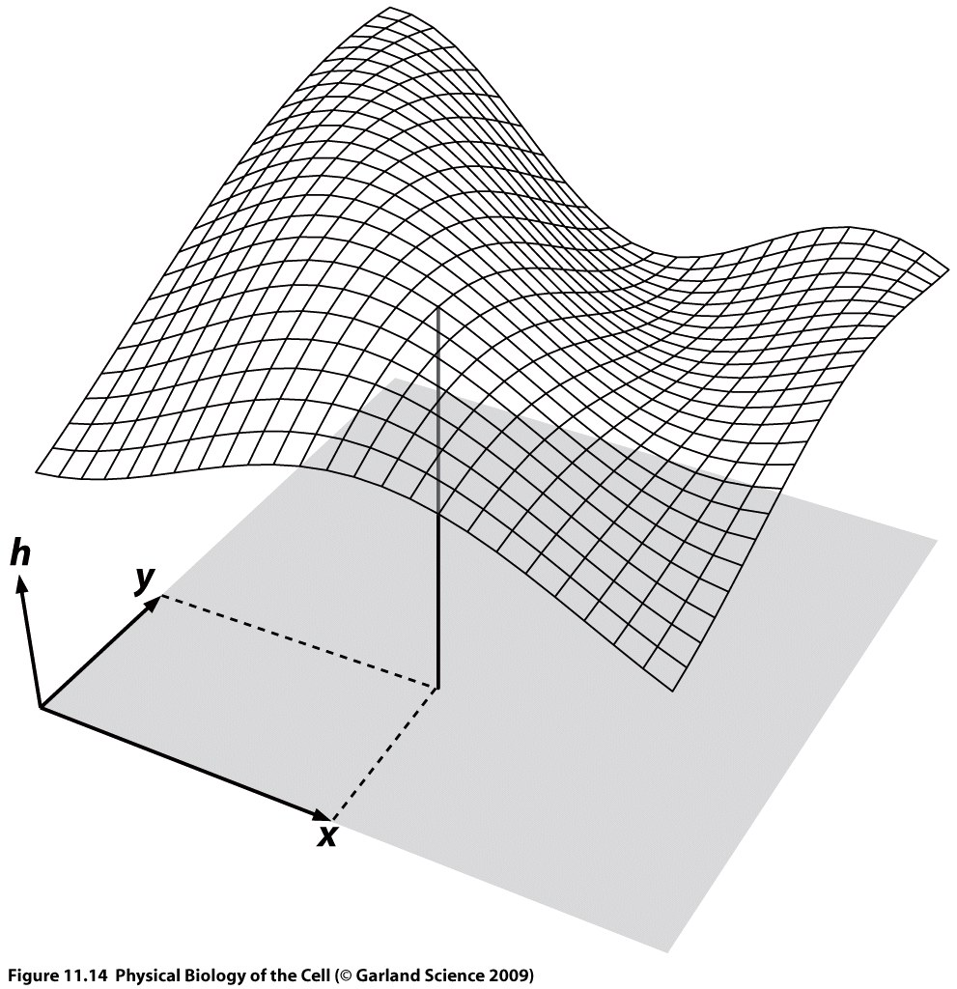
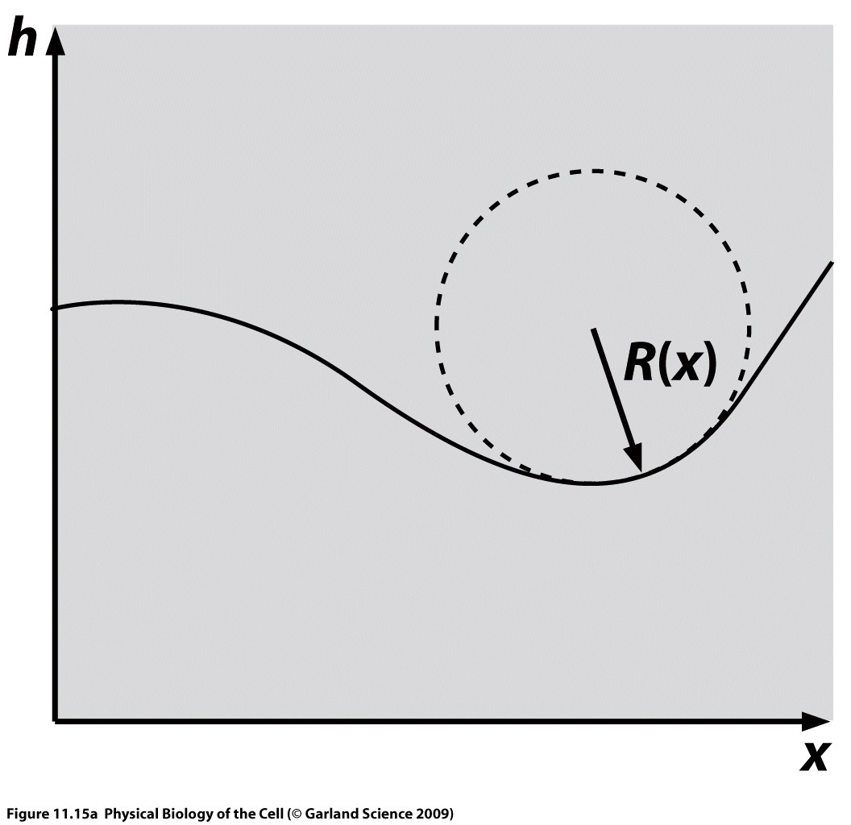
The springiness of biological membranes
Membrane shape
Notes:
Assumption: flat membrane has minimum energy.
h=constant
Curvature: 1/R

Slide 20
The springiness of biological membranes
Membrane shape: Curvature
Plane
shapes
principal curvatures
Notes:
k1 0 1/R 0 -1/R1
k2 0 1/R 1/R 1/R2

Slide 21
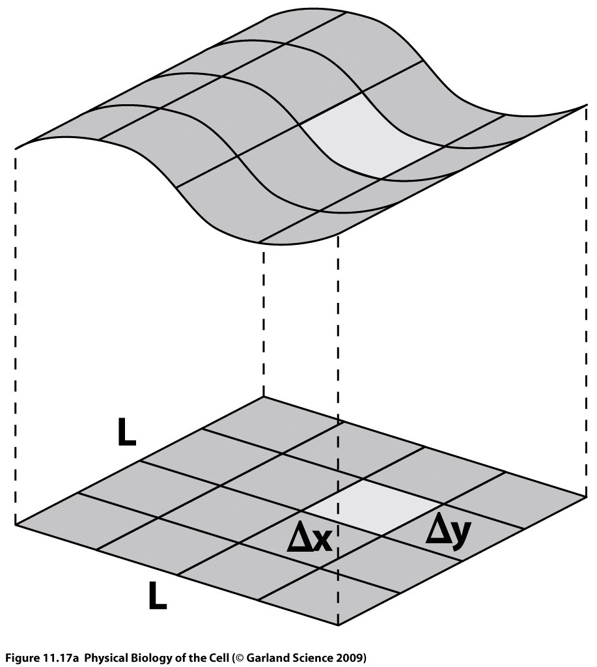
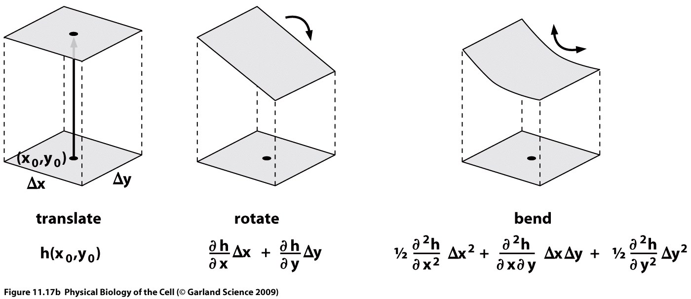
The springiness of biological membranes
Membrane shape: Taylor expansion
Notes:
h(x,y)
curvature matrix

Slide 22
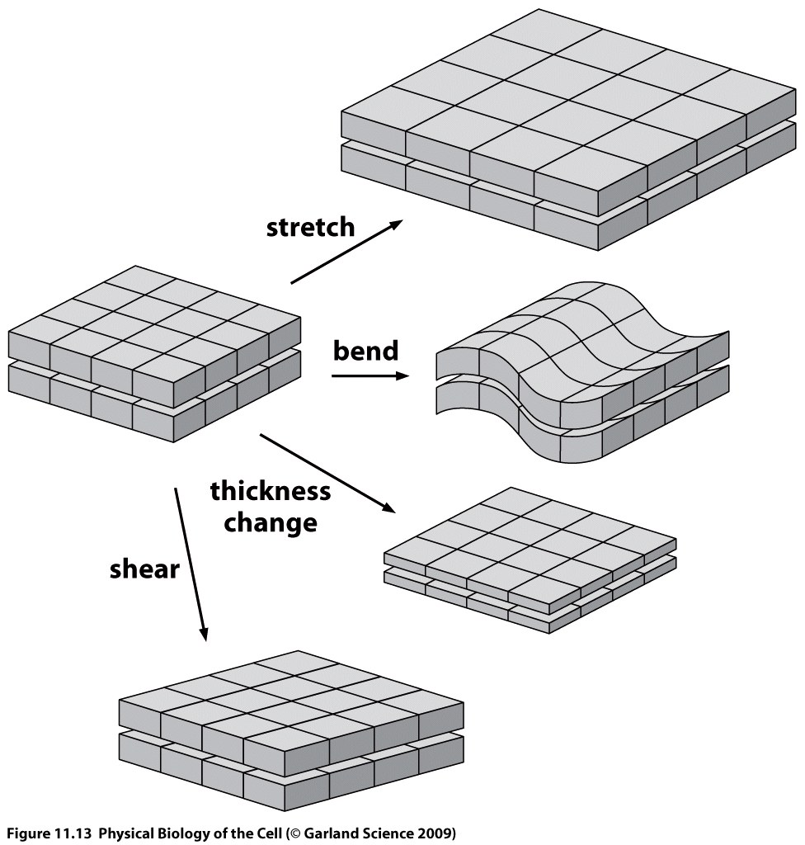
The springiness of biological membranes
Membrane elasticity
Notes:
From a mechanical perspective, the defining feature of these membranes is
their extremely tiny aspect ratio, with their lateral dimensions typically orders
of magnitude larger than their thickness of only 5 nm. As a result, the elastic
models that we will use to examine membrane deformation are two-dimensional
and emphasize the stretching and bending of the planar sheet.
Our approach
will be to develop the simplest elasticity theory that captures the energy of the
various kinds of membrane deformation. Materials are
often conveniently described without reference to the underlying discreteness of
matter by using continuum elasticity theories, and our treatment of membranes
will be developed in that spirit. We will use the fact that the membrane thickness
is much smaller than the lateral extent of membranes in order to construct a
reduced dimensionality surrogate for the full three-dimensional elasticity.
To get
a sense geometrically for how such deformations work, we will repeatedly appeal
to the square patch of membrane

Slide 23
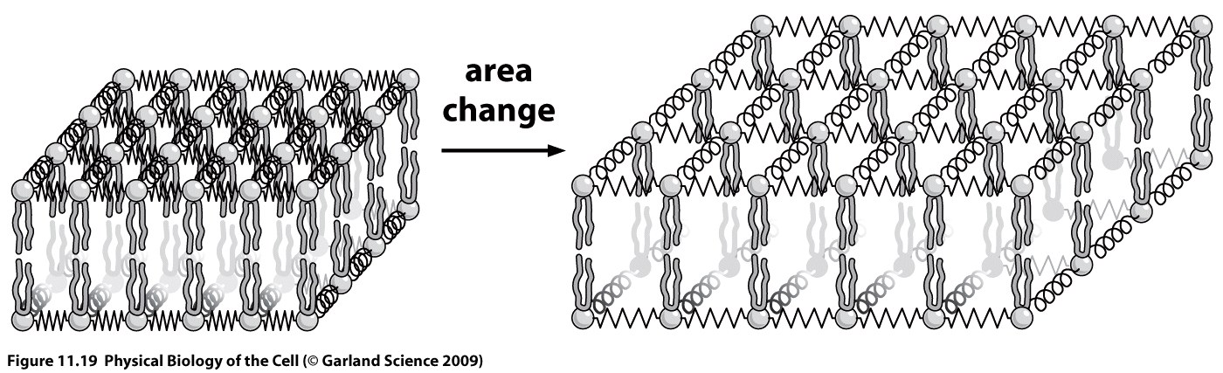
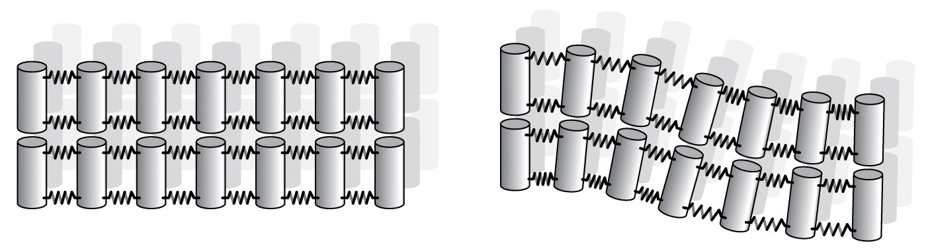
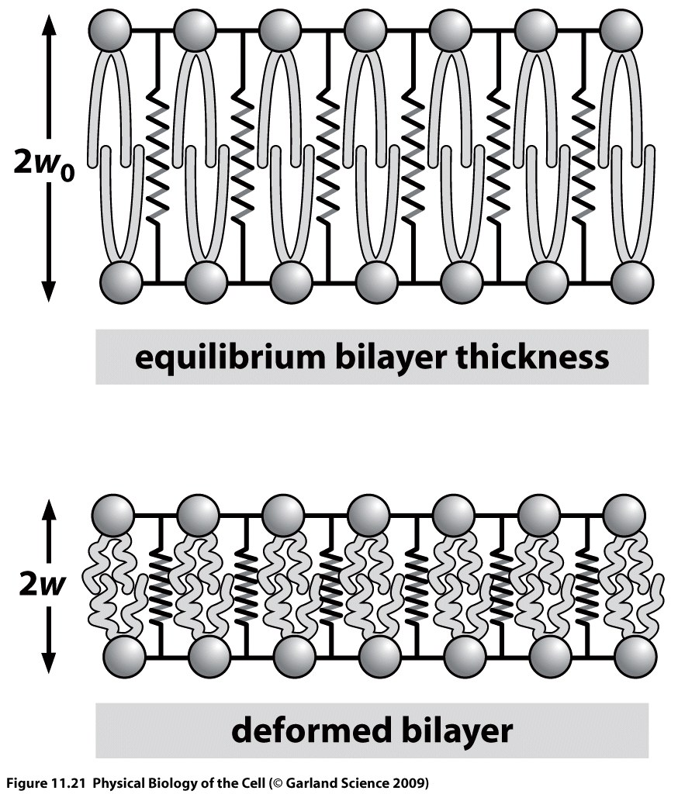
The springiness of biological membranes
Membrane elasticity

Slide 24
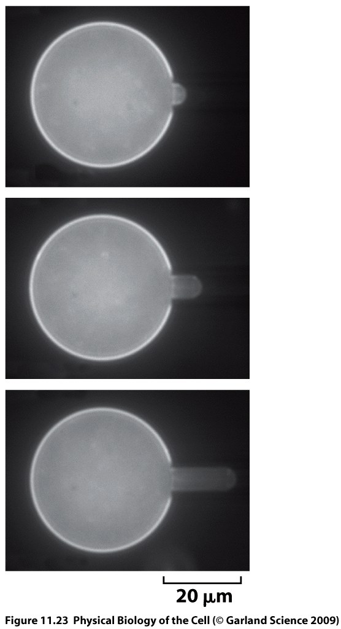
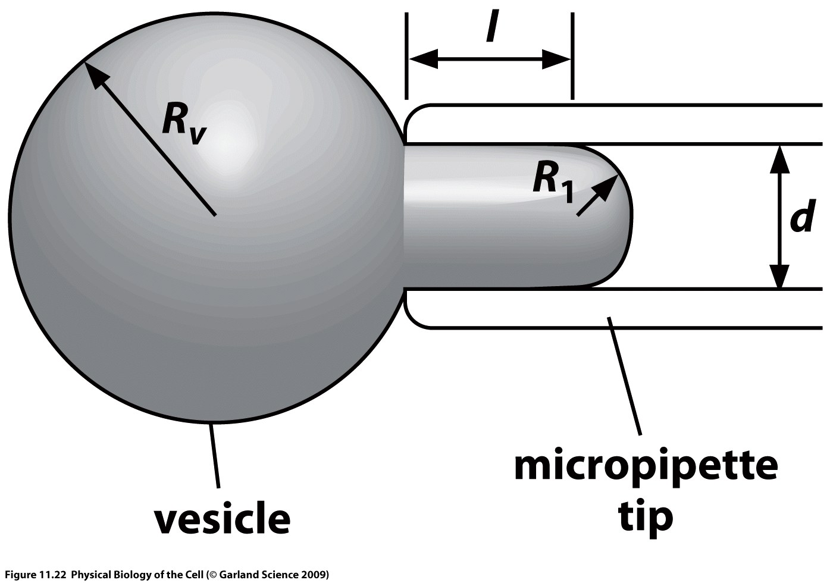
The springiness of biological membranes
Shape deformation model
Section 11.3.1

Slide 25
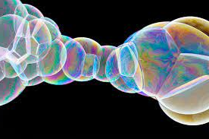
The springiness of biological membranes
Springiness of membranes
Notes:
soap bubbles

Slide 26
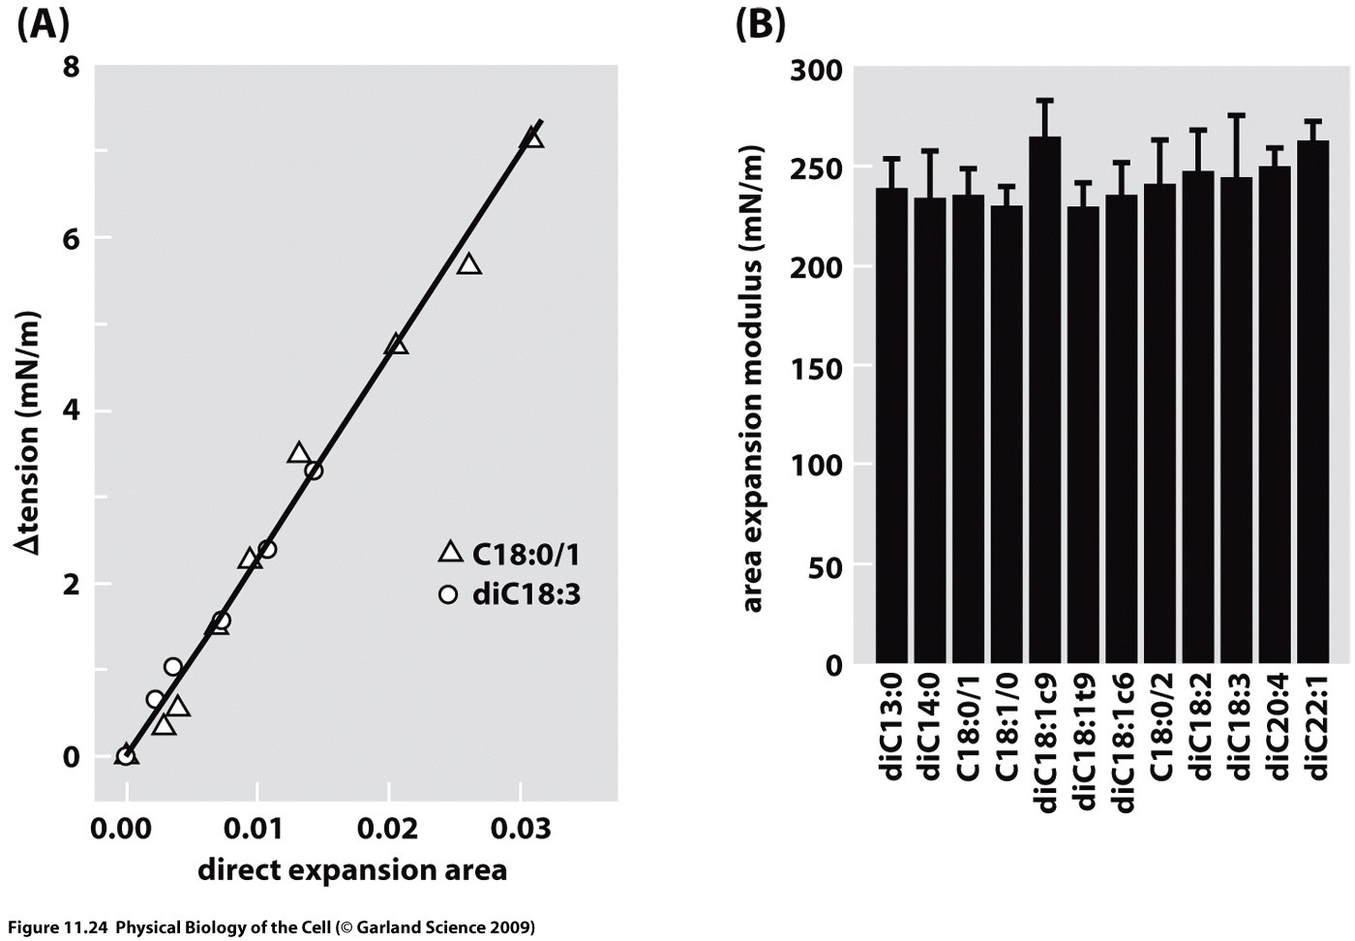
The springiness of biological membranes
Springiness of membranes
Notes:
Experimental data from a micropipette aspiration experiment.
(A) A series of tensions were applied by controlling the pipette pressure and
the associated tension and area were measured for each such pressure. The
slope of the graph is the area stretch modulus. (B) Measured values of the area
stretch modulus for different lipids.

Slide 27
Lecture 4: Biological membranes
Summary

Slide 28
Lecture 5: Biological membranes
Goal: Estimates and models of membrane shapes
Membrane pulling
Shapes of organelles
Shapes of cells
PBOC Chapter 11.3, 11.4

Slide 30
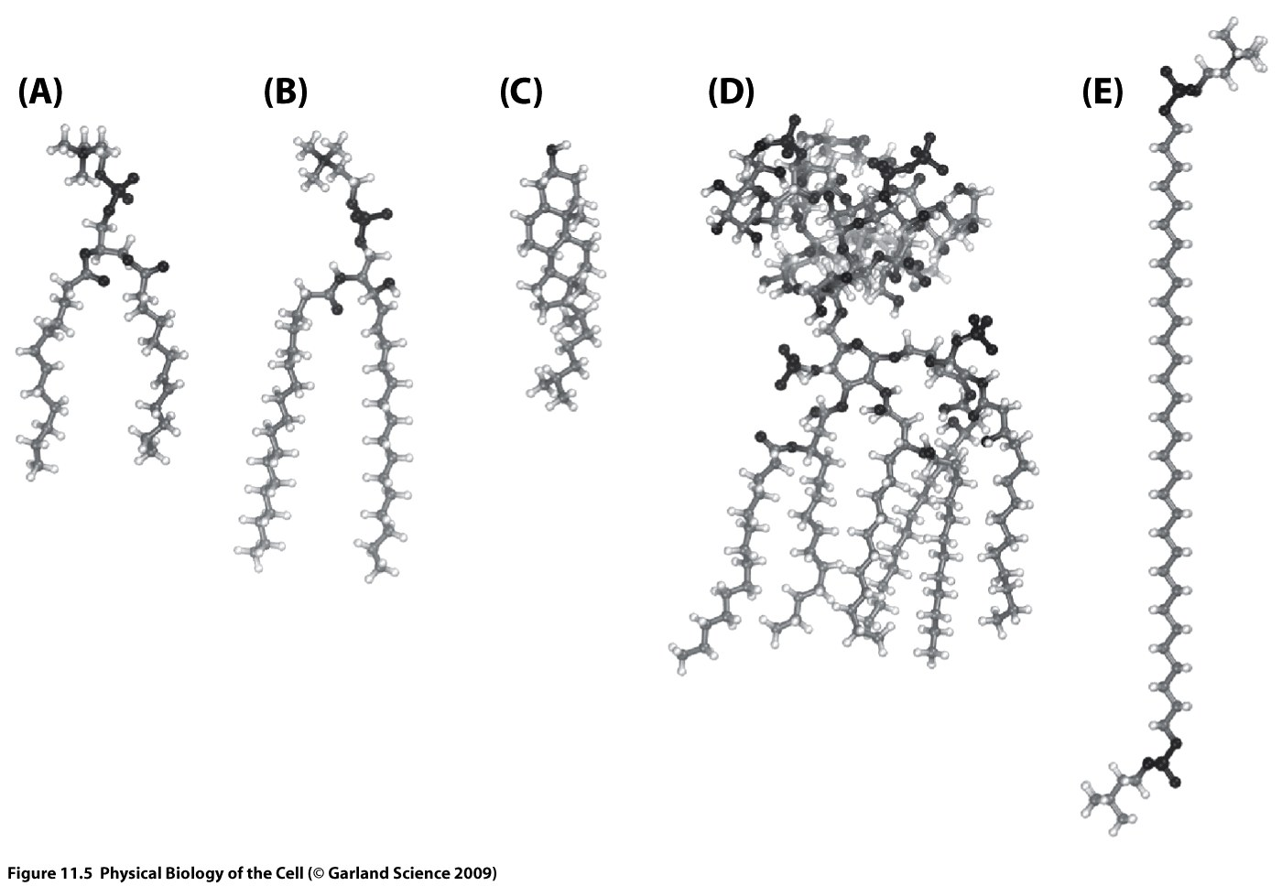
The nature of biological membranes
Cells and membranes

Slide 31
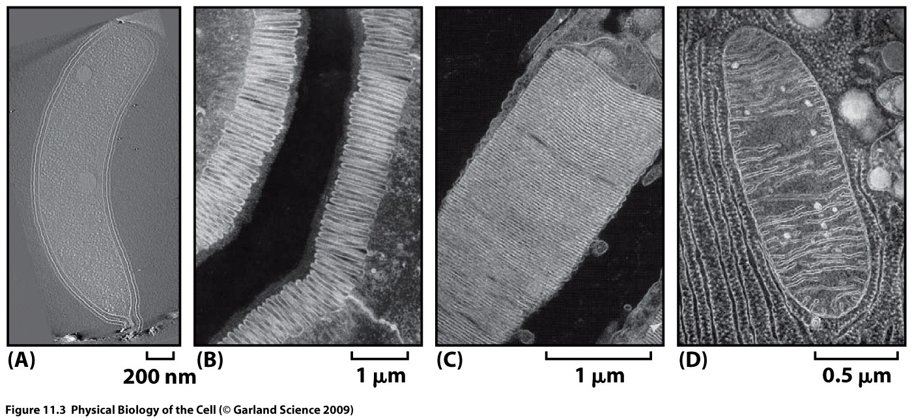
The nature of biological membranes
Cells and membranes
Notes:
contributors to free energy: energy and entropy
(C) Higher entropy in random fold, lower energy in folded state
(D) charge state of the protein reflects a competition between the entropy gained by permitting
charges to wander in solution and the corresponding energy cost associated with
removing those charges from their protein host
(E) entropy associated with free ligands and the energetic gain they garner as a result of being
bound to their protein host
(F) protein coexists in an
active and inactive form and where the relative probability of these states is dictated
by some external influence

Slide 32
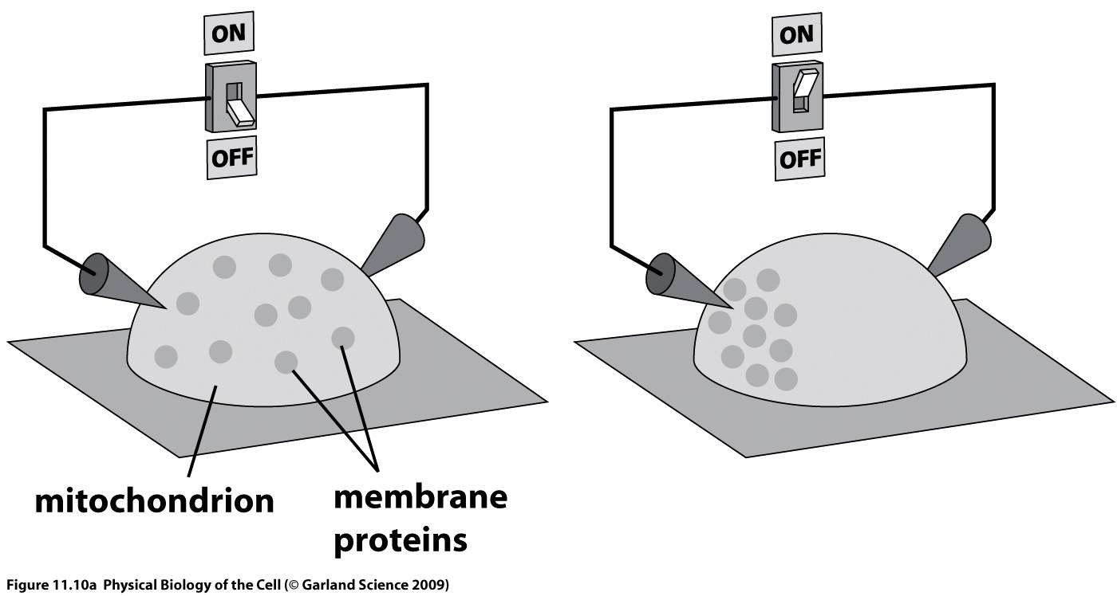
The nature of biological membranes
Biological membranes are fluidlike in-plane
Notes:
An experiment demonstrating mobility of proteins in the mitochondrial
membrane. (A) Isolated mitochondrial membranes were exposed to
an electric field. When the field is off, the proteins are uniformly distributed
on the mitochondrial surface. When the field is turned on, the membrane proteins
migrate preferentially to one pole. If the field is turned off, they return to
their uniformly distributed state in several seconds.

Slide 33
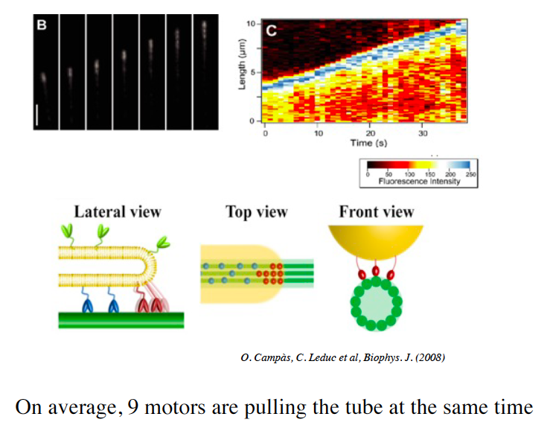
The springiness of biological membranes
Motors pull membranes
Notes:
contributors to free energy: energy and entropy
(C) Higher entropy in random fold, lower energy in folded state
(D) charge state of the protein reflects a competition between the entropy gained by permitting
charges to wander in solution and the corresponding energy cost associated with
removing those charges from their protein host
(E) entropy associated with free ligands and the energetic gain they garner as a result of being
bound to their protein host
(F) protein coexists in an
active and inactive form and where the relative probability of these states is dictated
by some external influence

Slide 34
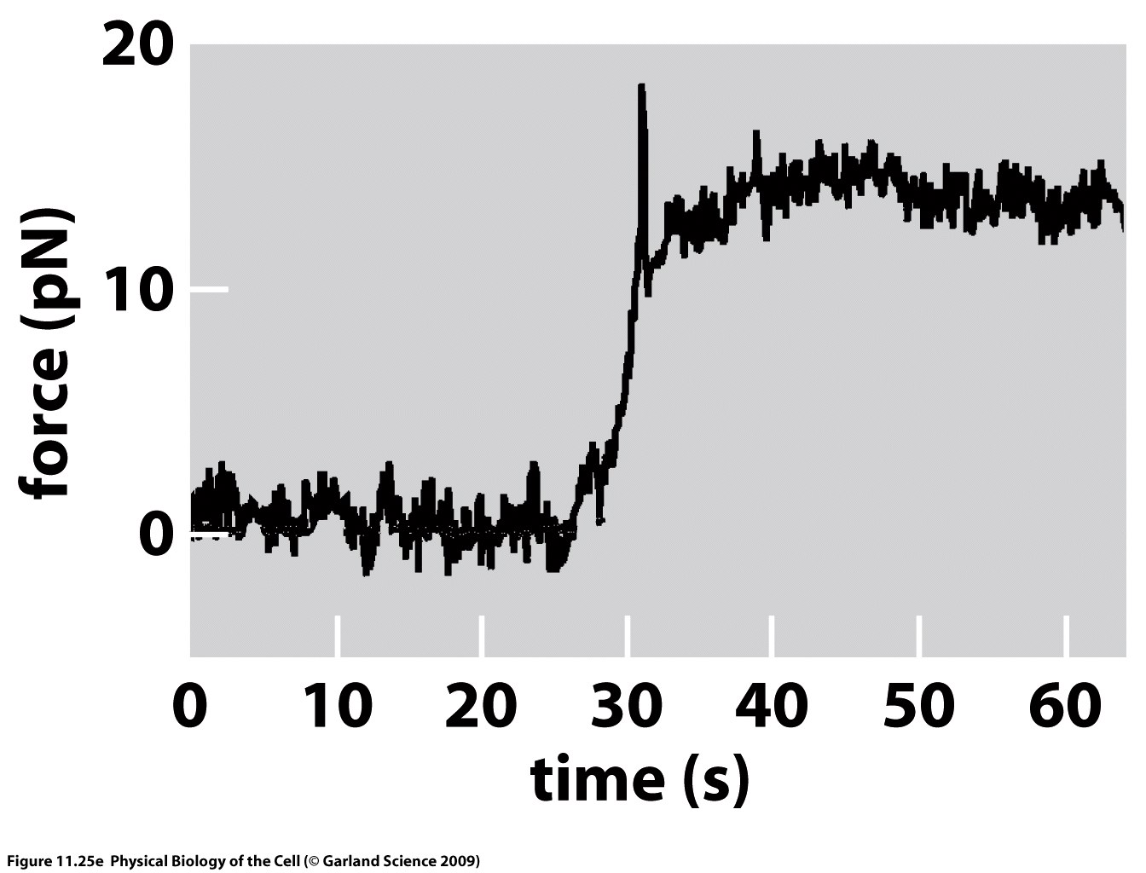
The springiness of biological membranes
Shape deformation model
What will happen if you use optical tweezers to pull on a bead attached to the membrane?
https://www.youtube.com/watch?v=8PZfglBI77A
Notes:
contributors to free energy: energy and entropy
(C) Higher entropy in random fold, lower energy in folded state
(D) charge state of the protein reflects a competition between the entropy gained by permitting
charges to wander in solution and the corresponding energy cost associated with
removing those charges from their protein host
(E) entropy associated with free ligands and the energetic gain they garner as a result of being
bound to their protein host
(F) protein coexists in an
active and inactive form and where the relative probability of these states is dictated
by some external influence

Slide 35
The springiness of biological membranes
Springiness of membranes

Slide 36
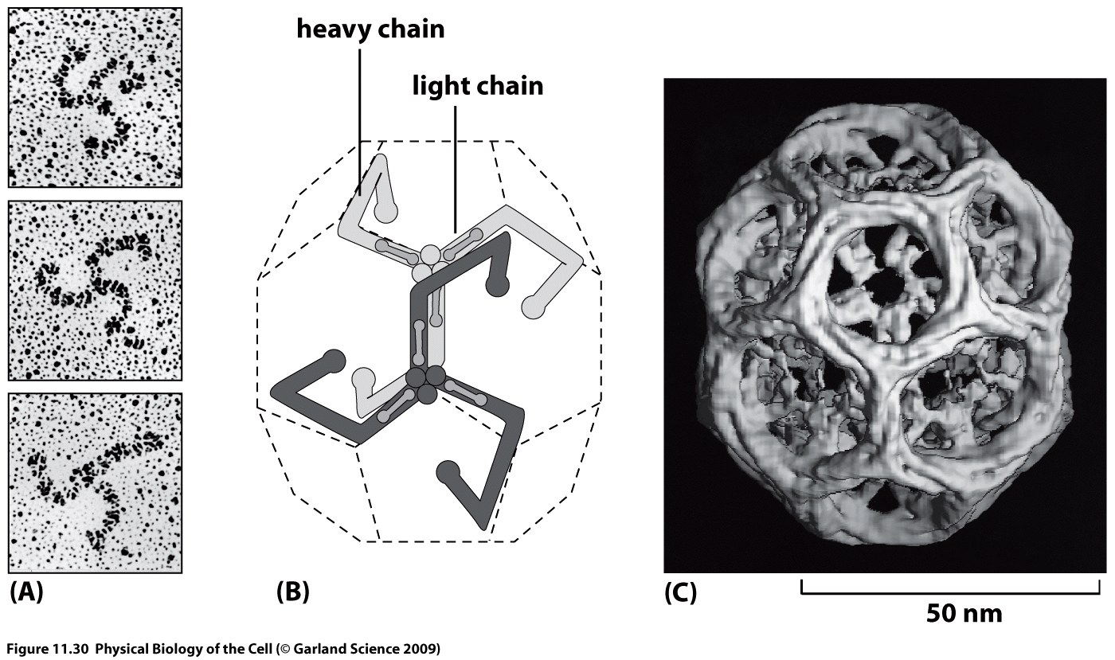
The springiness of biological membranes
Proteins shape membranes
Notes:
contributors to free energy: energy and entropy
(C) Higher entropy in random fold, lower energy in folded state
(D) charge state of the protein reflects a competition between the entropy gained by permitting
charges to wander in solution and the corresponding energy cost associated with
removing those charges from their protein host
(E) entropy associated with free ligands and the energetic gain they garner as a result of being
bound to their protein host
(F) protein coexists in an
active and inactive form and where the relative probability of these states is dictated
by some external influence

Slide 37
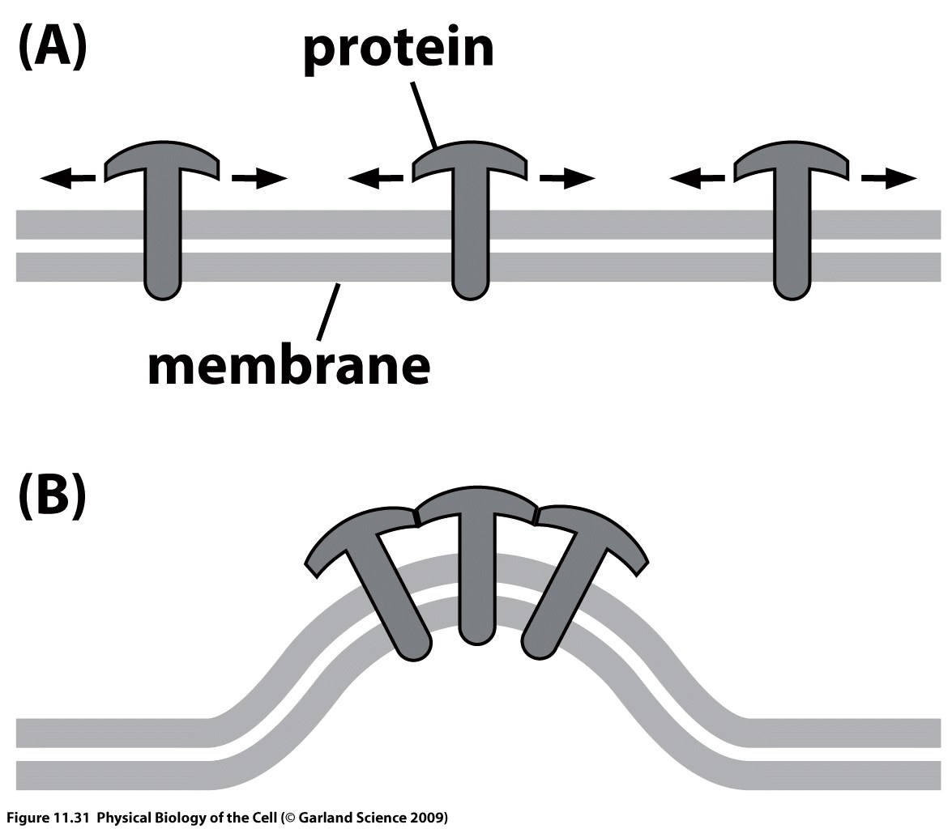
The springiness of biological membranes
Proteins shape membranes
Notes:
contributors to free energy: energy and entropy
(C) Higher entropy in random fold, lower energy in folded state
(D) charge state of the protein reflects a competition between the entropy gained by permitting
charges to wander in solution and the corresponding energy cost associated with
removing those charges from their protein host
(E) entropy associated with free ligands and the energetic gain they garner as a result of being
bound to their protein host
(F) protein coexists in an
active and inactive form and where the relative probability of these states is dictated
by some external influence

Slide 38
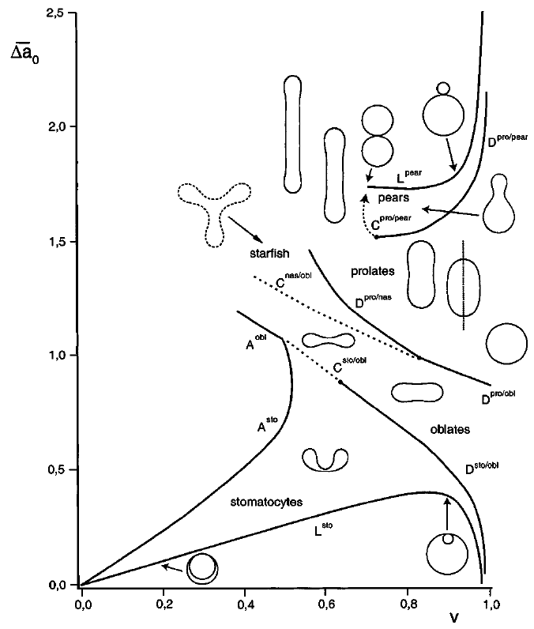
The springiness of biological membranes
Vesicle shapes: stretch and bend
minimize free energy for different volumes, different leaflet area differences (inner/outer)
V/V_{sphere}

Slide 39
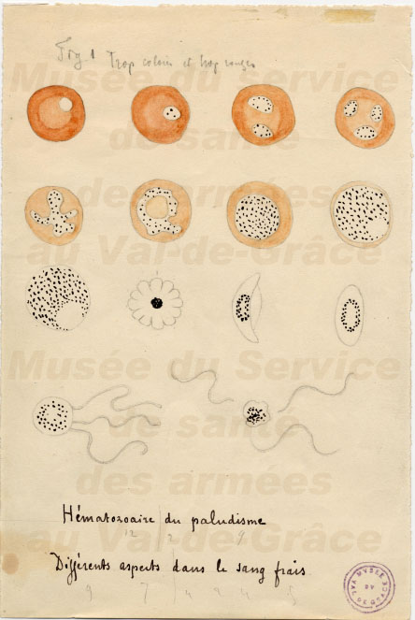
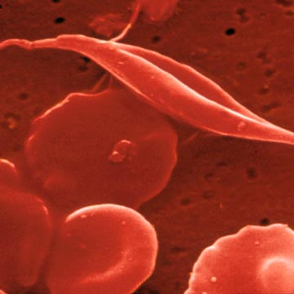
The springiness of biological membranes
Red blood cell shape and disease
Malaria
Sickle cell anemia
Hereditary elliptocytosis
Notes:
Red blood cells are a target of one of the most common infectious diseases suffered by humans caused by the invasion of a protozoan. Malaria infected red blood cells are much stiffer than normal cells and cannot deform to enter small capillaries. Consequently, people suffering from malaria experience severe pain and damage to tissues because of the inability of their red blood cells to enter those tissues and deliver oxygen.
Earlier theories were that malaria was caused by bad air ("mala aria" in Italian) from marshlands. However, following the discoveries of Louis Pasteur that most infectious diseases are caused by microbial germs (the "germ theory"), the hypothesis of a bacterial origin of malaria became increasingly attractive. constant element was the presence of granules of black pigment in the blood. These pigmented granules occurred at very different frequencies depending on the cases. Laveran concluded that these pigmented granules were specific to malaria, and that they originated in the blood. He patiently performed many examinations of freshly collected blood specimens, without the benefit of staining techniques (these were not yet available).
At the hospital in Bône, Laveran noticed spherical bodies, free or adherent to red blood cells. Some of these bodies were glassy ("hyaline") and difficult to see; others contained dark granules of pigment exhibiting ameboid movements.
In sickle hemoglobin (Hb S), a missense mutation (GAG to GTG) causes the substitution of a valine for glutamic acid on the surface of the Hb S molecule in the sixth position of the beta globin chain (HBB glu6val). In the revised convention for numbering amino acids of a protein, which includes counting the cleaved initiator methionine residue, the site of the Hb S mutation changes to position seven of the beta globin chain (to HBB glu7val). When deoxygenated, Hb S has a new property: the capacity to polymerize. Hb S polymer injures the sickle erythrocyte, increases its density, reduces its deformability, increases its adhesivity, and shortens its life span.
These mutations have a common end result; they destabilise the cytoskeletal scaffold of cells. This stability is especially important in erythrocytes as they are constantly under the influence of deforming shear forces. As disc-shaped erythrocytes pass through capillaries, which can be 2-3 micrometres wide, they are forced to assume an elliptical shape in order to fit through. Normally, this deformation lasts only as long as a cell is present in a capillary, but in hereditary elliptocytosis the instability of the cytoskeleton means that erythrocytes deformed by passing through a capillary are forever rendered elliptical.

Slide 40
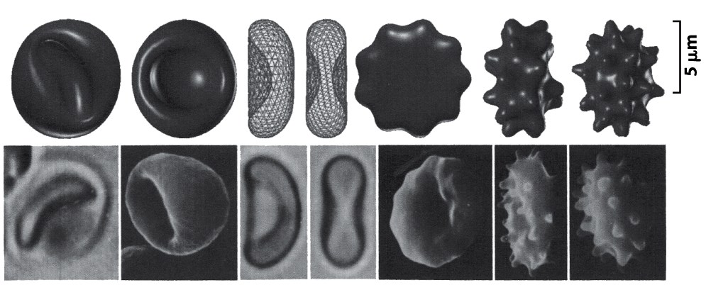
Biological systems as minimizers
Previously:
Cells as minimizers
changes in area difference between two leaflets of bilayer
states: membrane shapes satisfying geometric constraints (constant area, constant volume)
energy: mechanical (elastic) energy of deformation
Notes:
Red blood cell shapes. The left column shows shapes of red blood
cells as observed experimentally and the right column shows calculations of the
shapes. (Adapted from G. Lim et al., Proc. Nat. Acad. Sci., 99:16766, 2002.)

