Slide 1
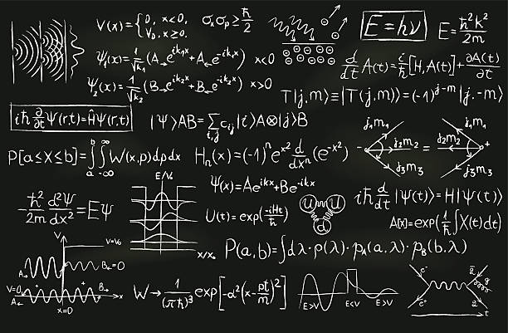
Quantum Mechanics I
PHYS-207
Teacher: Mitali Banerjee

Slide 2
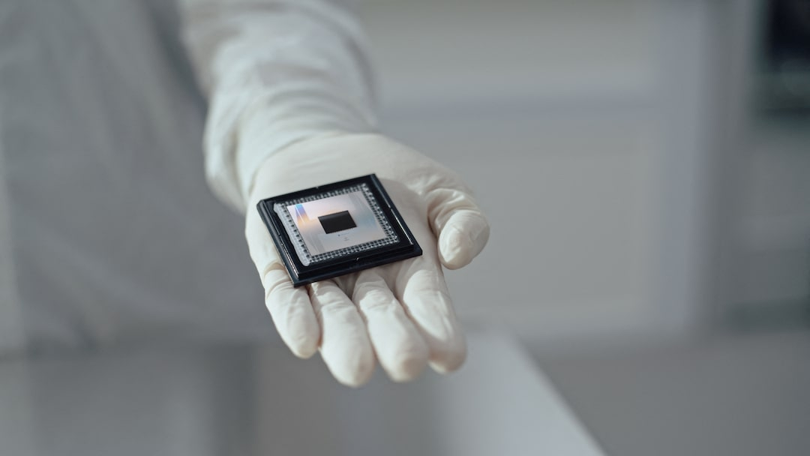
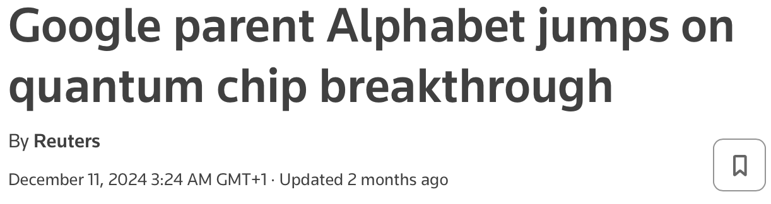


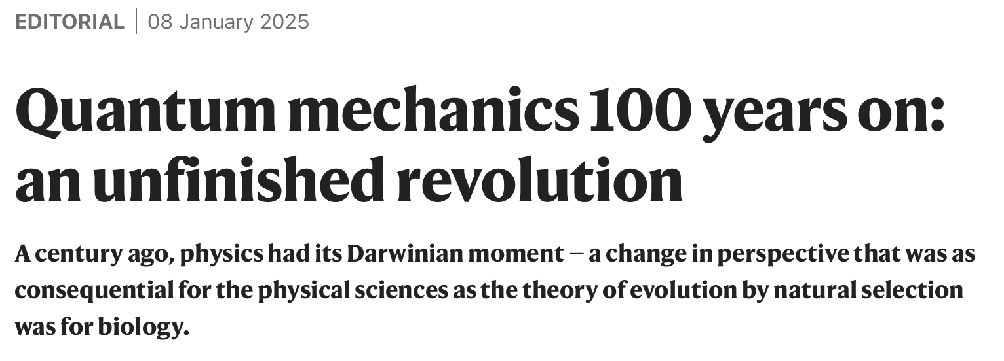

Slide 3

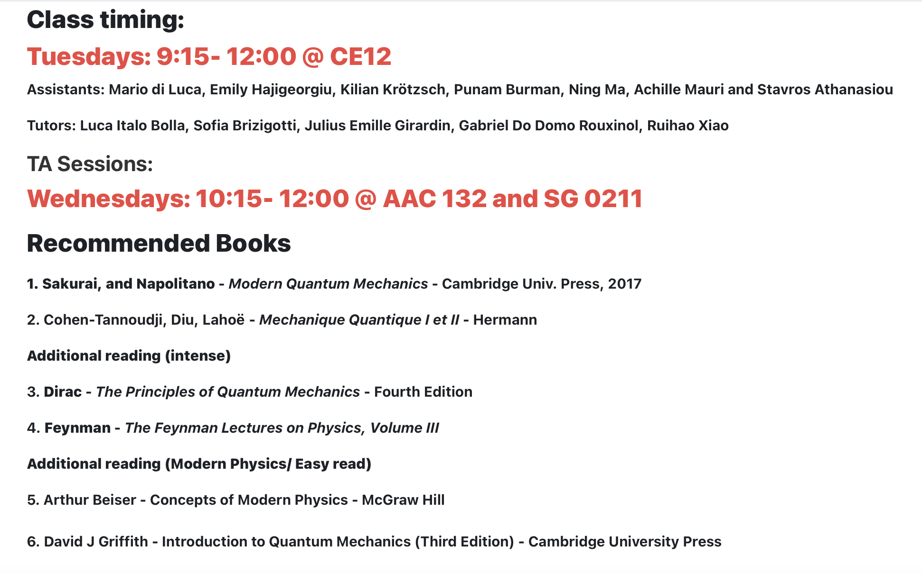

Slide 4
All is not well with Classical Mechanics

Slide 5
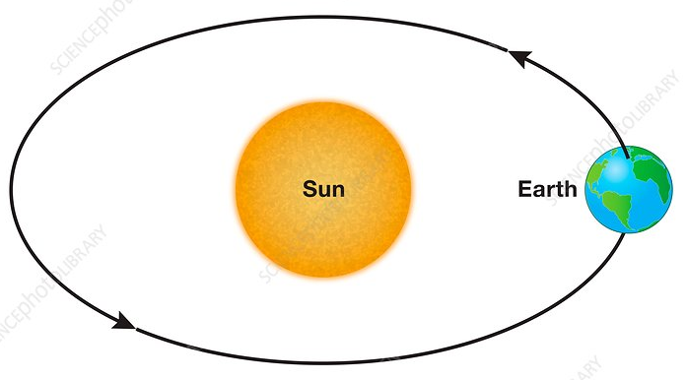
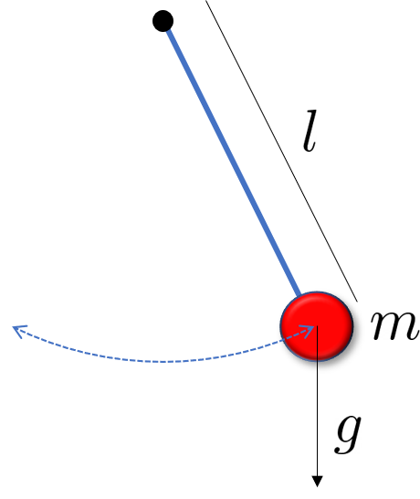

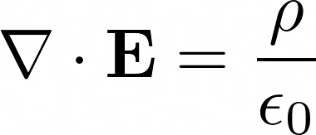
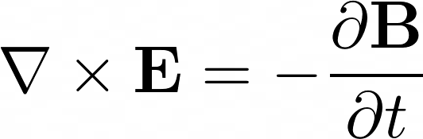
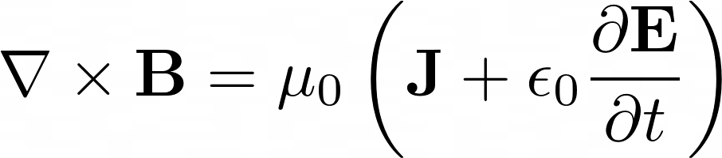

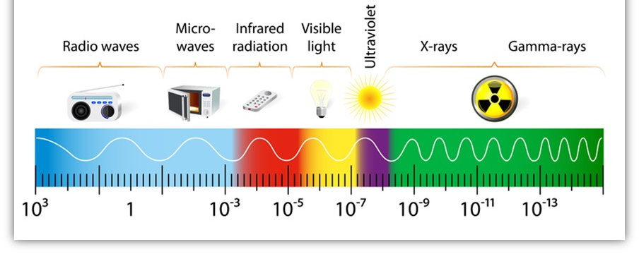
The Crisis of Classical Physics (1900)
Until 1900, the fundamental laws of physics were summarized in two theories: Newton's mechanics and Maxwell's electromagnetism.
Laws of mechanics (Newton) :
movement of objects subjected to forces
Maxwell's Laws of Electromagnetism : Behavior of Electromagnetic Waves, Electrostatic and Magnetic Forces

Slide 6
The Crisis of Classical Physics (1900)
Towards the end of the 19th century, it was noted that classical physics did not correctly describe several phenomena.
The stability of matter
The electromagnetic spectrum of the black body
The photoelectric effect
The spectra of atoms
…

Slide 7
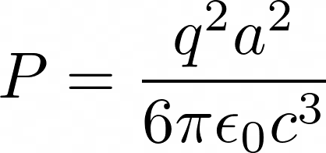
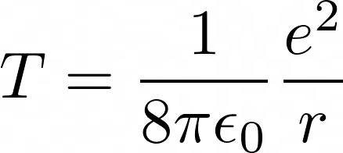

Problem of stability of matter
In 1897, JJ Thomson discovered the electron. He proposed a model of the atom where electrons are trapped in a matrix of positive charge: the "plum pudding model".
In 1909, E. Rutherford showed that the positive charge is concentrated at the centre of the atom and proposed a "planetary" model of the atom, where electrons orbit around a positively charged nucleus.
According to the laws of classical electromagnetism, a charge subjected to acceleration emits electromagnetic waves and therefore loses energy in the form of radiation. For a non-relativistic particle, the radiated power is given by the Larmor formula,
In Rutherford's model, the electron that makes a circular trajectory is obviously subject to an acceleration, so it radiates and thus loses energy. We can estimate the lifetime of the atom as the ratio between the kinetic energy of the electron and the radiated power. For the Hydrogen atom:
We obtain that the Hydrogen atom would have a very short life span!!! The stability of the matter that we observe around us is the most flagrant proof of the effects of quantum physics!

Slide 8


The black body
An object, heated to a temperature T , emits electromagnetic radiation
A black body is a closed cavity where the internal walls emit and reabsorb radiation several times, so as to reach an equilibrium
In experiments that approach this idealization, we observe that the power density emitted per unit area and wavelength (the black body "spectrum") takes a universal form

Slide 9

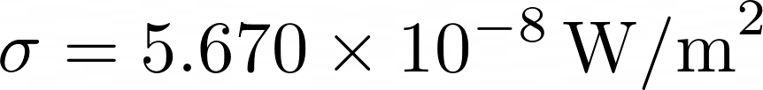



The Black Body: Empirical Laws
Before 1900, two empirical laws characterizing the black body were known
Stefan-Boltzmann law (1884): temperature dependence of total energy density
or, alternatively, the power emitted by an object of surface A :
(Here, e is the emissivity that characterizes the surface of the material. For a black body )
Wien's displacement law (1894): wavelength of maximum emission, as a function of temperature
The Stefan-Boltzmann and Wien laws had been demonstrated by experiments, and can be deduced by theoretical arguments involving thermodynamics

Slide 10
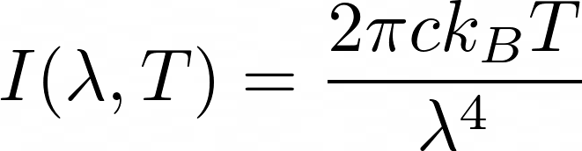


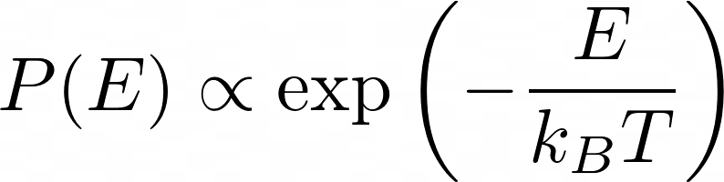
The black body: Rayleigh-Jeans law
Lord Rayleigh (June 1900) and J. H. Jeans (1905) proposed the first theory of the black body spectrum.
The theory was deduced from the hypothesis of the principle of equipartition of energy, assuming that the average energy associated with each wavelength is
In turn, this fact comes from the assumption that each wavelength is emitted by a harmonic oscillator (which is supposed to represent a blackbody molecule) of frequency , and that the energy of these oscillators obeys a statistical probability distribution characteristic of the canonical ensemble: the Boltzmann distribution
The divergence of the Rayleigh-Jeans law, for wavelengths approaching zero, predicts an infinite total energy density, known as the "ultraviolet catastrophe"

Slide 11
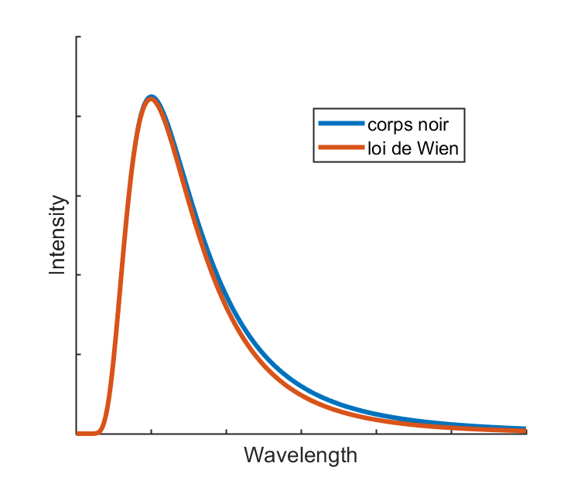
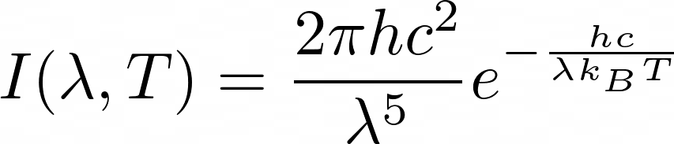
The Black Body: Wien's Law
Wilhelm Wien (1896) proposed a law to explain the black body spectrum at high frequencies (i.e. at small wavelengths ).
The law was deduced from the (unjustifiable) hypothesis that the wavelength emitted by molecule is a function of their speed.
Combining this hypothesis with Wien's displacement law, and with the Maxwell-Boltzmann distribution of velocities, we obtain (the constant h is defined in the following slide)

Slide 12
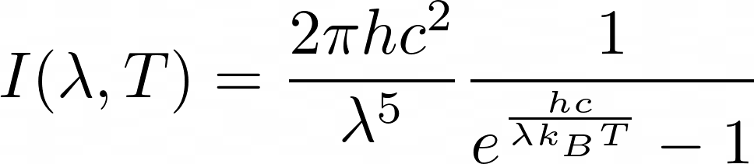
The black body: Planck's law
Max Planck – a master of thermodynamics – in October 1900, used an argument based on the entropy of the oscillators that emit radiation to understand that the Rayleigh-Jeans and Wien laws are two opposite limits of a more general law, which he stated empirically.
This form of the black body spectrum explains with great success the measurements that were made. It contains a constant, known today as Planck's constant
Max Planck spent the next few months thinking about what mechanism, at the level of the emission of radiation by molecules, could explain this law.

Slide 13
Planck's law and the "quantum" of energy
In December 1900, Max Planck formulated the following hypothesis:
The energy of the oscillators (molecules) making up the internal surface
of the black body can only take certain discrete values
where f is the frequency of the oscillator.
Energy is said to be "quantized", and each discrete value of energy corresponds to a "quantum state" .
Oscillators emit or absorb radiation by making "transitions" from one state to another . Energy can therefore only be emitted or absorbed in discrete quantities, called "quanta" .

Slide 14
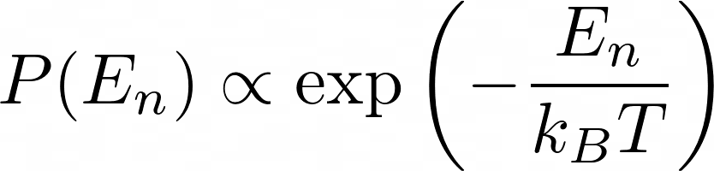
Planck's law and the "quantum" of energy
Combining the quantum hypothesis with the fact that the oscillator energies are distributed according to the Boltzmann distribution, we find Planck's law for the black body spectrum.
Max Planck presented his law to the German Physical Society on December 14, 1900. This was the official birth of Quantum Physics.

Slide 15
Intuition of Planck's Law
For an intermediate wavelength, the two effects combine together and we have a maximum of emitted intensity
At short wavelengths, the energy separation between states is large. According to Boltzmann's law, the probability that the oscillators are in high-energy states is therefore low. There are therefore few transitions and a low intensity of emitted radiation.
At long wavelengths, the energy separation is small, and we will have many oscillators in excited states. There will therefore be many transitions, but with a small energy, which explains the low intensity of the radiation.

Slide 16
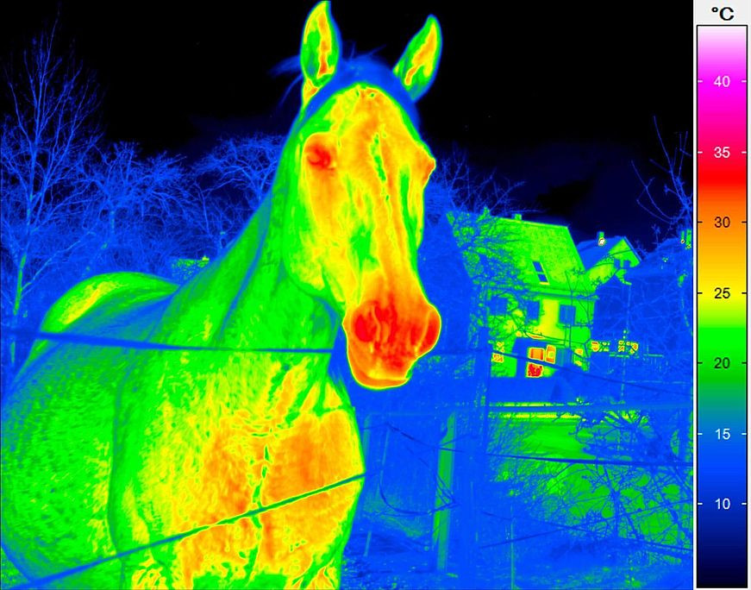
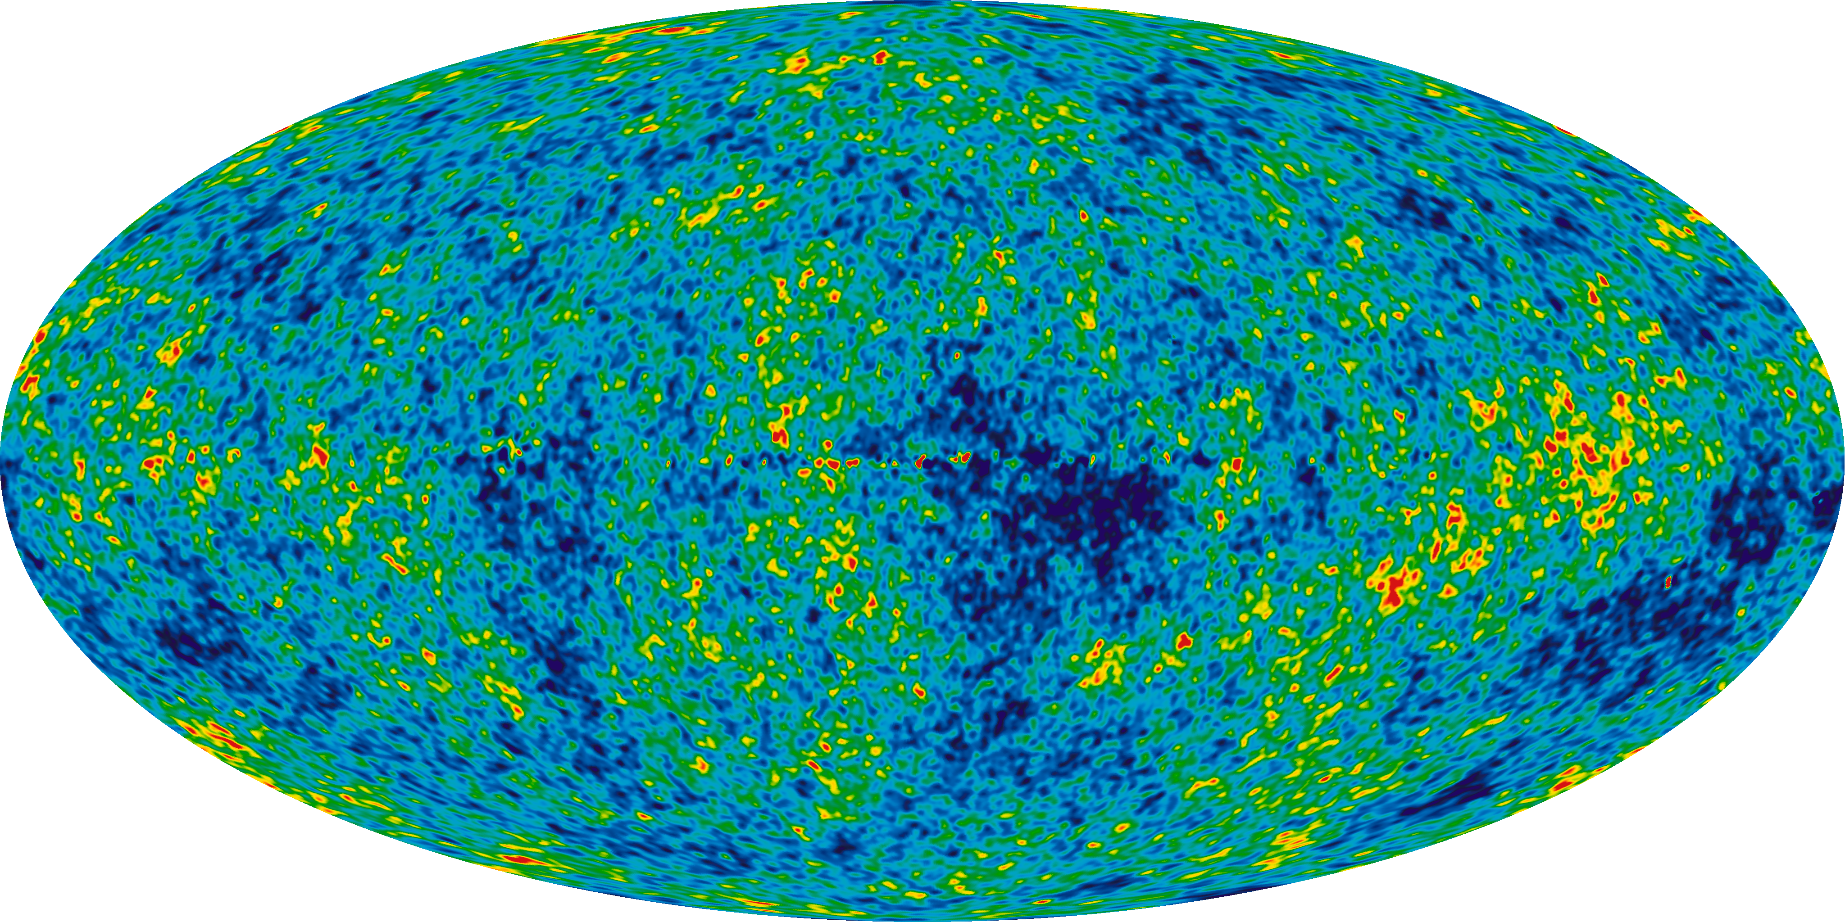

Application examples
Thanks to the Stefan-Boltzmann law, we can accurately estimate the temperature of an object by measuring the radiation it emits.
Since the emitted power depends on the fourth power of the temperature, a small variation in temperature translates into a large variation in emitted power.
This is the principle of operation of the ear thermometer and infrared cameras.
Another very important example in physics is the Cosmic Microwave Background (CMB). This is the radiation present in the universe following the decoupling between radiation and matter. It has a spectrum corresponding to a temperature of 2.7 K , and its fluctuations are a reflection of quantum fluctuations in the first moments of life of the universe.

Slide 17
Open questions
In 1900, the idea that oscillators emit radiation in quanta of energy was quite arbitrary.
What is the mechanism that would cause an oscillator to be unable to emit certain wavelengths?
Is it possible for radiation to have energies other than those predicted by the mechanism of "quantized" oscillators? In other words, is the quantization of energy a fundamental property of radiation, or just a consequence of the emission mechanism by the molecules composing the black body?
These questions were the subject of intense research at the beginning of the 20th century .
Albert Einstein in 1905 gave an answer to the question about the nature of electromagnetic radiation, studying the photoelectric effect. For this study he won the Nobel Prize in 1921.

Slide 18
Nature of energy quantization
Planck's blackbody theory suggests that:
The energy of the black body's "oscillators" (i.e. atoms) is quantized
Blackbody radiation at each frequency is emitted by energy quanta
The fundamental question that remains open is: is (2.) only a consequence of (1.)? In other words, can we have light of frequency f and energy other than E_{n} = nhf? Or is the quantization of energy a fundamental property of light, independent of the emission mechanism?

Slide 19
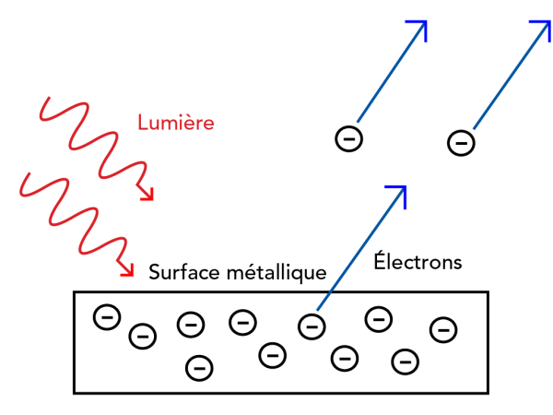
The photoelectric effect
Experimental observations of the photoelectric effect were at odds with the theory based on the laws of classical physics.
Einstein, in 1905 , developed a theory of the photoelectric effect based on the hypothesis that light is composed of energy quanta. Einstein's theory explains all the observations.
The success of the quantum hypothesis in explaining the photoelectric effect is proof that the quantization of energy is a fundamental property of light.
The energy quanta of light were first called "photons" in 1926.

Slide 20

Measurement of the photoelectric effect
An empty tube contains two metal plates, an emitter E and a collector C. A potential difference is generated between the two plates by a powered circuit.
The electrons emitted by E as a consequence of the incident light are accelerated by the potential difference. A part of the electrons reaches the collector and produces a current.
For a very high voltage, all the emitted electrons are attracted to the collector, and the current reaches a limit value for a given light intensity.
If we apply a negative potential difference, we slow down the electrons. If we slow them down so that they stop just before they reach the collector, the measured current will be zero .
Under this condition, the potential difference Δ V _{s} corresponds exactly to the kinetic energy of the emitted electrons (called K _{max} in the lecture notes).
This measured value does not depend on the intensity of the light

Slide 21
Measurement of the photoelectric effect
An empty tube contains two metal plates, an emitter E and a collector C. A potential difference is generated between the two plates by a powered circuit.
The electrons emitted by E as a consequence of the incident light are accelerated by the potential difference . A part of the electrons reaches the collector and produces a current.
For a very high voltage, all the emitted electrons are attracted to the collector and the current reaches a limit value for a given light intensity.
If we apply a negative potential difference, we slow down the electrons. If we slow them down so that they stop just before they reach the collector, the measured current will be zero .
Under this condition, the potential difference Δ V _{s} corresponds exactly to the kinetic energy of the emitted electrons (called K _{max} in the lecture notes).
This measured value does not depend on the intensity of the light
High intensity
Low intensity
Applied voltage

Slide 22
Characteristics observed in the experiment
How does the kinetic energy of electrons emitted by the metal depend on the intensity of light?
  What classical physics predicts : Electrons should absorb energy continuously, as in a forced harmonic oscillator (seen in general physics. Think of a swing that is pushed with each oscillation). If the intensity of the light is increased, the energy is absorbed more quickly by the electrons, which should be emitted with greater kinetic energy.
  What we observe in the experiment : The maximum kinetic energy of the emitted electrons does not depend on the intensity of the light.
Photo current
Low intensity
Applied voltage

Slide 23
Characteristics observed in the experiment
What is the delay between the light hitting the metal and the emission of electrons?
  What classical physics predicts : For a small intensity of light there should be a delay. Since at low intensity the energy is absorbed slowly by the electron, it will take longer for it to acquire enough energy to be torn off the atoms of the metal.
  What we observe in the experiment : Electrons are emitted instantly upon the arrival of light, regardless of its intensity.

Slide 24
Characteristics observed in the experiment
How does electron emission depend on the frequency of light?
  What classical physics predicts : Electrons should be torn out of the metal for any frequency of light, provided the intensity is high enough. Think of the forced oscillator. If the frequency of the forcing term is very different from the frequency of the oscillator, the energy transfer will be less efficient, but still present.
  What we observe in the experiment : We observe that there is a threshold frequency f_{c} . This frequency is characteristic of the type of metal used. If the frequency of the light is lower than the threshold frequency, no electrons are emitted, regardless of the intensity of the light.

Slide 25
Characteristics observed in the experiment
How does the kinetic energy of the emitted electrons depend on the frequency of light?
  What classical physics predicts : There should be no connection between the frequency of light and the energy of the emitted electrons. At each frequency, the energy of the emitted electrons should depend on the intensity of the light.
  What we observe in the experiment : The kinetic energy of the emitted electrons increases linearly with the frequency of the light.

Slide 26


Einstein's theory
Light is made of quanta of energy, called photons. For light with frequency f , each photon has energy E = hf .
When light hits the metal, each photon that is absorbed gives all its energy to an electron.
An electron is emitted as a result of the absorption of a photon (effects with 2 or more photons are rare).
The kinetic energy of an electron torn from the metal is therefore
Where φ is the work function , i.e. the minimum energy required to remove the electron
Output work

Slide 27
What Einstein's theory predicts
How does the kinetic energy of electrons emitted by the metal depend on the intensity of light?
  Clearly, the kinetic energy K _{max} = hf - φ does not depend on the intensity of the light. It only depends on the frequency of the light and the work function of the metal. If we increase the intensity of the light, we increase the number of photons per unit time, which will change the number of electrons per unit time that are emitted, but each electron will be emitted with the same kinetic energy.
What is the delay between the light hitting the metal and the emission of electrons?
  As soon as the photons hit the metal, some of them will give up their energy to an electron. So there will be electron emission without delay.
How does electron emission depend on the frequency of light?
  The photon must have at least energy φ to tear off an electron. This is why for photons of lower energy no electron emission is observed.
How does the kinetic energy of the emitted electrons depend on the frequency of light?
  A higher frequency photon has greater energy and therefore gives up more kinetic energy to the emitted electron.

Slide 28
What Einstein's theory predicts
Comparison between theory and measurements allows to determine the value of the work function for different metals.

Slide 29
Importance of the photoelectric effect in the development of quantum physics
Studies of the photoelectric effect in the early 20th century played a fundamental role in the development of quantum physics.
Einstein's theory clearly states that the quantization of energy is a fundamental property of light (because in the photoelectric effect, the quantization is observed regardless of how the light is produced to perform the experiment).
We thus begin to advance the hypothesis that the energy quanta of light could be particles. This is the corpuscular hypothesis of light.
In parallel with studies on light, other studies (which we will see later) suggested that the elementary particles that make up matter can behave like waves in certain situations. This is the wave hypothesis of matter.
The two hypotheses form a fundamental principle for quantum physics, as stated by Niels Bohr. This is the complementarity principle.
Experimental proof that the photon behaves like a particle came in 1923 with the Compton effect experiment .

Slide 30
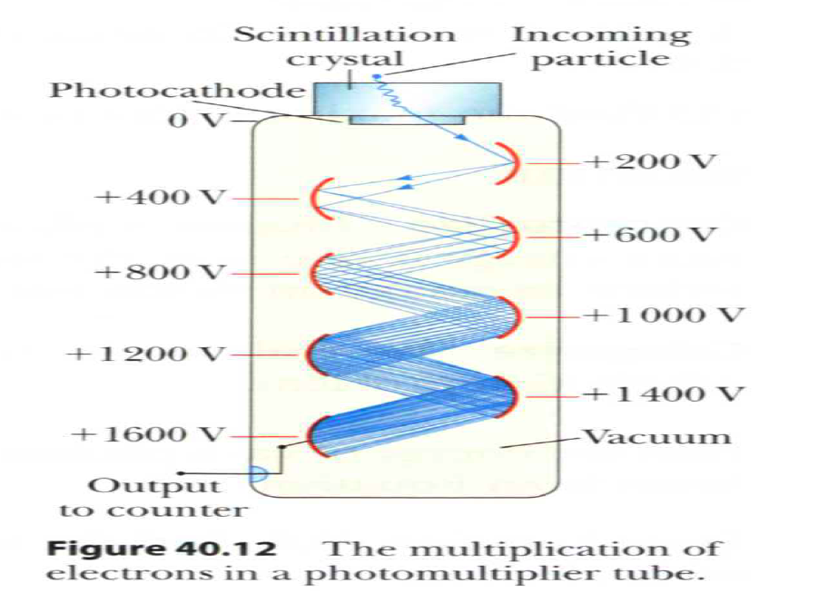
Applications of the photoelectric effect
The photomultiplier tube can detect very few photons, even one photon at a time.
A photon absorbed by the photocathode produces an electron which is accelerated by the potential difference in the first stage.
After having thus acquired kinetic energy, it arrives at a "dynode" where it tears off several electrons by collision.
The effect is repeated several times, until a macroscopic current is produced at the output, even with only one photon at the input.
The photomultiplier is used wherever very few photons need to be detected, for example, in astronomy, particle physics, etc.
Today, with the progress of electronics, photomultipliers are increasingly being replaced by charge-coupled devices (CCD)

Slide 31
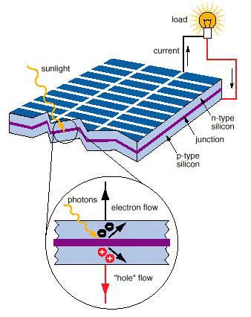

Applications of the photoelectric effect
The photovoltaic cell is the basic component of photovoltaic solar panels for the production of electrical energy.
In a semiconductor junction, the photon knocks an electron out of the valence band (creating a "hole"). The electron and hole move away from the junction and eventually generate an electric current.

Slide 32
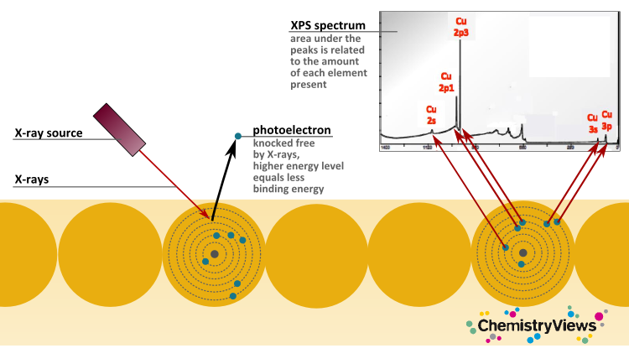
Applications of the photoelectric effect
Photoelectron spectrometry (XPS). The energy of the emitted electrons, as well as the electron flux at each energy level, can be precisely measured, and this data can be used to extract information about materials. In particular, the XPS technique removes the electrons that are most strongly bound to atoms. It, therefore, provides information about the chemical elements that make up the material being analyzed.

Slide 33
Open questions
The photoelectric effect led to the conclusion that electromagnetic radiation is distributed by energy quanta .
Einstein already has the intuition that these quanta are real elementary particles , but it needs to be proven.
The proof will be given by the experiment on the Compton effect , which we will see later.
If electromagnetic waves can behave like particles, is it possible that elementary particles also behave like waves under certain conditions?

Slide 34
The Compton Effect (1922)
The Compton effect is observed in experiments of light scattering on charged particles, especially electrons.
It is observed that the wavelength of the scattered light is different from that of the incident light, but depends on the angle of the scattering. For each value of the angle, only one wavelength is observed

Slide 35
The Compton effect: what we observe
In classical theory, the electromagnetic wave sets the electron into oscillatory motion.
The oscillating electron in turn emits an electromagnetic wave, the wavelength of which can be predicted using Maxwell's equations.
In classical theory, the wavelength change is produced by the Doppler effect if the electron is already moving in the laboratory frame. In particular, if the electron is at rest, the scattering is resonant and no wavelength change should be observed.
In the experiment, however, we observe, for each scattering angle, a maximum of the scattered intensity at a well-defined wavelength.

Slide 36
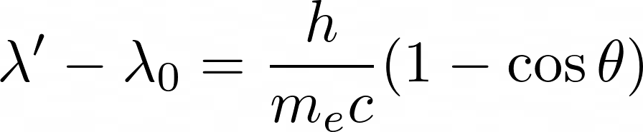
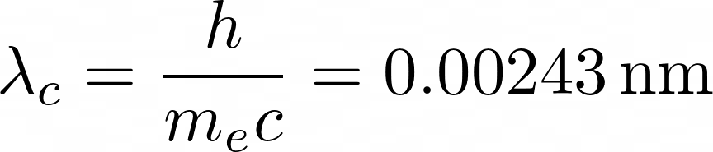
The corpuscular theory of the Compton effect
According to the corpuscular hypothesis of light, photons are particles. They must therefore perform an elastic collision with electrons, with conservation of energy and momentum .
The calculation gives a simple result in perfect agreement with experience .
The constant h/m_{e} c has the dimensions of a length and is called the Compton wavelength of the electron. It is equal to

Slide 37
Open questions
The Compton effect is proof that photons behave like particles. A phenomenon that we are used to considering as wave-like, manifests itself in corpuscular form.
If electromagnetic waves can behave like particles, is it possible that elementary particles also behave like waves under certain conditions?
This question, initially formulated by Albert Einstein and Louis de Broglie, will find a definitive answer in 1927 with the Davisson-Germer experiment , which we will see later.
What are these conditions that determine corpuscular or wave behavior? In other words, how can we know if an object – whether light or matter – will behave like a wave or like a particle? It was Niels Bohr who introduced the complementarity principle , which states that these two types of behavior are mutually exclusive . To be continued…

Slide 38
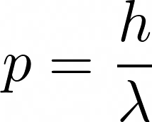

The photon as a particle
The Compton effect shows for the first time that light can behave like a corpuscle under certain conditions.
For radiation of frequency ν and wavelength λ = c/ν , the elementary particles that compose it – the photons – have an energy and a momentum given by
These are Einstein's relationships .
Note that the photon is a particle of zero mass, it always has the speed of light, and must therefore be described with the laws of relativity.

Slide 39
Light: waves or particles?
Light exhibits wave behavior under certain conditions, while under other conditions, such as in the photoelectric effect and the Compton effect, it exhibits corpuscular behavior.
Is electromagnetic radiation a wave or a particle?
…or perhaps these two notions of wave and particle, very intuitive for us, are not sufficient to correctly describe physical reality.

Slide 40
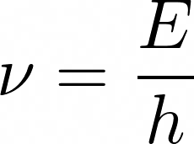
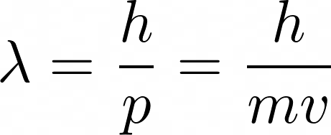
The wave nature of matter
In 1923, Louis de Broglie proposed the idea that the elementary particles that form matter can also have wave or corpuscular behavior depending on the conditions .
This hypothesis at the time had no experimental support. However, associating a wave with an elementary particle is a very natural conclusion if we make an analogy between Maxwell's laws of electromagnetism and Einstein's laws of relativistic mechanics.
Louis de Broglie postulates that a particle with energy E and momentum p is characterized by a wave with a frequency and wavelength given respectively by
Together with the other two relationships for light,
They are known as the Einstein-de Broglie relations .

Slide 41
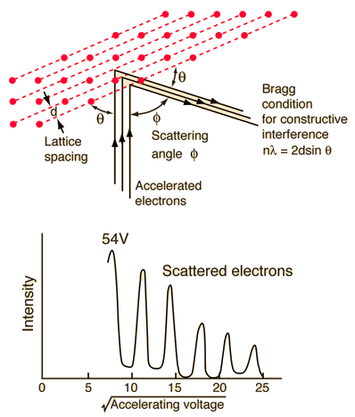
The Davisson-Germer experiment (1923-27)
Davisson and Germer discovered by chance in 1923 that de Broglie's hypothesis was correct.
They measured a diffraction pattern by scattering high-energy electrons off the crystal surface of a metal.
Electrons with a kinetic energy of 100 eV are characterized by a short de Broglie wavelength, which results in the spacing between atoms being small enough to produce diffraction patterns.
This was the first evidence that matter can exhibit wave-like behavior .

Slide 42
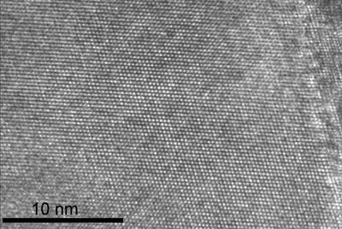
Application: electron microscope
Electron microscopy uses the wave behavior of electrons.
Since in microscopy the resolution is limited by the wavelength (diffraction limit), the short de Broglie wavelength of electrons allows very high resolutions to be achieved.
In particular, the transmission electron microscope, using electrons with energies of 40 to 400 keV, achieves a resolution of 0.5 Angstrom, and can resolve atoms.
Exercise: calculate the wavelength for an energy of 400 keV (at this energy, we can still use the laws of non-relativistic mechanics)

Slide 43
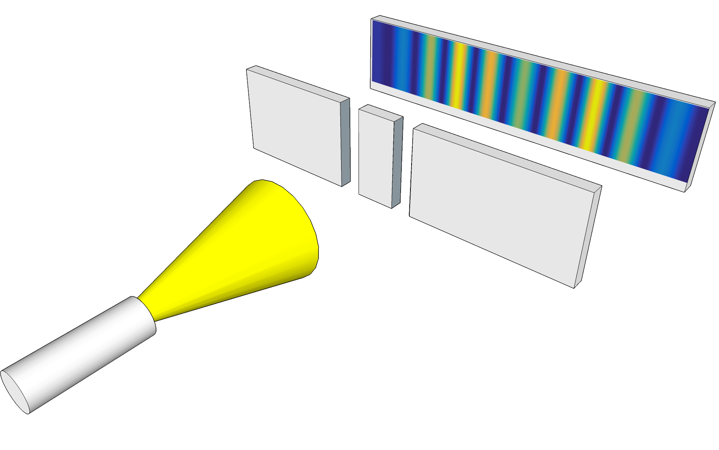
Young's Two-Slit Experiment
In 1801 Thomas Young designed and performed this experiment to demonstrate that light is a wave phenomenon. At the time, this was an open question.
Light is sent through two slits (small enough and close together). At the output, each slit behaves like a source of spherical waves (because of diffraction), and the two sources are mutually coherent (i.e. their relative phase does not vary with time).
If we collect light on a screen, we observe interference fringes . The intensity maxima and minima correspond to the regions where the amplitudes of the two waves combine with the same signs or with opposite signs.

Slide 44
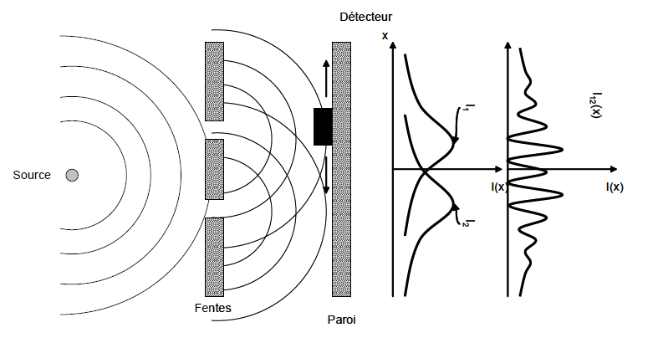
Young's experiment: waves
The goal now is to define the concepts of wave and particle using Young's experiment
A wave is a continuous phenomenon. Imagine waves on the surface of water. The detector at a given position measures a continuous variation in time of the height of the water.
If the first slit is blocked, the measured intensity profile does not show interference fringes. Same thing if the second slit is blocked.
If both slits are opened, an interference pattern is measured.
The waves are characterized by:
Continuous phenomenon
Interference

Slide 45
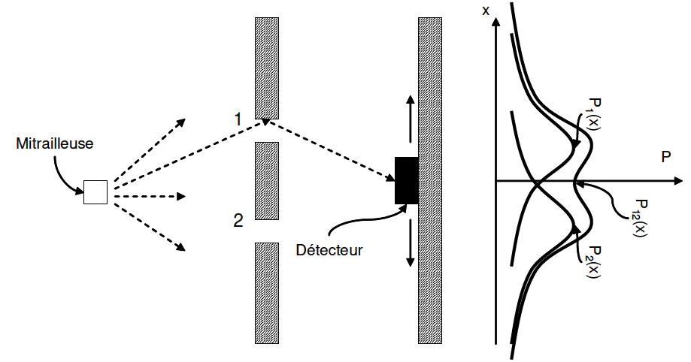
Young's experiment: particles
Let's do the same experiment with particles. Richard Feynman, in his famous "lecture notes" imagines using a machine gun that sends bullets in all directions.
The slots are narrow enough that most balls will bounce off the edges.
If we block the first slot, we observe a certain density profile in the arrival of the balls. If we block the second, we observe another profile.
If we open both slits, the observed profile is simply the sum of the two profiles.
A particle is a discrete phenomenon. It passes either through the first slit or through the second . This is why the result is simply the sum of the two results obtained with a blocked slit.
The particles are characterized by:
Discreet phenomenon
No interference

Slide 46
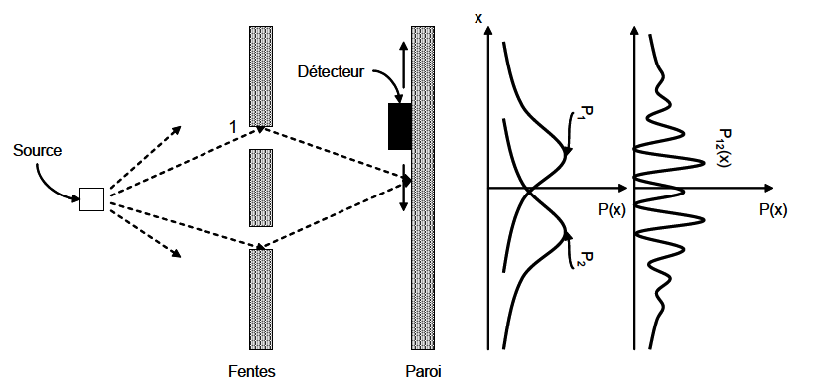
Young's experiment: quantum objects
We now think we have a vocabulary that allows us to identify waves and particles. Let us now experiment with electrons (this will require special conditions, which we will not discuss).
An electron source (e.g. a photocathode) sends electrons to the two slits. The electrons, like balls, bounce off and go in several directions.
The detector makes a click as each electron arrives. We can count them. It is a discrete phenomenon.
If a slit is blocked, the detected electron density profiles do not show fringes.
If we open both slits, we observe interference fringes!!!
Behavior of electrons:
Discreet phenomenon
Interference!
According to our vocabulary, these are not
neither waves nor particles!

Slide 47
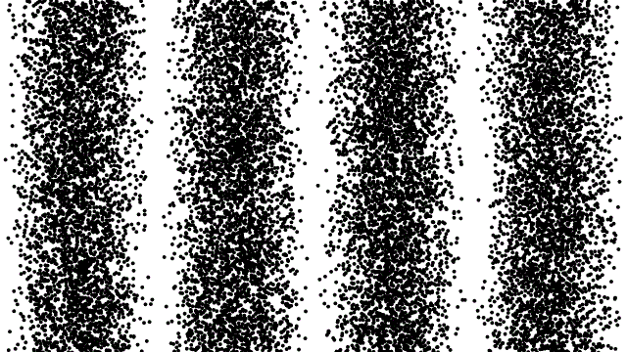
Young's experiment: quantum objects
What we would observe on the screen over time:
The experiment with single electrons was first conducted in 1974 :
PG Merli , GF Missiroli , and G. Pozzi , “On the statistical aspect of electron interference phenomena,” American Journal of Physics 44 , 306 (1976).

Slide 48
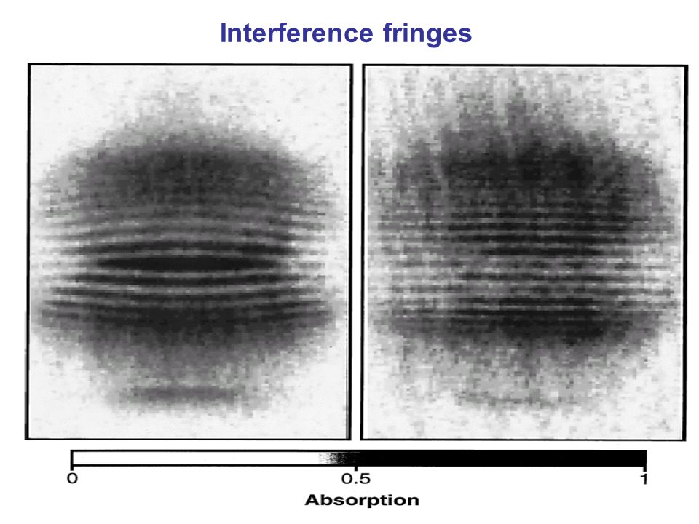
Interference of two Bose-Einstein condensates
A Bose-Einstein condensate is a gas of atoms where all the atoms behave collectively as a single quantum wave.
If two condensates are sent against each other, the resulting cloud will not be the sum of the two clouds, but it shows interference fringes. The experiment was conducted in 1997.
In the clear places in the figure, one atom plus one atom does not make two atoms but rather zero atoms !
M. R. Andrews et al., Science 275 , 637 (1997)

Slide 49
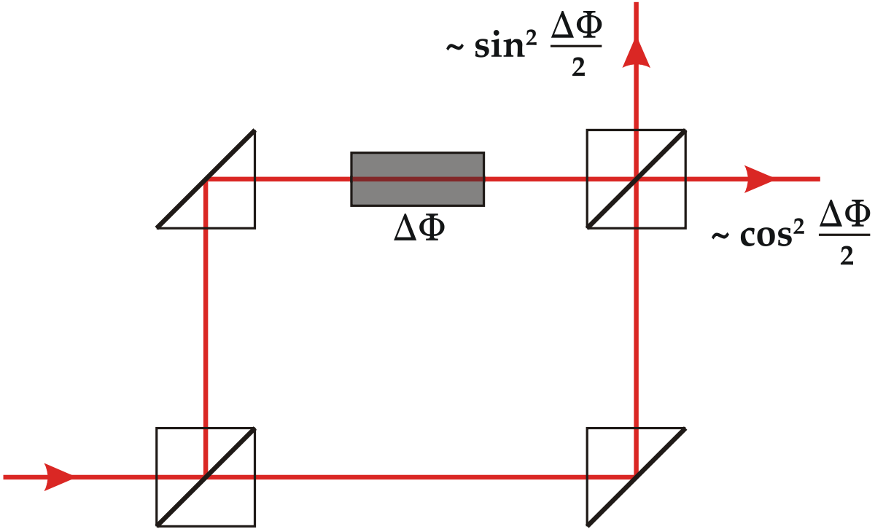
Young with a Mach-Zehnder interferometer
Interference fringes are produced by the phase difference of the two possible paths for light. No need to make slits small and close enough.

Slide 50
Young's Single Particle Experiment
Young's experiment with quantum objects (electrons, photons or other particles) shows interference fringes even if the particle flow rate is so low that there is never more than one particle in the space occupied by the experiment .
Since interference appears only when both slits are open, it is reasonable to think that the interference fringes are the result of a combined effect of the two slits .
But if we never have more than one particle in the experiment, and if we keep the classical notion of particle, we are then led to think that each particle passes through one and only one slit before reaching the screen .
If one particle passes through a slit, whether the other is open or blocked should have no effect on the outcome of the experiment. This leads to a contradiction, because the result is different in the two cases where only one slit is open (no interference) or both are open (interference).
The only possible explanation is that the classical concepts of wave and particle are not sufficient to describe the quantum object used in the experiment. They are only partial descriptions of the true nature of quantum objects.
For these objects, the question "where did the particle go?" (called "which-path information" in the literature) simply does not make sense!

Slide 51
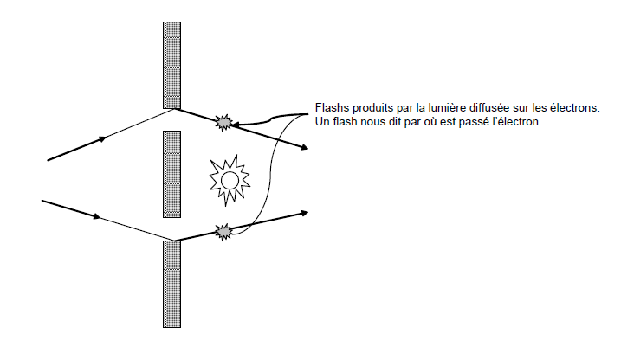
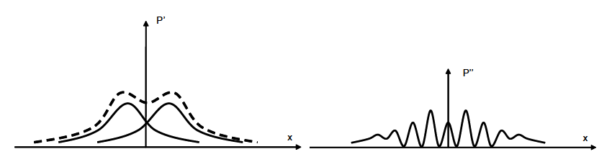
Which slit did the electron pass through?
Feynman proposes a variation of the experiment, where a light bulb placed behind the slits produces photon scattering on the passing electrons. We will thus see a flash of light where it is scattered by the electron. This allows us to know the "which-path information" for each electron passage.
The result is surprising. In the same experiment, if we acquire the "which-path information" the interference fringes disappear!!! If on the other hand we turn off the light without changing anything else, the fringes reappear!!! (the experiment is designed to exclude any significant effect of light on the electrons).
Light on
Light off

Slide 52
The complementarity principle (1928)
After much thought by the entire community of physicists, Niels Bohr stated the complementarity principle in 1928 :
Wave and particle behaviors are only partial aspects of physical reality. Every quantum object can exhibit wave or particle behavior, depending on the conditions.
The principle of complementarity, however, states that the two behaviors manifest themselves in a mutually exclusive manner: either we see wave behavior, or we see particle behavior.
In Young's light bulb experiment, the " which-path information" - which is a characteristic of particles - never manifests itself under the same conditions that produce interference fringes - which are a characteristic of waves .
The complementarity principle is one of the foundations of quantum physics.
The Heisenberg uncertainty principle (which we will see later) is a special case: knowledge of the position of the particle (which-path) and knowledge of its momentum (wave, because p=h/ λ ) are mutually exclusive.

Slide 53
Open questions
What are de Broglie waves? Are they associated with physical quantities, as with sound waves (pressure) or electromagnetic waves (electric and magnetic fields)?
We will see that, unlike most common wave phenomena, de Broglie waves do not correspond to oscillations of physical quantities . They are only a mathematical representation that allows us to explain the result of the measurements according to the laws of quantum physics.
But then, what are the physical laws? Can we write a wave equation for matter waves, just as we can write wave equations for electromagnetic waves or for sound waves?
We will see that the Schrödinger equation describes the behavior of de Broglie waves . It cannot be deduced from first principles, and in the formal theory of quantum physics it intervenes as an axiom.
More generally, what is the link between these waves (which are presumably extended in space) and the results of measurements of local quantities , such as the position of a particle?
We will see that measurement is a more complex process in quantum physics than in classical physics. In particular, we are forced to admit a fundamental random character for the results of most measurements .

Slide 54
Interpretation of atomic spectra
Before the development of Quantum Physics, one of the greatest challenges was the interpretation of the emission and absorption spectra of atoms .
A rarefied gas of atoms, subjected to an electric discharge, emits light. This is the principle of "neon" tubes.
Unlike a black body (i.e. an object heated to a temperature T ), this emission is composed only of a number of very narrow discrete lines, separated by spectral regions without emission.

Slide 55
Interpretation of atomic spectra
The simplest atom, Hydrogen, has the simplest emission spectrum. It is characterized by very few lines.
The emission spectrum can be used as a "signature" of different chemical elements. It is often used to determine their presence in a sample of unknown composition.
Neon tubes use this principle to emit red light, which characterizes the emission spectrum of neon. The tubes of different colors are obtained with a gas emitting in the ultraviolet (typically mercury) which in turn excites fluorescent materials on the walls of the tube, which emit in different colors.

Slide 56
Interpretation of atomic spectra
Similarly, absorption spectra of atoms show discrete "black" lines, against a background that shows no absorption of light. The lines are at the same wavelengths as those in the emission spectra.
Absorption is measured by shining white light (i.e. with all spectral components) on a sample, and looking at which components were absorbed and which passed through the sample.
Just like emission, absorption spectroscopy is very useful. For example, absorption lines in the spectrum of sunlight highlight the elements present in the solar atmosphere. This is how helium was discovered. Today, absorption spectroscopy is used to analyze the chemical composition of many objects. For example, absorption by hemoglobin is the operating principle of the oximeter used to measure oxygen saturation in the blood.

Slide 57
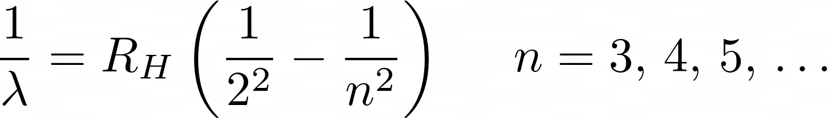
Hydrogen spectral series
Between 1860 and 1885 a great deal of data on atomic spectroscopy was accumulated. The discrete nature of the spectral lines was not in agreement with the (very simple) atomic models available .
In 1885, JJ Balmer (a Swiss teacher) discovered that the spectral lines of hydrogen are characterized by a very simple empirical law that explains their wavelengths. The Balmer series law, improved by J. Rydberg is
Here R _{H} is the Rydberg constant, which is equal to
The Balmer series describes wavelengths measured with a
accuracy of 0.1%.
We note that the series admits a finite limit for n which tends towards infinity.

Slide 58
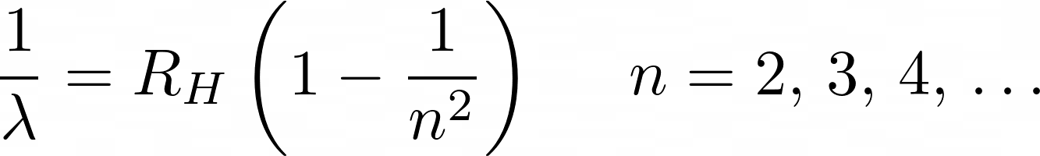
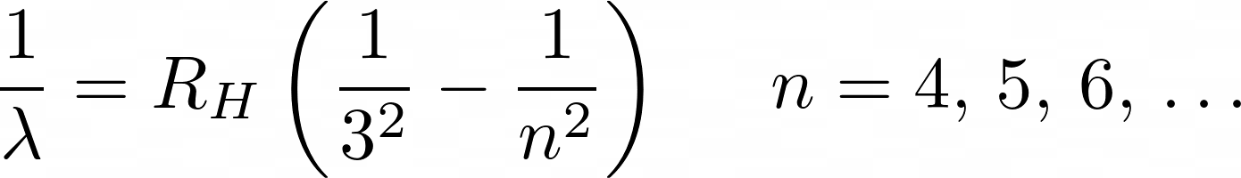
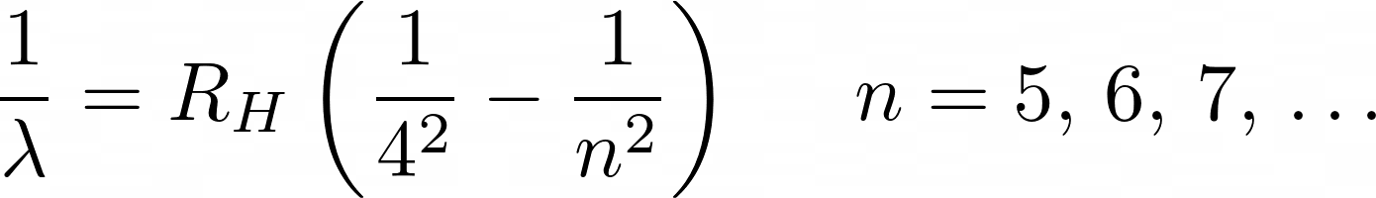
Hydrogen spectral series
The spectrum of the hydrogen atom shows other lines in addition to those of the Balmer series.
After Balmer's discovery, it was found that these other lines form other series characterized by similar empirical laws. These are the Lyman, Paschen , and Brackett series .
This regularity and the fact that the Rydberg constant appears in all these laws indicate that a fundamental theory must be at the base . But before 1900 no theory could explain these remarkable observations.

Slide 59
Thomson's model of the atom
Since ancient times, man has formulated the hypothesis of atoms and imagined these objects as the fundamental and indivisible units of matter. For this reason, they should not have any internal structure.
The model of indivisible atoms was effective in the kinetic theory of gases, but became insufficient when true elementary particles such as the electron and the proton were discovered.
In 1897, JJ Thomson established the relationship between the charge and mass of the electron. It was thus understood that the mass of atoms was mainly due to a positive charge.
Thomson therefore postulated that atoms are made of electrons trapped in a matrix in which the positive charge is uniformly distributed , much like the seeds of watermelons.

Slide 60
Rutherford's model of the atom
In 1911, Ernest Rutherford performed an experiment that showed that Thomson's model was not correct.
Rutherford used alpha particles ( helium nuclei) that were sent through a very thin sheet of metal . Most of the particles passed through the sheet and were scattered at small angles.
Some particles were nevertheless scattered at large angles, sometimes even backwards.
The positive charge distributed over a large region of space in the Thomson model does not explain these large-angle scatterings. Electrons cannot be responsible for these scatterings either because their mass is too small.

Slide 61
Rutherford's model of the atom
These observations led Rutherford to consider the hypothesis that, in atoms, the positive charge is also concentrated in a very small region of space , relative to the size of the atom. He called this region the "nucleus" of the atom .
The electrons in this model are distributed over a larger volume, which gives the size of the atom.
To explain why electrons are not attracted to the nucleus, Rutherford hypothesized that they orbit the nucleus like planets in the solar system. The model is thus called the planetary model of the atom .

Slide 62
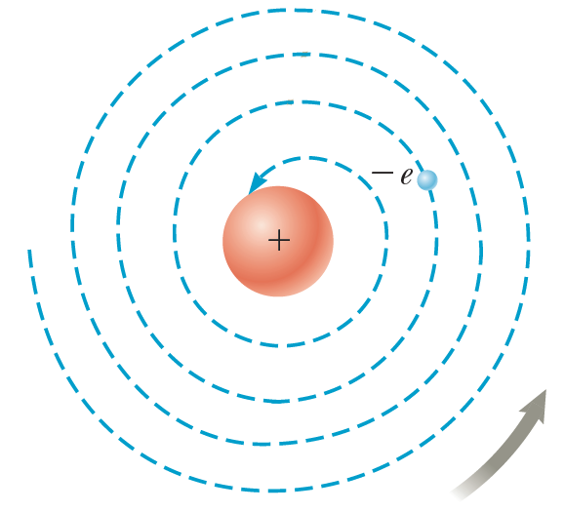
Problems of the planetary model of the atom
Rutherford's planetary model of the atom presents two difficulties of interpretation.
First, in 1911 the spectra of atoms were already widely known from experiments. The existence of discrete spectral lines was impossible to explain with this model . Indeed, in Kepler's model orbits can have arbitrary values of radius and therefore of energy.
The second difficulty is that, according to Maxwell's theory of electromagnetism, a charged particle subjected to acceleration emits radiation. The electron in a circular orbit undergoes centipede acceleration. It is therefore supposed to emit energy in the form of radiation. This loss of energy should induce a spiral trajectory that would eventually cause the electron to fall onto the nucleus . A simple calculation shows that this phenomenon would occur in a time of the order of 1 ns!
The stability of matter is an evidence of Quantum Physics!

Slide 63



Bohr's model of the hydrogen atom
In 1913 Niels Bohr proposed a new model of the hydrogen atom that resolved the difficulties of Rutherford's model.
The model is based on very strong and poorly justified hypotheses. It will be replaced in 1925 by the solution of the Schrödinger equation which explains the structure of the atom with great precision.
The electron moves in circular orbits around the nucleus as in the planetary model.
Only some orbits, among those that would be admitted by the planetary model, are stable. Bohr calls these orbits "stationary states" .
The atom emits or absorbs radiation when the electron makes a transition from one stable orbit to another . If the transition is from an orbit with a higher energy to an orbit with a lower energy, then the atom emits a photon whose frequency is determined by the difference between the energy of the initial orbit and that of the final orbit through the relation . If on the other hand, the transition is from a lower energy to a higher one, then the incident photon is absorbed (it disappears) and its energy is transferred to the electron according to
Stable orbits are determined by a very simple criterion: the angular momentum of the orbits is quantized . The quantum of angular momentum is . The Bohr radius is therefore determined by the relation

Slide 64
Bohr's model of the hydrogen atom
Some comments:
Bohr's model is not yet advanced enough to take into account notions such as the principle of complementarity, wave-particle duality, the uncertainty principle, etc. We imagine a trajectory for the electron.
However, we will see that the quantization of the kinetic momentum has a very strict link with the wave nature of electrons .
The circular trajectory hypothesis assumes that the electron, although accelerated, somehow does not emit radiation as predicted by Maxwell's equations.

Slide 65
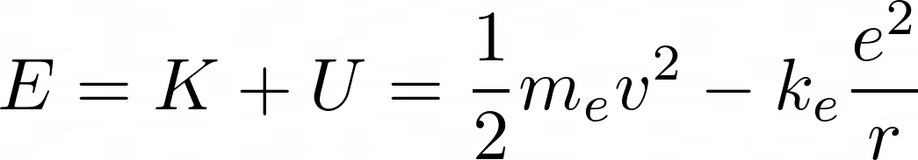
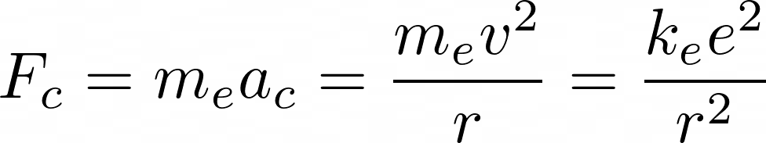

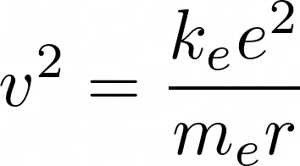
Bohr's model of the hydrogen atom
A major advance of the Bohr model is the fact that it makes quantitative predictions , particularly for the energies of stationary orbits and therefore for the wavelengths observed in the spectra of atoms.
Let us calculate the radius and energies of the orbits.
Consider the total energy of an electron orbiting a positively charged nucleus that attracts it with an electrostatic force
In the sum we have the kinetic energy of the electron K, and the potential energy due to the electrostatic attraction of the nucleus.
For a circular motion, the centripetal acceleration is given by . The orbit is defined by setting the centripetal force equal to the force of attraction. Therefore
which gives

Slide 66



Bohr's model of the hydrogen atom
Replacing the expression we just obtained for v ² in the total energy, we obtain
The total energy E is negative because the electron is "bound" to the nucleus . So it takes an energy of –E to tear the electron away from the atom. This is the ionization energy .
To obtain the expression for the quantized rays and energies, we use the hypothesis of quantization of the kinetic moment . If we determine v ² of this expression and set it equal to the previous expression, we have
from where

Slide 67



Bohr's model of the hydrogen atom
The orbits are therefore quantized. We can define a "unit" of radius called the Bohr radius
Experiments showed that the Bohr radius was a good approximation of the measured radius.
From the quantization of the radius we directly deduce the quantization of the energy
It should be noted that the spacing between the energies decreases as n increases . In the limit of large n , the energy tends to zero and the radius to infinity: this is the ionization of the atom . This is another success of Bohr's theory, because the ionization energy of the hydrogen atom had been measured to be equal to 13.6 eV!

Slide 68


Bohr's model of the hydrogen atom
The result can be used for energies, to calculate the series of emission spectra. It is necessary to consider the differences between energies, which correspond to the energies of the emitted photons.
Using λν = c, we have
The expression for the Rydberg constant, thus obtained from Bohr's theory, agrees with the experimental measurement to within 1%.
From the figure we see how this theory explains all the series observed in the spectrum.

Slide 69



Bohr's model of the hydrogen atom
How to justify the hypothesis of quantization of kinetic momentum?
If we take up de Broglie's theory, the wavelength associated with a quantum object is
If we replace in the expression for the quantification of the kinetic momentum, we have
We see that this result corresponds to asking that an orbit be composed of an integer number of wavelengths . This is intuitive, because otherwise the wave would not "cover" itself after one turn.

Slide 70
Open questions
Bohr's theory explains the hydrogen atom and atoms with only one electron, such as He⁺ , Li²⁺ , and Be³⁺ , very well. It thus allowed us to understand that the absorption lines in the spectrum of the sun were due to helium. However, the theory has difficulty explaining the spectrum of atoms with several electrons .
The theory also has difficulty explaining the "fine" features of the hydrogen atom spectrum . In particular, with technological progress in spectroscopy, it is found that each line in the different series is actually composed of several very closely spaced lines. Also, some lines separate into several lines under the effect of a magnetic field.
More generally, Bohr's theory is based on a very strong hypothesis, that of the quantification of the kinetic moment. How can such a hypothesis be justified?
We will see that the Schrödinger equation allows us to calculate very naturally the stationary states of the electron in the hydrogen atom and explain all the characteristics of the spectrum.
The quantization of the angular momentum also follows naturally from the Schrödinger equation. Better still, it can be shown that this quantization has a very deep origin in the rotational invariance of Coulomb's law (which depends only on distance, but not on direction).

Slide 71

The hydrogen atom: the “spin” of the electron
Measurements of the hydrogen atom spectrum also showed a feature that is not predicted by the Schrödinger equation. States with l = 0 are characterized by two spectral lines very close in wavelength . This feature has been called a "doublet" .
The Schrödinger equation does not allow us to explain the origin of this doublet, because for l = 0 we only expect the state with m = 0.
The work of Wolfgang Pauli, Samuel Goudsmit and George Uhlenbeck led to the introduction of a fourth quantum number, called "spin".
The physical origin of spin is quite deep. A very simplified (and largely false) classical image still gives an intuition on the mechanism at the base of spin.
We can imagine the electron as a sphere with a charged surface. If this sphere rotates on its axis (i.e. it has a "spin"), then it generates a magnetic moment associated with this rotation.
The spin component in the z direction can only take two values, called "spin up" and "spin down", which are equal to
Paul Dirac introduced the relativistic wave equation in 1927. Spin is an essential element of this extension of Quantum Physics.

Slide 72
The hydrogen atom: the “spin” of the electron
Beginning in 1921, Otto Stern and Walter Gerlach performed a series of experiments in which charged atoms were sent through a non-uniform magnetic field. The field gradient generated a force on a magnetic moment that moved through space . The beam of atoms was therefore deflected, by an angle proportional to the component of the magnetic moment parallel to the field.
The result is that only two opposite angles are measured . Each angle corresponds to a value of the component of the atom's magnetic moment.
The existence of spin has thus been demonstrated.
The same experiment was performed with hydrogen, which in its ground state would have zero magnetic moment if the spin did not exist. The result was the same, confirming the electron spin with only two possible values.

Slide 73



The magnetic moment of the electron
If an object with an electric charge e (defined with its sign) has an angular momentum L, it acquires a magnetic moment (magnetization) which, according to the laws of electromagnetism, is given by
The electron has a spin . For the electron, the value predicted by classical physics for the magnetic moment is not correct . On the other hand, we have
where g =2.002319304… is the gyromagnetic factor of the electron. The value g =2.0 is predicted by relativistic quantum physics using the Dirac equation.
The small difference with g = 2.0 is known as the anomalous magnetic moment . It is due to the interaction of the electron with the electromagnetic field of the vacuum . It is correctly predicted by quantum electrodynamics.
The vacuum does indeed have a fluctuating electromagnetic field. The principle is somewhat the same as for the zero-point energy of the harmonic oscillator.

Slide 74



The origin of the spin of elementary particles
To predict the fact that the electron (as well as most elementary particles) has a spin, non-relativistic Quantum Physics is not enough, and it is necessary to introduce relativity. However, Quantum Physics, in its mathematical structure, admits the existence of spin.
The angular momentum is described by the operator . The eigenvalues of its square modulus are, according to the measurement principle, the only possible values (which can be measured).
If we do the calculations properly, taking into account only the mathematical structure of the operator, we find that the eigenvalues are
"Half-integer" values of the angular momentum are therefore admissible according to non-relativistic Quantum Physics . However, they cannot be attributed to the motion of the electron in space.

Slide 75

Schematic of SG experiment

Slide 76

Chained SG Experiment (I)

Slide 77

Chained SG Experiment (II)

Slide 78

Chained SG Experiment (III)

Slide 79


Atoms with multiple electrons
A simple criterion for describing multi-electron atoms is to consider each electron as independent of the others . Each electron is therefore subject to an attractive force towards the nucleus.
The effect of the other electrons on the electron of interest is considered as a "screening effect" : the cloud of other electrons partially cancels the positive charge of the nucleus . The electron of interest is therefore subjected to a central Coulomb force, with "effective" charge
In this approximation, each electron is described by the four quantum numbers associated with the states of the hydrogen atom: n , l , m , s .

Slide 80
The Pauli Exclusion Principle
The Pauli exclusion principle states that no two electrons can have the same four quantum numbers . Therefore, no two electrons can be in the same quantum state.
If an electron is characterized by certain values of n, l, m, s, a second electron cannot have the same four values: at least one of the four must differ.
If this principle were not valid, all electrons would be placed in the lowest energy state, i.e. the 1s state. However, this is not what we observe from the spectra and other properties of atoms.
The physical origin of the Pauli principle is that electrons are identical particles . We are not going to see a detailed proof of this principle, which would be too complex for this course.
The quantum states that electrons can take are

Slide 81
Hund's Rule
Hund's rule states that if an atom has multiple orbitals of the same energy, electrons will fill them in such a way as to maximize the number of orbitals occupied by a single electron .
Some exceptions to this rule occur for atoms that have nearly filled subshells. These exceptions show that the rules stated here are only simplifications to characterize the states of several electrons in mutual interaction, which would otherwise be very difficult to describe by a direct solution of the Schrödinger equation.

Slide 82

The “Aufbau ”principle
The principle of Aufbau establishes that, to determine which states are occupied by electrons in an atom, it is necessary to "fill" the states in order of increasing energy , by applying the Pauli exclusion principle and Hund's rule.
More precisely, we apply the following two rules
The orbitals are filled in the order of increasing n+l.
For different orbitals with the same values of n+l , we first fill those with the smallest n.
The n+l rule is known as Madelung's rule , because it was proposed in 1936 by physicist Erwin Madelung .
For example, Titanium, with atomic number Z=22 (i.e. 22 protons in the nucleus), has the atomic configuration:
1s ² , 2s ² , 2p ⁶ , 3s ² , 3p ⁶ , 4s ² , 3d ²
n+l increasing

Slide 83


The “Aufbau ”principle
20 atoms are an exception to the Aufbau principle .
The reason is always the fact that these rules are simplifications, while the only correct description in detail would be the exact solution of the Schrödinger equation for the many interacting electrons.

Slide 85
The periodic table of elements
The periodic table of elements is arranged so that all elements in the same column have similar chemical properties.
This behavior can be explained by the structure of the corresponding electronic states.
For example, the noble gases occupy the last column on the right. These are elements where one electron shell is completely filled. Helium contains two electrons in the 1s² configuration. It is the shell with n=1 that is completely filled. Neon, immediately below, has 10 electrons in the 1s² 2s² 2p⁶ configuration . This time it is the n=2 shell that is completely filled.
The column immediately to the left is the halogen elements . In these atoms, one electron is missing to fill a shell. Therefore, these elements are chemically very active, because they have a great energetic advantage in hosting the electron that is missing to fill the shell.
The column at the opposite end contains the alkali metals . For all of these atoms, only one electron occupies the outermost shell. For this reason, this electron is more weakly bound and the atom is therefore easier to ionize.
Typically, halogens form very strong chemical bonds with alkali metals, which lose an electron very easily. This is the case, for example, with NaCl .

Slide 86
Ionization energies
The atomic structure is further confirmed from the measured ionization energies . It can be seen that the maxima correspond to the noble gases, the minima to the alkali metals. The distances between maxima correspond to the number of electrons in each electron shell .

Slide 87
Open questions
How to describe the emission and absorption spectra of atoms?
How can we explain how atoms bond together to form molecules and solids?
Can we predict and explain chemical reactions?
Is the Schrödinger equation sufficient to predict the behavior of more complex systems such as biomacromolecules ?
Is there a classical-quantum boundary, beyond which the laws of Quantum Physics no longer apply and classical physics takes their place? (answer: most likely not!)

