Slide 1
PHYS-106 (en) Thermodynamics
Week 1 - 20th February 2020
Exercise Class One

Slide 2
Linear Thermal Expansion
Δl =αl₀ΔT
ΔV = βV₀ΔT
β ≈ 3α

Slide 3
Linear Thermal Expansion
Δl =αl₀ΔT
ΔV = βV₀ΔT
β ≈ 3α
Why is it “≈” not “=”

Slide 4
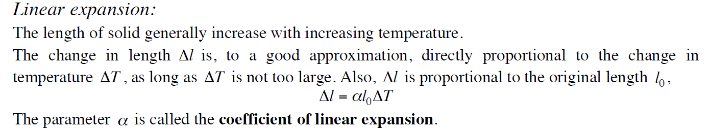
You may (or may not) have noticed

Slide 5
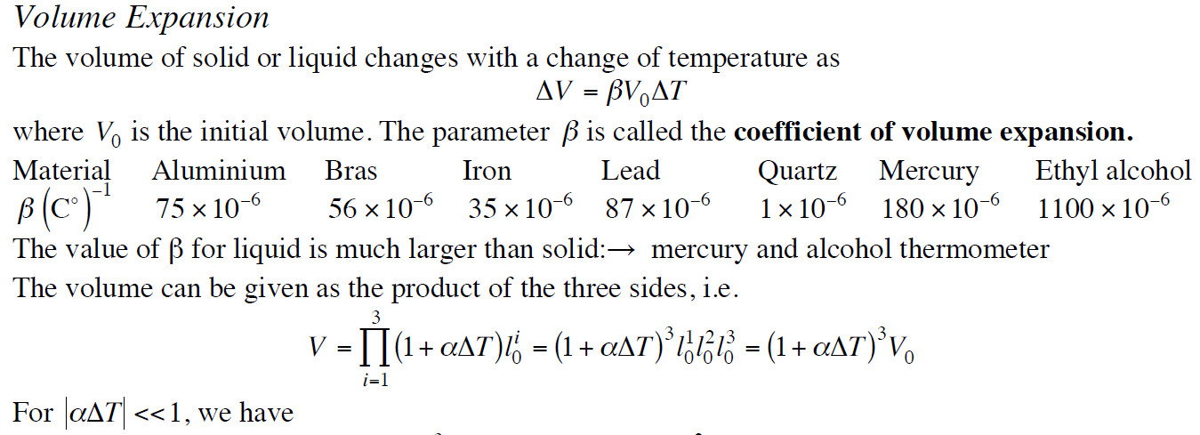
You may (or may not) have noticed

Slide 6
Why this condition?
Consider the following protocal of linear thermal expansion:
Step-1: increase the temperature by ΔT/2;
Step-2: increase the temperature by another ΔT/2.

Slide 7
Why this condition?
Consider the following protocol for linear thermal expansion:
Step-1: increase the temperature by ΔT/2;
Step-2: increase the temperature by another ΔT/2.
After the Step-1, the length of the bar is given by:
l_{step-1} = l₀ (1+αΔT/2);
and after Step-2:
l_{Step-2} = l_{Step-1} (1+αΔT/2) = l₀ (1+αΔT/2)².

Slide 8
Why this condition?
Consider the following protocol for linear thermal expansion:
Step-1: increase the temperature by ΔT/2;
Step-2: increase the temperature by another ΔT/2.
After the Step-1, the length of the bar is given by:
l_{step-1} = l₀ (1+αΔT/2);
and after Step-2:
l_{Step-2} = l_{Step-1} (1+αΔT/2) = l₀ (1+αΔT/2)².
Nonlinear relationship - different from Δl =αl₀ΔT !

Slide 9
What if there are n steps – continuous rise of temperature?
Temperature increase by ΔT/n for each step, and the length of the bar after n-steps is:
l_{Step-n} = l₀ (1+αΔT/n)^{n} = ?

Slide 10
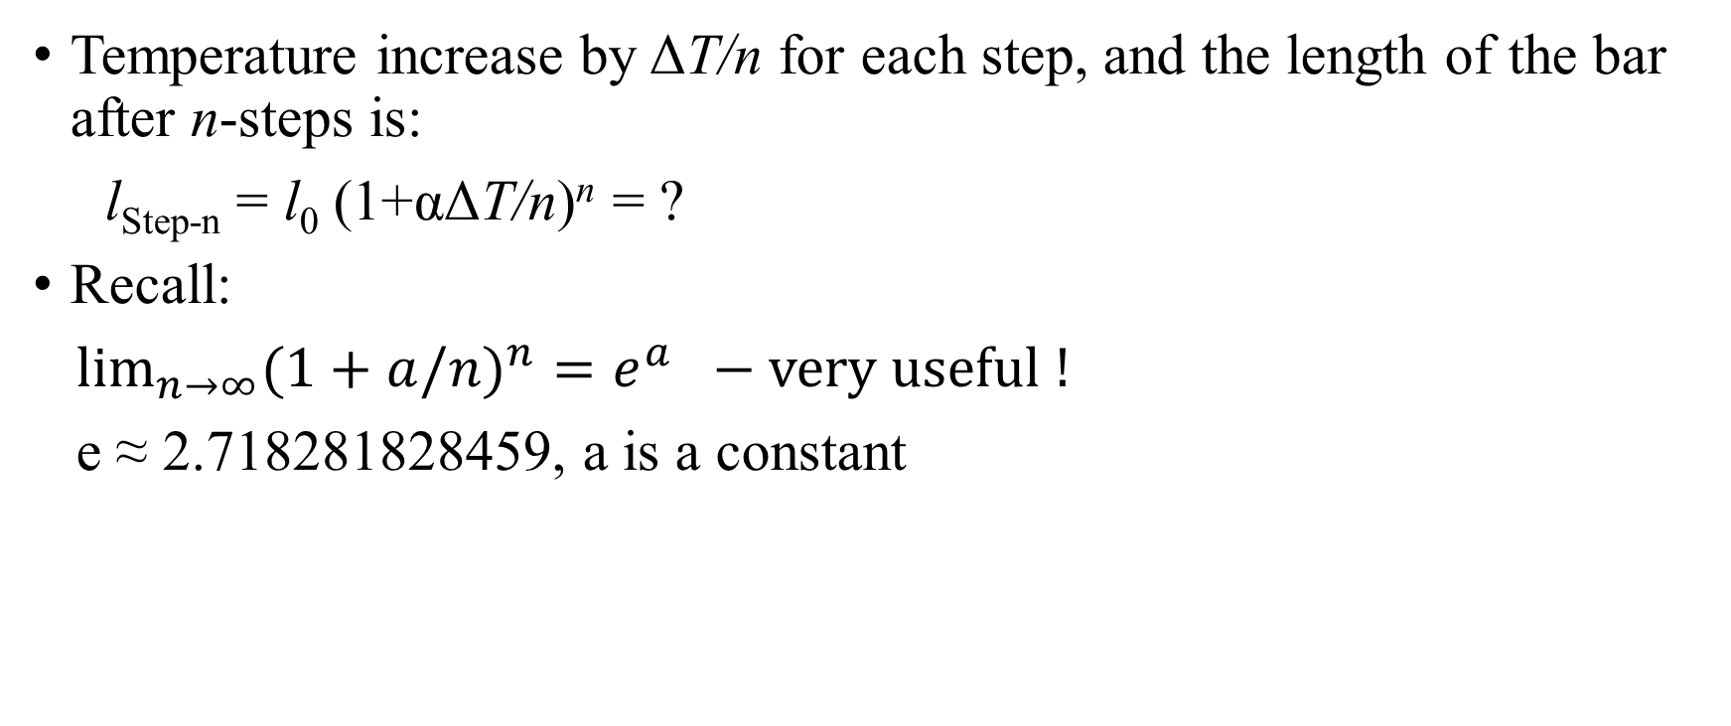
What if there are n steps – continuous rise of temperature?
Temperature increase by ΔT/n for each step, and the length of the bar after n-steps is:
l_{Step-n} = l₀ (1+αΔT/n)^{n} = ?
Recall:
$\lim_{n→∞}{{(1+a/n)}^{n}}=e^{a} −very useful !$
e ≈ 2.718281828459, a is a constant

Slide 11
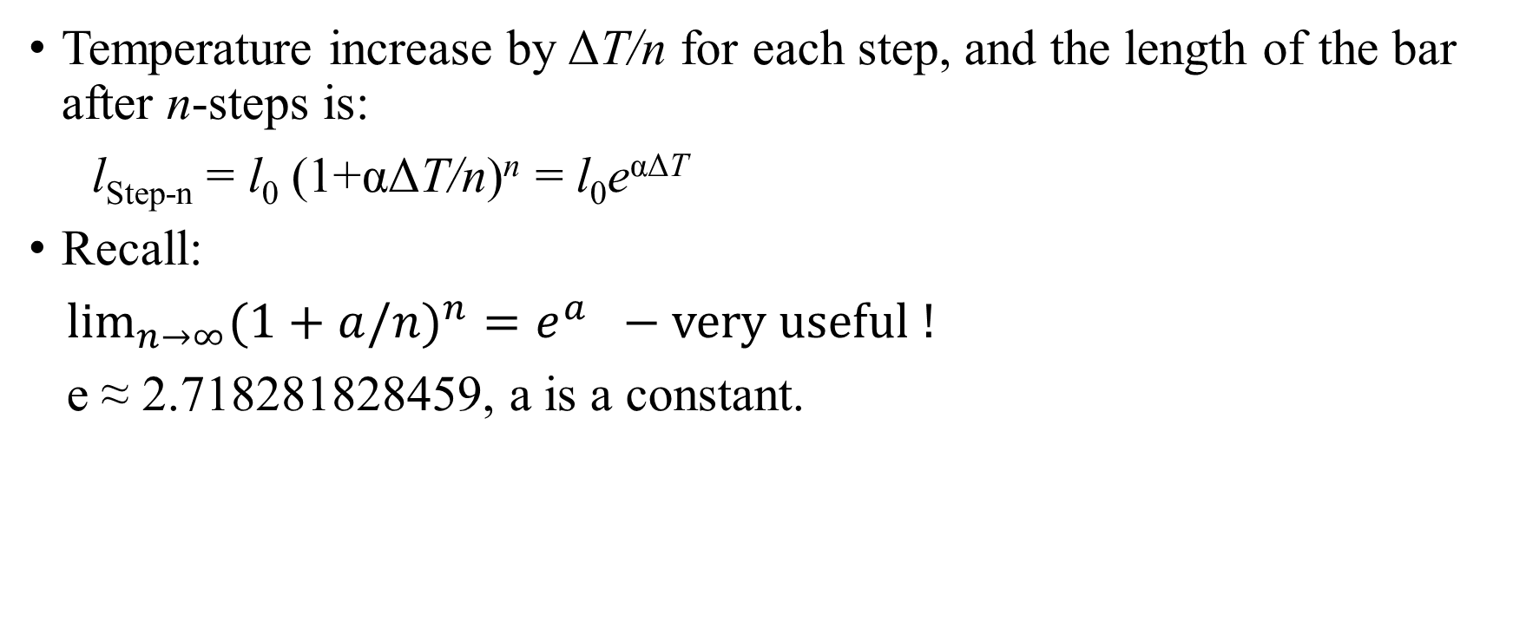
What if there are n steps – continuous rise of temperature?
Temperature increase by ΔT/n for each step, and the length of the bar after n-steps is:
l_{Step-n} = l₀ (1+αΔT/n)^{n} = l₀e^{αΔT}
Recall:
$\lim_{n→∞}{{(1+a/n)}^{n}}=e^{a} −very useful !$
e ≈ 2.718281828459, a is a constant.

Slide 12
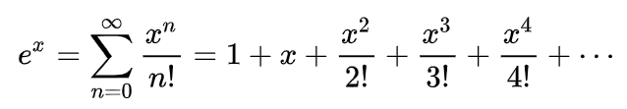
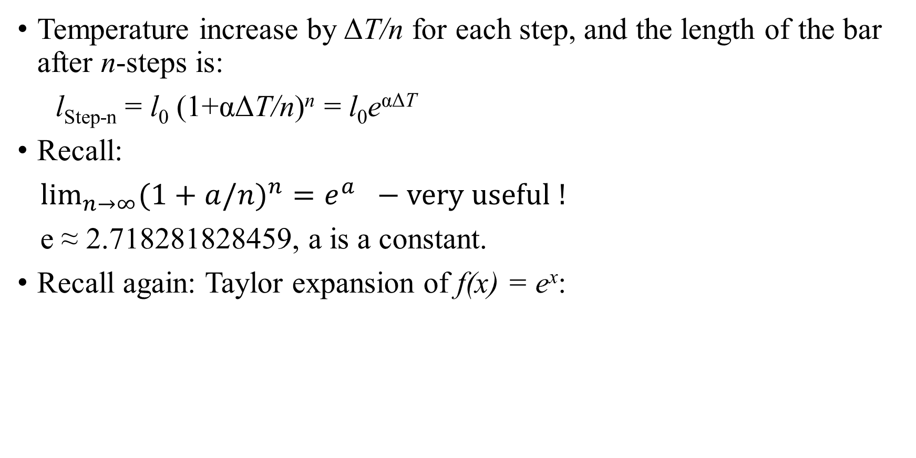
What if there are n steps – continuous rise of temperature?
Temperature increase by ΔT/n for each step, and the length of the bar after n-steps is:
l_{Step-n} = l₀ (1+αΔT/n)^{n} = l₀e^{αΔT}
Recall:
$\lim_{n→∞}{{(1+a/n)}^{n}}=e^{a} −very useful !$
e ≈ 2.718281828459, a is a constant.
Recall again: Taylor expansion of f(x) = e^{x}:

Slide 13
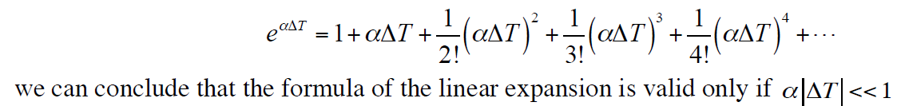
What if there are n steps – continuous rise of temperature?
Temperature increase by ΔT/n for each step, and the length of the bar after n-steps is:
l_{Step-n} = l₀ (1+αΔT/n)^{n} = l₀e^{αΔT} ≈ l₀ + αl₀ΔT,
We have returned to the linear thermal expansion formula that we met in the lecture: Δl =αl₀ΔT.

Slide 14
How much should I care?
Melting temperature of:
Aluminium – 933 K
Iron – 1811 K

Slide 15
How much should I care?
Melting temperature of:
Aluminium – 933 K
Iron – 1811 K
Estimate a 1 meter long iron bar and aluminium bar: assuming linear thermal expansion from room temperature (300 K) to melting point, the length will be:
Compare your results with that obtained from the precise formula of thermal expansion …

Slide 16
How much should I care? - Nothing
Unless you melt the solid…

Slide 17
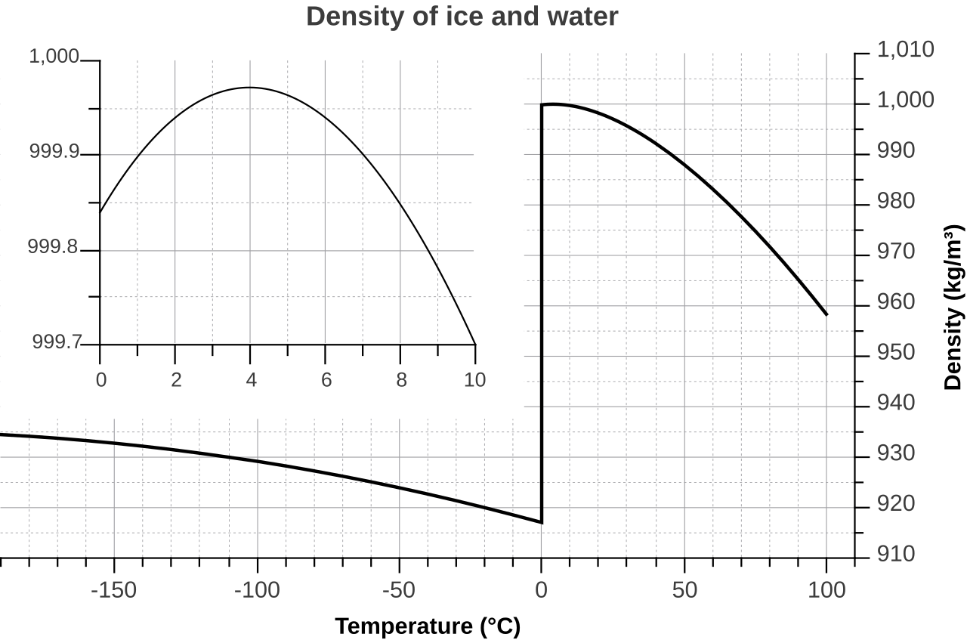
Anomalous behaviour of water
The density of water decreases (volume increases) with decreasing temperature, and it reaches at its maximum at 4 ºC, 1000 kg/m³.

Slide 18
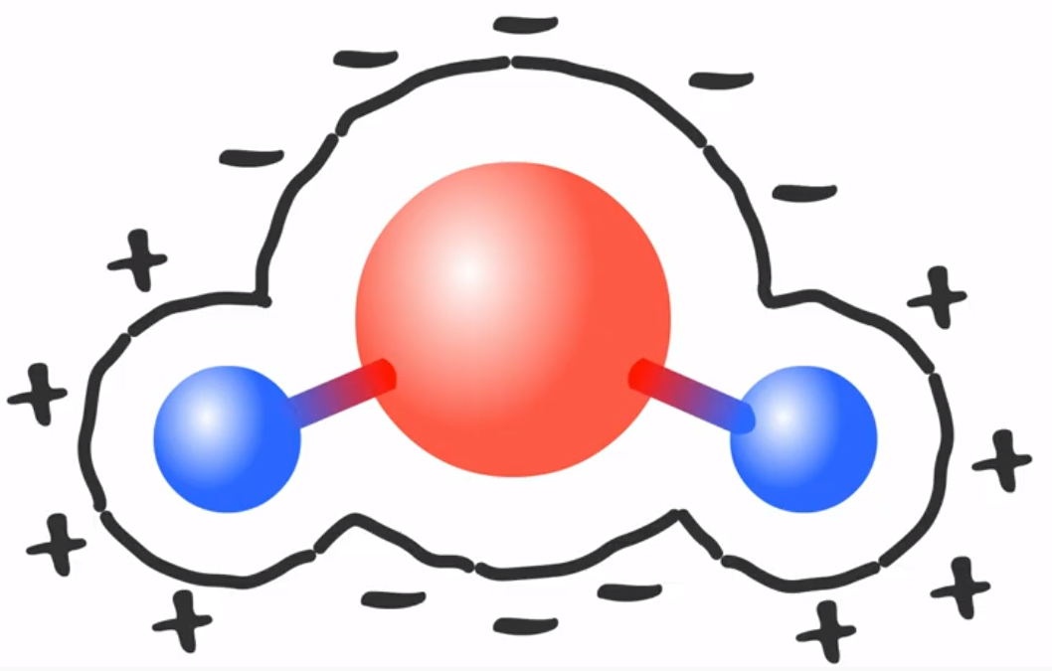
Reason
Inter-molecular force – also known as hydrogen bonds.
Thanks to the polar structure of water molecule!
https://www.youtube.com/watch?v=UukRgqzk-KE
O
H
H

