Slide 1
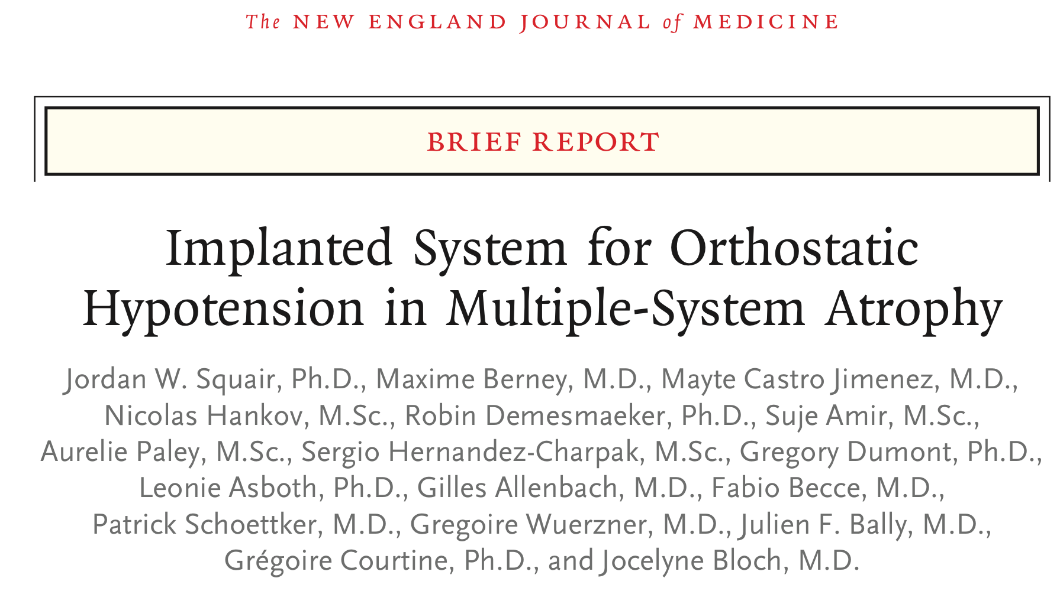
Martina Curcuruto, Beatrice Campo, Timofei Tunekov

Slide 2
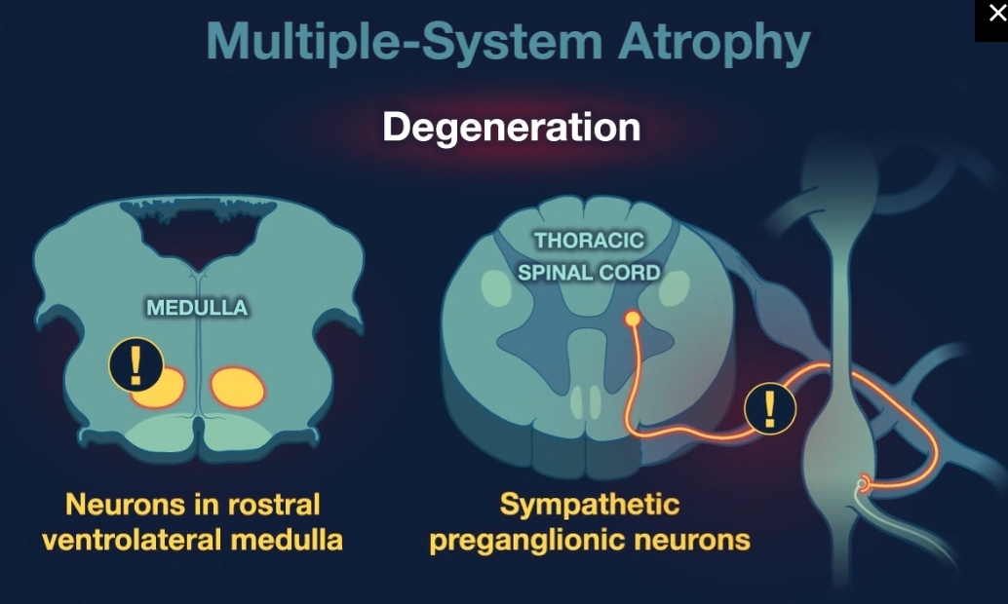





Background – Multiple System Atrophy (MSA)
Rare neurodegenerative disorder
Usually treated with drugs
Cerebellar or Parkinsonian subtype
Manifests as
Orthostatic hypotension: neuronal degeneration disrupts the regulation of BP and HR in response to upright posture
With preservation of sympathetic ganglia

Slide 3

Background – Case report
THE PATIENT
4 years history of limb rigidity
Tremor in both hands
Bradykinesia
Parkinson’s disease
Motor signs
MSA of the parkinsonian type
Limb spasticity, orthostatic hypotension, supine hypertension, incontinence…
Fail of pharmacologic treatment

Slide 4
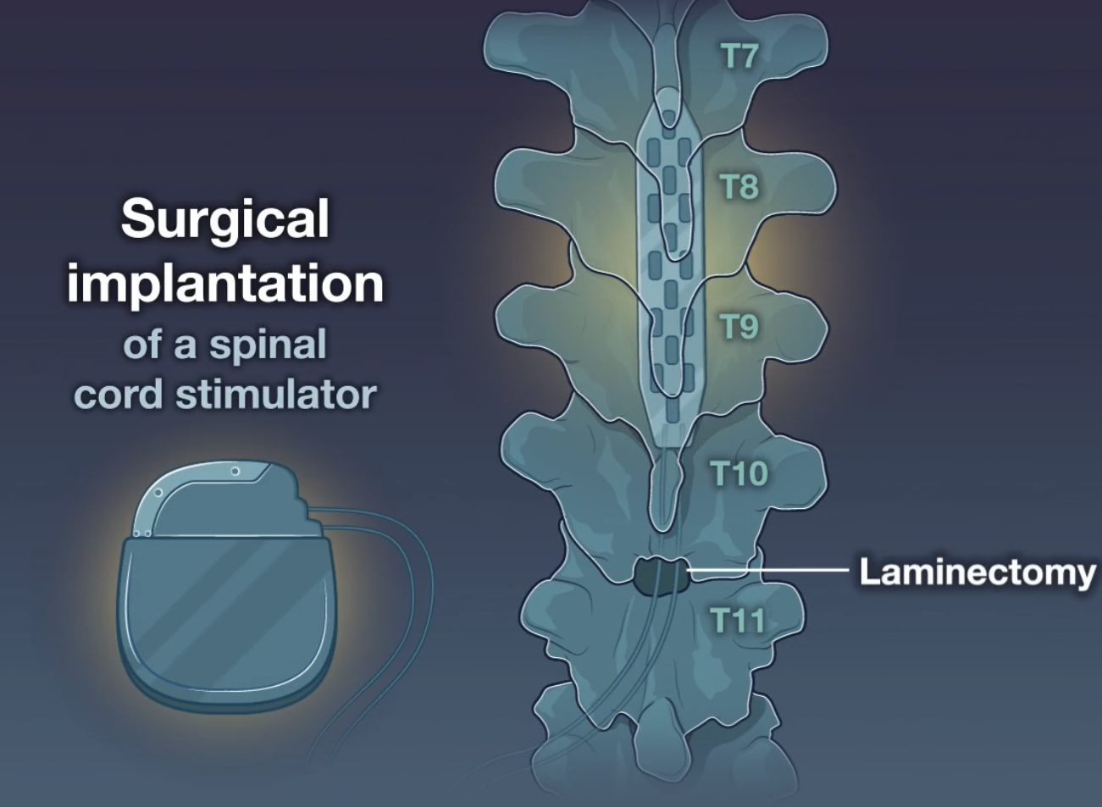
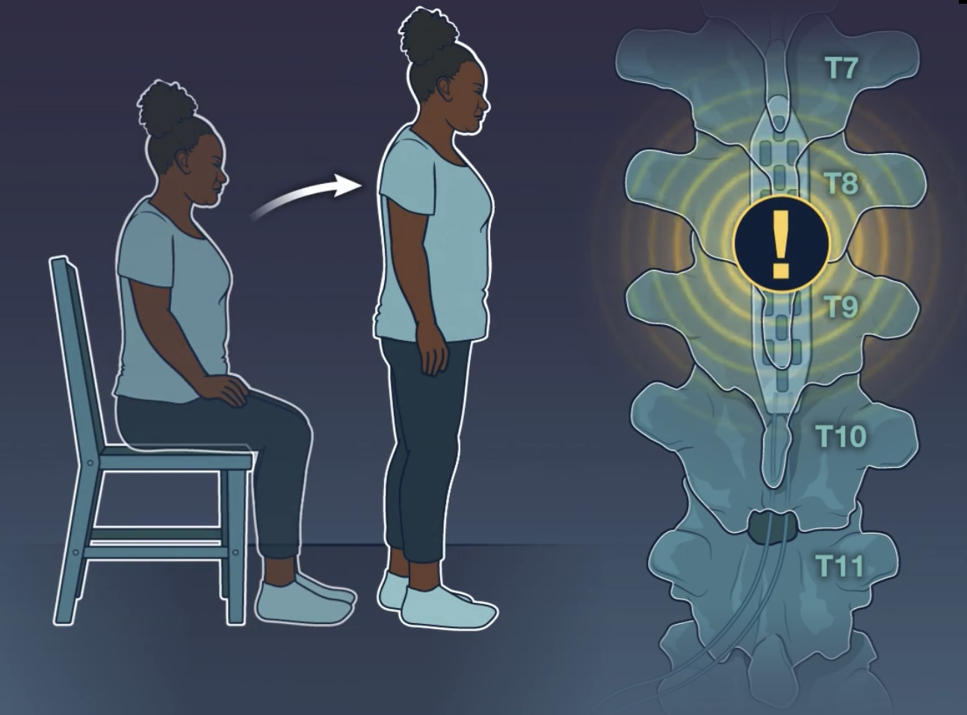
Methods - Proposed solution
Over the thoracic spinal cord

Slide 5
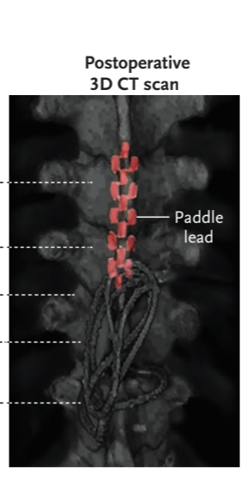
Methods - Proposed solution
Same approach for a patient with orthostatic hypotension due to a spinal cord injury.
The most pronounced pressor responses to spinal cord stimulation occurred when the stimulation is in the dorsal-root entry zone innervating the lower thoracic spinal segment
Over the thoracic spinal cord
Structural MRI sequence to identify the target area due to inter individual variability of the spinal cord anatomy

Slide 6
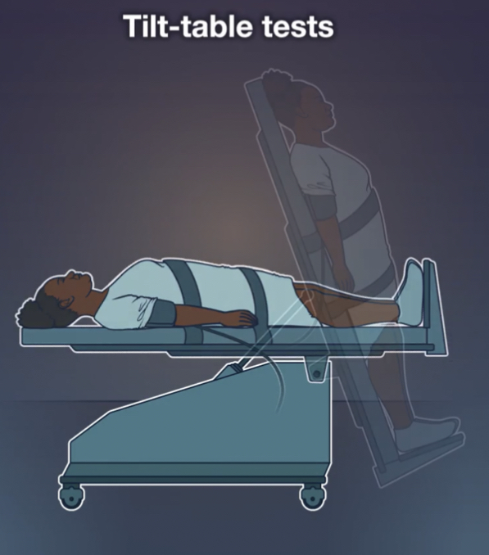
Methods - Preoperative assessments
Tilt-table tests (twice 2 different days)
HR and BP measured
Resting position: 120mmHg
70-degree up-right posture: drop to <50mmHg
(Within 1 minute)
HR: 100bpm

Slide 7
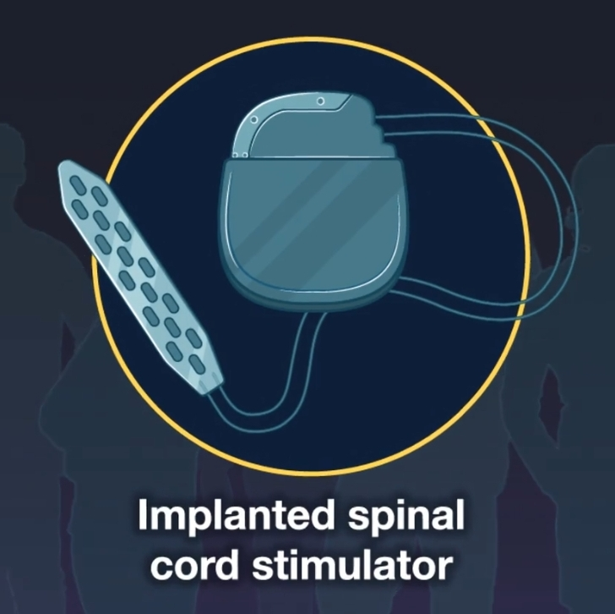
Methods - Implantable system
Implantable pulse generator, includes:
Embedded 3-axis accelerometer to detect body position (Intellis, Medtronic)
Specify 5-6-5 paddle surgical lead (Medtronic)
The system requires external wireless recharging
Implanted subcutaneously in the paraumbilicar region and it is connected to the electrode paddle by subcutaneous wires.

Slide 8
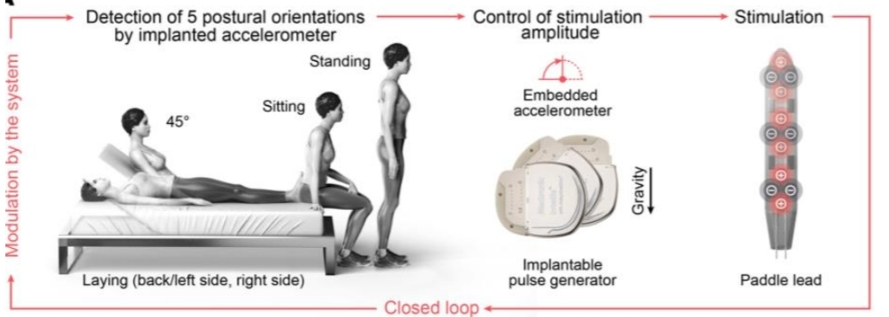
Final implant
Figure 1 Configuration of the closed-loop implantable system

Slide 9
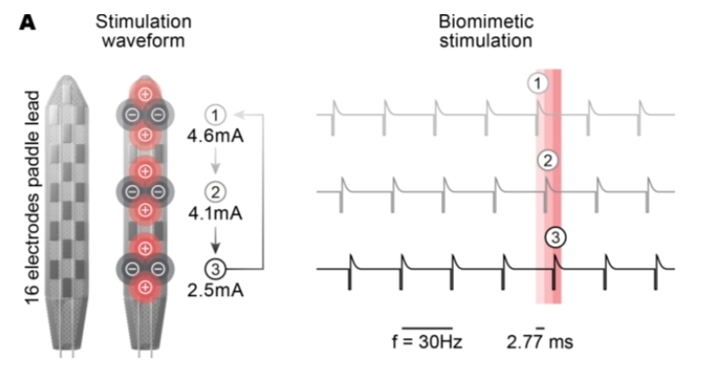
Final implant
Panel A Electrode configurations for each of the three waveforms leading to optimal pressor responses. The train of pulses associated with each waveform is shown on the right together with an emphasis on the short delay between each waveform, which aims to replicate the natural propagation of information down the spinal cord

Slide 10
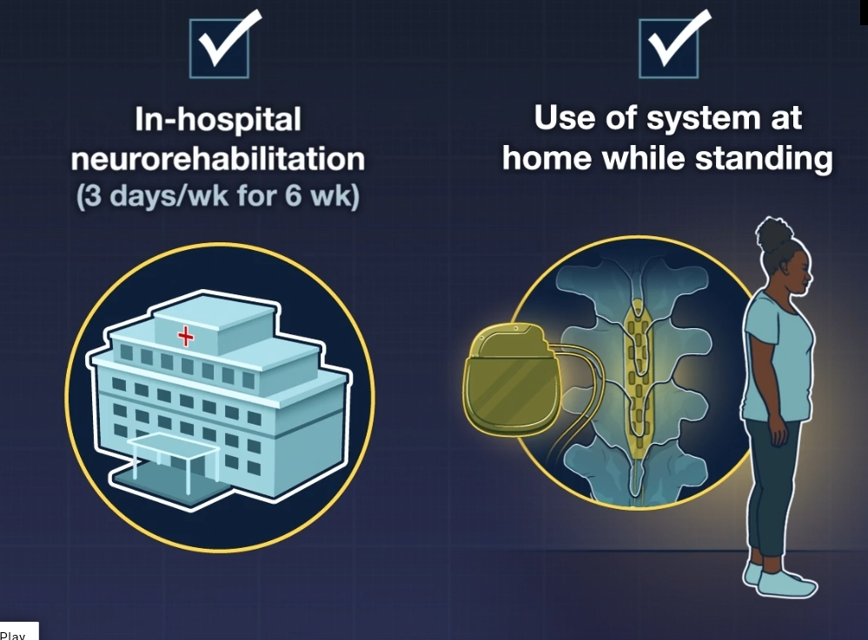
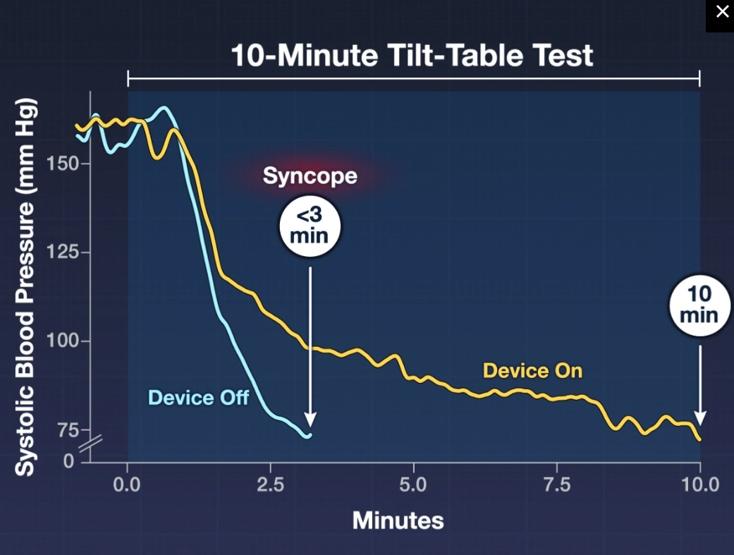
Results
With the system turned on:
Slower decline in systolic blood pressure
No presyncopal symptoms throughout the complete test
Increase in sudomotor function in patient’s feet

Slide 11
Results
The implantation was followed by 3 weeks of neurorehabilitation in the hospital and 3 weeks of autonomic neurorehabilitation and continuous use of the system at home.

Slide 12
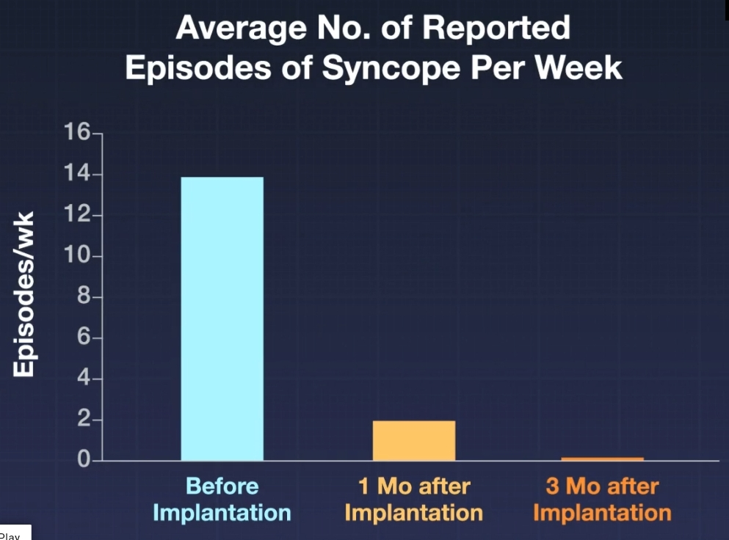
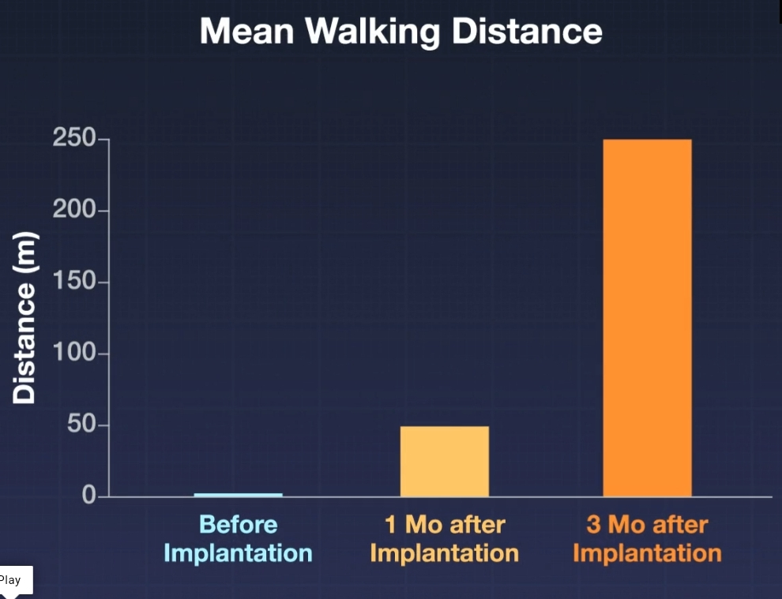
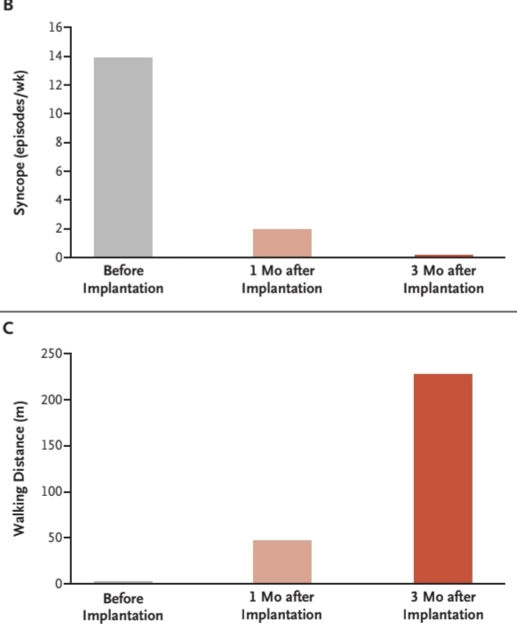
Results
Panel B shows a bar plot of the average number of
reported episodes of syncope per week before implantation of the system
and at 1 and 3 months after implantation, when the system was turned on
daily
Panel C shows the mean walking distance before implantation of the system and at 1 and 3 months after implantation, with autonomic neurorehabilitation and daily use of the system at home.

Slide 13
Novelty
Implantable system instead of pharmacologic treatments which were not effective for the patient
Stimulation of the lower thoracic spinal segments of the spinal cord which regulate sympathetic nervous system
Translation of a device from SCI patient to MSA patient
Closed-loop adjustment of stimulation amplitudes in the upright, sitting, and supine positions in dependence of the implantable accelerometer's indications

Slide 14
Limitations
Short-term research (8 months)
Conducting the research on a single patient
(intra-patient variability)
The lack of a control group that would receive standard pharmacological treatment to compare results
Role of repeated tilt-table tests and walking attempts in improvement

Slide 15
Challenges
The patient's consent to performing of the risk spinal cord surgery with potential side effects​
Development of a system that simultaneously includes implantable paddle surgical lead, stimulation generator, body position sensors, as well as settings for automatic adjustment during the changing of body position
Implantation of the paddle lead into the particular area containing the dorsal-root entry zone of the lower thoracic spinal segments
Development of the stimulation algorithm patient and position specific

Slide 16
Open Questions
The long-term effectiveness of the implanted system is unknown
Repeated tilt-table tests and walking attempts may have played a role in improvement in the patient’s condition
Long-term side effects
The effect of the implanted system on the progression of MSA
The effectiveness of the system for treatment of another MSA subtype (MSA-C with predominantly cerebellar deficits)

Slide 17
Thanks for the attention,
any questions?

Slide 18
References
[1] Jordan W. Squair et al., Implanted System for Orthostatic Hypotension in Multiple-System Atrophy
[2] Rowald, A., Komi, S., Demesmaeker, R. et al.Activity-dependent spinal cord neuromodulation rapidly restores trunk and leg motor functions after complete paralysis. Nat Med 28, 260–271 (2022). https://doi-org.proxy.findit.cvt.dk/10.1038/s41591-021-01663-5

Slide 19
Supplementary Slides

Slide 20
Background – Case report
Medication and diagnostic history
Parkinson’s disease
Motor signs
Levopa-benserazide treatment
Partially reduced the signs
MSA of the parkinsonian type
Limb spasticity, orthostatic hypotension, supine hypertension, incontinence…
Preservation of sympathetic innervation (cardiac imaging)
1 year after diagnosis:
The patient could no longer stand for more than few minutes and short distances
1-3 syncopal episodes per day

Slide 21
Background – Case report
Medication and diagnostic history
Drug treatment
Levodopa-benserazide
Fludrocortisone (then discontinued because causing supine hypertension)
Midodrine (scalp pruritus, medication doses decreased)
Domperidone
One month after:
She had presyncopal synthoms during attempts to stand
3-4 episodes of syncope per day
Levodopa-bensarazide (increased dose, but was causing increasing orthostatic hypotension)
Syncope episode occurred within 60seconds after standing,
The patient became bedridden
Conservative measures were not sufficient
(Leg crossing, compression stocking)
Failure of pharmacologic treatment

Slide 22
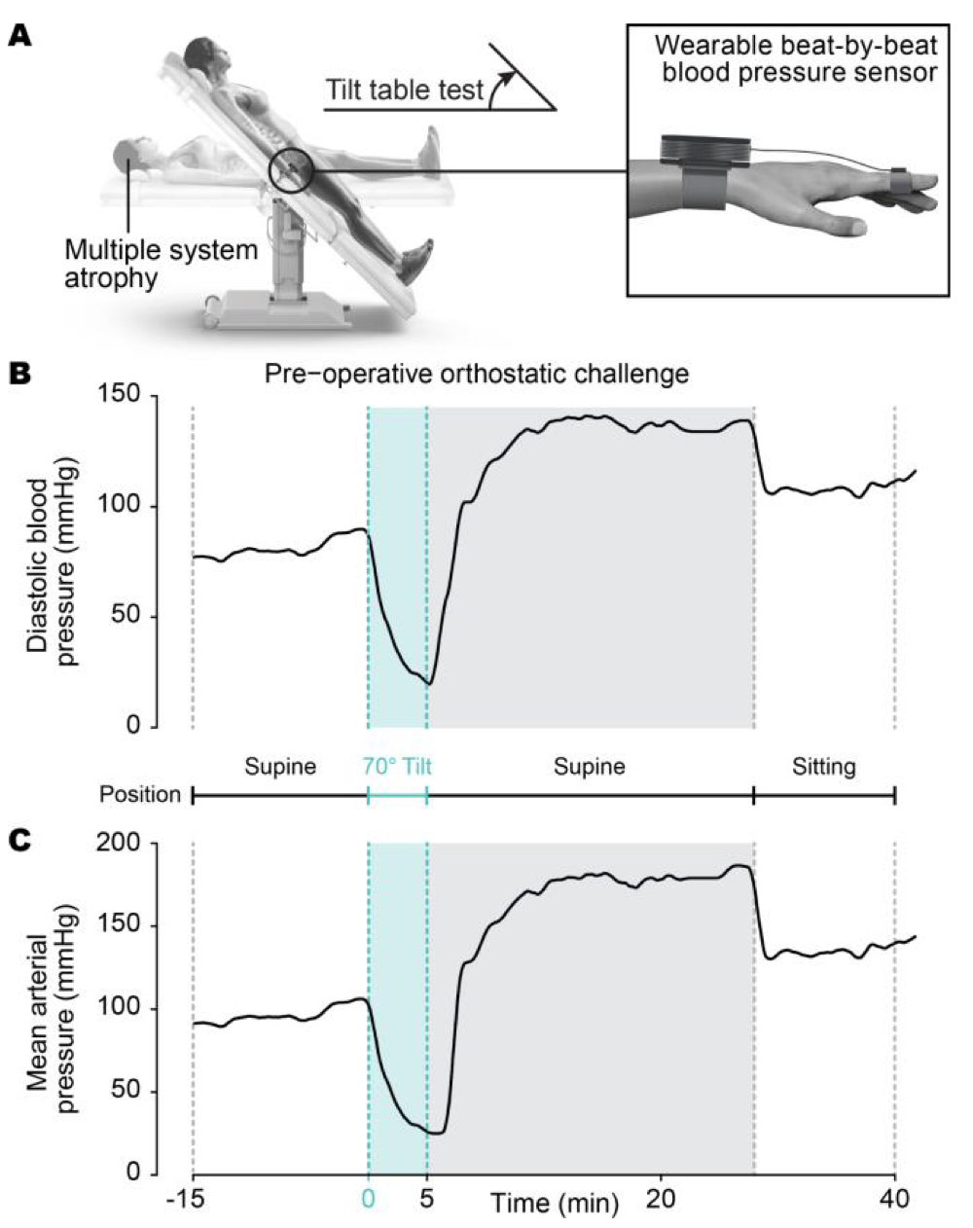
Methods – preoperative assessment
Data acquisition methods:
Beat-to-beat BP obtained via finger plethysmography
DBP pressure in the arteries during diastole. Important to assess organ perfusion
MAP average pressure in the arteries through a cardiac cycle

Slide 23
Methods – surgical procedure
The surgery was performed under general anesthesia (profol)
To minimize depression of sympathetic nervous system activity
Patient BP and HR were monitored with an implanted arterial catheter connected to a monitoring system
The stimulator and accelerometer were implanted subcutaneously in the paraumbilicar region and were connected to the electrode paddle by subcutaneous wires.

Slide 24
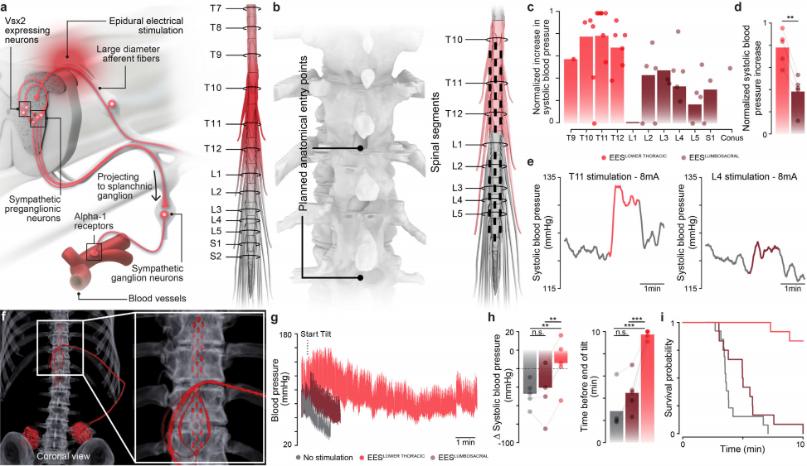
Location of Hemodynamic hotspot

Slide 25
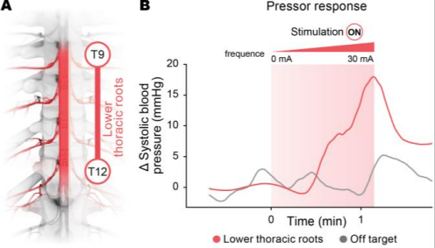
Intraoperative control
Figure S3: Panel A The dorsal root entry zones of the lower thoracic roots were targeted with the
implantable system. Panel B Pressor responses measured intraoperatively when the stimulation was
delivered with electrode configurations that targeted versus did not target the dorsal root entry zones of the
lower thoracic spinal segments (i.e., the region of the spinal cord with an enrichment of preganglionic
sympathetic neurons involved in the regulation of blood pressure).
At 100 Hz, for 0,5 ms with increasing current

Slide 26
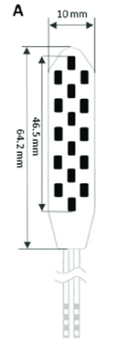
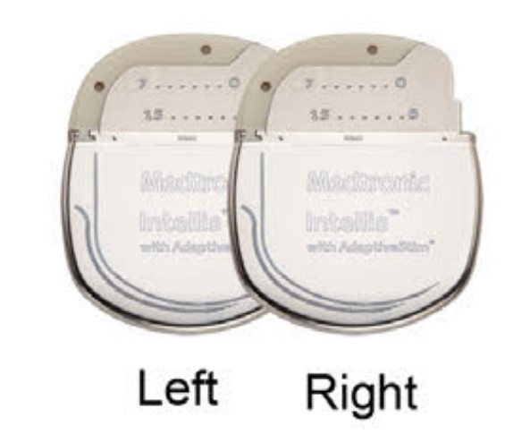
Pulse Generator features

Slide 27
Stimulation settings
Software: CT900 Clinicial Tablet Programmer
When: 1 day after surgery
Positions: Supine, Sitting, upright
For how long: 7 days (2 hours per session)
Pressure: arterial catheter
3 combination of anode and cathode that stimulated from both sides all the dorsal entry, amplitude and frequency were fine-tuned so that the patient
could maintain an upright position for at least
5 minutes while avoiding discomfort from muscle
contraction or paresthesia due to local stimulation
Figure S4: Panel A Electrode configurations for each of the three waveforms leading to optimal pressor responses. The train of pulses associated with each waveform is shown on the right together with an emphasis on the short delay between each waveform, which aims to replicate the natural propagation of
information down the spinal cord

Slide 28
Closed-loop system
Data from the 3-axis accelerometer were linked
to positions selected with the clinician programmer via the position-adaptive stimulation algorithm.
A total of 5 positions were configured: upright, sitting, sitting reclined, lying back and lying left. Detection
of change in postural orientation triggered an automated adjustment of the stimulation amplitude
to a pre-defined, position-dependent stimulation protocol previously defined by the patient and
clinician. This closed-loop adjustment of the amplitudes for each stimulation waveform enabled
amplitude adjustments of the implanted system to the ongoing orthostatic challenge.

Slide 29
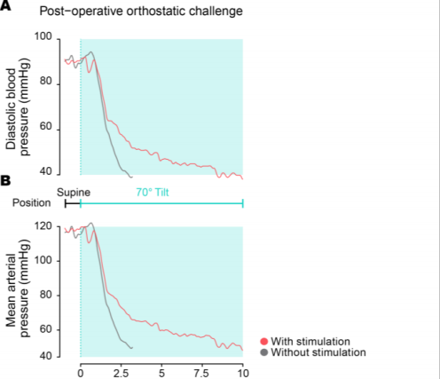
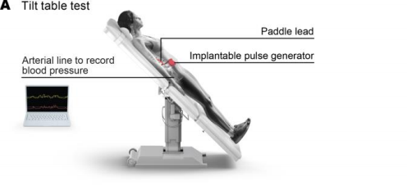
Post-operative tests
Figure S6:
Panel A Schematic of the post-operative Tilt Table test.
Figure S7:
Panel A Changes in diastolic blood pressure over the course of the 10-min Tilt Table without and with stimulation.
Panel B Changes in mean arterial pressure over the course of the 10-min Tilt Table
without and with stimulation. Beat-to-beat blood pressure and heart rate was obtained via an implanted arterial line connected to a monitoring system (IntelliVue X3, Koninklijke Philips N.V, NL)

Slide 30
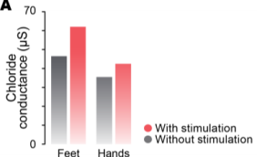
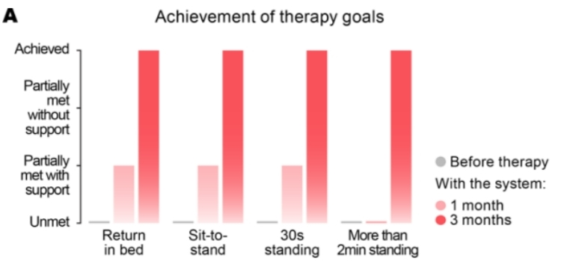
SudoScan and therapy
Figure S8: Chloride conductance in the feet and hands without and with stimulation with SudoScan device
Figure S10: Bar plot reporting the achievement of therapeutic goals before therapy, at one month
after autonomic neurorehabilitation, and at three months after the onset of therapy. The physiotherapist
discussed with the patient to define therapeutic goals to augment her autonomy

Slide 31
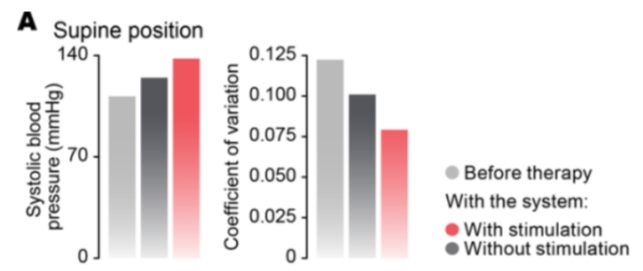
Systolic blood and coefficient of variation
Figure S11: Mean systolic blood pressure and its coefficient of variation over the course of a 7-
hour time window before the therapy, and at three months after the therapy without and with the system
turned on.

