Slide 1
MSE-494 Quantum materials: fundamentals and applications Week 8, Spring 2025
Gregor Jotzu
Dynamic Quantum Materials Laboratory
Notes:
French
French?

Slide 2
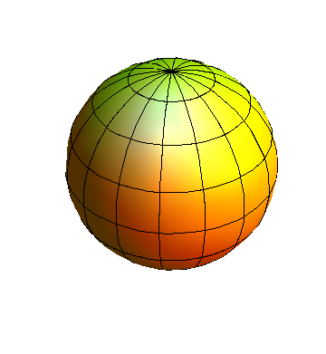
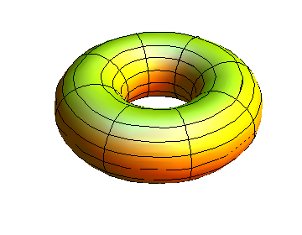

Slide 3



$$4π$$
$$0π$$
Can look similar locally,
but differ globally:
$$\int_{S }{K\left(r\right)}d^{2}r$$

Slide 4
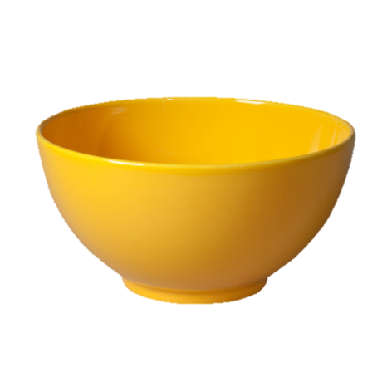
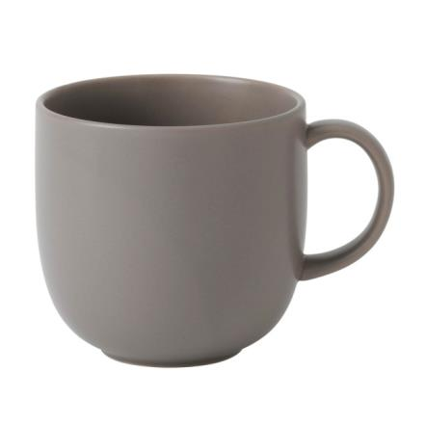
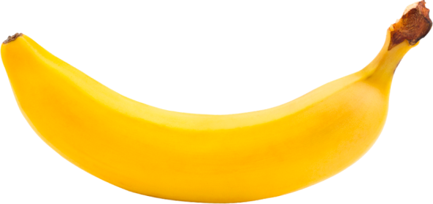
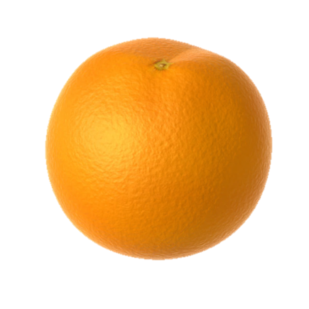
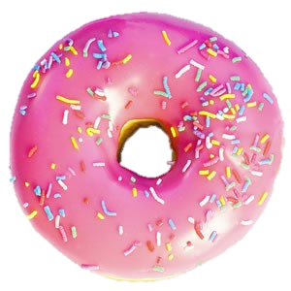


$$4π$$
$$0π$$

Slide 5
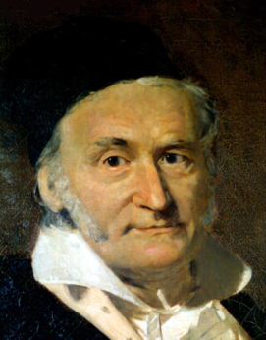
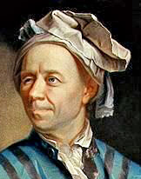

$$\int_{S }{K\left(r\right)}d^{2}r = 2π χ$$
Gaussian
Curvature
Euler
Characteristic
Notes:
LOCALLY CAN LOOK VERY SIMILAR

Slide 6
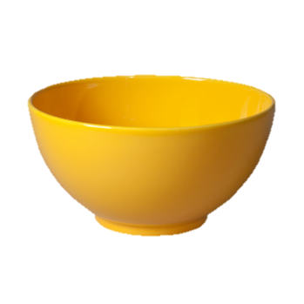

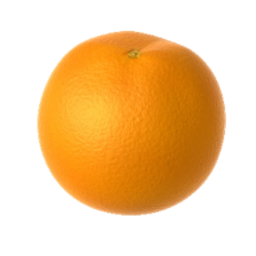


Slide 7
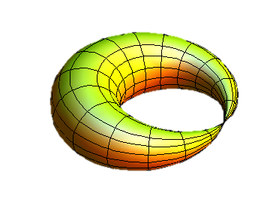
“Cut and glue”

Slide 8
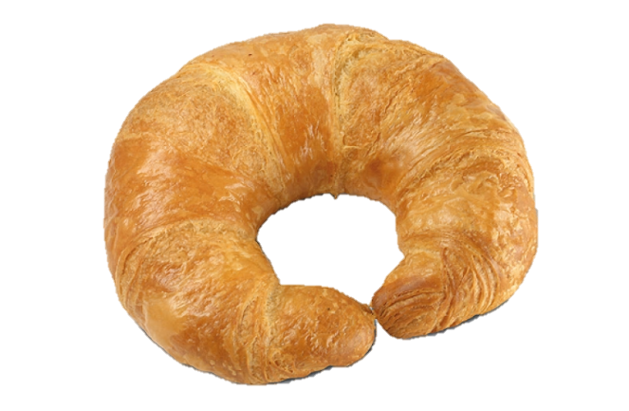
Topological transition AKA
“Gipfeli point”
Notes:
Hope you all had breakfast...

Slide 9


$$4π$$
$$0π$$
“Topologically different” means:
Need to “cut and glue” to go
from one topology to another
2) A local quantity (curvature), when integrated over
the whole system, is distinct.
Notes:
Two objects are topolocigally different if…
We will return
CMP seemed for a long time…

Slide 10
Physical consequences: The “Hairy Ball Theorem”
2 vortices
No vortices

Slide 11
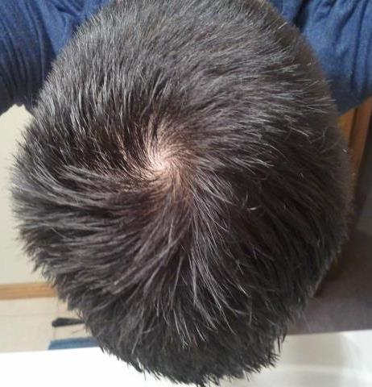
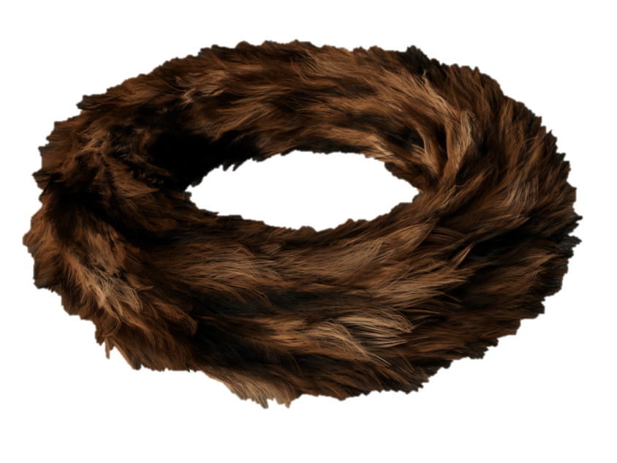
Physical consequences: The “Hairy Ball Theorem”
2 vortices
No vortices

Slide 12
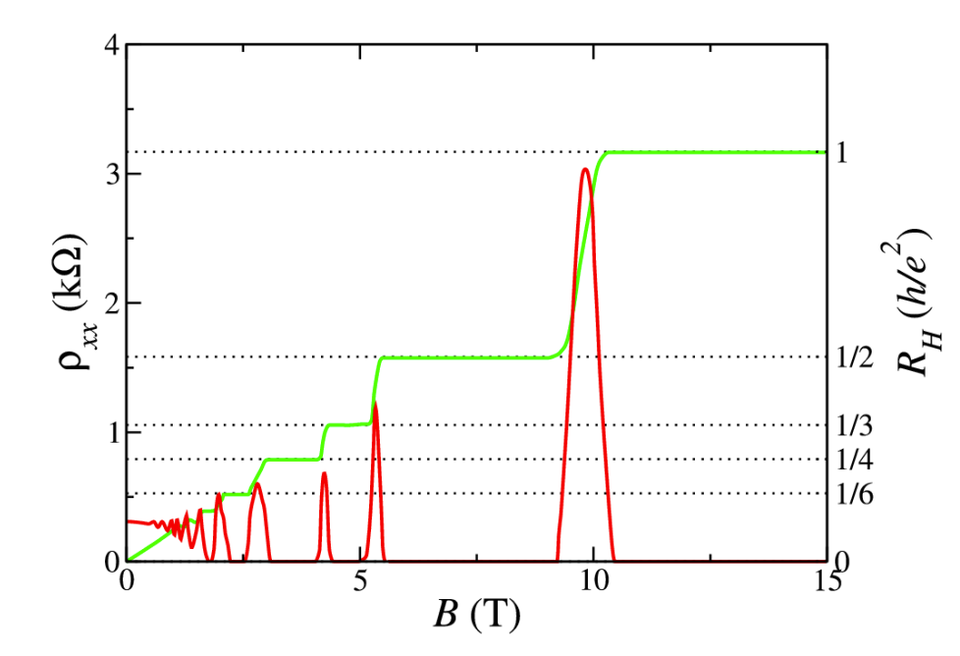
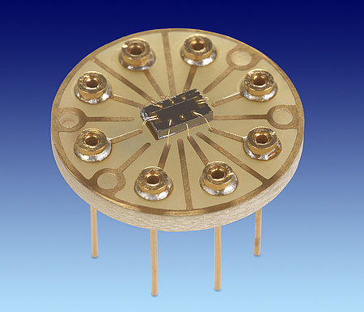
Physical consequences: The Quantum Hall effect
Manchester University

Slide 13
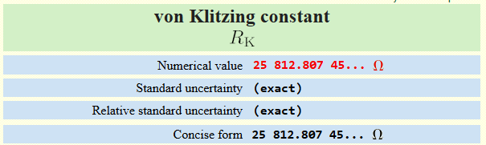
Physical consequences: The Quantum Hall effect
Manchester University

Slide 14
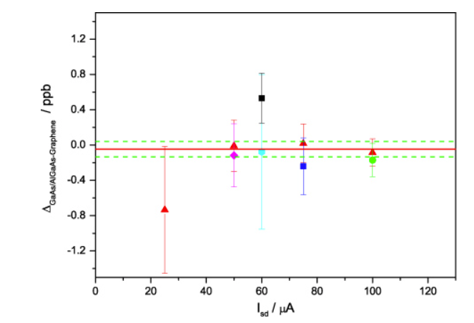
Physical consequences: The Quantum Hall effect
T J B M Janssen et al 2012 Metrologia 49 294

Slide 15
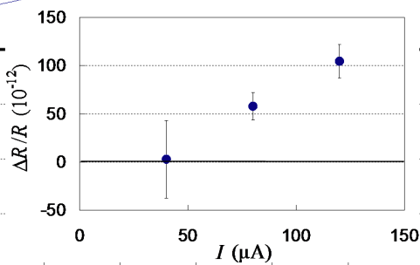
Physical consequences: The Quantum Hall effect
J. Appl. Phys, 114, 064508 (2013)

Slide 17
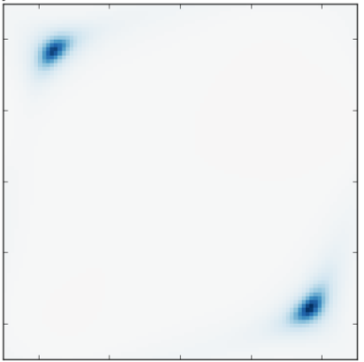


$$\int_{BZ}{Ω\left(q\right)}d^{2}q = \oint_{𝓒}{{\vec{A}}_{ }∙d\vec{q}}=0?$$
$$\text{Exp}\left[i\int_{BZ}{Ω\left(q\right)}d^{2}q\right]=\text{Exp}\left[i\oint_{𝓒}{{\vec{A}}_{ }∙d\vec{q}}\right]$$

Slide 19
Aharonov-Bohm Phase
Magnetic
Field
Closed loop in
real space
Magnetic Vector-Potential
Notes:
REVEALS THE STRUCTURE OF THE EIGENSTATES

Slide 20



Aharonov-Bohm Phase
Berry Phase
$$γ$$
Magnetic
Field
Berry
Curvature
$$Ω$$
Closed loop in
real space
Closed loop in parameter
(e.g. momentum) space
$$γ=\int_{S}{Ω\left(q\right)}d^{2}q = \oint_{𝓒}{{\vec{A}}_{ }∙d\vec{q}}$$
Magnetic Vector-Potential
Berry Connection
Notes:
REVEALS THE STRUCTURE OF THE EIGENSTATES

Slide 22

Measuring the Berry Curvature
→ Enclosed Berry curvature
→ Phase-gradient in
momentum-space
→ Velocity in real-space
$$Ω$$

Slide 23
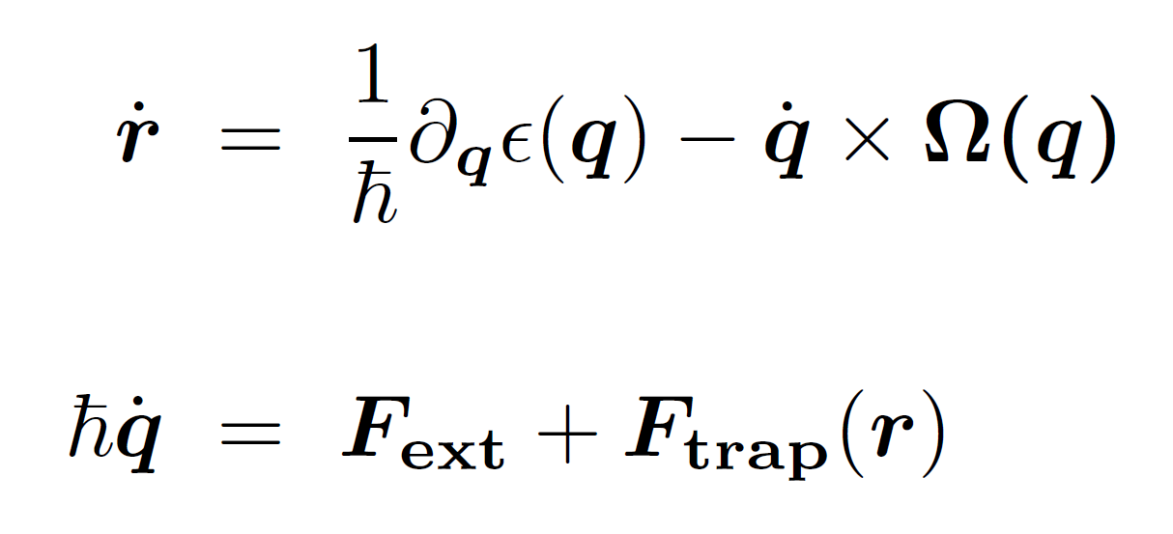
Measuring the Berry Curvature
$$Ω$$
Karplus & Luttinger , Phys. Rev. 95, 1154 (1954)
Chang & Niu, PRL 75, 1348 (1995)
Dudarev et al. PRL 92, 153005 (2004)

Slide 24
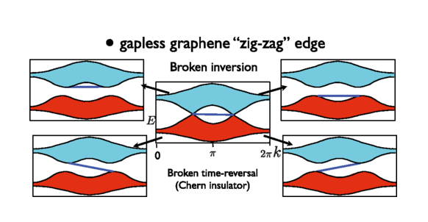

Slide 25
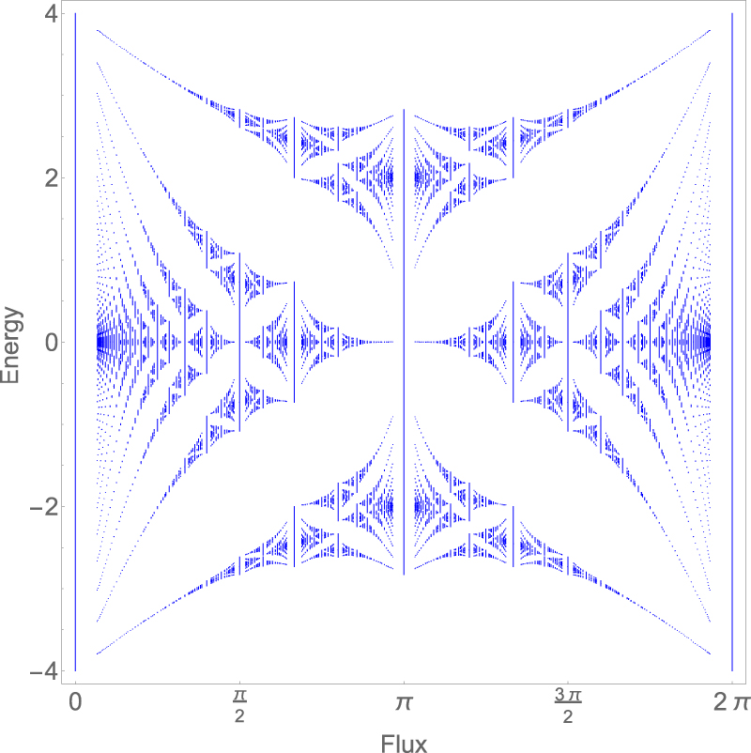

Slide 26
