Slide 1
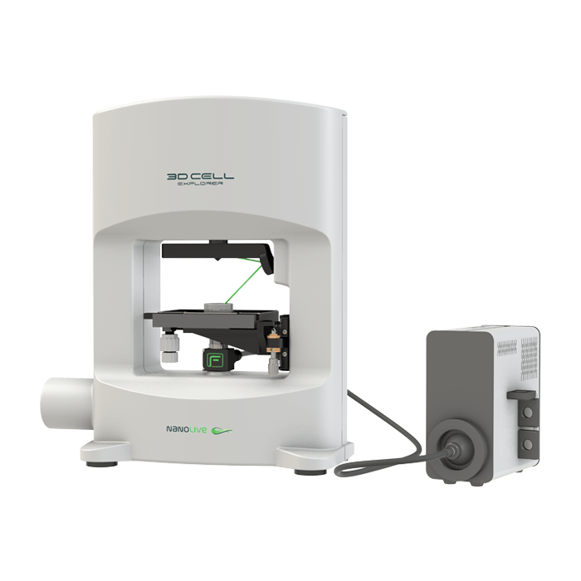



Bioimaging with holotomography microscopy
MSE-471. Biomaterials (pour MX)
Practical work sessions.

Slide 2
Objectives
1. Understand Instrumentation and workflow
- Self-study of PPT material and YouTube videos (EP1,2,3 on moodle);
- the working principle and advantages of Nanolive compared to traditional imaging
2. Sample preparation and image acquisition (In class)
Exposure to how sample preparation is performed, including multi-channel imaging
Video demonstration ( Nanolive imaging demo in LAB）
3. Data analysis and interpretation (In lab)
- Experience in processing and analyzing holotomography data using Nanolive software, including 3D visualization of subcellular structures
- Exercises (image processing, coloring/staining)

Slide 3
Logistics
 | Group 3 | Group 4
08:15-08:45 | Objective 2 | Objective 2
08:50-09:20 | Objective 3 (in lab) | Objective 1
09:20-09:50 | Objective 1 | Objective 3 (in lab)
Reflective questions:
1. How does Nanolive work?
2. In what circumstances would you use Nanolive rather than others?
3. Do you prefer to use this technique to image the cells in your gel and why/why not?

Slide 4
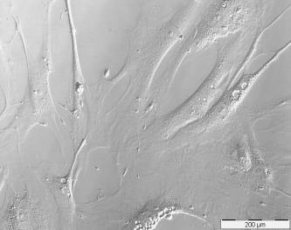
Bright field
Light microscopy in cell biology. Techniques.
Fluorescence microscopy
BRIGHT FIELD:
Imaging in accordance to light absorption, scattering and deflection by the sample.
BUT
Most cells are thin and transparent!
Phase contrast
Light microscopy
1

Slide 5
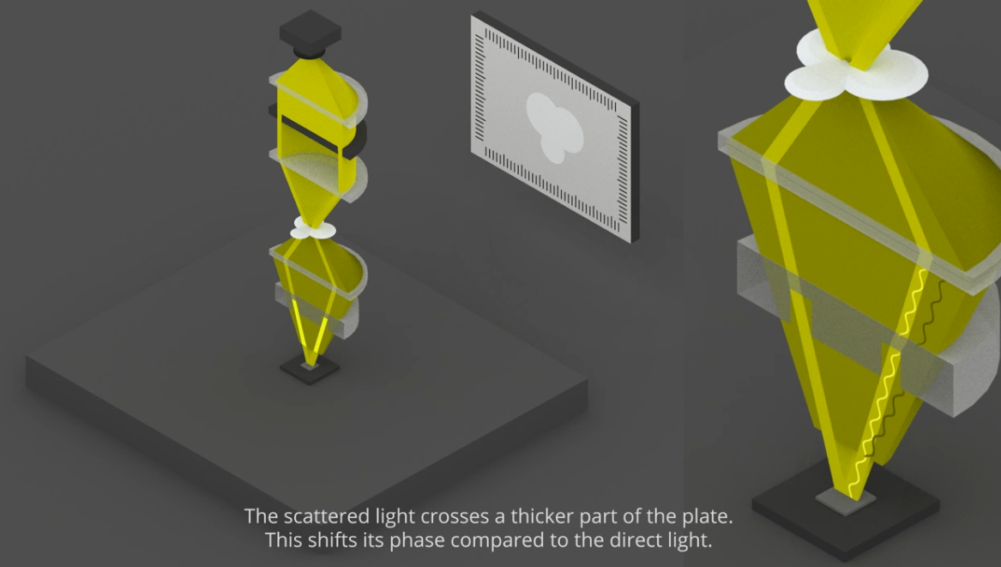
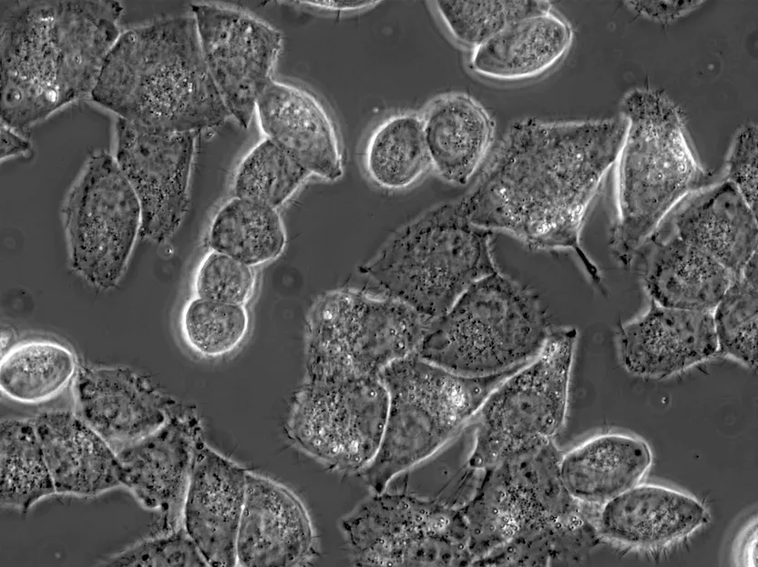
Light microscopy in cell biology. Techniques.
Phase contrast: Enhancement by phase shift.
Annular ring
Phase plate
Light microscopy
2

Slide 6
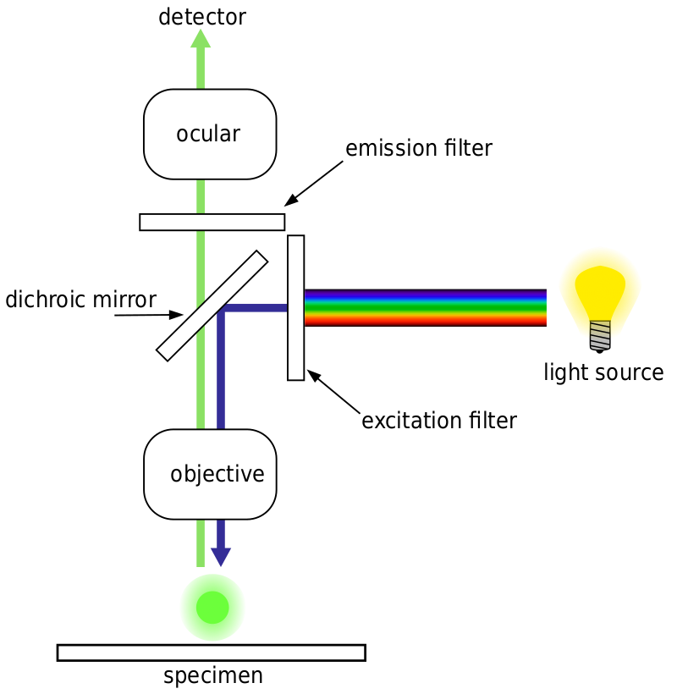
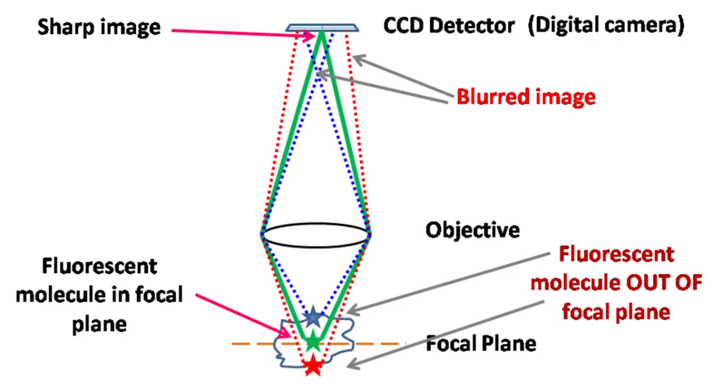
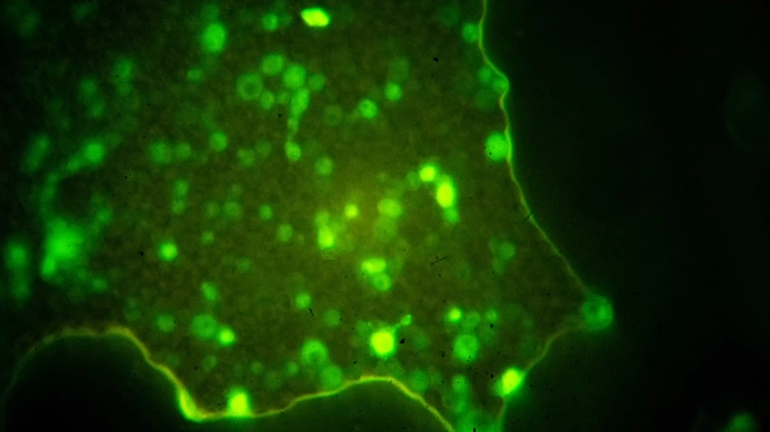
Light microscopy in cell biology. Techniques.
Intercalating dyes, immunofluorescence (primary and secondary antibodies)…
FLUORESCENCE MICROSCOPY:
Use of fluorophores →
- Photobleaching issues.
- Out-of-plane fluorescence.
Light microscopy
3

Slide 7
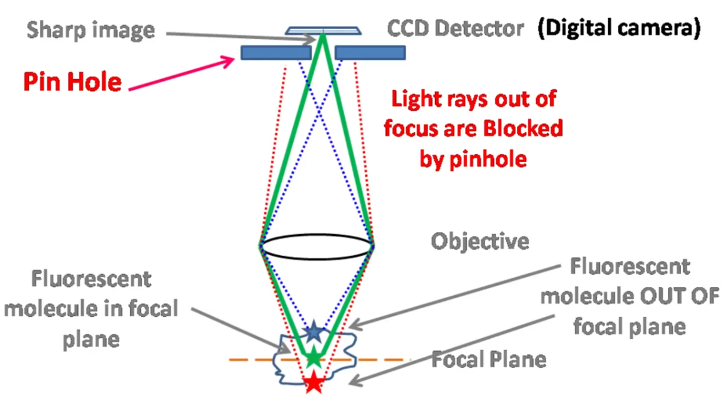
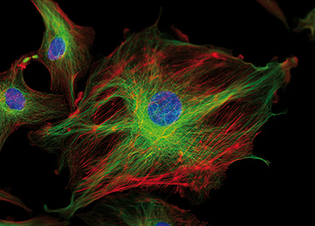
Light microscopy in cell biology. Techniques.
Confocal microscopy: only records light from the focal plane of the sample
Light microscopy
4

Slide 8
Light microscopy in cell biology. Techniques.
Certain limitations of fluorescence microscopy:
Long imaging time
Potential toxicity of exogenous dyes
Rigorous sample preparation
Limited to qualitative analysis
Holotomography microscopy
Light microscopy
5

Slide 9
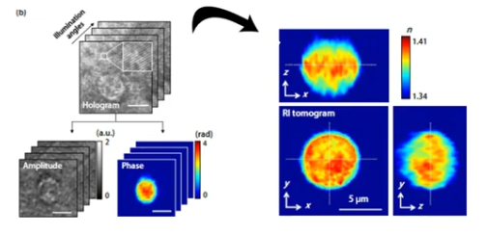
Holotomography microscopy.
HOLOGRAPHY
+
TOMOGRAPHY
2D quantitative phase imaging
3D refractive index distribution reconstruction
Holotomography
6

Slide 10
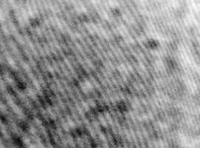
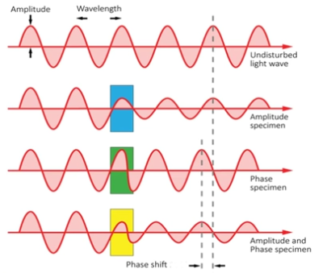
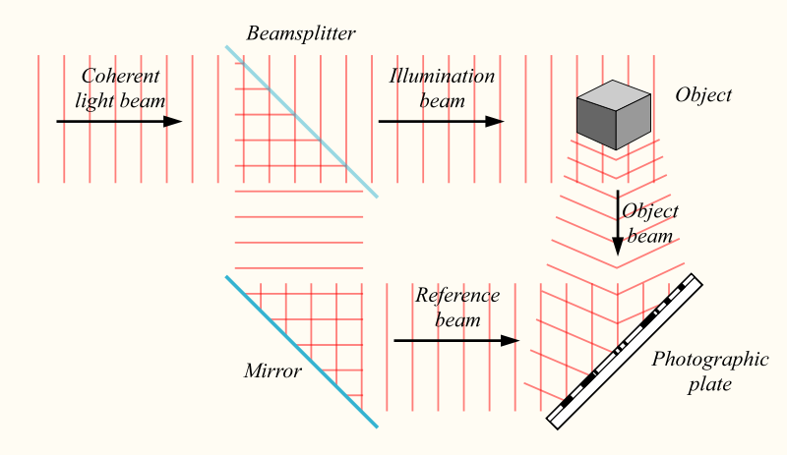
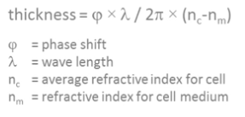
Holotomography microscopy.
HOLOGRAPHY. A hologram is a photographic recording of a light field.
Holotomography
7

Slide 11
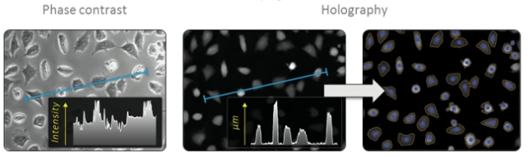
Holotomography microscopy.
HOLOGRAPHY. A hologram is a photographic recording of a light field.
Possible quantitative analysis
Holotomography
8

Slide 12
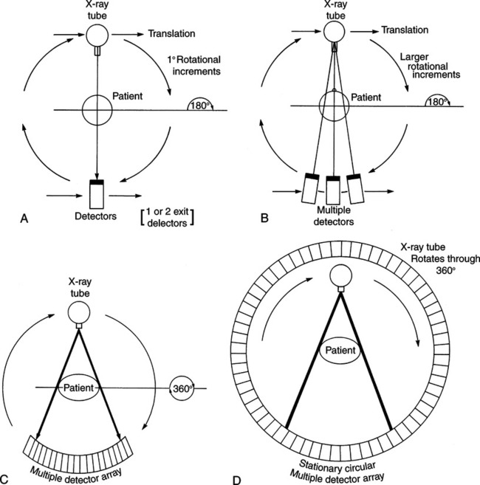
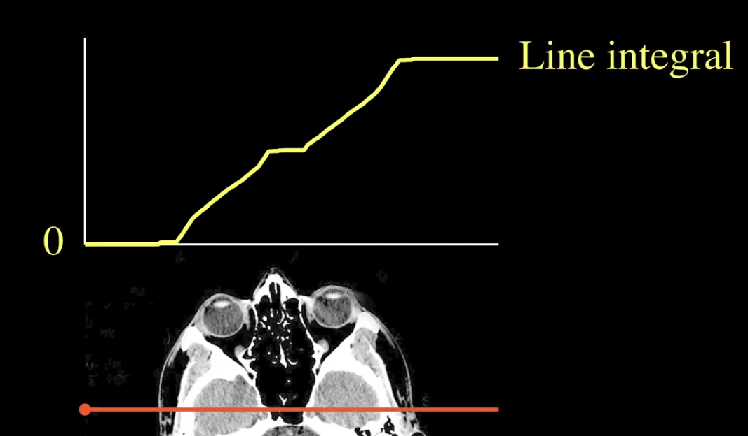
Holotomography microscopy.
TOMOGRAPHY. Imaging by sections (rotation) + reconstruction.
Attenuation
Holotomography
9

Slide 13
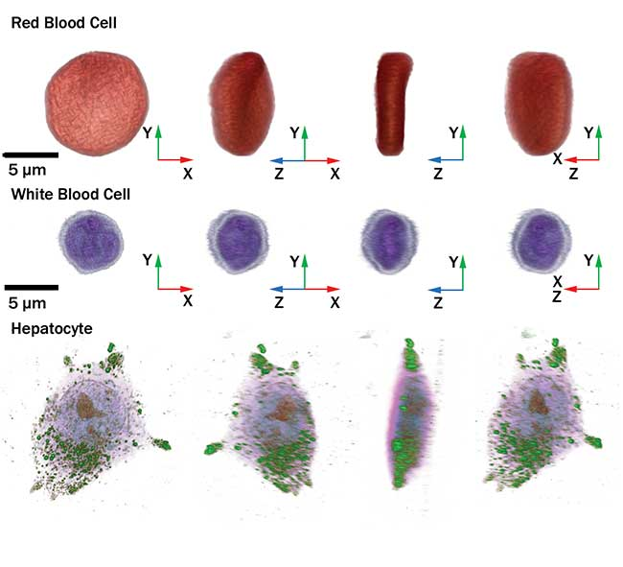
Holotomography microscopy.
General advantages:
Labelling process not required.
Non-invasive: Elimination of phototoxicity and no bleaching.
Enables quantitative analysis.
Allows for refractive index-based digital staining.
Ultra-fast imaging speed (1.7s/tomograph) → Real-time.
Holotomography
10

Slide 14
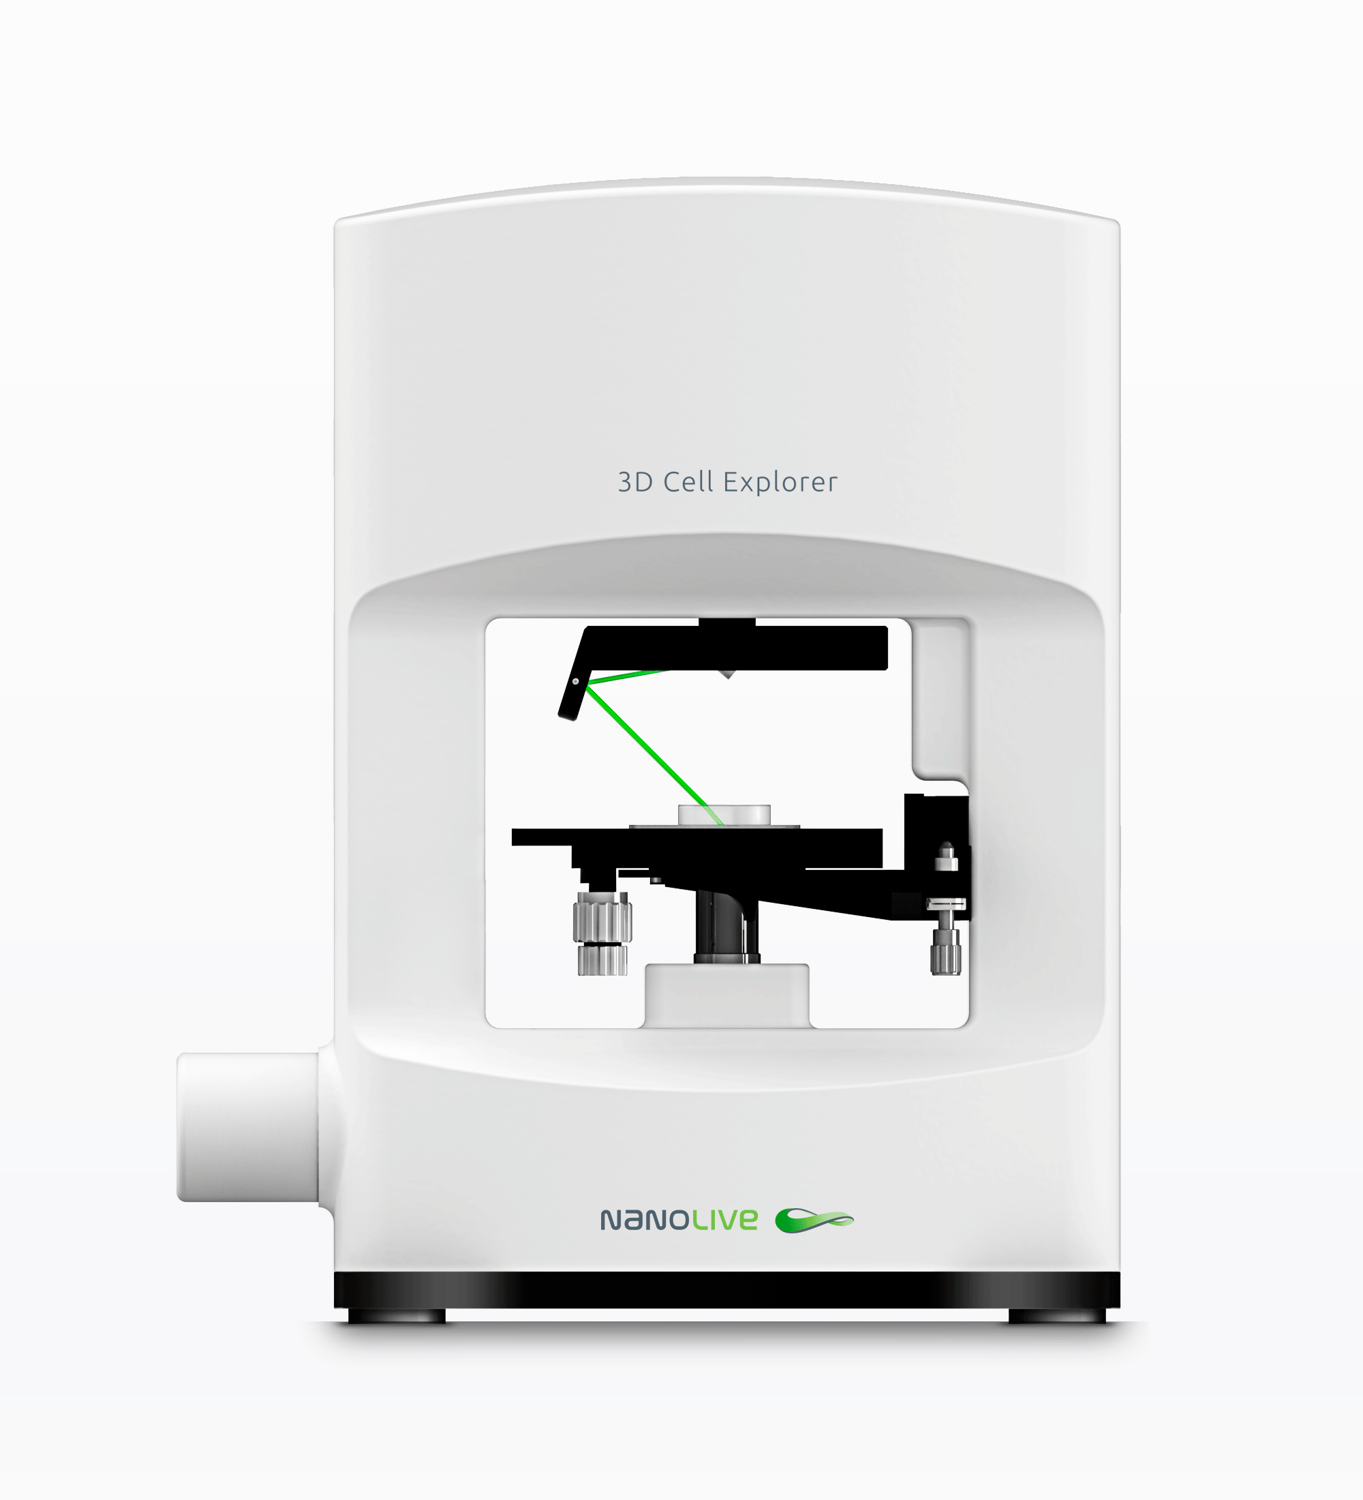
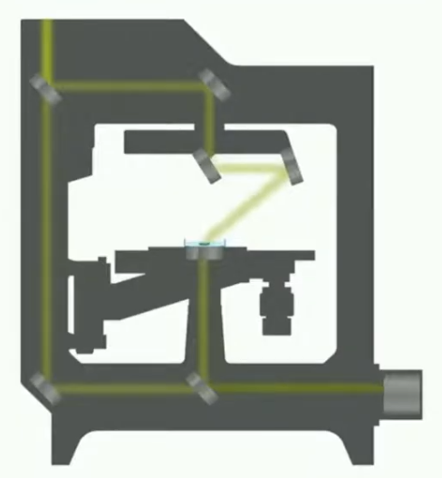
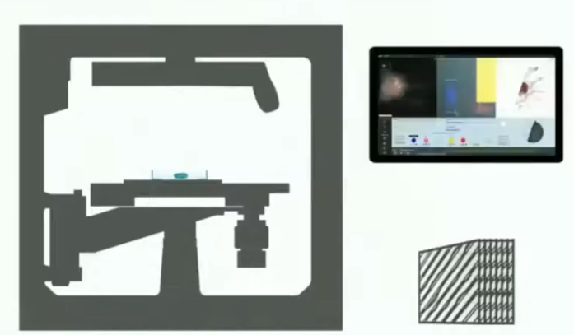
Holotomography microscopy.
Nanolive 3D Cell Explorer:
Nanolive 3D Cell Explorer
11

Slide 15
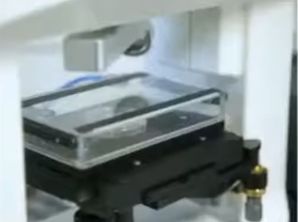
Holotomography microscopy.
Nanolive 3D Cell Explorer:
Self-adjusting optics (compatibility with different supports, dynamic adaptation).
Top-stage incubator to maintain physiological cell environment.
Fluorescence microscopy compatibility.
Nanolive 3D Cell Explorer
12

