Slide 1
SimaPro installation guide
Only for use in:
MSE-433, ME-203, ME-516
Cannot be for projects, including but not limited to:
used for semester projects, master’s projects, MAKE projects, PhD research, industrial projects

Slide 2
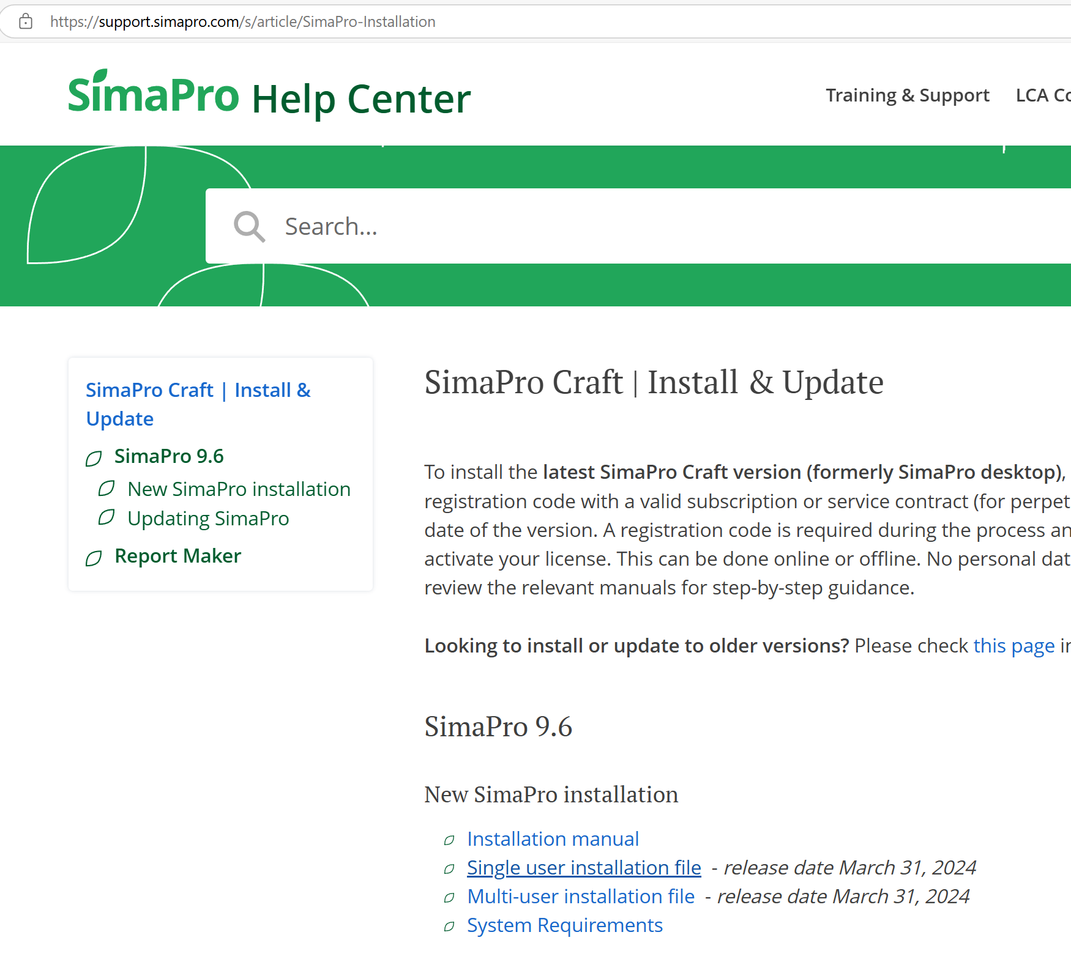

Slide 4
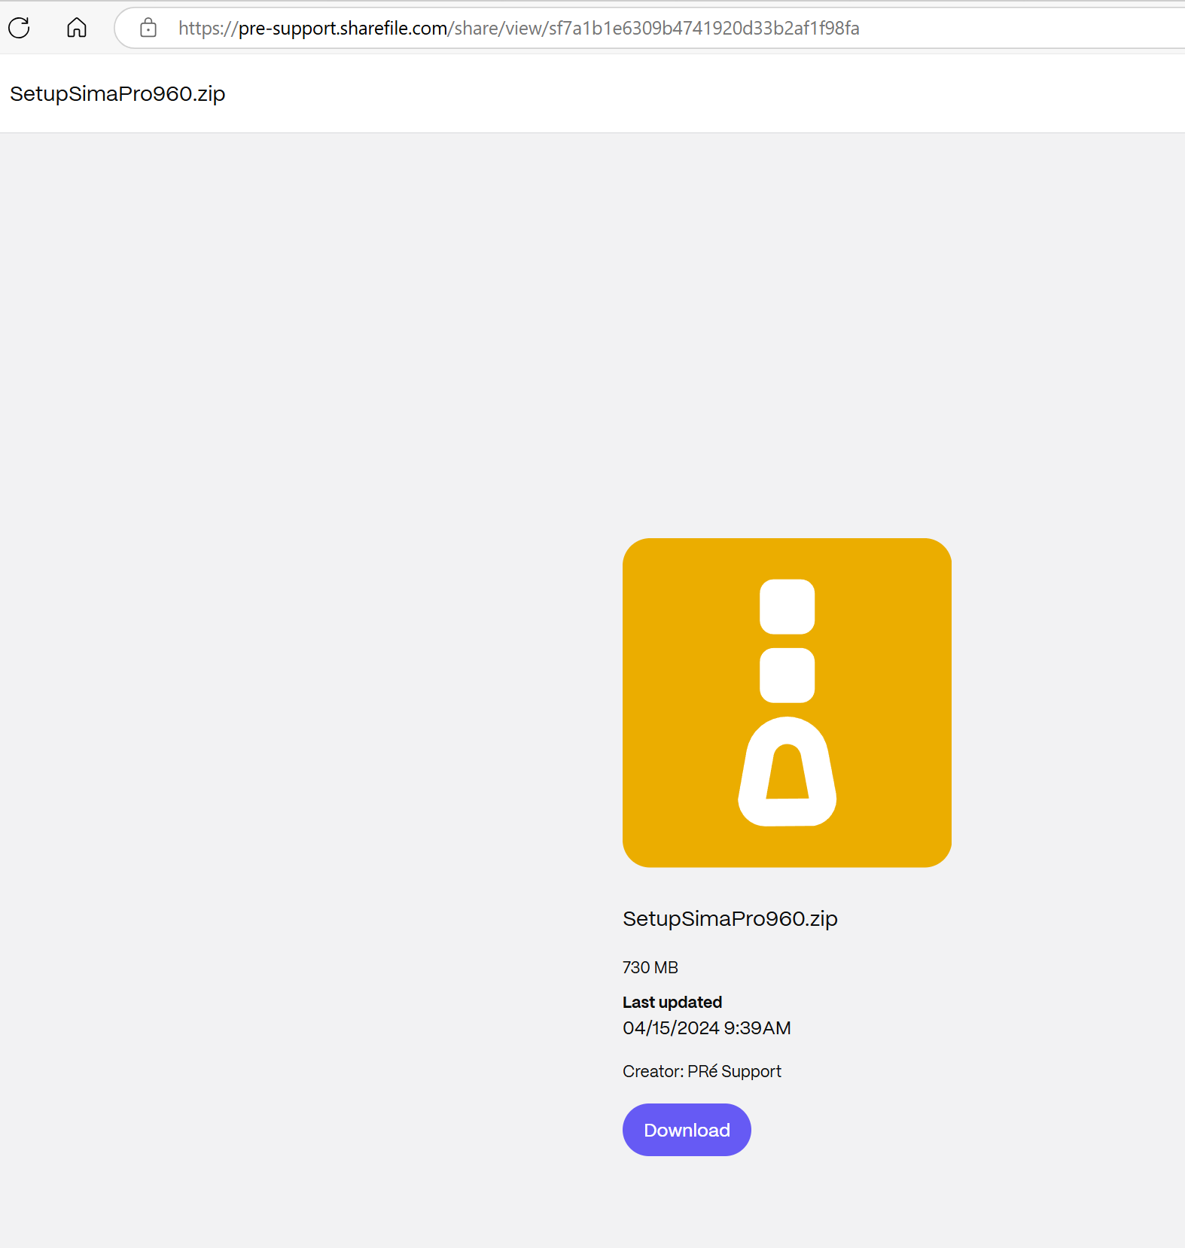

Slide 5
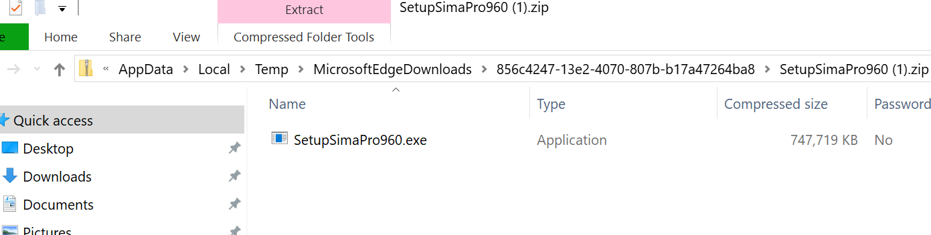
Double click on file to Install

Slide 6
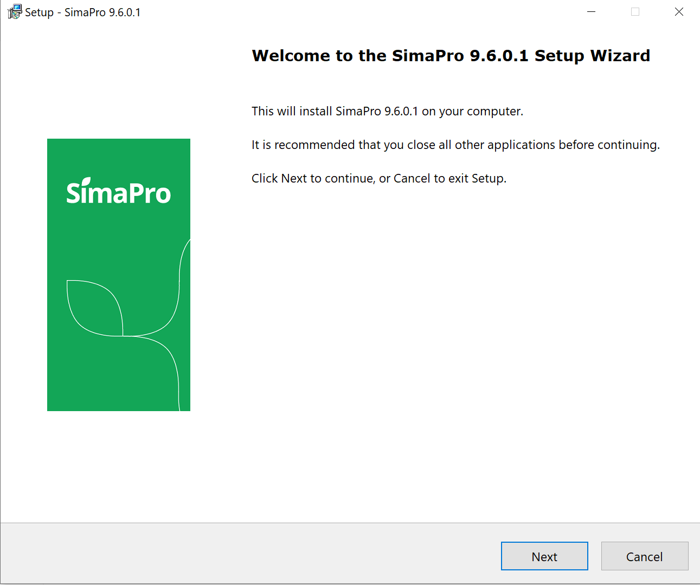

Slide 7
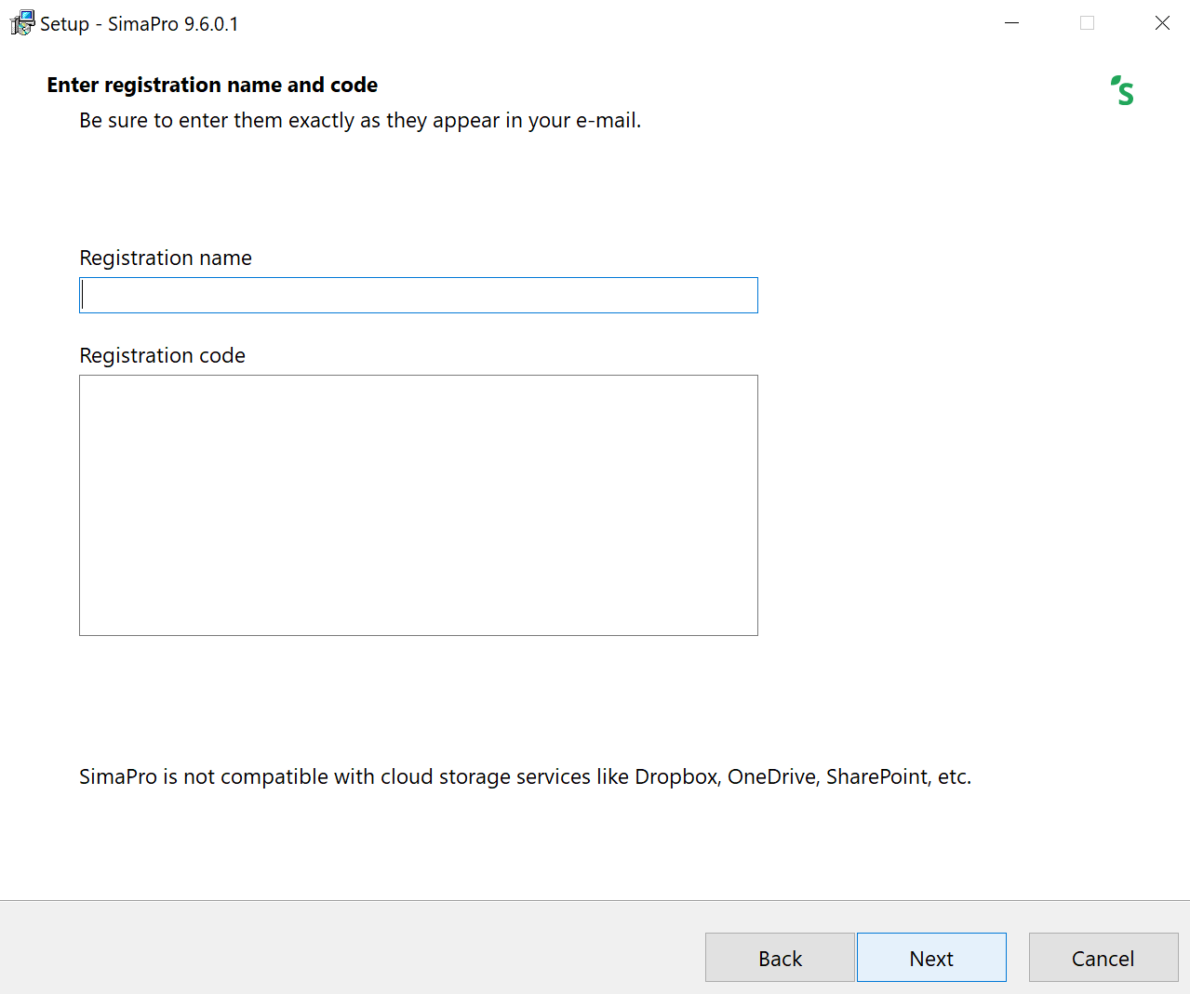

Slide 8
Enter this text, cut and paste
Registration name: STI Wakeman
Registration code:
YQkAAADcmgIAxY+ZJ5upAAgiAAA=#
ZoY+1aRt1rrDvkHEbAY+pJqAT1EYBZ+ByQsqVnbchlYAy/41ho
Yr72SOIzFZku8pJjih2463l5Jlon+F3vOG1F5ezhrXPKFrbXxX
Bms1+ZT+nNtgF1Dii8yXk115wvJ8iIQAcN9GFZLsHwqL7GkSmB
RwKldJ4JoOYFLXfD56lRk=

Slide 9
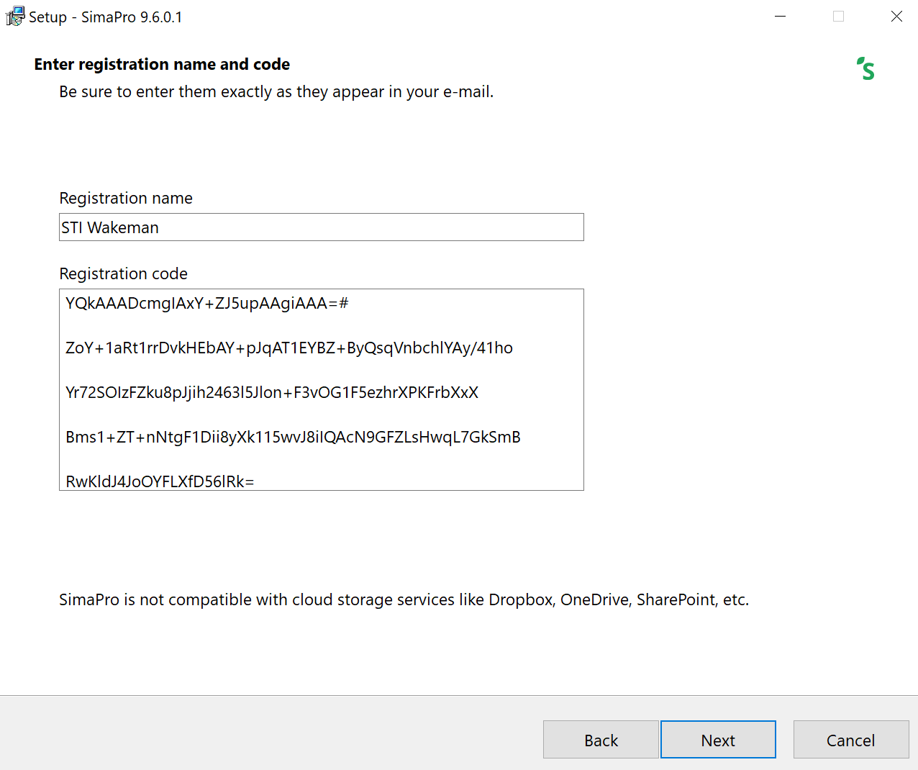

Slide 10
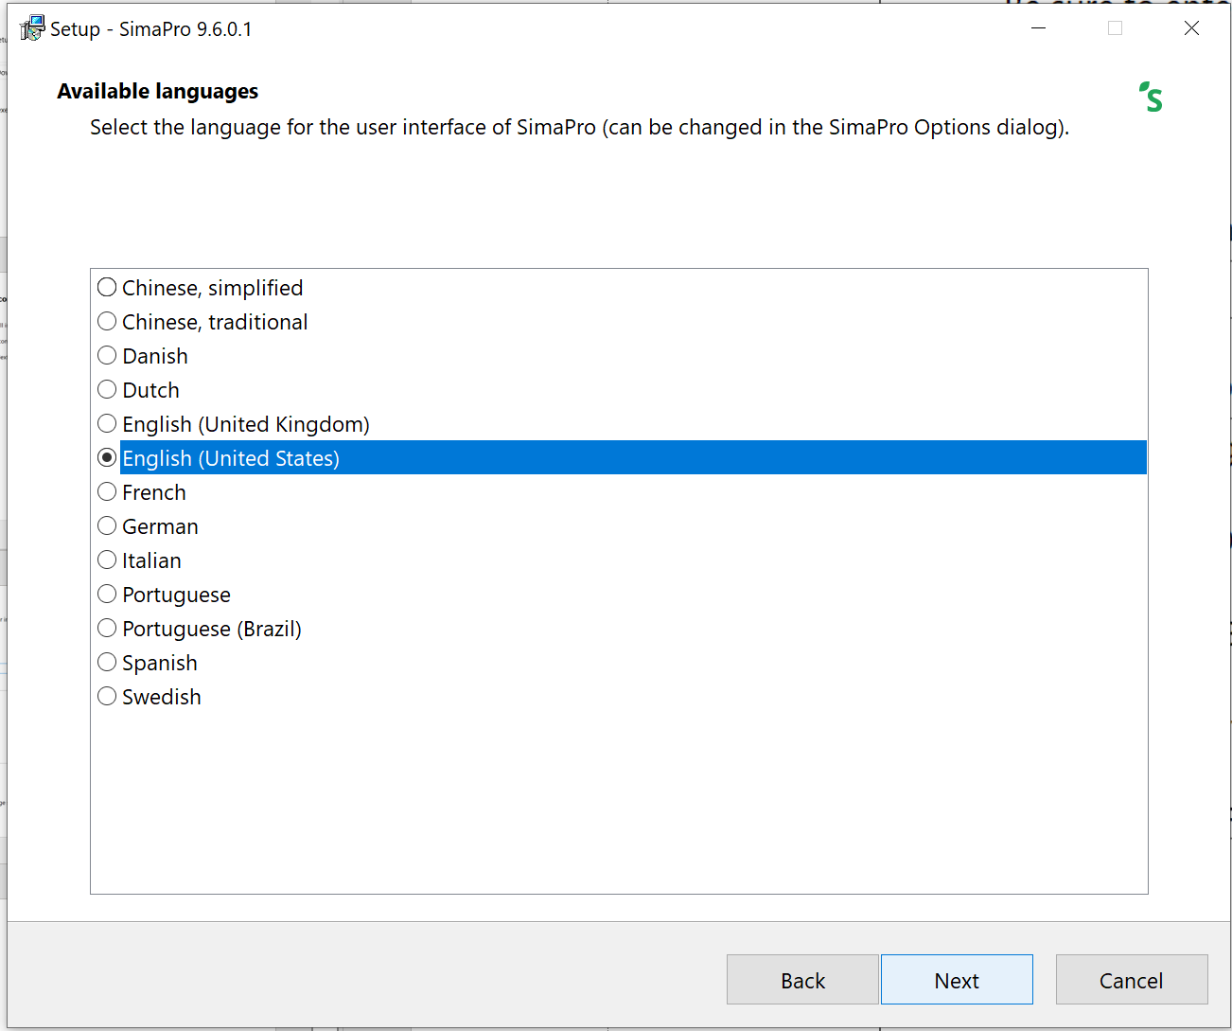

Slide 11
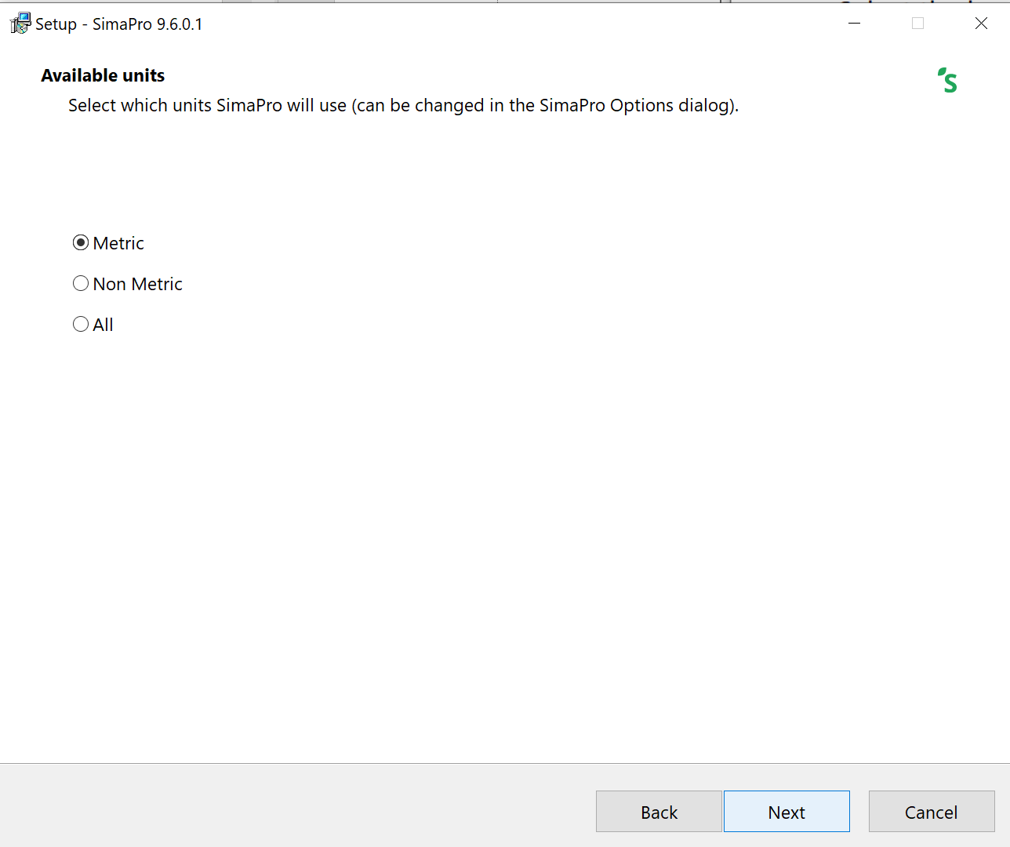

Slide 12
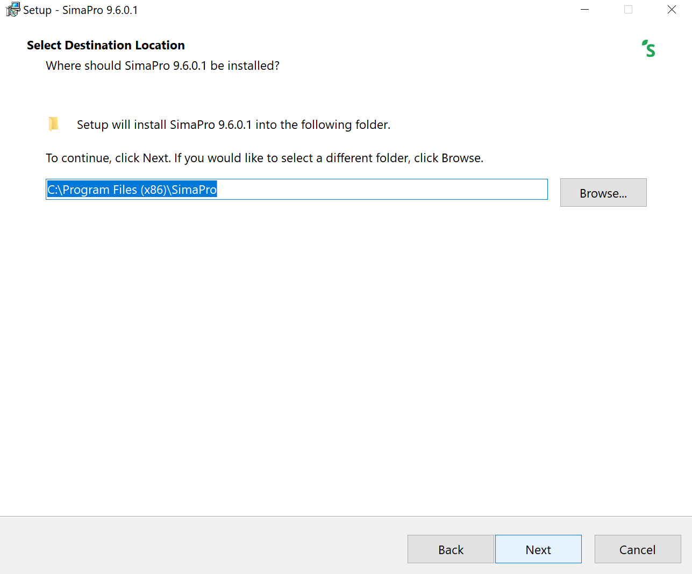

Slide 13
