Slide 1

MSE 423 Fall 2024 – Week 3 CURIOSITY KILLED THE CAT

Slide 2
Last week: First steps
Stationary and time-dependent Schroedinger eq.
Eigenvalue equations
Free particle, and particle in a 1D, 2D, 3D box.
Metal surfaces and STM
Quantum applets on osscar.org
Operators, eigenvalues, eigenfunctions, expectation values
Dirac notations, <bra|ket>

Slide 3
Physical Observables from Wavefunctions
Eigenvalue equation:
Expectation values for the operator (energy)

Slide 4
4 concepts
Operators
Eigenvalues
Eigenfunctions
Expectation values

Slide 5
Operators: Linear, Hermitian

Slide 6
Examples: (d/dx) and i(d/dx)

Slide 7
Product of operators, and commutators

Slide 8
Hermitian Operators
The eigenvalues of a Hermitian operator are real
Two eigenfunctions corresponding to different eigenvalues are orthogonal
The set of eigenfunctions of a Hermitian operator is complete
Commuting Hermitian operators have a set of common eigenfunctions

Slide 9
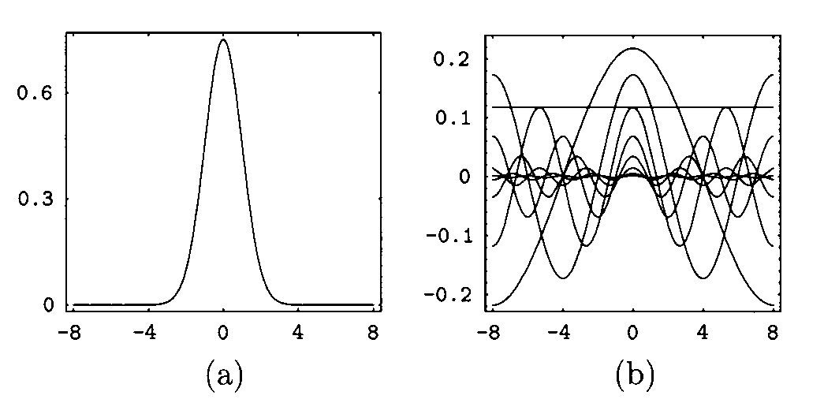
The set of eigenfunctions of a Hermitian operator is complete

Slide 10
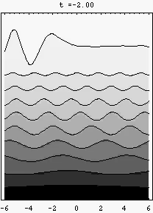
The set of eigenfunctions of a Hermitian operator is complete

Slide 11
Commuting Hermitian operators have a set of common eigenfunctions

Slide 12
First postulate: wavefunctions
All information of an ensemble of identical physical systems is contained in the ket (usually a wavefunction , which is complex, continuous, finite, and single-valued, square-integrable
The ket can also be a geometrical vector (e.g. spin); wavefunctions are objects that satisfy vector algebra, and the space of wavefunctions is a Hilbert space (instead of being 3-d, it’s infinite-d)

Slide 13
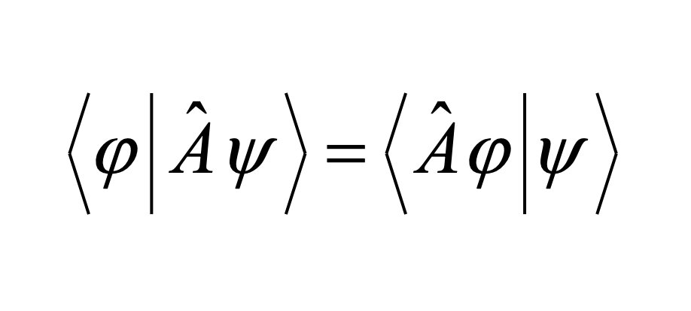
Second postulate: operators
For every physical observable there is a corresponding Hermitian operator

Slide 14
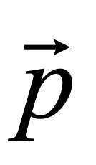
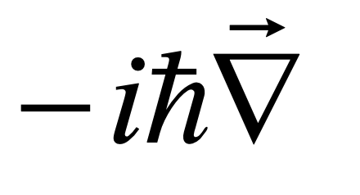
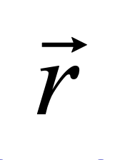
From classical mechanics to operators
classical momentum →
→ gradient operator
classical position →
→ multiplicative operator

Slide 15
The total energy of the system
Kinetic energy K
Potential energy V

Slide 16
Third postulate: measurements
In any single measurement of a physical quantity that corresponds to the operator A, the only values that will be measured are the eigenvalues of that operator.

Slide 17
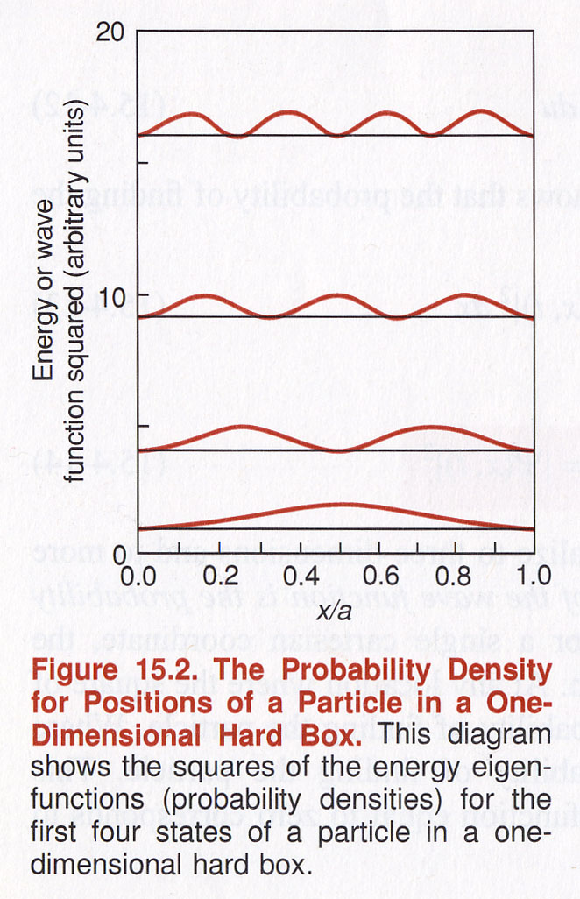
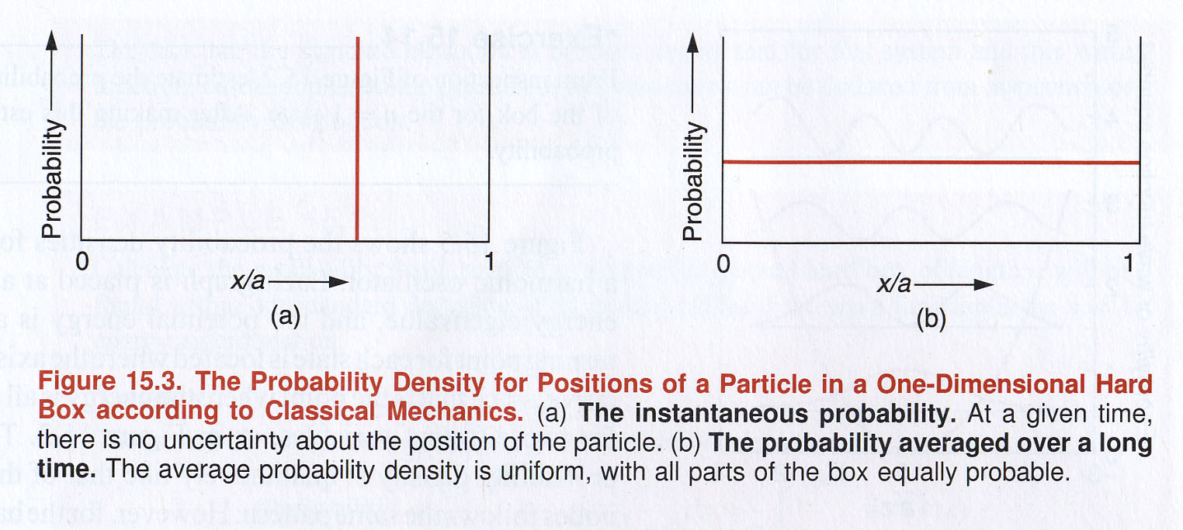
Position and probability

Slide 18
Fourth postulate: expectation values and probabilities
If a series of measurements is made of the dynamical variable A on an ensemble described by Ψ, the average (“expectation”) value is
i.e. the probability of obtaining an eigenvalue a_{n} is

Slide 21
Deterministic vs. stochastic
Classical, macroscopic objects: we have well-defined values for all dynamical variables at every instant (position, momentum, kinetic energy…)
Quantum objects: we have well-defined probabilities of measuring a certain value for a dynamical variable, when a large number of identical, independent, identically prepared physical systems are subject to a measurement.

Slide 22
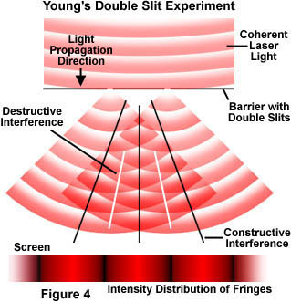
Quantum double-slit

Slide 23
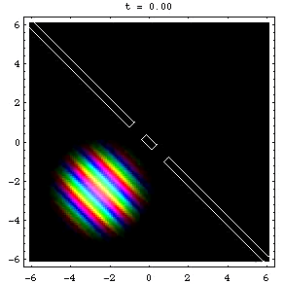
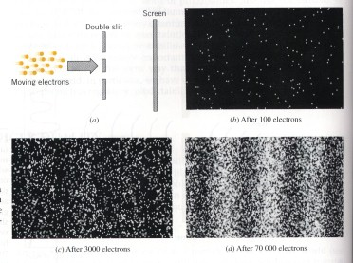
Quantum double-slit

Slide 24
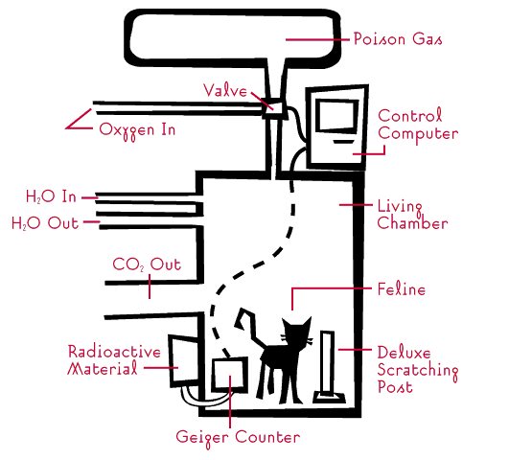
When scientists turn bad…

Slide 25
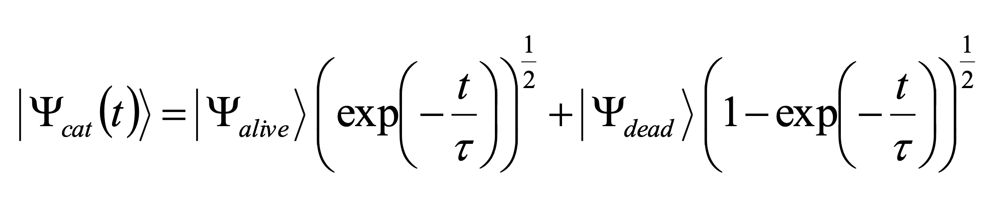
Cat wavefunction
There is not a value of the observable until it’s measured (a conceptually different “statistics” from thermodynamics)

Slide 26
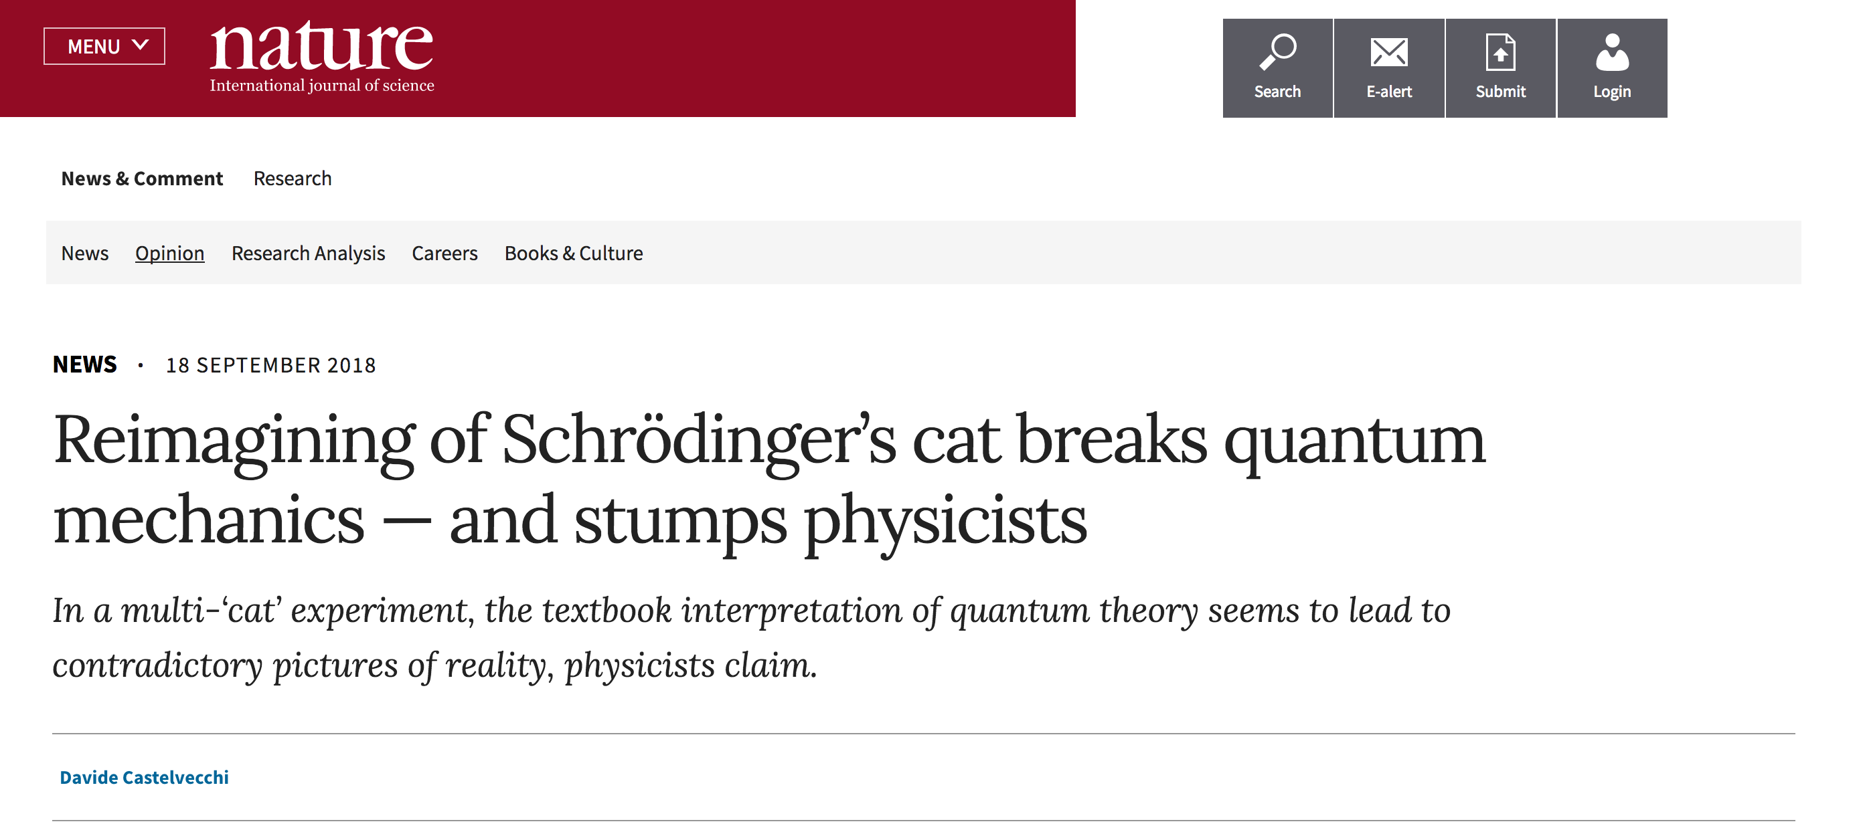

Slide 27
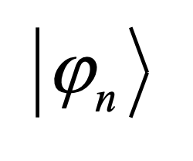
Fifth postulate: collapse
If the measurement of the physical quantity A gives the result a_{n} , the wavefunction of the system immediately after the measurement is the eigenvector

Slide 28
Top Three List
Albert Einstein: “Gott wurfelt nicht!” [God does not play dice!]
Werner Heisenberg “I myself . . . only came to believe in the uncertainty relations after many pangs of conscience. . .”
Erwin Schrödinger: “Had I known that we were not going to get rid of this damned quantum jumping, I never would have involved myself in this business!”

Slide 29
Uncertainties, and Heisenberg’s Indetermination Principle

Slide 30
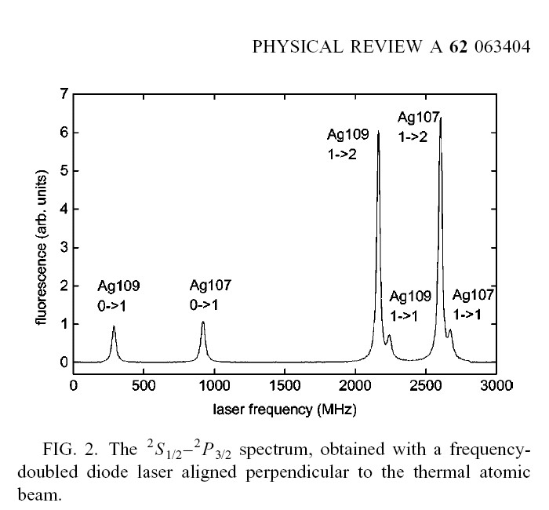
Linewidth Broadening

Slide 31
Good Quantum Numbers
If A commutes with the Hamiltonian, its expectation value does not change with time (it’s a constant of motion – if we are in an eigenstate, that quantum number will remain constant)

Slide 32
Variational Principle

Slide 33
Variational Principle
If , then Φ is the ground state wavefunction, and viceversa…

Slide 36
Matrix Formulation (I)

Slide 37
Matrix Formulation (II)

Slide 38
Matrix Formulation (III)

