Slide 1
The Renormalization Group Theory
Statistical Mechanics, Spring 2016
Ceriotti and Stellacci
<number>

Slide 2
Important Concepts from Last class
<number>

Slide 3
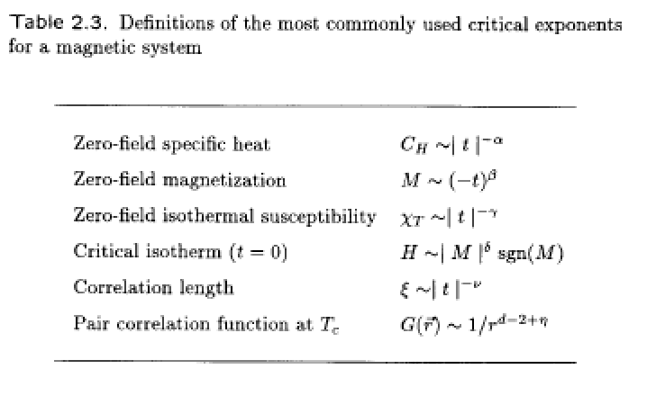
Critical Points Exponents
<number>

Slide 4
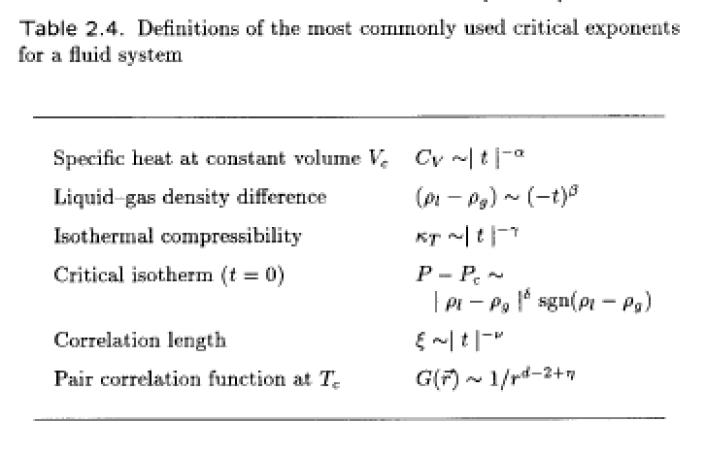
<number>

Slide 5
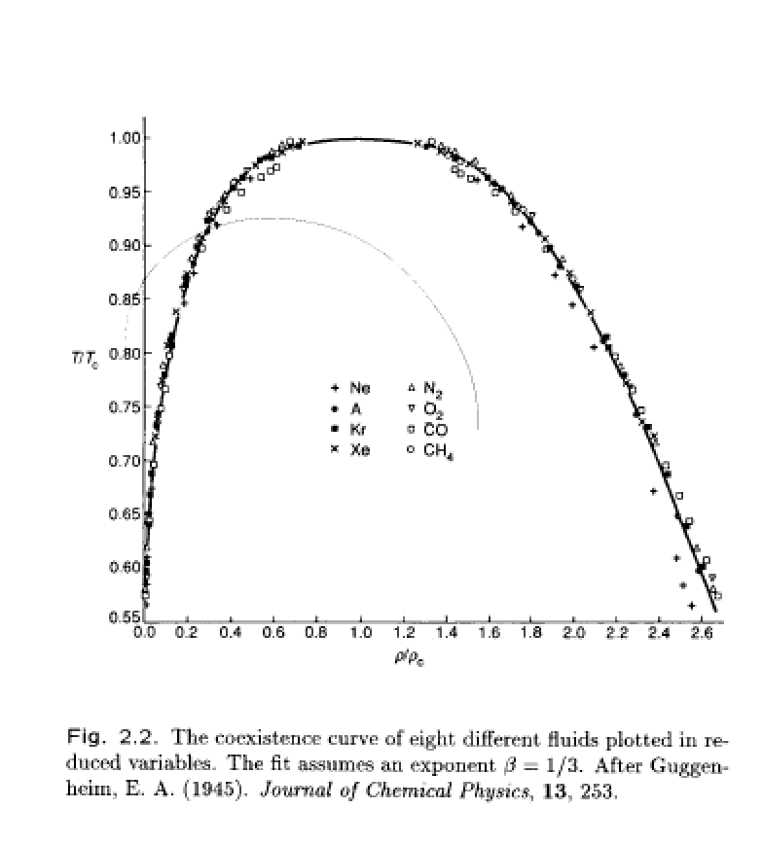
The concept of Universality
<number>

Slide 6



Exponent Inequalities
<number>

Slide 7
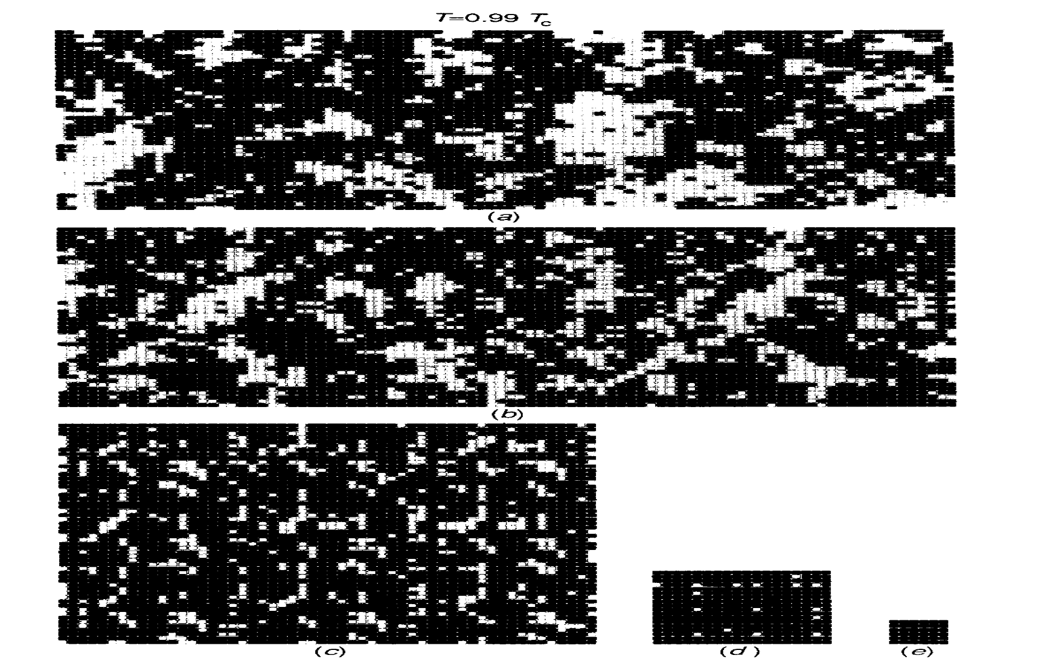
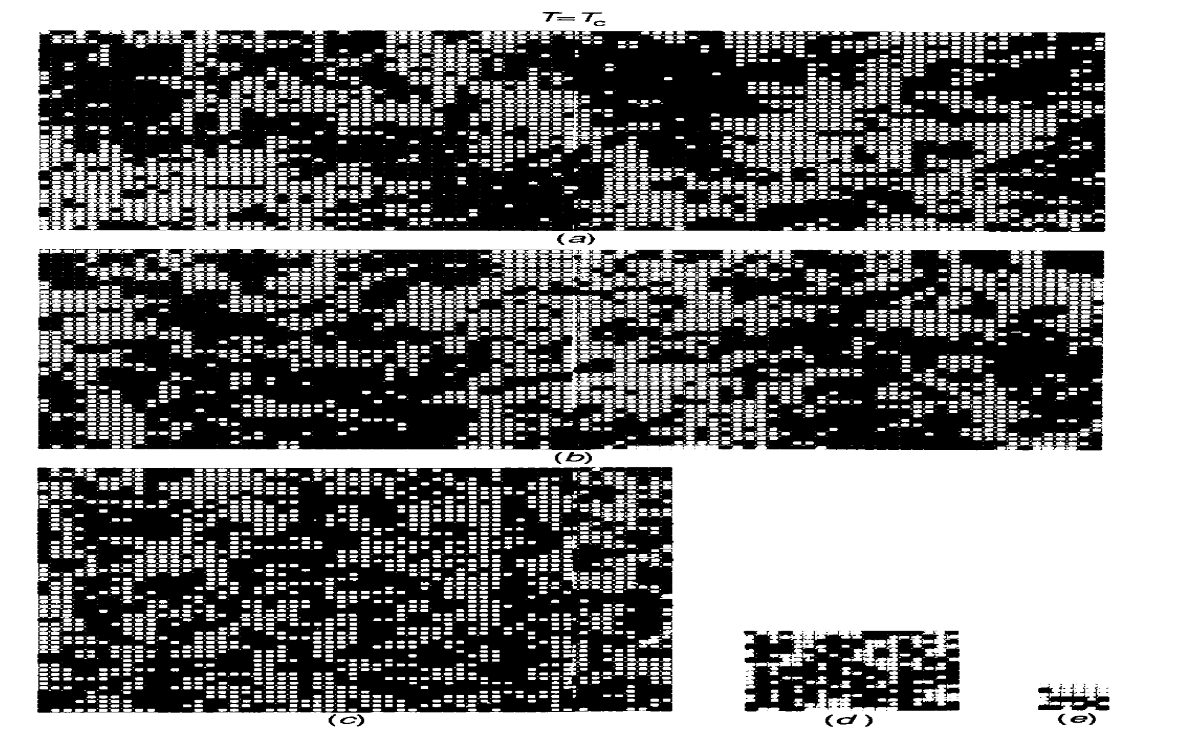
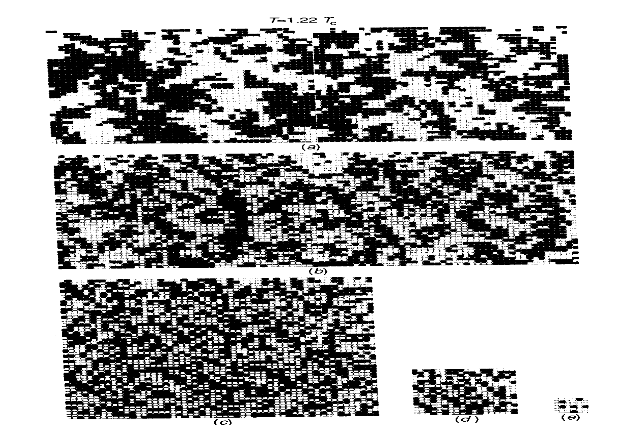
The Key Principle of Renormalization Group Theory
<number>

Slide 8
Definition of Renormalization Group
Reduced Hamiltonian
R reduces the degrees of freedom from N to N’; with the key condition that:
<number>

Slide 9
The Scale Factor
<number>

Slide 10
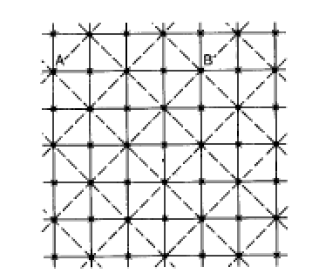
Example
<number>

Slide 11
The Key Concept
<number>

Slide 12
Flows in Parameter Space
<number>

Slide 13
Relevant and Irrelevant Parameters
<number>

Slide 14
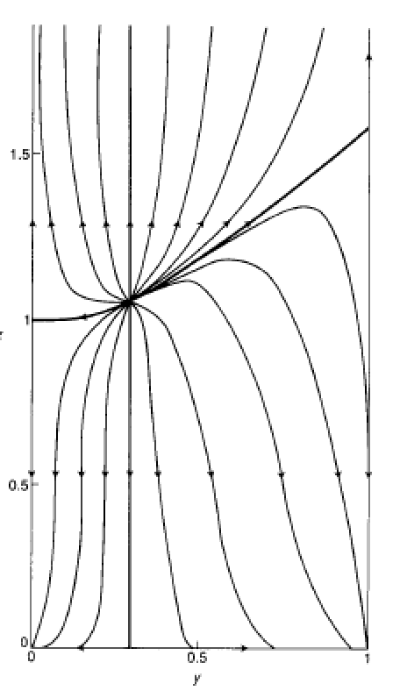
<number>

Slide 15
Universality and Critical Parameters
<number>

Slide 16

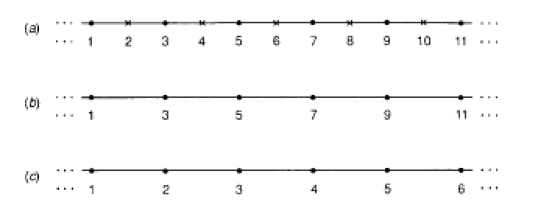
The Hamiltonian in the Ising Model
<number>

Slide 17
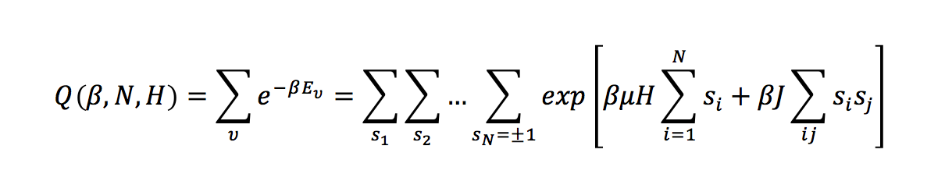
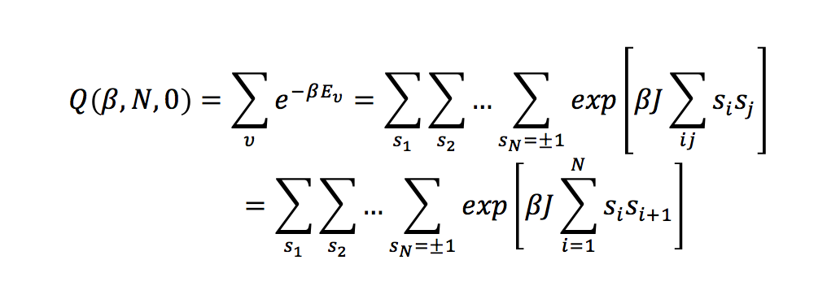
The 1D Ising Model
In general we can write:
In 1D for H=0 this reduces to:
<number>

Slide 18
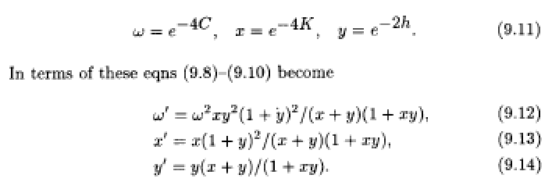
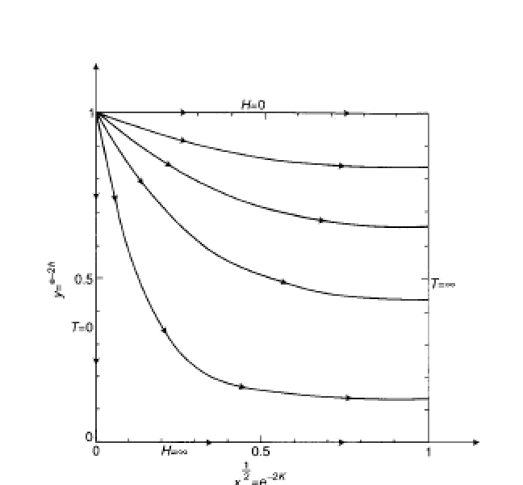
<number>

Slide 19
Practical Problems in the Renormalization Group Theory at Higher Dimensions
<number>

Slide 20
<number>

Slide 21
The Key Principle of Renormalization Group Theory
<number>

