Slide 1
Lab 5: Polymers

Slide 2
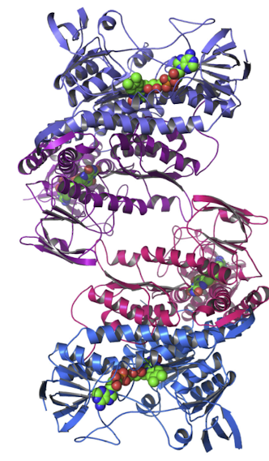
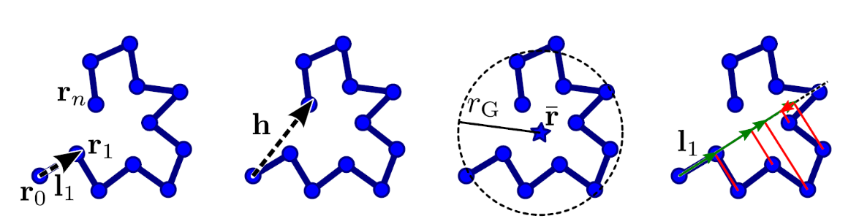
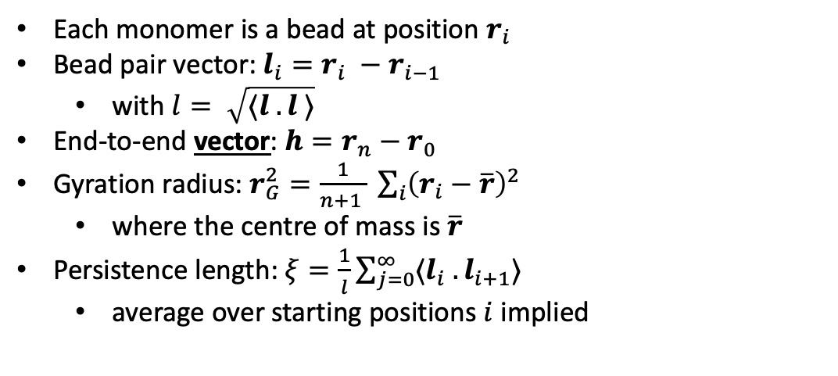
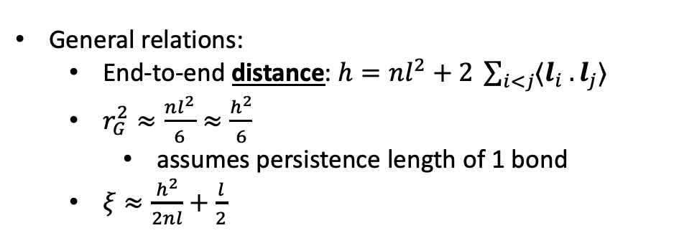
Characterizing Polymers
Each monomer is a bead at position $r_{i}$
Bead pair vector: $l_{i}=r_{i} −r_{i−1}$
  with $l= \sqrt{⟨l . l ⟩}$
End-to-end vector: $h=r_{n}−r_{0}$
Gyration radius: $r_{G}^{2}=\frac{1}{n+1 } \sum_{i}{{\left(r_{i}−\overline{r}\right)}^{2}}$
  where the centre of mass is $\overline{r}$
Persistence length: $ξ=\frac{1}{l}\sum_{j=0}^{∞}{⟨l_{i} . l_{i+1}}⟩$
  average over starting positions $i$ implied
General relations:
  End-to-end distance: $h=nl^{2}+2 \sum_{i<j}{⟨l_{i} . l_{j}⟩}$
  $r_{G}^{2}≈\frac{nl^{2}}{6}≈\frac{h^{2}}{6}$
    assumes persistence length of 1 bond
  $ξ≈\frac{h^{2}}{2nl}+\frac{l}{2}$

Slide 3
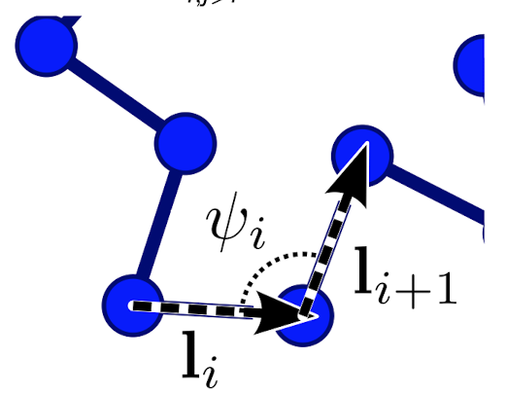
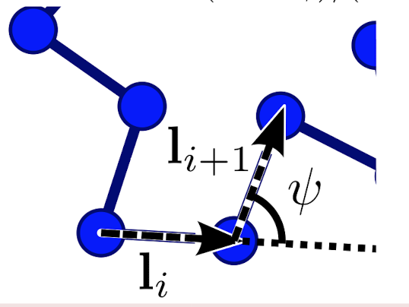
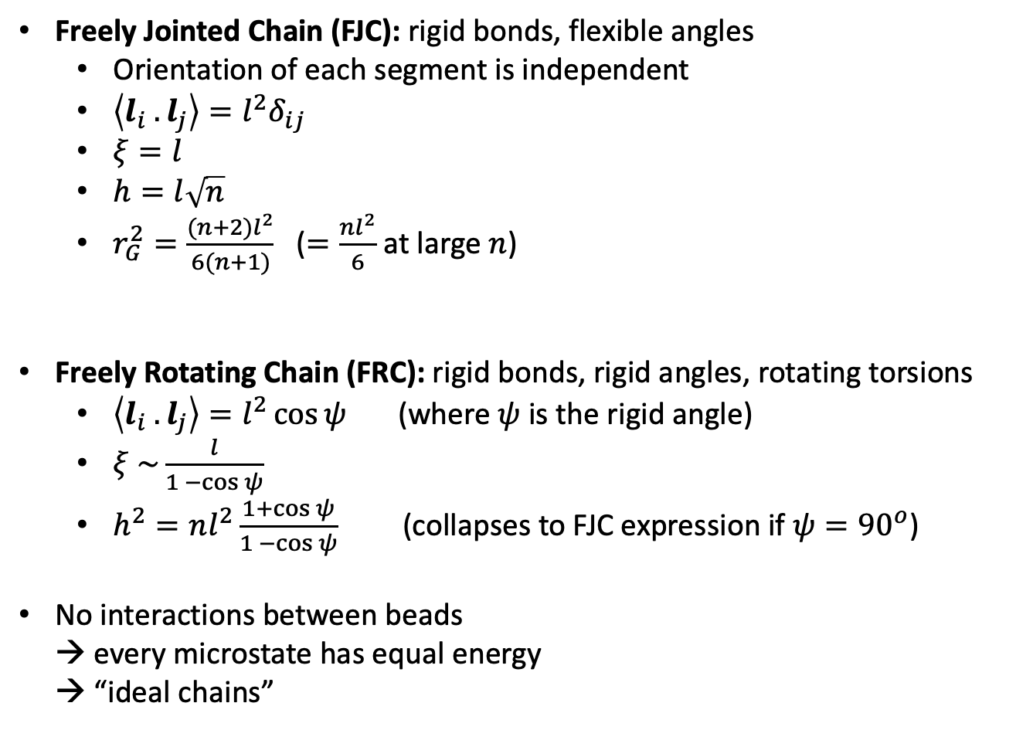
Models
FJC
Freely Jointed Chain (FJC): rigid bonds, flexible angles
  Orientation of each segment is independent
  $\left\langle l_{i} . l_{j}\right\rangle =l^{2}δ_{ij}$
  $ξ=l$
  $h=l\sqrt{n}$
  $r_{G}^{2}=\frac{(n+2)l^{2}}{6(n+1)}$ ($=\frac{nl^{2}}{6}$ at large $n$)
Freely Rotating Chain (FRC): rigid bonds, rigid angles, rotating torsions
  $\left\langle l_{i} . l_{j}\right\rangle =l^{2}\cos{ψ}$ (where $ψ$ is the rigid angle)
  $ξ \sim \frac{l}{1 −\cos{ψ}}$
  $h^{2}=nl^{2}\frac{1+\cos{ψ}}{1 −\cos{ψ}}$ (collapses to FJC expression if $ψ={90}^{o}$)
No interactions between beads
→ every microstate has equal energy
→ “ideal chains”
FRC

Slide 4
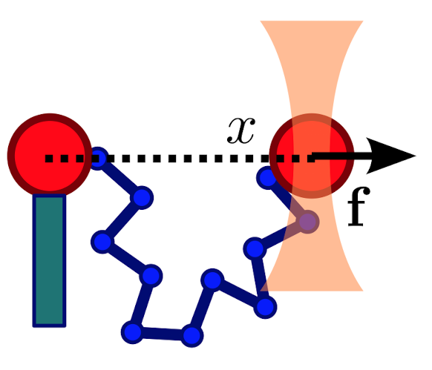
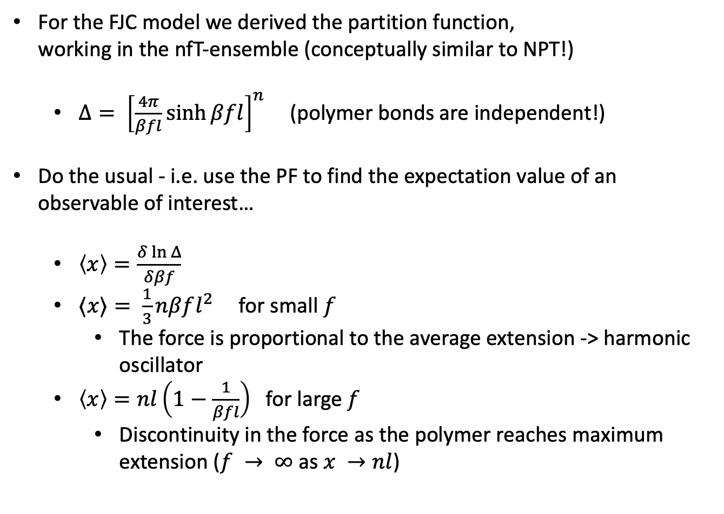
Polymer Extension
For the FJC model we derived the partition function,
working in the nfT-ensemble (conceptually similar to NPT!)
  $Δ= {\left[\frac{4π}{βfl}\sinh{βfl}\right]}^{n}$ (polymer bonds are independent!)
Do the usual - i.e. use the PF to find the expectation value of an observable of interest…
  $\left\langle x\right\rangle =\frac{δ\ln{Δ}}{δβf}$
  $⟨x⟩= \frac{1}{3}nβfl^{2}$ for small $f$
    The force is proportional to the average extension -> harmonic oscillator
  $\left\langle x\right\rangle =nl\left(1−\frac{1}{βfl}\right)$ for large $f$
    Discontinuity in the force as the polymer reaches maximum extension ($f → ∞$as $x →nl$)
All microstates are equal in energy -> entropic oscillator!
For an FJC, entropy is the driving force that dictates the average extension

Slide 5
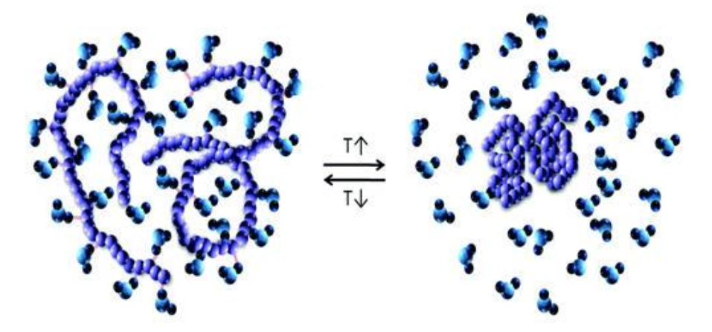
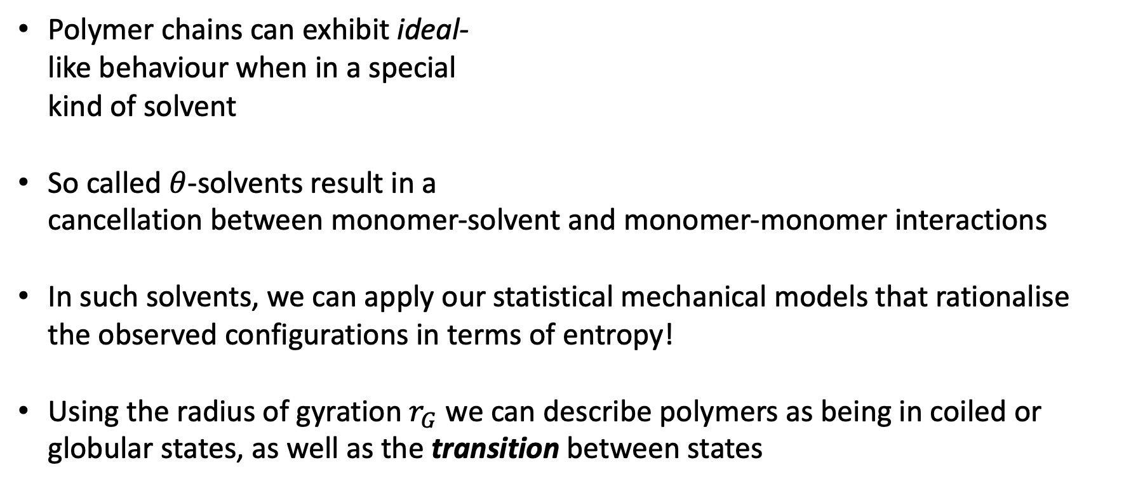
Ideal chains IRL
Polymer chains can exhibit ideal-
like behaviour when in a special
kind of solvent
So called $θ$-solvents result in a
cancellation between monomer-solvent and monomer-monomer interactions
In such solvents, we can apply our statistical mechanical models that rationalise the observed configurations in terms of entropy!
Using the radius of gyration $r_{G}$ we can describe polymers as being in coiled or globular states, as well as the transition between states

Slide 6
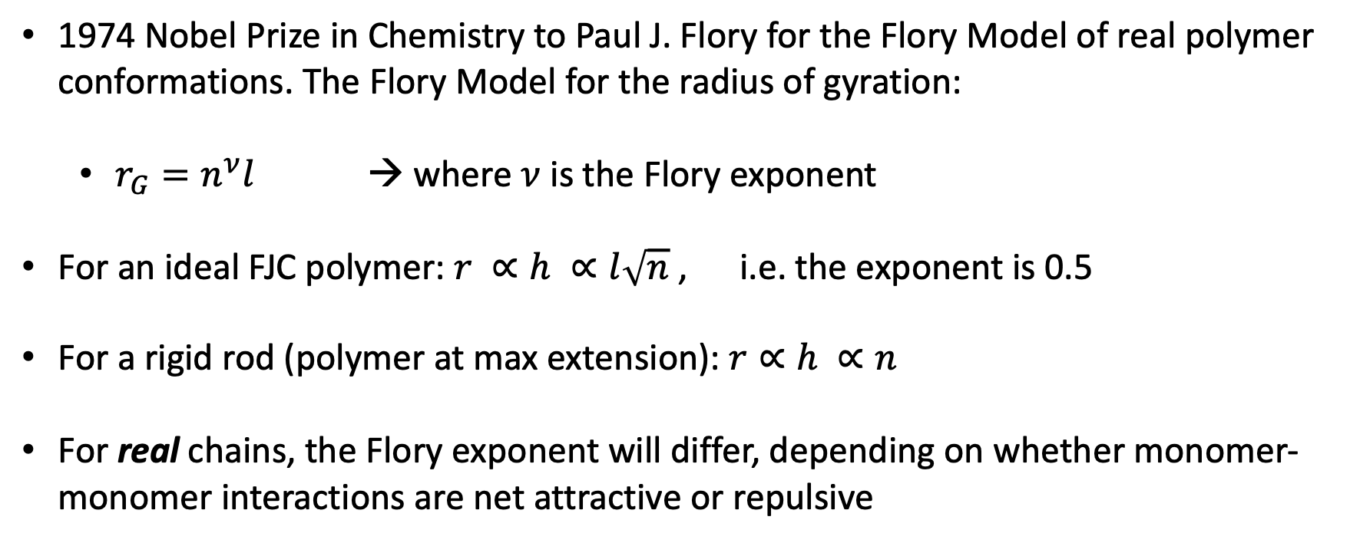
Flory Theory
1974 Nobel Prize in Chemistry to Paul J. Flory for the Flory Model of real polymer conformations. The Flory Model for the radius of gyration:
  $r_{G}=n^{ν}l$ → where $ν$ is the Flory exponent
For an ideal FJC polymer: $r ∝h ∝l\sqrt{n}$ , i.e. the exponent is 0.5
For a rigid rod (polymer at max extension): $r∝h ∝n$
For real chains, the Flory exponent will differ, depending on whether monomer-monomer interactions are net attractive or repulsive

Slide 7
This Lab
Again we will analyse some molecular dynamics simulations using VMD
Trajectories at a range of temperatures (in Lennard-Jones units) from 0.5 to 4.4
Also data files containing the potential energy (again LJ units) as a function of MD step
At T = 4.4, there are trajectories for systems with N = 75, 100, 150
Note: the simulations are for a simple model for a real polymer, using LJ interactions between beads, with the chain in vacuum.

Slide 8
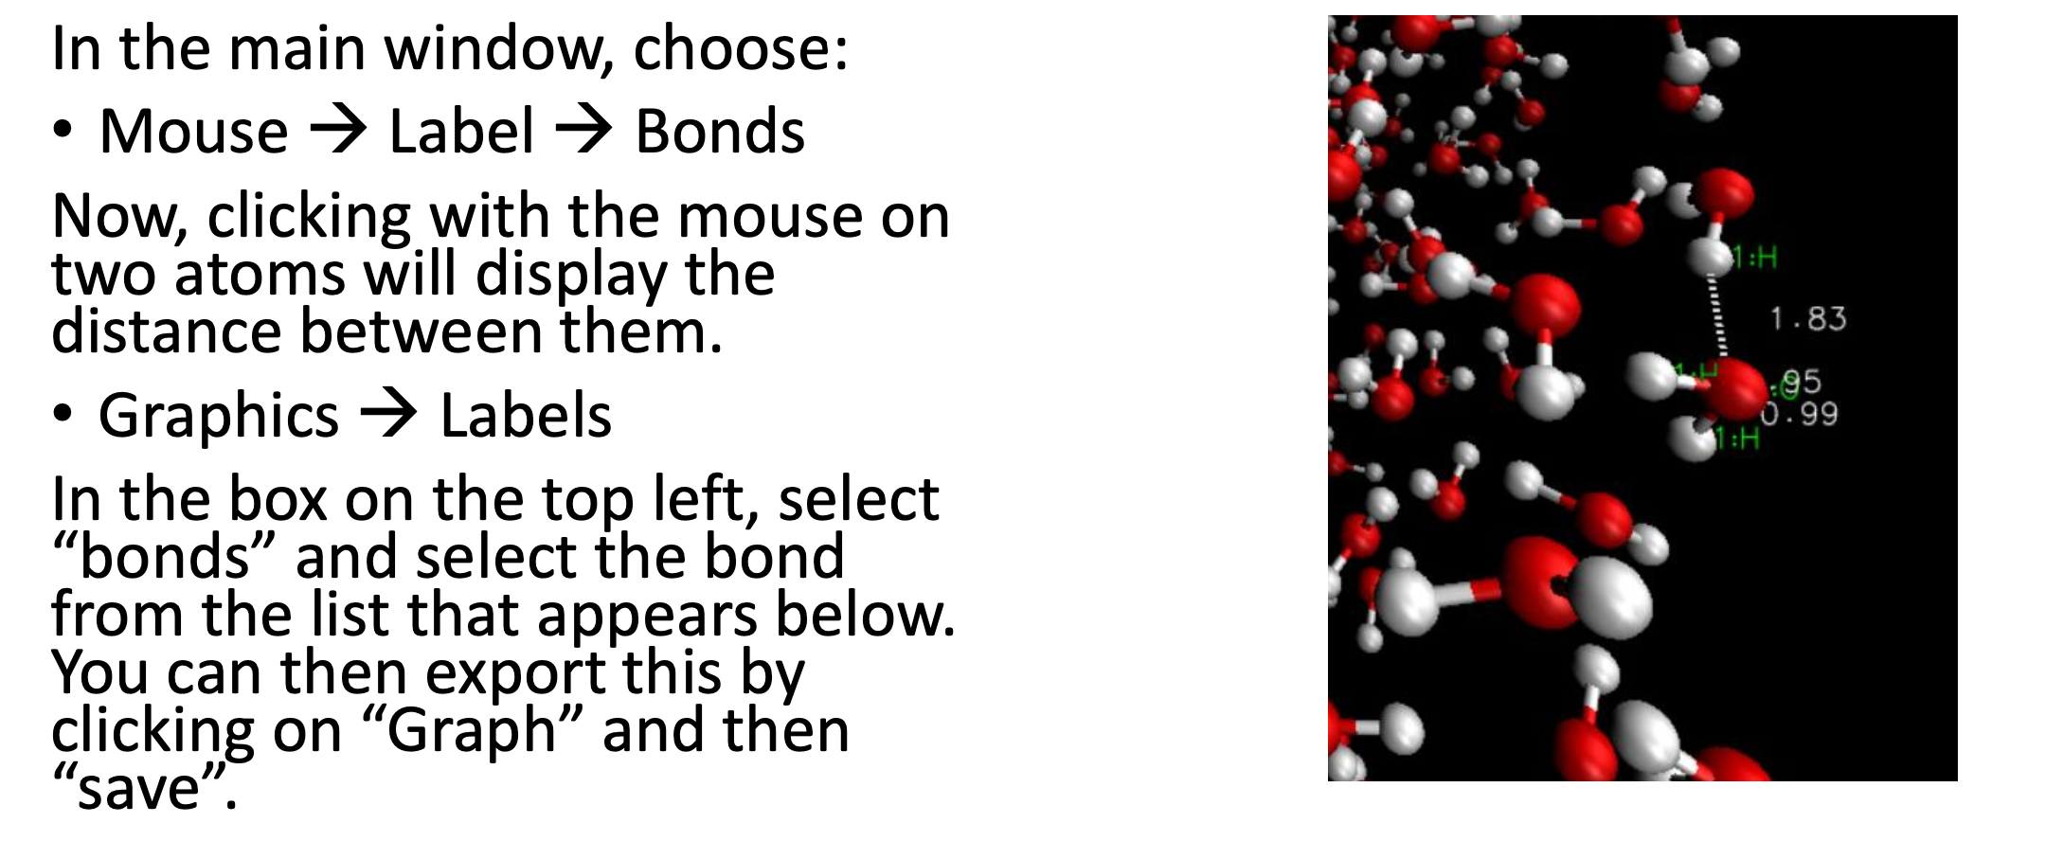
VMD: how to compute atomic distances

Slide 9
VMD: how to save bond distances
First define the bond distance you are interested in (i.e. end-to-end)
Then Graphics -> Labels opens a new window
Select “bond” from the dropdown menu
Select the desired bond (only the ones that you have pre-defined should show there)
Click on “save” to save the bond data for each bond

Slide 10
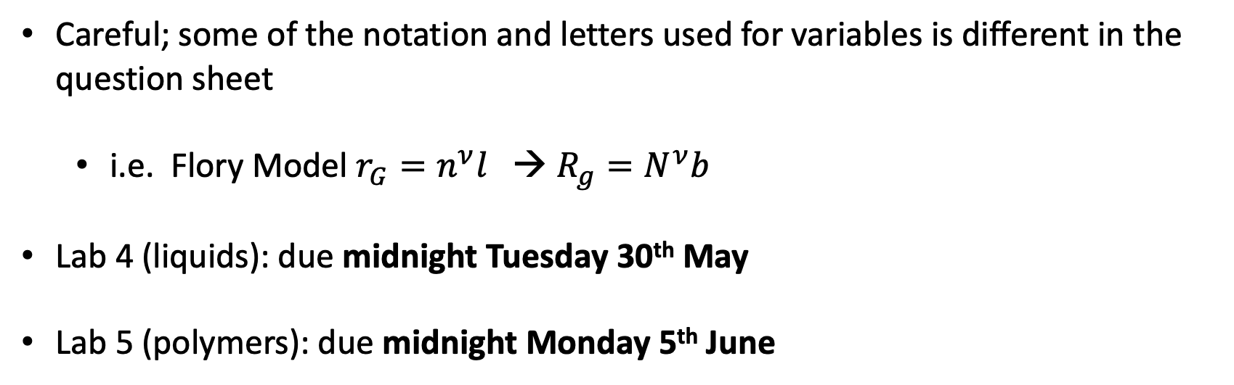
Notes
Careful; some of the notation and letters used for variables is different in the question sheet
  i.e. Flory Model $r_{G}=n^{ν}l$ → $R_{g}=N^{ν}b$
Lab 4 (liquids): due midnight Tuesday 30th May
Lab 5 (polymers): due midnight Monday 5th June

Slide 11
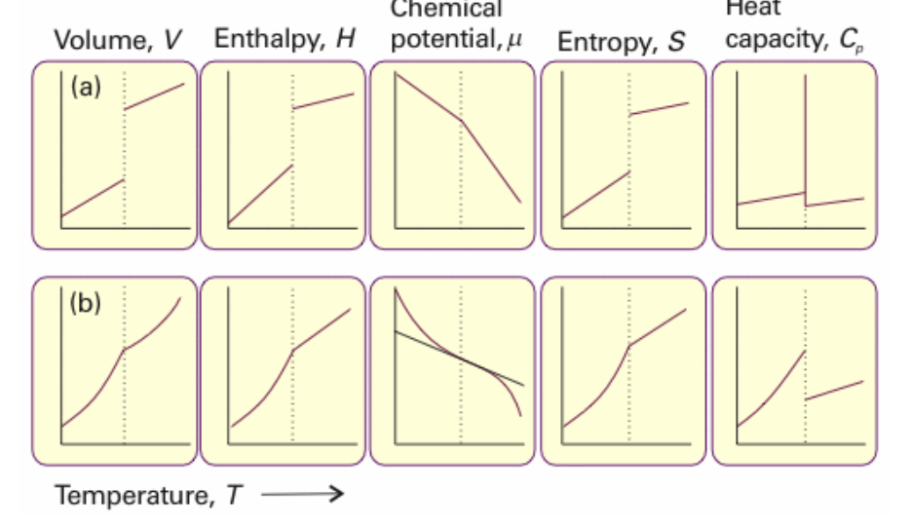
Phase Transitions

Slide 12
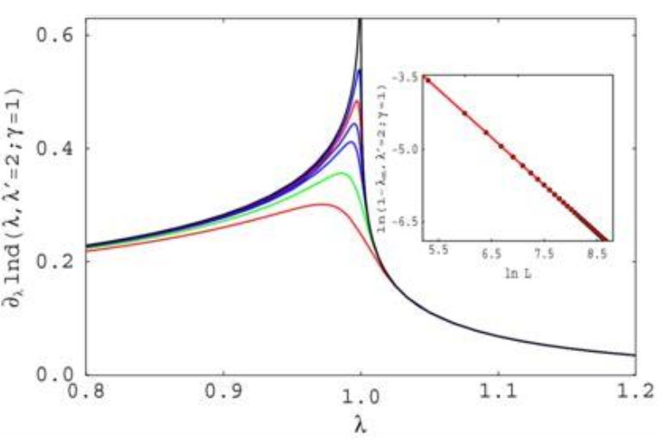
Finite Size Scaling

