Slide 1
Lab 4: Liquids

Slide 2
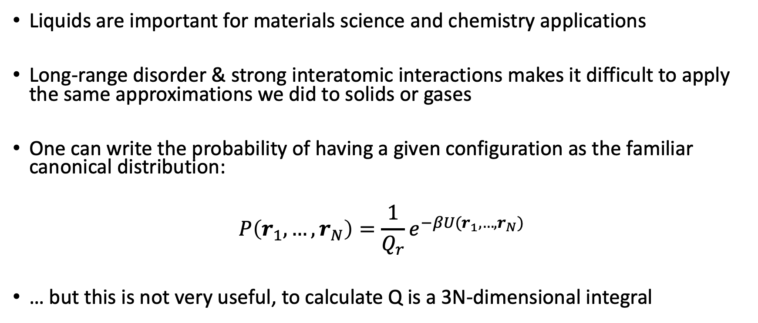

The Radial Distribution Function, $g(r)$
Liquids are important for materials science and chemistry applications
Long-range disorder & strong interatomic interactions makes it difficult to apply the same approximations we did to solids or gases
One can write the probability of having a given configuration as the familiar canonical distribution:
$$P\left(r_{1}, …, r_{N}\right)=\frac{1}{Q_{r}}e^{−βU(r_{1}, …, r_{N})}$$
… but this is not very useful, to calculate Q is a 3N-dimensional integral

Slide 3
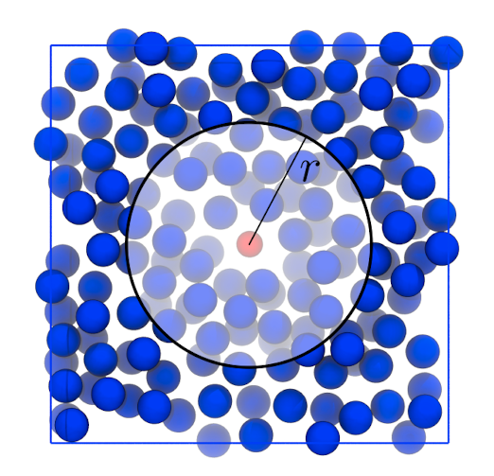
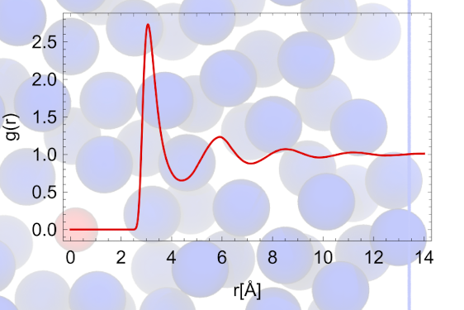
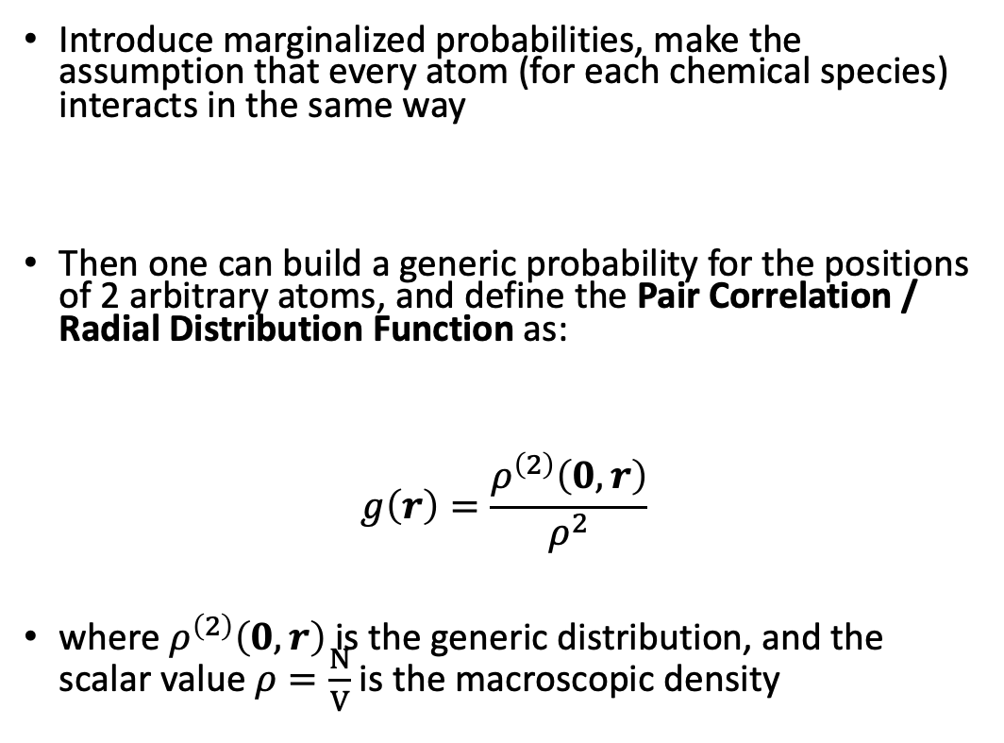
The Radial Distribution Function, $g(r)$
Introduce marginalized probabilities, make the assumption that every atom (for each chemical species) interacts in the same way
Then one can build a generic probability for the positions of 2 arbitrary atoms, and define the Pair Correlation / Radial Distribution Function as:
$$g\left(r\right)=\frac{ρ^{\left(2\right)}\left(0, r\right)}{ρ^{2}}$$
where $ρ^{\left(2\right)}\left(0, r\right)$is the generic distribution, and the scalar value $ρ=\frac{N}{V}$ is the macroscopic density

Slide 4
The Radial Distribution Function, $g(r)$
A microscopically defined function that helps us understand the macroscopic structure of systems, based on the spatial distribution of atoms
Connected to other macroscopic quantities, i.e. reversible work, energy, virial coefficient
The best part: we have both computational and experimental procedures that can measure it!

Slide 5
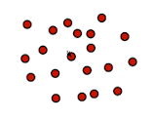
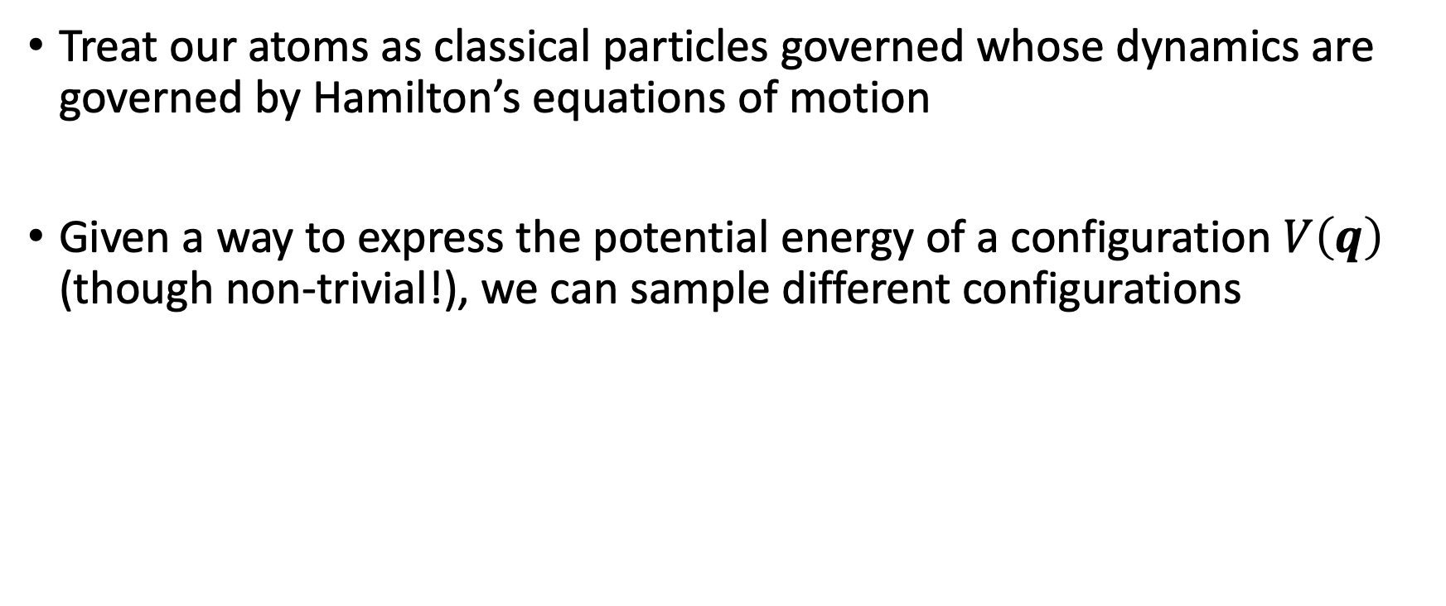


Molecular Dynamics (MD) as a tool to measure g(r)
Treat our atoms as classical particles governed whose dynamics are governed by Hamilton’s equations of motion
Given a way to express the potential energy of a configuration $V\left(q\right)$ (though non-trivial!), we can sample different configurations
$$F_{i=1}$$
Update positions
Calculate forces
etc etc
$$F_{i=2}$$

Slide 6
Molecular Dynamics (MD) as a tool to measure g(r)
Treat our atoms as classical particles governed whose dynamics are governed by Hamilton’s equations of motion
Given a way to express the potential energy of a configuration $V\left(q\right)$ (though non-trivial!), we can sample different configurations
trajectory

Slide 7
This Lab
Analyse molecular dynamics trajectories using VMD.
4 different trajectories of H₂O are provided:
Solid @ 273 K
Liquid @ 300 K
Liquid @ 580 K (high pressure)
Gas at 580 K
Goal: to compare and rationalise the differences between the RDFs for the different phases of matter

Slide 8
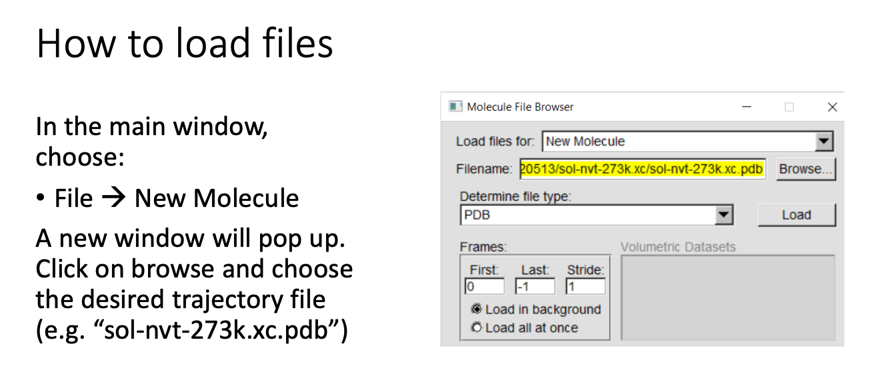
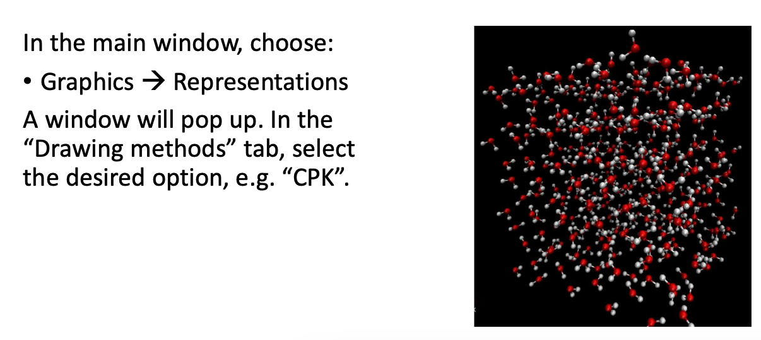
VMD Basics

Slide 9
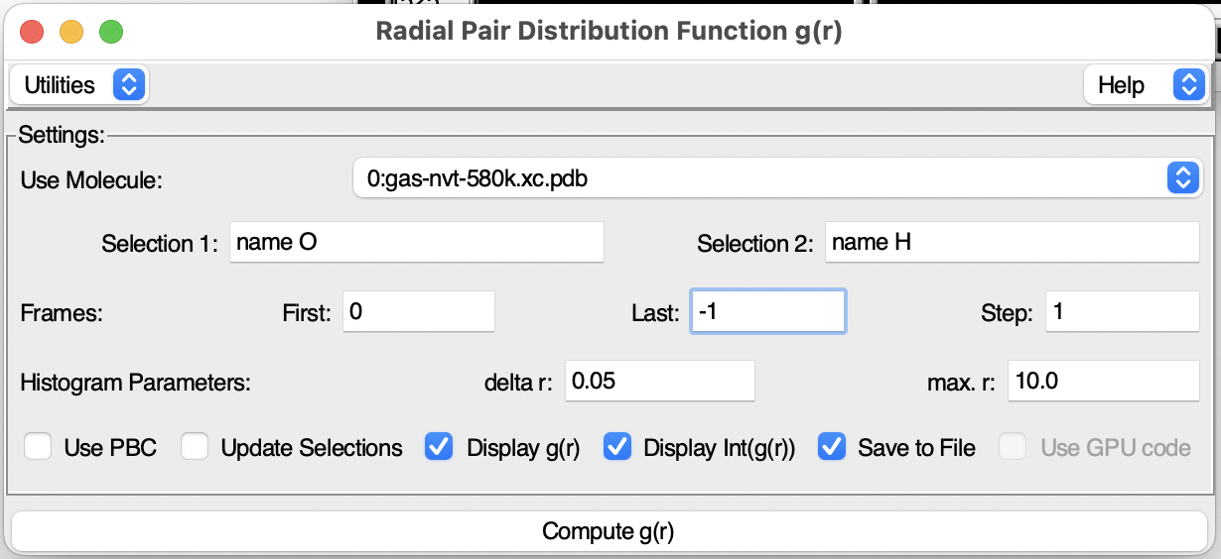
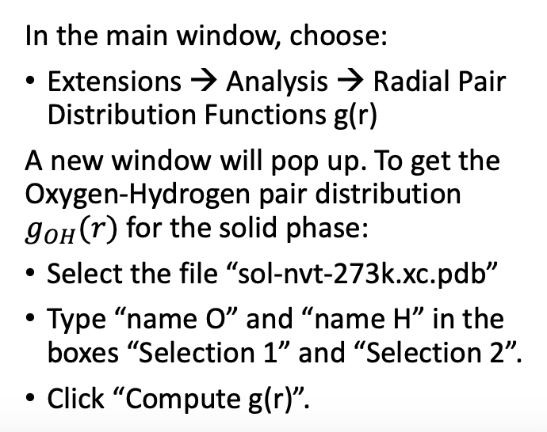
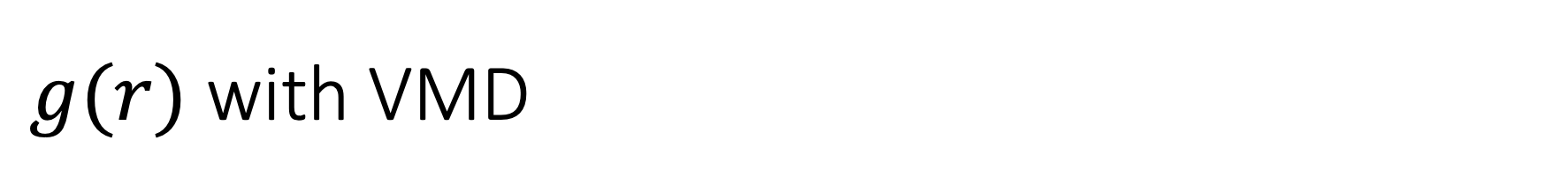
$g(r)$ with VMD
last frame

Slide 10
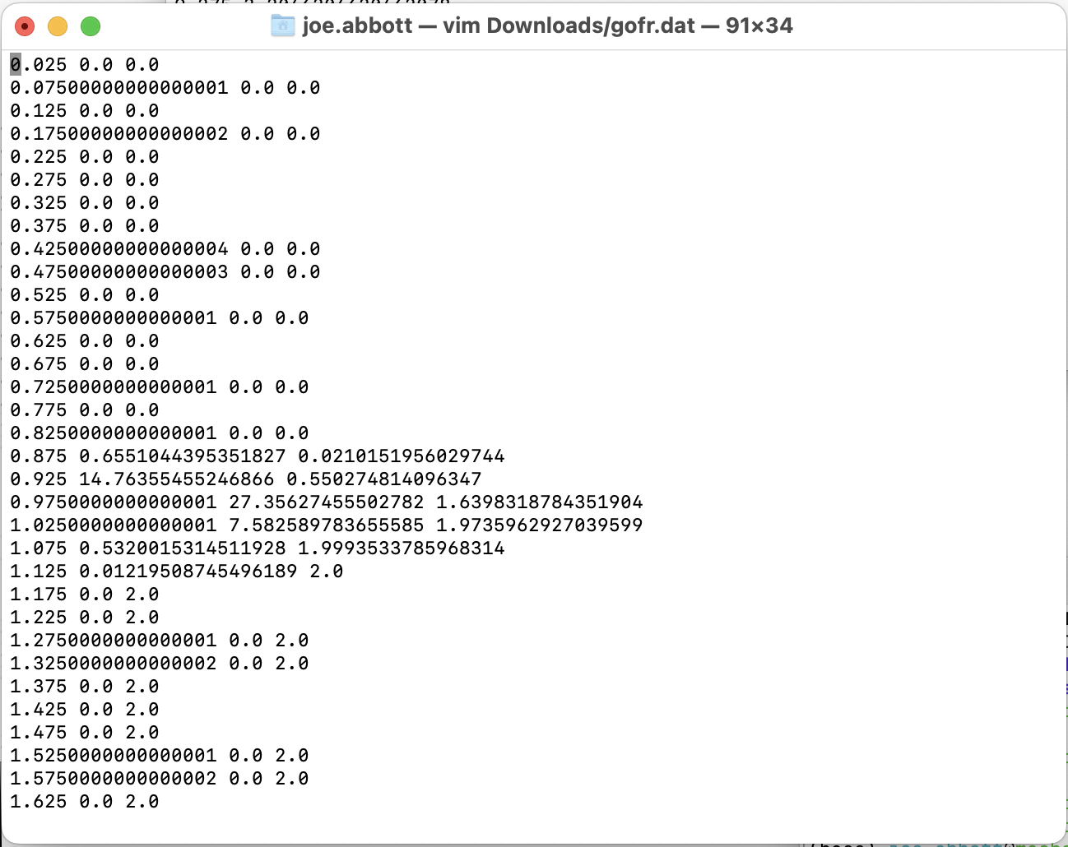
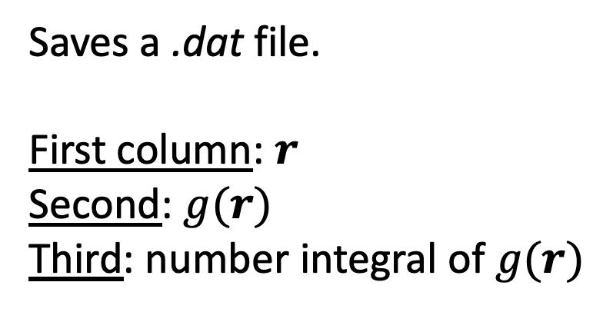
$g(r)$ with VMD
Saves a .dat file.
First column: $r$
Second: $g(r)$
Third: number integral of $g(r)$

Slide 11
