Slide 1
The Value of Natural Capital
Edoardo Chiarotti
20.03.2024

Slide 2
Enterprise for Society
Enterprise for Society is a research and action center created by three institutions of academic excellence (UNIL, IMD, EPFL)
OUR MISSION
« Inspiring and activating the transition to a resilient and inclusive economy within planetary boundaries, mindful of the opportunities and challenges raised by scientific and technological change.»

Slide 3



Enterprise for Society
RESEARCH
EDUCATION
innovation
Inspire social and economic transformation by supporting interdisciplinary research
Train the next generation of leaders by promoting the Master’s Program in Sustainable Management and Technology
Activating the growth of the Swiss ecosystem of sustainable innovation by expanding the expertise developed within our three institutions

Slide 4
Capital
Capital goods, or more simply “capital”, are durable produced goods (or assets) that are in turn used as productive inputs for further production of goods and services
Examples:
  At the company level: the machinery used in a factory.
  At the country level: buildings, equipment, software, and inventories during a given year (capital stock)
It is tempting to call all assets capital goods
  public knowledge -> knowledge capital
  the law, the market system, financial institutions -> institutional capital
  mutual trust, solidarity -> social capital
  culture and norms of behavior -> cultural capital
  religion -> religious capital

Slide 5
Types of capital in economics
Economists confine the use of the term “capital” to assets that are measurable.
Produced capital
  Tangible and alienable: roads, buildings, machines, ports
  Intangible and alienable: patents
Human capital
  Intangible and non-alienable: health, education and skills
Natural capital: natural resources available in an economy
  Tangible and alienable: plants
  Tangible and non-alienable: pollinators
  Intangible and alienable: view from someone’s home
  Intangible and non-alienable: global climate
  Or
  Renewable: plants, forests, fisheries, agricultural land
  Non-renewable: minerals, fossil fuels
Notes:
Capital is realted to something that we then produce
Maybe nature has a value in itself for us, and not only because it allows us to produce goods and services

Slide 6
Focus on natural capital
Example of mining and natural capital:
  Extracted natural capital: minerals
  Damaged natural capital (negative externalities): forests cut, water polluted, atmosphere used
    Resource extraction and use is responsible for about half of the global GHG emissions (Global Resource Outlook, 2019)
  Damaged enabling asset for natural capital: biodiversity loss
    Resource extraction and use is responsible for 90% of the loss in biodiversity (Global Resource Outlook, 2019)

Slide 7
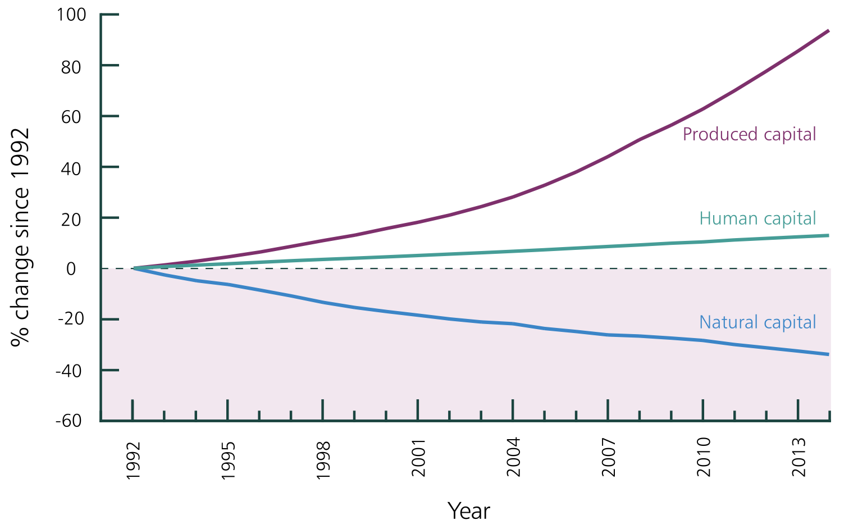
Focus on natural capital
Mining, and other human-based activities, are
  Staking up produced and human capital
  depleting natural capital almost 2 times faster than it can regenerate (Ecological Footprint, 2019)
Source: Managi and Kumar (2018)

Slide 8
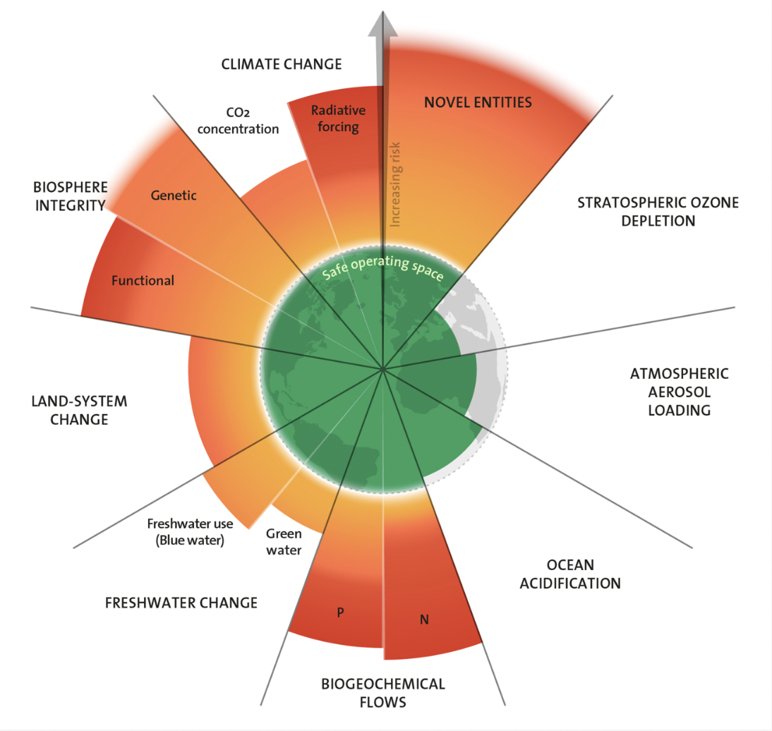
Focus on natural capital
There are limits to the depletion our planet can tolerate
We are already outside 6 out of 9 of these “planetary limits”
As we pass them, we will leave the Holocene and enter the “danger zone”: a highly uncertain, poorly predictable world where Earth system changes likely increase risks to societies (Rockstrom et al., 2009)
Richardson et al. (2013)

Slide 9
Valuing Natural Capital
One way to stop this depletion is to put an artificial monetary value on natural capital (when markets do not do it themselves, or do it too little)
How to decide which is the right value? Start with ecosystem services
Ecosystem services are services provided by natural capital, such as energy, water, plant and fiber growth, from which people derive benefits
Ecosystem Services Valuation (ESV) (Liu et al., 2010)
  Revealed-preference approaches: market methods, travel cost, hedonic methods, production approaches.
  State-preference approaches: contingent valuation, conjoint analysis
  Cost-based approaches: replacement cost, avoidance cost
Notes:
Revealed-preference approaches
•Market methods: Valuations are directly obtained from what people must be willing to pay for the service or good (e.g., timber harvest).
•Travel cost: Valuations of site-based amenities are implied by the costs people incur to enjoy them (e.g., cleaner recreational lakes).•Hedonic methods: The value of a service is implied by what people will be willing to pay for the service through purchases in related markets, such as housing markets (e.g., open-space amenities).
•Production approaches: Service values are assigned from the impacts of those services on economic outputs (e.g., increased shrimp yields from an increased area of wetlands).
State-preference approaches
•Contingent valuation: People are directly asked their willingness to pay or accept compensation for some change in ecological service (e.g., willingness to pay for cleaner air).
•Conjoint analysis: People are asked to choose or rank different service scenarios or ecological conditions that differ in the mix of those conditions (e.g., choosing between wetlands scenarios with differing levels of flood protection and fishery yields).
Cost-based approaches
•Replacement cost: The loss of a natural system service is evaluated in terms of what it would cost to replace that ser-vice (e.g., tertiary treatment values of wet-lands if the cost of replacement is less than the value society places on tertiary treatment).
•Avoidance cost: A service is valued on the basis of costs avoided, or of the extent to which it allows the avoidance of costly averting behaviors, including mitigation (e.g., clean water reduces costly incidents of diarrhea).

Slide 10
Valuing Natural Capital
Artificial mechanisms for valuing natural capital draw on these methods
Market mechanisms: regulators set a starting condition, and the value of 1 unit of natural capital is given by supply and demand of credits (permits) following that condition
  Compliance carbon markets: regulator sets a treshold for emissions
  Voluntary carbon markets: companies voluntary trade carbon credits
  Individual Transferable Quotas: regulator sets a threshold for fishing
  National schemes for biodiversity offsets: regulator sets a scheme to avoid, mitigate and restore

Slide 11
Valuing Natural Capital
Non-market mechanisms: regulators directly set the value of 1 unit of natural capital
  Carbon taxes
  Polluter-pays funds
  Payments for Ecosystem Services (PES)
  Biodiversity-relevant taxes
  Official Development Assistance (ODA) program
  Debt-for-nature swaps
Notes:
Official Development Assistance (ODA) is an international funding scheme targeted for developing countries [48]. USA, Germany, France and Japan are the main donors of biodiversity-related ODA, with the main projects being about the sustainable management of forestry, water supply, agriculture and fishing in African countries [49].
Debt-for-nature swaps can be used by developing countries to receive a debt or interest discount, and in exchange must invest the related savings into nature preservation and restoration.

Slide 12
Valuing Natural Capital
(Non-exhaustive) example with mining company in Switzerland
Market mechanisms
  Compliance carbon market: for each tonne emitted above its threshold (assigned by the government in line with the Paris agreement), it must buy carbon credits in the compliance market for around 100€ a tonne, or uses credits that has in stock.
  Voluntary carbon market: if it wants to, it buys other carbon credits in the voluntary market for around 1€ a tonne
  National scheme for biodiversity offsets: it must avoid, mitigate and restore any negative impact on biodiversity of a new mine
Non-market mechanisms
  Carbon tax: it must pay a levy of 120 CHF on its purchase invoices of thermal fuel used to produce heat, light or electricity.
  …

Slide 13
Valuing Natural Capital - Issues
The current price of natural capital is far below the “just” value that would halt its depletion
  The social cost of carbon is calculated to be around 300$ per tonne (Kikstra et al., 2021)
  The cost of extracting mineral resources does not include the fact that they are limited, nor all the natural capital and enabling assets that are destroyed in the extraction process
There is a large financing gap for natural capital (or enabling asset)

Slide 14
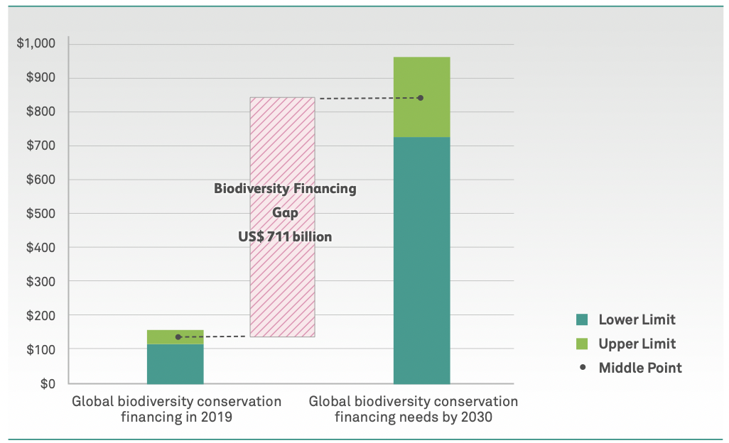
Biodiversity Financing Gap
Current biodiversity financing gap around 700 Billion US$ a year
86 % from public funds, only 14% from private funds. Private companies need to step in
COP 15 pledged to create the Global Biodiversity Framework (GBF) fund to mobilize at least 200 billion US$ a year by 2030 into nature preservation and restoration
Source: Financing Nature, Closing the Global Biodiversity Financing Gap (Paulson Institute, The Nature Conservancy, Cornell Atkinson).

Slide 15
E4S Research
What we propose: non-market mechanism to increase private-sector payments in the GBF fund
Estimate the local impact a company’s facility has on nature (”local scope 1”)
Estimate the cost of this nature loss by considering the restoration cost
The company pays this cost by channeling the due amounts into the GBF fund, that reinvests in nature restoration.

Slide 16
Vegetation
We focus on vegetation because it is “easy” to measure with satellites
During photosynthesis, the mesophyll leaf structure scatters near-infrared light, while the chlorophyll absorbs red light
Normalized Difference Vegetation Index (NDVI) or Enhanced Vegetation Index
EVI is between -1 and 1, and the higher the photosyntesis (the higher the difference between NIR for mesophyll and R for clorophyll) the higher the EVI
Data: Landsat 5 (1984-2012, 30-meter resolution)

Slide 17
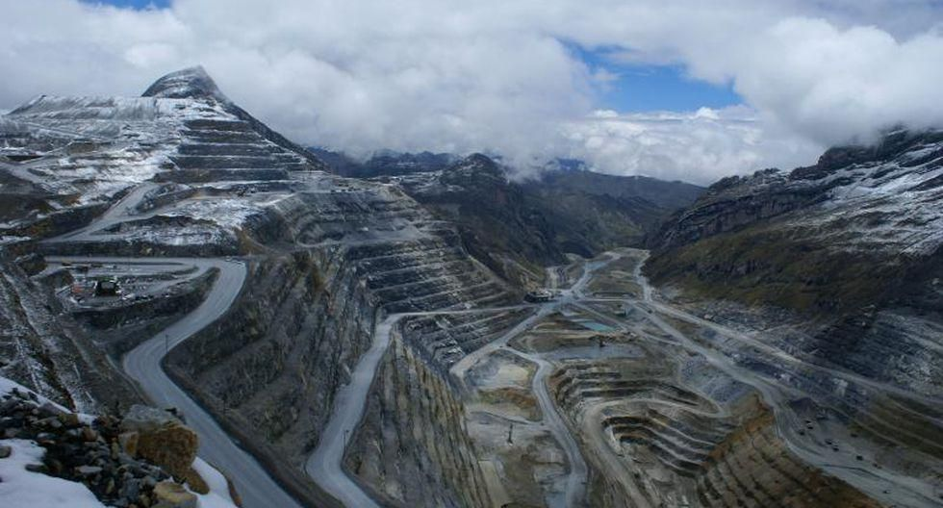
Antamina
The Antamina mine (copper / zinc) is located in the Puna grassland, 270 kilometers north of Lima, at an average elevation of 4,200 meters
The mine is managed by a joint venture of four companies: Glencore plc (33.75%), BHP plc (33.75%), Teck (22.5%), and Mitsubishi Corporation (10%)
The building phase started in 1998, and it was operational in 2001
Figure 4: Antamina – Land View Today
Source: Economy (https://euro.eseuro.com/local/198876.html)

Slide 18
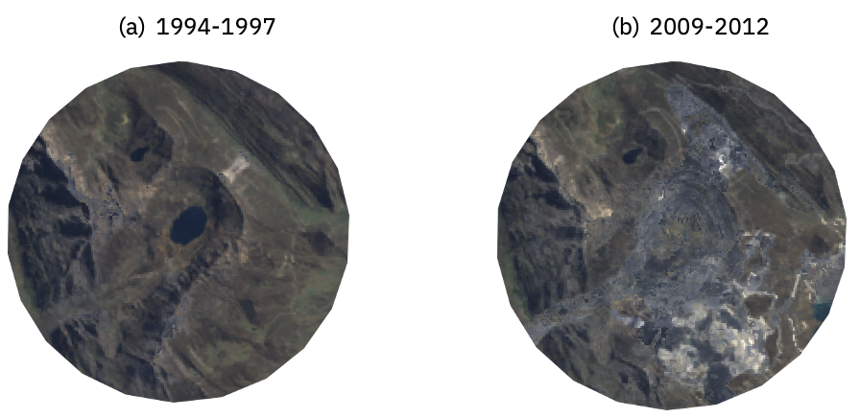
Antamina: Impact on Vegetation
Figure 5: Antamina – Satellite Composite Pictures
Source: Authors’ calculations. This figure reports the images for the Antamina site before and after the site was built (3-km radius). The first image was obtained by compressing all images available in the window 1994-1997. The compression minimized the presence of clouds. The same procedure was applied to obtain the second image over the window 2009-2012 (end of the dataset).

Slide 19
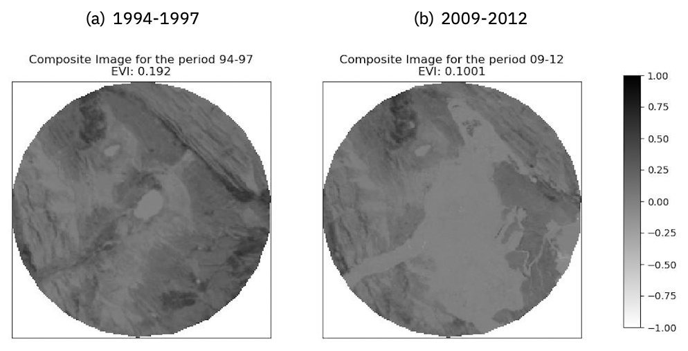
Antamina: Impact on Vegetation
EVI goes from 0.192 to 0.1001
0.0921 point decrease, i.e. -48% decrease in vegetation
We adjust this with a control location, obtaining a 0.0899 point decrease
Figure 7: Antamina - Changes in the Enhanced Vegetation Index
Source: Authors’ calculations. This figure reports the values at the pixel level for the Enhanced Vegetation Index in images of the area of the Antamina site before (panel a) and after (panel b) the site was built (3-km radius). Darker pixels are for positive EVI values (presence of vegetation), while clearer pixels are for negative EVI values (absence of vegetation).

Slide 20





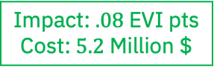
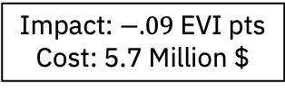
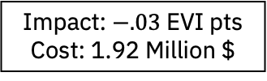
Application: Cost of Vegetation Loss for Antamina/Glencore
Glencore
Instituto Terra
Impact: $−.03$ EVI pts
Cost: 1.92 Million $
Impact: $.08$ EVI pts
Cost: $5.2$ Million $
Antamina
Impact: $−.09$ EVI pts
Cost: 5.7 Million $

Slide 21


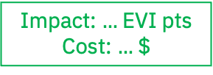
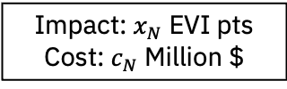
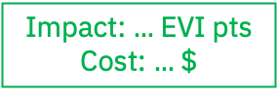
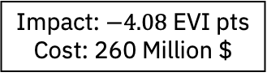
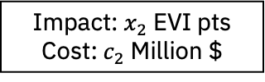
Application: Cost of Vegetation Loss for Glencore
Fund Capital: $260 Mil.$$
Impact: $…$ EVI pts
Cost: $…$$
Glencore
…
Instituto Terra
Impact: $−4.08$ EVI pts
Cost: 260 Million $
Impact: $…$ EVI pts
Cost: $…$ $
Impact: $.08$ EVI pts
Cost: $5.2$ Million $
Antamina
Site 2
Site N
…
Impact: $−.09$ EVI pts
Cost: 5.7 Million $
Impact: $x_{2}$ EVI pts
Cost: $c_{2}$ Million $
Impact: $x_{N}$ EVI pts
Cost: $c_{N}$ Million $

Slide 22
Policies to preserve natural capital are on their way
The GBF fund (and other measures) of COP 15 were a landmark deal in 2022 (next COP on biodiverstiy is taking place this year)
In 2023:
  High Seas Treaty to protect the world's oceans that lie outside national boundaries
  COP28 launches the long-awaited fund for loss and damage caused by climate change.
  The European Union is stopping imports of commodities and products linked to deforestation (regulation)
  EU’s parliament sets a target for the EU to restore at least 20% of the EU’s land and sea areas by 2030
  After the Lula’s government took office in Brazil, the rate of deforestation in the Amazon rainforest dropped sharply

