Slide 1
Heterophase Interfaces and Thin Films Lesson 12
MSE 304
Francesco Stellacci

Slide 2
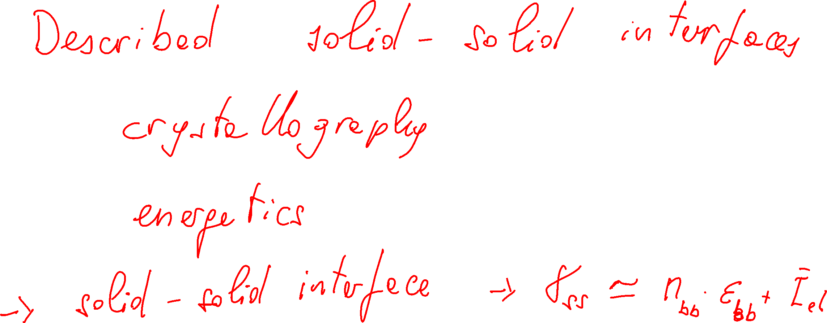
Key Topics in the Previous Class
Lesson 12 – MSE 304 – Fall 2020

Slide 3
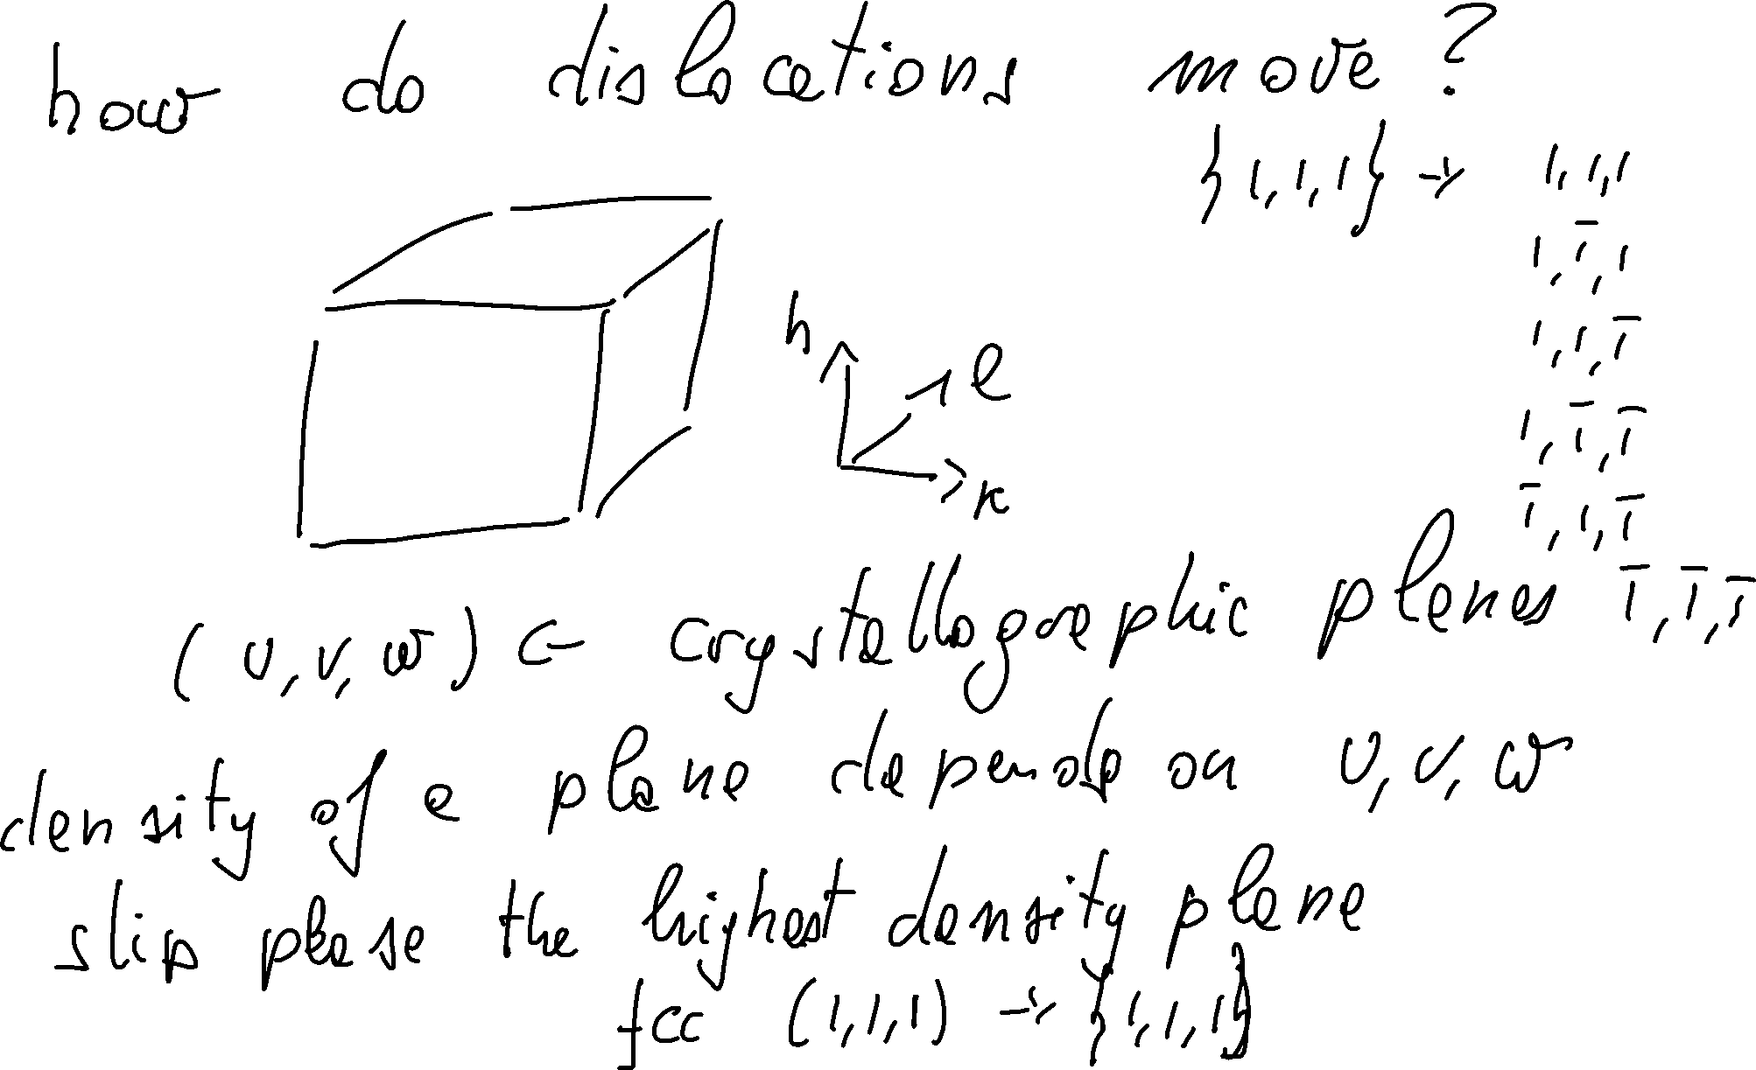
Slip Planes in a Crystal Structure
Lesson 12 – MSE 304 – Fall 2020

Slide 4
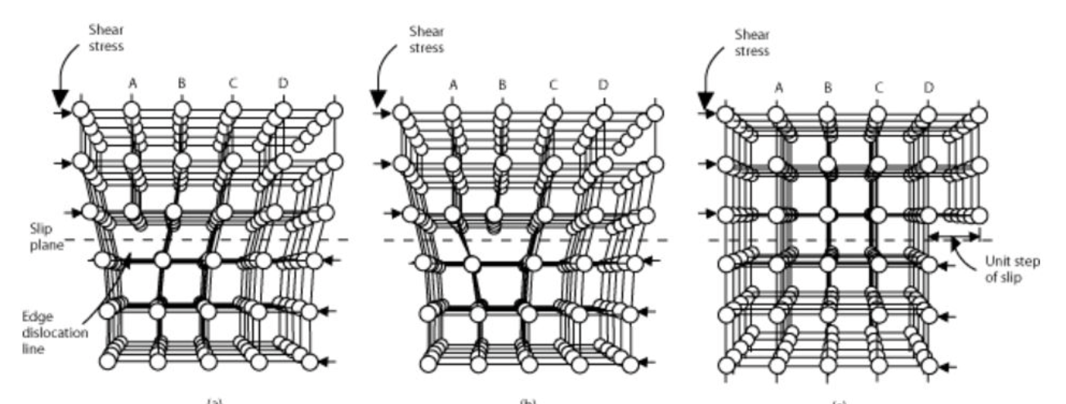

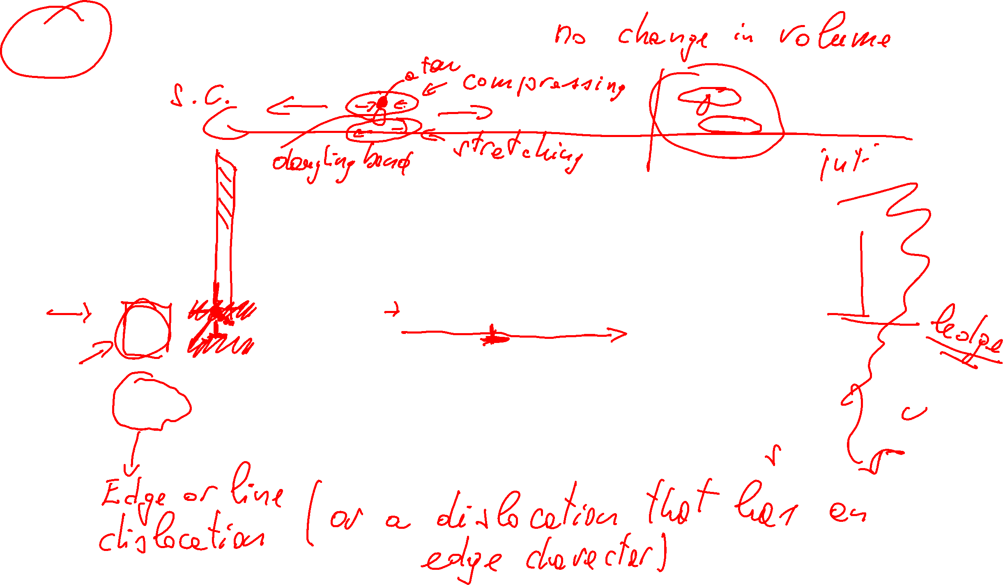






Glide Motion of Dislocations
Lesson 12 – MSE 304 – Fall 2020

Slide 5
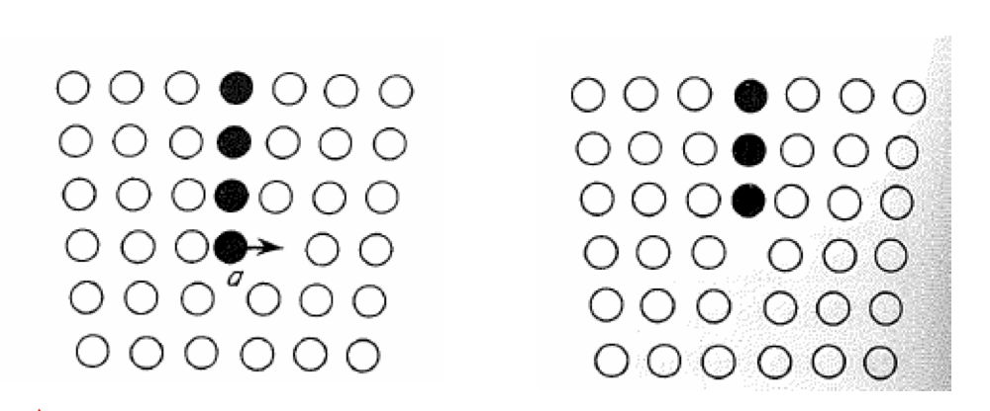
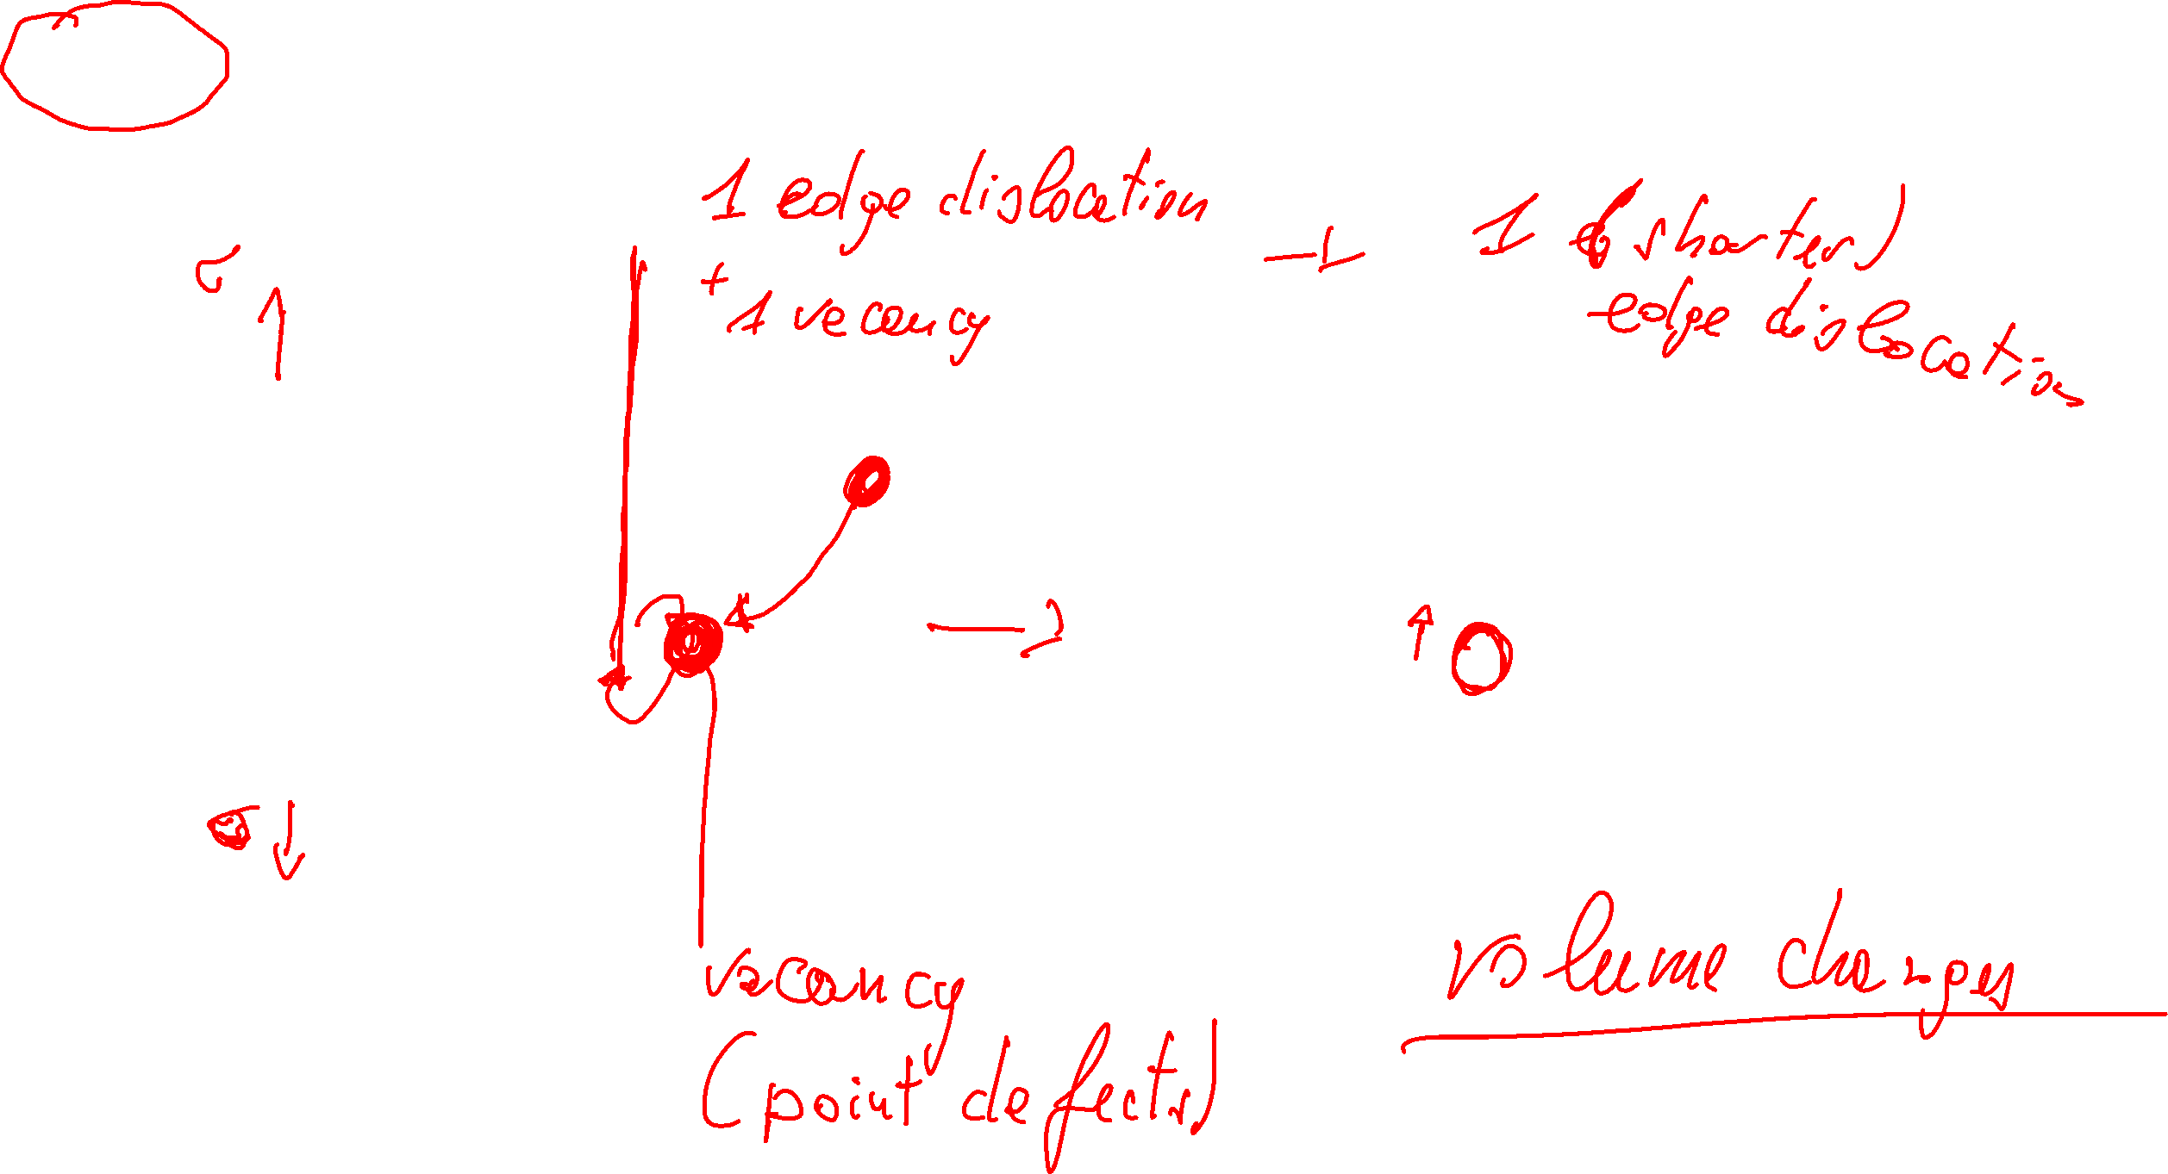
Climb Motion for Dislocations
Lesson 12 – MSE 304 – Fall 2020

Slide 6
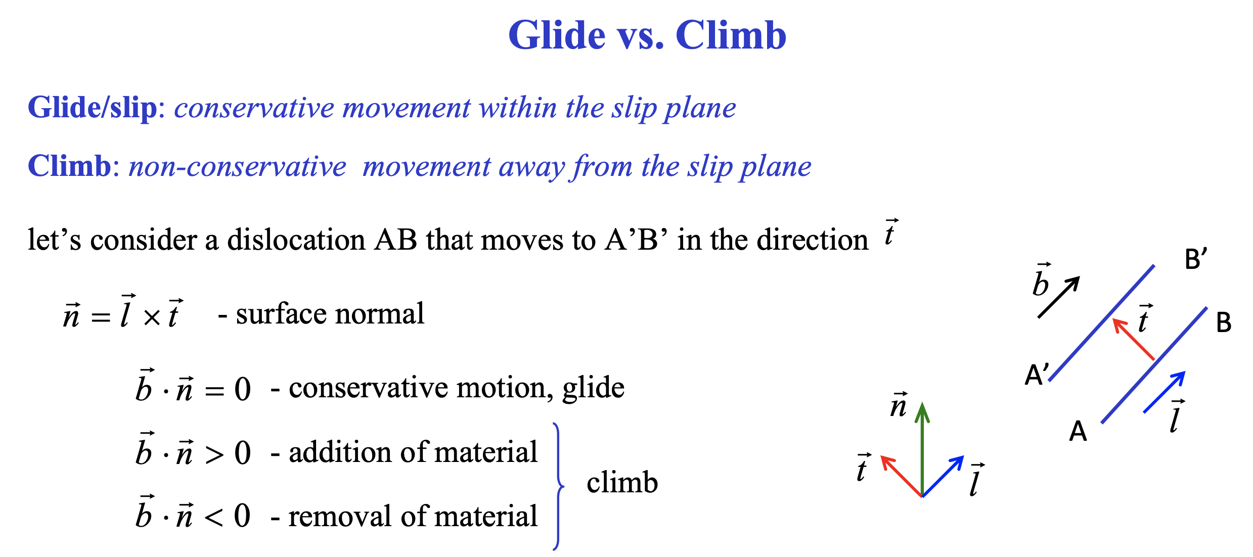
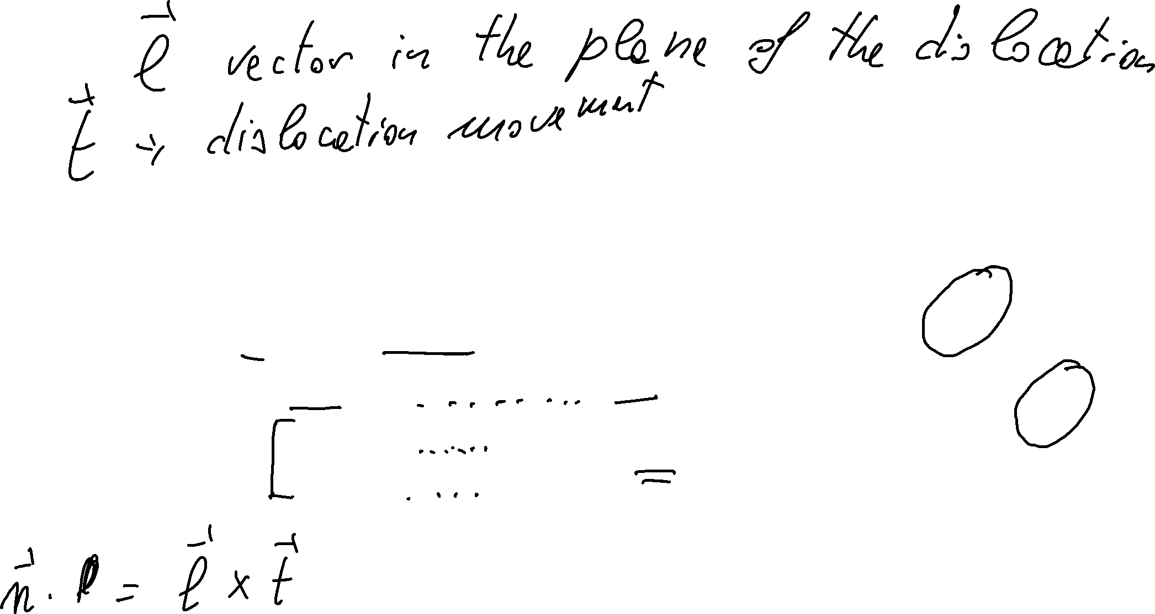
Glide and Climb Motion for Dislocations
Lesson 12 – MSE 304 – Fall 2020

Slide 7
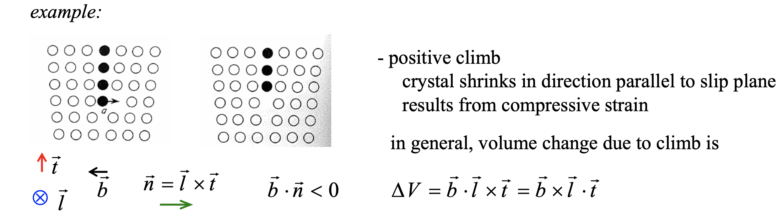
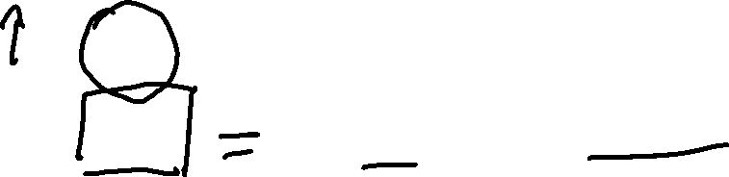
Glide and Climb Motion of Dislocations
Lesson 12 – MSE 304 – Fall 2020

Slide 8
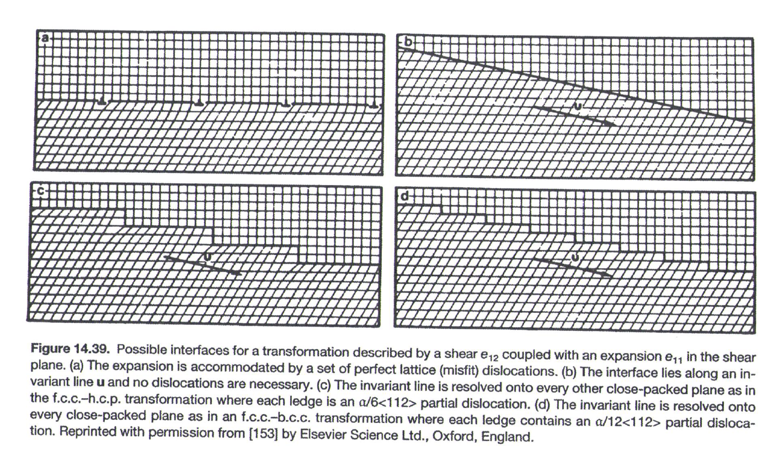
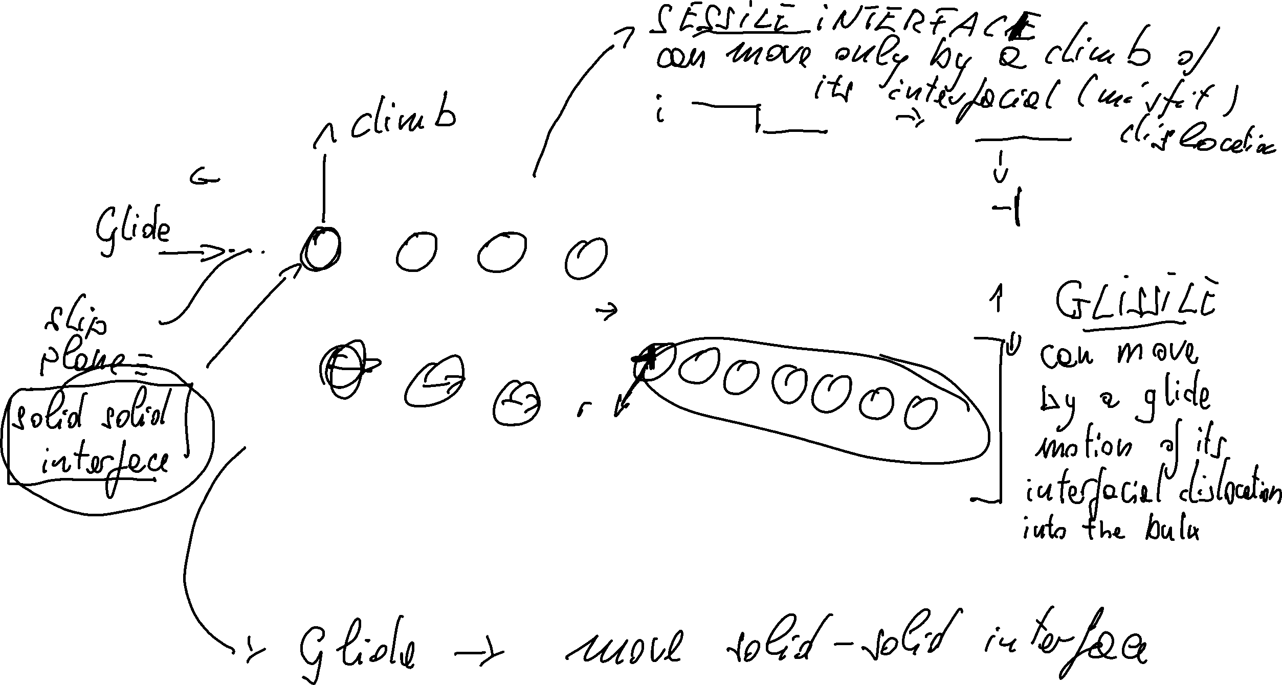
Glissile and Sessile Interfaces
Lesson 12 – MSE 304 – Fall 2020

Slide 9
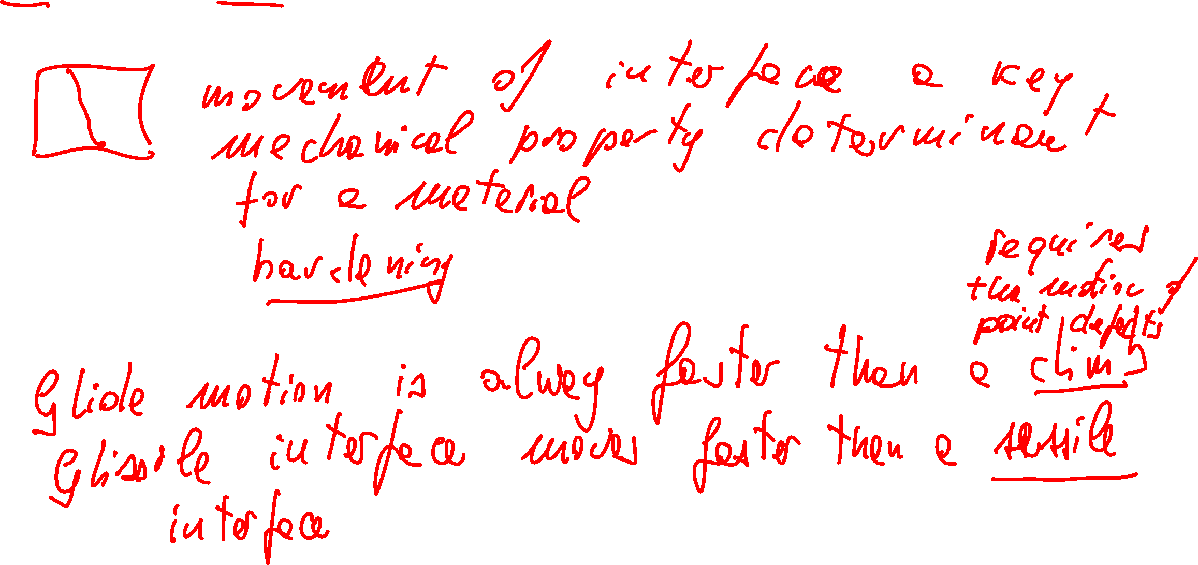
Glissile and Sessile Interfaces
Lesson 12 – MSE 304 – Fall 2020

Slide 10
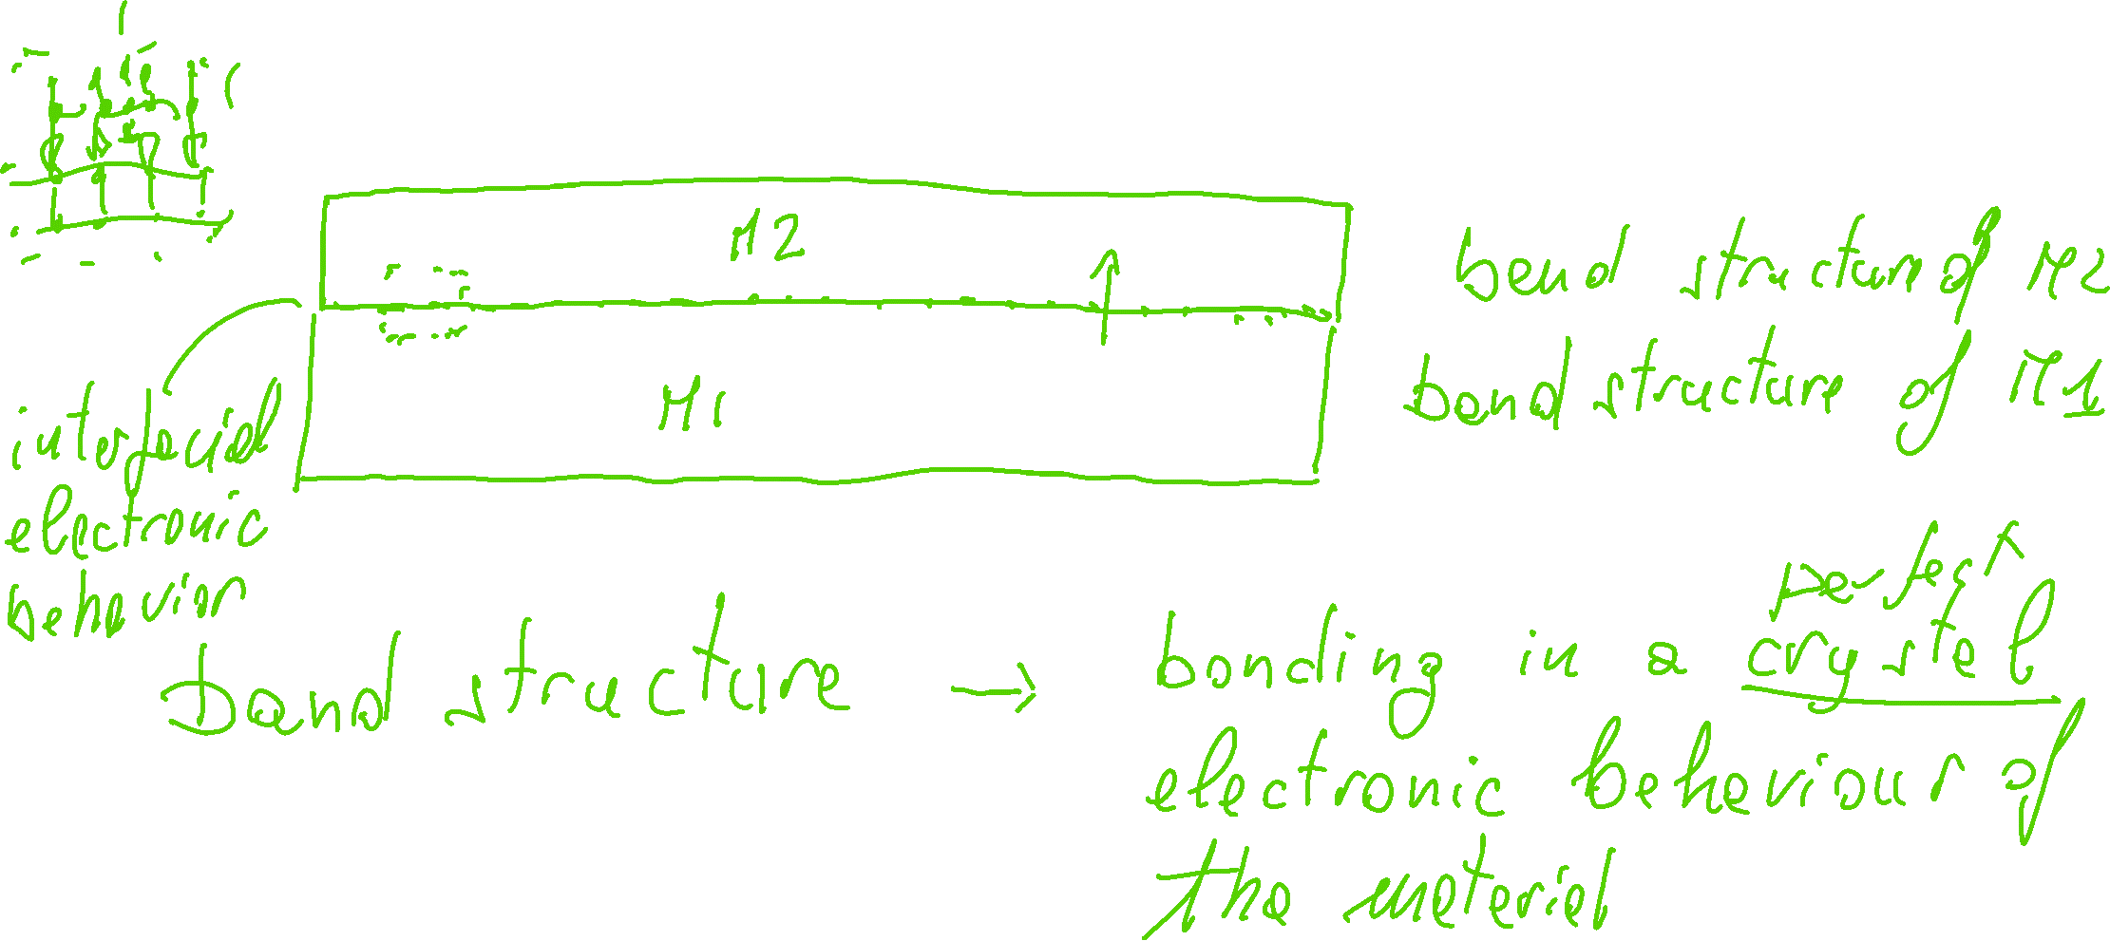
Thin Films in Modern Technology
Lesson 12 – MSE 304 – Fall 2020

Slide 11
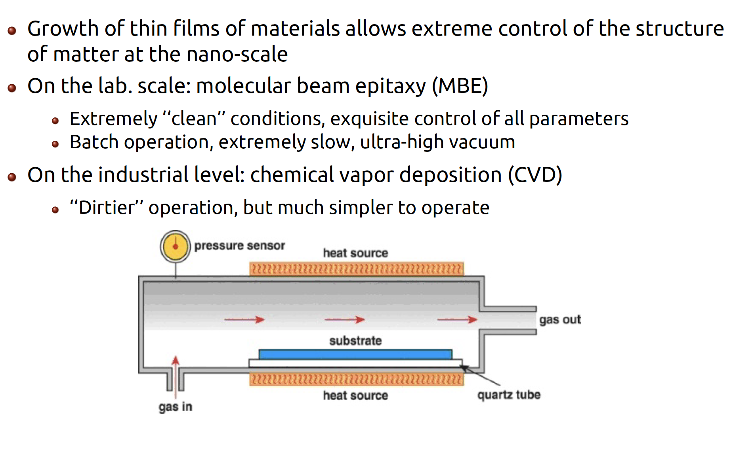
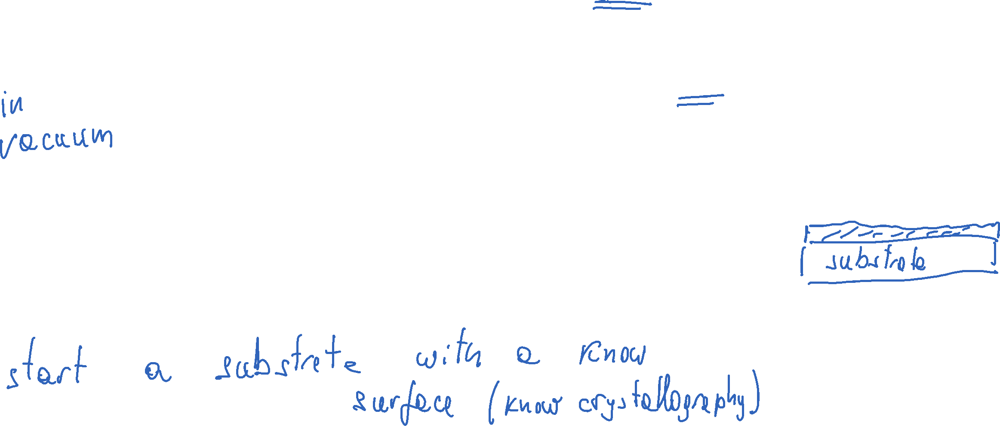
Thin Films in Modern Technology
Lesson 12 – MSE 304 – Fall 2020

Slide 12
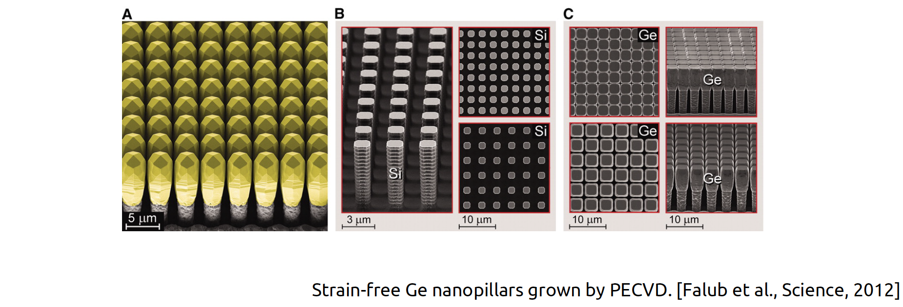
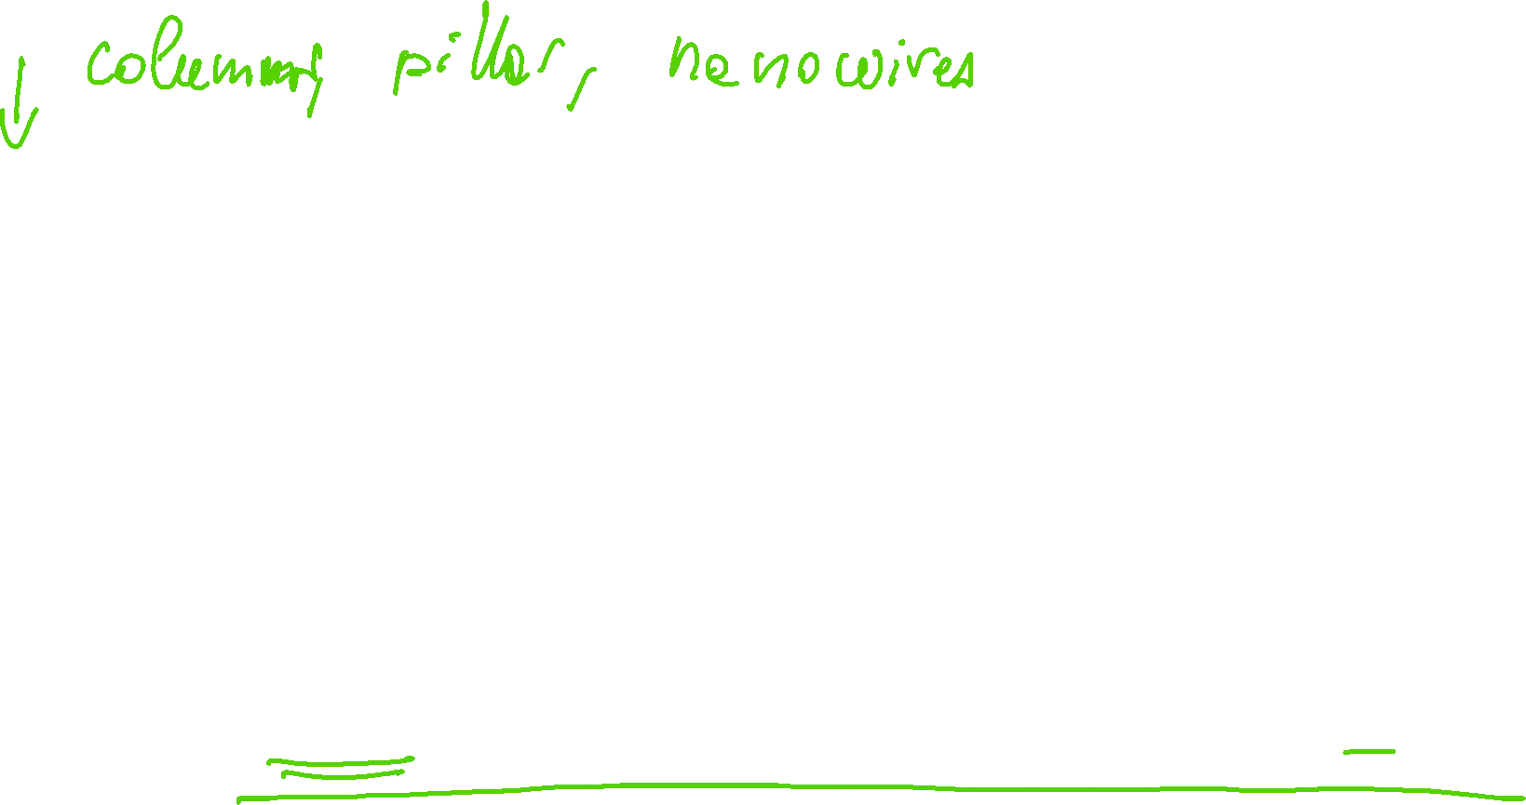
Thin Films – Morphology Control
Lesson 12 – MSE 304 – Fall 2020

Slide 13
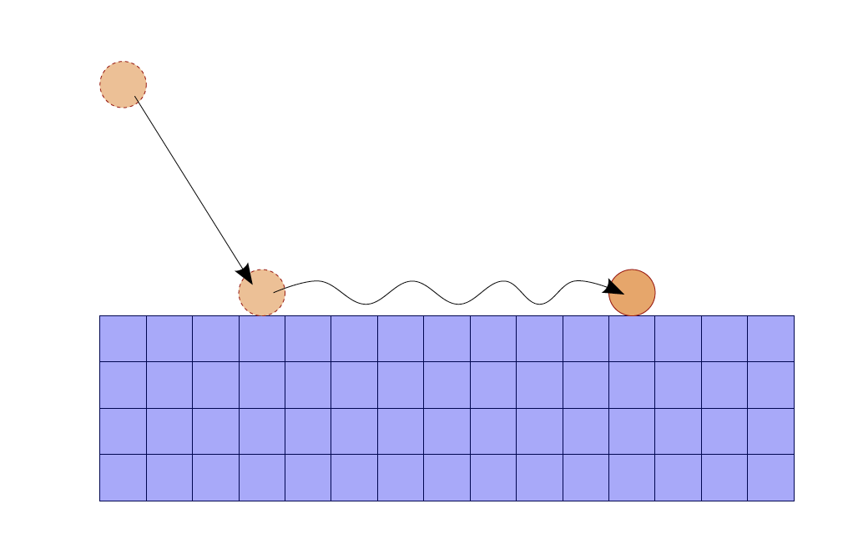
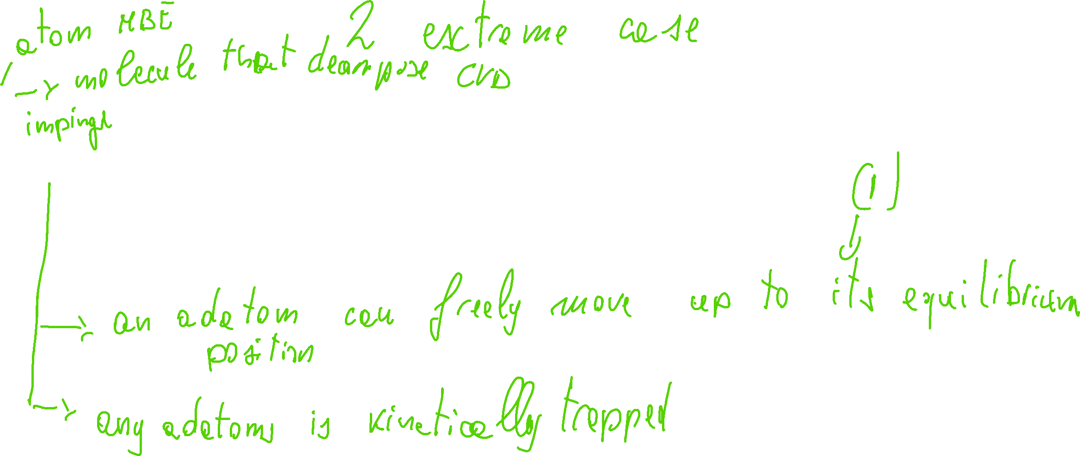
Growth Models for Thin Films
Lesson 12 – MSE 304 – Fall 2020

Slide 14
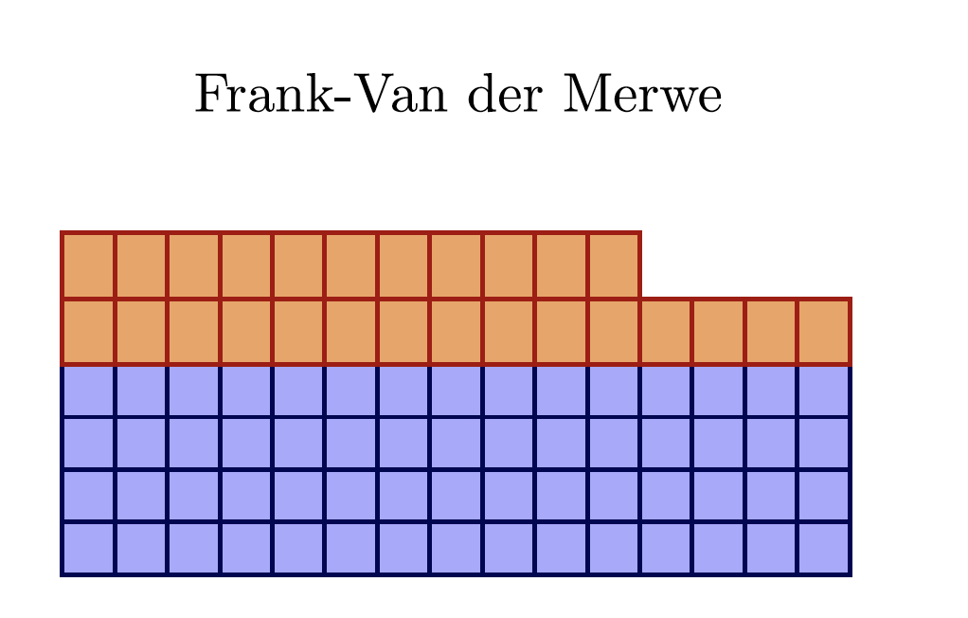
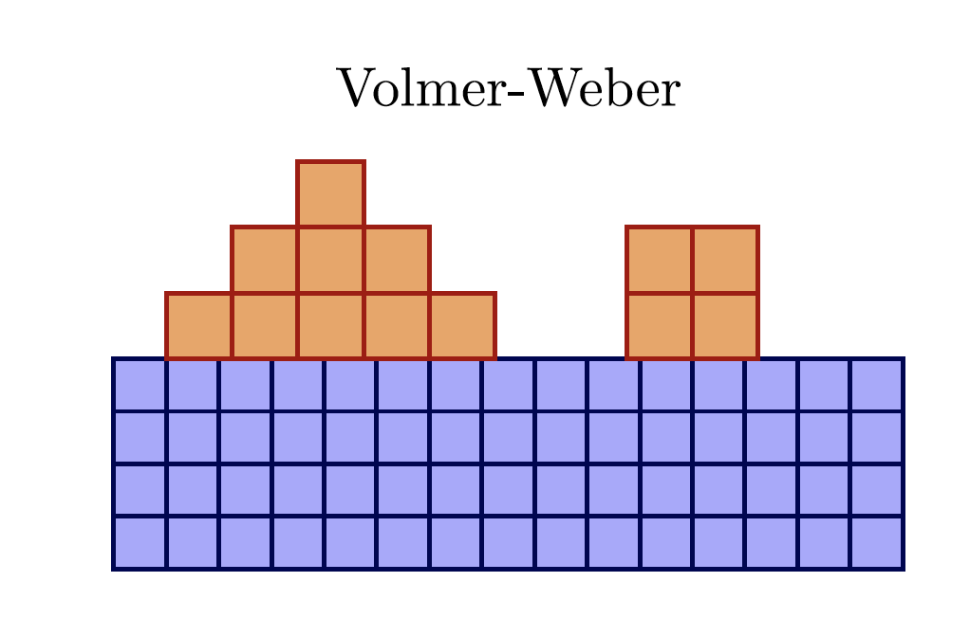
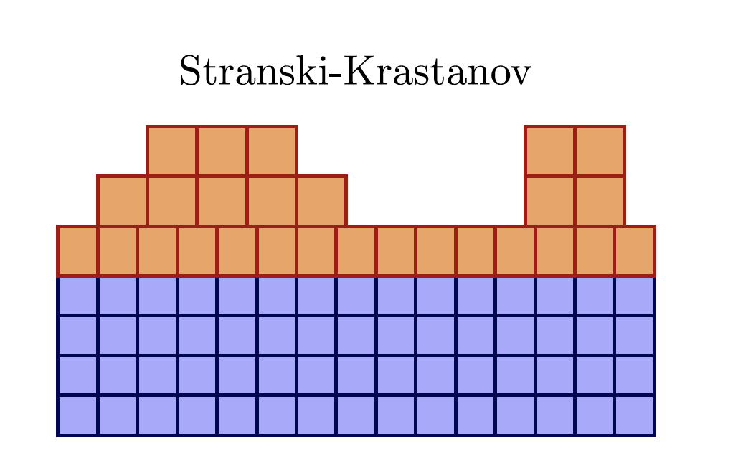
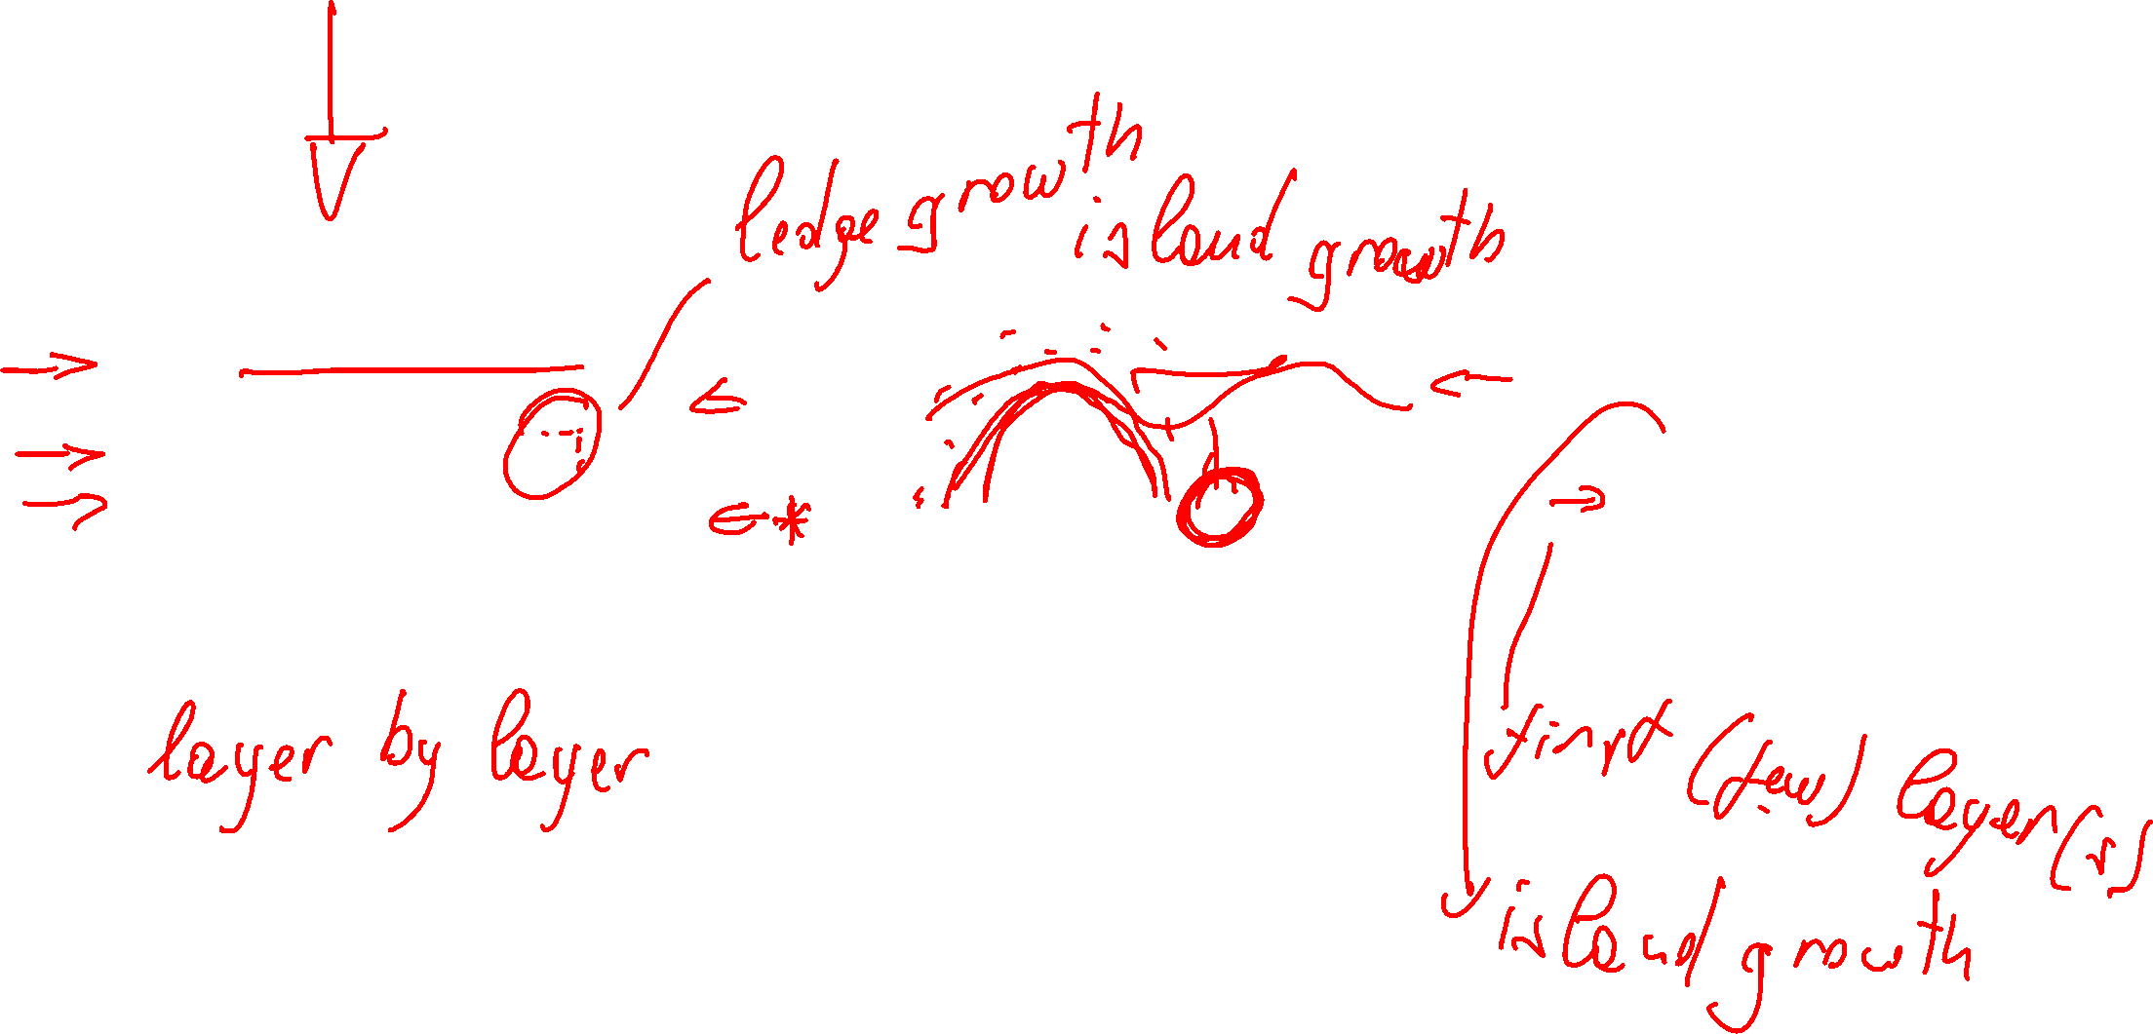
Growth Models for Thin Films
Lesson 12 – MSE 304 – Fall 2020

Slide 15
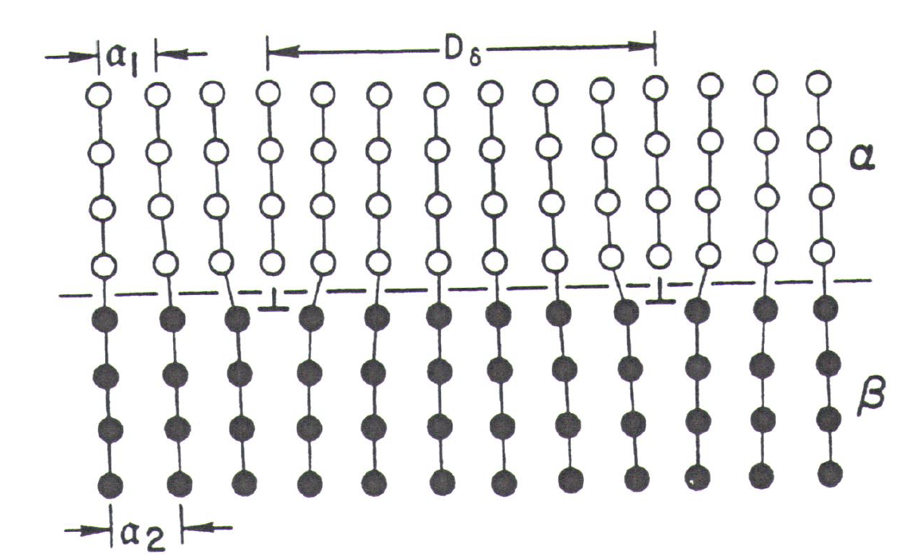
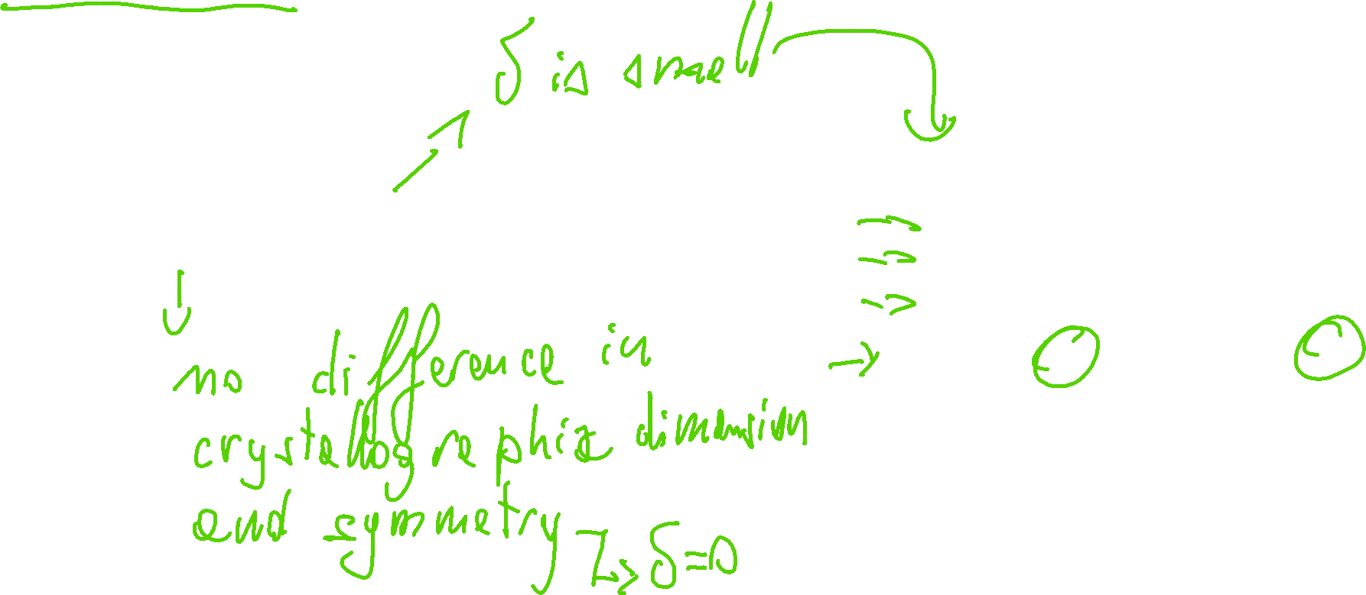
Growth Models for Thin Films
Lesson 12 – MSE 304 – Fall 2020

Slide 16
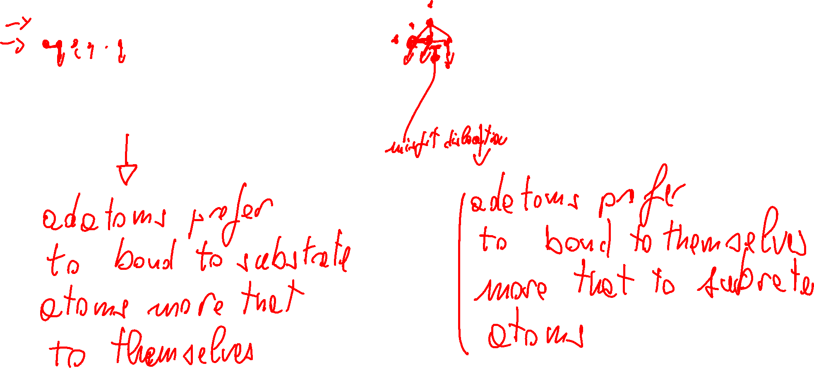
Growth Models for Thin Films: First Explanation
Lesson 12 – MSE 304 – Fall 2020

Slide 17
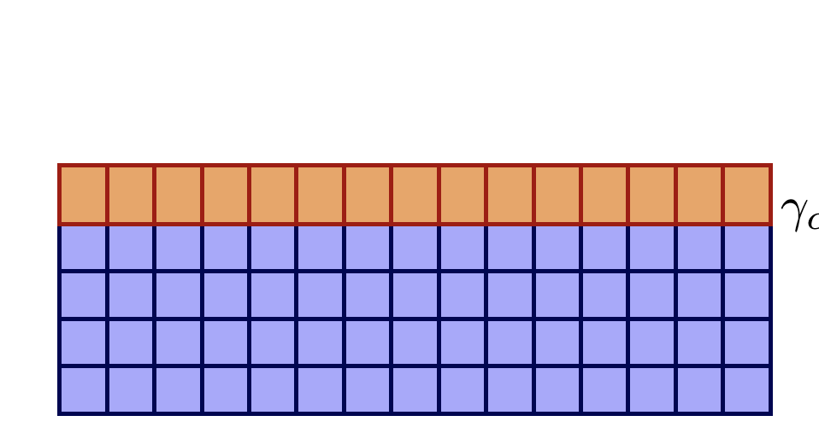
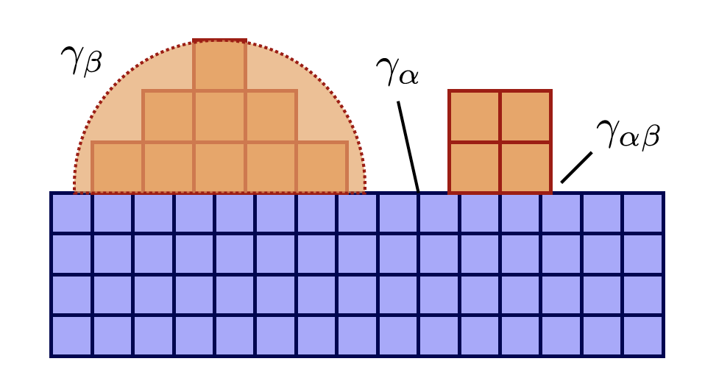
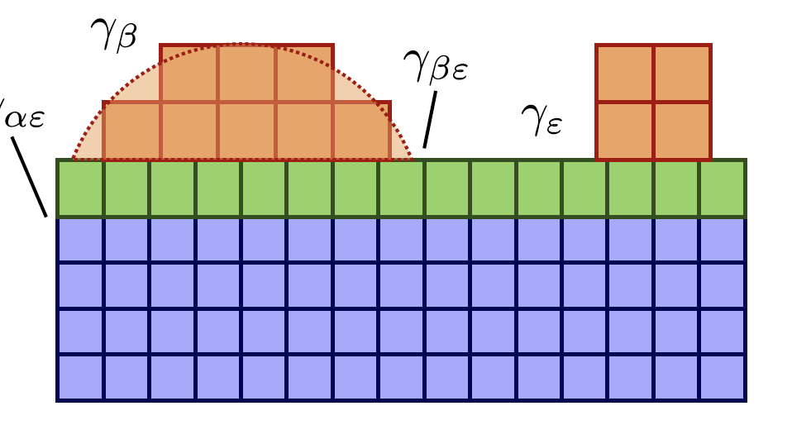
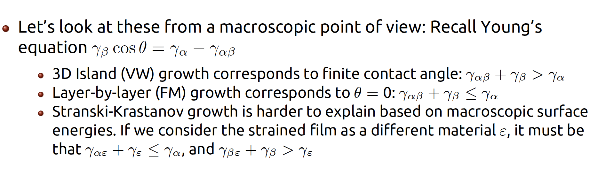
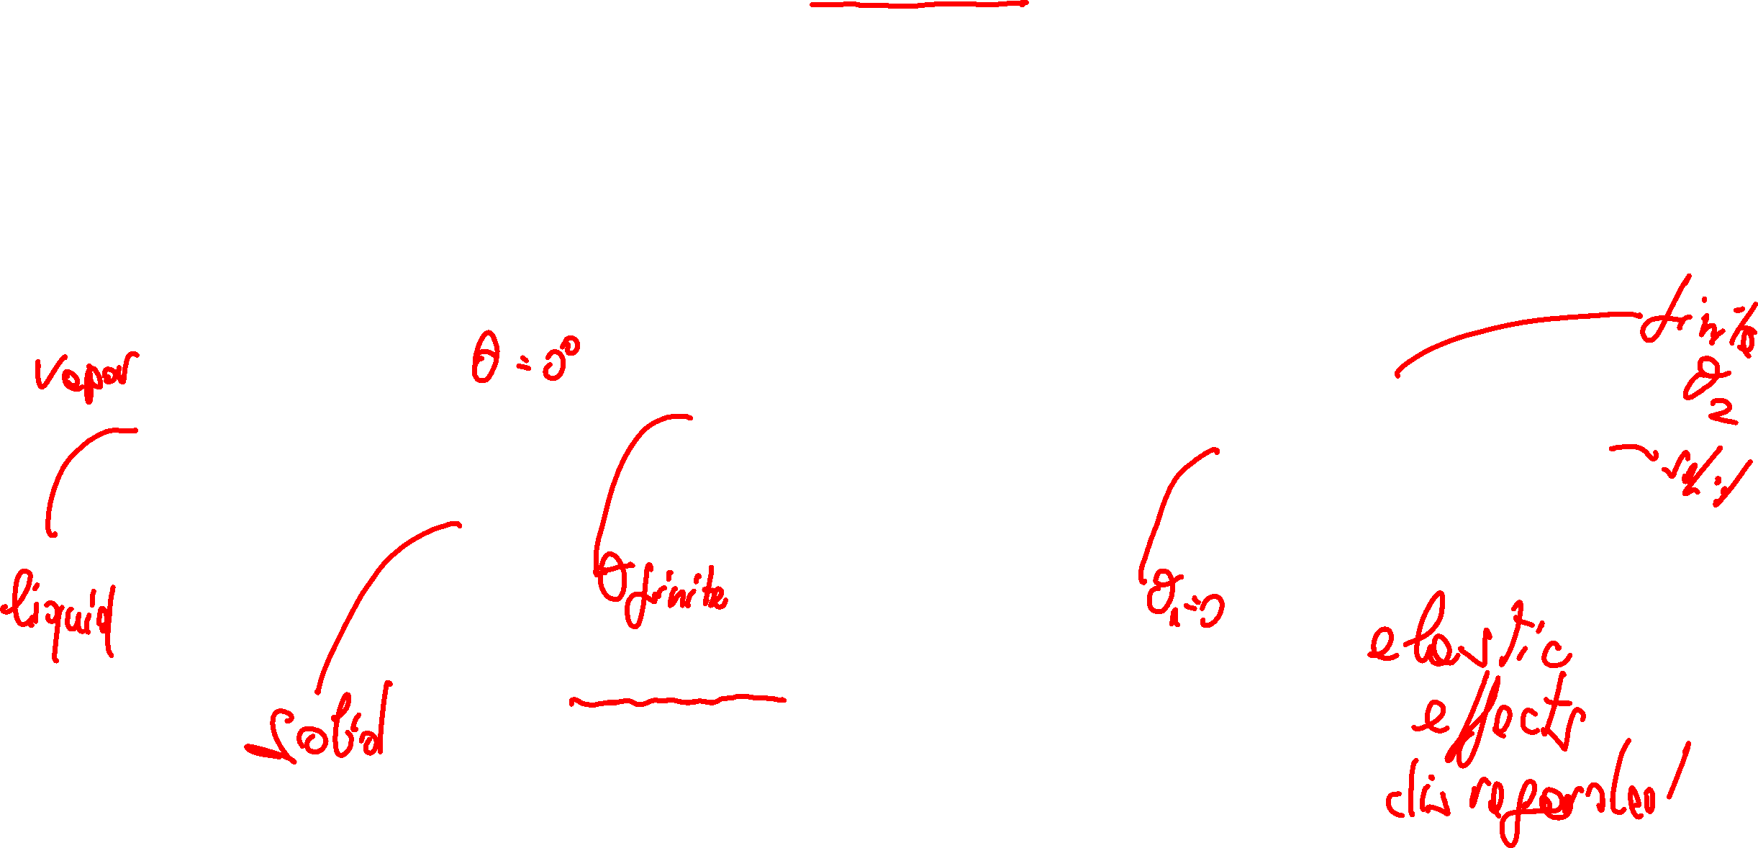
Growth Models for Thin Films: Second Explanation
Lesson 12 – MSE 304 – Fall 2020

Slide 18

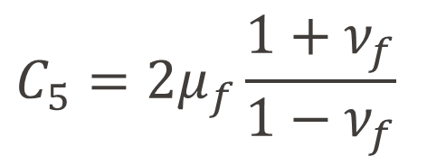
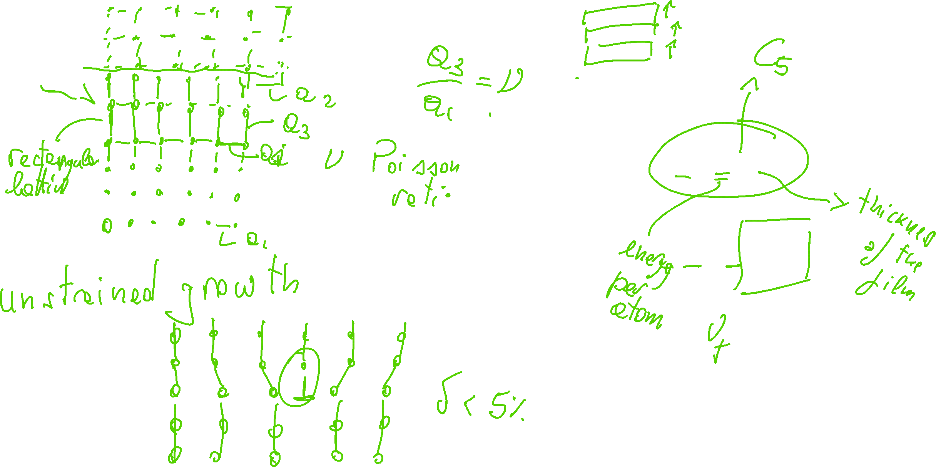
Strained and Unstrained Growth
$$E_{el}=e^{2}C_{5}L_{f}$$
$$C_{5}=2μ_{f}\frac{1+ν_{f}}{1−ν_{f}}$$
Lesson 12 – MSE 304 – Fall 2020

Slide 19
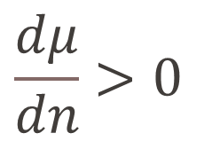
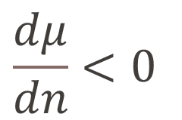
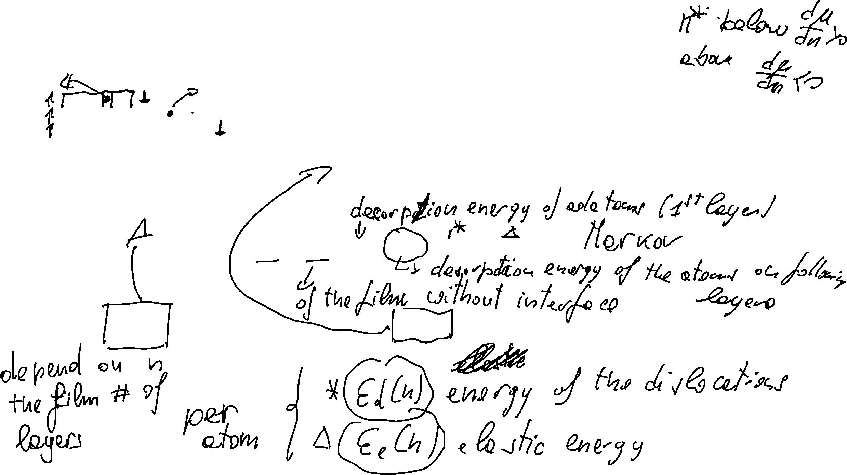
Growth Models for Thin Films: Third Explanation
$$\frac{dμ}{dn}>0$$
$$\frac{dμ}{dn}<0$$
Lesson 12 – MSE 304 – Fall 2020

Slide 20
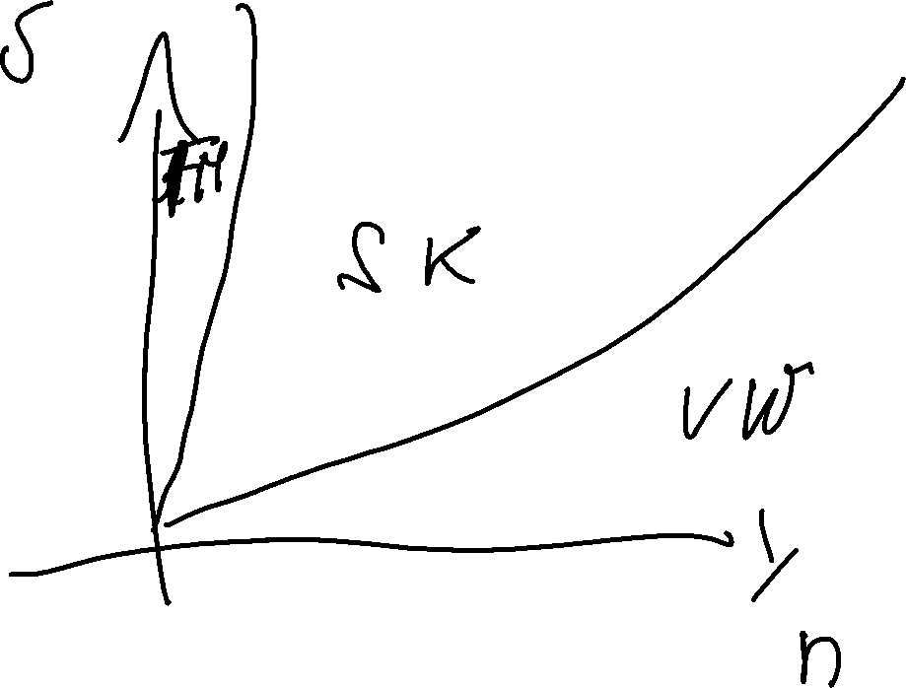
Growth Models for Thin Films: Third Explanation
Lesson 12 – MSE 304 – Fall 2020

Slide 21
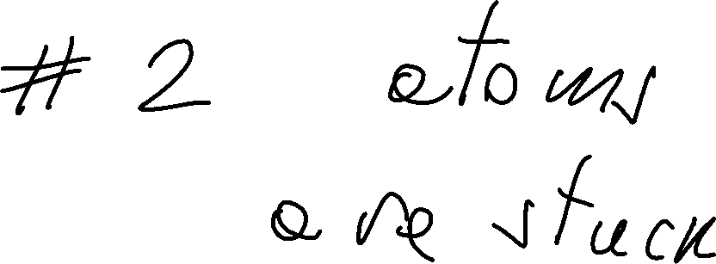
Growth Models for Thin Films
Lesson 12 – MSE 304 – Fall 2020

Slide 22
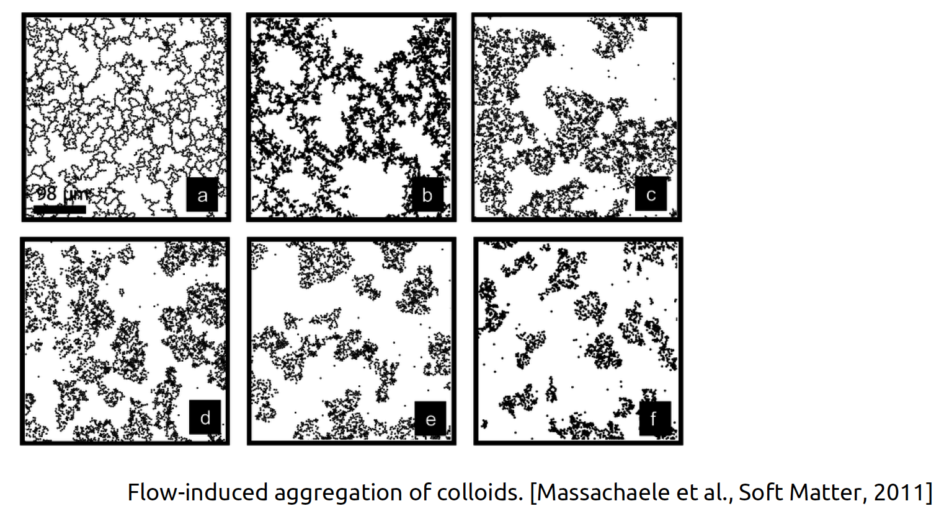
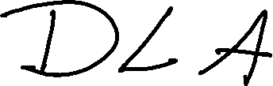
Diffusion Limited Aggregation
Lesson 12 – MSE 304 – Fall 2020

Slide 23
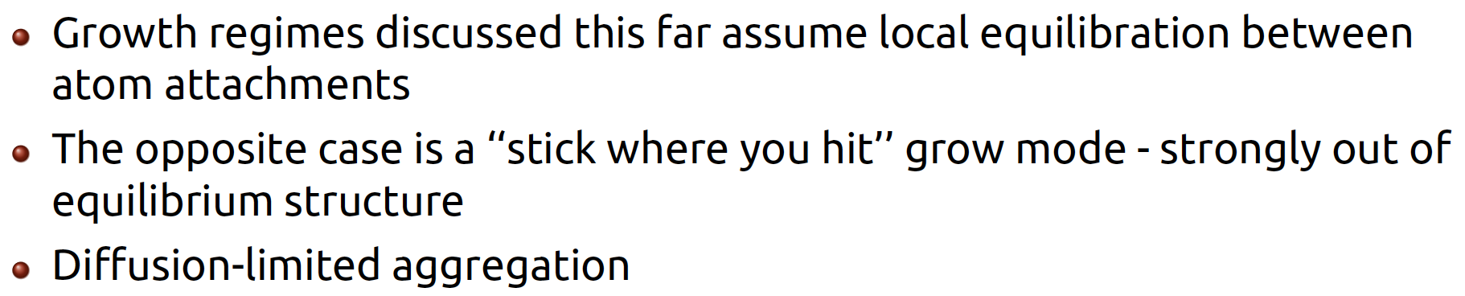
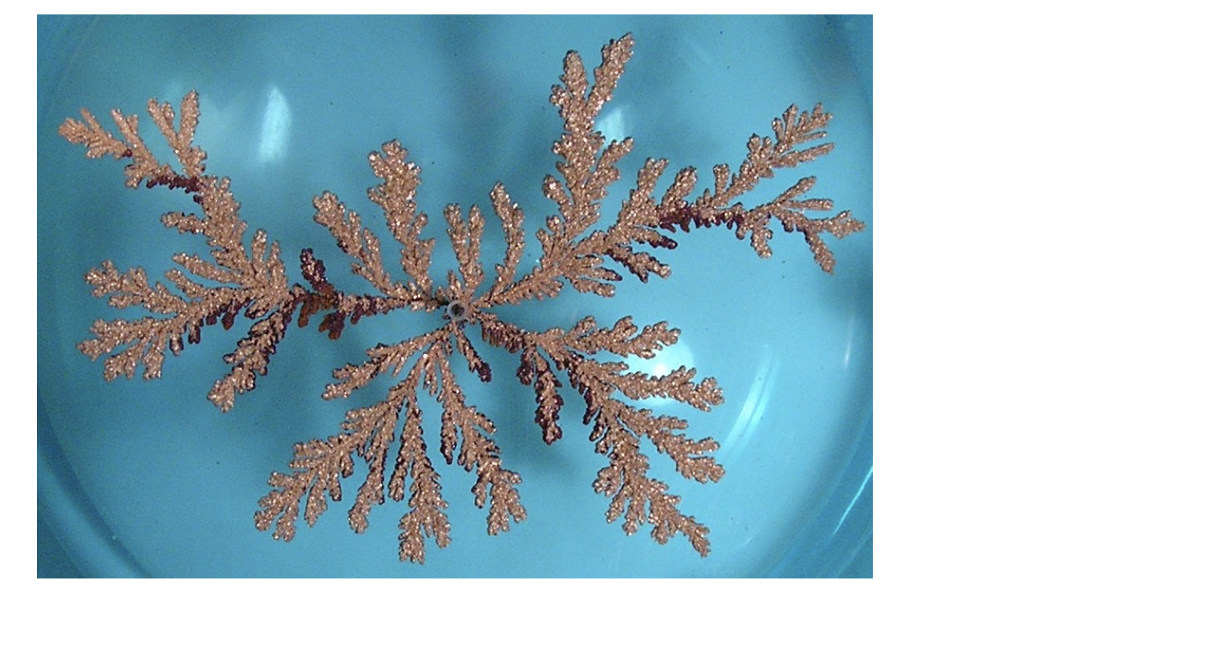
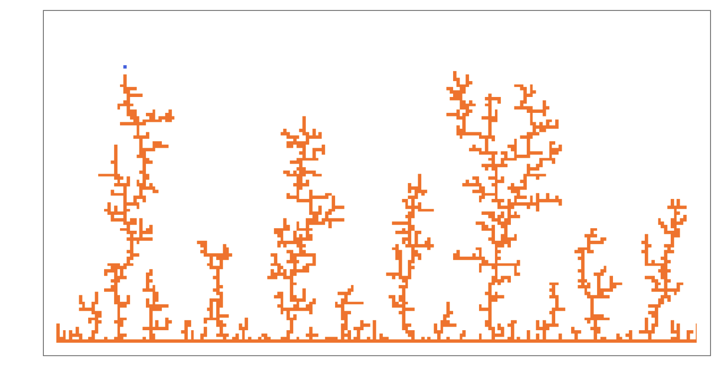
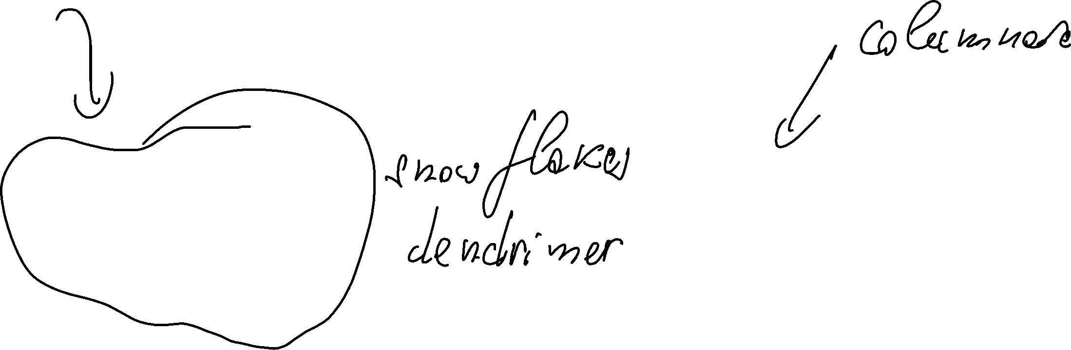
Diffusion Limited Aggregation
Lesson 12 – MSE 304 – Fall 2020

Slide 24
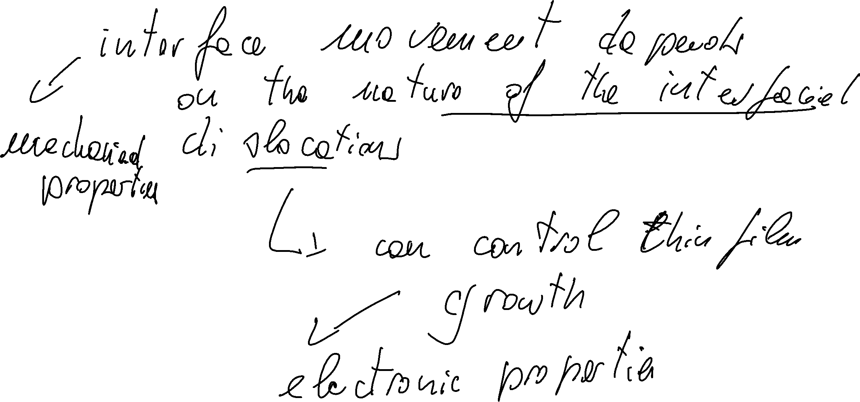
Conclusions
Lesson 12 – MSE 304 – Fall 2020

