Slide 1
Heterophase Interfaces and Thin Films Lesson 12
MSE 304
Francesco Stellacci

Slide 2
Key Topics in the Previous Class
Lesson 12 – MSE 304 – Fall 2020

Slide 3
Slip Planes in a Crystal Structure
Lesson 12 – MSE 304 – Fall 2020

Slide 4
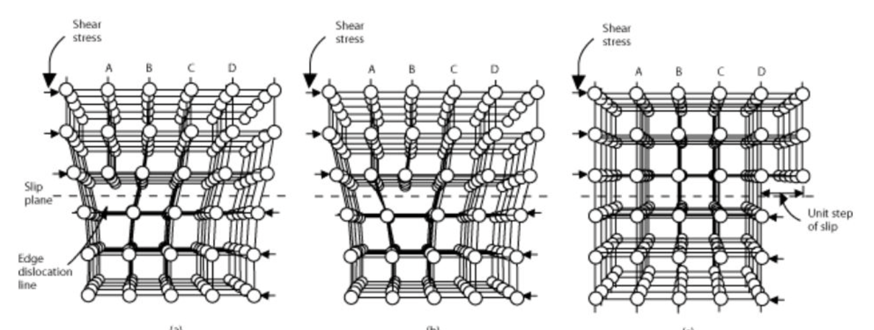
Glide Motion of Dislocations
Lesson 12 – MSE 304 – Fall 2020

Slide 5
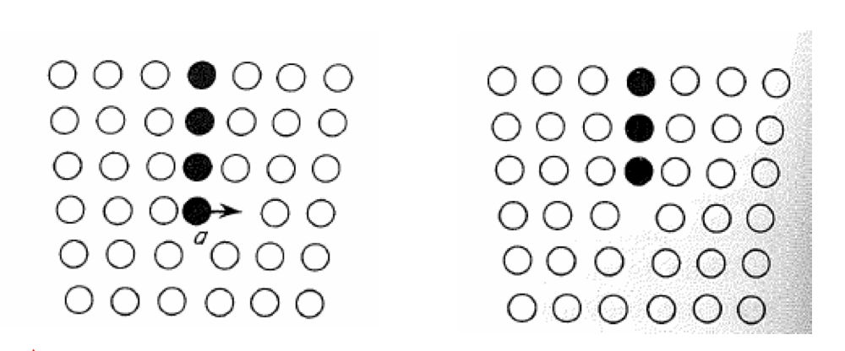
Climb Motion for Dislocations
Lesson 12 – MSE 304 – Fall 2020

Slide 6
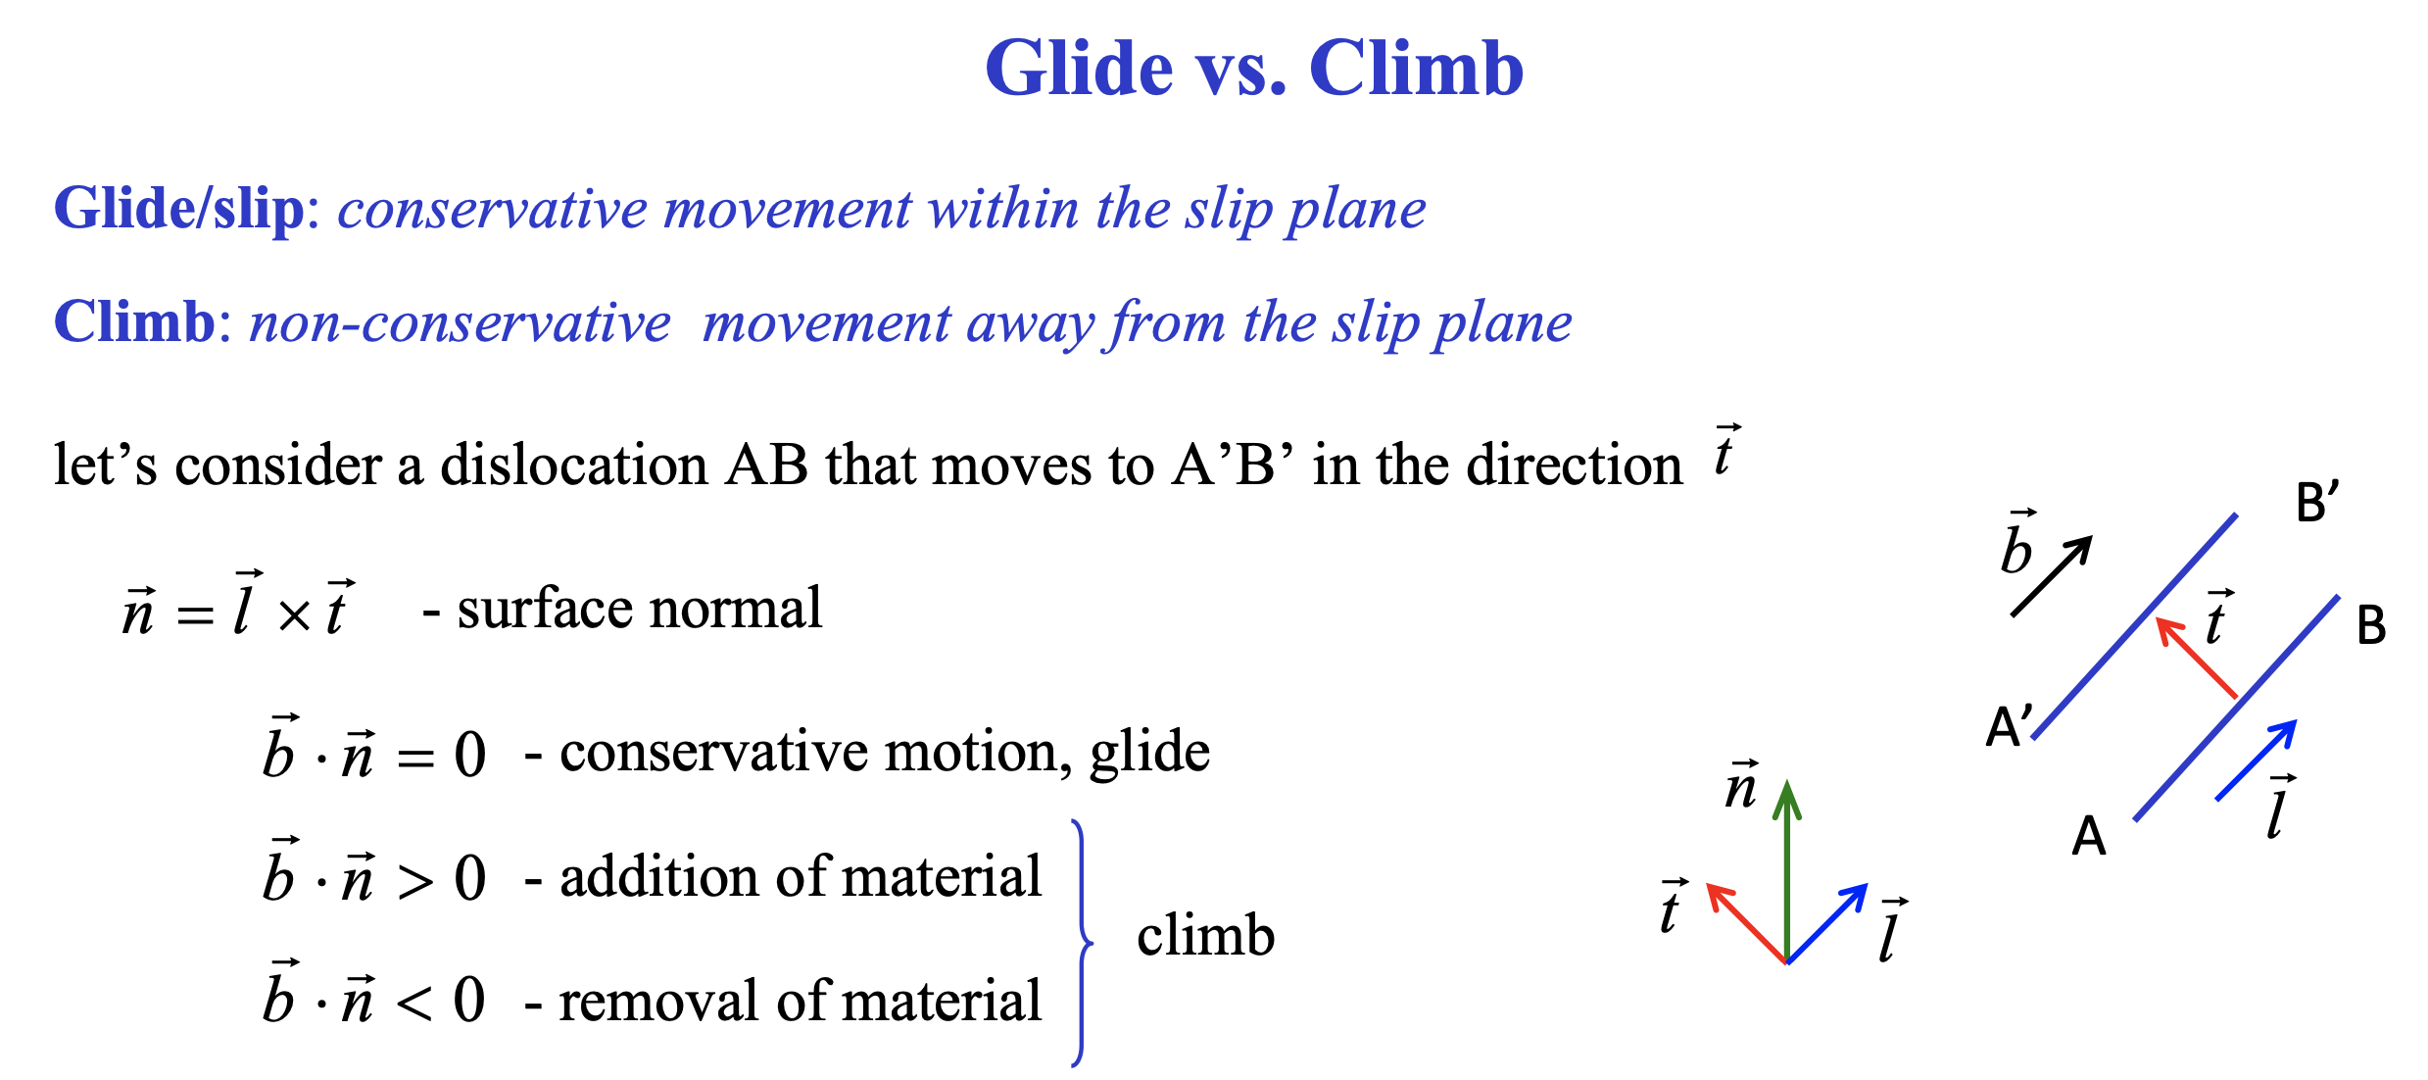
Glide and Climb Motion for Dislocations
Lesson 12 – MSE 304 – Fall 2020

Slide 7
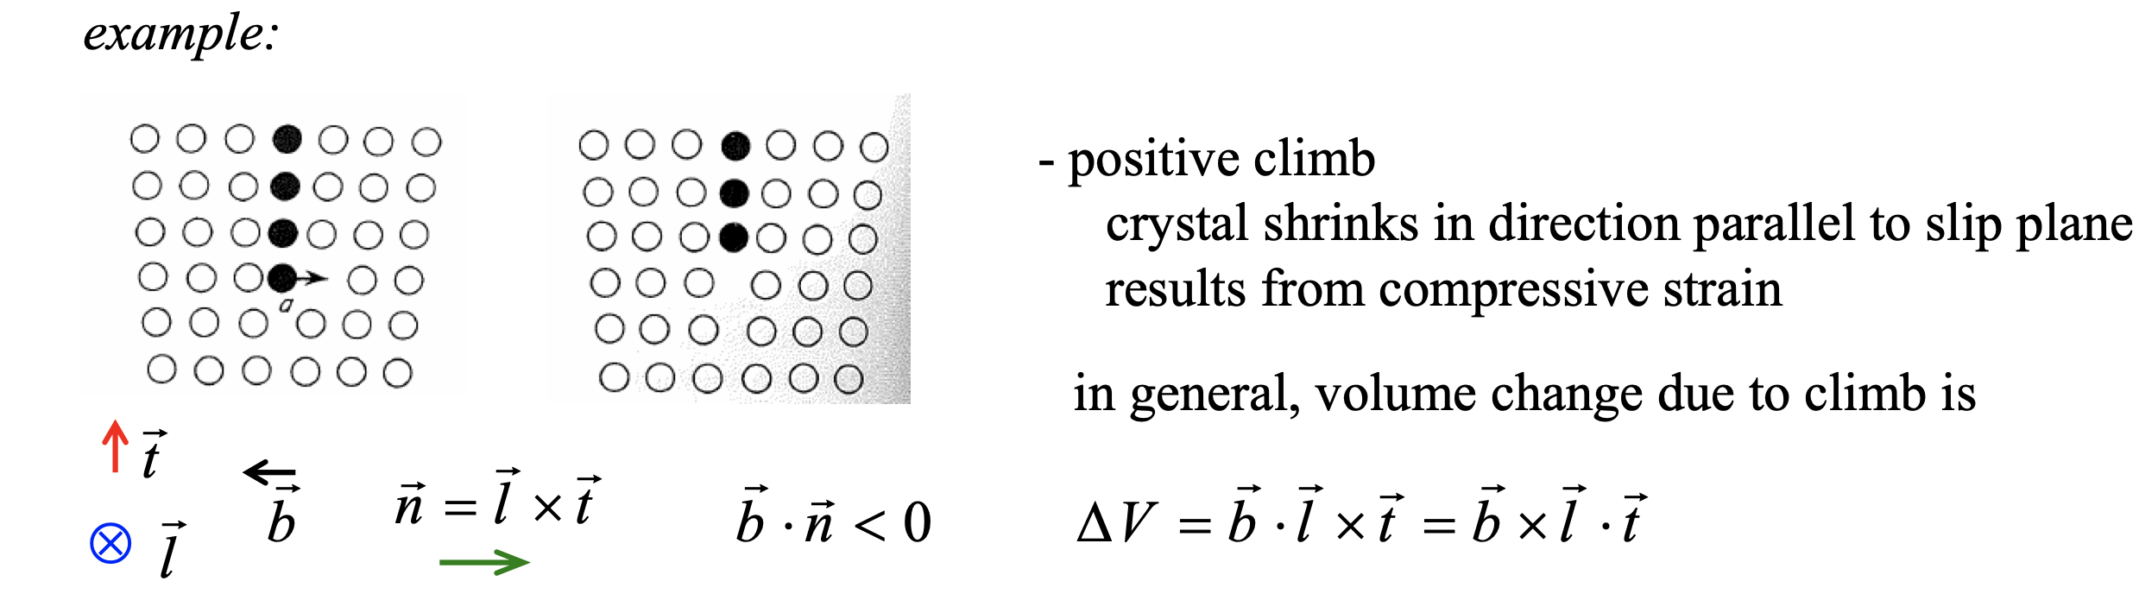
Glide and Climb Motion of Dislocations
Lesson 12 – MSE 304 – Fall 2020

Slide 8
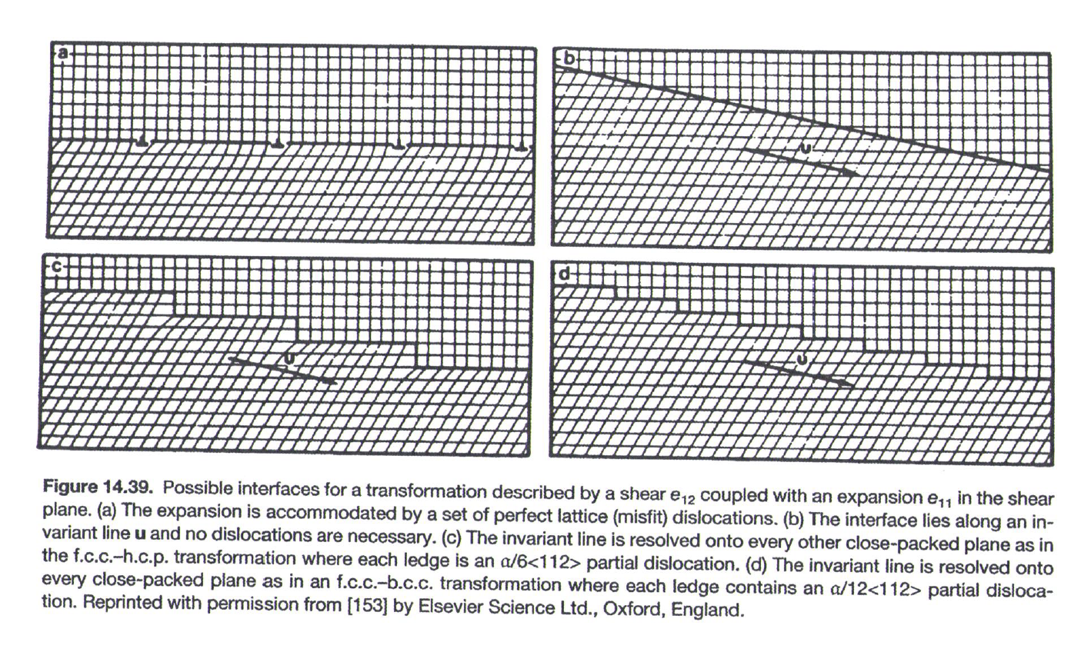
Glissile and Sessile Interfaces
Lesson 12 – MSE 304 – Fall 2020

Slide 9
Glissile and Sessile Interfaces
Lesson 12 – MSE 304 – Fall 2020

Slide 10
Thin Films in Modern Technology
Lesson 12 – MSE 304 – Fall 2020

Slide 11
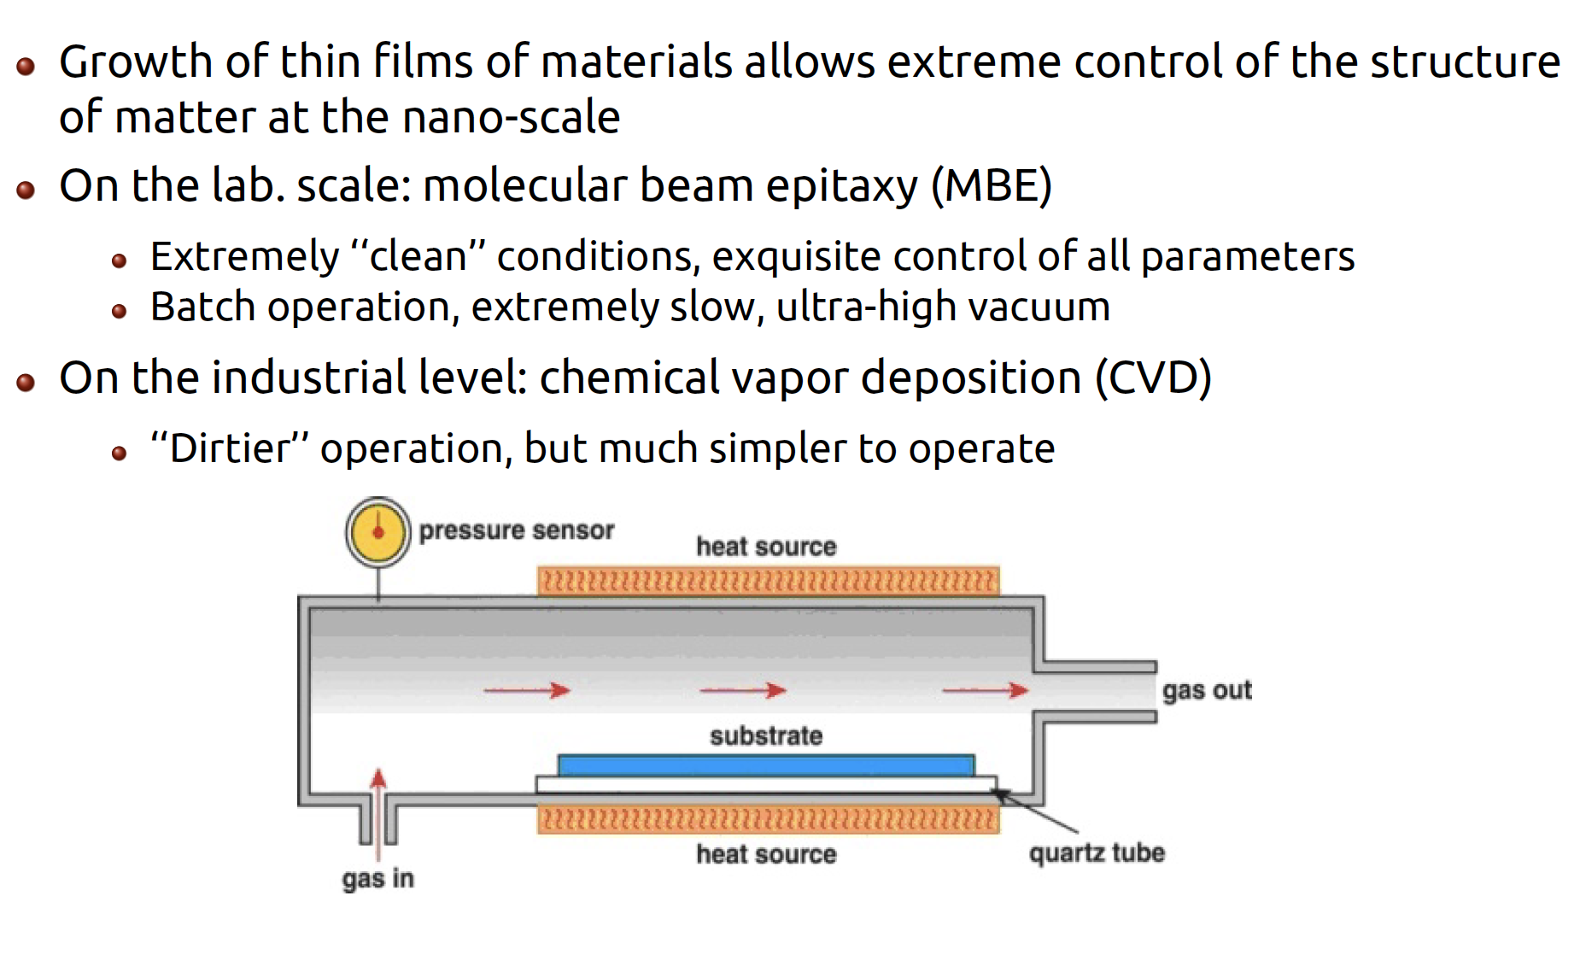
Thin Films in Modern Technology
Lesson 12 – MSE 304 – Fall 2020

Slide 12
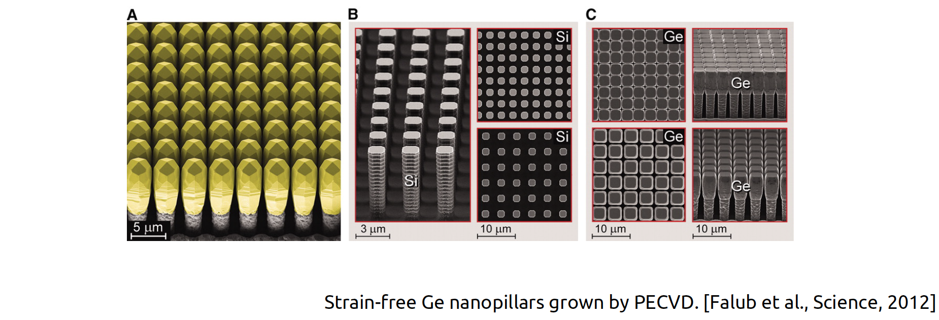
Thin Films – Morphology Control
Lesson 12 – MSE 304 – Fall 2020

Slide 13
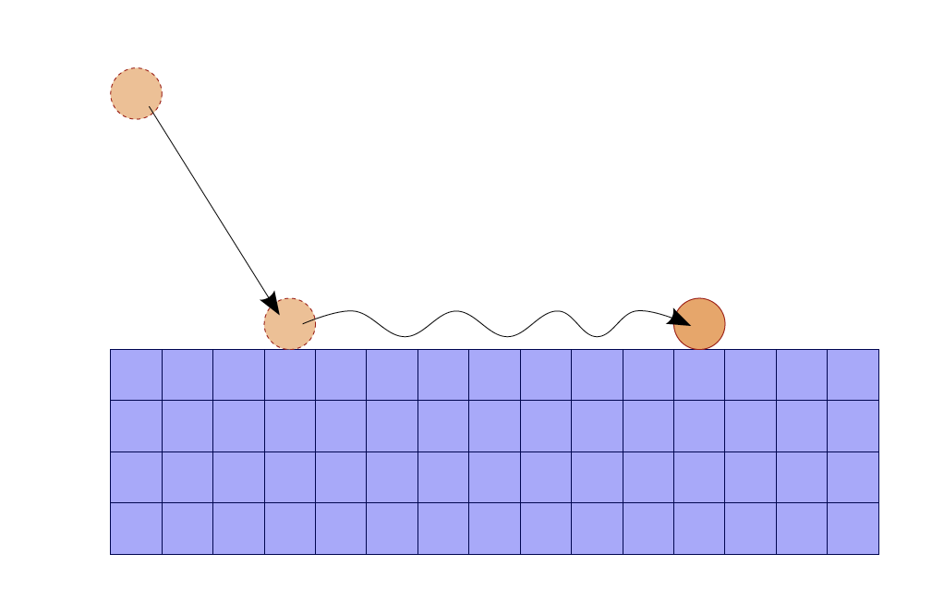
Growth Models for Thin Films
Lesson 12 – MSE 304 – Fall 2020

Slide 14
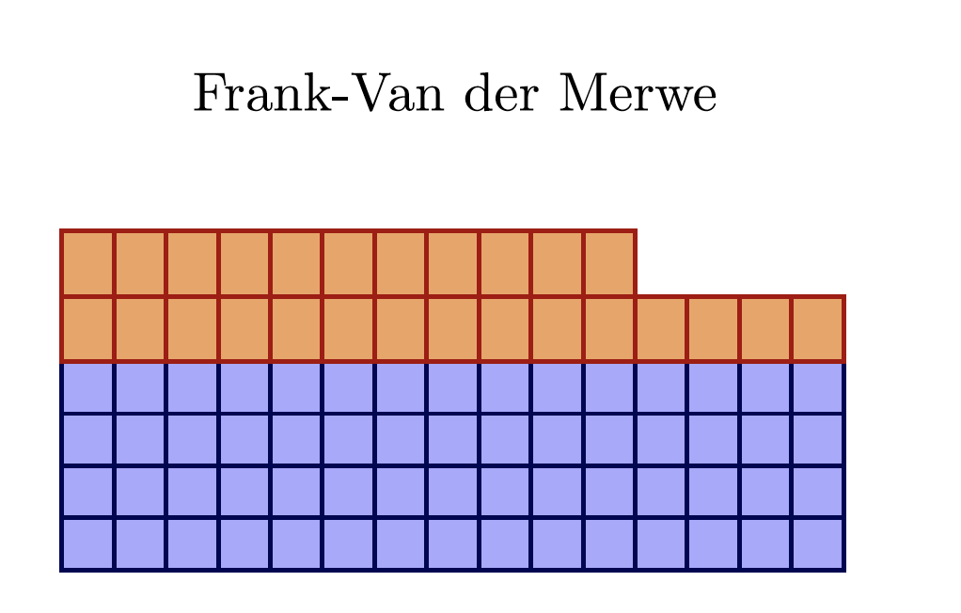
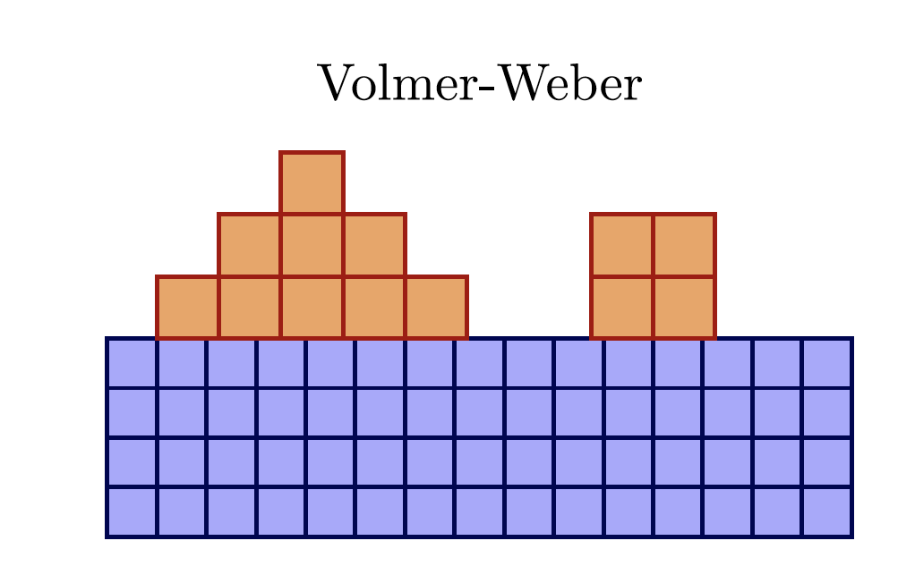
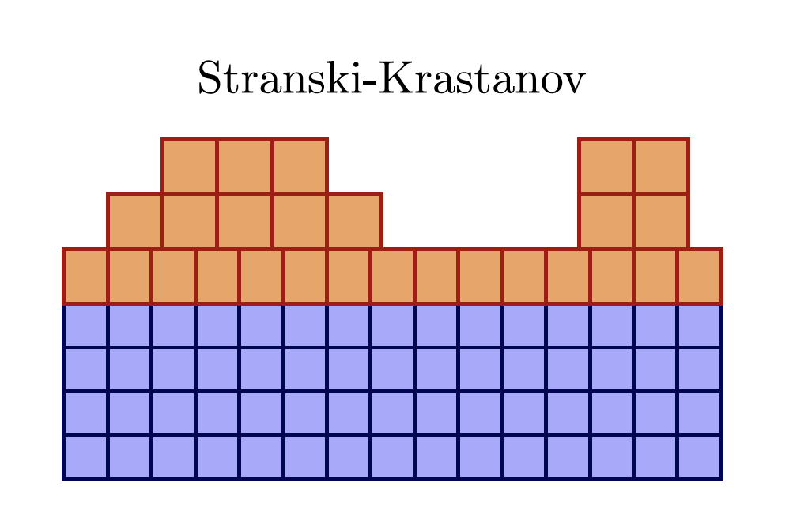
Growth Models for Thin Films
Lesson 12 – MSE 304 – Fall 2020

Slide 15
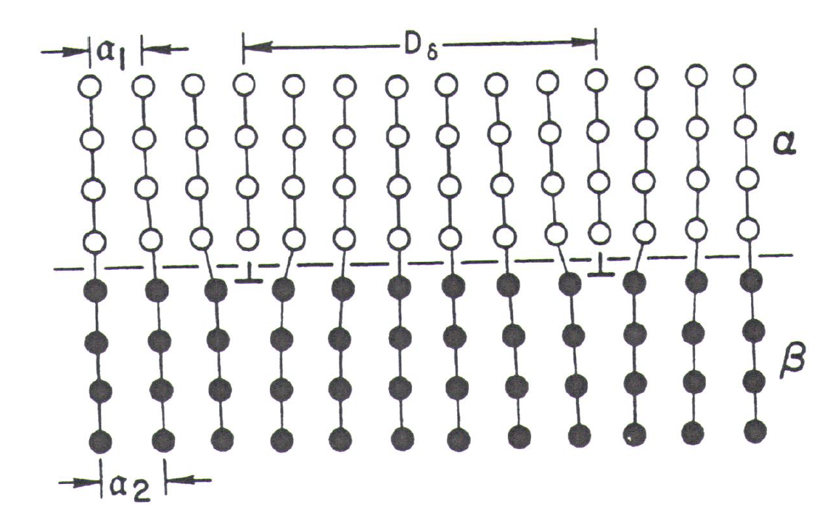
Growth Models for Thin Films
Lesson 12 – MSE 304 – Fall 2020

Slide 16
Growth Models for Thin Films: First Explanation
Lesson 12 – MSE 304 – Fall 2020

Slide 17
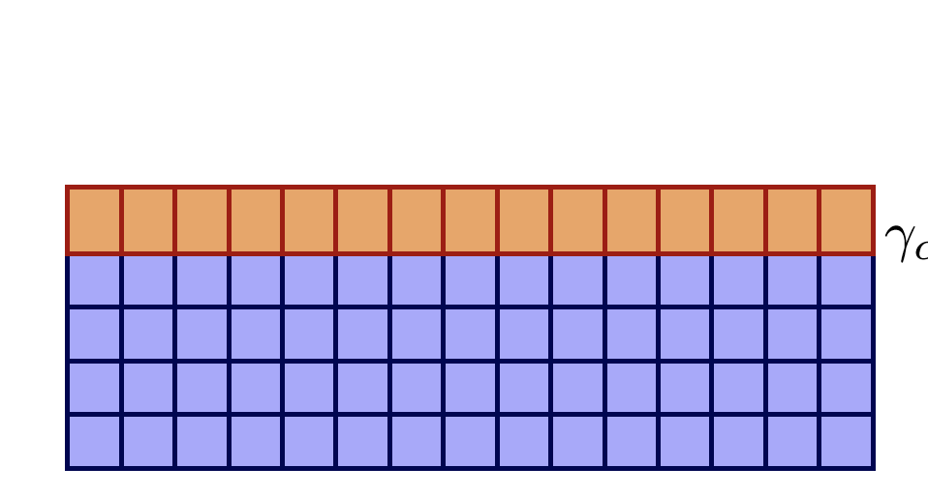
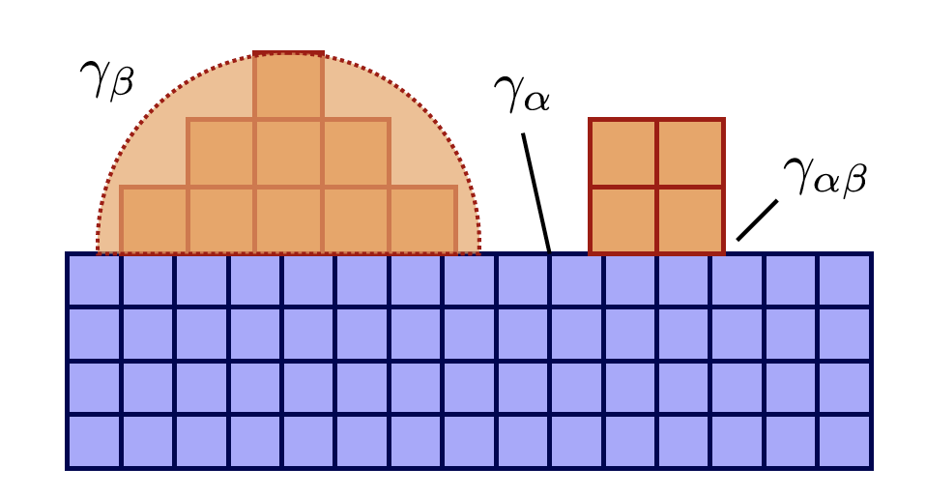
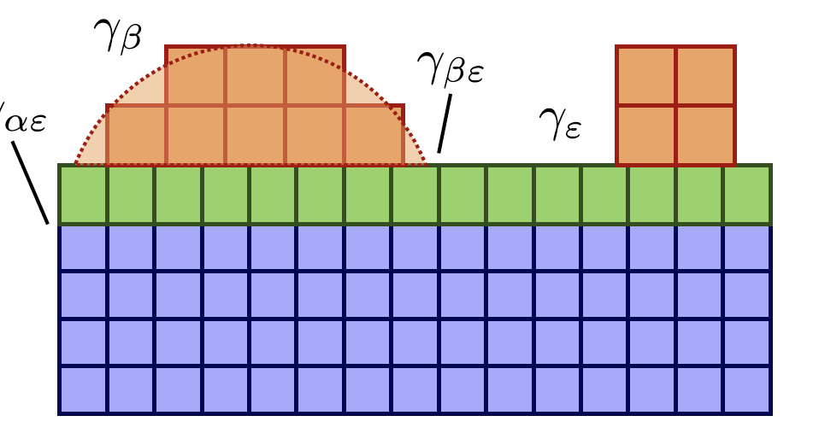
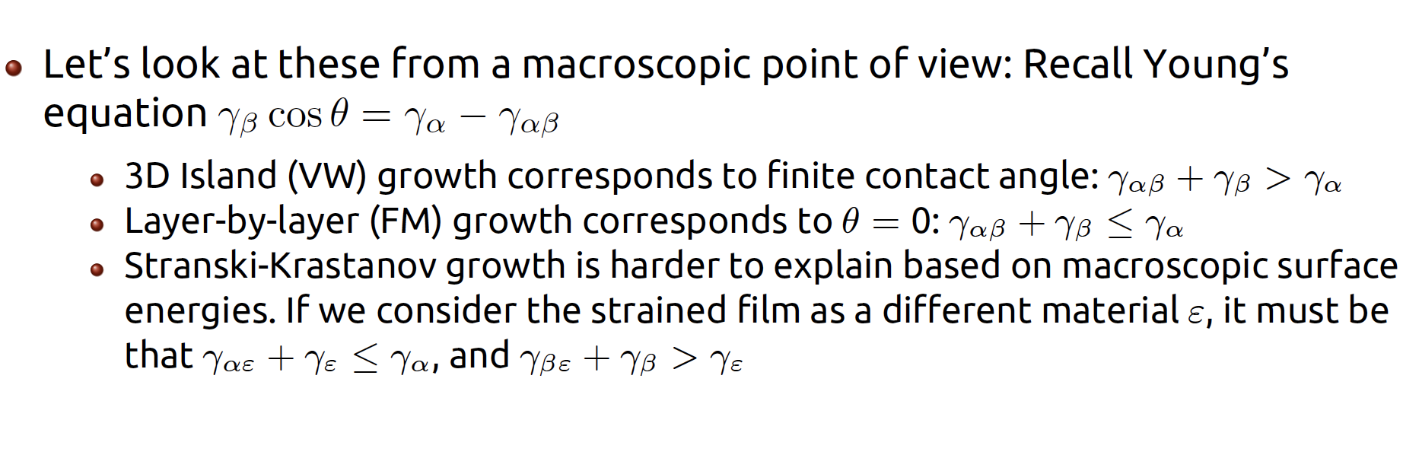
Growth Models for Thin Films: Second Explanation
Lesson 12 – MSE 304 – Fall 2020

Slide 18
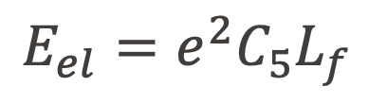
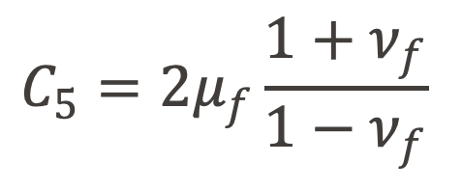
Strained and Unstrained Growth
$$E_{el}=e^{2}C_{5}L_{f}$$
$$C_{5}=2μ_{f}\frac{1+ν_{f}}{1−ν_{f}}$$
Lesson 12 – MSE 304 – Fall 2020

Slide 19
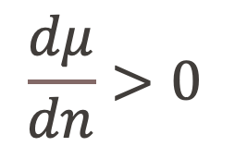
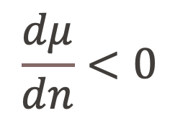
Growth Models for Thin Films: Third Explanation
$$\frac{dμ}{dn}>0$$
$$\frac{dμ}{dn}<0$$
Lesson 12 – MSE 304 – Fall 2020

Slide 20
Growth Models for Thin Films: Third Explanation
Lesson 12 – MSE 304 – Fall 2020

Slide 21
Growth Models for Thin Films
Lesson 12 – MSE 304 – Fall 2020

Slide 22
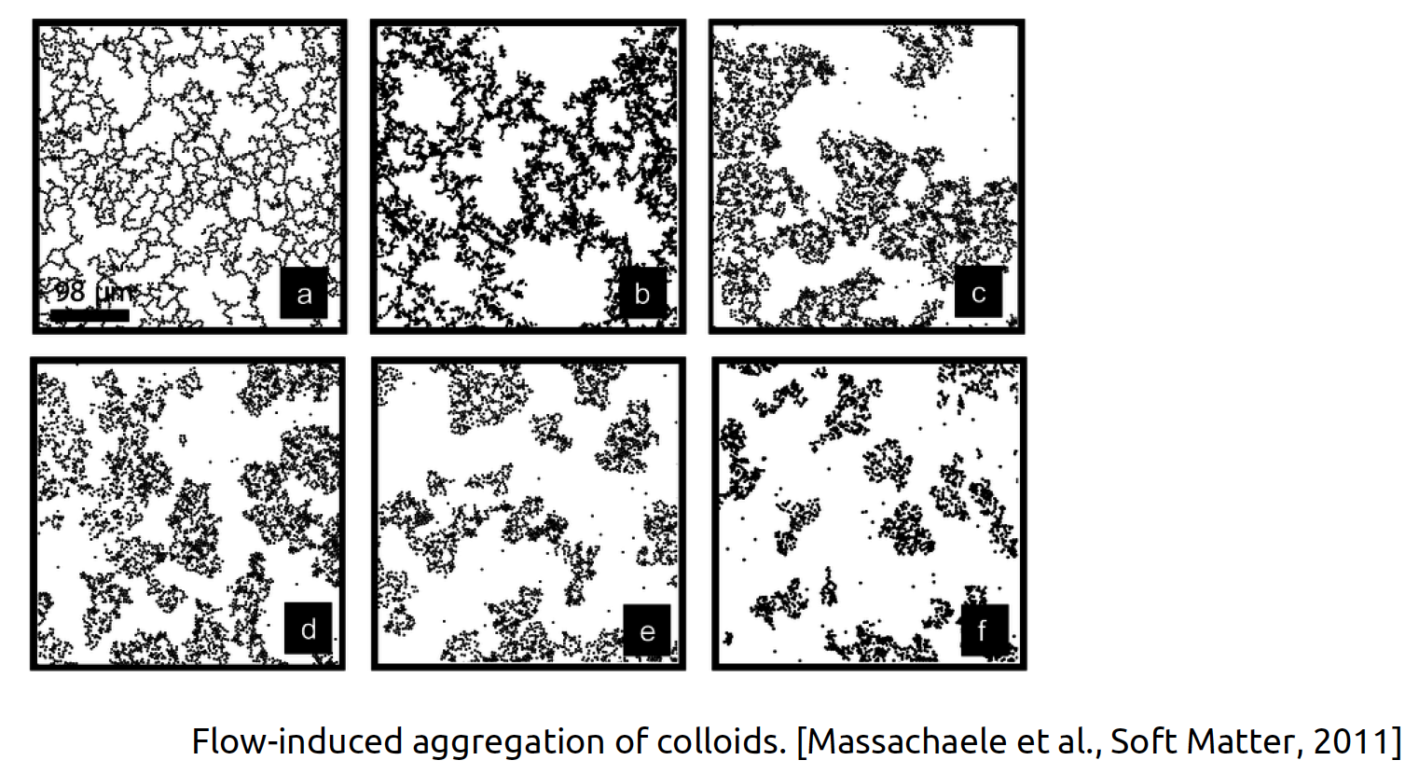
Diffusion Limited Aggregation
Lesson 12 – MSE 304 – Fall 2020

Slide 23
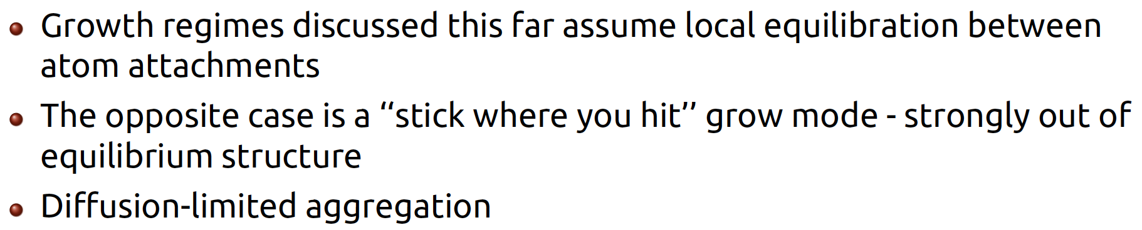
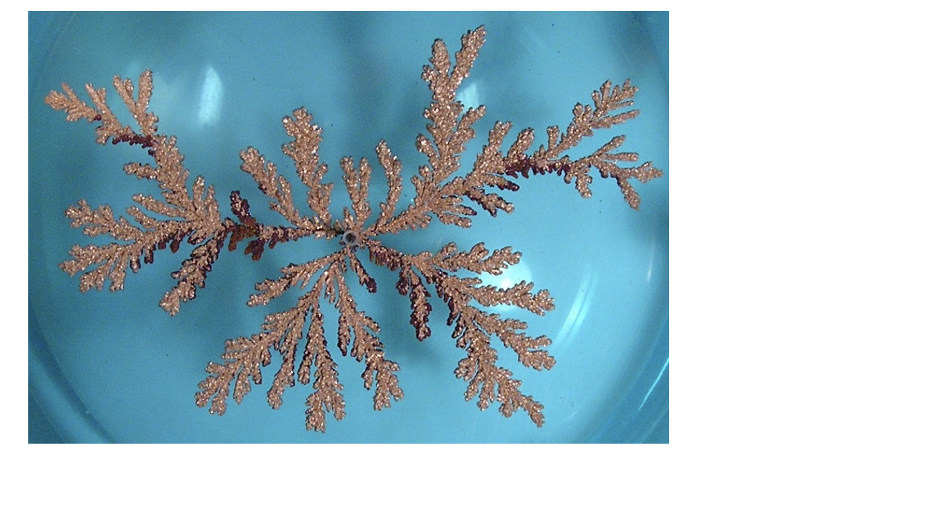
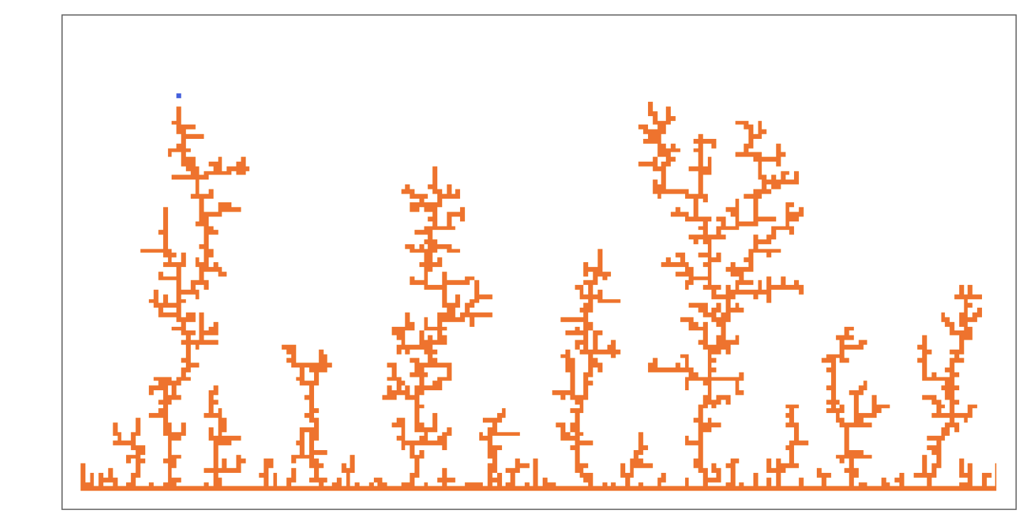
Diffusion Limited Aggregation
Lesson 12 – MSE 304 – Fall 2020

Slide 24
Conclusions
Lesson 12 – MSE 304 – Fall 2020

