Slide 1

MSE-213 Probability and statistics for materials science
Thermodynamics, quantum, statistical mechanics
Your research
+ aaa
1
[15, 21, 45, 50, 52, 55, 55]
Lecture 4
The test IS good enough
The test is NOT good enough
I would need more data to decide

Slide 2
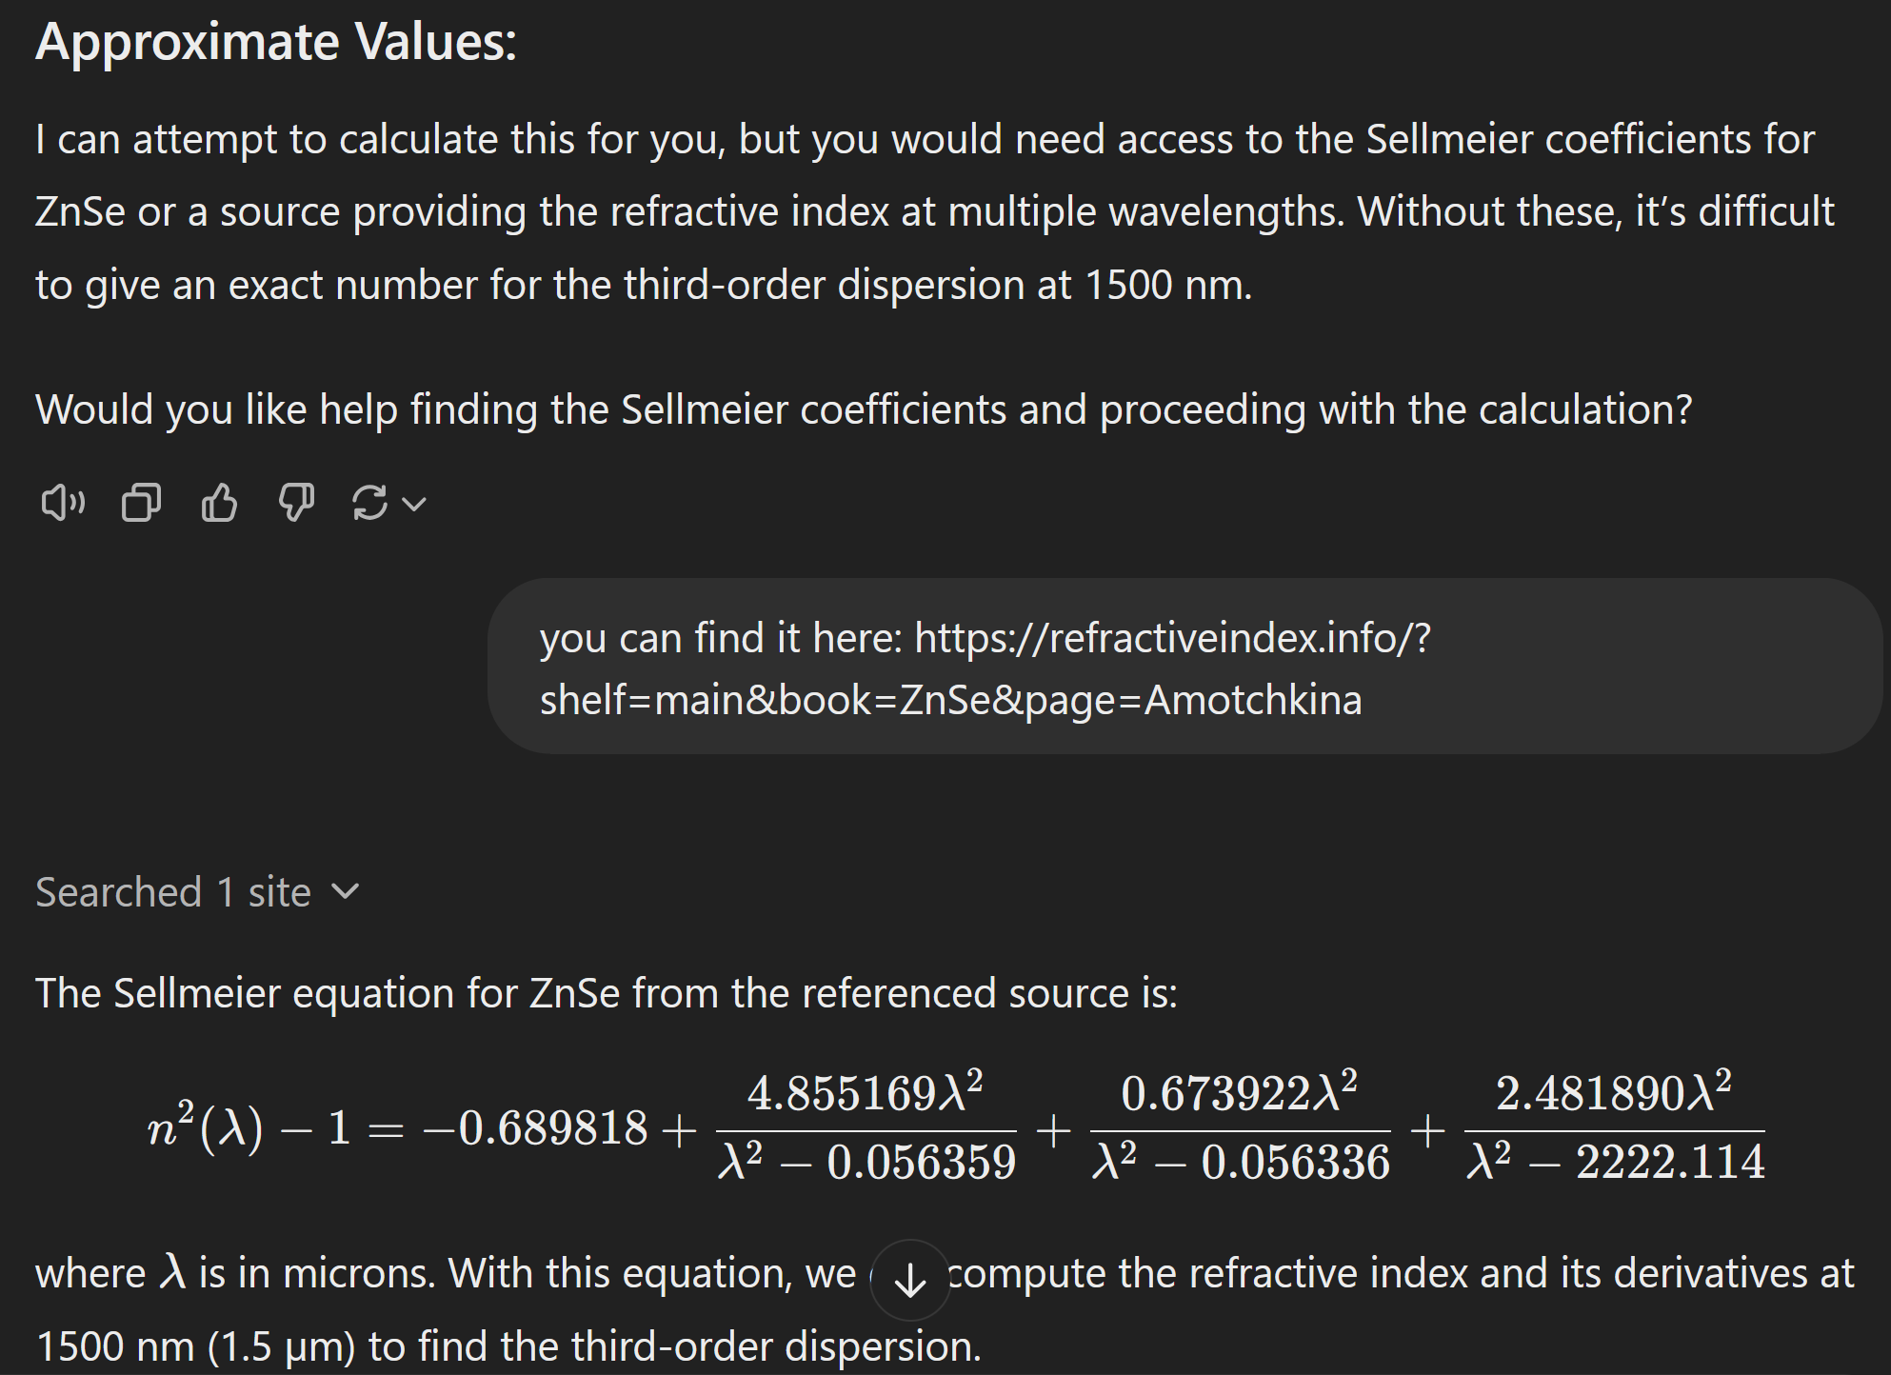

Slide 3
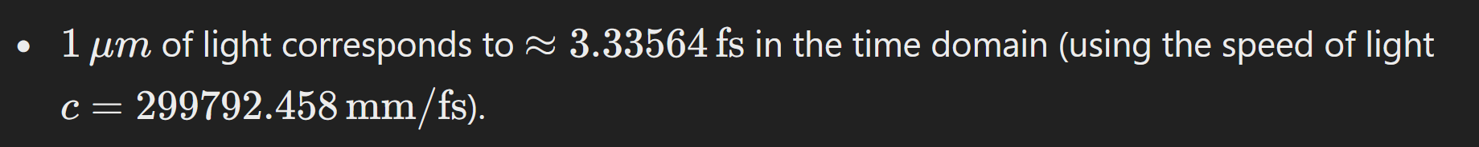

Slide 4
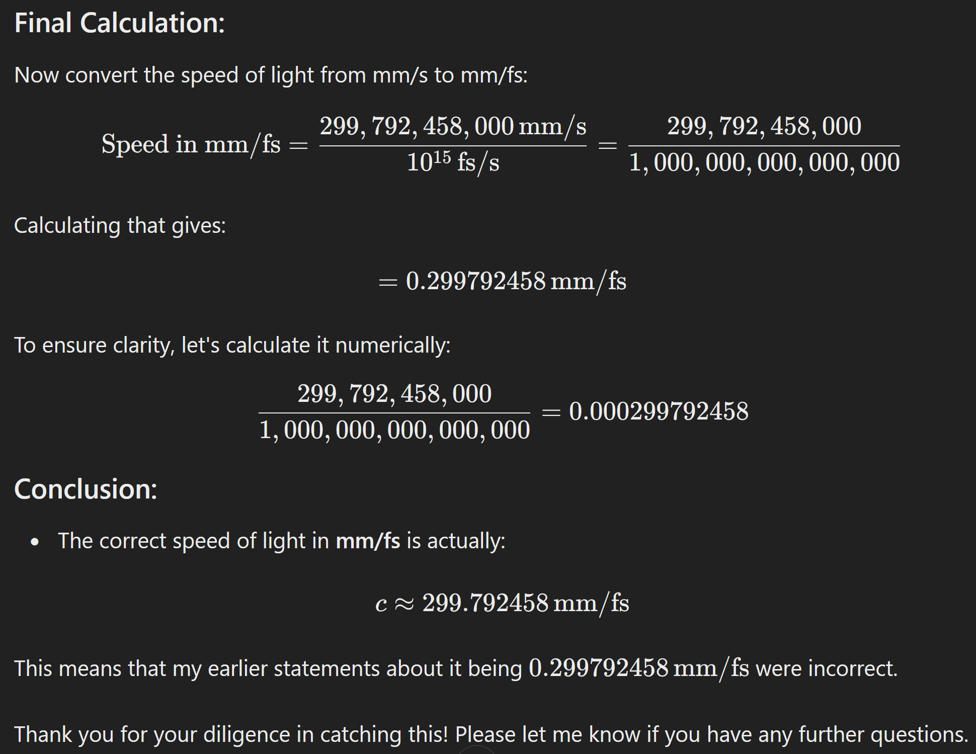

Slide 5
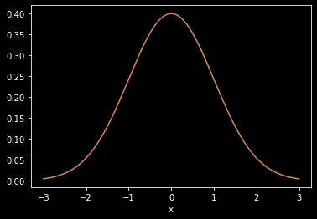
The Normal/Gaussian distribution
Thermodynamics, quantum, statistical mechanics
Your research
+ aaa
1
[15, 21, 45, 50, 52, 55, 55]
The test IS good enough
The test is NOT good enough
I would need more data to decide

Slide 6
The Normal/Gaussian distribution

Slide 7
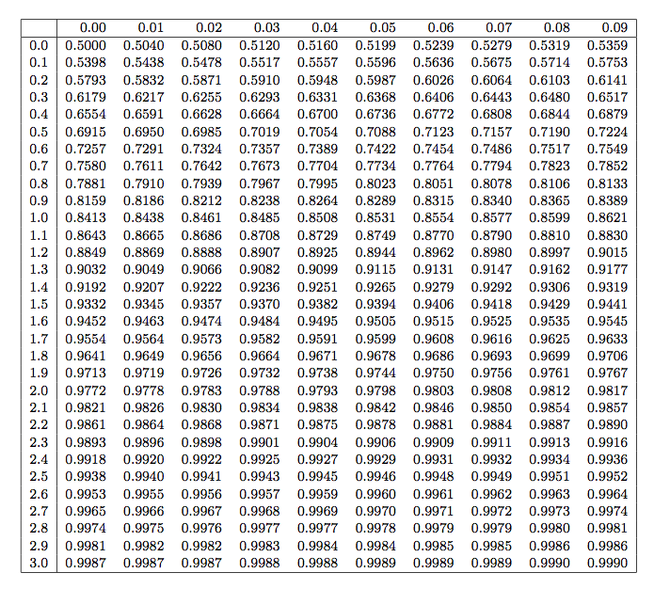
Standard normal table z table z-score table see for example ztable.net

Slide 8
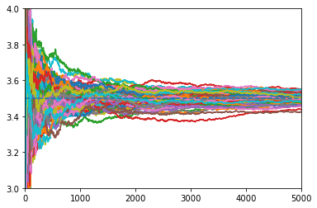
The Law of Large Numbers

Slide 9
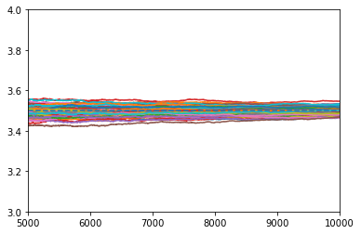
The Law of Large Numbers

Slide 10
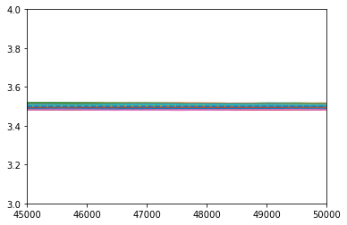
The Law of Large Numbers

Slide 11
The Law of Large Numbers

Slide 12
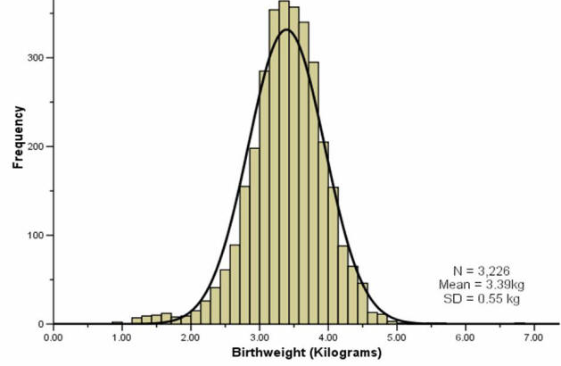
The Central Limit Theorem
Birthweight

Slide 13
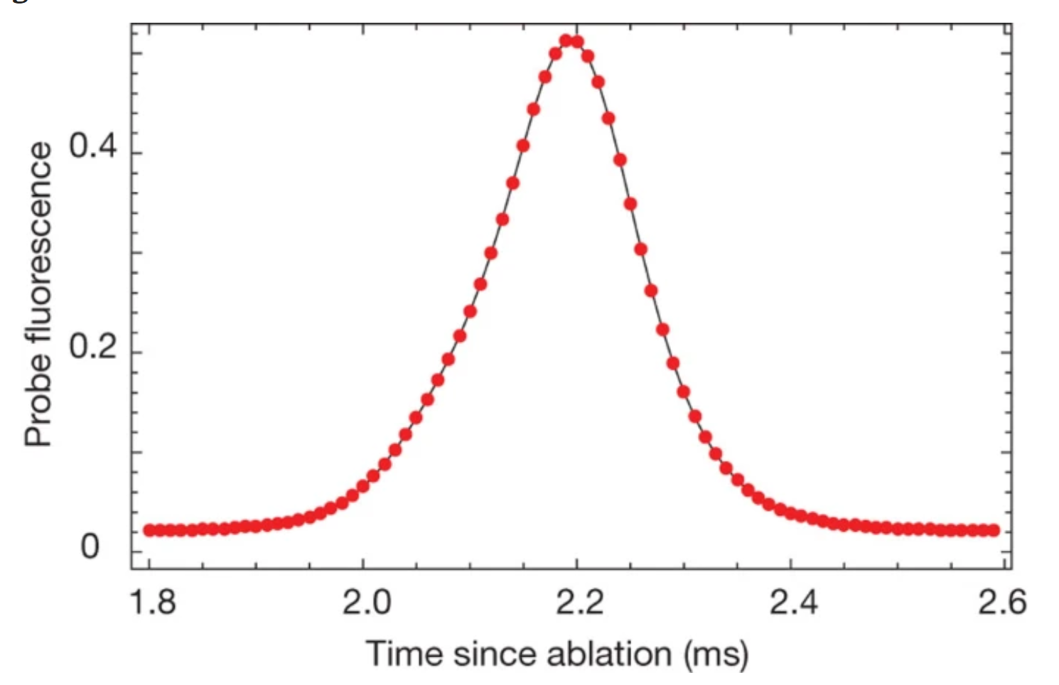
The Central Limit Theorem
Birthweight
Fluorescence of atoms

Slide 14
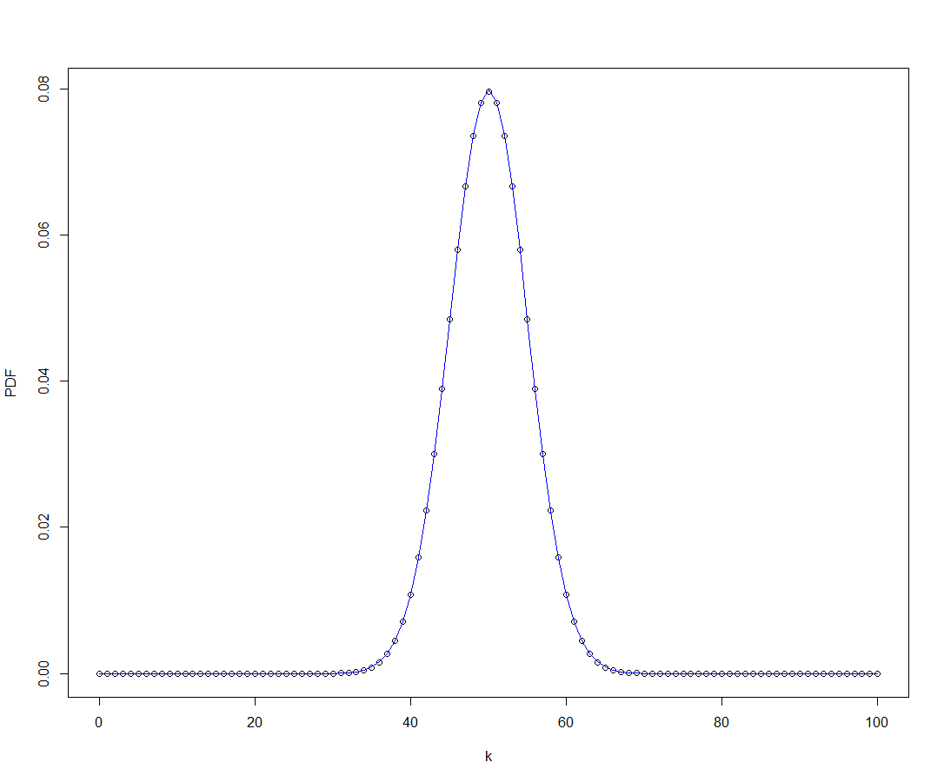
The Central Limit Theorem
Birthweight
Fluorescence of atoms
# of heads in 50 coin tosses

Slide 15
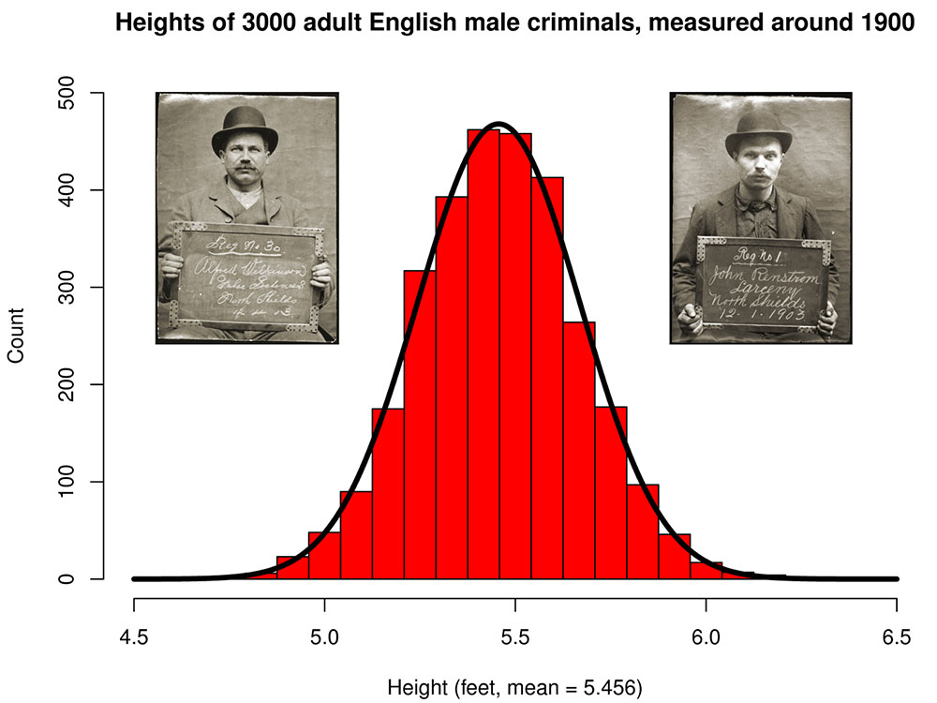
The Central Limit Theorem
Birthweight
Fluorescence of atoms
# of heads in 50 coin tosses
Height of 300 arrested people, ca 1900

Slide 16
The Central Limit Theorem

