Slide 1
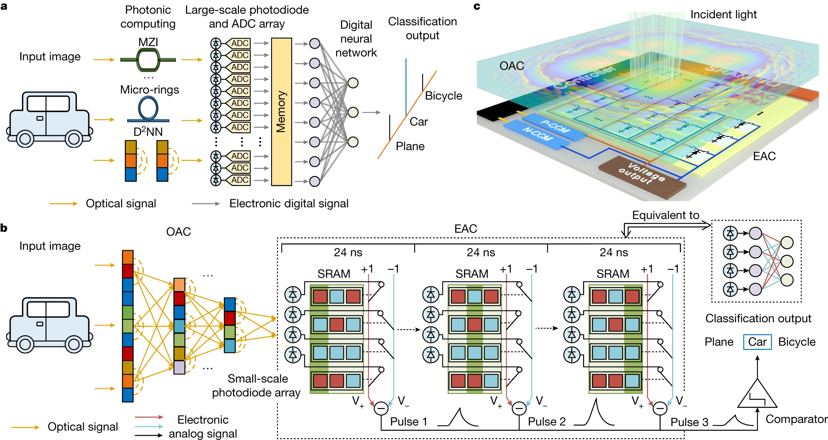
All-analog photoelectronic chip for high-speed vision tasks https://doi.org/10.1038/s41586-023-06558-8
Felix Richter
PHYS 608
Optical Computing
March 25, 2024
École polytechnique fédérale de Lausanne

Slide 2

Starting point
Vision tasks are ubiquitous
autonomous driving, robotics, medical diagnostic
Classical computation is expensive
energy consumption, hardware
Conversion optical-digital is expensive
many pixels
many analog-digital converters
→ slow and energy intense
Today’s optical NN are cumbersome
complicated optical nonlinearity
vulnerable to noise and system errors
hard to train
https://www.werbewoche.ch/de/werbung/2016-09-16/ksp-eierlegende-wollmilchsau-zu-kaufen/
We need hybrid system to balance different pros and cons!

Slide 3
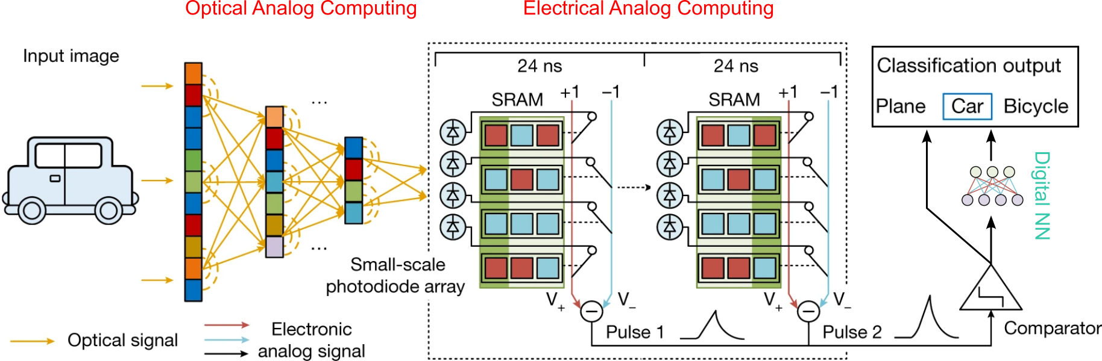
Proposed ACCEL Framework
All-analog Chip Combining Electronics and Light

Slide 4
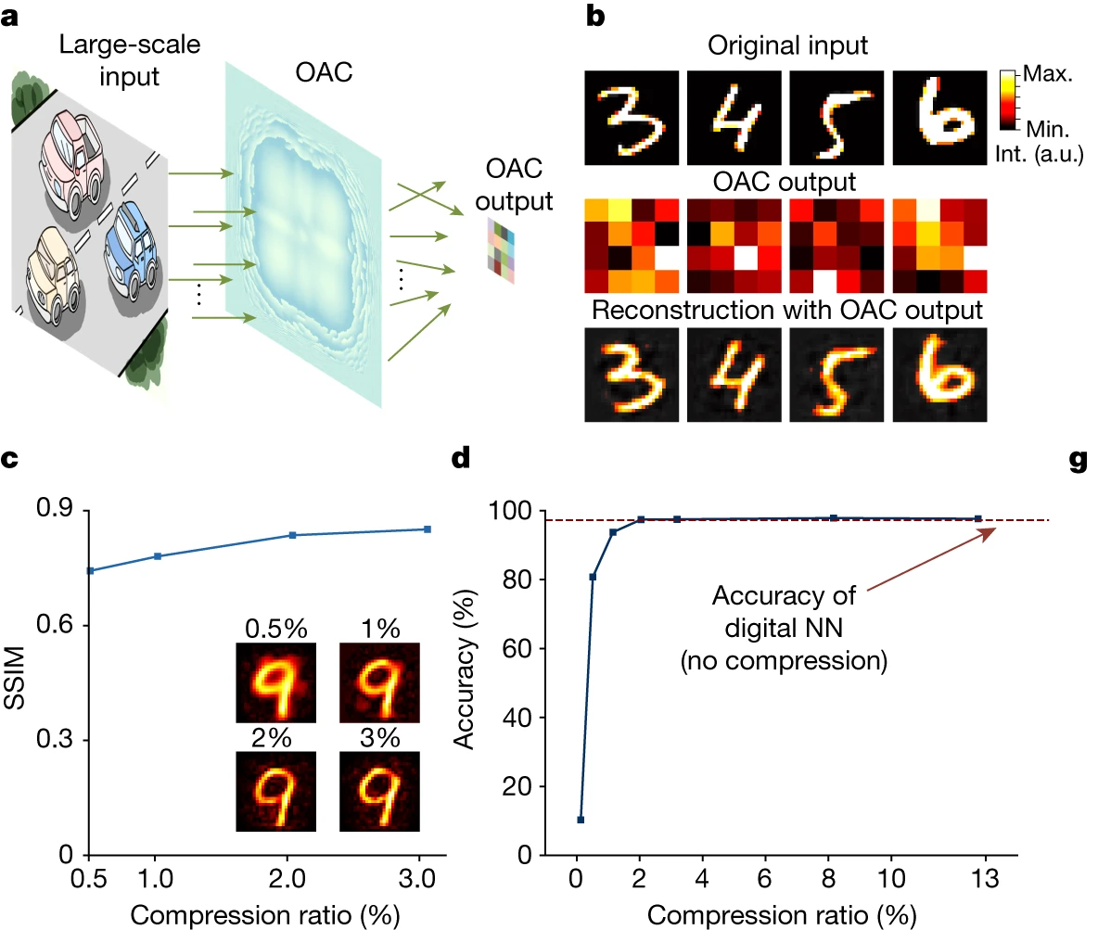
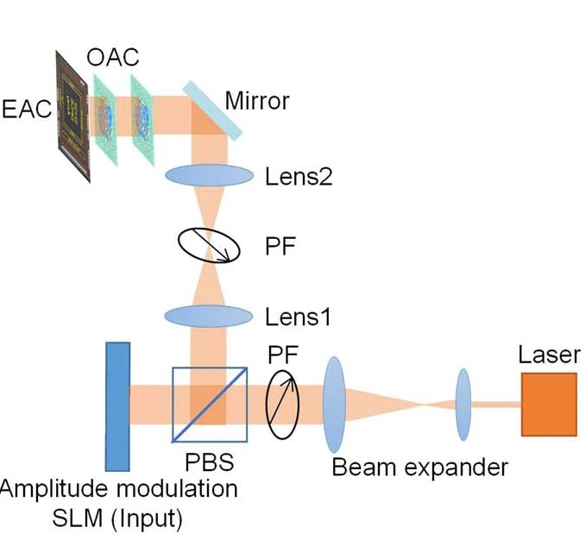
Optical Analog Computing
Goal:
Data compression / preprocessing
Reduce photodiodes / ADCs
Imaging optical system as frontend
Diffractive optical components
8 levels, 3 µm or 9.2 µm pixels
Multilayer
Optimized in numerical simulation
Linear matrix multiplications

Slide 5
Electrical Analog Computing
Goal:
Nonlinear activation
Binary fully connected NN
“Real-time” trainable
Photodiodes as frontend
Programmable connector circuit
Sequential output in time
Weights binary +1 / - 1
Integrated on chip
Backend options:
Direct readout e.g. Classification
Input for digital NN

Slide 6
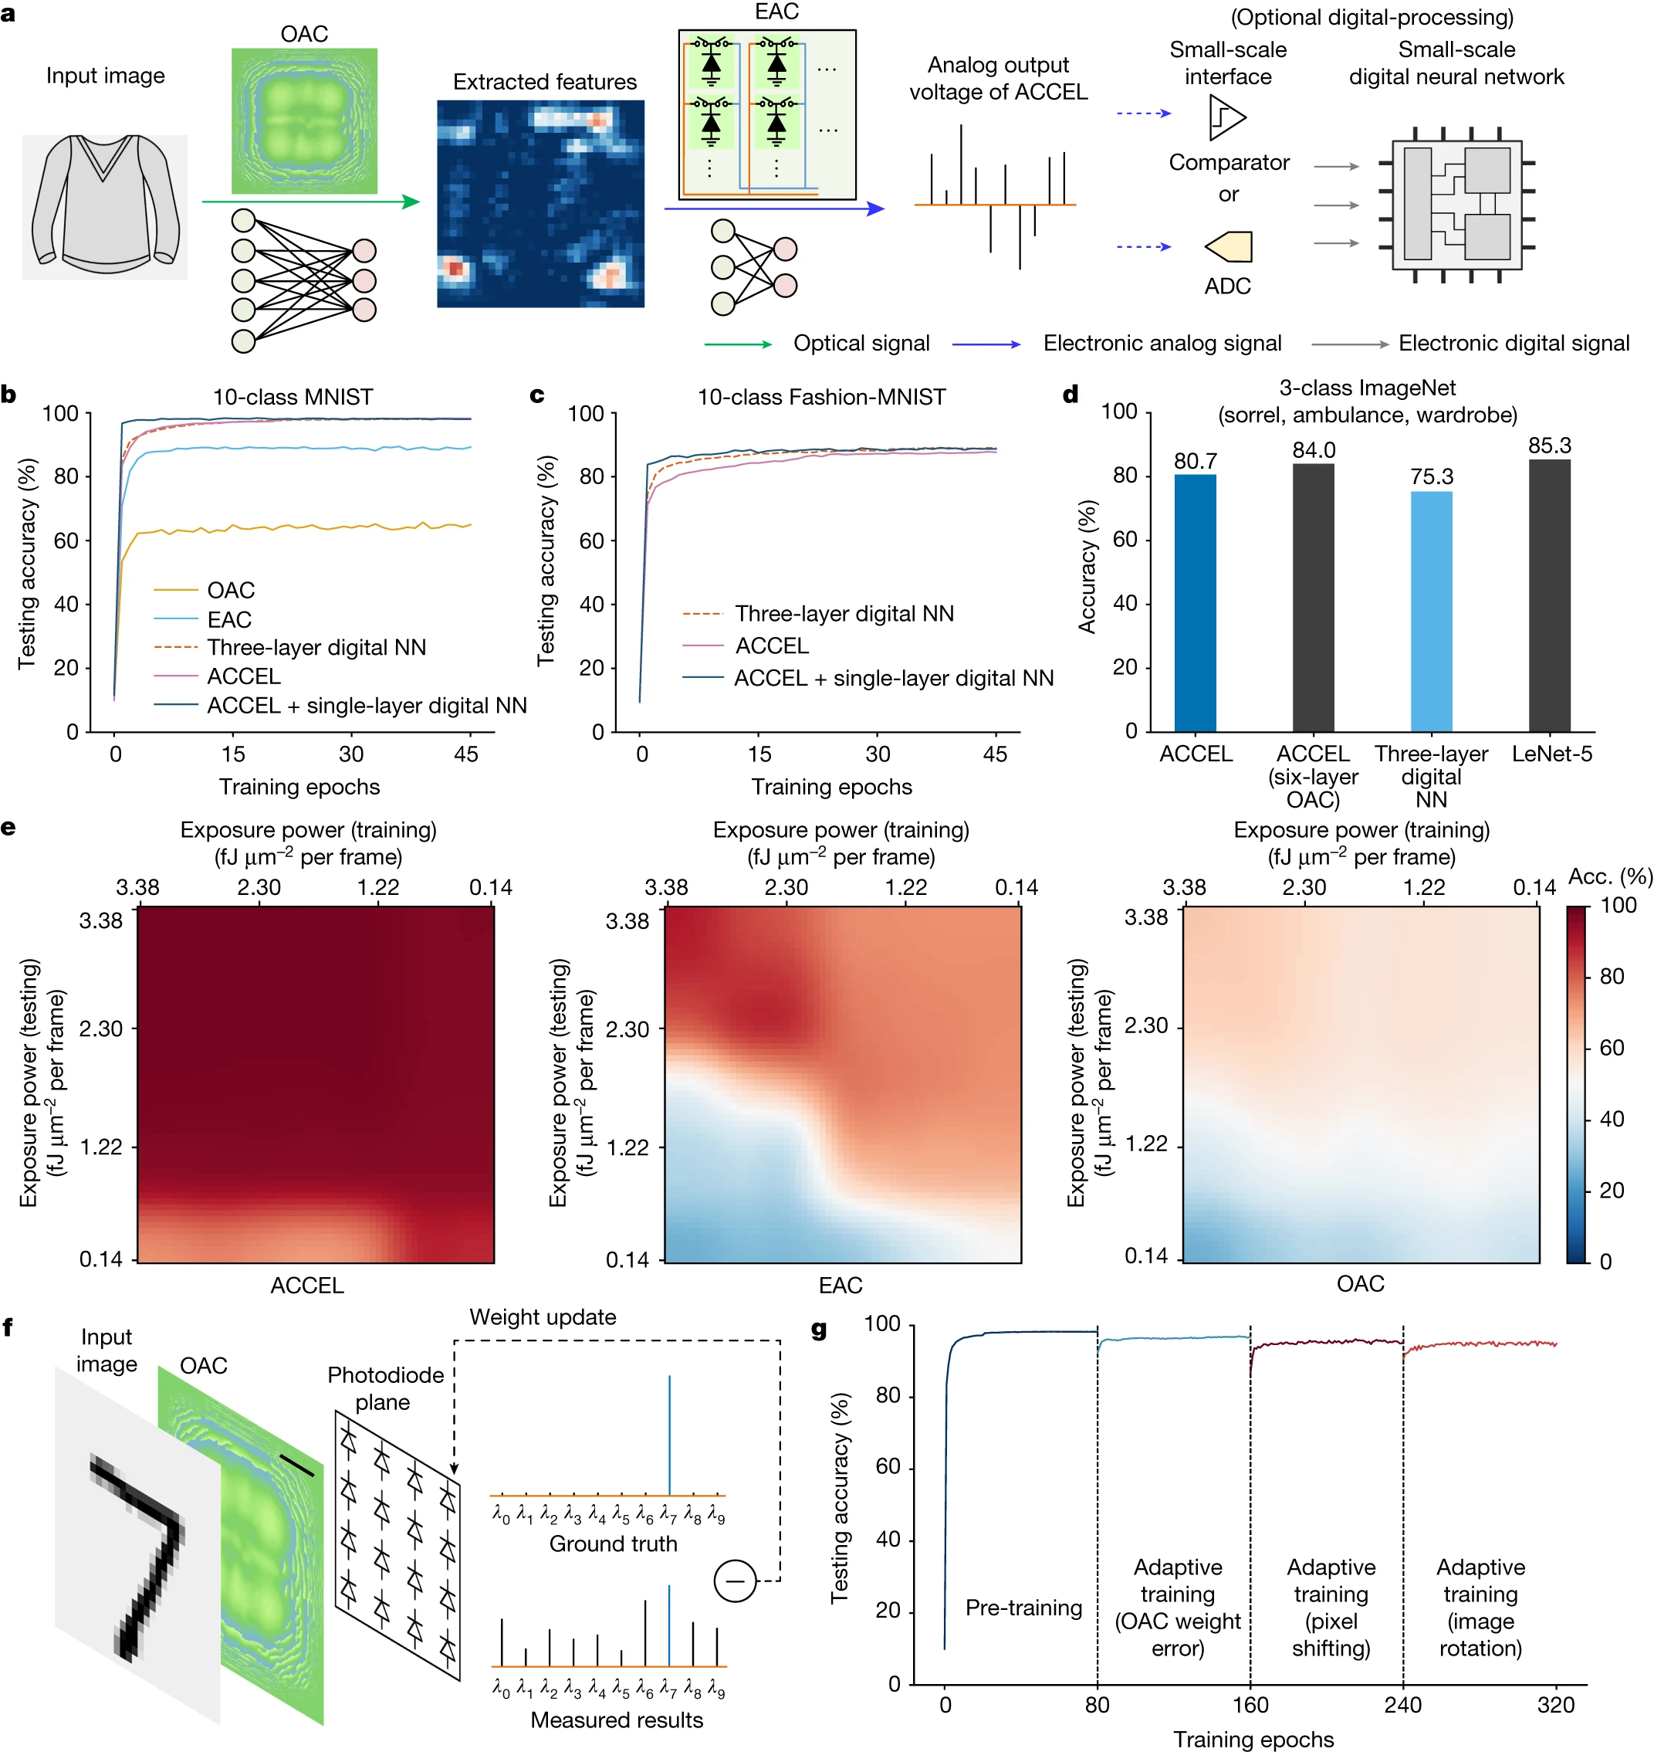
Everything together

Slide 7
Numerical Performance Comparison

Slide 8
Low light condition

Slide 9
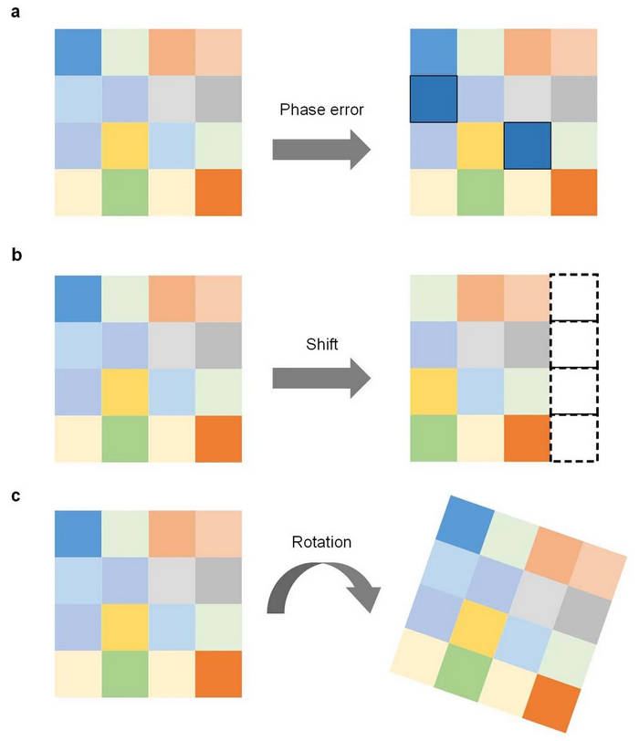
Pre- and Adaptive training
Goal: Increase robustness against:
Fabrication errors
Misalignment
Procedure:
Small data part <10%
Gaussian noise on phase
Shifts 1/32
Rotations 5°

Slide 10
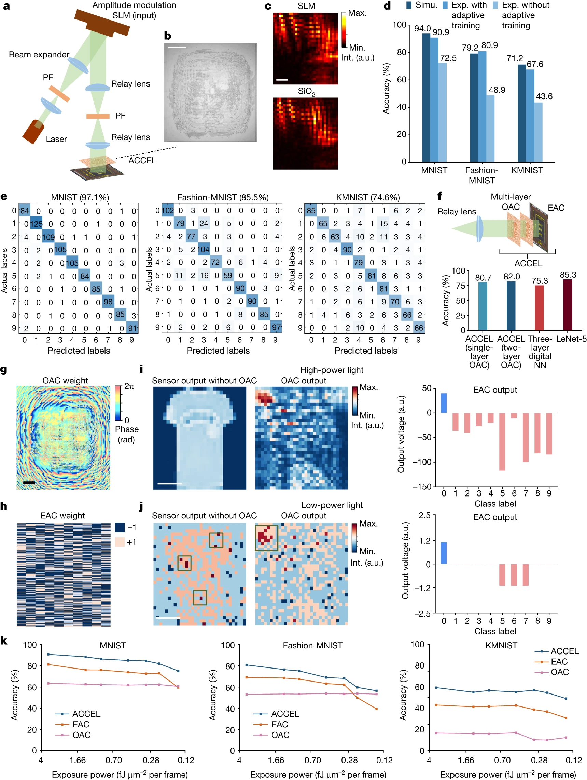
Experimental Performance

Slide 11
Experimental Performance

Slide 12
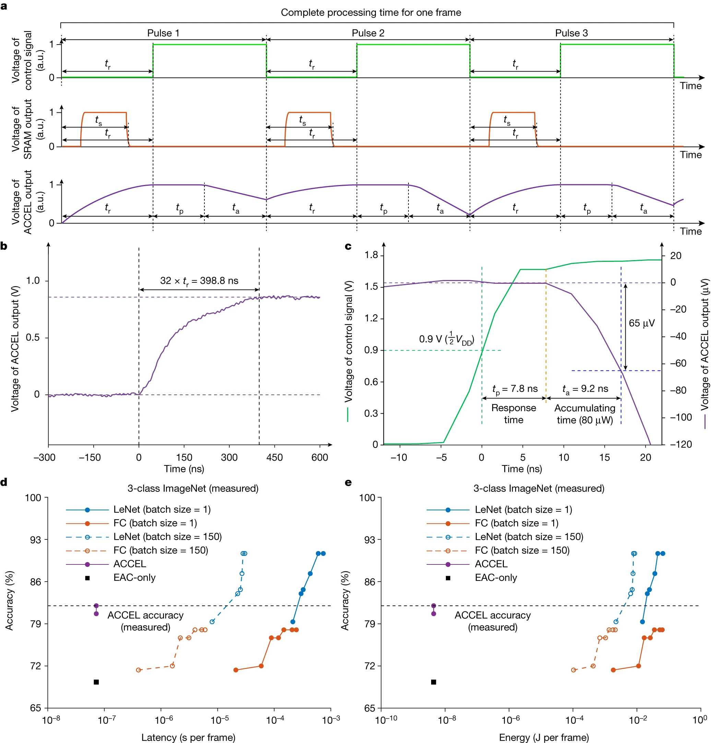
Comparison
Speed:
Per cycle: 24 – 72 ns
Reset: resetting electronics
Accumulation: light collection
Response: processing electronics
~5e3 TOPS
Energy:
7.5e4 TOPS/W

Slide 13
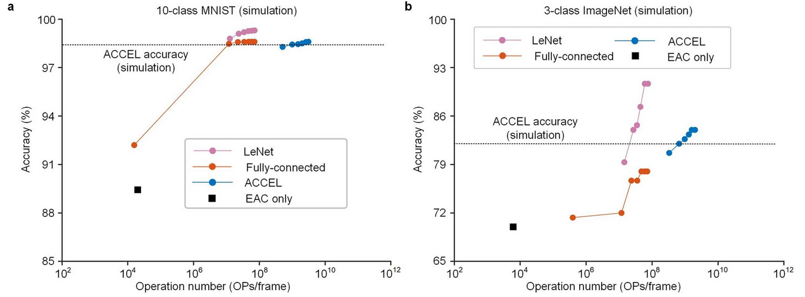
Comparison
Speed:
Per cycle: 24 – 72 ns
Reset: resetting electronics
Accumulation: light collection
Response: processing electronics
~5e3 TOPS
Energy:
~7.5e4 TOPS/W
Operations:
LeNet equivalent:
Number of operation a LeNet requires to get same accouracy.

