Slide 1
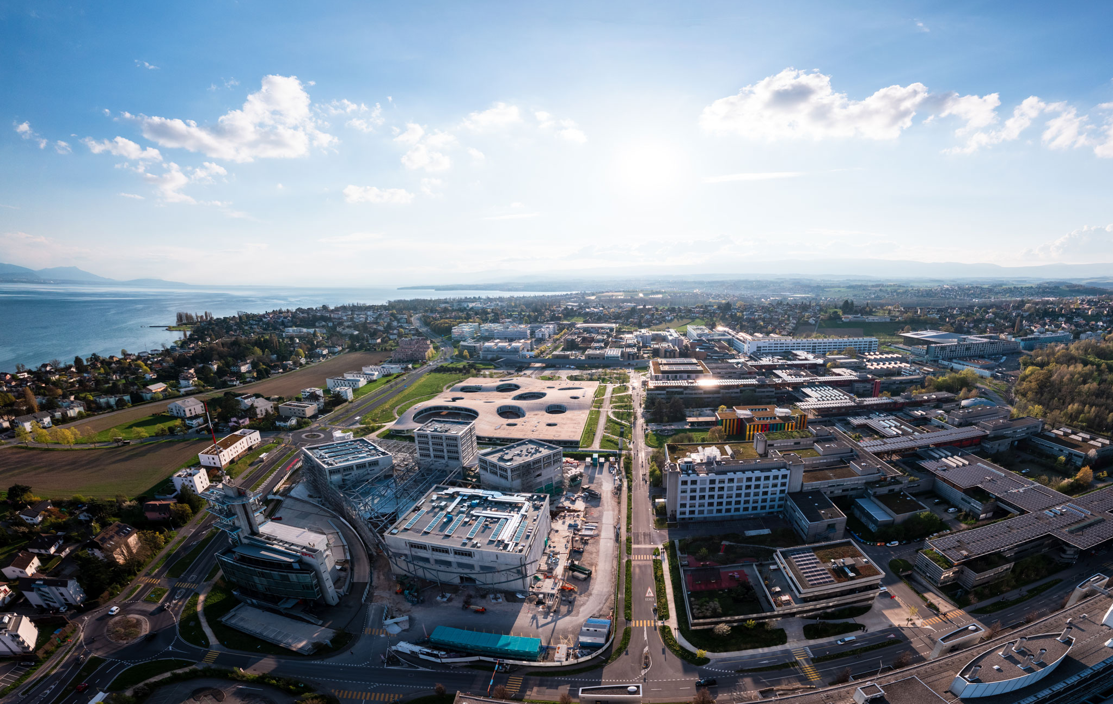

Nanomechanics of Soft Materials: From AFM to OT
Alexandre Dao
Giulia Cortelazzo
Federico Mengozzi
Julian Ruiz Rodriguez
Timofei Tunekov
May 2025

Slide 2
Introduction & Motivation
What is soft matter?
Biopolymers, hydrogels, liquid crystals, cells…
Why measure nanomechanics?
Mechanical properties (rigidity, elasticity) govern performance in robotics, tissue engineering, biosensors, drug delivery, etc.
Limitations of bulk methods
MRE, ultrasonic testing, tensile tests, micro‑indentation lack spatial resolution and can’t capture transient/singular behaviours
Notes:
MRE = Magnetic Resonance Elastography

Slide 3
Innovations of AFM & OT
Atomic Force Microscopy (AFM)
High spatial resolution nanoindentation & topography mapping
Operates in liquid, preserves sample integrity (no staining, no cryo‑prep)
Multimodal: force‑spectroscopy, nano‑IR, magnetic and electrochemical modes
Optical Tweezers (OT)
Contactless pico‑ to nano‑Newton force application on beads, biomolecules, cells
Combined with fluorescence, label‑free imaging, microfluidics for real‑time dynamics
Advances in structured light and high‑throughput force‑torque toolboxes

Slide 4
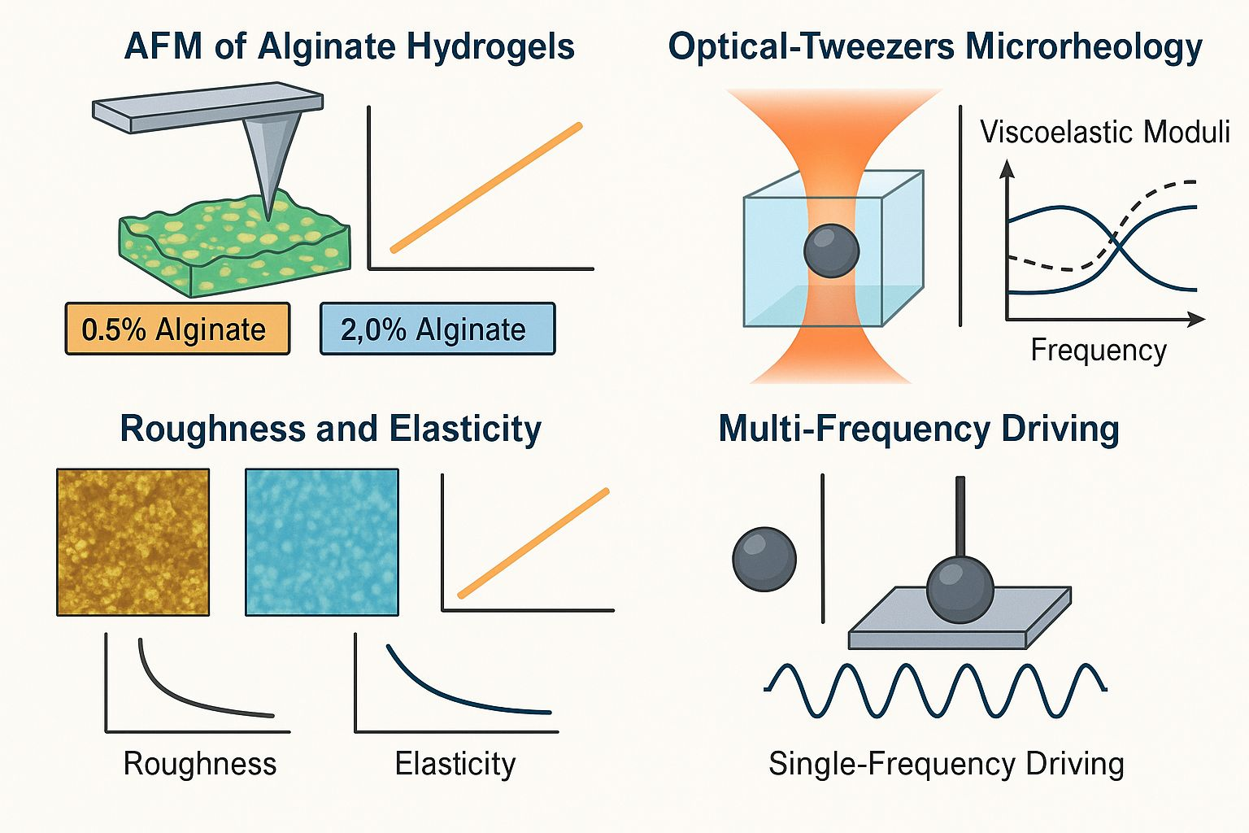
Innovations of AFM & OT
Atomic Force Microscopy (AFM)
High spatial resolution nanoindentation & topography mapping
Operates in liquid, preserves sample integrity (no staining, no cryo‑prep)
Multimodal: force‑spectroscopy, nano‑IR, magnetic and electrochemical modes
Optical Tweezers (OT)
Contactless pico‑ to nano‑Newton force application on beads, biomolecules, cells
Combined with fluorescence, label‑free imaging, microfluidics for real‑time dynamics
Advances in structured light and high‑throughput force‑torque toolboxes

Slide 5
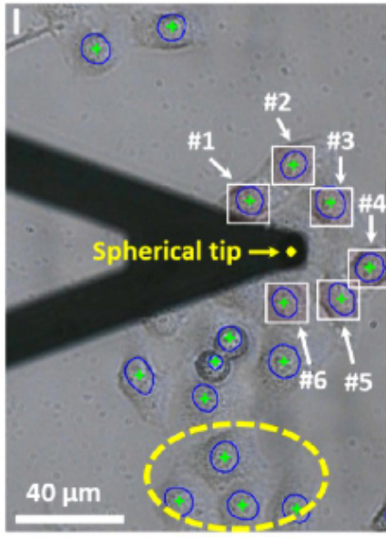
Paper 1 – Automated High-Throughput AFM Single-Cell Nanomechanical Assay Enabled by Deep Learning-Based Optical Image Recognition Rui XiaoYanzhu Zhang and Mi Li*(2024)
Motivation
Conventional AFM is slow and operator dependent
Reduce operator bias in single-cell stiffness mapping
Innovation
Deep‑learning optical image recognition locates cell features and AFM tip
Fully automated stage/tip control for indentation and force spectroscopy
Throughput increased ≳ 10× with operator‑independent workflows
Notes:
MRE = Magnetic Resonance Elastography

Slide 6
Paper 2 – Multi‑Frequency Passive & Active Microrheology with Optical Tweezers Randhir Kumar et al., Sci. Rep. 11, 13917 (2021)
Motivation
Single‑frequency OT calibration is slow (minutes), cells reorganize over time
Need rapid, broadband viscoelastic measurements in complex fluids (e.g. methylcellulose)
Extracted complex moduli (G′, G″) quickly and reliably
Innovation
Active–passive calibration with multi‑frequency stage driving (10–400 Hz)
Iterative phase‑optimization minimizes bead oscillation amplitudeBroadband rheological mapping in seconds, preserving cell equilibrium
Notes:
MRE = Magnetic Resonance Elastography

Slide 7
Combined Impact & Outlook
Synergies
AFM + AI → high‑throughput, high‑resolution cell mechanotyping
OT + multiplexed calibration → fast, broadband microrheology
Future Directions
Integrate AFM and OT for correlative mechanical–rheological assays
Apply in vivo: real‑time monitoring of tissue stiffness changes
Expand AI‑driven automation across other nanomechanical platforms

