Slide 1
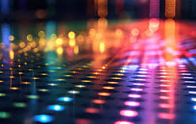
Nanophotonics
Discussing nanophotonics publications
Group D - Torrés T., Baube M., Calcoen L., Nourry M., Robson N.
April 2024

Slide 2
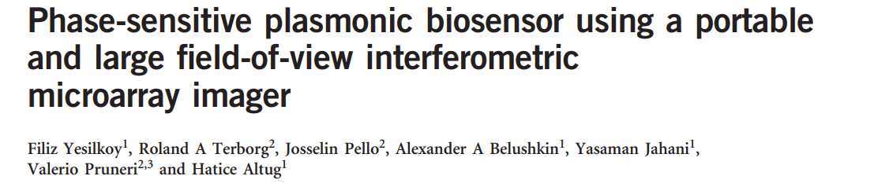
Publication I
Why we chose it
Globally biosensors are interesting given their many applications such as disease diagnostics, environmental monitoring, etc..
This paper introduces a new phase-sensitive approach, which is more accurate and more sensitive than an intensity based approach
The paper also discusses the manufacturing, this is also interesting and more in the scope of the course.
Subjective opinion
The device seems nice but applications are not that developed unclear
Summary
In this paper, plasmonic effects obtained with nanostructures and phase contrast are combined to improve the detection of proteins.
Nanomanufactured gold devices combined with common optical devices allow high throughput multiplexed biosensing.

Slide 3
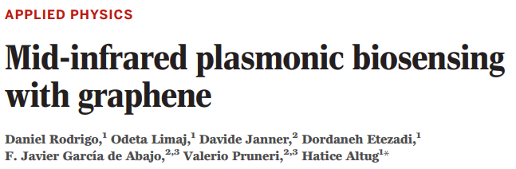
Publication II
Why we chose it
Usage of other materials and quantum effects to improve classical identification techniques is a nice thing to learn
Allows to get better molecular structure
Subjective opinion
Applying a new point of view to a new technique
Summary
In this paper, they try to use 2D-material graphene to generate plasmonics effects (instead of Au) for enhance spectroscopy.
This allows a more precise detection of the characteristic groups and thus detect the specificities of the proteins.

Slide 4
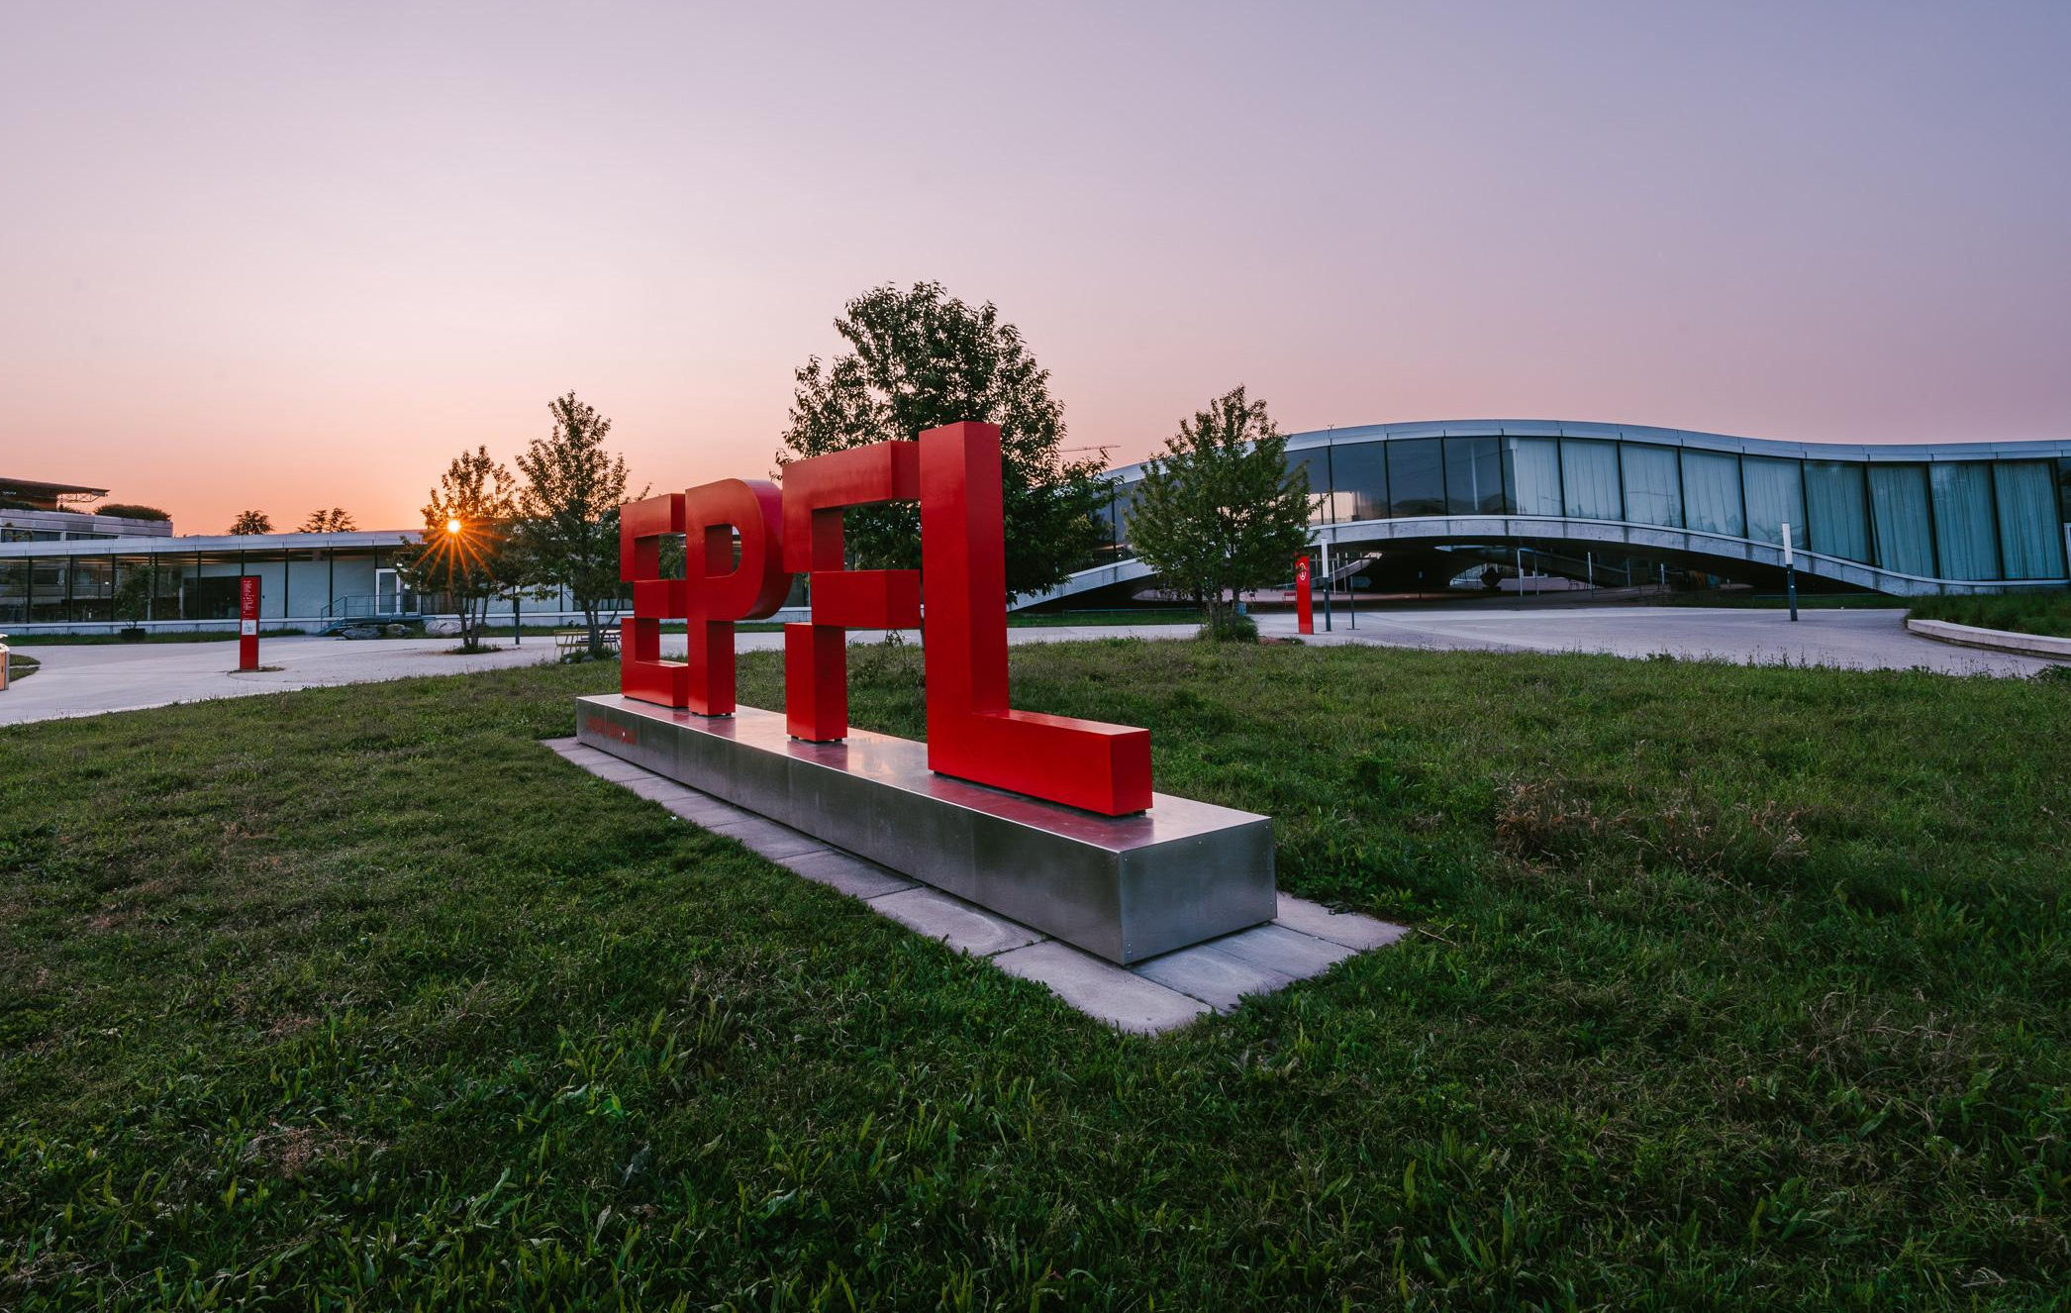
Thank you
Discussing nanophotonics publications
Group D - Torrés T., Baube M., Calcoen L., Nourry M., Robson N.

