Slide 1
Advanced materials processing with intelligent systems
Signal Processing and Data Acquisition
Shevchik Sergey, Giulio Masinelli & Patrik Hoffmann

Slide 2
Outline
Set the scene
Time vs frequency domains
Negative frequencies
Another fundamental tool: convolution
Sampling => conversion continuous to discrete time signal
Aliasing demo
Anti-aliasing demo
Materials processing with intelligent systems (MICRO-457) Shevchik S., Masinelli G. & Hoffmann P.

Slide 3
Set the scene
In this lecture we will not:
Tell you which acquisition board to use for which signal
which board to use for which sensors e.g. a microphone
In this lecture we will:
See the mathematical foundation of data acquisition
In particular, life happens in the time domain
Human perceives the time passing; a continuous variable
See why we need to discretize a signal?
Computer can process only discrete signal
See what is the correct data acquisition frequency?
See how to downsample the signal and their consequences?
Materials processing with intelligent systems (MICRO-457) Shevchik S., Masinelli G. & Hoffmann P.
Notes:
Ste

Slide 4
Set the scene
Before we start speaking about data acquisition, there are a few question to be answered:
What is the laser process I am interested in?
heat treatment, bending, polishing, welding, AM, cutting, drilling
Which laser shall I choose?
Continuous wave, pulsed => long, short, ultrashort
What is the event I am interested in?
Temperature, ablation rate, defects e.g. pores, crack, phase transformation
What is the dynamic of the event I am interested in?
Timescale s, ms, μs, ps, fs
What is the correct data acquisition frequency?
What to do if the required data acquisition frequency is to high?
How to downsample the signal and for which consequences?
Materials processing with intelligent systems (MICRO-457) Shevchik S., Masinelli G. & Hoffmann P.

Slide 5
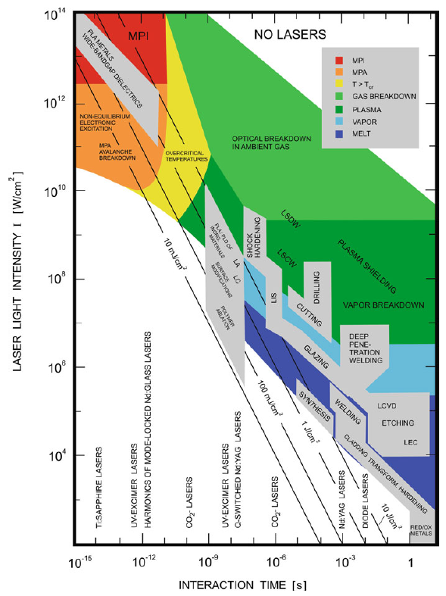
Set the scene – the laser process
PLA/PLD – pulsed laser ablation/ deposition
LA – laser annealing
LC – laser cleaning
LIS – laser induced isotope separation/IR – laser photochemistry
MPA/MPI – multiphoton absorption ionization
LSDW/LSCW – laser supported detonation/combustion waves
LCVD – laser induced chemical vapour deposition
LEC – laser induced electrochemical plating/etching
RED/OX – long pulse or cw CO₂-laser induced reduction/oxidation
D. Bäuerle; Laser Processing and Chemistry, 4th ed. Springer, Berlin, 2011
Materials processing with intelligent systems (MICRO-457) Shevchik S., Masinelli G. & Hoffmann P.

Slide 6
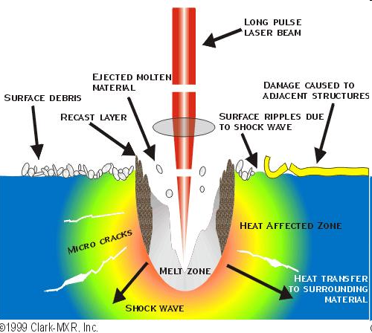
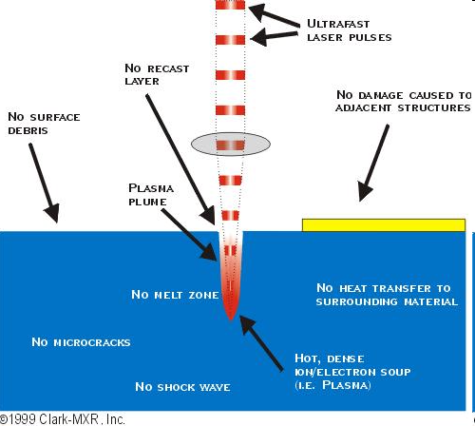
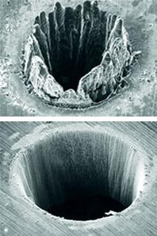
Set the scene – process dynamic
ns
fs
Materials processing with intelligent systems (MICRO-457) Shevchik S., Masinelli G. & Hoffmann P.

Slide 7
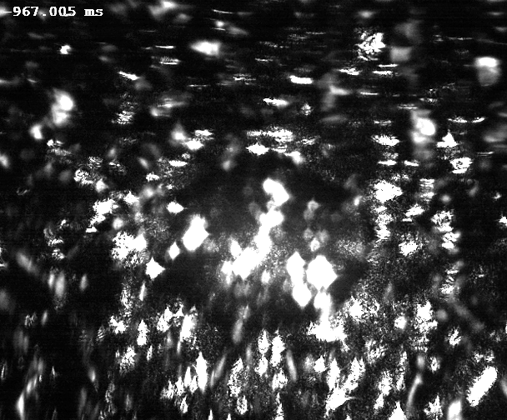
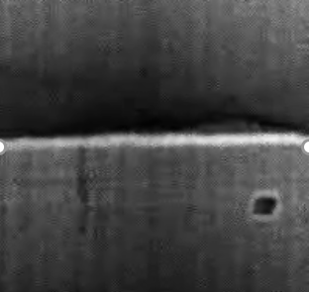
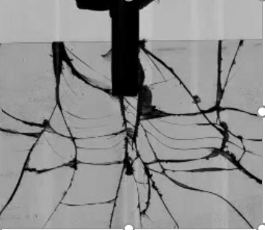
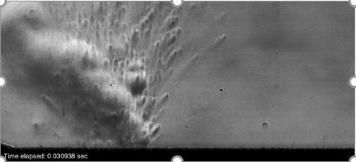
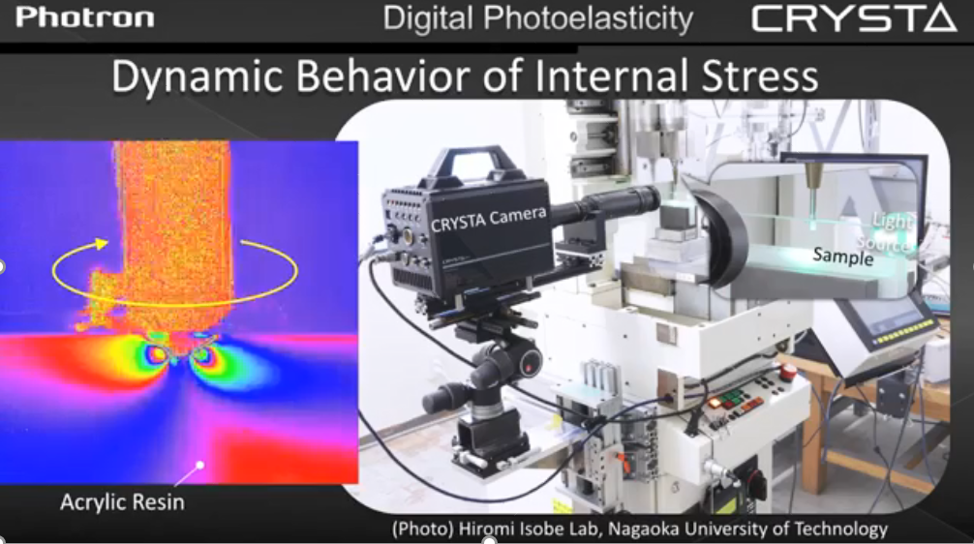
Set the scene – time scale of the events
Melting [1s] & solidification [4 ms]
Pore formation & removal of a moving laser beam [5 ms]
Crack initiation & propagation
Laser plume, material composition
Stress; other e.g. phase transformation
Materials processing with intelligent systems (MICRO-457) Shevchik S., Masinelli G. & Hoffmann P.

Slide 8
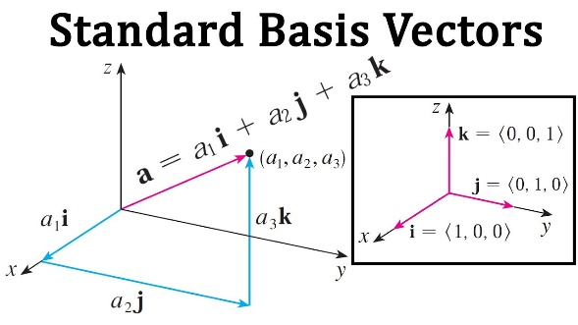



Hilbert Spaces
Euclidian space
Topological
Banach
Hilbert
Hilbert space
RKHS
Materials processing with intelligent systems (MICRO-457) Shevchik S., Masinelli G. & Hoffmann P.

Slide 9
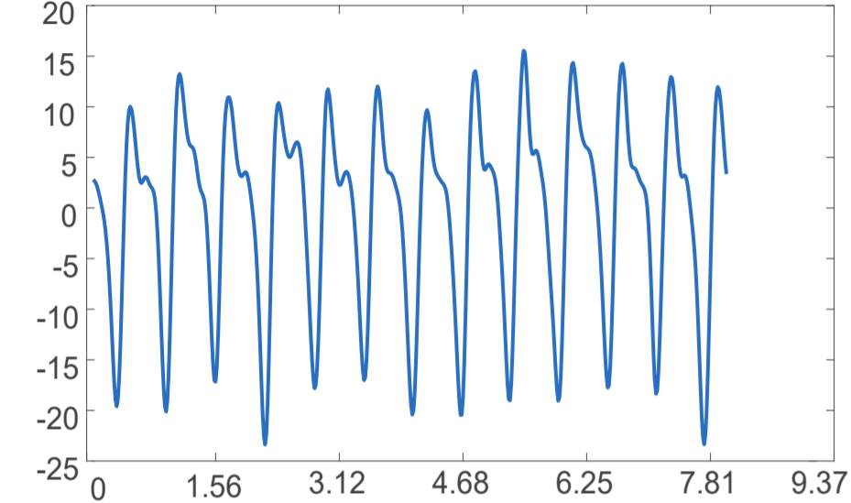
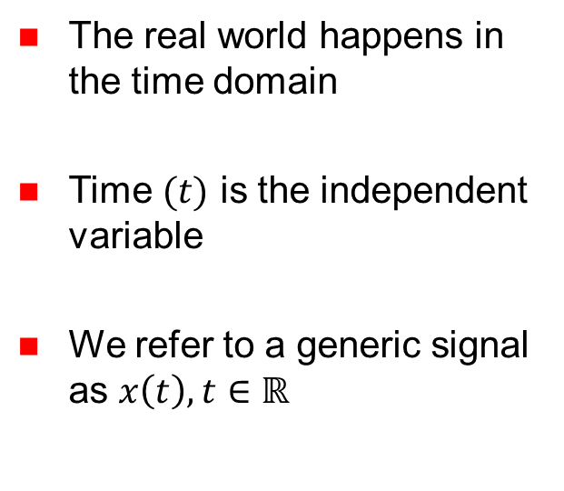


Time domain
Analysis of a function, time series, or a signal with respect to time
$$x\left(t\right)$$
Blood volume pulse
The real world happens in the time domain
Time $(t)$ is the independent variable
We refer to a generic signal as $x\left(t\right), t∈ℝ$
$$t [s]$$
Materials processing with intelligent systems (MICRO-457) Shevchik S., Masinelli G. & Hoffmann P.

Slide 10
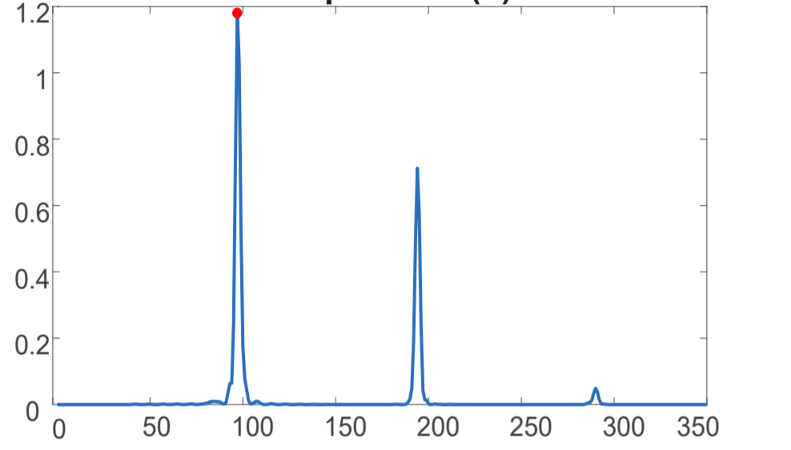

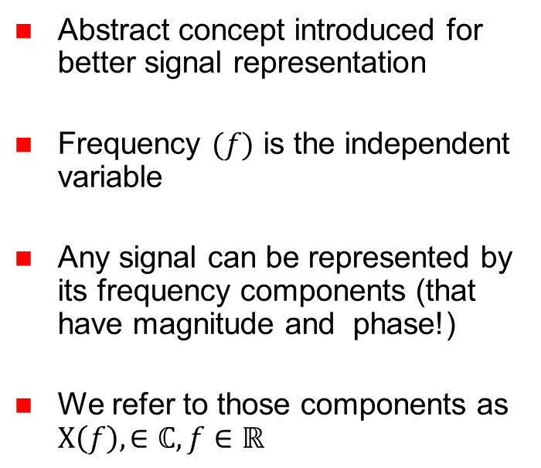

Frequency domain
Analysis of a function, time series, or a signal with respect to frequency
Abstract concept introduced for better signal representation
Frequency $(f)$ is the independent variable
Any signal can be represented by its frequency components (that have magnitude and phase!)
We refer to those components as $X\left(f\right),∈ℂ, f∈ℝ$
$|X\left(f\right)|$
Blood volume pulse
$$f [bpm]$$
Materials processing with intelligent systems (MICRO-457) Shevchik S., Masinelli G. & Hoffmann P.

Slide 11
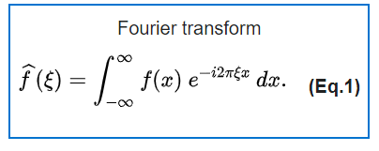
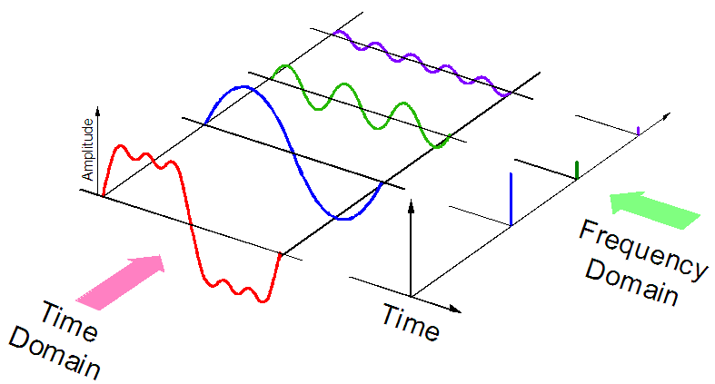
Time domain vs Frequency domain
Every signal can be considered as the sum of several sinusoidal components. The frequency analysis is the visualization of their amplitude and phase
Materials processing with intelligent systems (MICRO-457) Shevchik S., Masinelli G. & Hoffmann P.

Slide 12
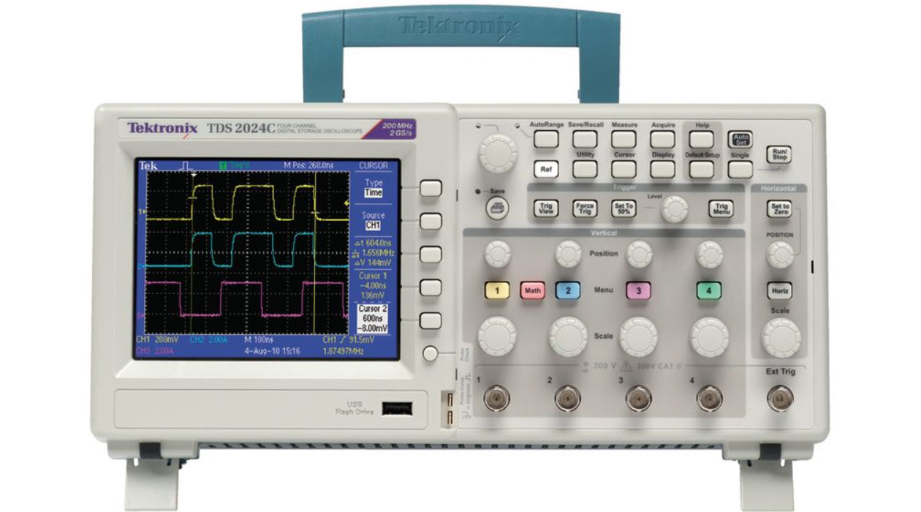
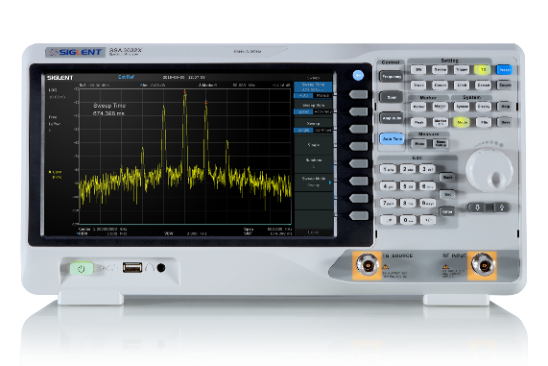
Time domain vs Frequency domain
What instrument should we use for measuring a signal in time or frequency domain?
Oscilloscope (time)
  It displays the amplitude of the signal to the varying of time
Spectrum Analyzer (frequency)
  It displays the amplitude (and phase) of the signal to the varying of the frequency
Materials processing with intelligent systems (MICRO-457) Shevchik S., Masinelli G. & Hoffmann P.

Slide 13

Time domain vs Frequency domain
These two representations are linked by the Fourier transformation
$x\left(t\right)↔X(f)$
The two representations contain the same information, meaning that if we modify the signal in one domain, the corresponding representation in the other domain changes as well.
However, the change may have a different effect on one domain compared to the other (more on that later on).
Materials processing with intelligent systems (MICRO-457) Shevchik S., Masinelli G. & Hoffmann P.
Notes:
Change Amplitude => same effect in time and frequency domain
But shift in the time => same amplitude in the frequency domain but phase change linearly

Slide 14
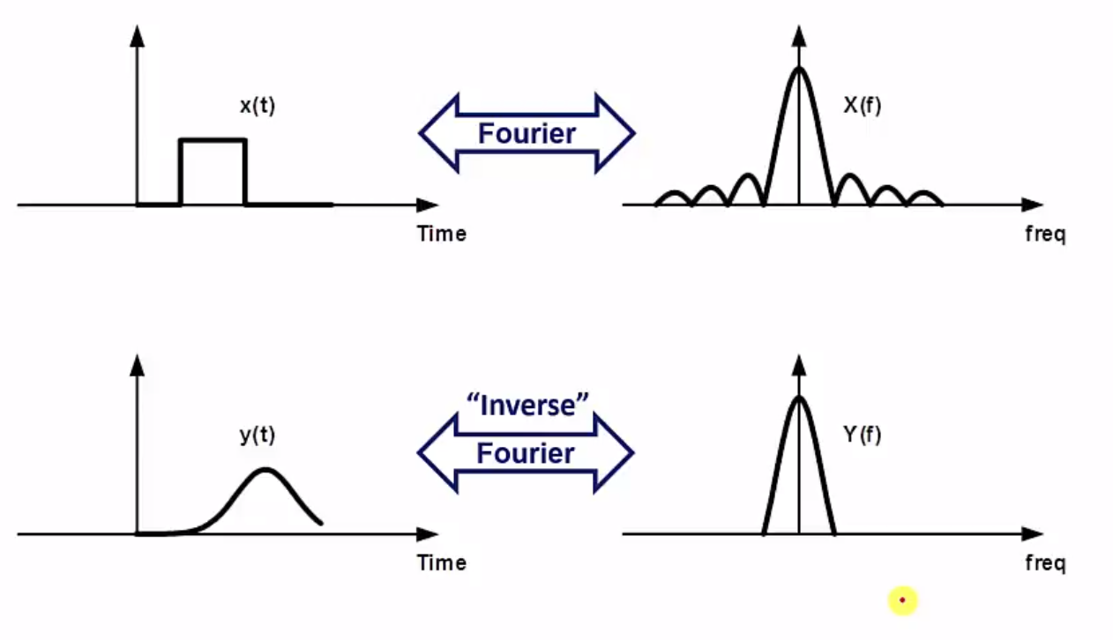
Time domain vs Frequency domain
Example of convenience of the frequency representation: applying a filter
Materials processing with intelligent systems (MICRO-457) Shevchik S., Masinelli G. & Hoffmann P.
Notes:
Top bottom time => effect of low pass filter => solve difficult integral and difficult to see
Then, go through fourier transform of time domain => left top
Then, apply low pass filter => red line
Then, to get bottom frequency = point wise multiplication
We know why we call it low pass filter => supressing high (respect to filter frequency) frequency content
So easy way is top left > top right= bottom right => bottom left since frequency has same info as time domain

Slide 15
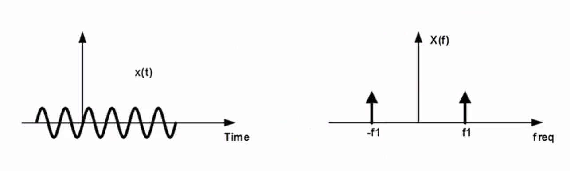
Negative frequencies
As the previous plots have shown, the Fourier transform of a real signal is also defined for frequencies that have a negative value – the so-called image frequencies
Materials processing with intelligent systems (MICRO-457) Shevchik S., Masinelli G. & Hoffmann P.
Notes:
A sinusoidal signal is often called a single-tone because of its frequency domain representation contains only a single frequency
For real signal, we mean signals that are physically possible measurable with instruments
If you do the calculations for the coeffiencients of the fourier transform of a sinusois, you end up withtwo coefficients, one of those having a –j 2 pi f1 t terms.

Slide 16

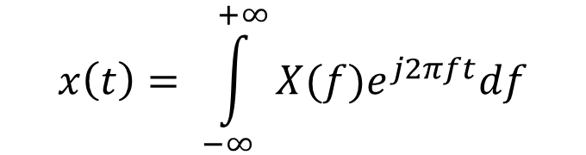


Negative frequencies
What we are plotting here are indeed the terms $e^{j2πft}$ that comes out form the Fourier transform
$$e^{−j2πf_{1}t}$$
$$e^{j2πf_{1}t}$$
$$x\left(t\right)= \int_{−∞}^{+∞}{X(f)e^{j2πft}df}$$
Materials processing with intelligent systems (MICRO-457) Shevchik S., Masinelli G. & Hoffmann P.
Notes:
e^j2pift = phasor
e^-j has a negative phase
E^j has a positive phase

Slide 17
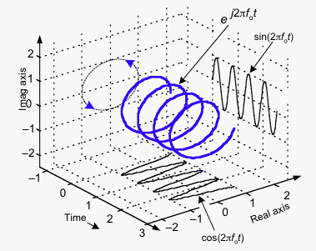

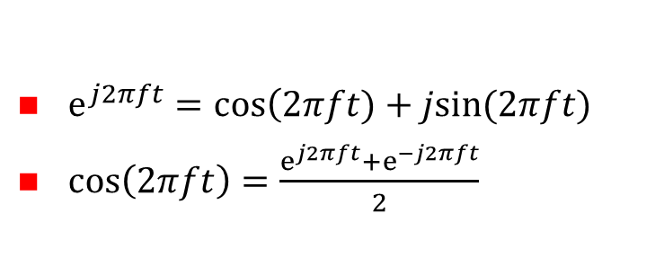


Negative frequencies
What we are plotting here are indeed the terms $e^{j2πft}$ that comes out form the Fourier transform. We know that:
$ⅇ^{j2πft}=\cos\left(2πft)+jsin(2πft)\right.$
$\cos\left(2πft\right)=\frac{ⅇ^{j2πft}+ⅇ^{−j2πft}}{2}$
$$e^{−j2πf_{1}t}$$
$$e^{j2πf_{1}t}$$
Can be seen as a phase shift (with two directions).
Materials processing with intelligent systems (MICRO-457) Shevchik S., Masinelli G. & Hoffmann P.
Notes:
E to the j is cosine + j sin. So if the signal would have just been this, I would get an imaginary signal. To get a real signal I need to combine two of these e to the j. That removes the imaginary component
So think of this plot as a e to j plot, and this makes very clear why need both components
In the case of real signals, there are always two equal-amplitude complex exponentials, rotating in opposite directions, so that their real parts combine and imaginary parts cancel out, leaving only a real sinusoid as the result. This is why the spectrum of a sine wave always has 2 spikes, one positive frequency and one negative. Depending on the phase of the two spirals, they could cancel out, leaving a purely real sine wave, or a real cosine wave, or a purely imaginary sine wave, etc.
https://dsp.stackexchange.com/questions/431/what-is-the-physical-significance-of-negative-frequencies
Question: in which cases the positive frequencies can be different from the negative ones? –
Answer:

Slide 18
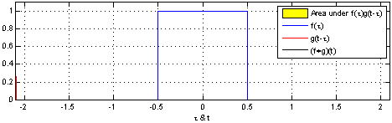
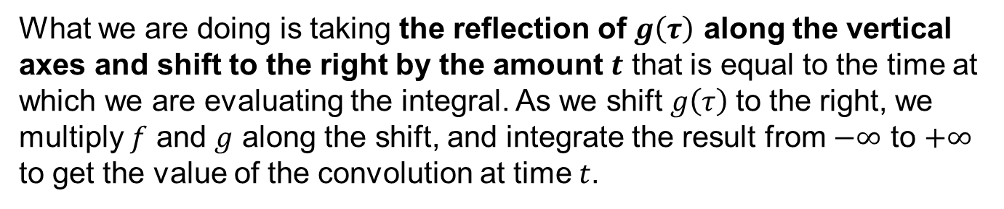
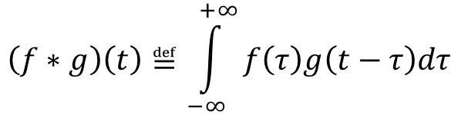
Another fundamental tool: convolutions
Given two signals $f(t)$ and $g\left(t\right)$, their convolution is defined as:
$$\left(f∗g\right)\left(t\right)≝\int_{−∞}^{+∞}{f\left(τ\right)g\left(t−τ\right)dτ}$$
What we are doing is taking the reflection of $g\left(τ\right)$ along the vertical axes and shift to the right by the amount $t$ that is equal to the time at which we are evaluating the integral. As we shift $g\left(τ\right)$to the right, we multiply $f$ and $g$ along the shift, and integrate the result from $−∞$ to $+∞$ to get the value of the convolution at time $t$.
Materials processing with intelligent systems (MICRO-457) Shevchik S., Masinelli G. & Hoffmann P.
Notes:
We will focus on the intuition behind it
As t increases, the function g moves to the right. If the two functions do not touch, the multiplication between g and f will give a zero and the integral will be zero as well. And the convolution remains zero as long as the g and f do not overlap. As soon as the two functions start to touch each other, the multiplication will give a positive value, and the integral will start to increase. As the overlap increase, the value of the multiplication increases, and so does the integral. We there will be a full overlap, the integral will peak. The overlap will then decrease in amount and the integral will do the same.
The meaning of the convolution is

Slide 19
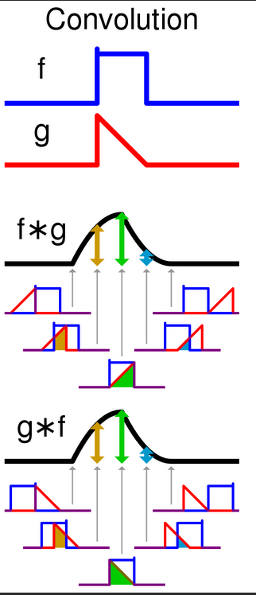
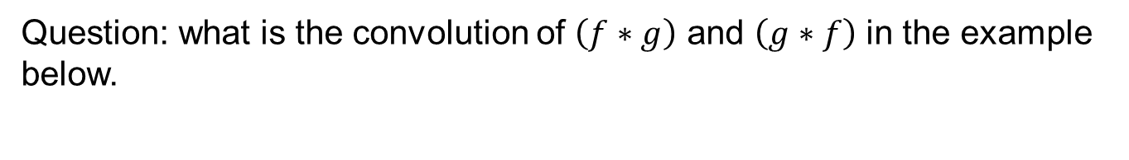
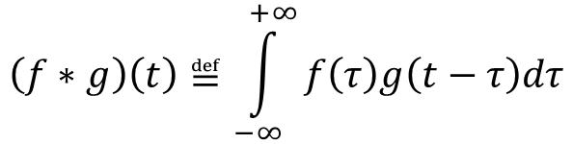
Another fundamental tool: convolution
Given two signals $f(t)$ and $g\left(t\right)$, their convolution is defined as:
$$\left(f∗g\right)\left(t\right)≝\int_{−∞}^{+∞}{f\left(τ\right)g\left(t−τ\right)dτ}$$
Question: what is the convolution of $\left(f∗g\right)$ and $\left(g∗f\right)$ in the example below.
Materials processing with intelligent systems (MICRO-457) Shevchik S., Masinelli G. & Hoffmann P.

Slide 20
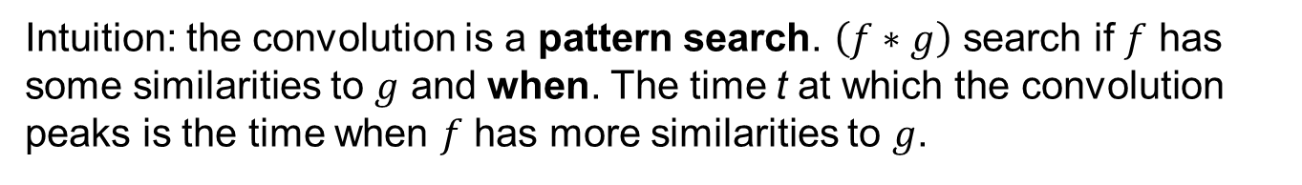
Another fundamental tool: convolution
Given two signals $f(t)$ and $g\left(t\right)$, their convolution is defined as:
$$\left(f∗g\right)\left(t\right)≝\int_{−∞}^{+∞}{f\left(τ\right)g\left(t−τ\right)dτ}$$
Intuition: the convolution is a pattern search. $\left(f∗g\right)$ search if $f$ has some similarities to $g$ and when. The time t at which the convolution peaks is the time when $f$ has more similarities to $g$.
Materials processing with intelligent systems (MICRO-457) Shevchik S., Masinelli G. & Hoffmann P.
Notes:
We will focus on the intuition behind it
As t increases, the function g moves to the right. If the two functions do not touch, the multiplication between g and f will give a zero and the integral will be zero as well. And the convolution remains zero as long as the g and f do not overlap. As soon as the two functions start to touch each other, the multiplication will give a positive value, and the integral will start to increase. As the overlap increase, the value of the multiplication increases, and so does the integral. We there will be a full overlap, the integral will peak. The overlap will then decrease in amount and the integral will do the same.

Slide 21

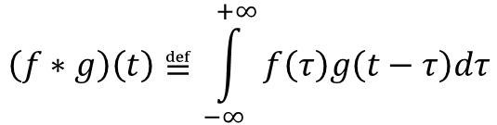
Another fundamental tool: convolution
$$\left(f∗g\right)\left(t\right)≝\int_{−∞}^{+∞}{f\left(τ\right)g\left(t−τ\right)dτ}$$
Convolution theorem:
ℱ[$\left(f∗g\right)\left(t\right)]=\text{ℱ}\text{[}f(t)\text{]}$ $\text{ℱ}\text{[}g(t)\text{]}$
Very handy results that shows that the Fourier transform of the convolution of two functions is equal to the product of the Fourier transforms of the individual functions.
Materials processing with intelligent systems (MICRO-457) Shevchik S., Masinelli G. & Hoffmann P.

Slide 22
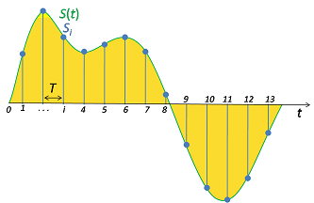
Sampling – conversion of a continuous-time signal to discrete time
All the measurement we are interested in (light intensities, temperature, acoustic shockwaves…) are all continuous signals.
However, we want to take advantage of the digital electronics, that can only process discrete signals.
Materials processing with intelligent systems (MICRO-457) Shevchik S., Masinelli G. & Hoffmann P.
Notes:
For example, if you remembered when we discussed tho photodiodes we mentioned the exposition time. It measn that phyiscal devices/detectors need time to accumulate enough light to be able to recognise it from noise. Therefore we cant sense continiously.

Slide 23
Sampling – conversion of a continuous-time signal to discrete time
Sampling allows the use of modern digital electronics to process, record, transmit, store, and retrieve continuous signals.
Pictures, digital cameral, printers
Audio: MP3, wav, smartphones…
Video: MP4, avi …
Everything we can find on the web
Thus, there is a huge interest in understanding how to take a continuous time signal and turn it into a discrete representation
Materials processing with intelligent systems (MICRO-457) Shevchik S., Masinelli G. & Hoffmann P.

Slide 24
Sampling – conversion of a continuous-time signal to discrete time
Can we discretize them without loosing information?
If we properly chose the discretization interval (T), from a discrete signal we can fully recover the original one
But we have to know the physical mechanism that generate the signal
Materials processing with intelligent systems (MICRO-457) Shevchik S., Masinelli G. & Hoffmann P.

Slide 25
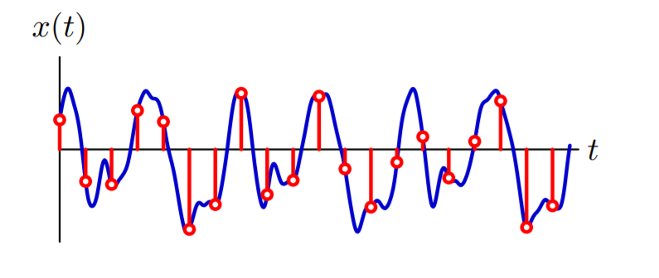
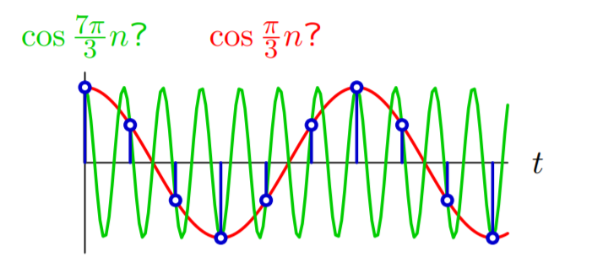
Sampling – conversion of a continuous-time signal to discrete time
We would like to sample in a way that preserves information, which may not seem possible
Information between samples is lost. Therefore, the same samples can represent multiple signals.
Materials processing with intelligent systems (MICRO-457) Shevchik S., Masinelli G. & Hoffmann P.
Notes:
We'd like to sample a signal-- so think about the blue signal here and think about the red samples. We'd like to sample a signal in a way that we preserve all of the information about that signal. And as you can see from the example that I picked, it's not at all clear that you can do that. In fact, if you look at the bottom picture, I have coerced two signals to follow on the same samples. So the green signal is the cos 7 pi n over 3 and the red signal is the cos pi n over 3. And they all go through the same blue samples. The same blue samples is shared by both of those signals. So it's patently obvious that I cannot uniquely reconstruct a signal from the samples. That's absolutely clear. It's also clear by just thinking about the basic mathematics of signals.
A CT signal could move up and down arbitrarily between two samples. How could you possibly learn information about what happened between the samples by looking just at the samples? So it's not at all clear that you're going to be able to do this.

Slide 26
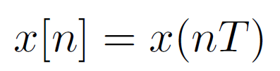
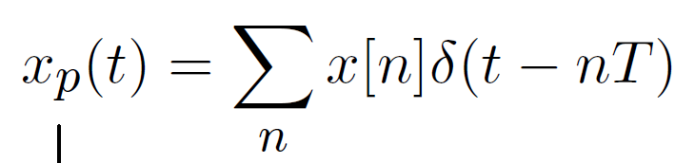
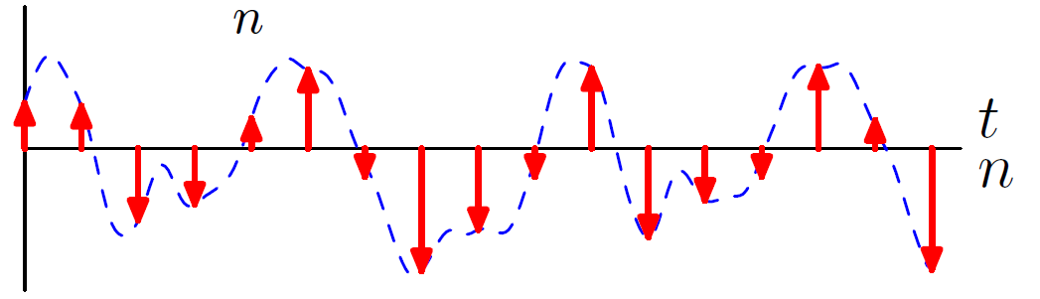
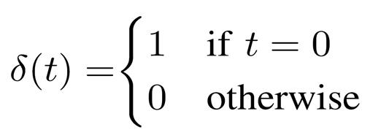
Sampling – conversion of a continuous-time signal to discrete time
Let’s define
The sampled signal can be represented as:
Materials processing with intelligent systems (MICRO-457) Shevchik S., Masinelli G. & Hoffmann P.

Slide 27
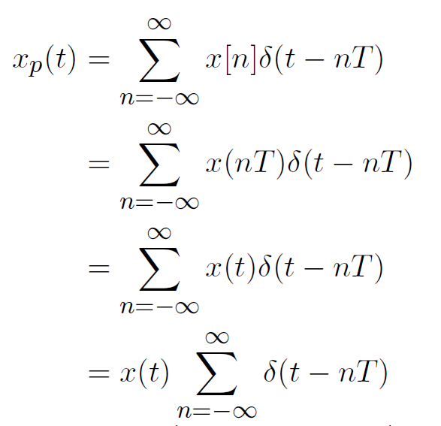
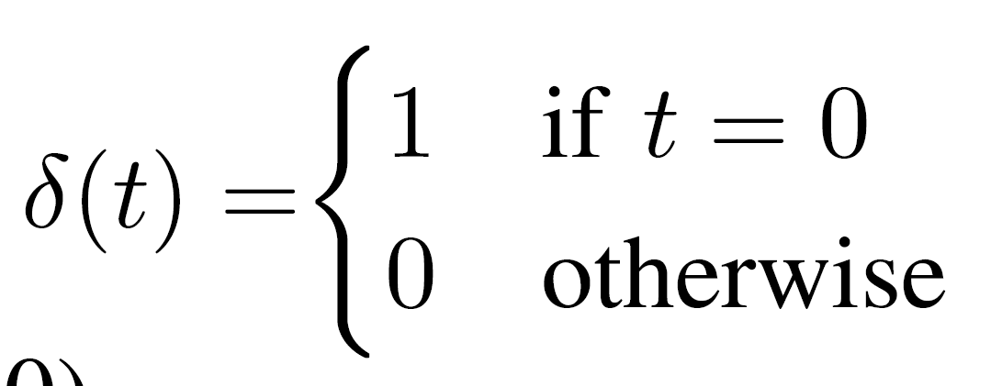
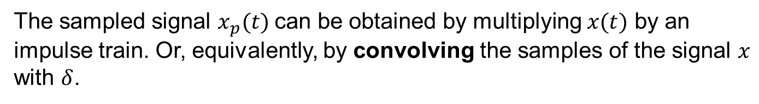
Sampling – conversion of a continuous-time signal to discrete time
The sampled signal $x_{p}(t)$can be obtained by multiplying $x(t)$ by an impulse train. Or, equivalently, by convolving the samples of the signal $x$ with $δ$.
Materials processing with intelligent systems (MICRO-457) Shevchik S., Masinelli G. & Hoffmann P.

Slide 28
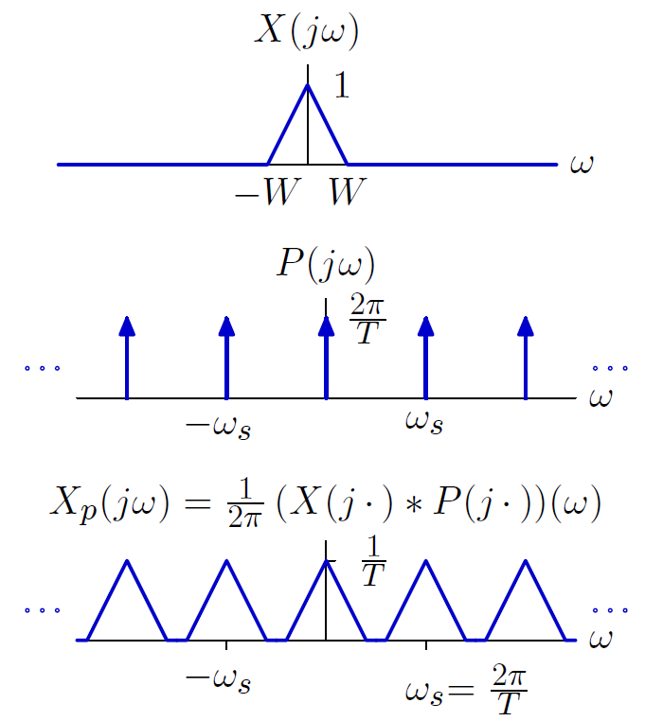
Sampling – conversion of a continuous-time signal to discrete time
Multiplication by an impulse train in time is equivalent to convolution by an impulse train in frequency.
This operation generates multiple copies of the original spectrum.
Materials processing with intelligent systems (MICRO-457) Shevchik S., Masinelli G. & Hoffmann P.
Notes:
Which has a repetition periode equal to the sampling period.

Slide 29
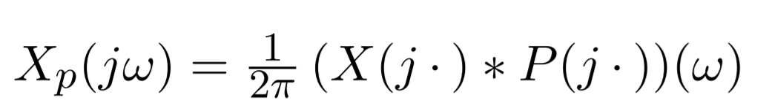
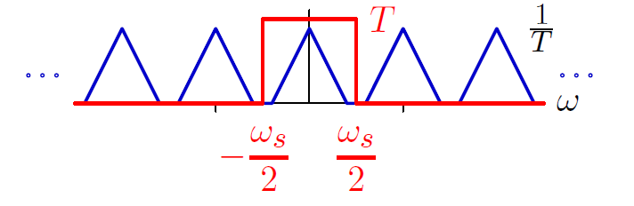
Sampling – conversion of a continuous-time signal to discrete time
The high frequency copies can be removed with a low-pass filter (also multiply by T to undo the amplitude scaling).
Impulse reconstruction followed by ideal low-pass filtering is called bandlimited reconstruction
Materials processing with intelligent systems (MICRO-457) Shevchik S., Masinelli G. & Hoffmann P.

Slide 30
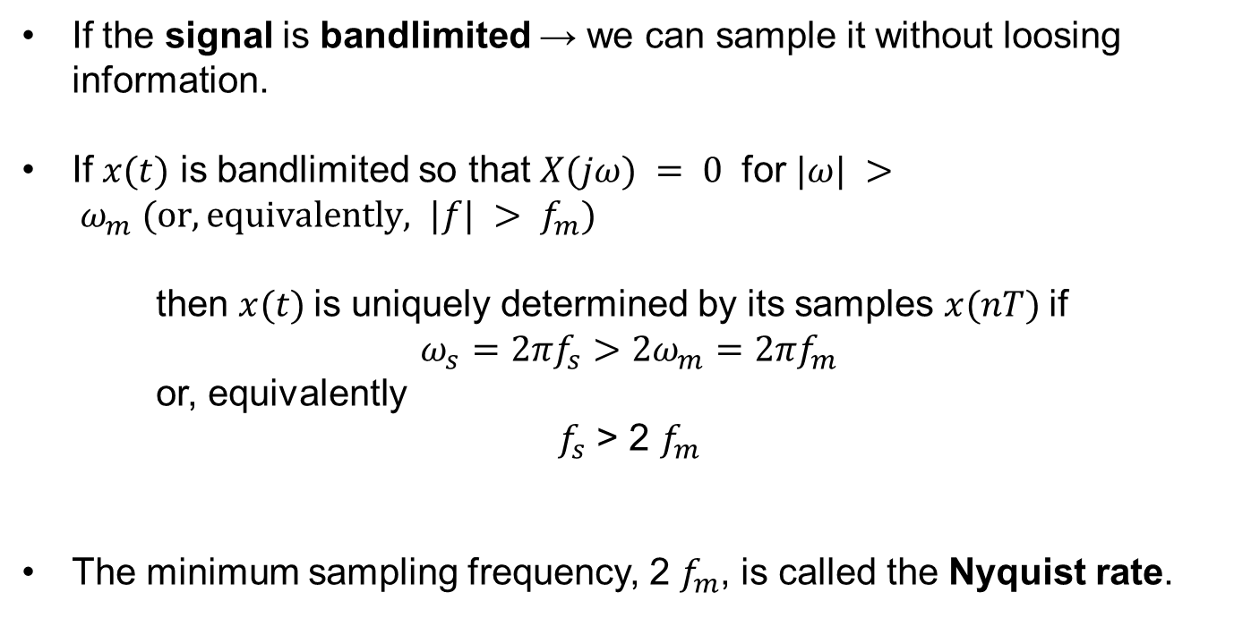
Sampling – conversion of a continuous-time signal to discrete time
If the signal is bandlimited → we can sample it without loosing information.
If $x(t)$ is bandlimited so that $X(jω) = 0$ for $|ω| > ω_{m} (or, equivalently, |f| > f_{m})$
then $x(t)$is uniquely determined by its samples $x(nT)$if
$$ω_{s}=2πf_{s}>2ω_{m}=2πf_{m}$$
or, equivalently
$f_{s}$ > 2 $f_{m}$
The minimum sampling frequency, 2 $f_{m}$, is called the Nyquist rate.
Materials processing with intelligent systems (MICRO-457) Shevchik S., Masinelli G. & Hoffmann P.

Slide 31
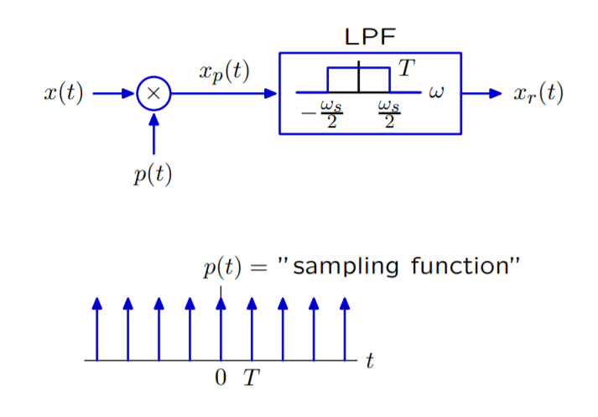
Sampling – conversion of a continuous-time signal to discrete time
Sampling followed by bandlimited reconstruction is equivalent to multiplying by an impulse train and then low-pass filtering.
Materials processing with intelligent systems (MICRO-457) Shevchik S., Masinelli G. & Hoffmann P.

Slide 32
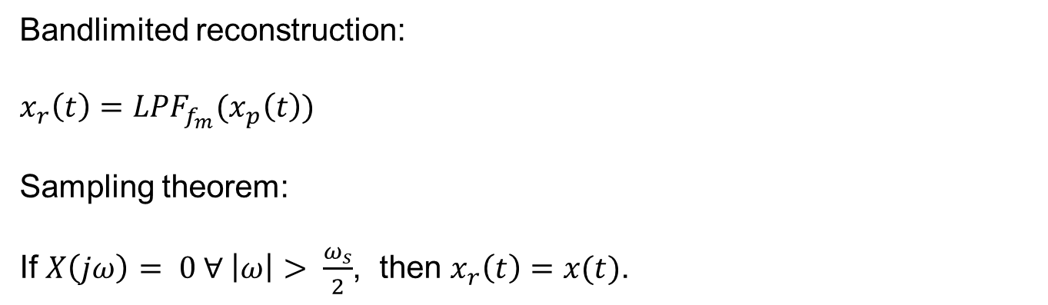
Sampling – conversion of a continuous-time signal to discrete time
Summary
Bandlimited reconstruction:
$$x_{r}\left(t\right)={LPF}_{f_{m}}(x_{p}\left(t\right))$$
Sampling theorem:
If $X\left(jω\right)= 0 ∀ \left|ω\right|> \frac{ω_{s}}{2}$, then $x_{r}\left(t\right)=x(t)$.
Materials processing with intelligent systems (MICRO-457) Shevchik S., Masinelli G. & Hoffmann P.
Notes:
https://mdav.ece.gatech.edu/ece-6250-fall2019/notes/01-notes-6250-f19.pdf
When xc(t) is bandlimited, i.e. when Xc(jΩ) = 0 for all |Ω| ≥ π/T where Xc(jΩ) is the continuous time Fourier transform (CTFT) of xc(t): Xc(jΩ) = Z ∞ −∞ xc(t)e −jΩt dt. In other words, the sampling rate (= 1/T in Hz, or 2π/T in rad/sec) must be larger than twice the maximum frequency present in the signal. This is known as the Nyquist criterion.

Slide 33
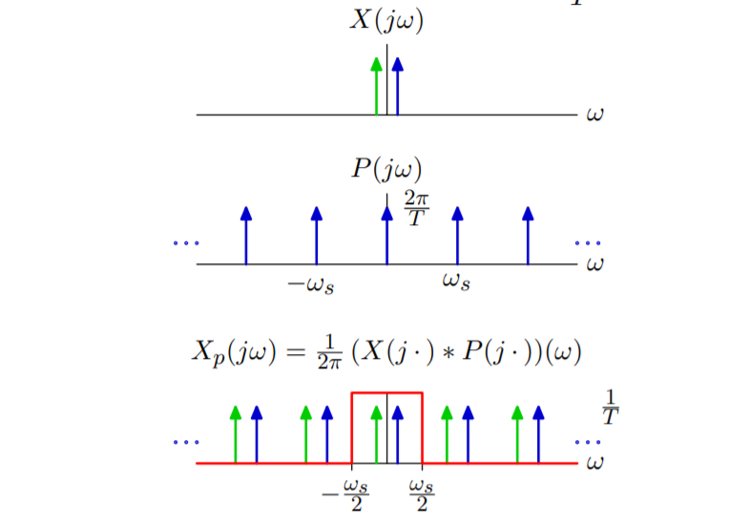
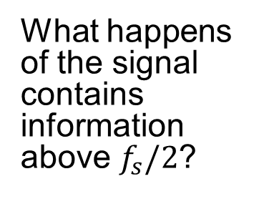
Sampling – conversion of a continuous-time signal to discrete time
What happens of the signal contains information above $f_{s}/2$?
Materials processing with intelligent systems (MICRO-457) Shevchik S., Masinelli G. & Hoffmann P.

Slide 34
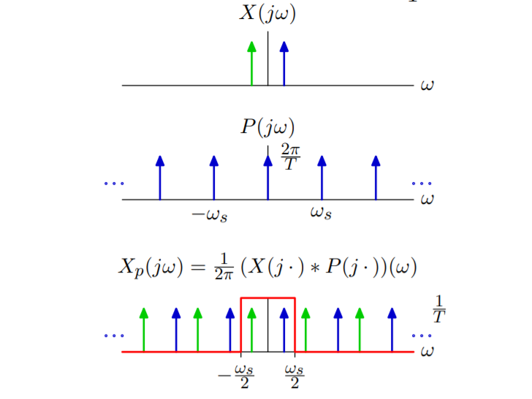
Sampling – conversion of a continuous-time signal to discrete time
Materials processing with intelligent systems (MICRO-457) Shevchik S., Masinelli G. & Hoffmann P.

Slide 35

Sampling – conversion of a continuous-time signal to discrete time
Materials processing with intelligent systems (MICRO-457) Shevchik S., Masinelli G. & Hoffmann P.

Slide 36

Sampling – conversion of a continuous-time signal to discrete time
Materials processing with intelligent systems (MICRO-457) Shevchik S., Masinelli G. & Hoffmann P.

Slide 37
Sampling – conversion of a continuous-time signal to discrete time
Materials processing with intelligent systems (MICRO-457) Shevchik S., Masinelli G. & Hoffmann P.

Slide 38

Sampling – conversion of a continuous-time signal to discrete time
Materials processing with intelligent systems (MICRO-457) Shevchik S., Masinelli G. & Hoffmann P.

Slide 39

Sampling – conversion of a continuous-time signal to discrete time
Materials processing with intelligent systems (MICRO-457) Shevchik S., Masinelli G. & Hoffmann P.

Slide 40

Sampling – conversion of a continuous-time signal to discrete time
Materials processing with intelligent systems (MICRO-457) Shevchik S., Masinelli G. & Hoffmann P.

Slide 41

Sampling – conversion of a continuous-time signal to discrete time
Materials processing with intelligent systems (MICRO-457) Shevchik S., Masinelli G. & Hoffmann P.

Slide 42

Sampling – conversion of a continuous-time signal to discrete time
Materials processing with intelligent systems (MICRO-457) Shevchik S., Masinelli G. & Hoffmann P.

Slide 43

Sampling – conversion of a continuous-time signal to discrete time
Materials processing with intelligent systems (MICRO-457) Shevchik S., Masinelli G. & Hoffmann P.

Slide 44

Sampling – conversion of a continuous-time signal to discrete time
Materials processing with intelligent systems (MICRO-457) Shevchik S., Masinelli G. & Hoffmann P.

Slide 45

Sampling – conversion of a continuous-time signal to discrete time
Materials processing with intelligent systems (MICRO-457) Shevchik S., Masinelli G. & Hoffmann P.

Slide 46

Sampling – conversion of a continuous-time signal to discrete time
Materials processing with intelligent systems (MICRO-457) Shevchik S., Masinelli G. & Hoffmann P.

Slide 47

Sampling – conversion of a continuous-time signal to discrete time
Materials processing with intelligent systems (MICRO-457) Shevchik S., Masinelli G. & Hoffmann P.

Slide 48

Sampling – conversion of a continuous-time signal to discrete time
Materials processing with intelligent systems (MICRO-457) Shevchik S., Masinelli G. & Hoffmann P.

Slide 49

Sampling – conversion of a continuous-time signal to discrete time
Materials processing with intelligent systems (MICRO-457) Shevchik S., Masinelli G. & Hoffmann P.

Slide 50

Sampling – conversion of a continuous-time signal to discrete time
Materials processing with intelligent systems (MICRO-457) Shevchik S., Masinelli G. & Hoffmann P.

Slide 51

Sampling – conversion of a continuous-time signal to discrete time
Materials processing with intelligent systems (MICRO-457) Shevchik S., Masinelli G. & Hoffmann P.

Slide 52

Sampling – conversion of a continuous-time signal to discrete time
Materials processing with intelligent systems (MICRO-457) Shevchik S., Masinelli G. & Hoffmann P.

Slide 53

Sampling – conversion of a continuous-time signal to discrete time
Materials processing with intelligent systems (MICRO-457) Shevchik S., Masinelli G. & Hoffmann P.

Slide 54
Sampling – conversion of a continuous-time signal to discrete time
Aliasing demo
Materials processing with intelligent systems (MICRO-457) Shevchik S., Masinelli G. & Hoffmann P.

Slide 55

Sampling – conversion of a continuous-time signal to discrete time
Materials processing with intelligent systems (MICRO-457) Shevchik S., Masinelli G. & Hoffmann P.

Slide 56

Sampling – conversion of a continuous-time signal to discrete time
Materials processing with intelligent systems (MICRO-457) Shevchik S., Masinelli G. & Hoffmann P.

Slide 57

Sampling – conversion of a continuous-time signal to discrete time
Materials processing with intelligent systems (MICRO-457) Shevchik S., Masinelli G. & Hoffmann P.

Slide 58

Sampling – conversion of a continuous-time signal to discrete time
Materials processing with intelligent systems (MICRO-457) Shevchik S., Masinelli G. & Hoffmann P.

Slide 59

Sampling – conversion of a continuous-time signal to discrete time
Materials processing with intelligent systems (MICRO-457) Shevchik S., Masinelli G. & Hoffmann P.

Slide 60
Sampling – conversion of a continuous-time signal to discrete time
Anti-aliasing demo
Materials processing with intelligent systems (MICRO-457) Shevchik S., Masinelli G. & Hoffmann P.

Slide 61
Sampling – conversion of a continuous-time signal to discrete time
The effects of sampling are easy to see once we are in the frequency domain.
Signals that are band limited can be sampled without loss of information.
The minimum sampling rate for sampling without loss of information is called Nyquist rate.
The Nyquist rate is twice as high as the highest frequency contained in a limited band signal.
Sampling at frequencies below the Nyquist rate causes aliasing.
Aliasing can be eliminated with a pre-filter to remove frequency components that would otherwise be aliased.
Materials processing with intelligent systems (MICRO-457) Shevchik S., Masinelli G. & Hoffmann P.

Slide 62
Thank you for your attention
Materials processing with intelligent systems (MICRO-457) Shevchik S., Masinelli G. & Hoffmann P.

Slide 63
Sampling – conversion of a continuous-time signal to discrete time
The sampled signal $x_{p}(t)$can be obtained by multiplying $x(t)$ by an impulse train. Or, equivalently, by convolving the samples of the signal $x$ with $δ$.
Materials processing with intelligent systems (MICRO-457) Shevchik S., Masinelli G. & Hoffmann P.

Slide 64


Set the scene
He, F.; Liao, Y.; Lin, J.; Song, J.; Qiao, L.; Cheng, Y.; Sugioka, K. Femtosecond Laser Fabrication of Monolithically Integrated Microfluidic Sensors in Glass. Sensors 2014, 14, 19402-19440.
Themal processes
Heat diffusion
Thermalization
crystalline lattice – electrons
Light absorption
by electrons
Materials processing with intelligent systems (MICRO-457) Shevchik S., Masinelli G. & Hoffmann P.

Slide 65

Set the scene
He, F.; Liao, Y.; Lin, J.; Song, J.; Qiao, L.; Cheng, Y.; Sugioka, K. Femtosecond Laser Fabrication of Monolithically Integrated Microfluidic Sensors in Glass. Sensors 2014, 14, 19402-19440.
Themal processes
Heat diffusion
Thermalization
crystalline lattice – electrons
Light absorption
by electrons
Materials processing with intelligent systems (MICRO-457) Shevchik S., Masinelli G. & Hoffmann P.

