Slide 1
Computational Optical Imaging
Lecture 7
Superresolution

Slide 2
Outline
Diffraction limited resolution delta x and delta z
Localization versus resolution
Solid and oil immersion (BPM simulation of subwavelength features in high index material)
SIM (including confocal?)
STED
Neural network based superresolution
Exercise 1 Low resoluton images to sharp (Ilker)
NSOM
Ulas on converting evanescent to propagating
Exercise 2 Exercise on parallel NSOM (Ulas)

Slide 3
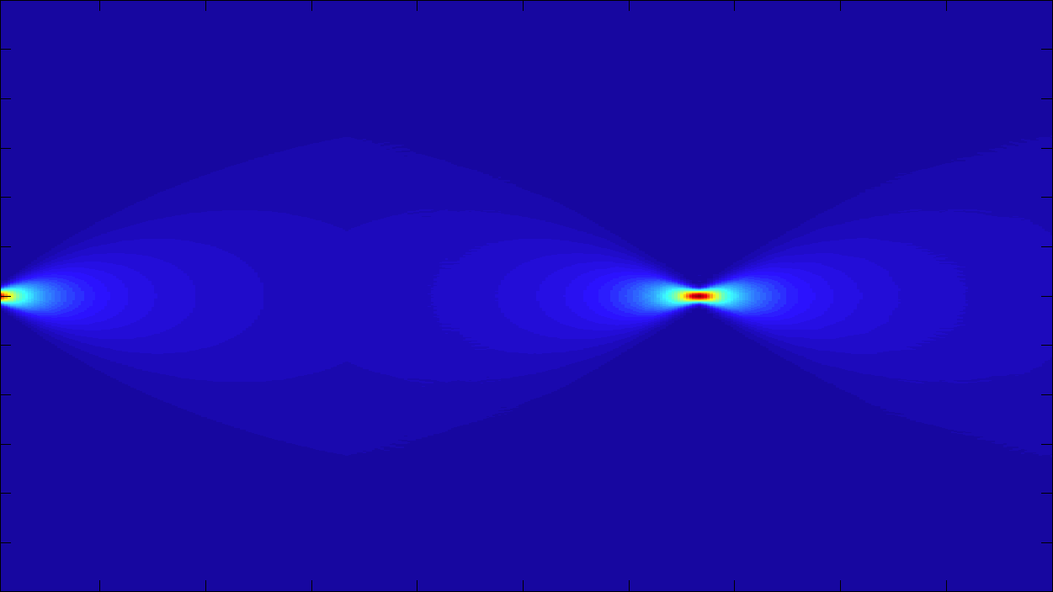
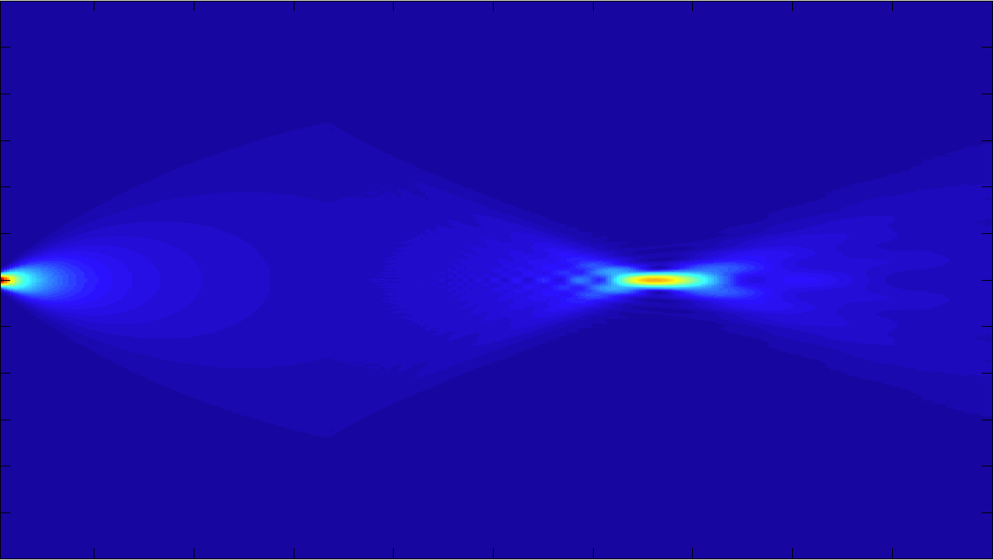
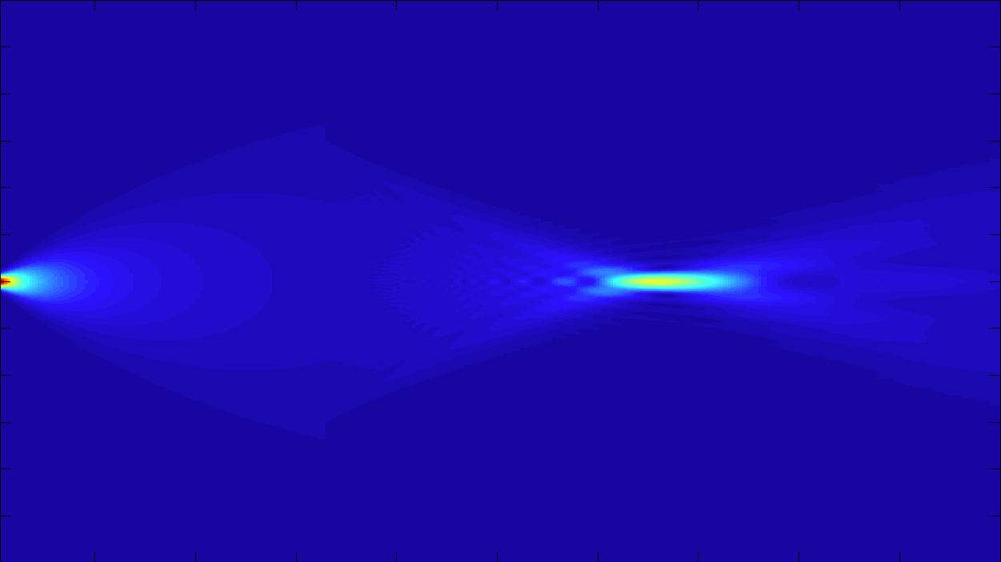
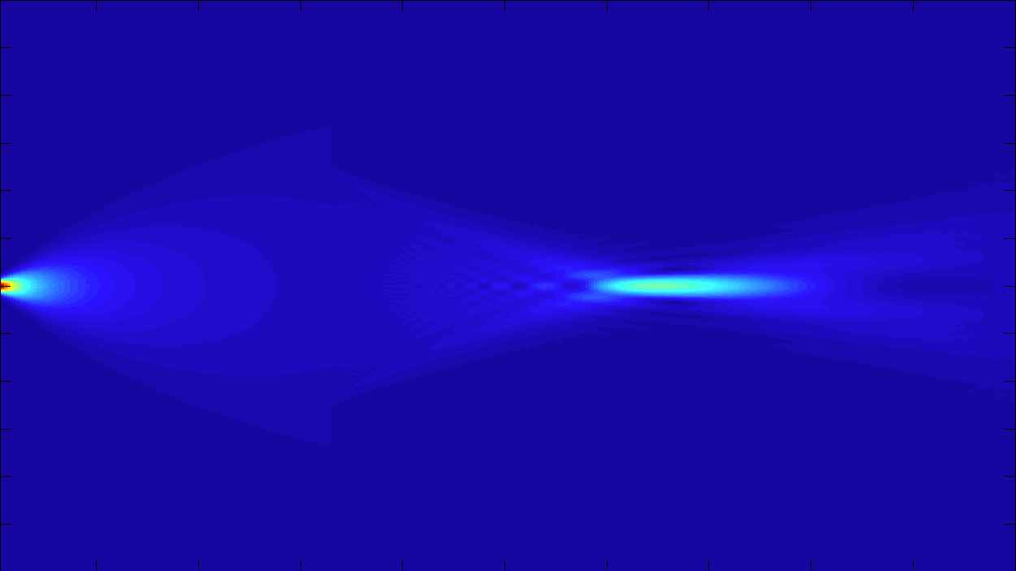
Reminder: Resolution in x and z
Δx=λ₀/2NA Δz= λ₀/NA²

Slide 4
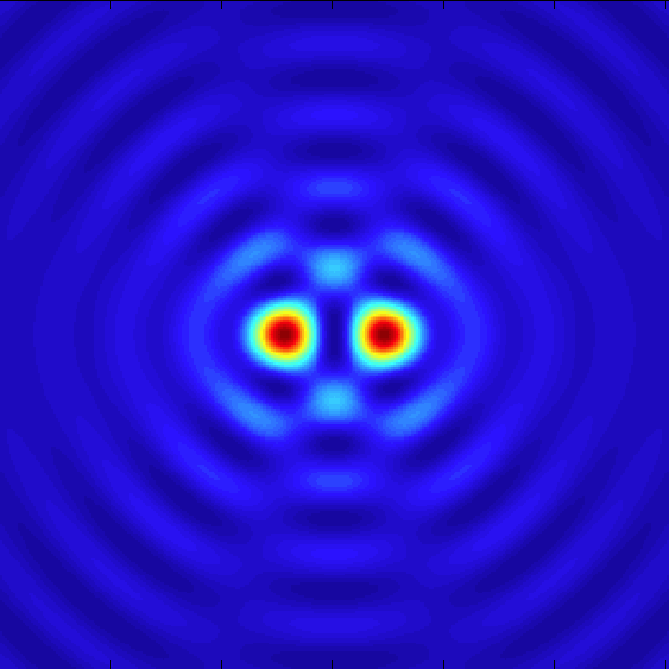
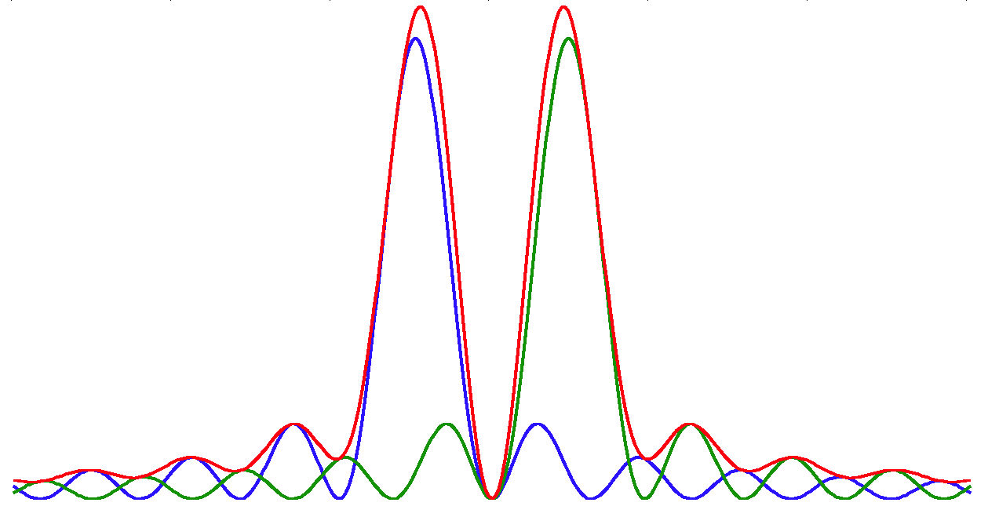
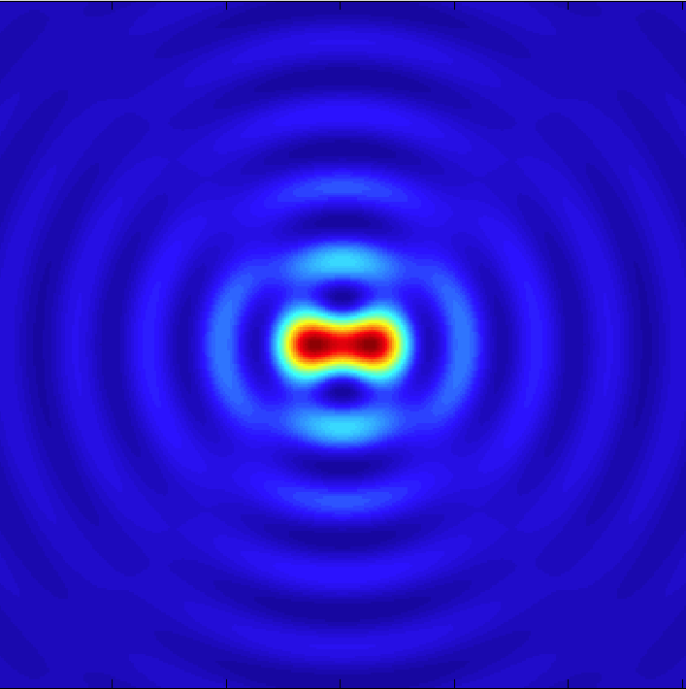
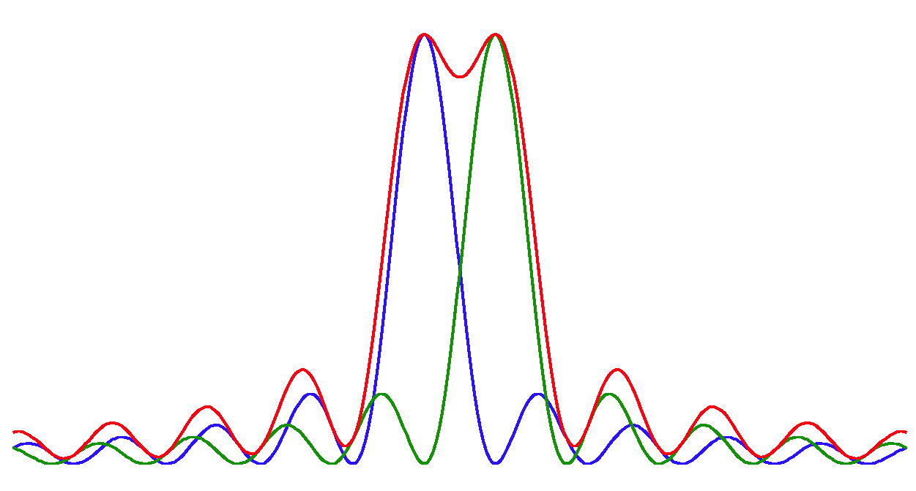
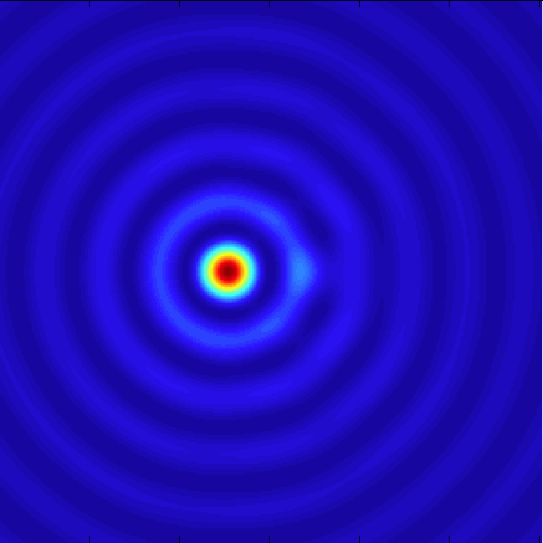
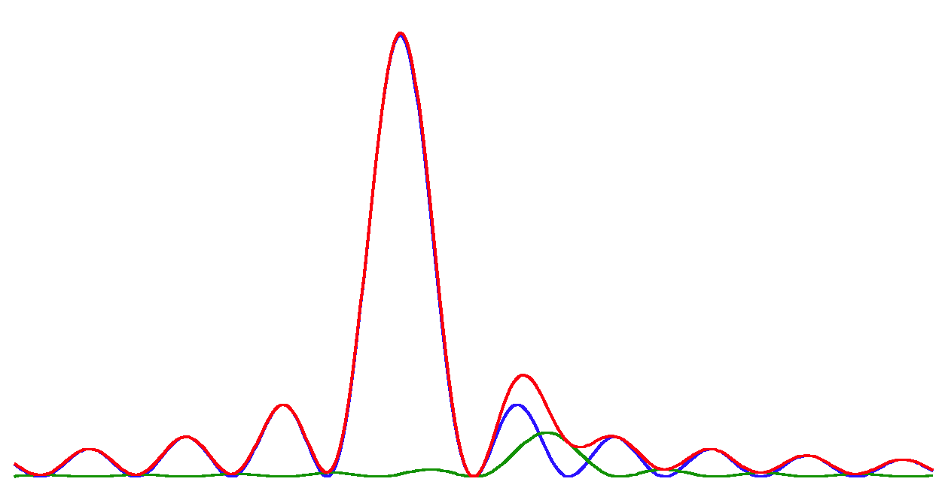
Resolution

Slide 5
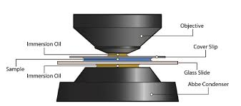
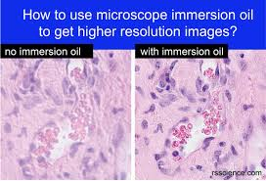
Oil immersion microscope
θx
Δx=λ/2NA NA=n sinθ
k_{x} = 2π cosθx/λ= 2πn cosθx/λ₀= 2π u
cosθ_{χ} =λ₀ u/n
t(x)=1/2(1+cos(2πux))

Slide 6

SIM
Structured Illumination Microscopy
F
F
F
F
Laser
illumination
f(x)
Max Spatial Frequency (Bandwidth) = B/2λF
$$\frac{λF}{B}$$
Resolution Δx =

Slide 7


SIM
Structured Illumination Microscopy
F
F
F
F
Laser
illumination
f(x)
Max Spatial Frequency (Bandwidth) = B/λF
Resolution =
$$\frac{λF}{2B}$$
$$\frac{λF}{2B}$$
Resolution =

Slide 8
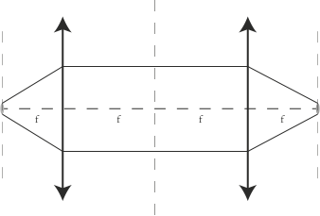
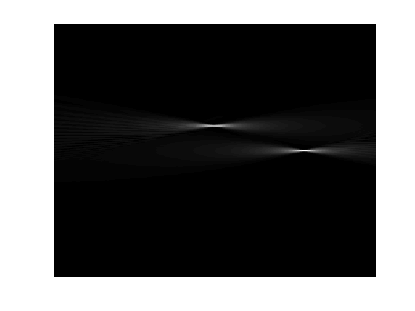
Point Spread Function
Out of focus light can deteriorate the performance of the imaging system
We only need to probe at a very small region to capture the light by a point source at the focal plane
z

Slide 9
Confocal
F1
F2
x
z
y
Scanning
the sample in XYZ

Slide 10
Confocal
F1
F2
x
z
y

Slide 11
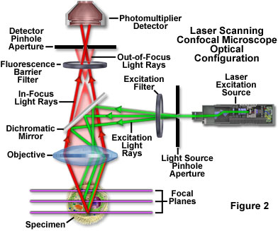
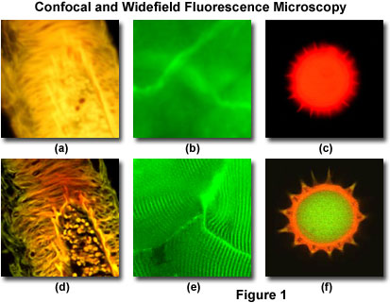
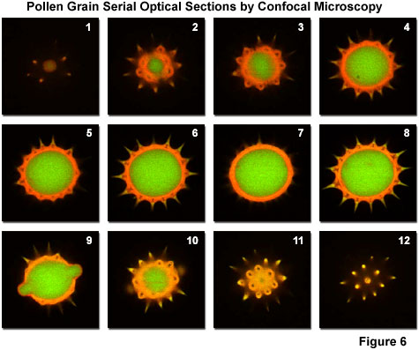
Confocal Microscope
Out of plane image rays get blocked by the pinhole
Widefield
Confocal
fluorescently stained human medulla
whole rabbit muscle fibers stained with fluorescein
Autofluorescence in a sunflower pollen grain
3-d scanning
http://www.olympusfluoview.com/theory/confocalintro.html

Slide 12
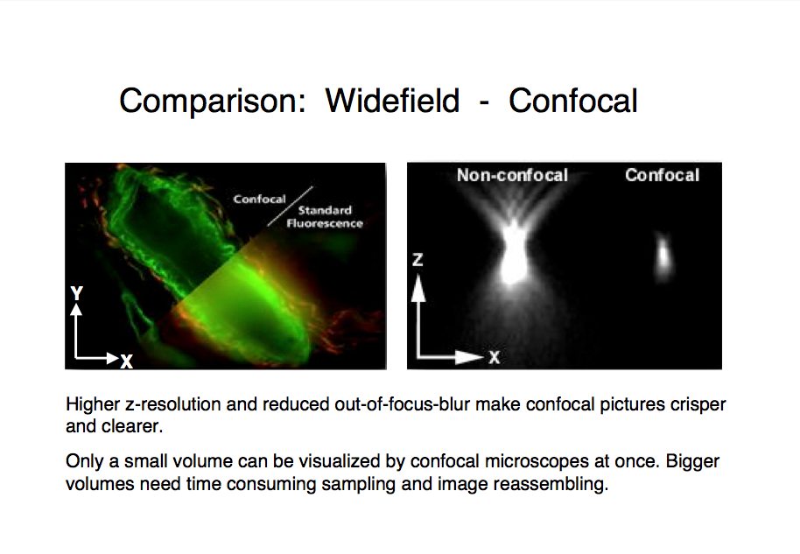
Confocal Microscope

Slide 13
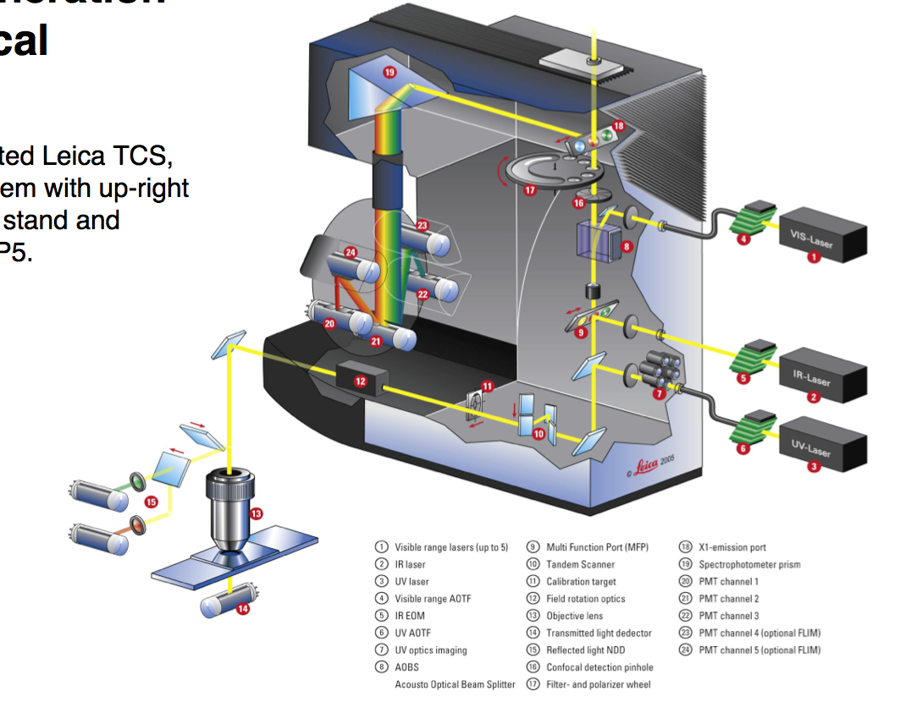
Confocal Microscope

Slide 14
STED superresolution microscopy

Slide 15
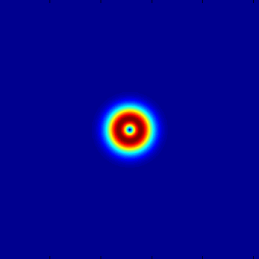
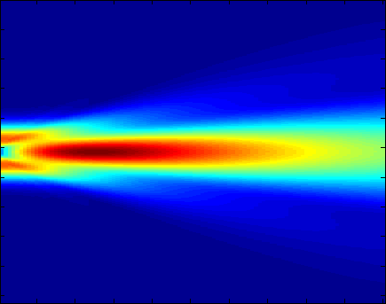
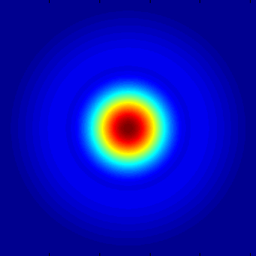

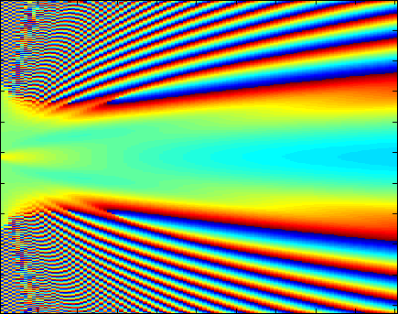
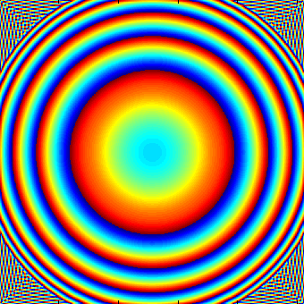
Donut beam with plane phase
λ = 800nm
Input
Propagation profile
Output
Amplitude
Phase

Slide 16
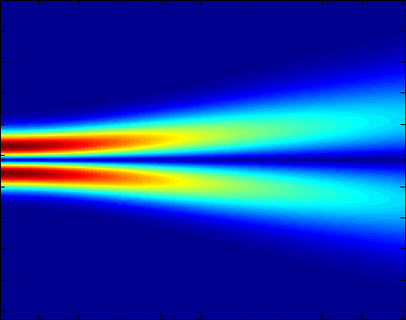
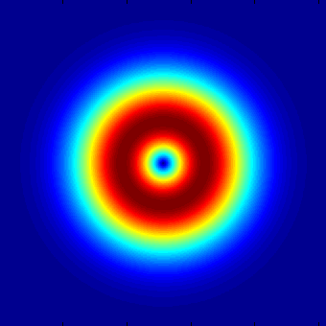
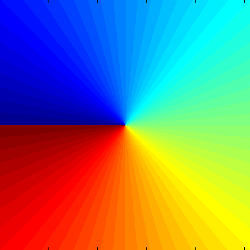
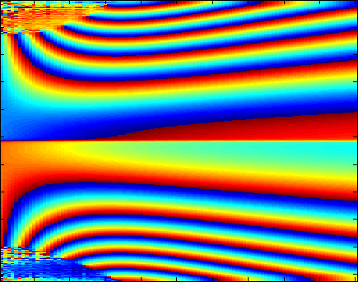
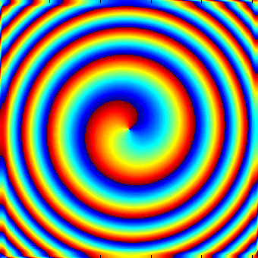
Vortex
λ = 800nm
Input
Propagation profile
Output
Amplitude
100μm
20mm
Phase

Slide 17
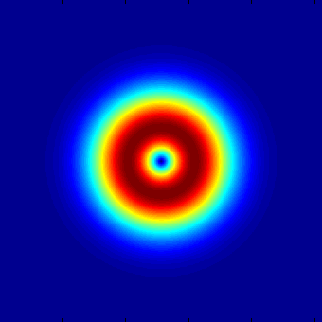
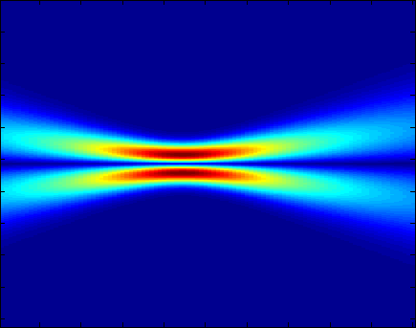
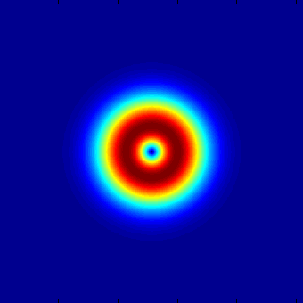
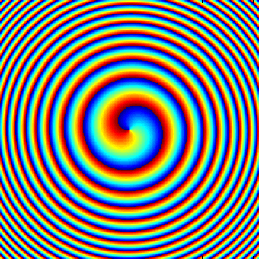
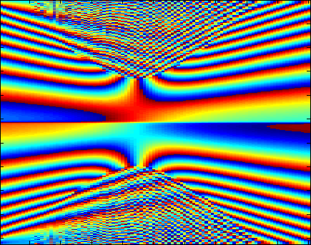
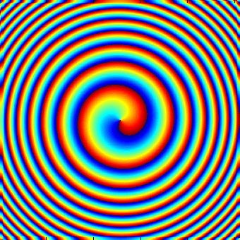
Converging vortex, cannot fill the center
λ = 800nm
Input
Propagation profile
Output
Amplitude
100μm
20mm
Phase
D. Psaltis, Optical Waves Propagation – EPFL, Fall semester 2013

Slide 18
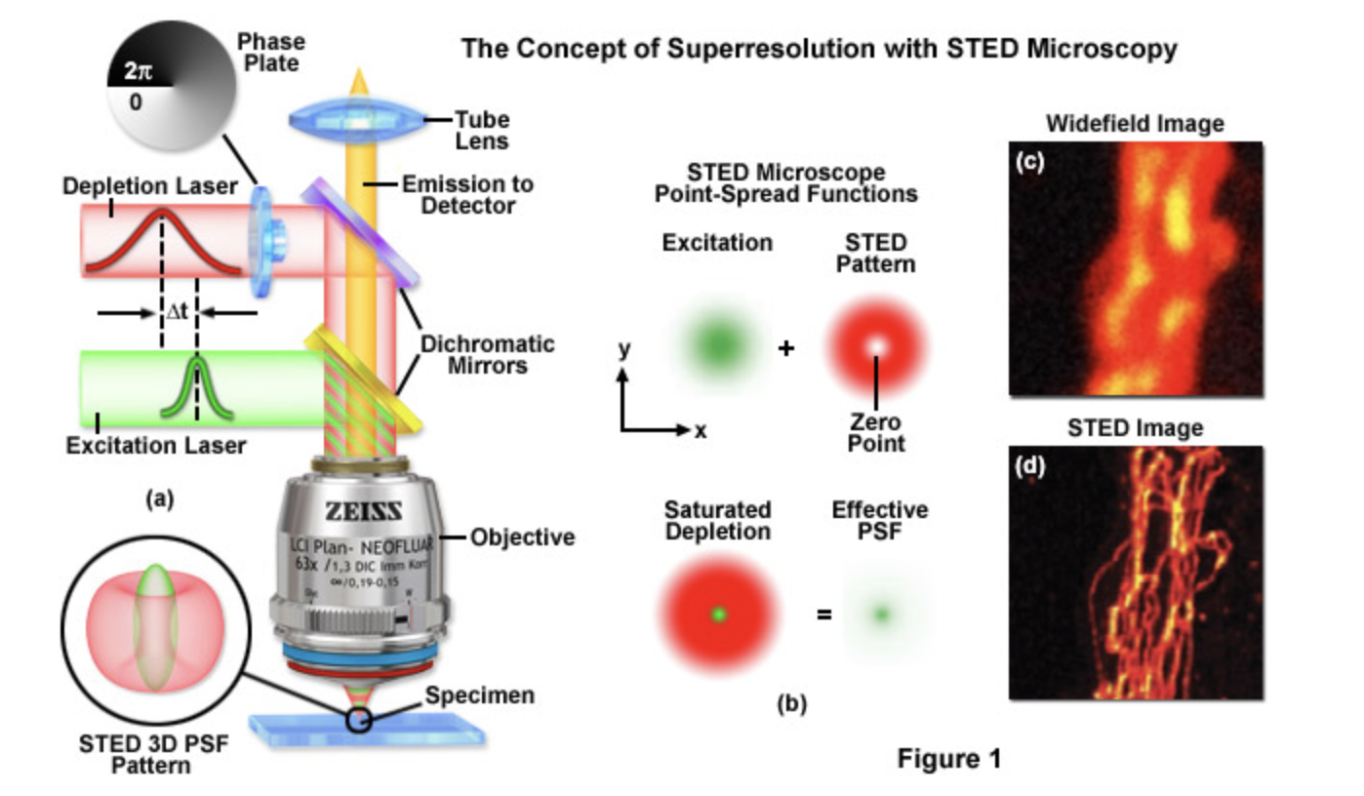

Slide 19
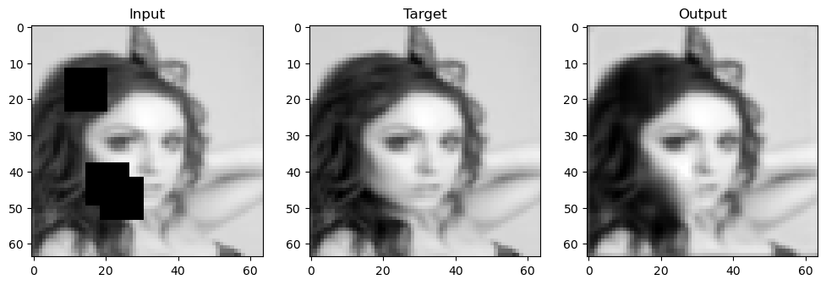
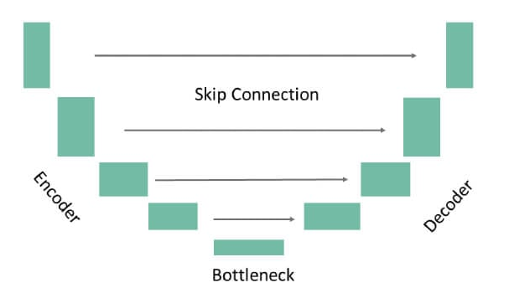
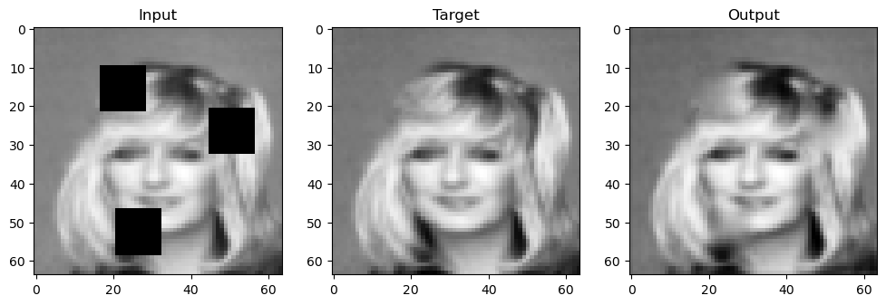
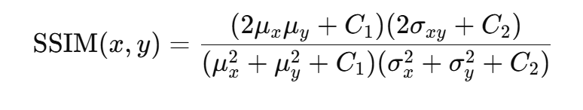
In-painting Face Images
Input
Ground Truth
Output
U-Net
-3x3 Convolutions with ReLU
-3 down and 3 upsampling layers
-900K parameters
Dataset
-2400 training and 600 test images, 64x64 px
-Inputs have 3 randomly placed 12x12 cropped areas
SSIM: 0.80
SSIM: 0.94

Slide 20
Classifying In-Painted Face Images
Cropped
Intact
Filled-in
Input
Training
2400 intact train images
Tests
600 intact, cropped and filled-in test images
Conv
64x64x32
Conv
64x64x64
FC
128
Test Acc.
75.17%
87.17%
84.83%
FC
Classification
8.4M params

Slide 21
Exercise 1
U-Net to recover resolution from data; Ilker

Slide 22
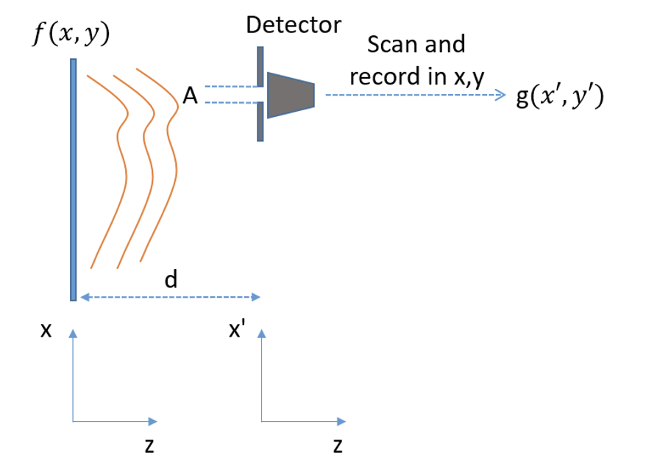
NSOM
Near-field Scanning Optical Microscope
A=3 µm
λ= 500nm

Slide 23
NSOM
Near-field Scanning Optical Microscope

Slide 24
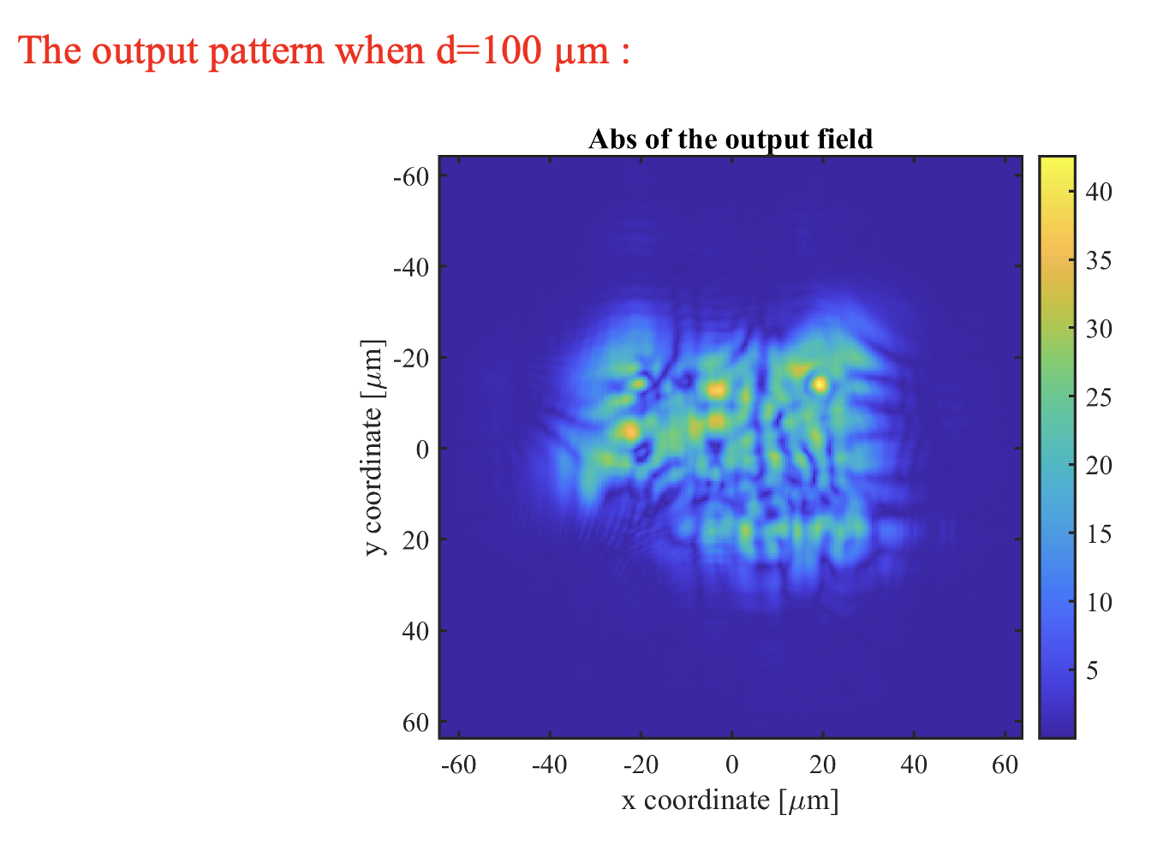
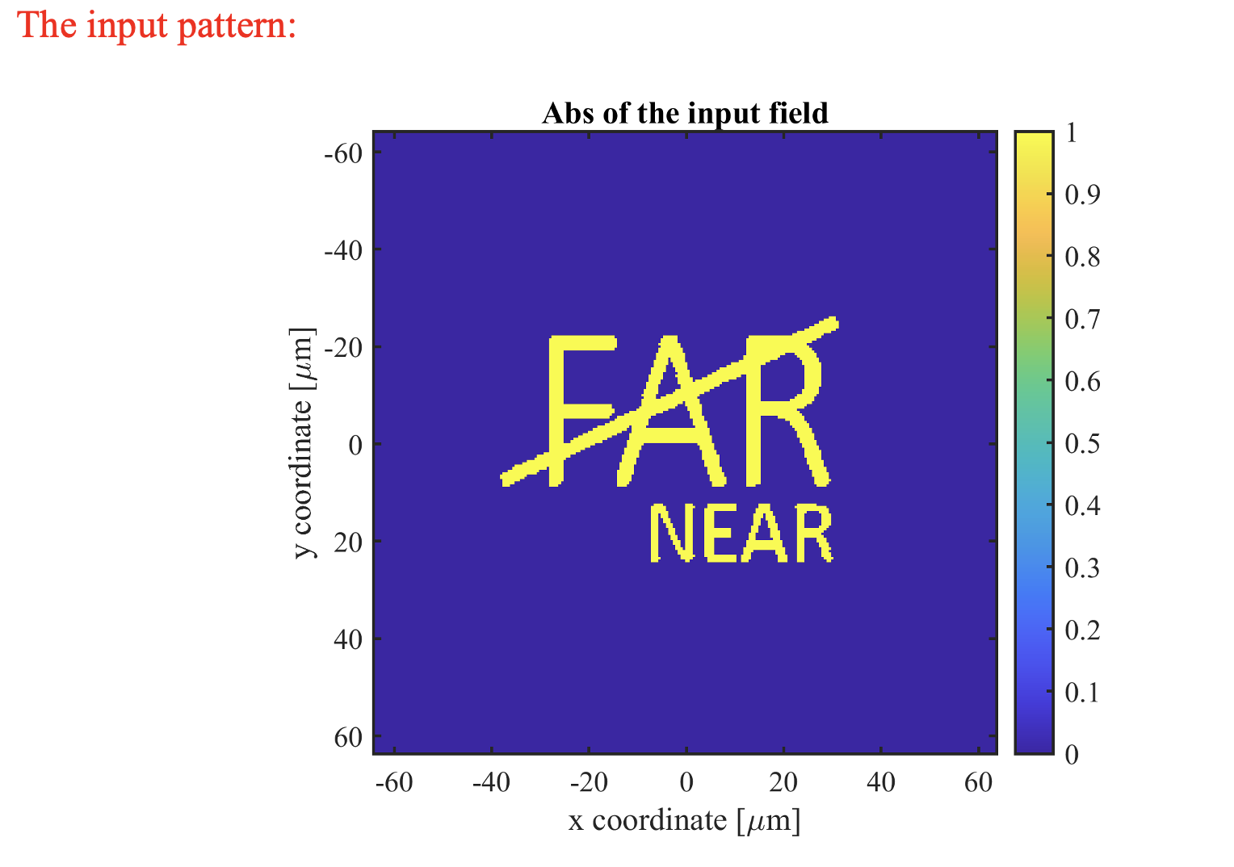
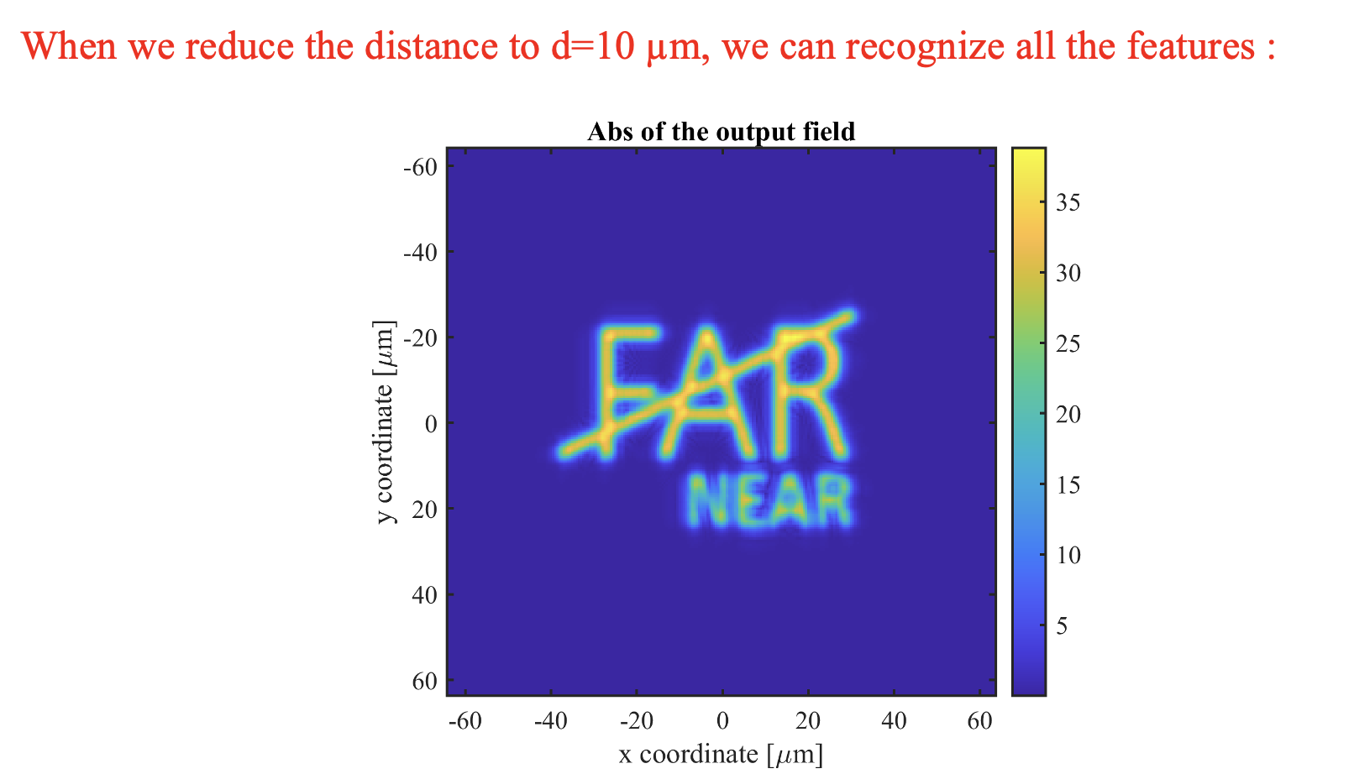
NSOM

Slide 25
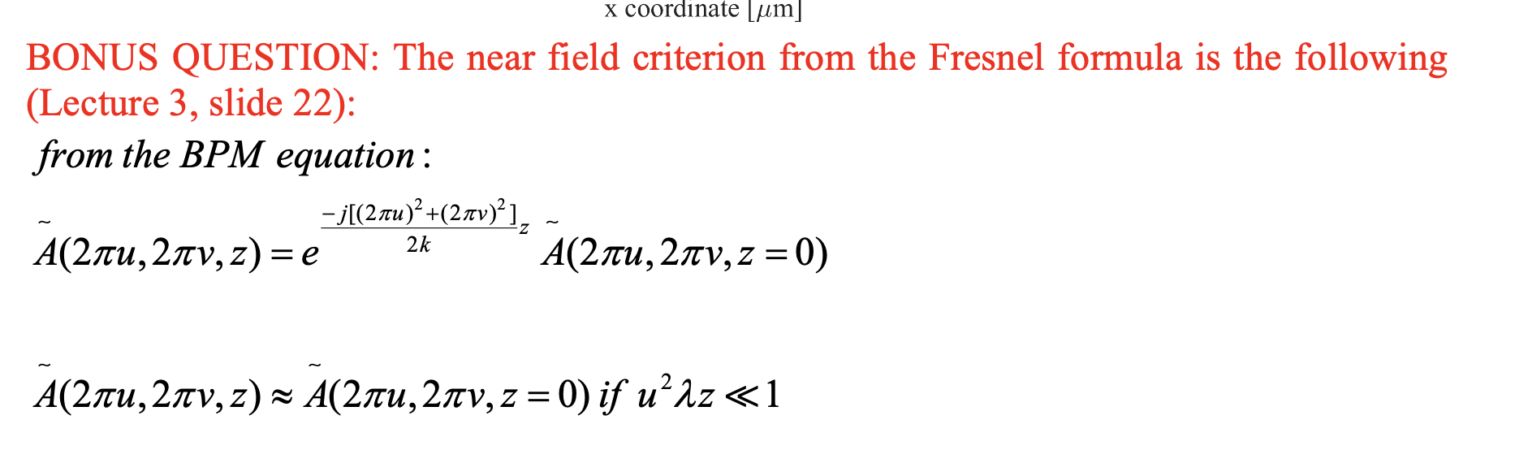

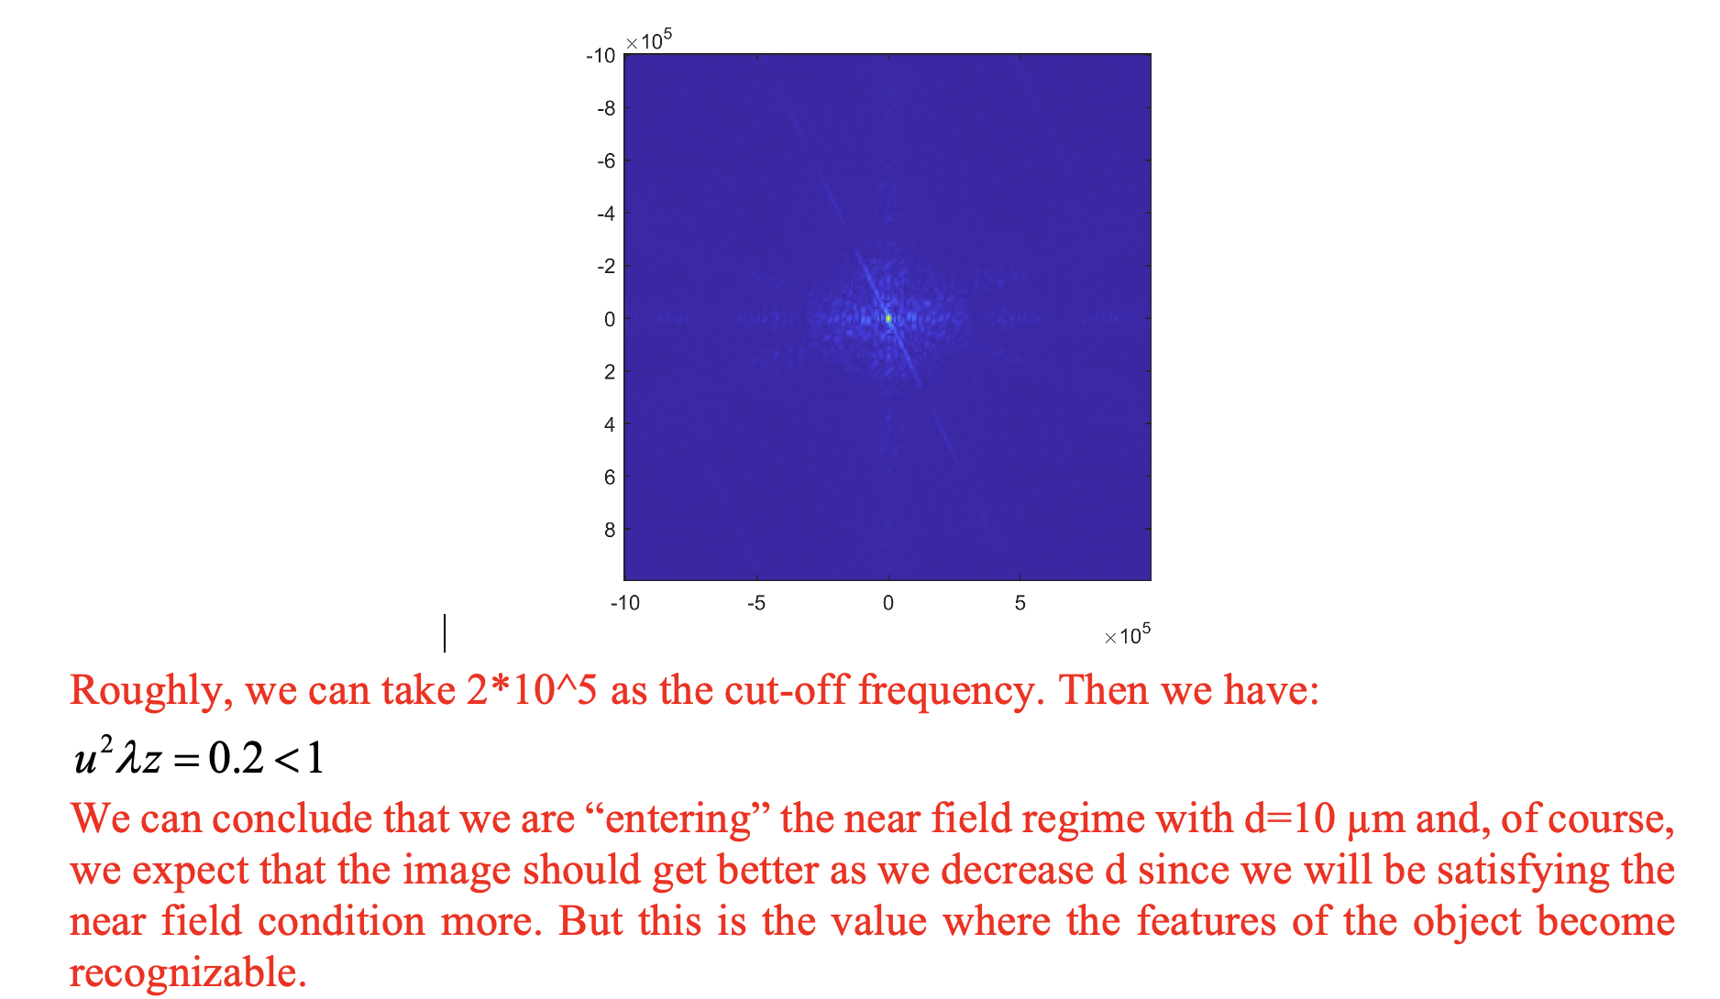
NSOM

Slide 26
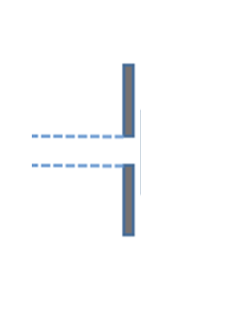
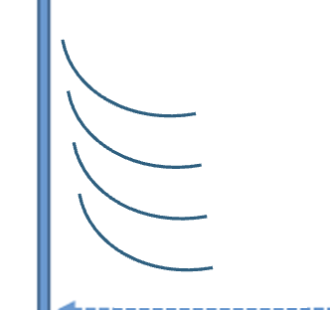
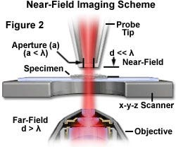
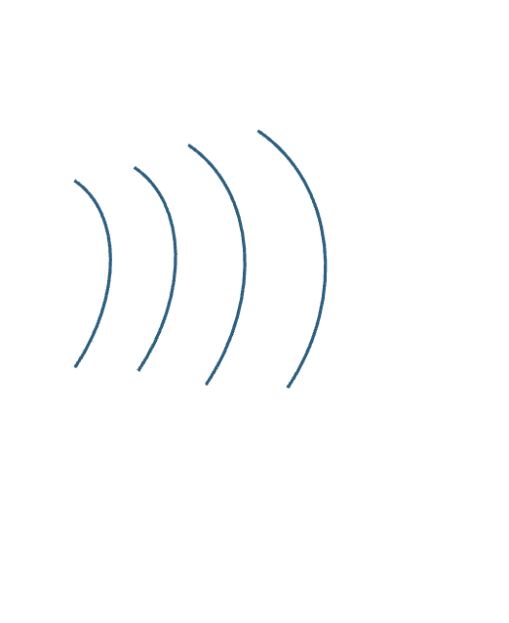

NSOM
How about evanescent waves?
Subwavelength
aperture
Detector
Subwavelength
features
Propagating
waves
Evanescent
waves

Slide 27
Conversion of evanescent waves to propagating modes
Ulas slides

Slide 28

Diffraction-limited imaging

Slide 29

Evanescent waves

Slide 30



Evanescent waves
$$Diffraction kernel=exp\left(−j∆z\frac{k_{x}^{2}+k_{y}^{2}}{k+\sqrt{k^{2}−\left(k_{x}^{2}+k_{y}^{2}\right)}}\right)$$
DFR = np.exp(-1j * K2 * 0.5 * dz * scale_ratio / (k + np.emath.sqrt(k**2 - K2)))

Slide 31

How to image them?

Slide 32

A hybrid method proposal

Slide 33

Proof of concept

Slide 34
Exercise 2
multiple scattering; Ulas

