Slide 1
Computational Optical Imaging
Lecture 6
Neural networks in optical imaging

Slide 2
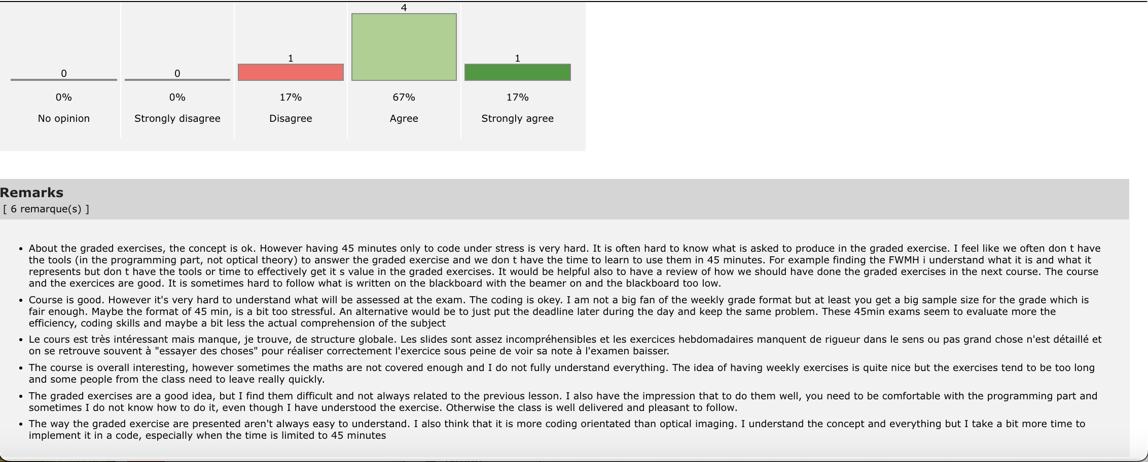
Grades and Student Feedback

Slide 3
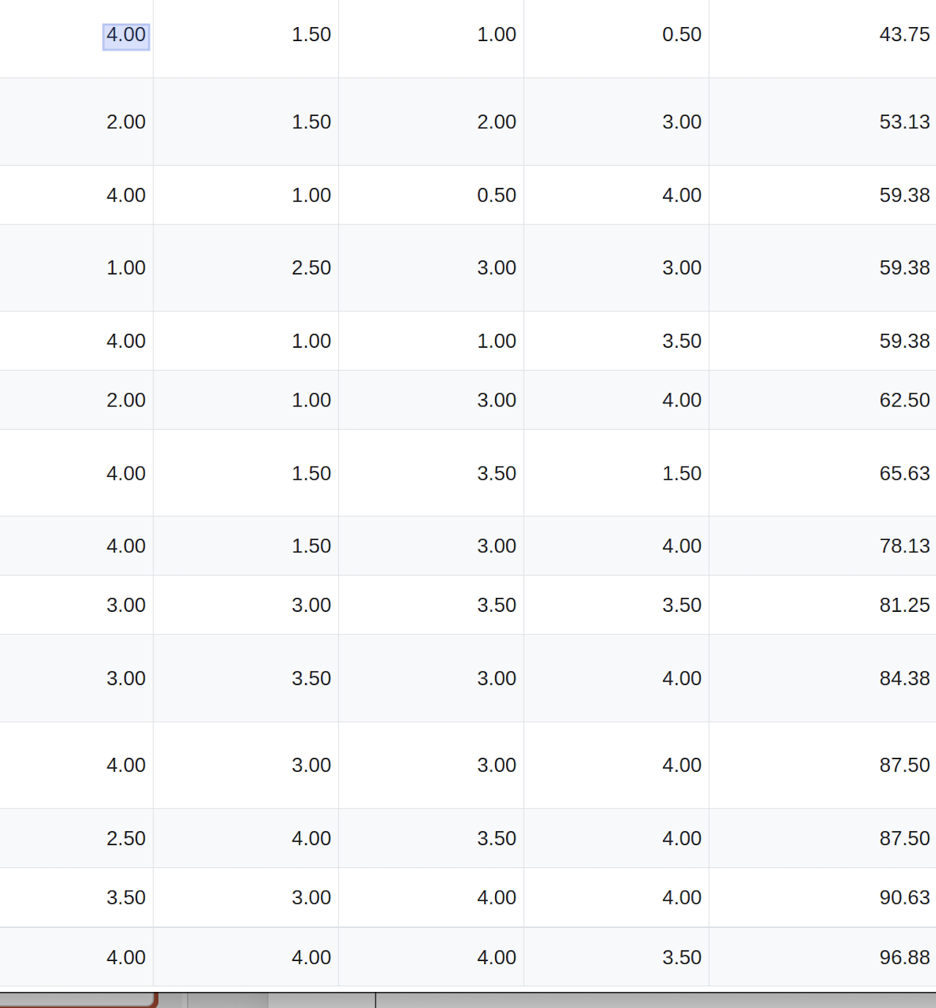
Grades so far

Slide 4
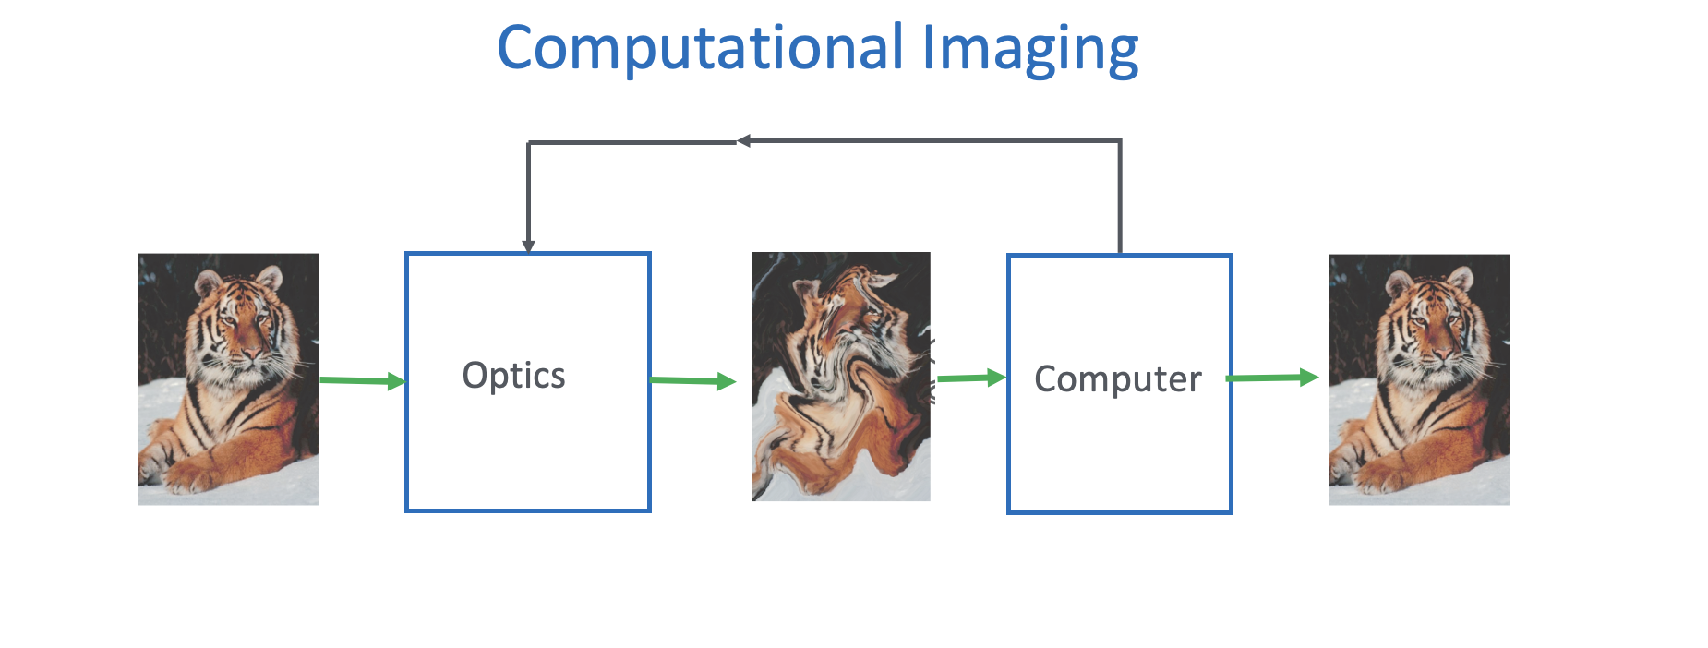

Slide 5
Outline
MMF imaging example
Single neuron and multi-layer neurons (Brain inspiration?)
Adaline
Exercise 1: Adaline
2 layer fully connected
Convolutional networks:
  Feature extraction front end followed by classification or reconstruction
Denoising as an example
Exercise 2: U-net autoencoder on out of focus digits

Slide 6

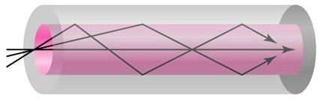
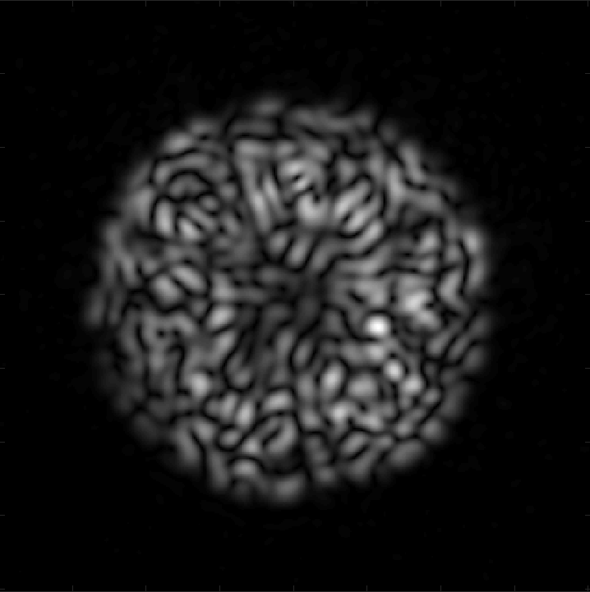
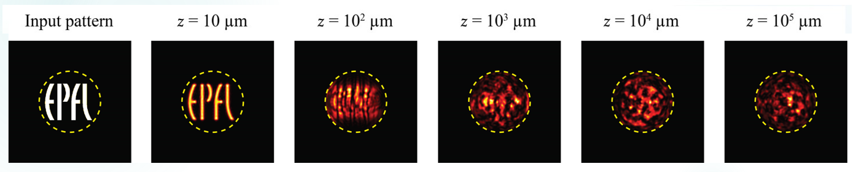
Imaging through multimode fibers
Effects of modal dispersion
Proximal
input
Core
Distal intensity
speckle pattern
Multimode fiber
z
Low-order mode – shorter path
Cladding
High-order mode – longer path
Notes:
The object at every distance z can be represented as a linear combination of the modes supported by the MMF. In the ideal case this alfa does not change in z, but what generated this speckle then?
Modal dispersion
Decorrelation
Injection
Modes different velocities

Slide 7
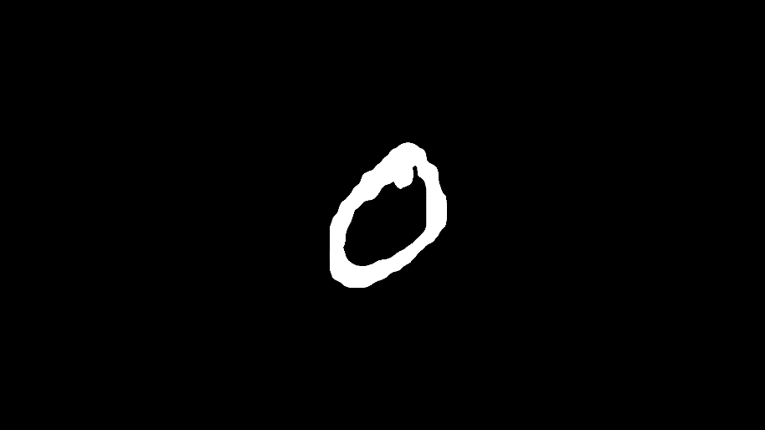
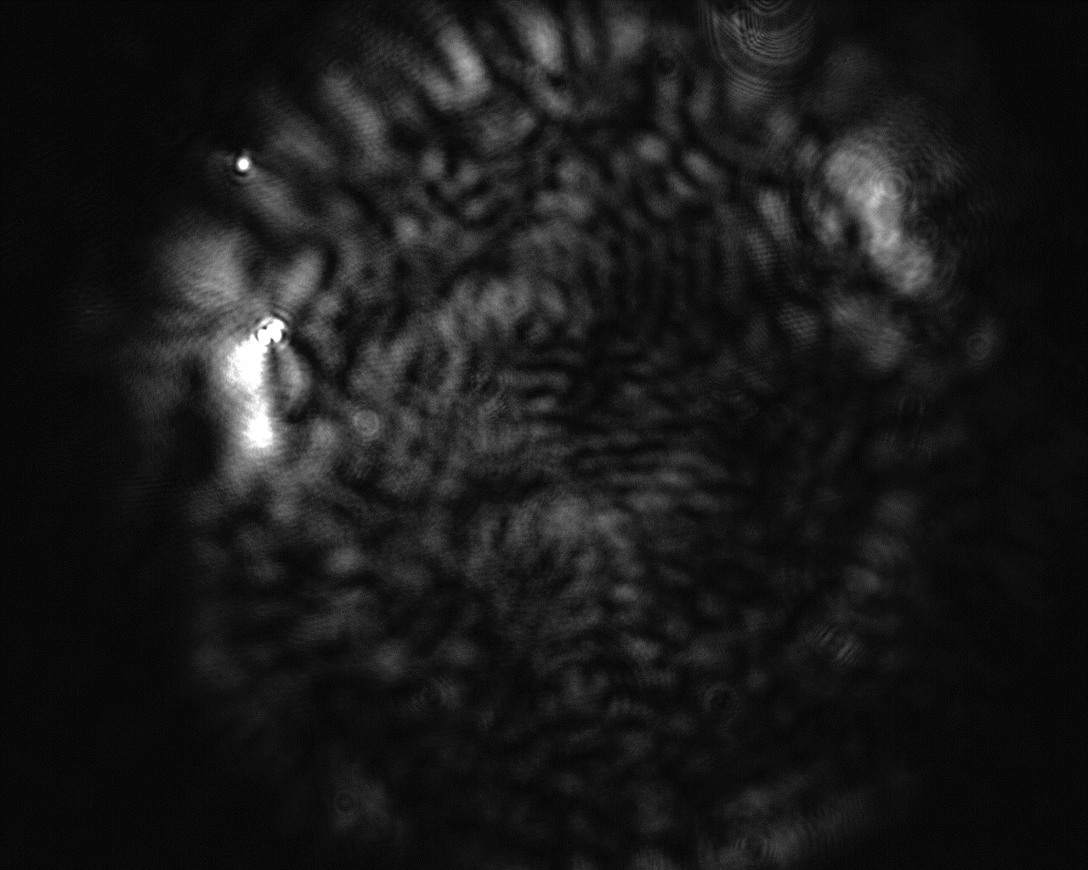
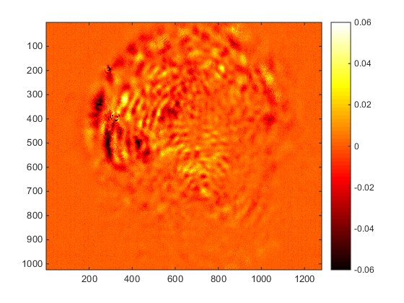
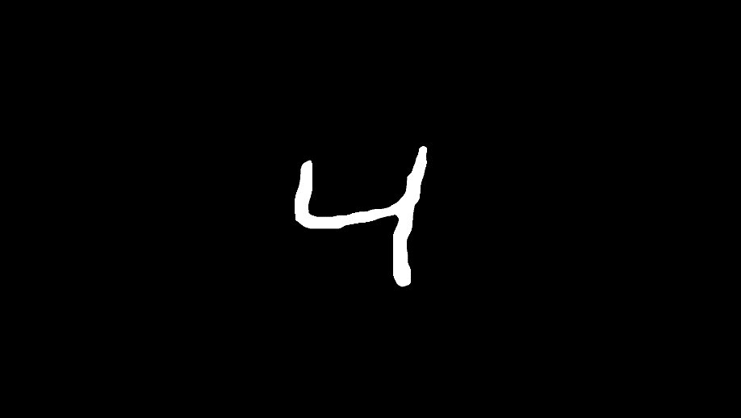
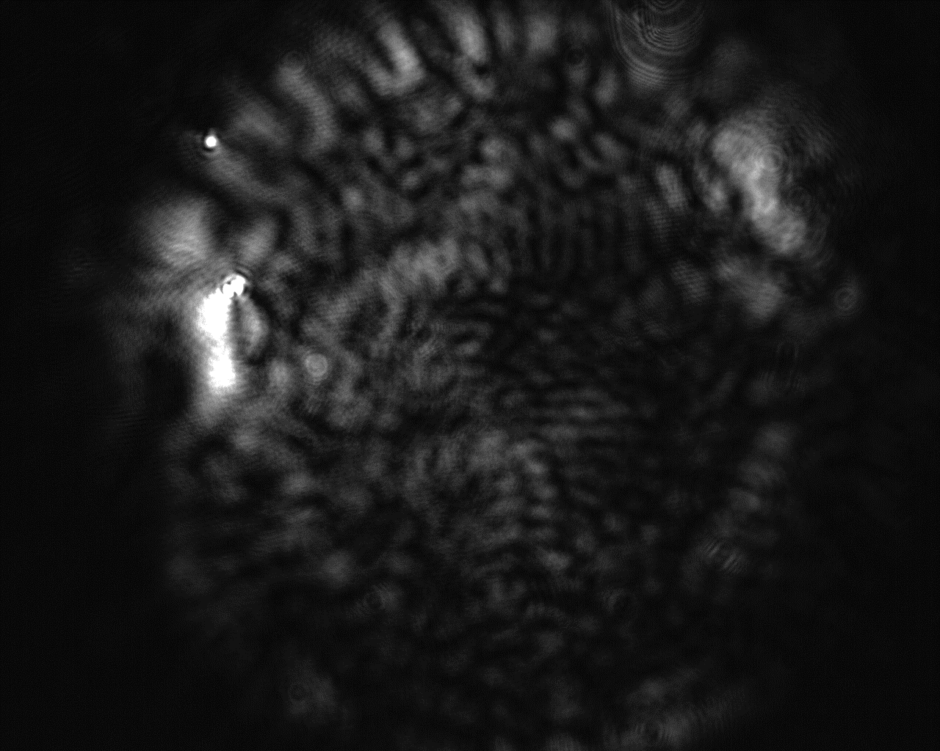
Imaging through multimode fibers
Information content of the distal speckle patterns
Difference between output speckle patterns
Distal intensity
speckle pattern
SLM input
Notes:
Inter class: between classes

Slide 8
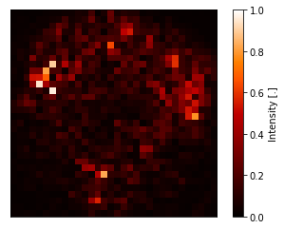
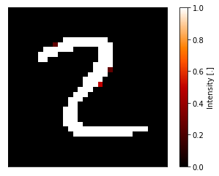
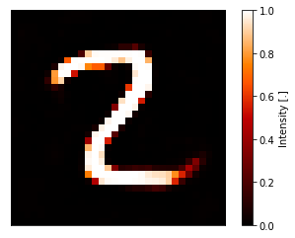
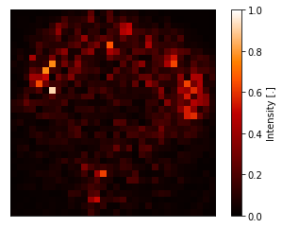
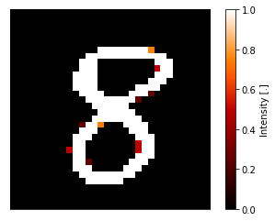
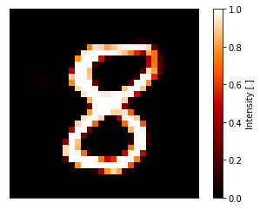
Imaging through multimode fibers
SLM input reconstruction – 10 cm fiber
Distal speckle
intensity
True SLM input
Predicted SLM input
Reconstruction
accuracy 97%

Slide 9
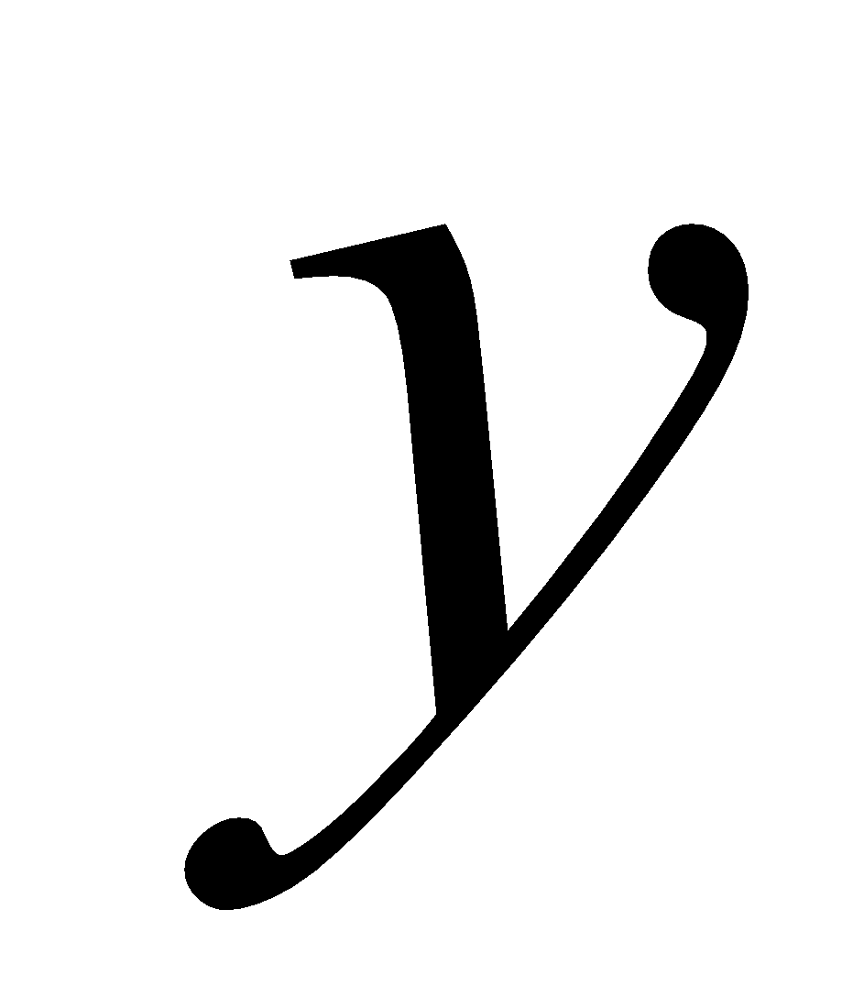
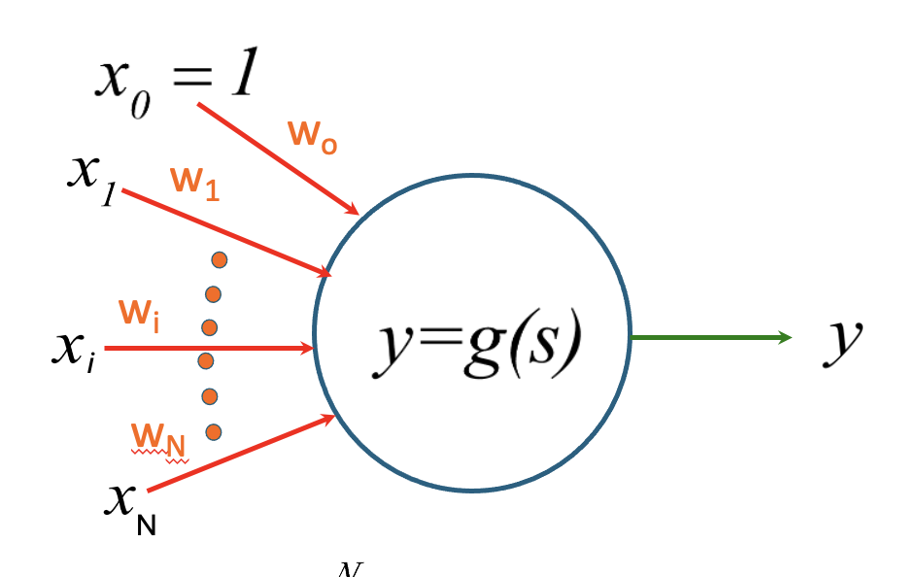
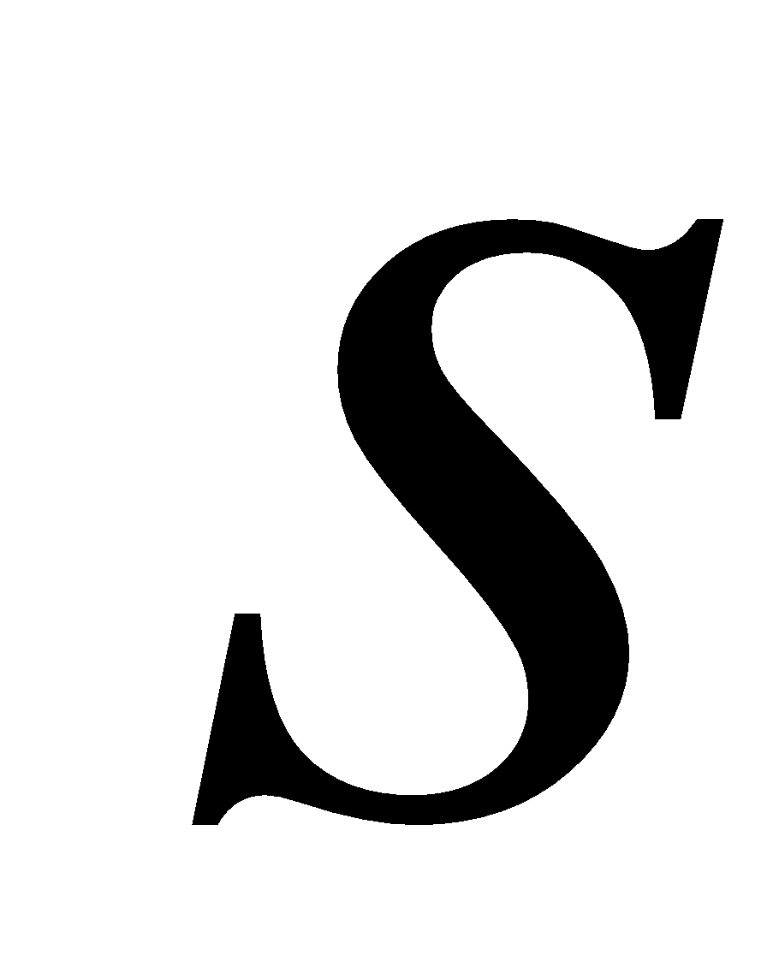
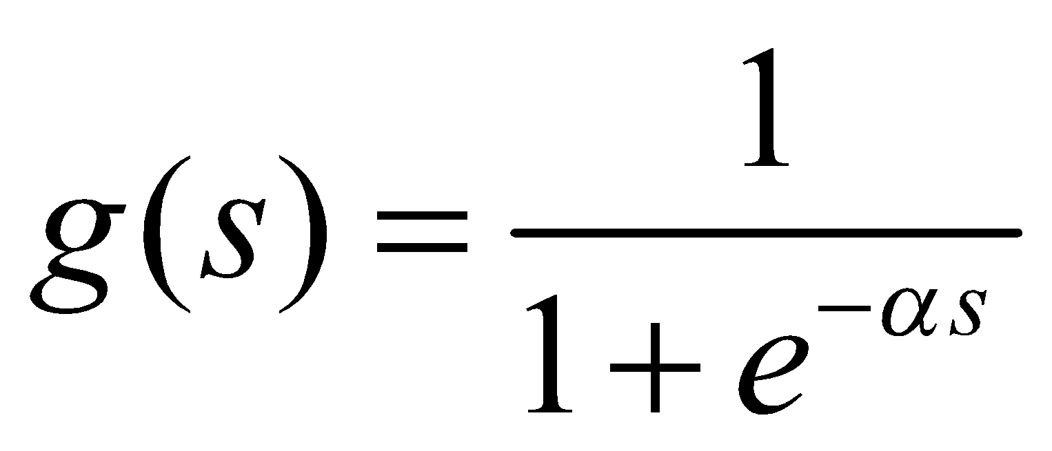
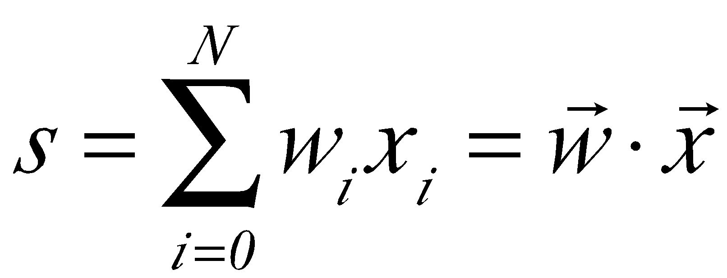




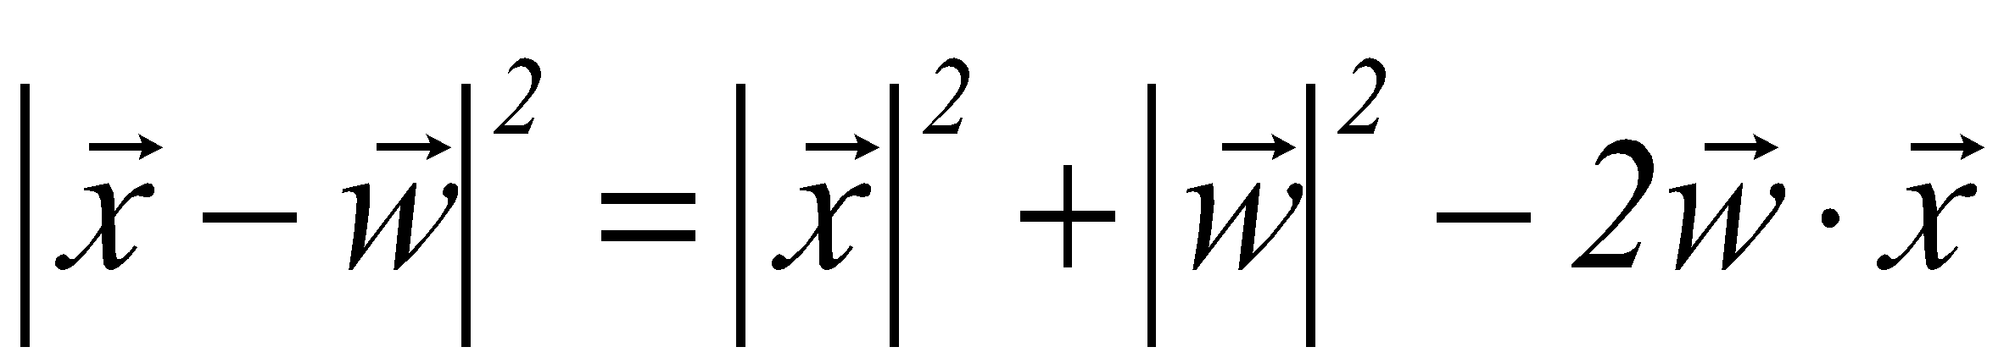
Single Neuron
Hard
threshold
Soft
threshold
ReLu
Rectifying
Linear
Unit

Slide 10
Adaline

Slide 11
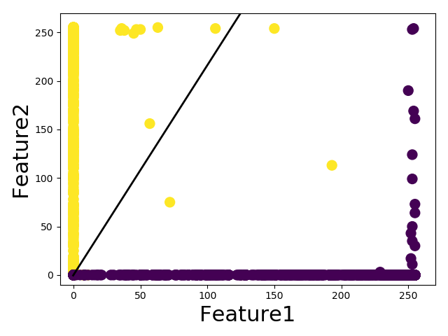
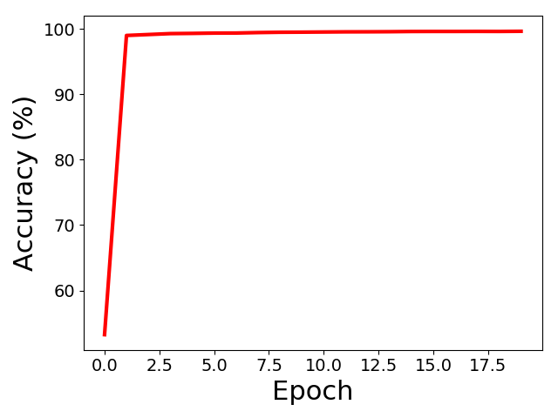
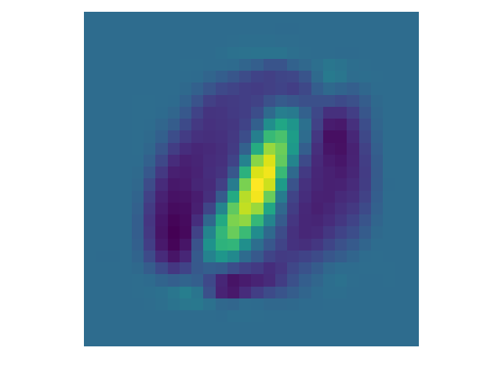
Binary classification of digits-ADALINE
Accuracy of classification
Weights
Training accuracy | 99.66%
Test accuracy | 99.95%
x₂
x₁
12665 Training samples
2115 Test samples
Sigmoid activation function

Slide 12
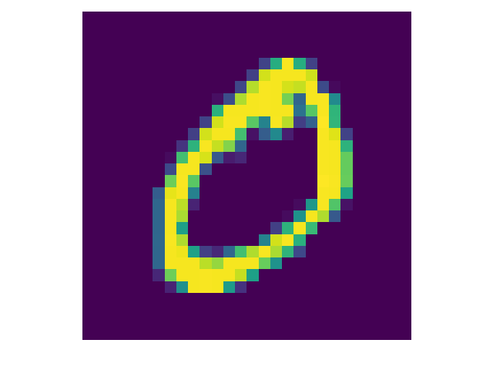
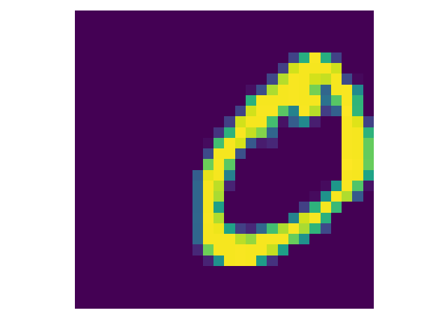
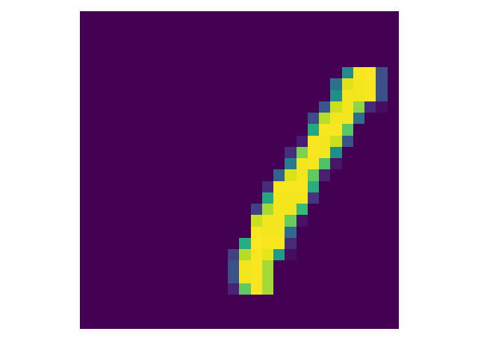
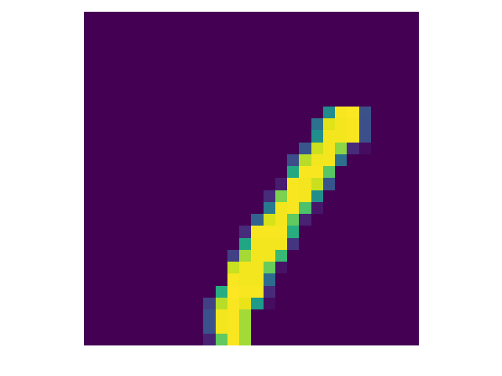
Digits: Shift
Images in test set are moved randomly in different locations
Perceptron - Test | 61.70%
ADALINE - Test | 59.95%
Including shifted images in the training
Perceptron - Test | 85.72%
ADALINE - Test | 88.56%
It needs more iteration when the shifted images are included in the training.
12665 Training samples
2115 Test samples
Sigmoid activation function is used for ADALINE

Slide 13
Exercise 1
Adaline
3 and 8 rotated images

Slide 14
Two layer network
x₀=1
1
g(s)
x_{i}
g(s)
g(s)
y
x_{N}
g(s)

Slide 15
Error Back Propagation
x₀=1
1
g
x_{i}
g
g
y
x_{N}
g

Slide 16
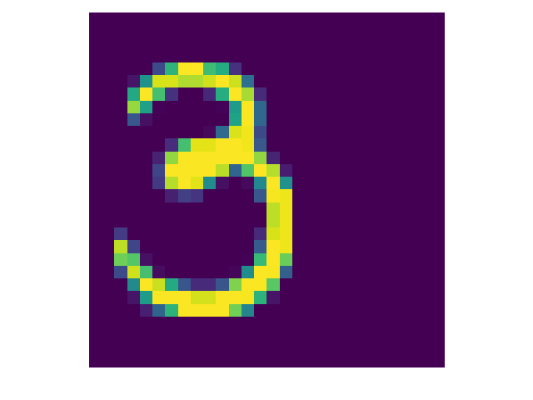
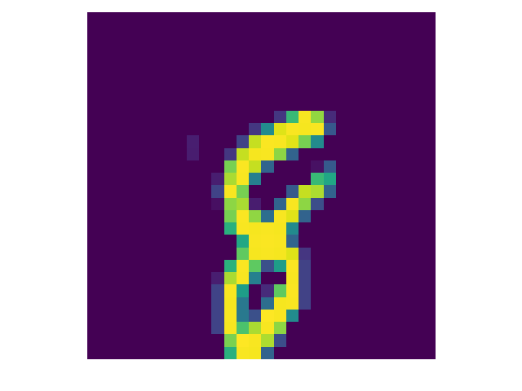
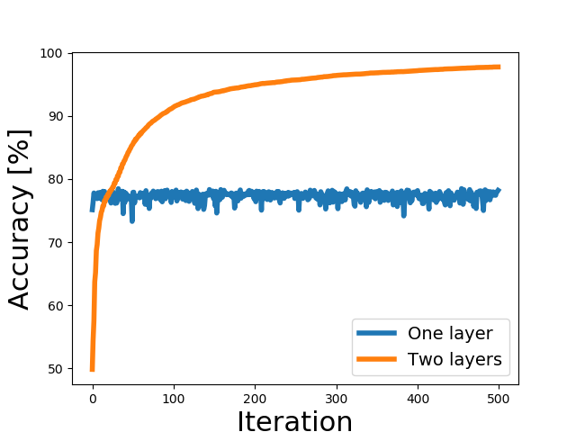
Two layer network: shifted images of 3 and 8
11,982 images of 3 and 8 are shifted by 10 pixels in horizontal and vertical direction
1984 images in the test set
2 layers network has 20 neurons in the hidden layer
C=Mean square error
One layer network
Adaline
Training accuracy | 78.20%
Test accuracy | 77.87%
Two layers network
Training accuracy | 97.89%
Test accuracy | 95.97%

Slide 17
Convolution and correlation

Slide 18
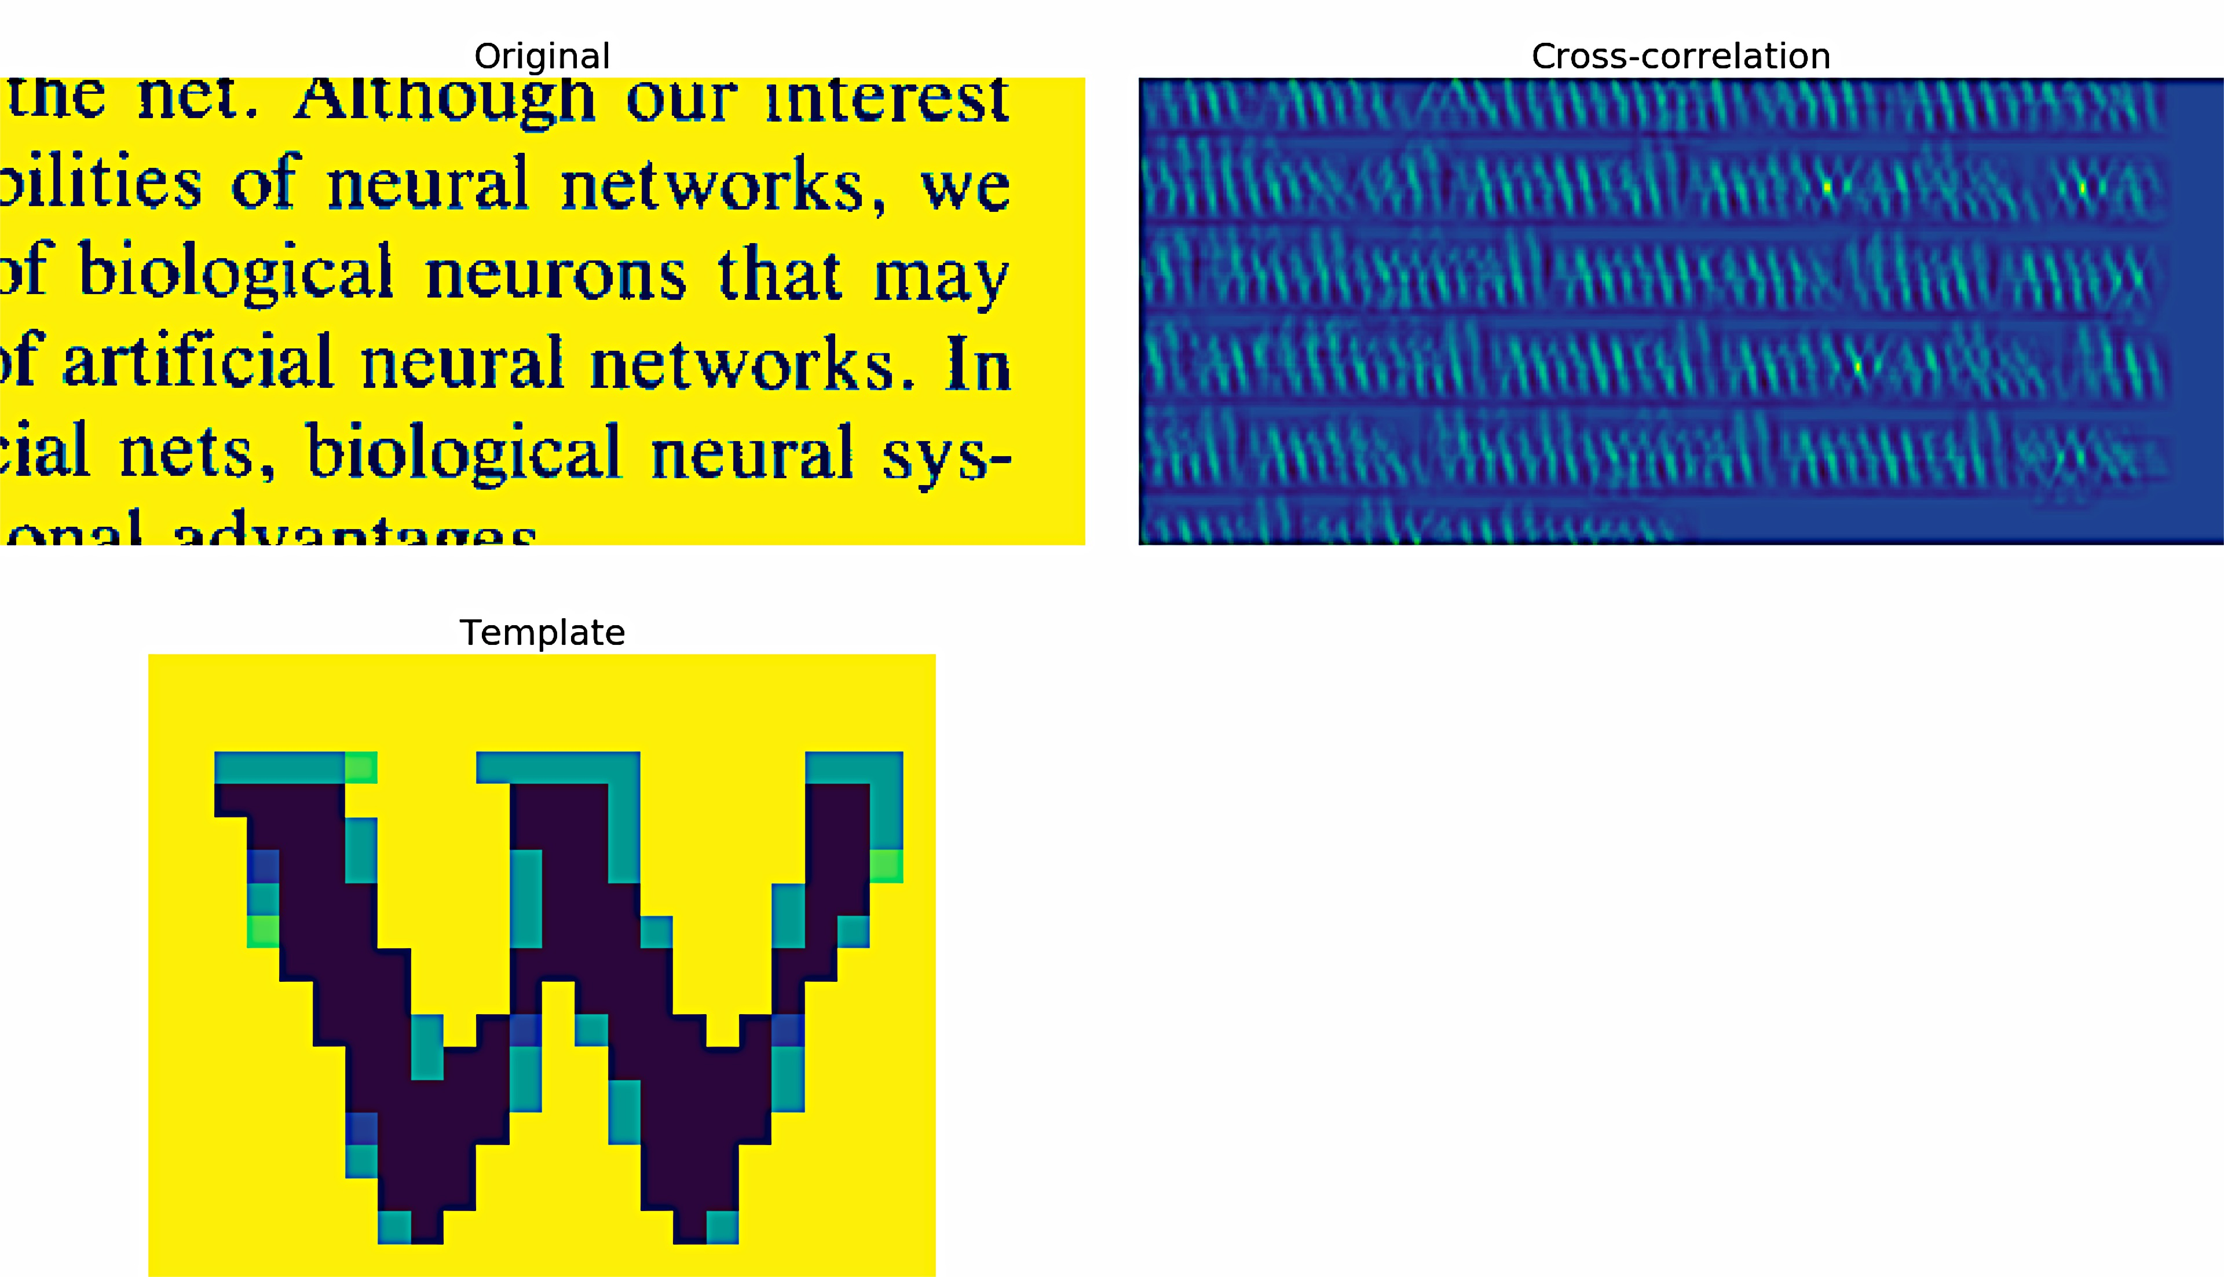
Correlator

Slide 19
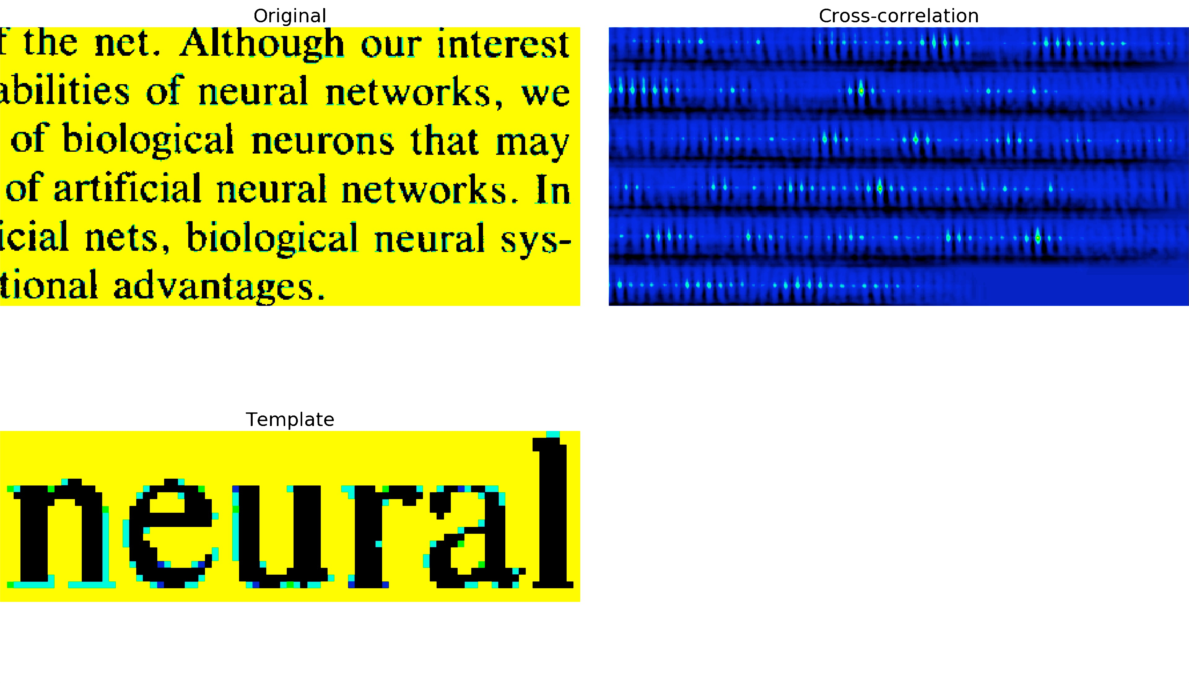
Correlator

Slide 20
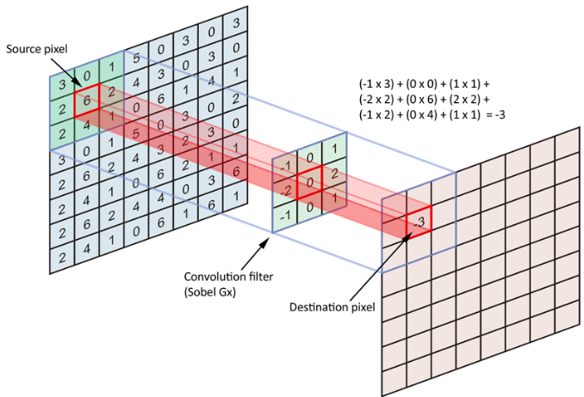
Feature detection using discrete 2-dimensional convolution with a filter
Template matching
Image
Feature layer
Convolution of the image with a learnt filter (template) identifies the structure in the image and localises it in the feature layer

Slide 21
Convolution: Single channel input – single filter
Input
Feature layer: 1/1
0 | 0 | 0 | 0 | 0 | 0 | 0 | 0
0 | 0 | 0 | 0 | 0 | 0 | 0 | 0
0 | 0 | 1 | 1 | 1 | 1 | 0 | 0
0 | 0 | 1 | 0 | 0 | 1 | 0 | 0
0 | 0 | 1 | 0 | 0 | 1 | 0 | 0
0 | 0 | 1 | 1 | 1 | 1 | 0 | 0
0 | 0 | 0 | 0 | 0 | 0 | 0 | 0
0 | 0 | 0 | 0 | 0 | 0 | 0 | 0
0 | 0 | 0 | 0 | 0 | 0 | 0 | 0
0 | 0 | 1 | 1 | 1 | 1 | 0 | 0
0 | 0 | 2 | 1 | 1 | 2 | 0 | 0
0 | 0 | 3 | 1 | 1 | 3 | 0 | 0
0 | 0 | 3 | 1 | 1 | 3 | 0 | 0
0 | 0 | 2 | 1 | 1 | 2 | 0 | 0
0 | 0 | 1 | 1 | 1 | 1 | 0 | 0
0 | 0 | 0 | 0 | 0 | 0 | 0 | 0
0 | 1 | 0
0 | 1 | 0
0 | 1 | 0
X
Filter kernel
# Filters = n_{f} = 1
Size: [f_{x} , f_{y}] = [3, 3]
Filter depth = n_{c} = 1
Filter bias = b = 0
# Filter weights:
= f_{x} x f_{y} x n_{c} + 1
= 3x3x1 + 1 = 10
Stride: [s_{x} , s_{y}] = [1, 1]
Input – image or feature layer from previous convolution block
Size: [L_{x} , L_{y}] = [8, 8]
# Channels: [n_{c}] = 1
Zero padded
Output – feature layer
# Feature layers = n_{f} = 1
Size: [F_{x} , F_{y}] = [8, 8]
# Channels / feature = 1
Detects vertical edges

Slide 22
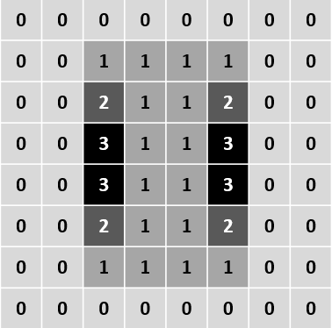
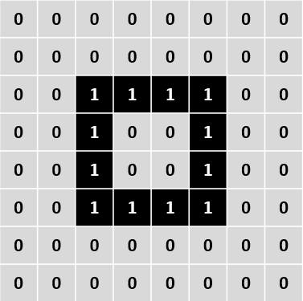
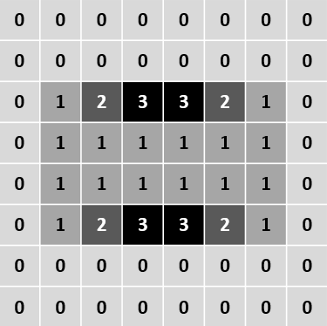
Convolution: Single channel input – Multiple filters
Multiple feature detection
Feature layer: 1/2
Filter: 1
0 | 1 | 0
0 | 1 | 0
0 | 1 | 0
Input
X
Feature layer: 2/2
Filter: 2
0 | 0 | 0
1 | 1 | 1
0 | 0 | 0
X
Input – image or feature layer from previous convolution block
Size: [L_{x} , L_{y}] = [8, 8]
# Channels: [n_{c}] = 1
Zero padded
Filter kernels
# Filters = n_{f} = 2
Size: [f_{x} , f_{y}] = [3, 3]
Filter depth = n_{c} = 1
Filter bias = b = 0
# Filter weights = 10
Stride: [s_{x} , s_{y}] = [1, 1]
Detects vertical and horizontal edges
Output – feature layers
# Feature layers = n_{f} = 2
Size: [F_{x} , F_{y}] = [8, 8]
# Channels / feature = 1

Slide 23
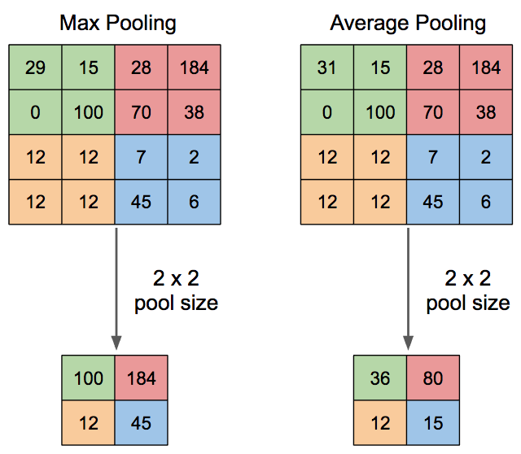
Spatial down-sampling using pooling functions
More common
Higher response

Slide 24
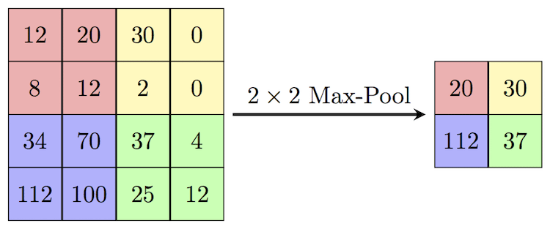
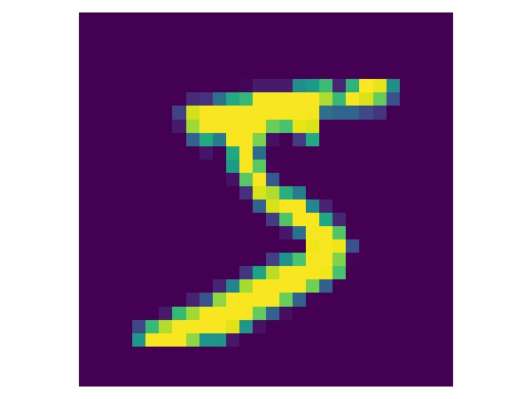
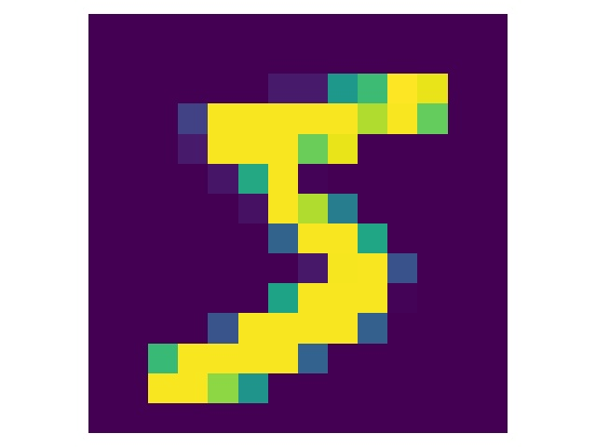
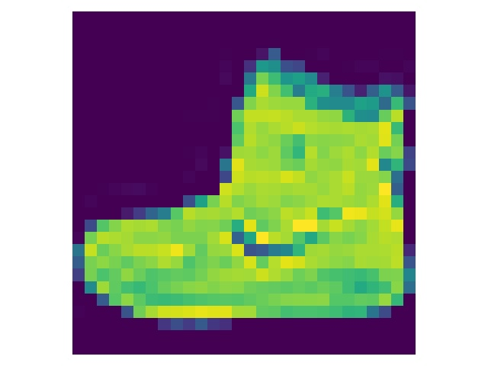
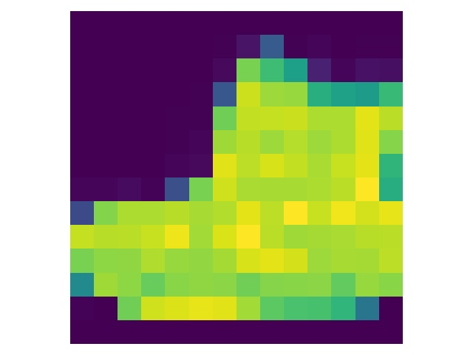
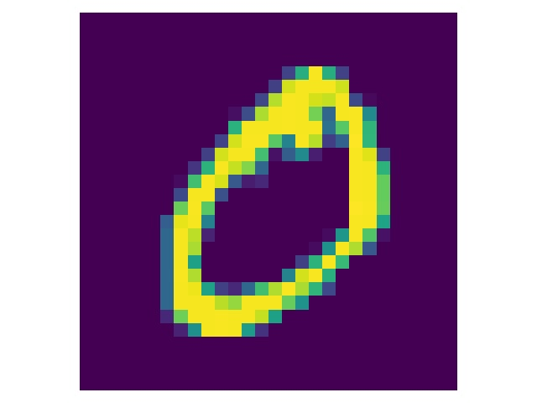
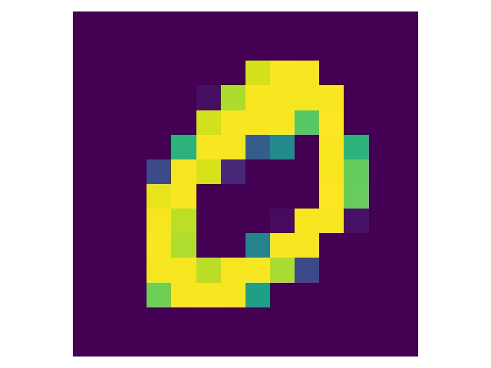
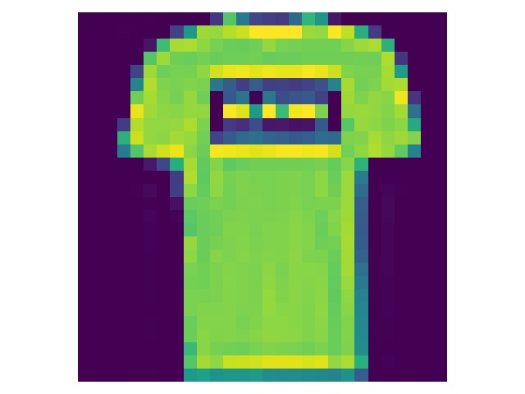
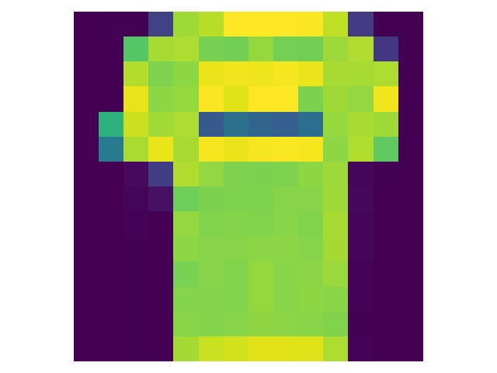
Down sampling through Max(imum) pooling
Input
28x28 pixels
After max-pooling
14x14 pixels
Input
28x28 pixels
After max-pooling
14x14 pixels

Slide 25
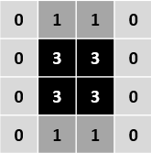

Max pooling of feature layers
Feature layer: 1/2
Max pooling
Filter: 1
0 | 1 | 0
0 | 1 | 0
0 | 1 | 0
Image or feature layer from
previous convolution block
X
Feature layer: 2/2
Filter: 2
0 | 0 | 0
1 | 1 | 1
0 | 0 | 0
X
Input
Size: [L_{x} , L_{y}] = [8, 8]
# Channels: [n_{c}] = 1
Zero padded
Filter kernels
# Filters = n_{f} = 2
Size: [f_{x} , f_{y}] = [3, 3]
Filter depth = n_{c} = 1
Filter bias = b = 0
# Filter weights = 10
Stride: [s_{x} , s_{y}] = [1, 1]
Output – feature layers
# Feature layers = n_{f} = 2
Size: [F_{x} , F_{y}] = [8, 8]
# Channels / feature = 1

Slide 26

Convolution: Multiple channels-one filter

Slide 27




Note: no activation function has been applied in this case – linear demo
Convolution: Multiple channel input – Single filter
Input channel: 1/2
Filter
Filter channel: 1/2
Flattened feature vector
Feature layer
Max pooled
Classify
Input channel: 2/2
X
Filter channel: 2/2
Output
# Feature layers = n_{f} = 1
Size: [F_{x} , F_{y}] = [4, 4]
# Channels / feature = 1
Filter kernel
# Filters = n_{f} = 1
Size: [f_{x} , f_{y}] = [3, 3]
Filter depth = n_{c} = 2
Filter bias = b = 0
# Filter weights:
= f_{x} x f_{y} x n_{c} + 1
= 3x3x2 + 1 = 19
Stride: [s_{x} , s_{y}] = [1, 1]
Input
Size: [L_{x} , L_{y}] = [4, 4]
# Channels: [n_{c}] = 2
Zero padded
Detects a square
nb: no activation function has been applied after max pooling

Slide 28



Two-layer convolutional network (digits MNIST)
60000 Training samples
10000 Test samples
Optimizer: gradient descent, MSE
Rectified linear activation function in the middle layer
Softmax activation function in the final layer
Receptive field : 20x20
Batch size : 1000
Epochs: 40
Learning rate:0.05
Convolutional 1st layer
Training accuracy: 98.4%
Test accuracy: 98.3% 125K weights
Fully connected 1st layer (20 HU)
Training accuracy: 97%
Test accuracy: 95.7% 16K weights
Fully connected network parameters: 100 epoch, 1 learning rate, sigmoid activation in the middle layer, 1000 batch size
The receptive fields of the convolutional layer are trained simultaneously for all positions

Slide 29
















2-layer convolutional network
16 Receptive fields (Channels)

Slide 30









Two-layer convolutional network
Output of the convolutional layer: 16 filters
Input image
Input image
20x20
Receptive field
2 out of 16 channels
Convolutional layer output
Convolutional layer output

Slide 31






Fully connected and Convolutional network
Shifted digits
Convolutional neural network
Optimizer: gradient descent, MSE
Rectified linear activation function in the middle layer
Softmax activation function in the final layer
Receptive field : 20x20 with 16 filters
Batch size : 1000
Epochs: 40
Learning rate:0.05
Examples
Original
Shifted
Fully connected network
Optimizer: gradient descent, MSE
Sigmoid activation function in the middle layer
Softmax activation function in the final layer
Hidden units: 20
Batch size : 1000
Epochs: 100
Learning rate: 1

Slide 32
Fully connected and Convolutional network
Shifted digits
Shifted images are not included in the training
Shifted images are included in the training
Test accuracy (%)
Unshifted images
Test accuracy (%)
Shifted images
Test accuracy (%)
Unshifted images
Test accuracy (%)
Shifted images
Convolutional neural network
2 filters
97.2
42.9
97.2
90.6
16 filters
98.3
53.4
98.5
96
100 filters
98.4
54
98.7
96.7
Fully connected network
20 hidden units
95.7
35.8
93.7
80.8

Slide 33

Gradient-based Localization
Original Image
Cat Classification
Dog Classification
Notes:
Forward Pass: First, the input is passed through the neural network, generating a prediction (output).
Backpropagation: Then, the gradient of the output with respect to the input is computed using backpropagation. This measures how much each pixel or feature in the input influences the network’s decision.
Gradient Visualization: The gradient values are visualized to identify which regions of the input (e.g., image) have the highest impact on the output. This often involves taking the absolute value or the magnitude of the gradients.

Slide 34


Neural network types for imaging applications
Convolutional neural networks (CNN) are ideal for feature vector extraction for imaging applications
Comprise convolutional blocks with/without spatial resampling and/or skip connections
Choice of network type depends on the imaging application
  Image classification: CNN encoder : FC classifer
  Image mapping/regression: CNN encoder : CNN decoder
VGG classifier
U-Net mapper/regressor

Slide 35


Imaging through multimode fibers
Speckle classification
VGG type convolutional neural network (CNN)
Distal speckle
pattern
Number class
A
Notes:
endcoder classifier
. feature vector classification

Slide 36


U-Net type convolutional neural network (CNN)
Imaging through multimode fibers
SLM input reconstruction
8
8
Distal speckle
pattern
SLM input
Notes:
Encoder-decoder cnn
. pixel feature vector mapping

Slide 37

def forward(self, x):
# Encoder
enc1 = self.enc1(x)
enc2 = self.enc2(enc1)
pool1 = self.pool1(enc2)
enc3 = self.enc3(pool1)
enc4 = self.enc4(enc3)
pool2 = self.pool2(enc4)
# Bottleneck
bottleneck1 = self.bottleneck1(pool2)
bottleneck2 = self.bottleneck2(bottleneck1)
# Decoder
upconv4 = self.upconv4(bottleneck2)
dec4 = torch.cat((upconv4, enc4), dim=1)
dec4_1 = self.dec4_1(dec4)
dec4_2 = self.dec4_2(dec4_1)
upconv3 = self.upconv3(dec4_2)
dec3 = torch.cat((upconv3, enc3), dim=1)
dec3 = self.dec3(dec3)
dec2 = self.dec2(dec3)
return dec2
class UNetSingleConvDoublePool(nn.Module):
def __init__(self, in_channels=1, out_channels=1):
super(UNetSingleConvDoublePool, self).__init__()
# Encoder (Downsampling path)
self.enc1 = nn.Conv2d(in_channels, 256, kernel_size=3) # 140x140 -> 138x138
self.enc2 = nn.Conv2d(256, 256, kernel_size=3) # 138x138 -> 136x136
self.pool1 = nn.MaxPool2d(2) # 136x136 -> 68x68
self.enc3 = nn.Conv2d(256, 512, kernel_size=3) # 68x68 -> 66x66
self.enc4 = nn.Conv2d(512, 512, kernel_size=3) # 66x66 -> 64x64
self.pool2 = nn.MaxPool2d(2) # 64x64 -> 32x32
# Bottleneck
self.bottleneck1 = nn.Conv2d(512, 1024, kernel_size=3) # 32x32 -> 30x30
self.bottleneck2 = nn.Conv2d(1024, 1024, kernel_size=3) # 30x30 -> 28x28
# Decoder (Upsampling path)
self.upconv4 = nn.ConvTranspose2d(1024, 512, kernel_size=2) # 28x28 -> 56x56
self.dec4_1 = nn.Conv2d(1024, 512, kernel_size=3) # 56x56 -> 54x54
self.dec4_2 = nn.Conv2d(512, 512, kernel_size=3) # 54x54 -> 52x52
self.upconv3 = nn.ConvTranspose2d(512, 512, kernel_size=2, stride=2) # 52x52 -> 104x104
self.dec3 = nn.Conv2d(512, 256, kernel_size=3) # 104x104 -> 102x102
self.dec2 = nn.Conv2d(256, out_channels, kernel_size=3) # 102x102 -> 100x100
Notes:
Crop or concatenate?

Slide 38
Exercise 2
U-Net correcting defocused digits 3

