Slide 1
Computational Optical Imaging
Lecture 5
Interference and coherence

Slide 2
Toolkit
Free space propagation
Angular Spectrum method
Fresnel Diffraction
BPM
z
Illlumination
e.g. $Ae^{j(ωt−kz)}$
Thin
Transparency
t(x,y)
Thick
Transparency
BPM
Thin
Transparency
t(x,y)
Thick
Transparency
BPM
Detector
CCD
CMOS

Slide 3
Outline
Laser
Young interferometer-Spatial coherence
Michelson-Temporal coherence
Simulating light propagation with spatially incoherent light
Exercise 1: Speckle
Imaging with Incoherent light
Exercise 2: 4F system with 2 slits

Slide 4
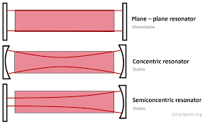
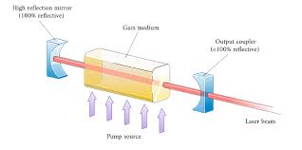
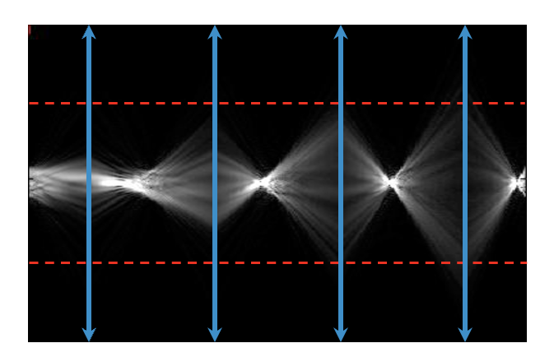
Laser
Fabry-Perot Cavity

Slide 5
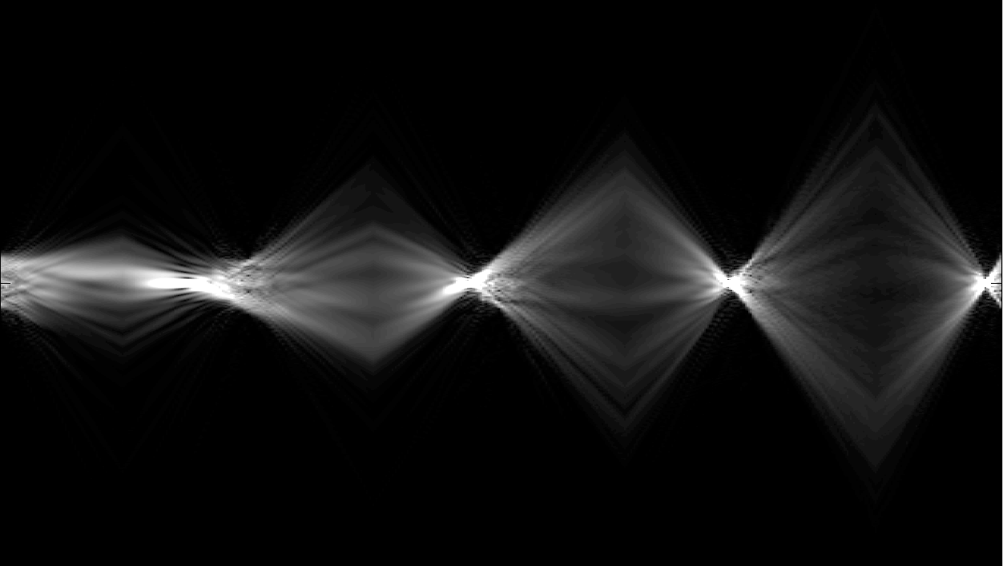
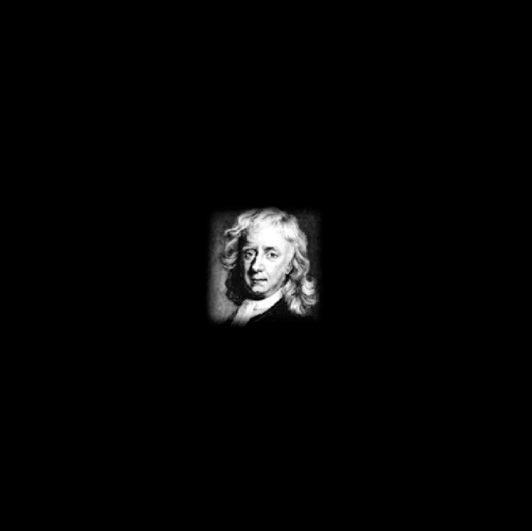
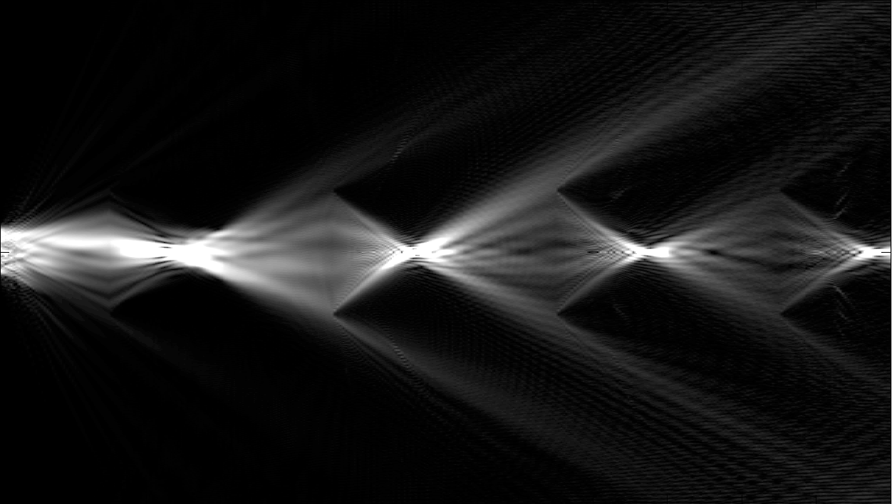
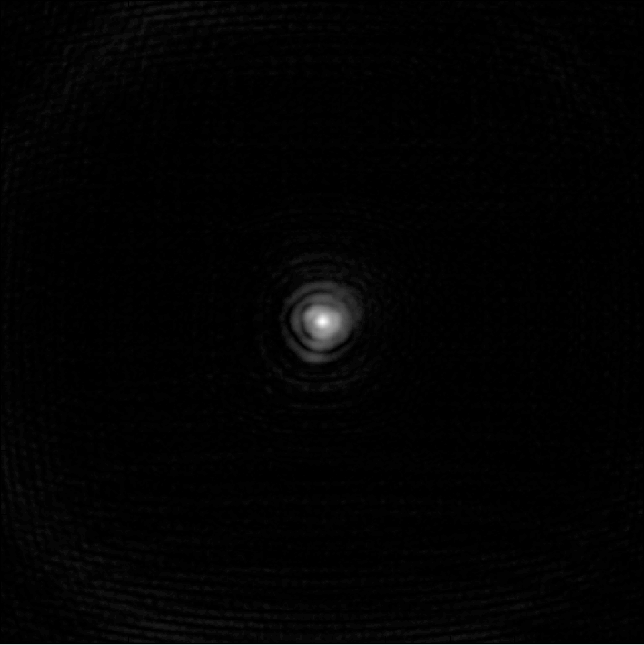
Lens Waveguide – Finite aperture

Slide 6
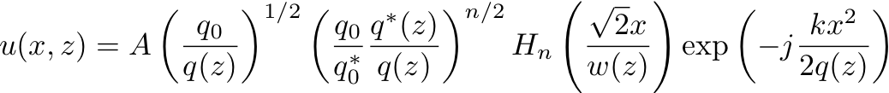
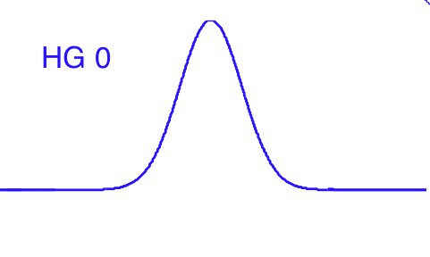
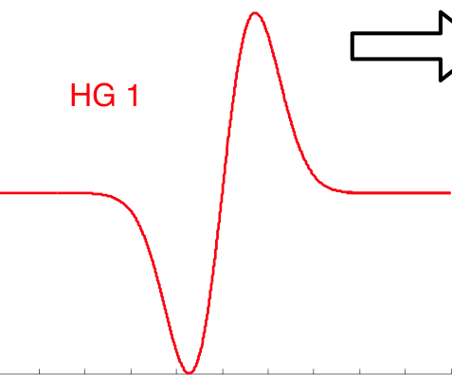
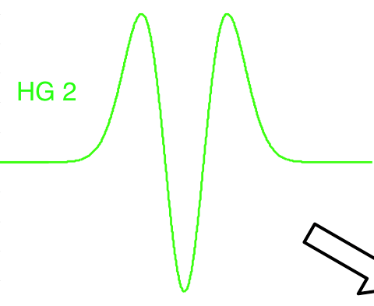
Hermite-Gauss modes
For z=0
If n=0
If n=1
If n=2

Slide 7
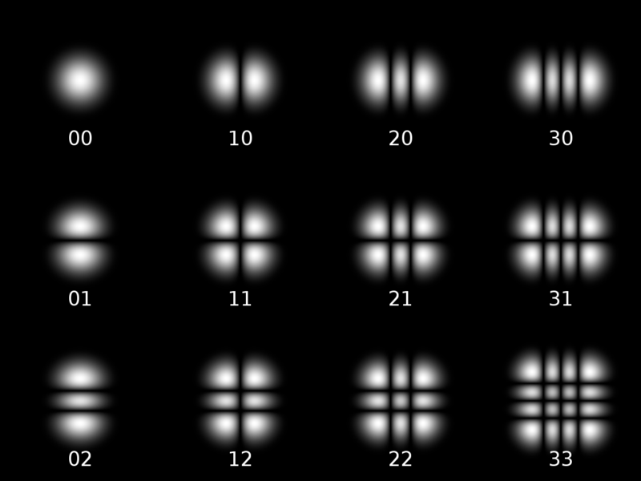
Hermite-Gauss modes

Slide 8
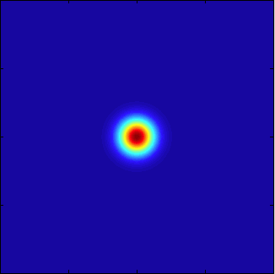
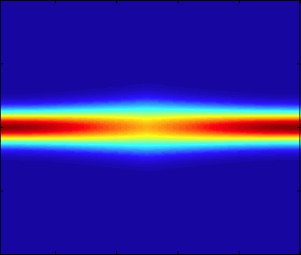
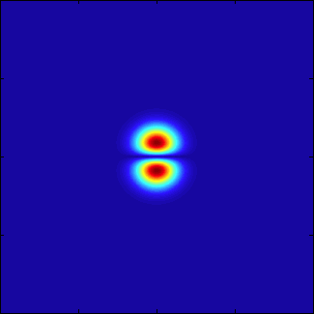
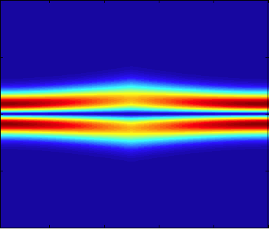
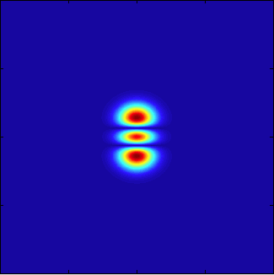
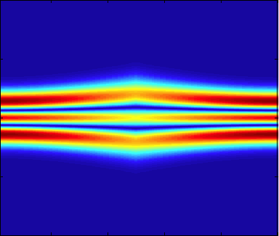
Hermite-Gauss modes
HG 00
HG 01
HG 02

Slide 9
Light Propagation:
Diffraction or Interference?
Optical
System
Output
Input

Slide 10
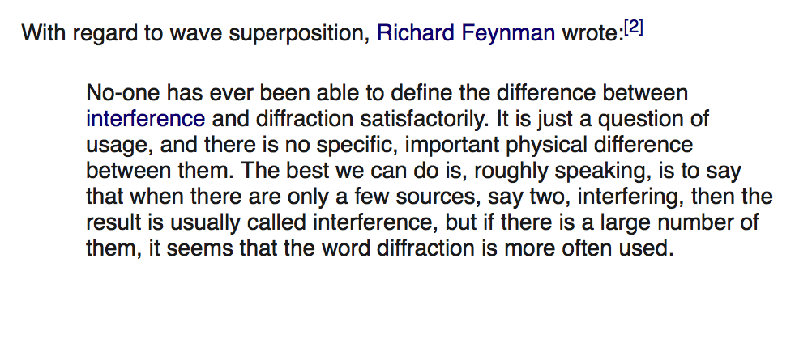

Slide 11
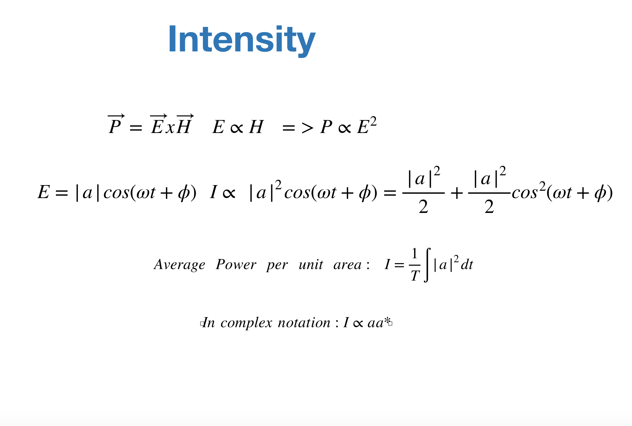
2
2

Slide 12
2
2

Slide 13
Interferometry
Interference fringes

Slide 14
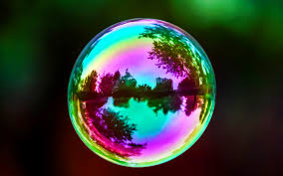
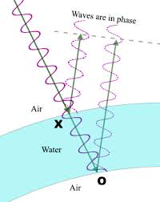
Soap Bubbles

Slide 15
Michelson Interferometer
Mirror
Illumination
Mirror
Beam splitter
Detector

Slide 16
Temporal (longitudinal) coherence
Δz= v τ
z
a(t)
a(t-τ)

Slide 17
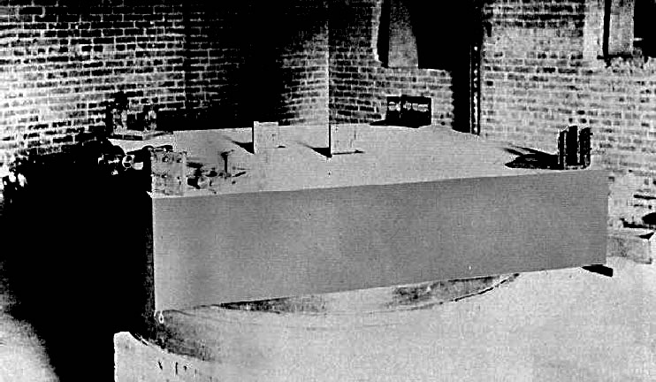
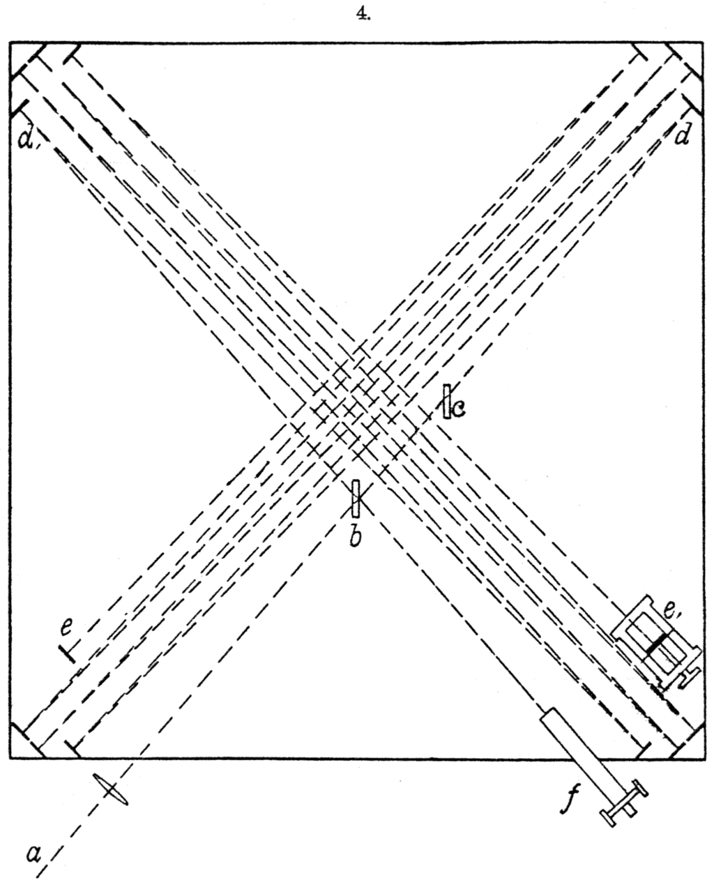
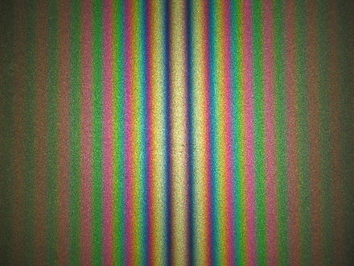
Michelson’s apparatus

Slide 18
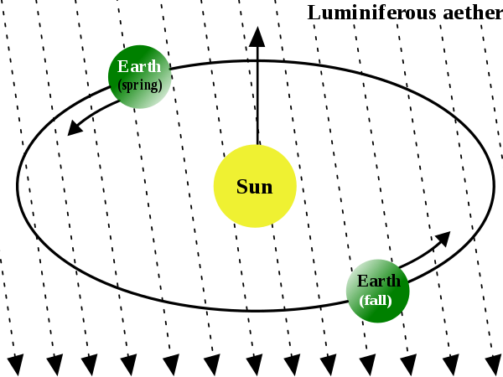
Michelson-Morley experiment

Slide 19
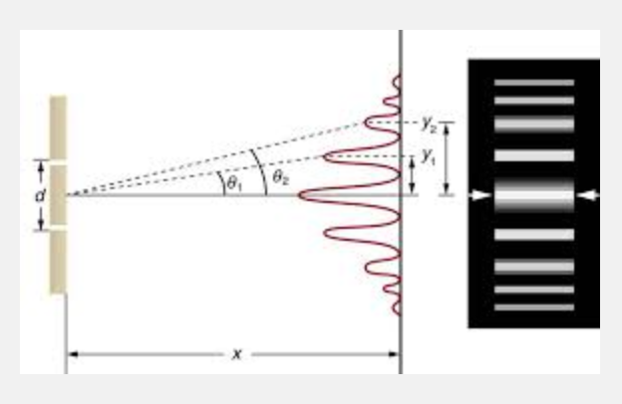
Young’s double slit interferometer

Slide 20
Spatially incoherent illumination
x₁
P
x₂
E(x,z=0,t)=a(x,t)e^{jωt} where a=|a| e^{jφ} is random

Slide 21
dt

Slide 22
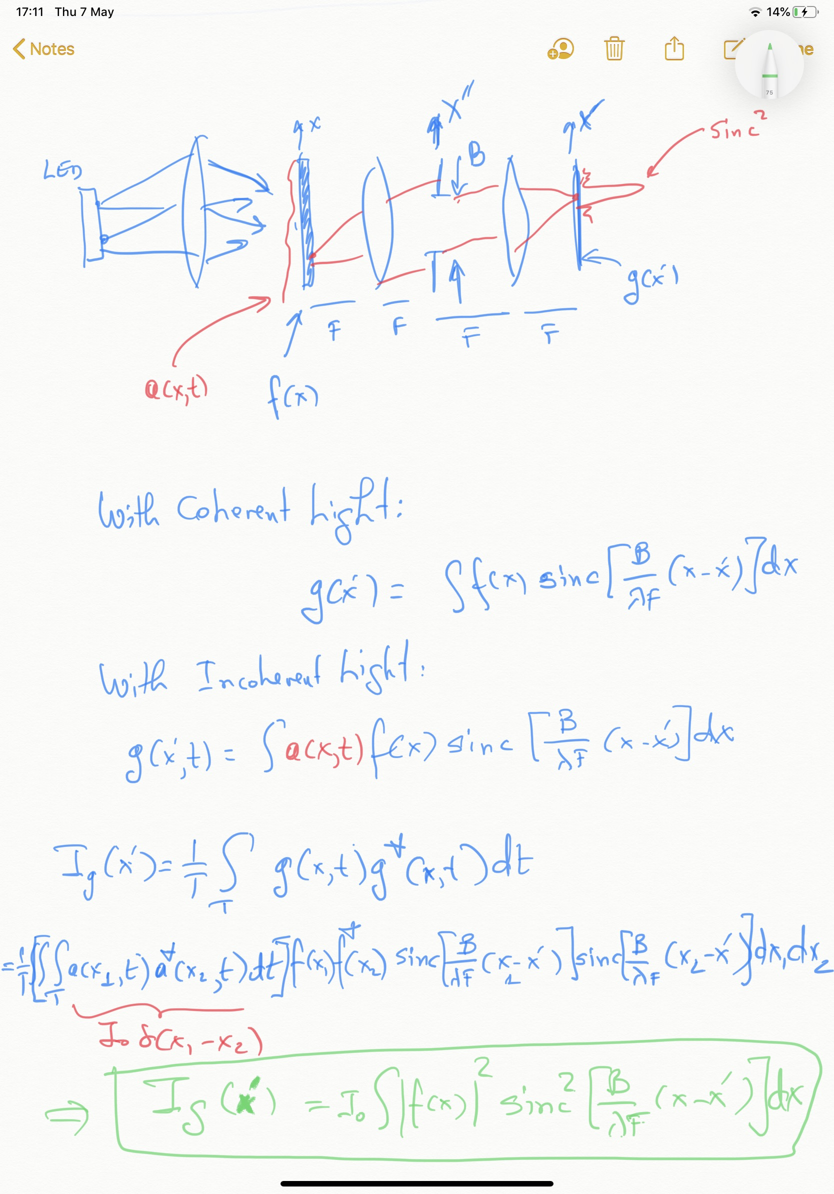

Slide 23
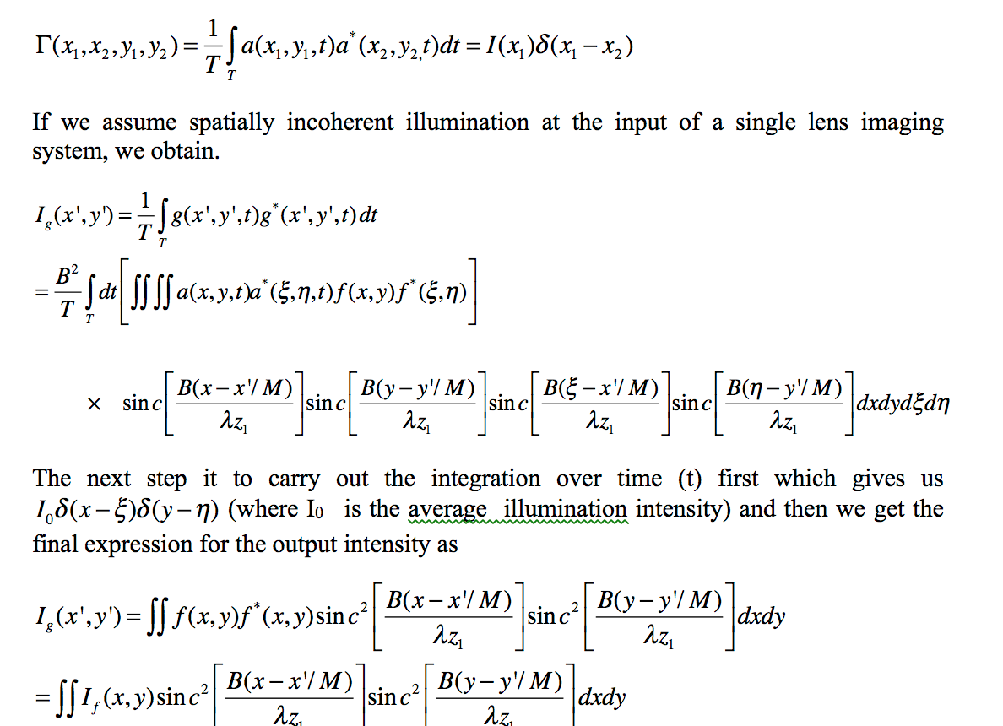

Slide 24
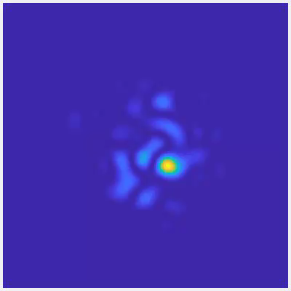

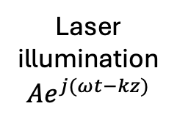
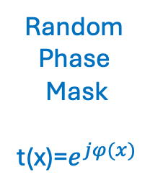
Speckle
F
F
F
F
Laser
illumination
$$Ae^{j(ωt−kz)}$$
B
Random
Phase
Mask
t(x)=$e^{jφ(x)}$
Speckle size ~
$$\frac{λF}{B}$$

Slide 25
Exercise1
Speckle with 4F system

Slide 26
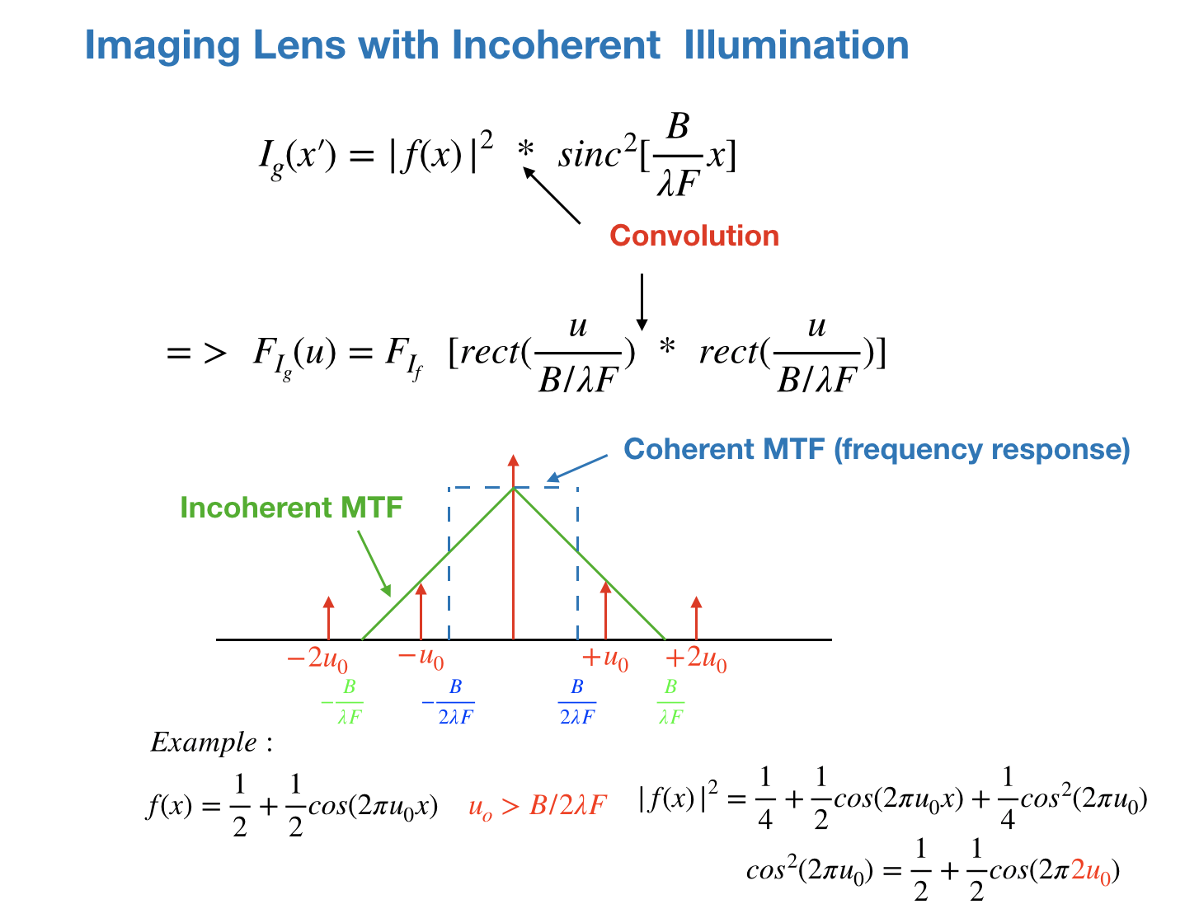

Slide 27
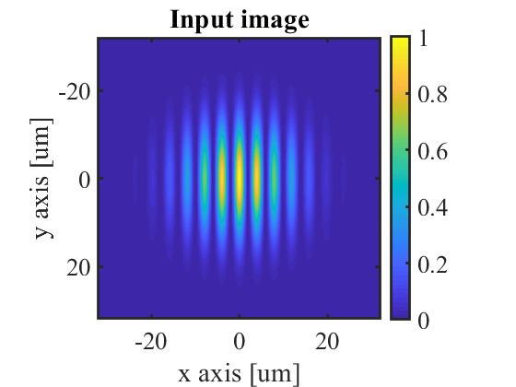
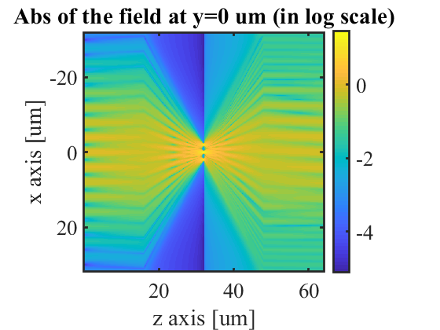
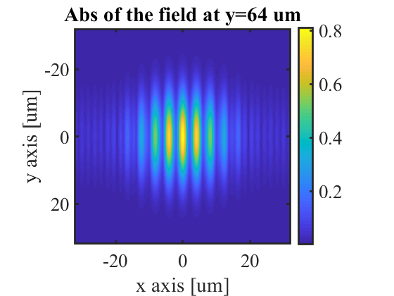
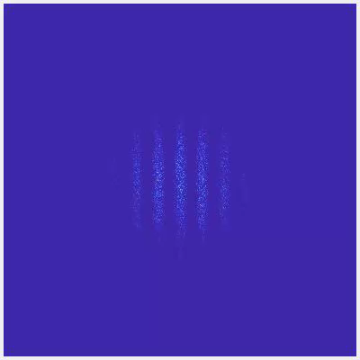
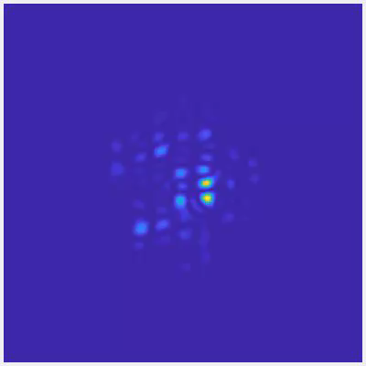
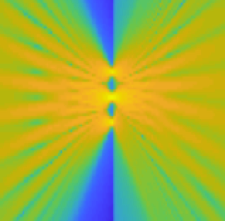
Intensity

Slide 28
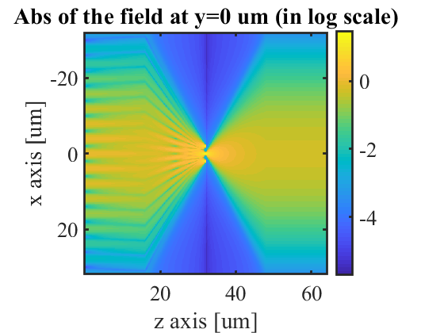
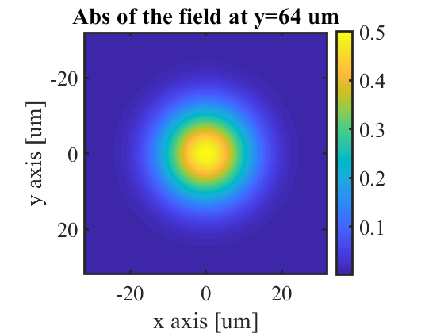
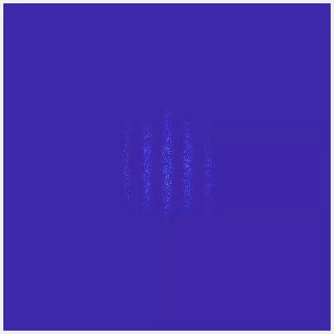
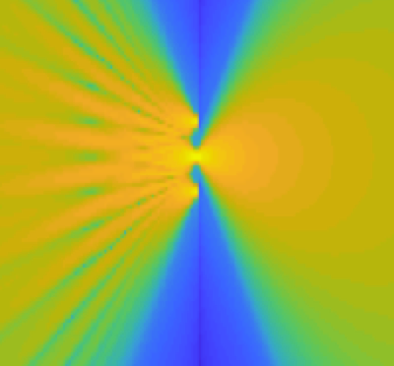
Intensity

Slide 29
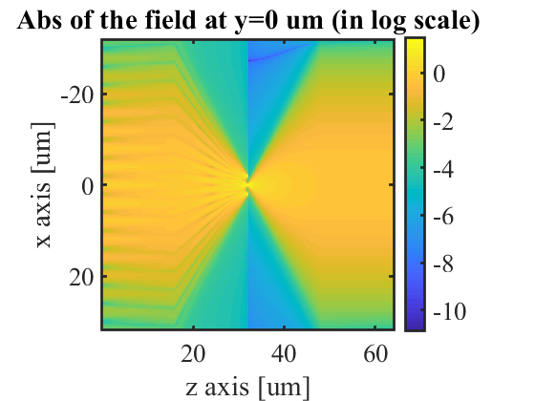
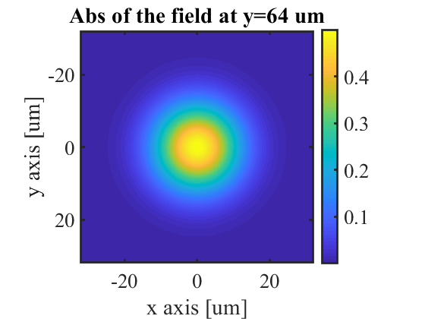
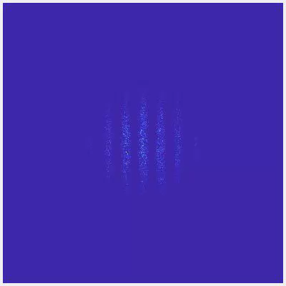
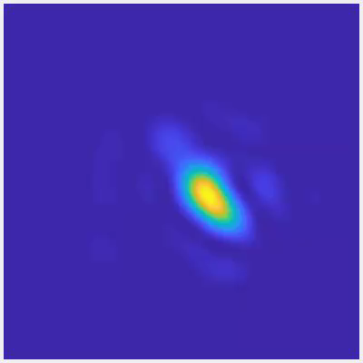
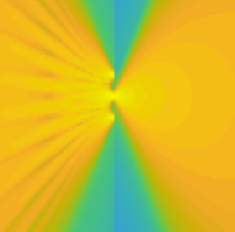
Intensity

Slide 30
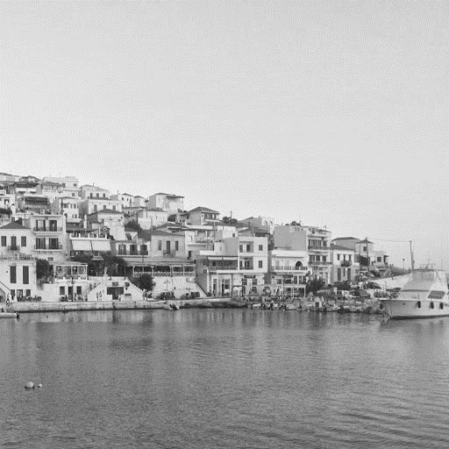

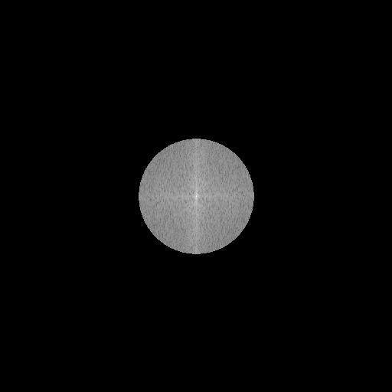



Original image and
its angular spectrum
Angular spectrum
at the output
Image
Coherent imaging
Incoherent imaging

Slide 31
Original image and
its angular spectrum
Angular spectrum
at the output
Image
Coherent imaging
Incoherent imaging

Slide 32
Exercise 2
4F system with slits
Coherent and incoherent

