Slide 1
Computational Optical Imaging
Lecture 1a
Reality is a construct

Slide 2
Outline for today
A few words about the course
The best example of computational imaging: Human visual system

Slide 3
Computational Optical Imaging
Graded weekly exercise sessions (60% of the grade)
Final (40% of the grade)
No weekly homework
4 hours per week, 13 weeks
First hour (Friday 10:15 to 1100): Lecture introducing the topic
Second hour (Friday 11:15 to 12:00) : Lecture and code on topic
Third hour (Friday 12:15 to 13:00): In class exercise on topic
Fourth hour (Wednesday 10:15 to 11:00): Graded exercise on topic (10 out of 13 will count)

Slide 4


Computational Imaging
Optics
Computer

Slide 5
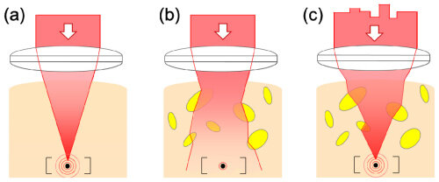
Computational Imaging
Optics
Computer
An Example: Focusing in scattering media

Slide 6
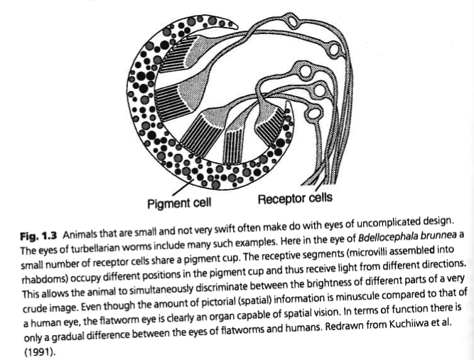
Early eyes

Slide 7
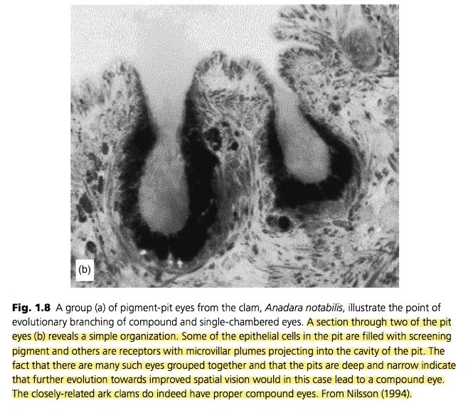
Eary eyes

Slide 8
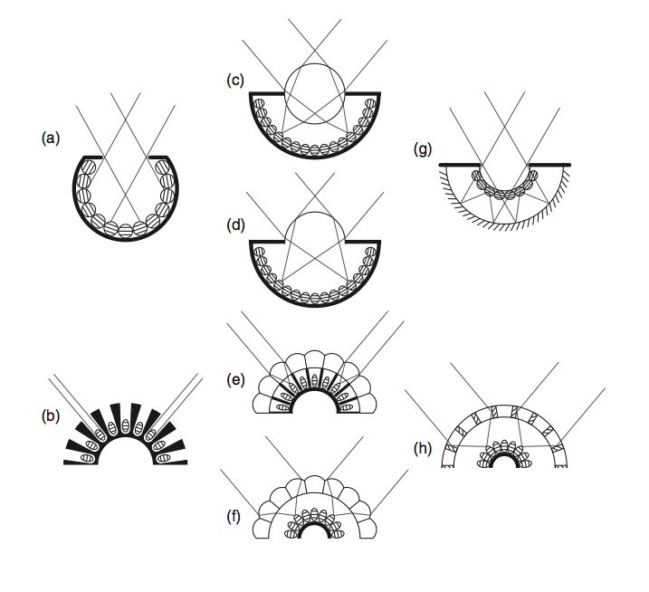
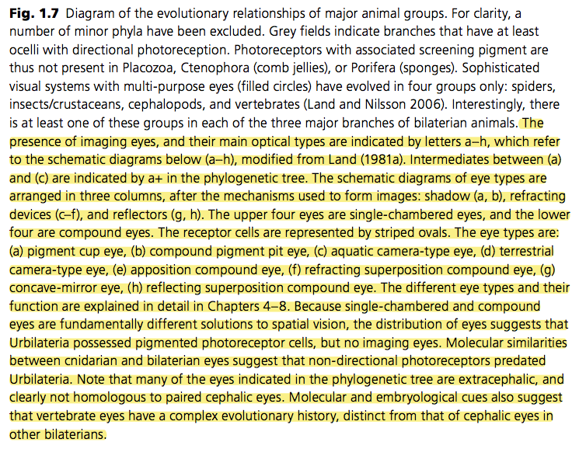
Single chamber and compound eyes

Slide 9
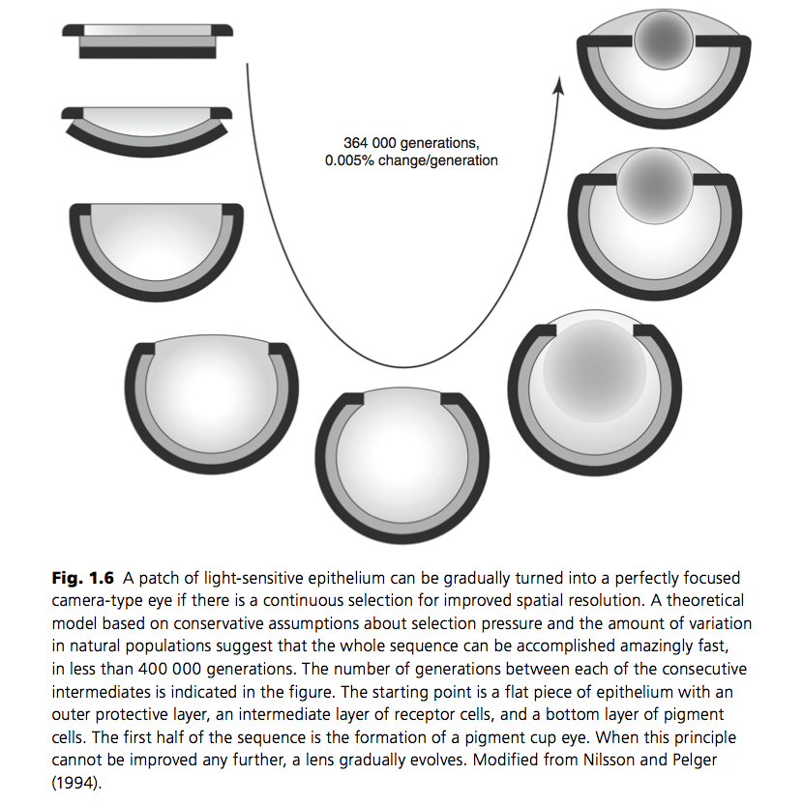
The human eye

Slide 10
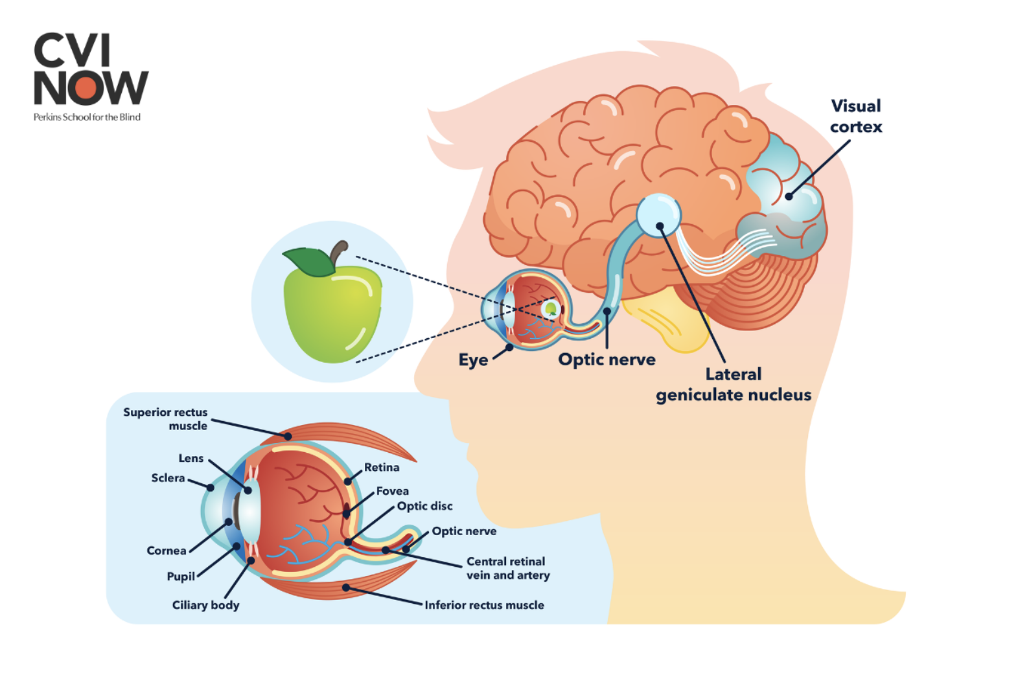

Slide 11
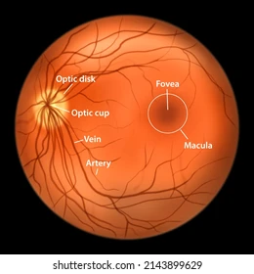

Slide 12
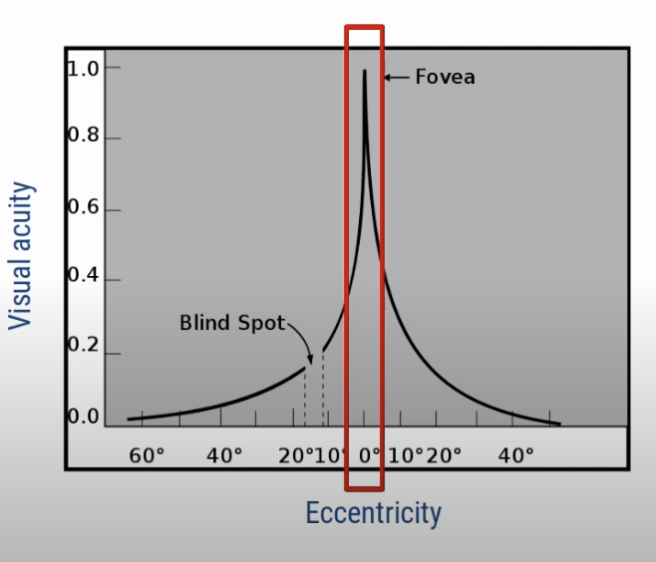
https://www.youtube.com/watch?v=00eRYdljesQ

Slide 13


Slide 14



Slide 15
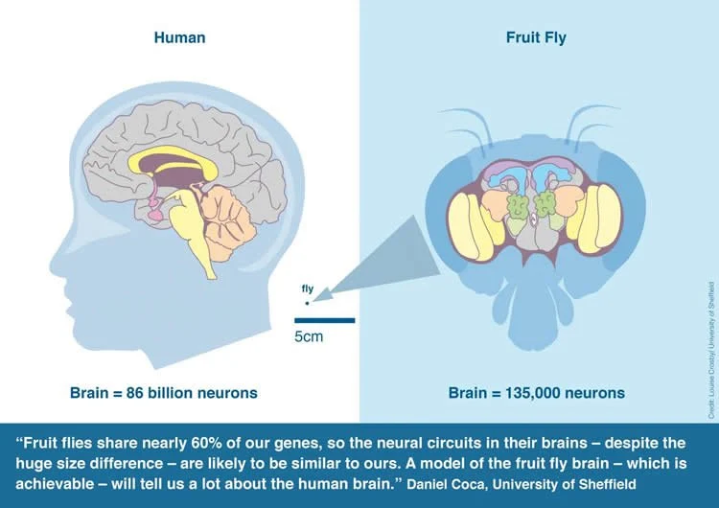
The human brain

Slide 16
Eye movements
Gaze stabilization
Smooth pursuit
Saccadic eye movements

Slide 17
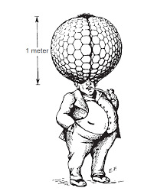

Slide 18


Slide 19
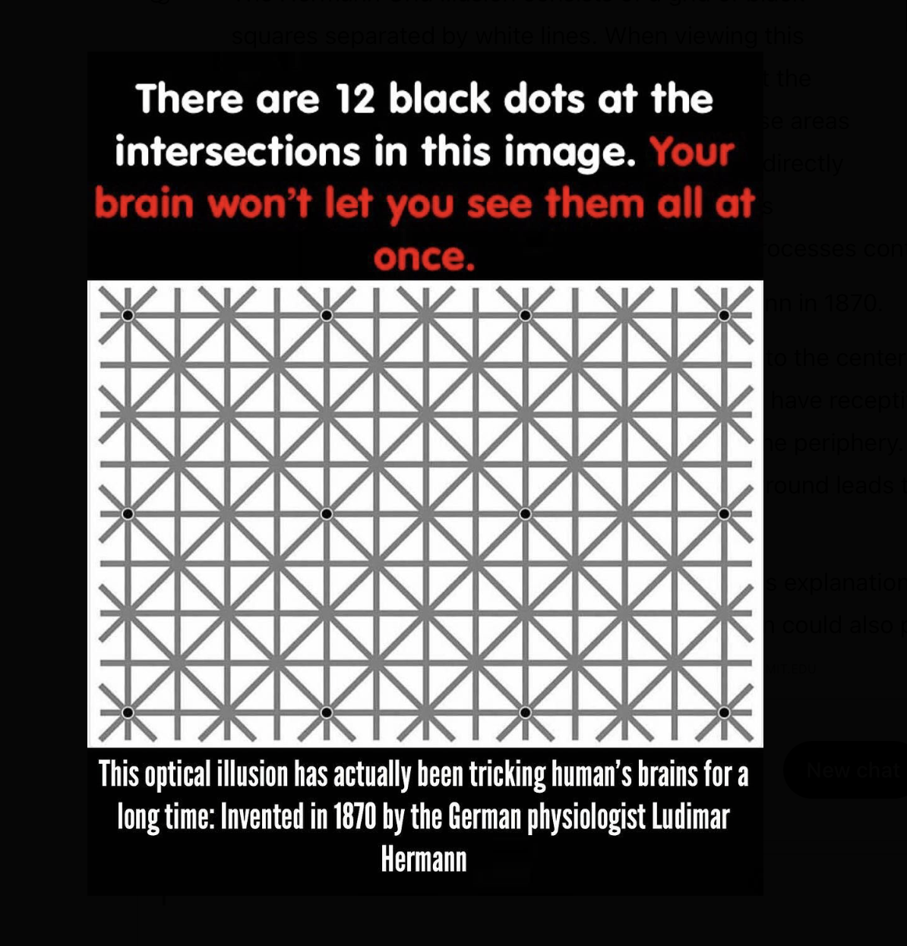

Slide 20
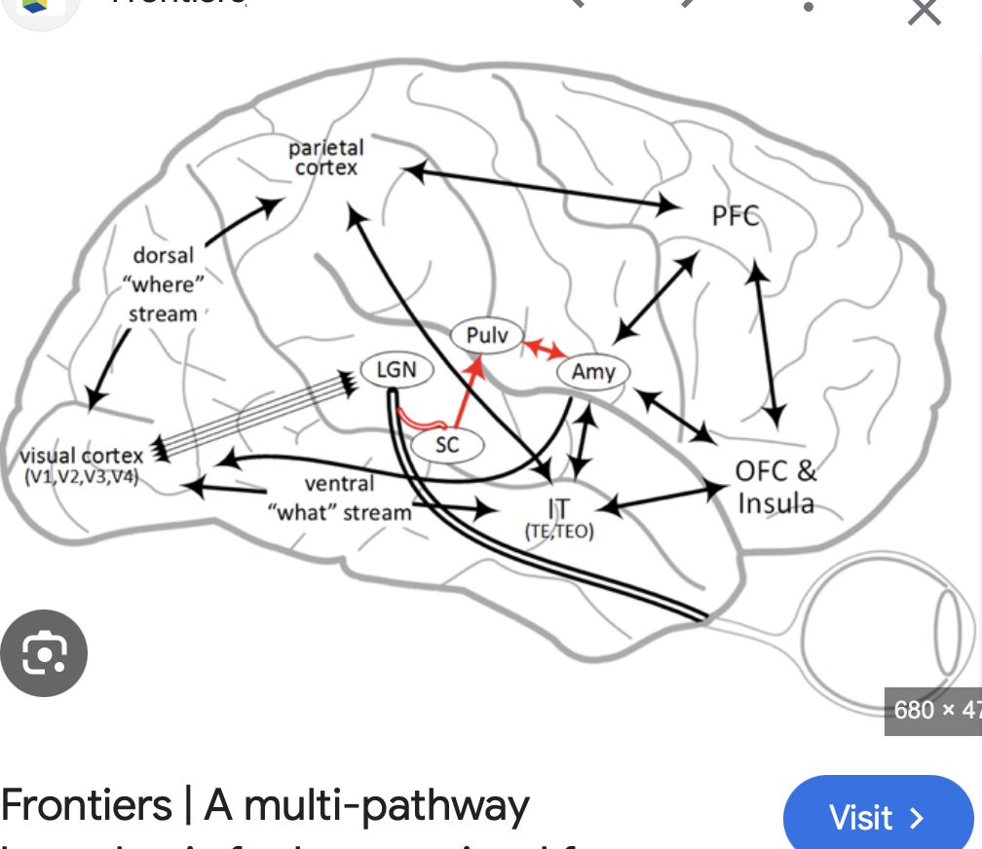

Slide 21
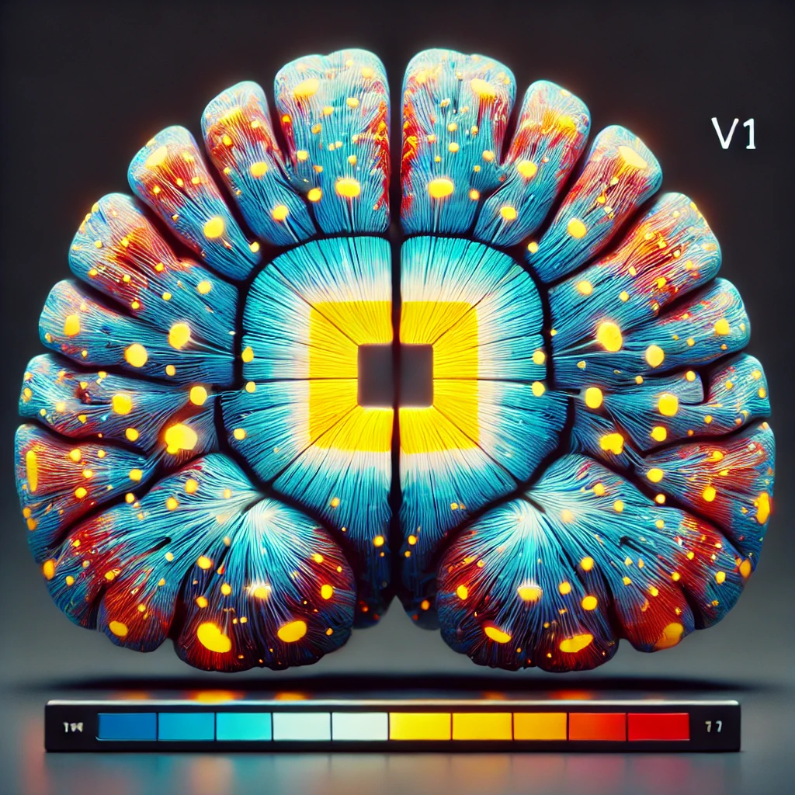
Activation in V1 (early visual area) for a rectanngle on the retina
chatgpt

Slide 22

Activation in V1 (early visual area) for a smiley face on the retina
Chatgpt

Slide 23
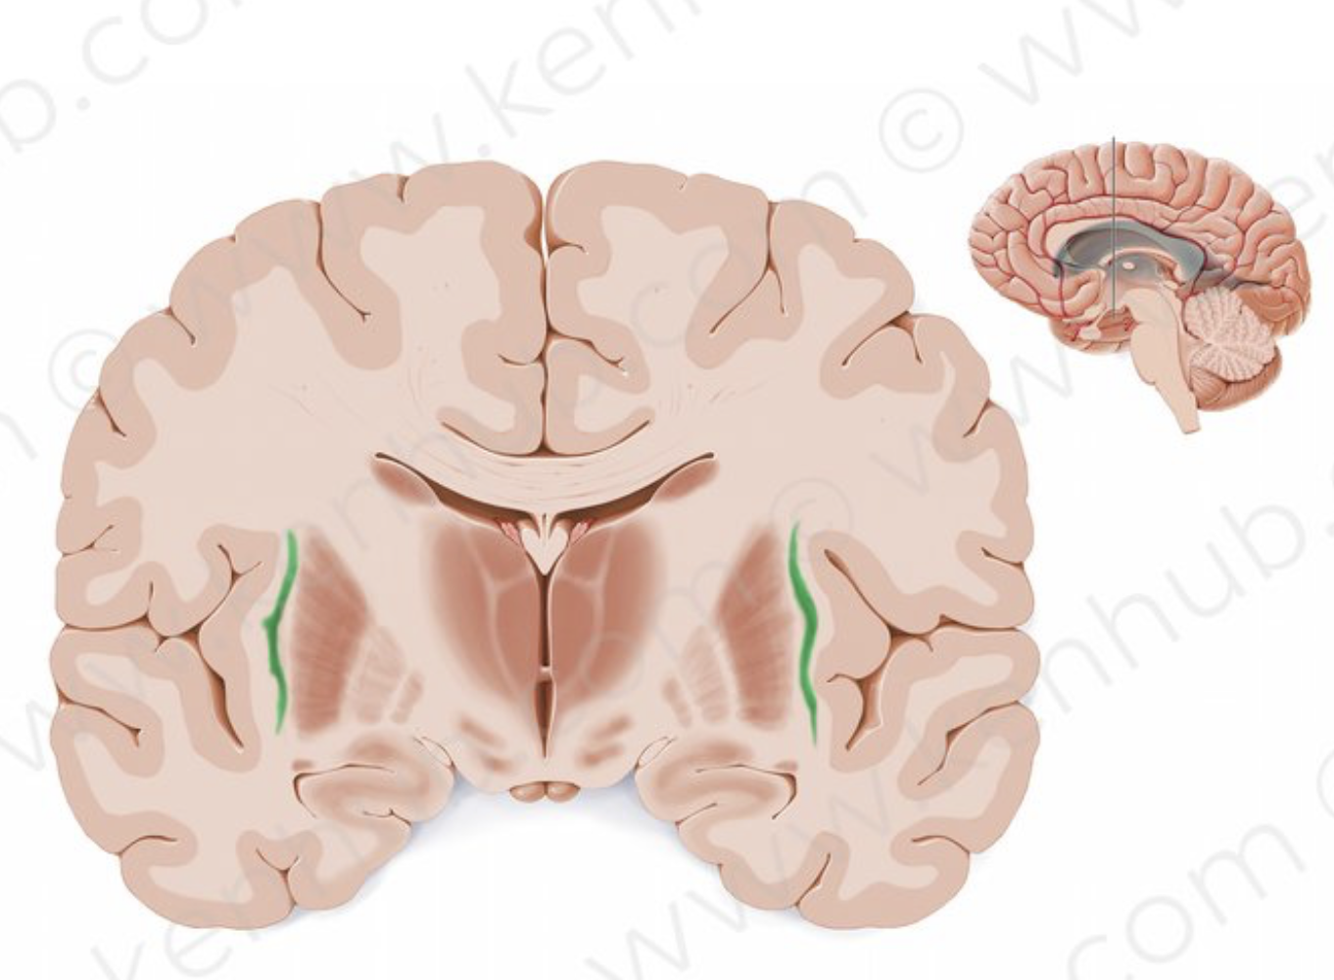
Claustrum
Through interhemispheric connections, the claustrum is believed to play a
role in synchronizing activity in widely separated, but functionally related, parts of the brain
such as between frontal eye fields and the visual cortex.^{[1][10][11]} As such, the claustrum is thought to
play a role in combining different information modalities, potentially to support consciousness itself.^{[10][12]}
Another proposed function of the claustrum is to differentiate between relevant and irrelevant information
so that the latter can be ignored.^{[5][12][13]}

Slide 24

Chatgpt prompt;
image of a student in Psaltis’ course

Slide 25
reality is a construct

Slide 26
Top-down influences on visual processing
Charles D. Gilbert &
Wu Li
Nature Reviews Neuroscience volume 14, pages 350–363 (2013)Cite this article
Reconstructing feedback representations in the ventral visual pathway with a generative adversarial autoencoder
Haider Al-TahanID1,2, Yalda MohsenzadehID1,2* 1 Department of Computer Science, The University of Western Ontario, London, Ontario, Canada, 2 Brain
and Mind Institute, The University of Western Ontario, London, Ontario, Canada

