Slide 1
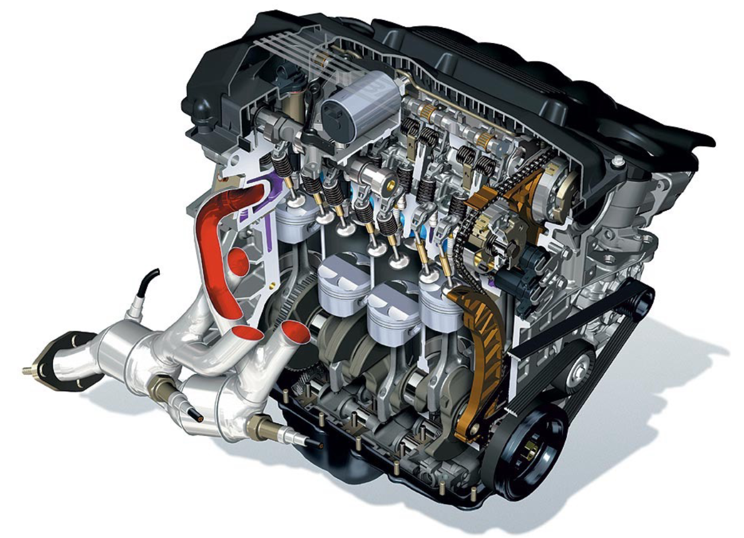
Engines and Fuel cells
Exercise ENG2

Slide 2
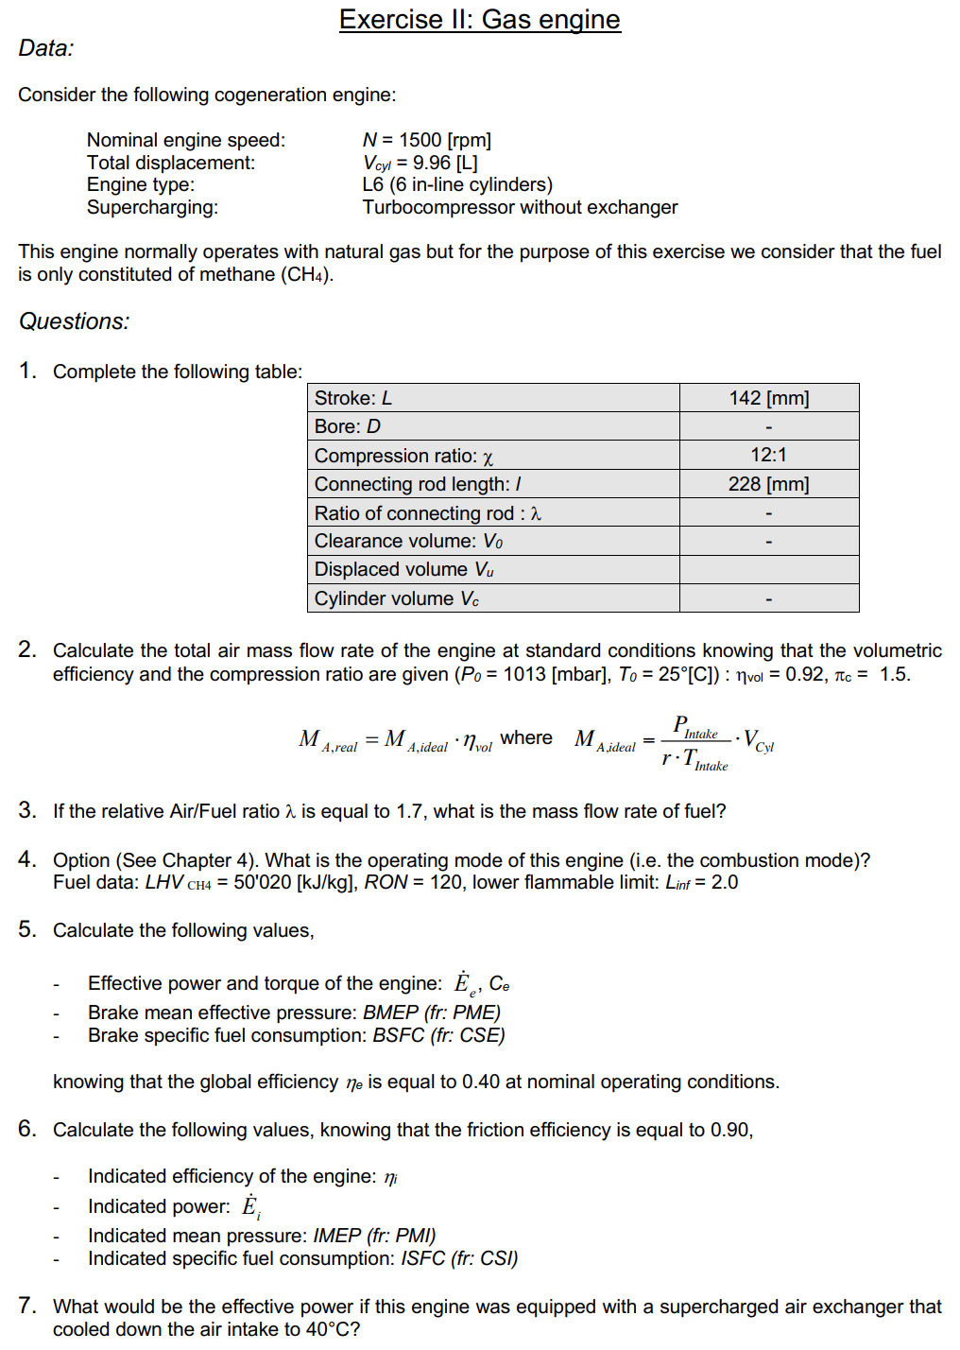
Exercise ENG2: Gas engine
Reference:
1. Formula Memento, Page 1, 4-7
2. Lecture 3, page 16-22, 33-36

Slide 3
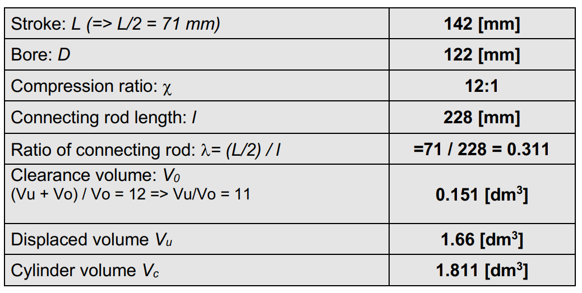

Exercise ENG2: Gas engine
Reference:
1. Formula Memento, Page 1, 4-7
2. Lecture 3, page 16-22, 33-36

Slide 4
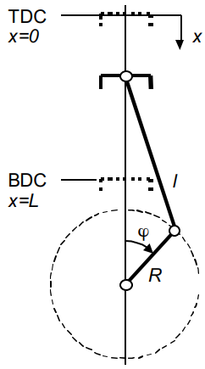

Exercise ENG2: Gas engine
Reference:
1. Formula Memento, Page 1, 4-7
2. Lecture 3, page 16-22, 33-36

Slide 5
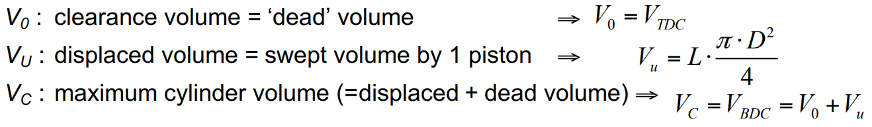
Exercise ENG2: Gas engine
Reference:
1. Formula Memento, Page 1, 4-7
2. Lecture 3, page 16-22, 33-36

Slide 6
Exercise ENG2: Gas engine
Reference:
1. Formula Memento, Page 1, 4-7
2. Lecture 3, page 16-22, 33-36

Slide 7
Exercise ENG2: Gas engine
Reference:
1. Formula Memento, Page 1, 4-7
2. Lecture 3, page 16-22, 33-36

Slide 8
Exercise ENG2: Gas engine
Compression ratio related to pressure
Reference:
1. Formula Memento, Page 1, 4-7
2. Lecture 3, page 16-22, 33-36
Air density, how come?
Geometric compression ratio

Slide 9

Exercise ENG2: Gas engine
Reference:
1. Formula Memento, Page 1, 4-7
2. Lecture 3, page 16-22, 33-36
Air density, how come?
$$P_{air}V_{air}=n_{air}RT_{air}=\frac{m_{air}}{M_{air}}RT_{air}=\frac{R}{M_{air}}m_{air}T_{air}=r_{air}m_{air}T_{air}$$

Slide 10

Exercise ENG2: Gas engine
Compression ratio related to pressure
Reference:
1. Formula Memento, Page 1, 4-7
2. Lecture 3, page 16-22, 33-36
Air density, how come?
$$P_{air}V_{air}=n_{air}RT_{air}=\frac{m_{air}}{M_{air}}RT_{air}=\frac{R}{M_{air}}m_{air}T_{air}=r_{air}m_{air}T_{air}$$
$$ρ_{air}=\frac{m_{air}}{V_{air}}=\frac{P_{air}}{r_{air}T_{air}}$$
Geometric compression ratio

Slide 11
Exercise ENG2: Gas engine
Reference:
1. Formula Memento, Page 1, 4-7
2. Lecture 3, page 16-22, 33-36
Air density, how come?
$$P_{air}V_{air}=n_{air}RT_{air}=\frac{m_{air}}{M_{air}}RT_{air}=\frac{R}{M_{air}}m_{air}T_{air}=r_{air}m_{air}T_{air}$$
$$ρ_{air}=\frac{m_{air}}{V_{air}}=\frac{P_{air}}{r_{air}T_{air}}$$

Slide 12

Exercise ENG2: Gas engine
Reference:
1. Formula Memento, Page 1, 4-7
2. Lecture 3, page 16-22, 33-36
Rpm to cycle/s
$$ρ_{air}=\frac{m_{air}}{V_{air}}=\frac{P_{air}}{r_{air}T_{air}}$$

Slide 13
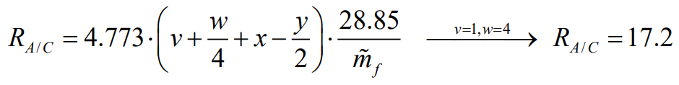
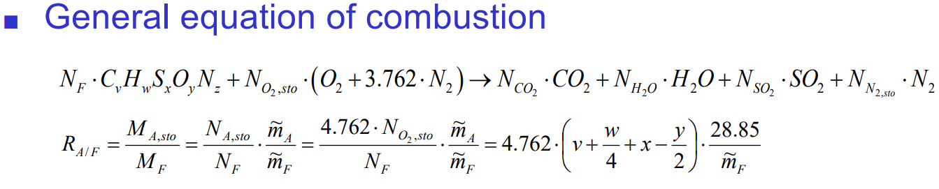
Exercise ENG2: Gas engine
Reference:
1. Formula Memento, Page 1, 4-7
2. Lecture 3, Page 16-22, 33-36

Slide 14
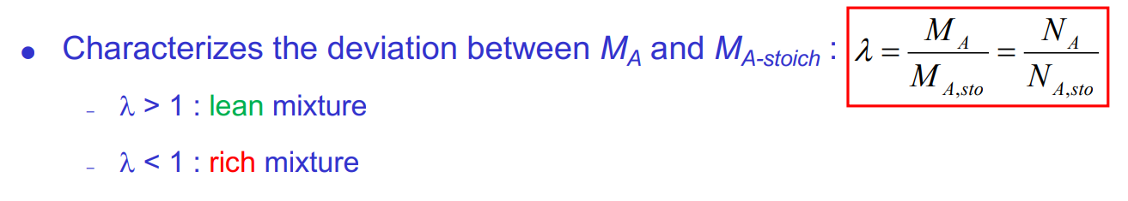
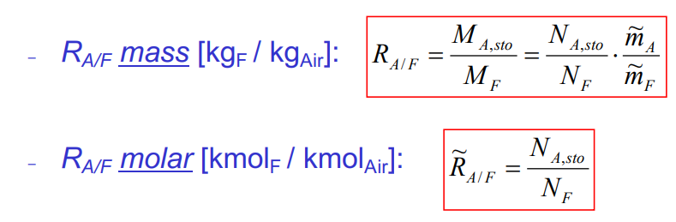
Exercise ENG2: Gas engine
Reference:
1. Formula Memento, Page 1, 4-7
2. Lecture 3, Page 16-22, 33-36

Slide 15
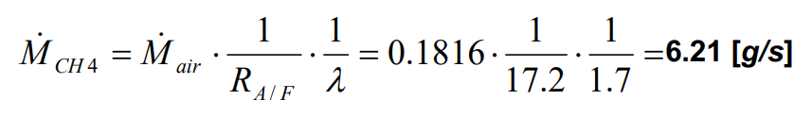
Exercise ENG2: Gas engine
Reference:
1. Formula Memento, Page 1, 4-7
2. Lecture 3, Page 16-22, 33-36

Slide 16
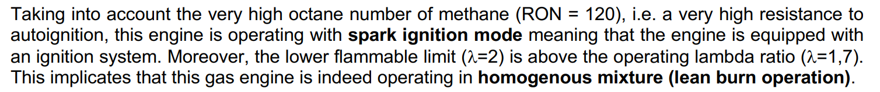
Exercise ENG2: Gas engine
Reference:
1. Formula Memento, Page 1, 4-7
2. Lecture 3, Page 16-22, 33-36

Slide 17
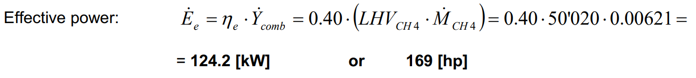
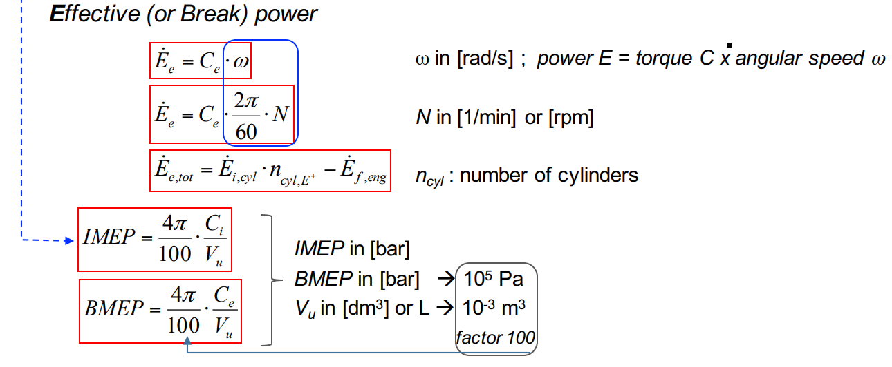

Exercise ENG2: Gas engine
Reference:
1. Formula Memento, Page 1, 4-7
2. Lecture 3, Page 16-22, 33-36
$$LHV_{CH_{4}}=50020 kJ/kg$$

Slide 18
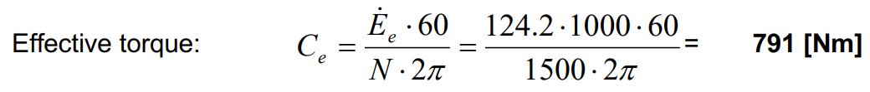
Exercise ENG2: Gas engine
Reference:
1. Formula Memento, Page 1, 4-7
2. Lecture 3, Page 16-22, 33-36
$$LHV_{CH_{4}}=50020 kJ/kg$$

Slide 19
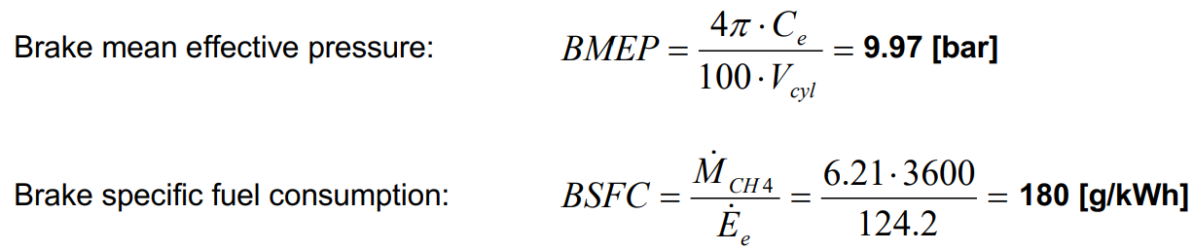
Exercise ENG2: Gas engine
Reference:
1. Formula Memento, Page 1, 4-7
2. Lecture 3, Page 16-22, 33-36
$$LHV_{CH_{4}}=50020 kJ/kg$$

Slide 20
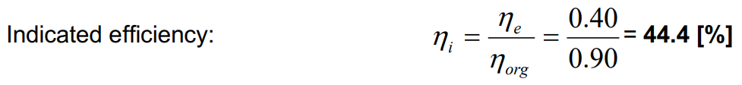

Exercise ENG2: Gas engine
Global efficiency: $η_{e}=0.4$
Reference:
1. Formula Memento, Page 1, 4-7
2. Lecture 3, Page 16-22, 33-36

Slide 21
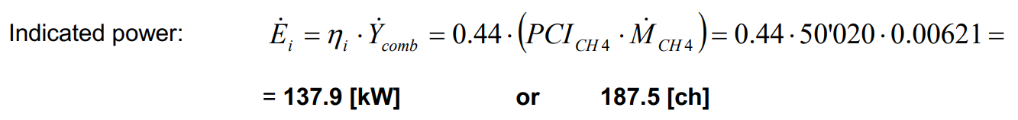
Exercise ENG2: Gas engine
Global efficiency: $η_{e}=0.4$
Reference:
1. Formula Memento, Page 1, 4-7
2. Lecture 3, Page 16-22, 33-36

Slide 22

Exercise ENG2: Gas engine
Global efficiency: $η_{e}=0.4$
Reference:
1. Formula Memento, Page 1, 4-7
2. Lecture 3, Page 16-22, 33-36
Indicated torque: $C_{i}=\frac{C_{e}}{0.9}=\frac{791}{0.9}=878.9 [Nm]$

Slide 23

Exercise ENG2: Gas engine
Global efficiency: $η_{e}=0.4$
Reference:
1. Formula Memento, Page 1, 4-7
2. Lecture 3, Page 16-22, 33-36
Indicated torque: $C_{i}=\frac{C_{e}}{0.9}=\frac{791}{0.9}=878.9 [Nm]$
Indicated mean pressure: $IMEP=\frac{4π}{100}⋅\frac{C_{i}}{V_{u}}=11.07 [bar]$

Slide 24
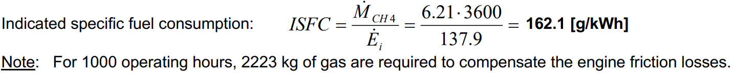
Exercise ENG2: Gas engine
Global efficiency: $η_{e}=0.4$
Reference:
1. Formula Memento, Page 1, 4-7
2. Lecture 3, Page 16-22, 33-36
Indicated torque: $C_{i}=\frac{C_{e}}{0.9}=\frac{791}{0.9}=878.9 [Nm]$
Indicated mean pressure: $IMEP=\frac{4π}{100}⋅\frac{C_{i}}{V_{u}}=11.07 [bar]$

Slide 25

Exercise ENG2: Gas engine
$$E_{e}=η_{e}⋅Engine speed⋅E_{CH_{4}}=η_{e}⋅\frac{N\left(rpm\right)}{120}⋅{\dot{M}}_{CH_{4}}⋅LHV_{CH_{4}}$$
Reference:
1. Formula Memento, Page 1, 4-7
2. Lecture 3, Page 16-22, 33-36

Slide 26

Exercise ENG2: Gas engine
$$E_{e}=η_{e}⋅Engine speed⋅E_{CH_{4}}=η_{e}⋅\frac{N\left(rpm\right)}{120}⋅{\dot{M}}_{CH_{4}}⋅LHV_{CH_{4}}$$
Reference:
1. Formula Memento, Page 1, 4-7
2. Lecture 3, Page 16-22, 33-36
$$E_{e}=η_{e}⋅\frac{N\left(rpm\right)}{120}⋅{\dot{M}}_{air}⋅\frac{1}{λR_{A/F}}⋅LHV_{CH_{4}}$$

Slide 27

Exercise ENG2: Gas engine
$$E_{e}=η_{e}⋅Engine speed⋅E_{CH_{4}}=η_{e}⋅\frac{N\left(rpm\right)}{120}⋅{\dot{M}}_{CH_{4}}⋅LHV_{CH_{4}}$$
Reference:
1. Formula Memento, Page 1, 4-7
2. Lecture 3, Page 16-22, 33-36
$$E_{e}=η_{e}⋅\frac{N\left(rpm\right)}{120}⋅{\dot{M}}_{air}⋅\frac{1}{λR_{A/F}}⋅LHV_{CH_{4}}$$
$$E_{e}=η_{e}⋅\frac{N\left(rpm\right)}{120}⋅\frac{P_{coll}}{r_{air}T_{coll}}⋅\frac{1}{λR_{A/F}}⋅LHV_{CH_{4}}$$

Slide 28
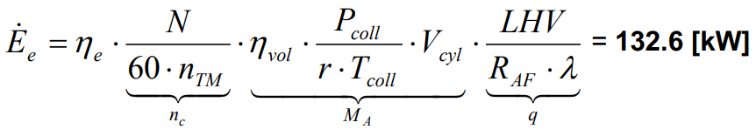
Exercise ENG2: Gas engine
$$E_{e}=η_{e}⋅Engine speed⋅E_{CH_{4}}=η_{e}⋅\frac{N\left(rpm\right)}{120}⋅{\dot{M}}_{CH_{4}}⋅LHV_{CH_{4}}$$
Reference:
1. Formula Memento, Page 1, 4-7
2. Lecture 3, Page 16-22, 33-36
$$E_{e}=η_{e}⋅\frac{N\left(rpm\right)}{120}⋅{\dot{M}}_{air}⋅\frac{1}{λR_{A/F}}⋅LHV_{CH_{4}}$$
$$E_{e}=η_{e}⋅\frac{N\left(rpm\right)}{120}⋅\frac{P_{coll}}{r_{air}T_{coll}}⋅\frac{1}{λR_{A/F}}⋅LHV_{CH_{4}}$$
$$T_{coll}=40+273.15=313.15 K$$

Slide 29
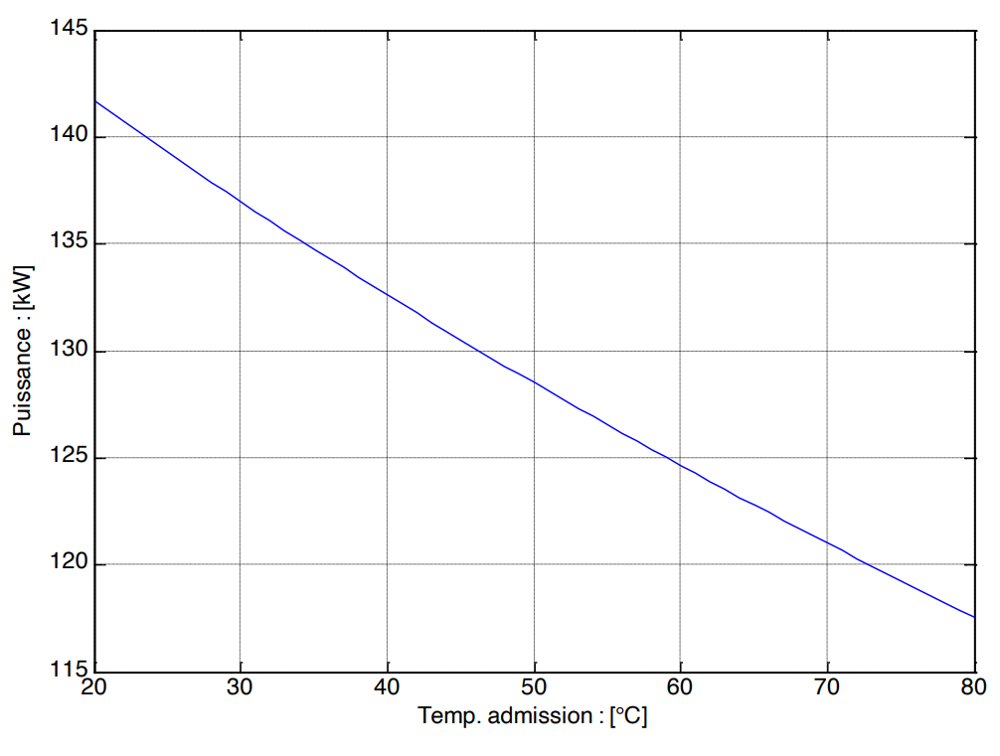
Exercise ENG2: Gas engine
$$E_{e}=η_{e}⋅Engine speed⋅E_{CH_{4}}=η_{e}⋅\frac{N\left(rpm\right)}{120}⋅{\dot{M}}_{CH_{4}}⋅LHV_{CH_{4}}$$
Reference:
1. Formula Memento, Page 1, 4-7
2. Lecture 3, Page 16-22, 33-36
$$E_{e}=η_{e}⋅\frac{N\left(rpm\right)}{120}⋅{\dot{M}}_{air}⋅\frac{1}{λR_{A/F}}⋅LHV_{CH_{4}}$$
$$E_{e}=η_{e}⋅\frac{N\left(rpm\right)}{120}⋅\frac{P_{coll}}{r_{air}T_{coll}}⋅\frac{1}{λR_{A/F}}⋅LHV_{CH_{4}}$$
$$T_{coll}=40+273.15=313.15 K$$

Slide 30
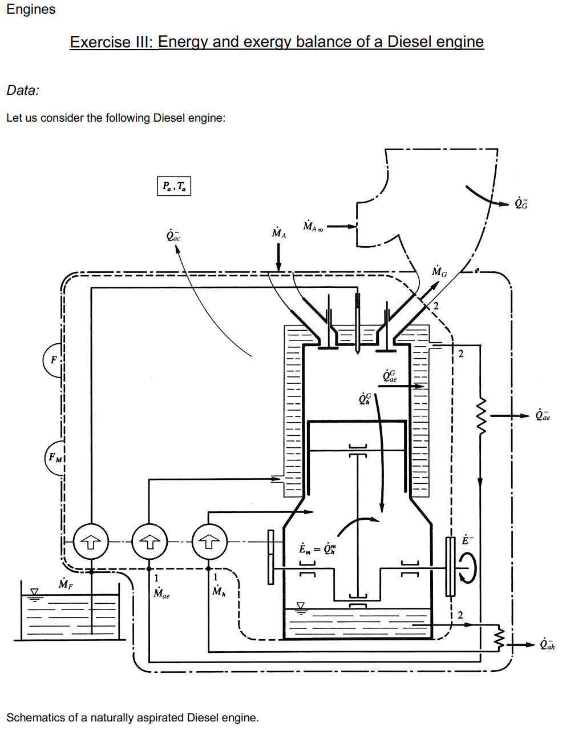
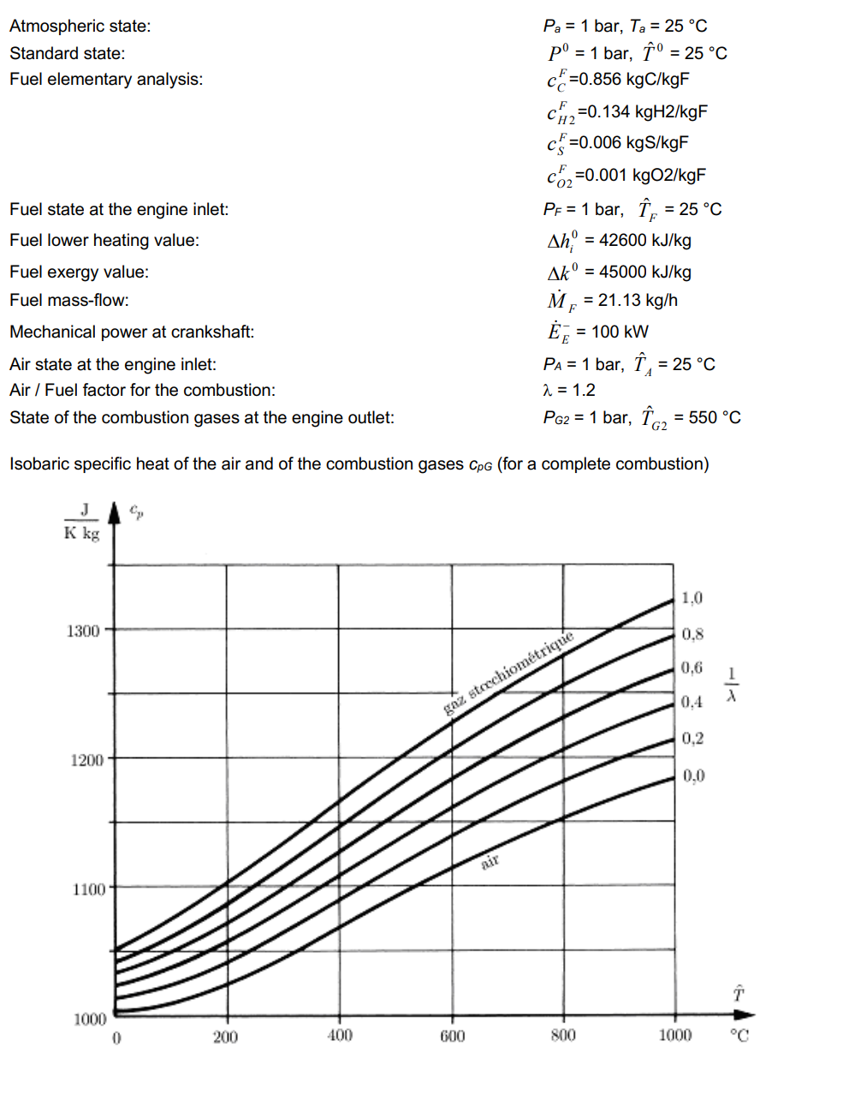
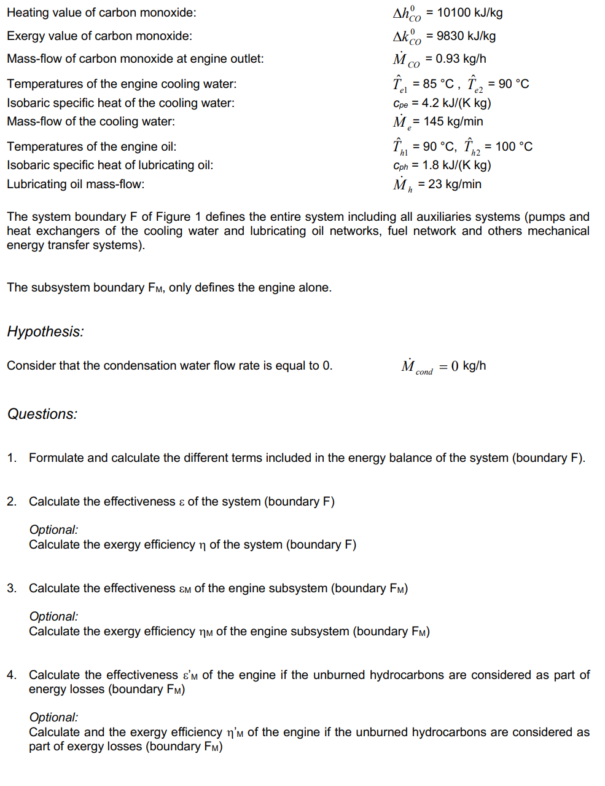
Exercise ENG3: Energy and exergy balance of a Diesel engine
Notes:
这个习题的主题是关于柴油发动机的能量与火用（exergy）平衡分析。具体来说，题目要求学生从能量和火用的角度分析柴油发动机的工作情况，包括对系统边界的能量平衡计算、系统和子系统的有效性（effectiveness）分析，并进一步探讨未燃碳氢化合物的能量损失对发动机整体效能的影响。
重点内容：
1. 能量平衡分析：
• 学生需要根据柴油机的燃油输入、空气输入、冷却水、润滑油等不同部分的能量流，进行能量守恒的计算。这部分分析涉及到输入和输出功率、热损失等要素。
2. 火用分析（Exergy Analysis）：
• 火用分析的重点是计算系统中各部分的有效利用能量，特别是燃料的火用值（Δ𝐸_f^0），并通过火用效率来衡量系统的损失和改进空间。
• 题目要求学生计算整个系统的火用效率以及发动机单独部分的火用效率，并考虑未燃碳氢化合物是否作为能量损失。
3. 有效性（Effectiveness）计算：
• 有效性定义了系统或子系统在不同能量转换过程中达到的效率。题目分别要求学生计算整个系统、子系统和含未燃碳氢化合物的有效性。
背后的意义：
• 能量与火用分析的结合：这一练习让学生理解能量与火用分析的区别和联系。能量守恒是基本原理，但能量的质量（即火用）在实际过程中可能下降，因此火用分析提供了更细致的能效评估。
• 工业应用中的优化：柴油发动机广泛用于工业和交通领域。通过这种分析，学生可以学会识别和评估系统中能量的浪费情况，进而为提高系统效率、减少环境污染提供理论支持。
• 可持续发展和节能降耗的思考：随着能源和环保要求的提升，如何更有效地利用燃料、减少排放、提高效率是柴油机等内燃机技术优化的重要方向。这一练习帮助学生建立这种分析能力。

