Slide 1
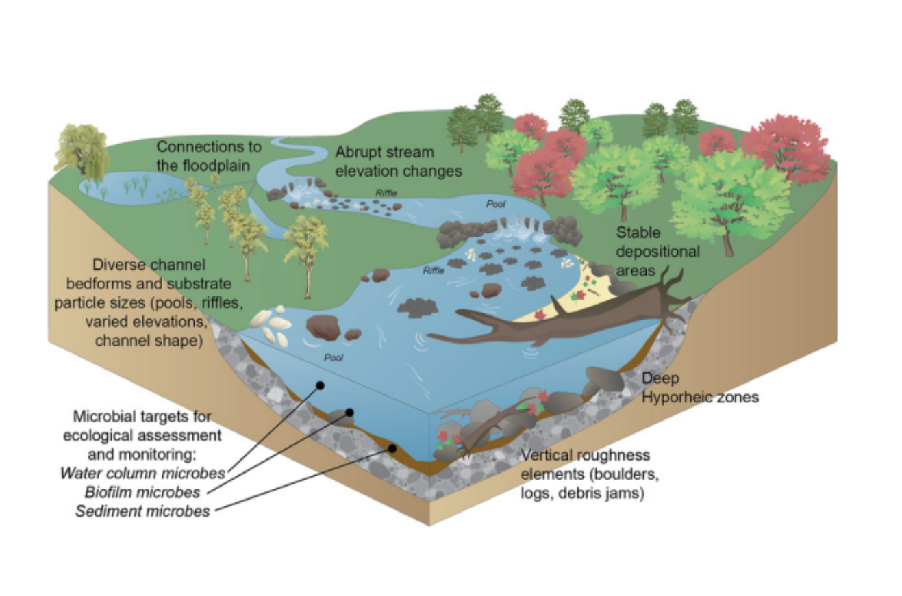
Linkages between flow regime, biota, and ecosystem processes:
Implications for river restoration
by Margaret Palmer and Albert Ruhi

Slide 2
Introduction
Goal: understand the mechanisms whereby flow regimes affect biota and ecosystem processes, and the interplay between them, in a three way interaction we call the flow-biota-ecosystem processes nexus
Findings:
Temporal changes in flow magnitude can heighten risks of community collapse and disrupt ecosystem functions like primary production.
Storm flows enhance terrestrial carbon input to rivers and influence water chemistry and biogeochemical processes, affecting food webs.
Extreme flows impact stream metabolism disproportionately, with effects varying based on flow predictability
Combining flow pattern changes with stable isotope analysis reveals how habitat and basal resource changes affect food web structure
Notes:
review emerging advances in hydroecology, as well as challenges → restoration. Early stage of this “flow-biota-ecosystem processes” nexus → need more research.

Slide 3
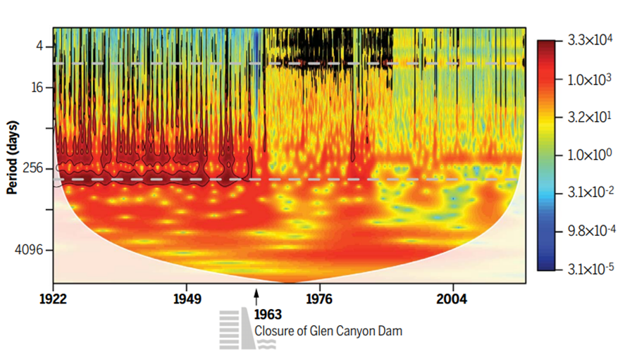
Hydrologic alteration and its biotic effect
Biota degradation by dam building, diversion or abstraction of water, clearing of land, and climate change.
Changes in flow regimes disrupt species adapted to natural variations.
Closure of Glen Canyon Dam is a typical example of changes in flow management that had a strong impact on communities.
Notes:
degradation by dam building, diversion or abstraction of water, clearing of land, and climate change. For example, Closure of Glen Canyon Dam: typical example of flow management that had a strong impact on communities. 1963 → regime changed completely. Muted flow seasonally opened niches for non-natives, particularly organisms adapted to stable and resource-limited environments. At the expense of many native fishes adapted to highly variable flow conditions.

Slide 4
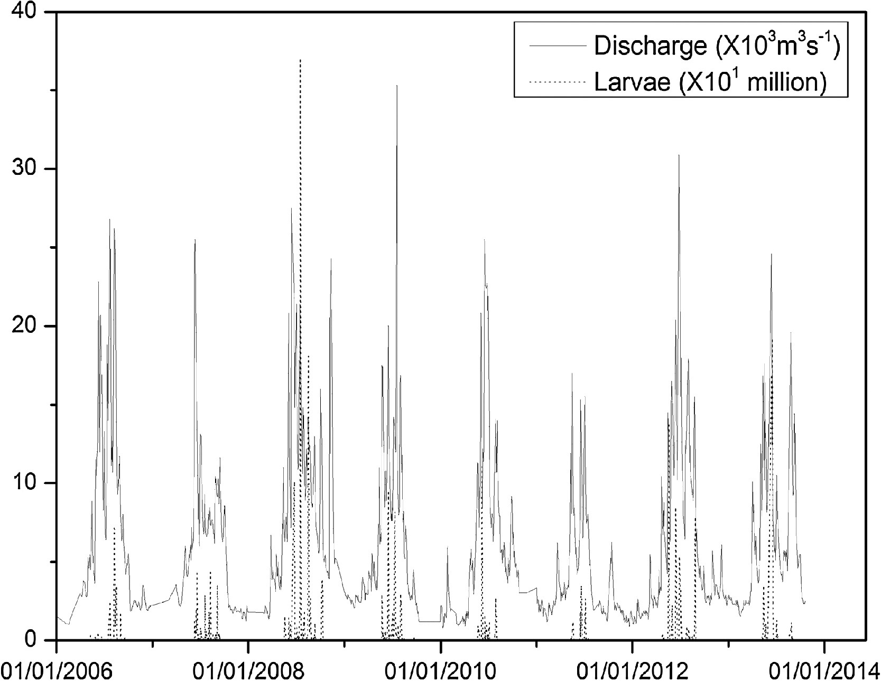
Biota and Flow Variation as Stressors
Figure: The seasonal flows and the occurrence of larvae from 2006 to 2013. ( F. Shuai et al., Silver carp larva abundance in response to river flow rate revealed by cross-wavelet modelling. Ecol. Modell. 383, 98–105 (2018). doi: 10.1016/j. ecolmodel.2018.05.020)
Flow regimes described by frequencies, amplitudes, and phases
Flow regimes influence biota through:
Physical Stress:
Floods remove substrate habitats.
Drought reduces oxygen in isolated pools.
Predation and Competition:
High flows suppress invasive predators.
Reduced flows allow competitors to dominate.
Energy and Resource Availability:
Floods bring nutrients (terrestrial carbon), supporting detritivores like shredders.
Drought reduces basal resources like algae, disrupting food webs.
Example: spawning and peak flow are interconnected over a particular magnitude.
Notes:
Consequences? alteration of flow. Flow regime = key driver of a river’s structure and functioning. characterized by magnitude, frequency, duration, timing. Spatiotemporal variation in flow exert direct and indirect control on the composition, structure, and dynamics of communities at local and regional scales.
Flow can be a source of stress: dictate the quality of the habitat in which organisms live (direct), as well as keeping predators/competitors at bay (indirect), controlling energy sources that enters the food web, or by affecting movement of organisms and matter.
To illustrate, spawning and peak flow big correlations, proving that flow regimes has big influence

Slide 5
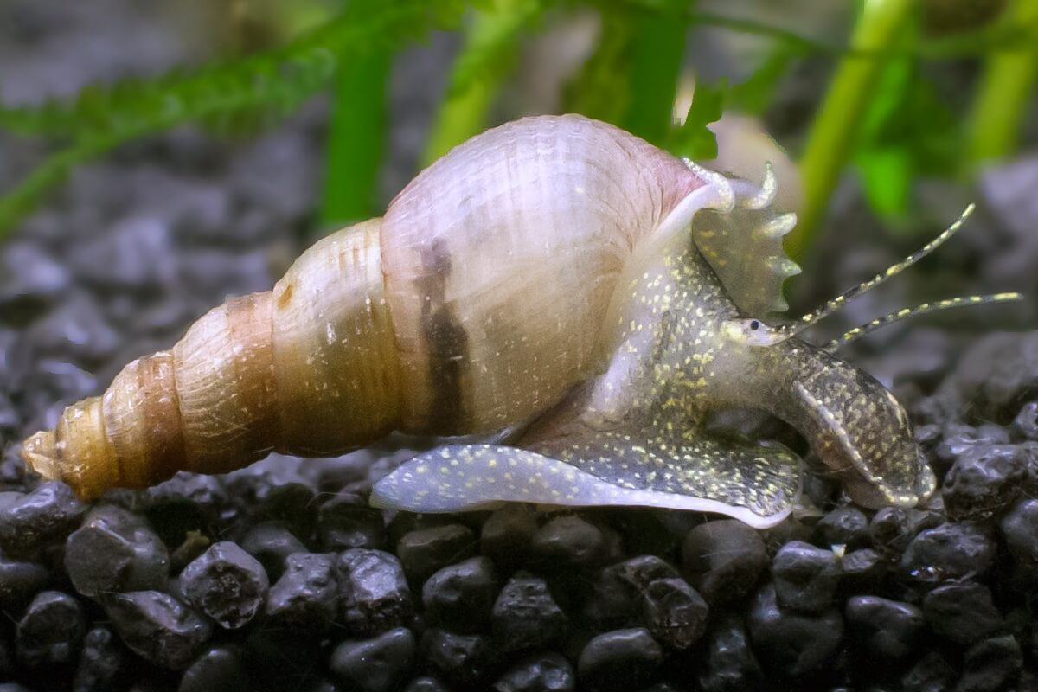
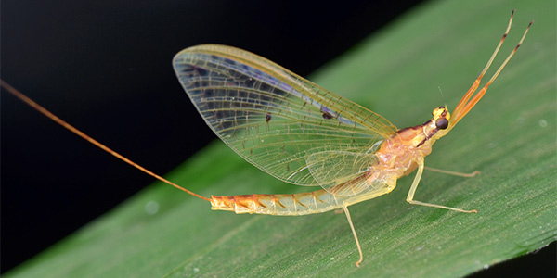
Adaptations to Flow Variability
by analyzing community’s taxonomic characteristics (e.g., species classification) and functional characteristics (e.g., dispersal modes, feeding strategies) → analyze organisms’ traits.
Organisms have evolved traits to cope with natural flow variability:
Resilience to Drought:
  Invertebrates burrow into hyporheic zones to survive.
  Fish retreat to perennial refuges.
Resistance to Floods:
  Streamlined bodies and anchoring traits in snails and algae.
Recolonization:
  Mobile organisms (like mayflies) recolonize post-disturbance.
Notes:
flow regime has shaped species adaptations - life history strategies, behaviours, morphologies of both aquatic and riparian organisms. low-flow and high-flow events can temporarily reduce abundance and diversity of invertebrates and fishes. However, long-time patterns also have big consequences → develop ability to persist under physical stress. has been proven that flow characteristics (amplitude…) can be connected to organismal dynamics. Now how do these organisms react? By studying community’s taxonomic characteristics (e.g., species classification) and functional characteristics (e.g., dispersal modes, feeding strategies) → analyze organisms’ traits, that they’ve grown overtime.
For instance, SLIDE
asynchronous dynamics = when populations or communities respond differently to changes across space and time → maximizing stability because localized adverse events do not simultaneously impact all populations or habitats. Portfolio effect describes how diversity in phenotypic traits (e.g., timing, behaviour, or physiology) spread the risk of adverse conditions. Ex: different spawning time → some groups may avoid floods that could wipe out early life stages.
end by saying that complex system, without which ecosystem can’t be considered. → Raphael

Slide 6
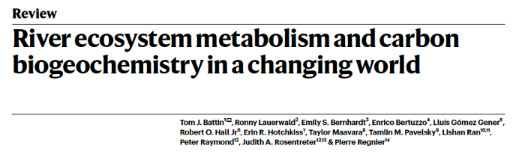
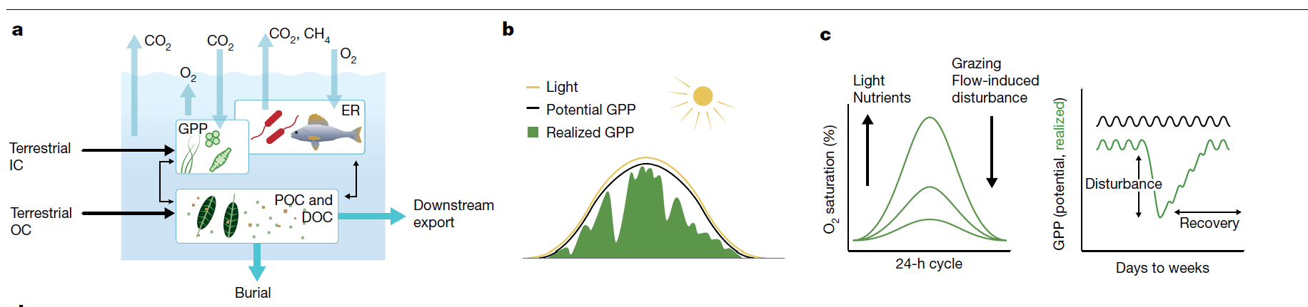
River ecosystem processes
Species loss = ecosystem functions loss (ex : detrital decomposition)
The metabolic balance between heterotrophic and autotrophic production that provides resources for consumers can shift seasonally or with changing flows, as can hydrologic connectivity that influences inputs of OM and solutes to rivers
Notes:
Rivers produce, transform, and store organic matter (OM) and nutrients.
These fluxes are influenced by stream ecosystem metabolism, which can be described as net ecosystem production, or the difference between gross primary production (GPP) and ecosystem respiration (ER).

Slide 7
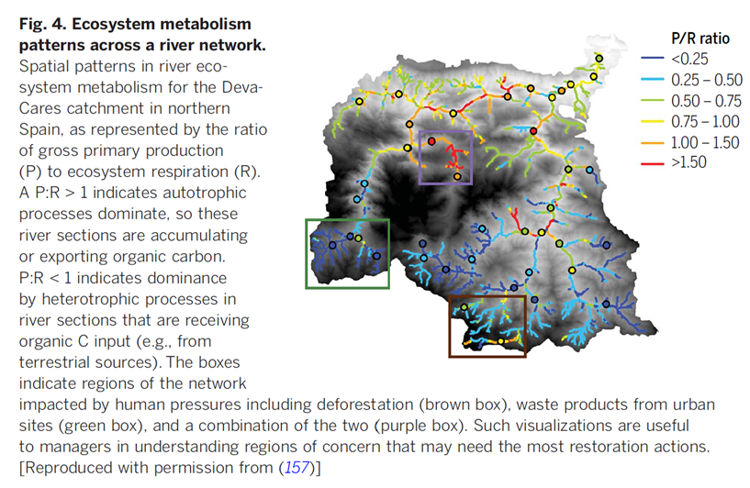
Flow variation and river ecosystem processes
Heterotrophic
Deva-Cares catchment (northern Spain)
Autotrophic
Tamara Rodríguez-Castillo & All
Notes:
Flow regime is a major driver of the spatiotemporal variability of rivers ecosystem processes
Spatial patterns in river ecosystem metabolism for the Deva-Cares catchment in northern Spain
P:R > 1 indicates autotrophic processes dominate, so these river sections are accumulating or exporting organic carbon. P:R < 1 indicates dominance by heterotrophic processes in river sections that are receiving organic C input (e.g., from terrestrial sources).

Slide 8
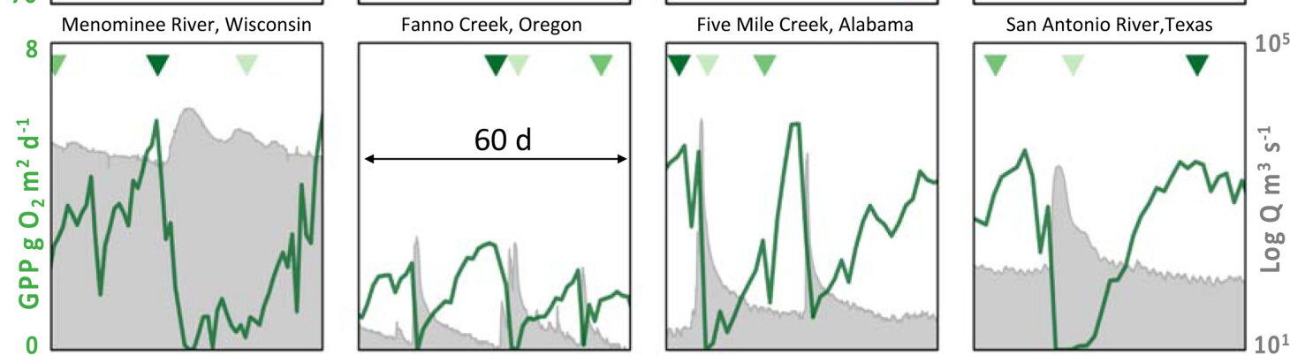
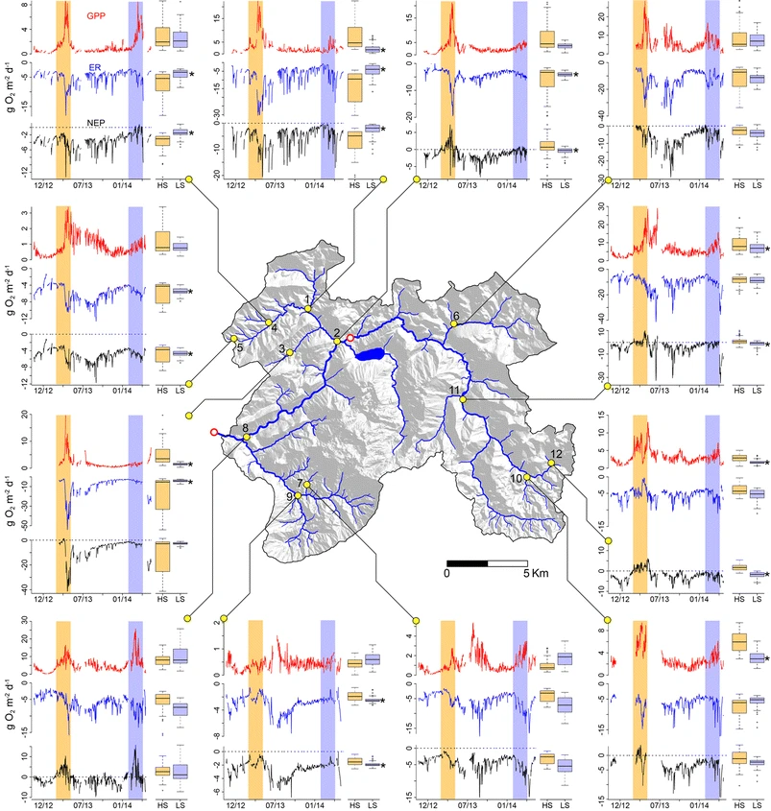
Flow variation and river ecosystem processes
Strong GPP seasonal pattern (less predictable in regions with little seasonality and/or continual canopy cover)
Predictability
Storms event induce GPP drop
Disturbance of benthic producers (scouring flows) + low light availability because of turbidity
>
GPP
ER
NEP
E. S. Bernhardt
Amber J. Ulseth
Notes:
Flow regime is a major driver of the spatiotemporal variability of rivers ecosystem processes
Increasing autotrophy at high discharge seems counterintuitive because elevated discharge may disturb benthic algae and therefore depress GPP. For instance, others have reported prolonged autotrophy during baseflow in spring or summer, which was punctuated by storms reducing GPP.
While we observed a decrease in both GPP and ER following large rain events resulting in high stream discharge spates throughout the study period (Figure 1), snowmelt in the YRN differs from storm spates in that it is a sustained but likely non-scouring, increase in stream flow.

Slide 9
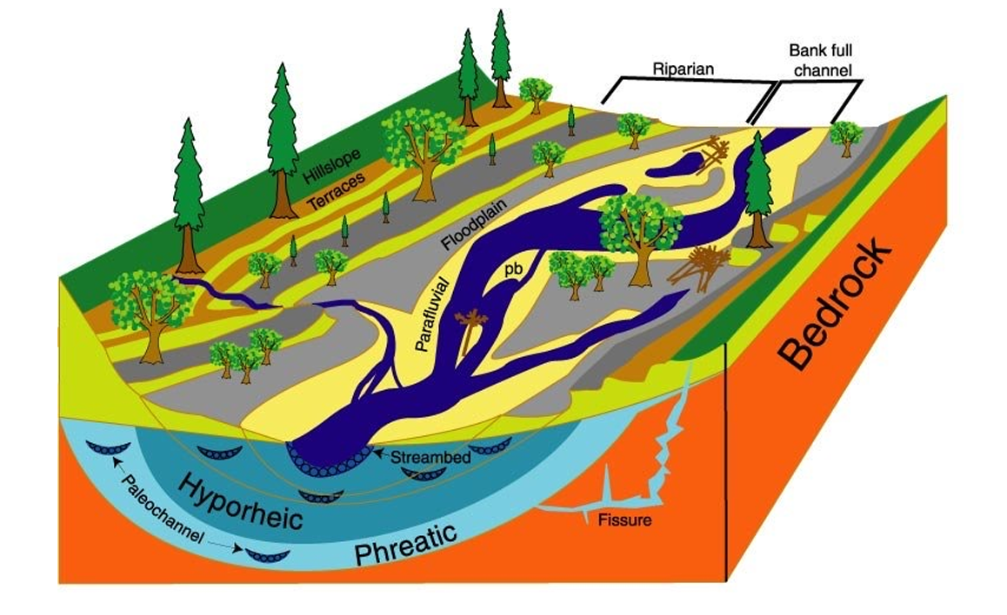
Hydrologic connectivity and solute dynamics
Not part of the flow regime but strongly linked to stream processes or patterns
Notes:
Can be characterized by timing, duration, and frequency and then linked
to stream processes or patterns.

Slide 10
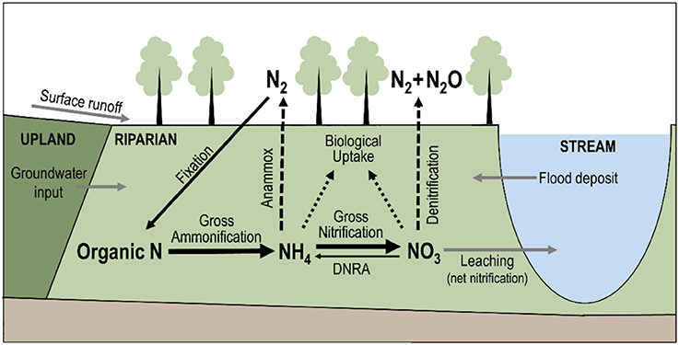
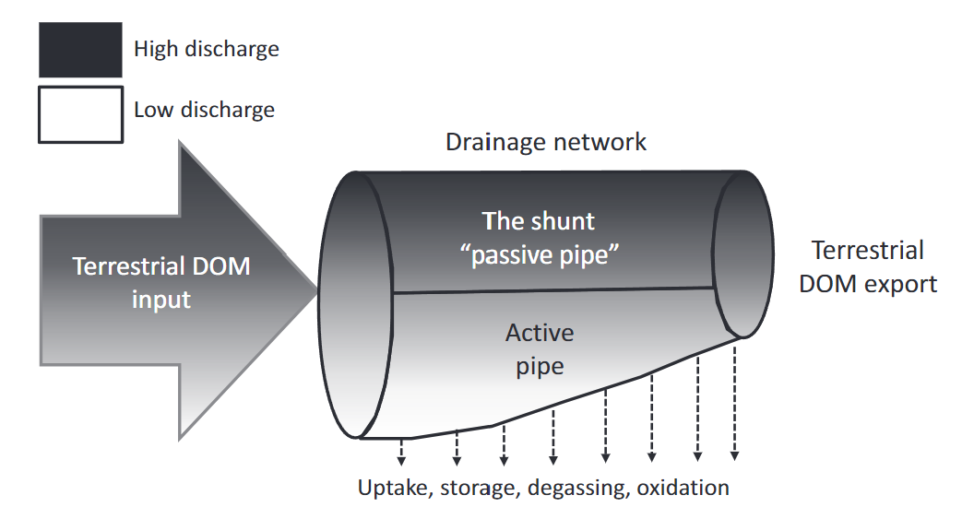
Hydrologic connectivity and solute dynamics
It influences the nature and the quantity of OM and nutrients entering streams and rivers waters.
A high connectivity with watershed => High inputs of solutes
Energetic and water quality importance of network connectivity to soils and diverse landscape elements (such as wetlands and ponds) is becoming a major area of research
The way OM is degrade
Schematic representation of the nitrogen cycle in riparian corridors. Gilles Pinay et all.
Peter A. R Aymond and all.
Notes:
High terrestrial DOC input is dominated by high-discharge events it may exceed microbial uptake degradation ability. It is then shunted down to be processed in larger part of the network. However, this depends on DOM composition (how much it is usable by biota).
DOC that enters the watershed at lower to moderate discharge events enters the active pipe, where it may be processed and is not exported

Slide 11
Hydrologic influence on decomposition via consumers
Detritus (decaying DOM) supports most of the consumers. It is the basis of the aquatic food web.
Water cover substantial for decomposition.
In perennial streams, microbial processes best explained by daily variability in discharge.
Intermittent flow can impede microbial and consumer colonization of POM with consequences on the associated food-web

Slide 12
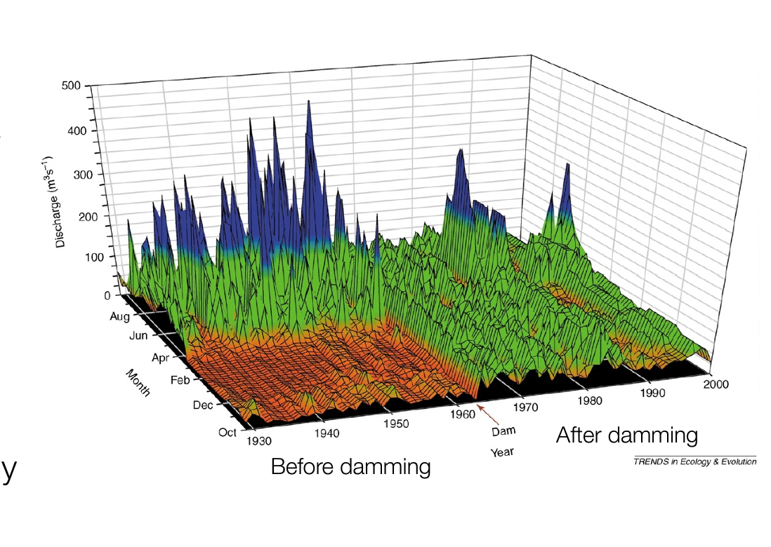
Urbanizations and dams change flow regimes
Less seasonal
River flow peaks can be muted but hydropeaking due to electricity production (hours to week scale)
Temperature peaks
Downstream organisms and ecosystems are subject to multiple periodic stress
Notes:
Flow regime below hydropower dams and in urban streams are highly altered. Less seasonal than daily rainfall would suggest. Especially with large dams.
Muted river flow peak but hydropeaking at human-scale (hours to weeks)

Slide 13
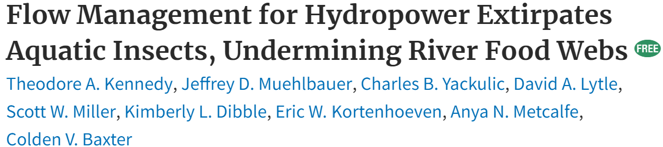
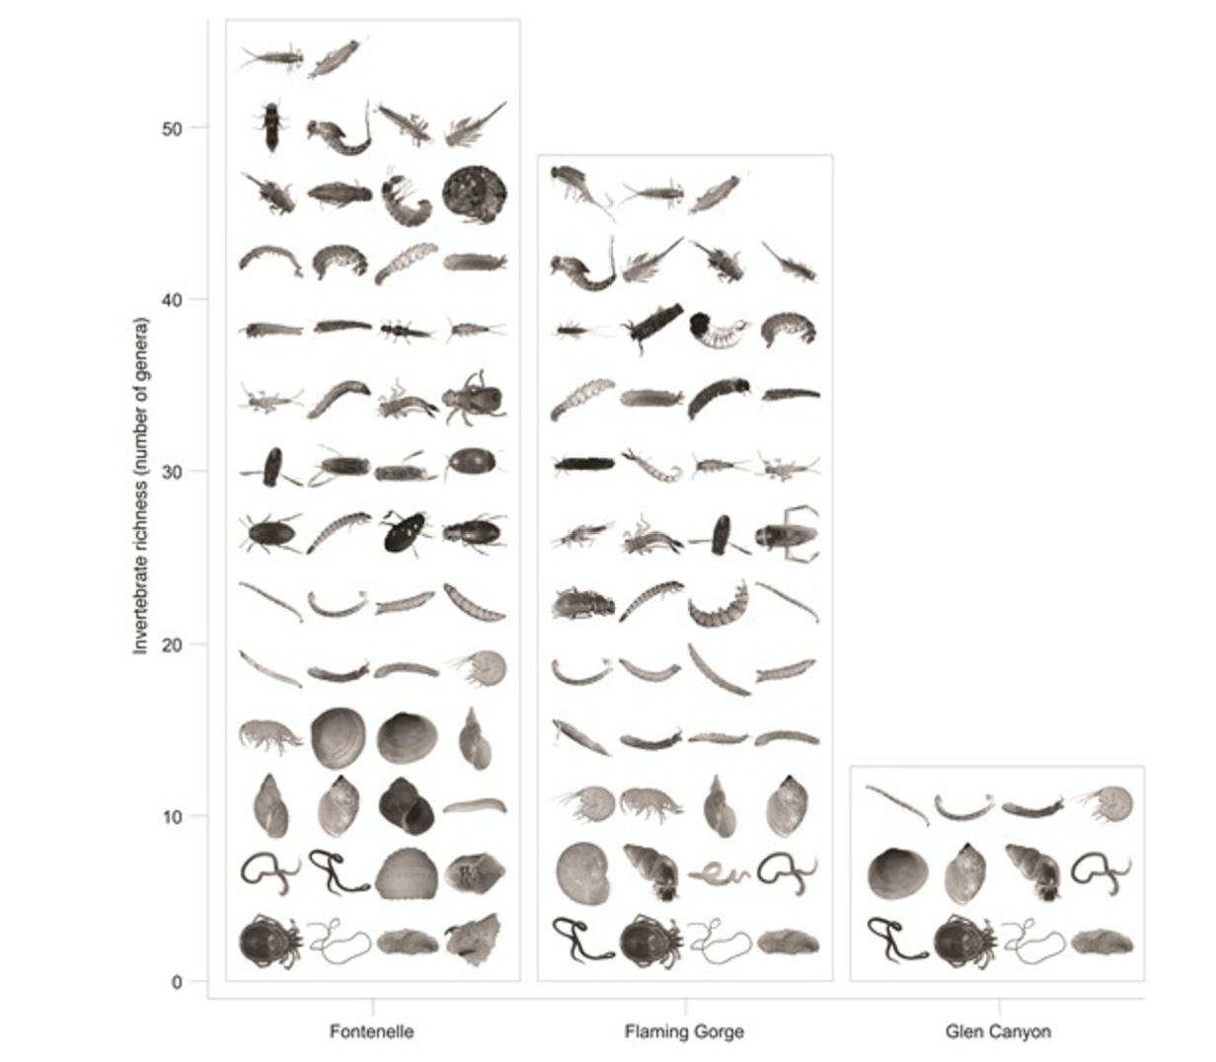
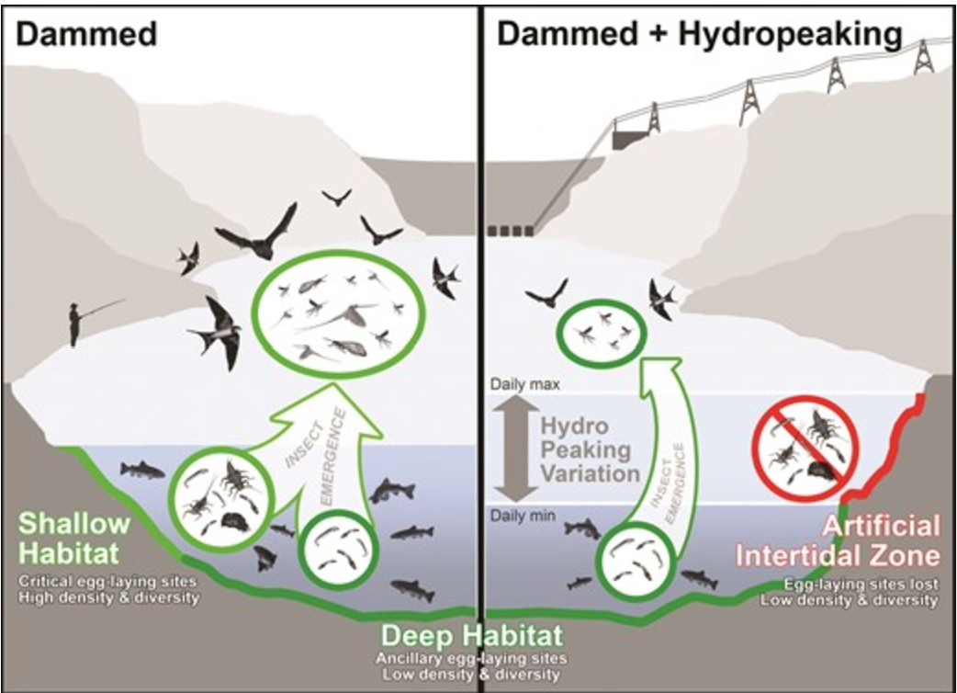
Urbanizations and dams change
flow regimes
Mainly non insects
Hydropeaking index
Notes:
Ecologically important insect groups such as mayflies, stoneflies, and caddisflies cement their eggs along river-edge habitats, making them especially sensitive to dam water management practices such as hydropeaking that affect these edge habitats.

Slide 14
Urbanizations and dams change flow regimes
Urban streams have a strongly altered flow regime
Isolated pools in stream with lowered base-flow : Hypoxia
Higher scouring peak flow (More runoff + less infiltration)
Pulses of solutes, including N,DOM, and various pollutant.
However, it is hard to distinguish flow effect from pollutant concentration

Slide 15
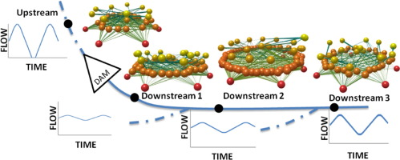
Linkage between flow, biota and ecosystems processes
Flow-induced changes in dominant resource type (algae vs detritus), resource quantity (biomass) or resource quality (nutrient content) can propagate to higher trophic levels
basal resources (red), intermediate consumers (orange) and top predators (yellow), and the interactions among them
The number of nodes and trophic links in the food webs increased downstream of the dam with a large fraction of intermediate species and a wider food web
Jordi-René Mor & All
Notes:
The higher nutritional quality of algae relative to detritus (Bowen, 1987, Stelzer and Lamberti, 2002), and the associated increase in algal production downstream of dams, can turn detritus-based into algae-based food webs (Power et al., 2013). Several studies have shown that dams vastly reduce the frequency of high flows, favouring less dynamic hydromorphological conditions downstream (Batalla et al., 2004, Döll et al., 2009). This reduction in the frequency and intensity of floods often results in the terrestrialization of fluvial systems.

Slide 16
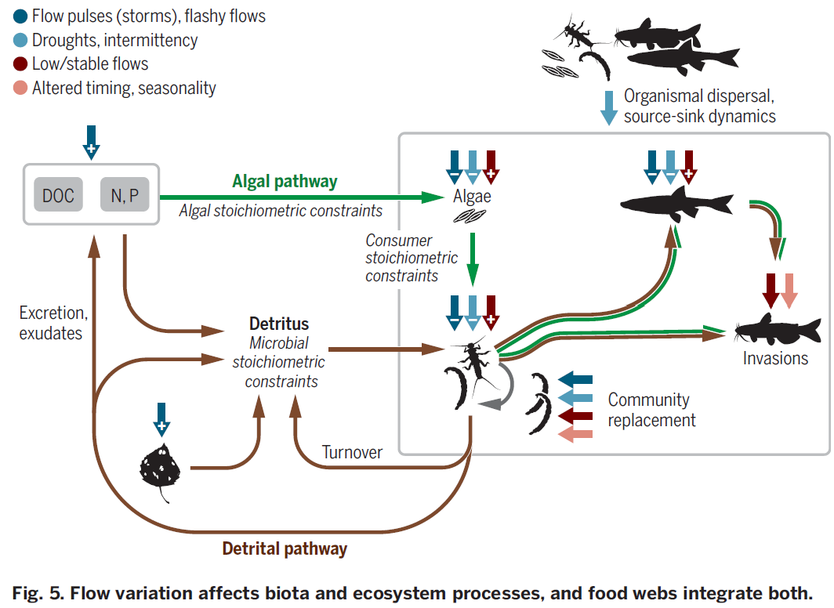
Linkage between flow, biota and ecosystems processes
Notes:
Hydrologic connectivity along river networks is a first, landscape-level filter constraining dispersal of organisms in river networks.
Extreme flow variation (floods and droughts) are a source of disturbance to all organisms (gray box), but particularly to the higher trophic levels given their higher metabolic demands.
In turn, flow variation controls inputs of nutrients and terrestrial leaf litter to the stream, which influences microbial activity and the relative contributions of the detrital (brown) and algal (green) pathways in sustaining aquatic consumers.
Not just quantity but also food quality (e.g., C:N and C:P ratios) influence dietary choices of consumers and thus trophic transfer efficiency.
Finally, alteration of flow regimes may influence all these compartments and may also open niches for new players. If biological invasions occur at the top of the food web, these have the potential to divert energy away from native predators and to alter food-web structure through top-down controls.

Slide 17
Restoration practice
“Restoring full flow regimes rather than events”
High and low flow carefully modeled and designed that can maintain ecosystem integrity, mimicking a natural flow regime or at adequately timed releases.
BUT unregulated regime can favoured non-native species or they can bounced back after the flow release.
AND even natural flow features may have inadvertent negative effects.
Re-creating discrete flow events, such as flood pulses or reduction of high storm flows.
BUT can still serve as valuable experiments with a combination of experimental-flow releases and deep knowledge of target ecosystems, that will provide insights of restoration actions.
Notes:
even natural flow features may have inadvertent negative effects if only a part of the community or the ecosystem is considered.
flood pulses = one-time rewetting but do not promote establishment of native woody riparian seedlings
reducing high storm flows = shift of the spatial distribution of velocities within the channel (channel sinuosity, weirs, etc.) -> reduce local erosion but no improvement in water quality or biodiversity

Slide 18
Restoration practice
“Restoring full flow regimes rather than events”
Dam operations that restore important features.
Urban stormwater infrastructure that mimic rivers’ natural flow regime.
BUT do not solve problem with habitat fragmentation, altered sediment, disrupted biogeochemical processes and thermal regimes.
“Structural engineered approaches”, focusing only on river geomorphology and habitat, not on how to support and sustain biological communities.
Focus on the channel rather than the watershed context.
-> more integrative research needed to understand how flow regime restoration could help restoring other important altered aspects.
Notes:
Possible positive impacts of dams: improvement of spawning habitat, reduction of water temperature and the abundance of non-native species, stabilisation of flowing conditions.
ideas of other way to restore = cold-water releases

Slide 19
Restoration practice
To prioritize restoration sites, we need to understand local and watershed-scale environmental drivers variation.
Identification of sub catchments that disproportionately influence stream chemistry,
Local communities contribution to river biodiversity.
Deva-Cares catchment (northern Spain)
Combination of deforestation and urban sites
Waste products from urban sites
Deforestation
-> How altered flow regimes propagate through entire river networks ?
Tamara Rodríguez-Castillo & All
Notes:
drivers of biota and ecosystem processes temporally + along river networks
ex: river with no in-stream removal of nutrients with high source of inputs -> restoration will focus on improving water quality
Local communities contribution to river biodiversity = host a disproportionate share of species or unique species) -> keystone habitats, local sites, or system-wide stability
headwaters should be prioritized (poor water quality => downstream impacts)
Mainly dam cascades

Slide 20
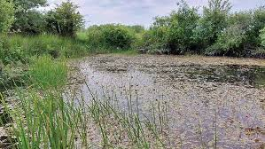
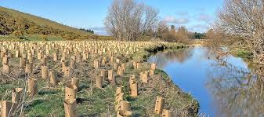
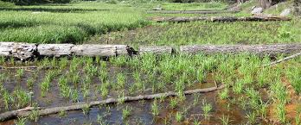
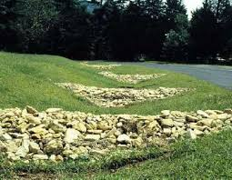
Restoration practice examples
Green infrastructures
Reduce ecological impacts and cascading effects and target the cause of streamflow alteration at watersheds-level.
BUT lack of data before and after implementation.
Examples:
Ponds
Tree planting
Constructed wetlands
Grass swales
Notes:
tackle insufficient infiltration, groundwater recharge, limited watershed storage
-> Need to understand how exact design and watershed context influence performance.

Slide 21
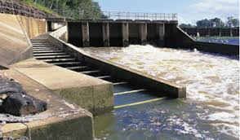
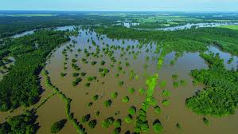
Restoration practice examples
Hydrologic connectivity
Reminder: urban streams = unnatural levels of connectivity (pipes, roads, land use, WWTP)
Knowledge on streambed structure, landscape storage capacity, groundwater connectivity can help imagine novel restoration approaches via stormwater management.
Focus on:
Land use
Soil properties
Biodiversity
-> integration of HC in ecological restoration = minimize ecological effects of fragmentation, restore free-flowing watercourses, operate green infrastructure to enhance infiltration, floodplain connectivity or other ecological processes.
Notes:
(substantial challenge for flow-degraded rivers and streams)
Stormwater management = indicates where to build, remove, re-operate hydrologic infrastructure
Land use = landscape heterogeneity is really needed (especially with wetlands, lakes, ponds)
Soil properties = precipitation and infiltration influence watershed flow paths
Biodiversity = longitudinal = fishways, passage facilities, trap and transport -> immediate geomorphic effects, lateral = flood-plain processes

Slide 22
Research challenges and opportunities
Rarely possible to restore all facets of a natural flow regime -> mimic key aspects of natural flow regime or not natural but maximize outcomes.
Major issue is the lack of data on:
Connecting organismal to ecosystem-level processes
Ecological consequences of hydrologic connectivity
Scaling and transferring flow-ecology relationships across space and time
Cascading implications of hydrologic alteration
Using hydro-ecological science to inform river ecosystem restoration
…

